Slide 1
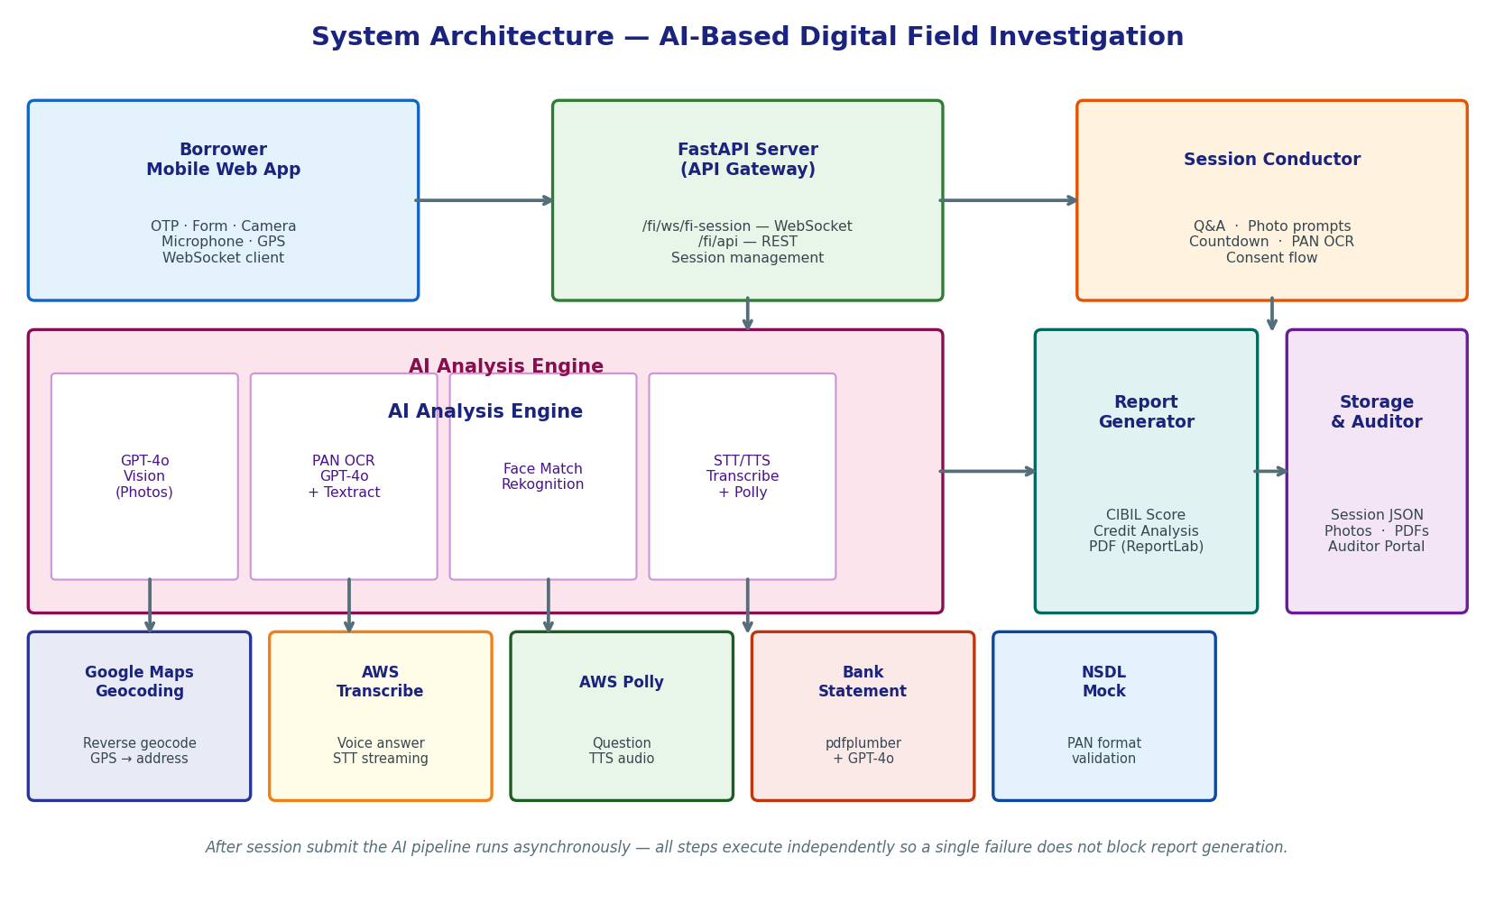
Figure 1 — System Architecture
Six-layer architecture: Mobile Web App → FastAPI → Session Conductor → AI Engine → Report Generator → Storage

Slide 2
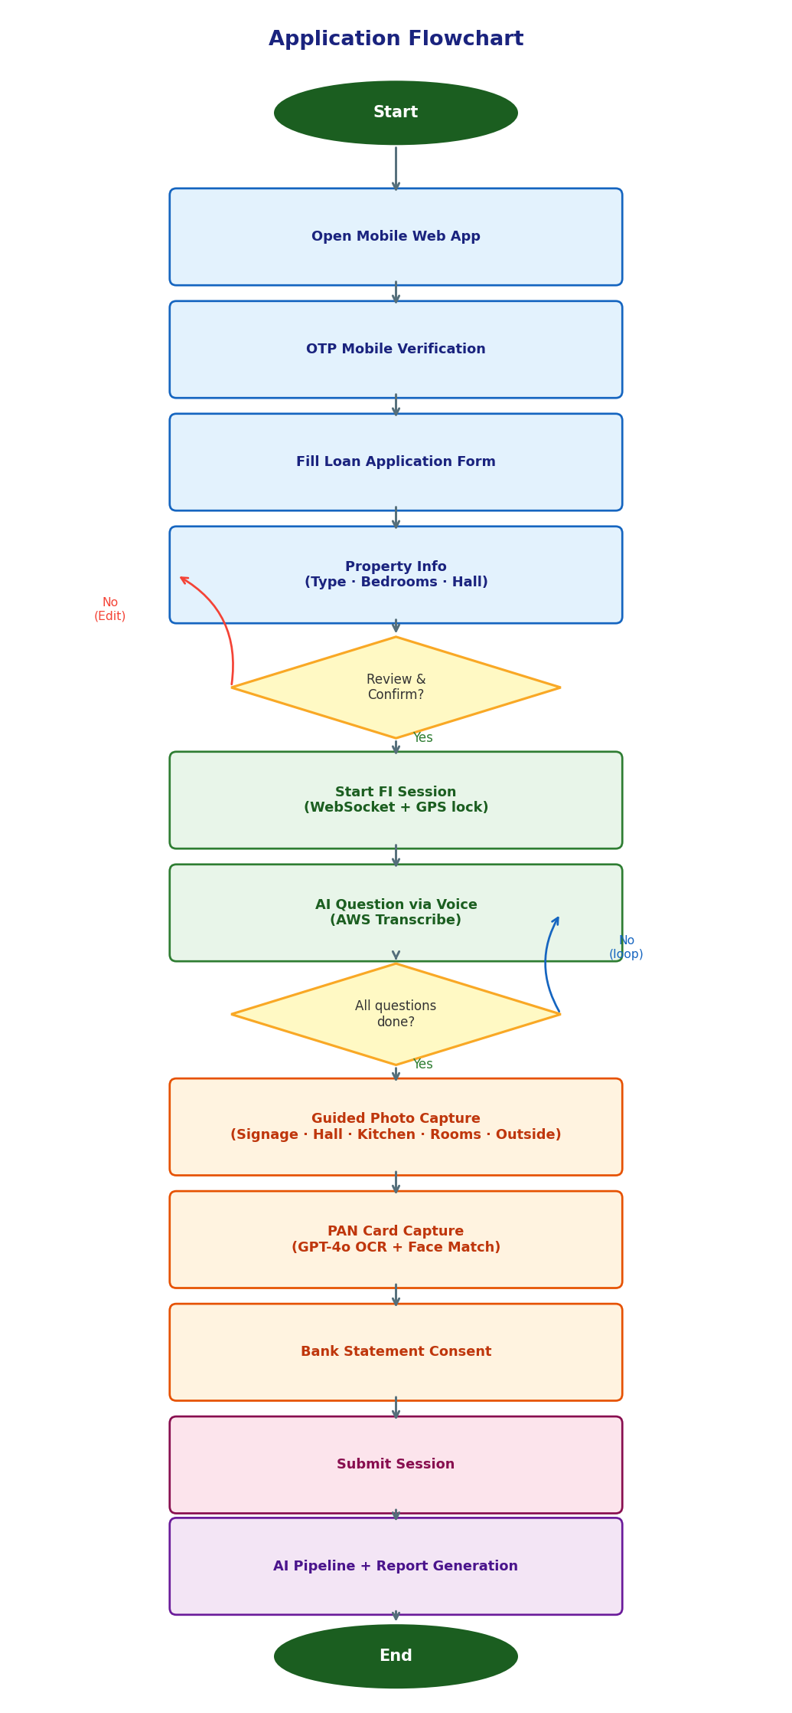
Figure 2 — Application Flowchart
End-to-end user flow: OTP → Form → FI Session → Q&A → Photo Capture → PAN → Submit → Report

Slide 3
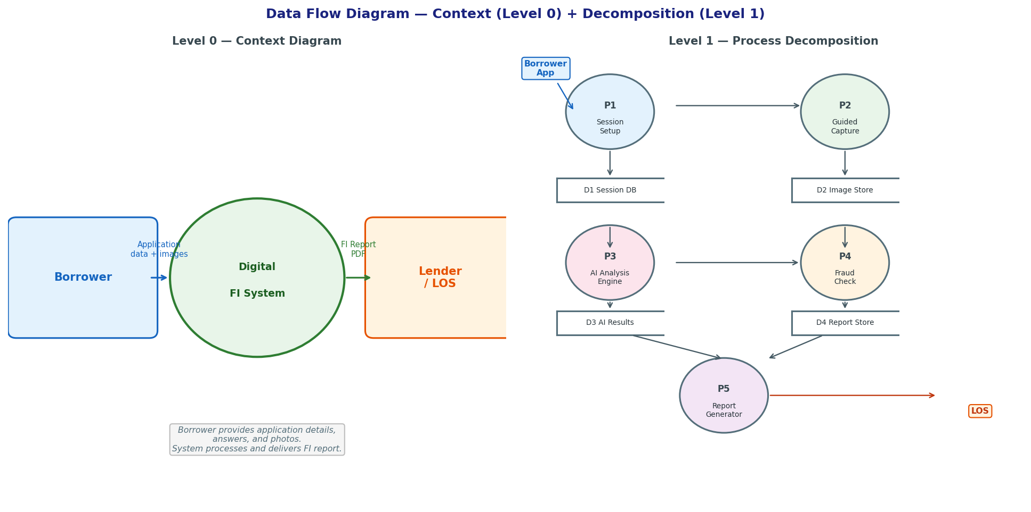
Figure 3 — Data Flow Diagram (Level 0 + Level 1)
Context diagram and process decomposition showing data flow from Borrower through the FI System to Lender/LOS

Slide 4
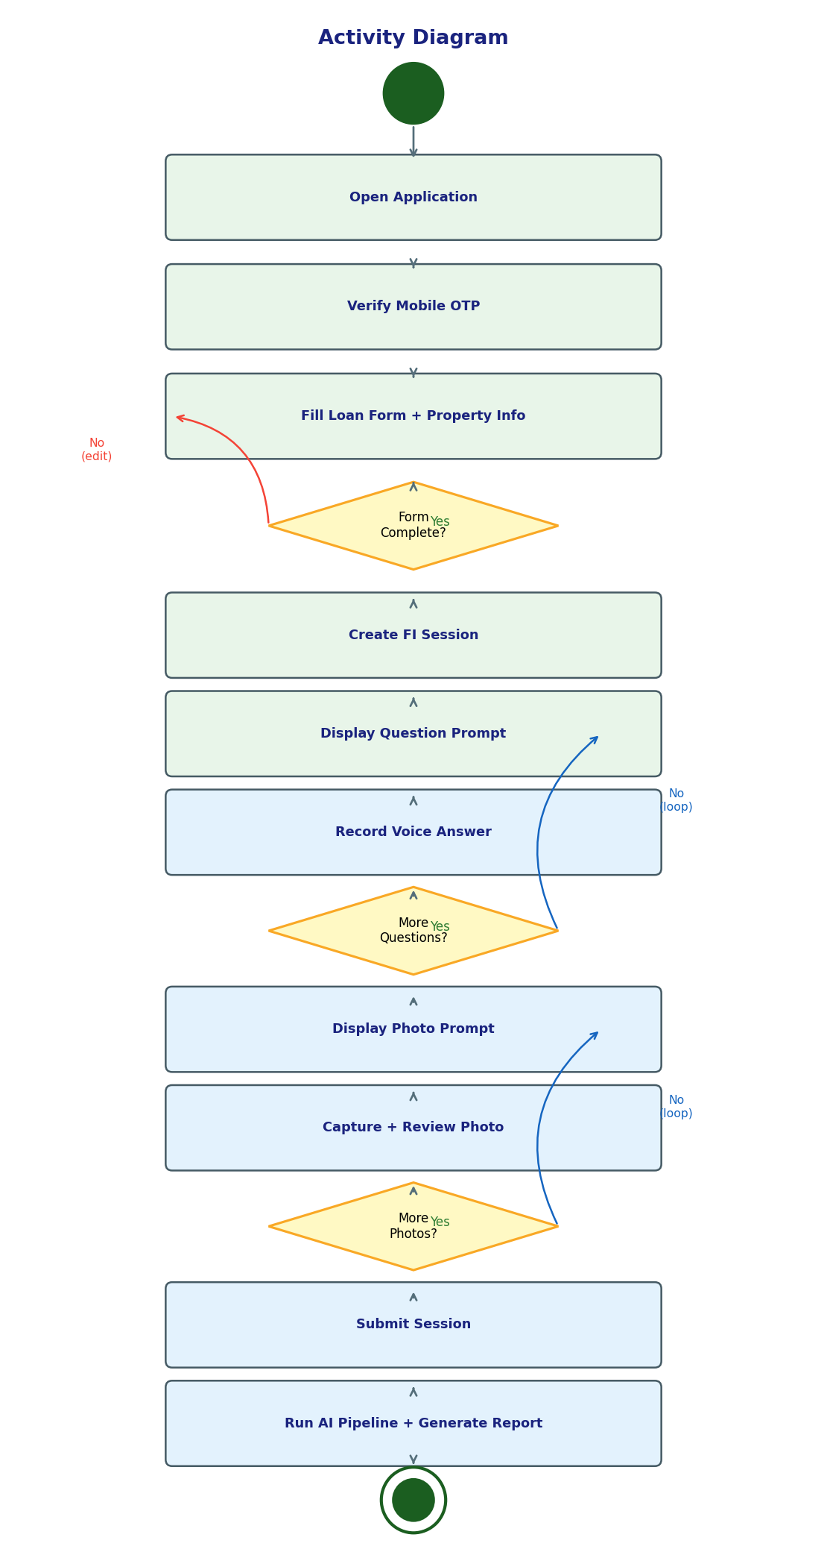
Figure 4 — Activity Diagram
Session activity flow with decision gates for form completion, question loop, and photo capture loop

Slide 5
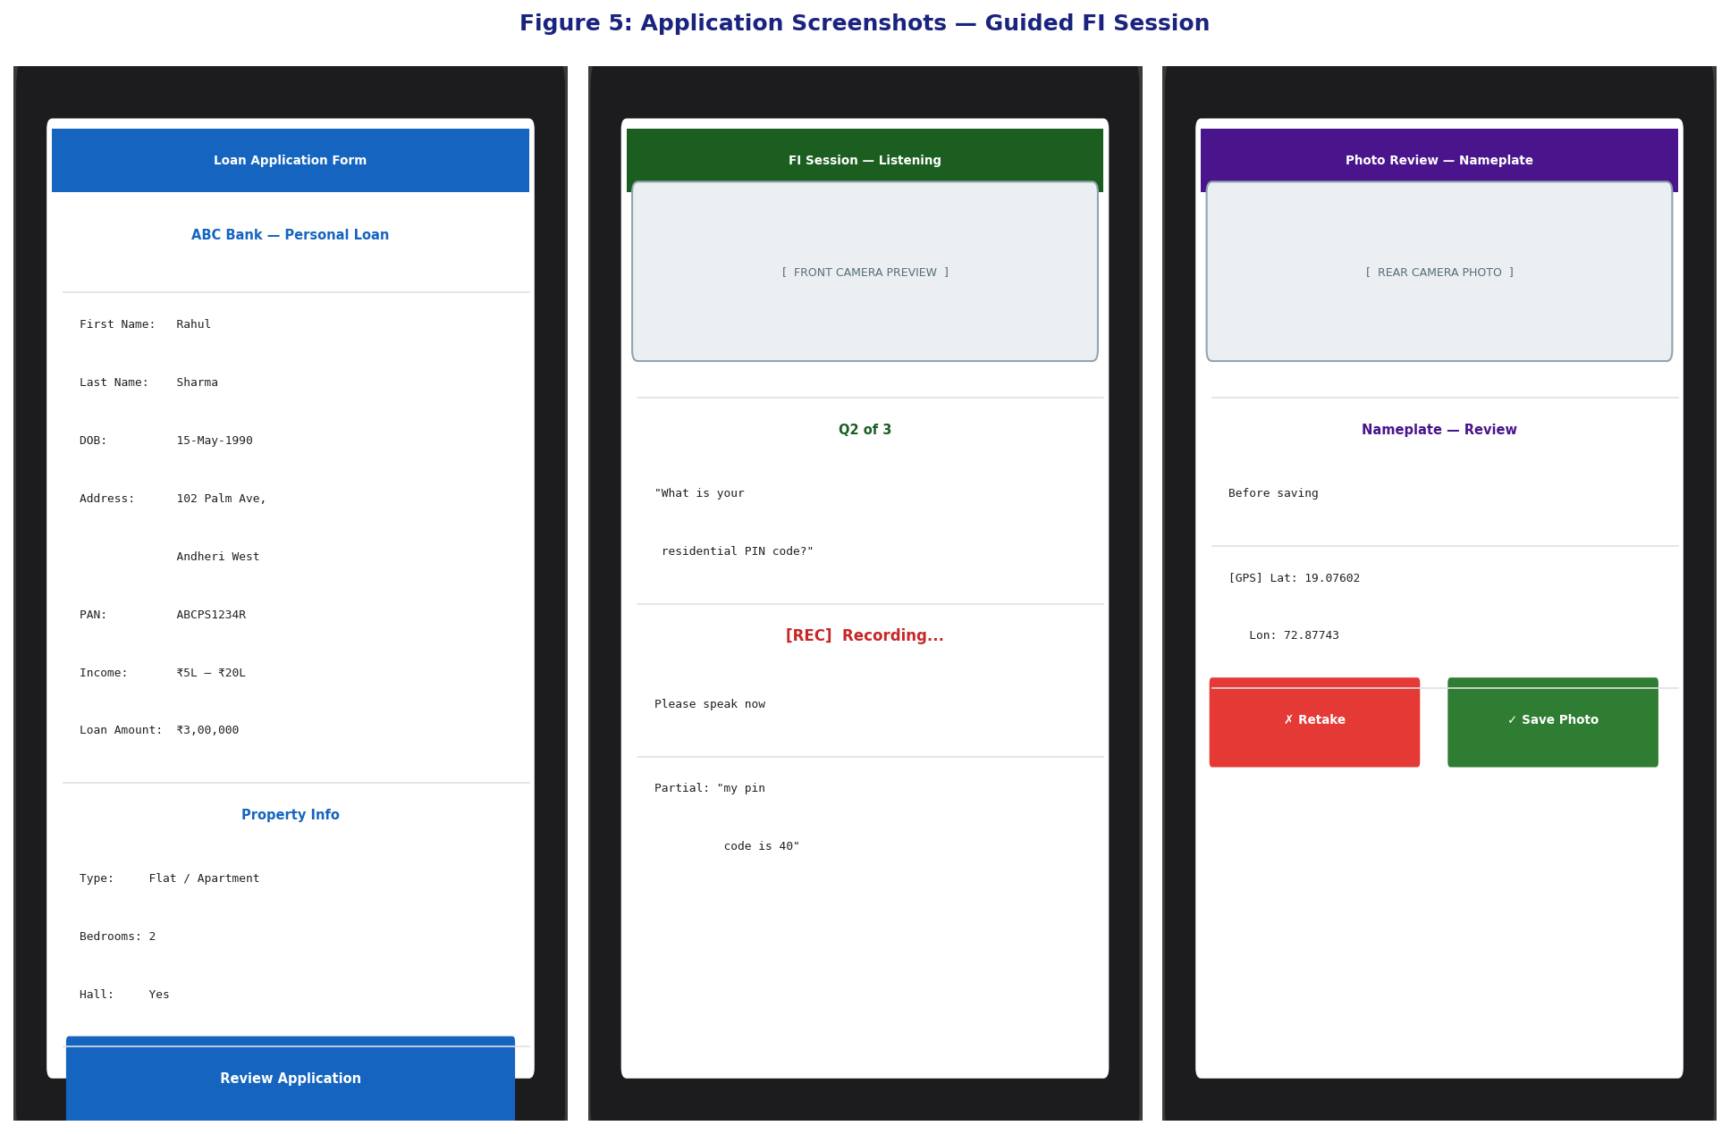
Figure 5 — Application Screenshots
Loan Application Form · FI Session Recording screen · Photo Review screen (simulated mobile UI)

Slide 6
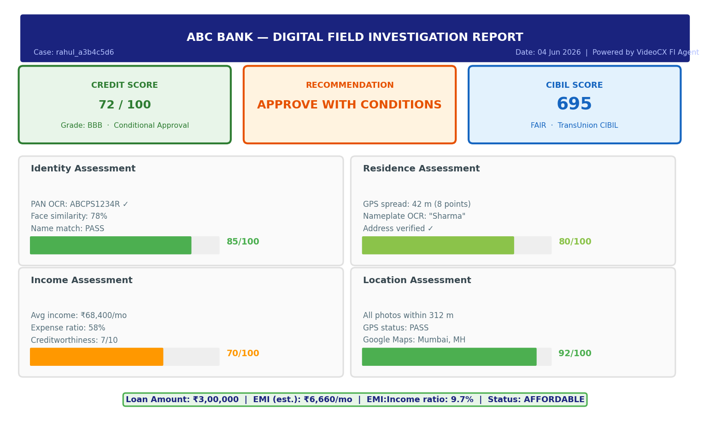
Figure 6 — AI Analysis Output
Sample credit report summary: Credit Score, CIBIL Score, Recommendation, and four assessment panels

