Slide 1

Jata
J(ava) (D)ata
By Shankar Narayan.

Slide 2
And
Annotation
Templates

Slide 3
Use Jata to create data in java syntax.

Slide 4
You can use Jata files in place of
property files
& XML files.

Slide 5
Use Annotation Templates to help redefine
java annotations at runtime.

Slide 6

XML
Configuration

Slide 7
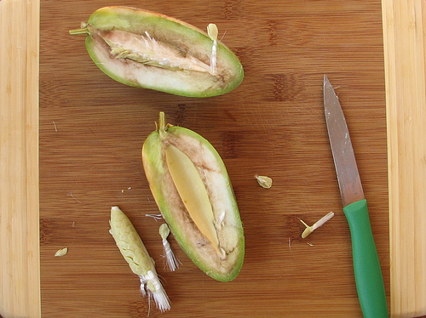
Jata framework
has two parts.

Slide 8

Jata Writer

Slide 9

Jata Reader

Slide 10
Two Sample classes
BoxWithLatch and Latch
to show off Jata.

Slide 11
package org.jata.write.sample;
public class BoxWithLatch {
private int width;
private int length;
private Latch latch;
public BoxWithLatch(int width, int length) {
}
}
Has a couple of primitive fields.

Slide 12
package org.jata.write.sample;
public class BoxWithLatch {
private int width;
private int length;
private Latch latch;
public BoxWithLatch(int width, int length) {
}
}
Has an association to Latch class.

Slide 13
package org.jata.write.sample;
public class Latch {
private String name;
public Latch(String Name) {
}
}
Latch has a single “primitive” field.

Slide 14
How to write jata?

Slide 15
BoxWithLatch box = new BoxWithLatch(10, 20);
Latch latch = new Latch();
latch.setName("sealed");
box.setLatch(latch);
JataWriter.write(box, OUTPUT_DIR);
You wire up an instance of BoxWithLatch.

Slide 16
BoxWithLatch box = new BoxWithLatch(10, 20);
Latch latch = new Latch();
latch.setName("sealed");
box.setLatch(latch);
JataWriter.write(box, OUTPUT_DIR);
You write it out.

Slide 17
What is written?

Slide 18
package data.org.jata.write.sample.BoxWithLatch.a;
@JataUUId(id="UUID-a")
public class BoxWithLatch {
public int width = 10;
public int length = 20;
public org.jata.write.sample.Latch latch =
data.org.jata.write.sample.Latch.a.Latch.getData();
public static org.jata.write.sample.BoxWithLatch getData() {
String dataObjectClassName =
data.org.jata.write.sample.BoxWithLatch.a.BoxWithLatch.class.getName();
return (org.jata.write.sample.BoxWithLatch)
org.jata.write.util.DataObjectUtil.getData(
dataObjectClassName,org.jata.write.sample.BoxWithLatch.class.getName());
}
}
Package Name is different

Slide 19
package data.org.jata.write.sample.BoxWithLatch.a;
@JataUUId(id="UUID-a")
public class BoxWithLatch {
public int width = 10;
public int length = 20;
public org.jata.write.sample.Latch latch =
data.org.jata.write.sample.Latch.a.Latch.getData();
public static org.jata.write.sample.BoxWithLatch getData() {
String dataObjectClassName =
data.org.jata.write.sample.BoxWithLatch.a.BoxWithLatch.class.getName();
return (org.jata.write.sample.BoxWithLatch)
org.jata.write.util.DataObjectUtil.getData(
dataObjectClassName,org.jata.write.sample.BoxWithLatch.class.getName());
}
}
Has some meta information to identify jata.

Slide 20
package data.org.jata.write.sample.BoxWithLatch.a;
@JataUUId(id="UUID-a")
public class BoxWithLatch {
public int width = 10;
public int length = 20;
public org.jata.write.sample.Latch latch =
data.org.jata.write.sample.Latch.a.Latch.getData();
public static org.jata.write.sample.BoxWithLatch getData() {
String dataObjectClassName =
data.org.jata.write.sample.BoxWithLatch.a.BoxWithLatch.class.getName();
return (org.jata.write.sample.BoxWithLatch)
org.jata.write.util.DataObjectUtil.getData(
dataObjectClassName,org.jata.write.sample.BoxWithLatch.class.getName());
}
}
See the primitive data.

Slide 21
package data.org.jata.write.sample.BoxWithLatch.a;
@JataUUId(id="UUID-a")
public class BoxWithLatch {
public int width = 10;
public int length = 20;
public org.jata.write.sample.Latch latch =
data.org.jata.write.sample.Latch.a.Latch.getData();
public static org.jata.write.sample.BoxWithLatch getData() {
String dataObjectClassName =
data.org.jata.write.sample.BoxWithLatch.a.BoxWithLatch.class.getName();
return (org.jata.write.sample.BoxWithLatch)
org.jata.write.util.DataObjectUtil.getData(
dataObjectClassName,org.jata.write.sample.BoxWithLatch.class.getName());
}
}
See the association? You can navigate to the
instance of Latch in eclipse ide with a Ctrl-Click.

Slide 22
package data.org.jata.write.sample.BoxWithLatch.a;
@JataUUId(id="UUID-a")
public class BoxWithLatch {
public int width = 10;
public int length = 20;
public org.jata.write.sample.Latch latch =
data.org.jata.write.sample.Latch.a.Latch.getData();
public static org.jata.write.sample.BoxWithLatch getData() {
String dataObjectClassName =
data.org.jata.write.sample.BoxWithLatch.a.BoxWithLatch.class.getName();
return (org.jata.write.sample.BoxWithLatch)
org.jata.write.util.DataObjectUtil.getData(
dataObjectClassName,org.jata.write.sample.BoxWithLatch.class.getName());
}
}
Helper code that helps f/w read data back &
Wire associations at read time.

Slide 23
Latch jata looks similar to BoxWithLatch jata.

Slide 24
package data.org.jata.write.sample.Latch.a;
@JataUUId(id="UUID-a")
public class Latch {
public java.lang.String name = "sealed";
public static org.jata.write.sample.Latch getData() {
String dataObjectClassName =
data.org.jata.write.sample.Latch.a.Latch.class.getName();
return (org.jata.write.sample.Latch)
org.jata.write.util.DataObjectUtil.getData(
dataObjectClassName,
org.jata.write.sample.Latch.class.getName());
}
}

Slide 25
Works with collections and arrays as well.

Slide 26
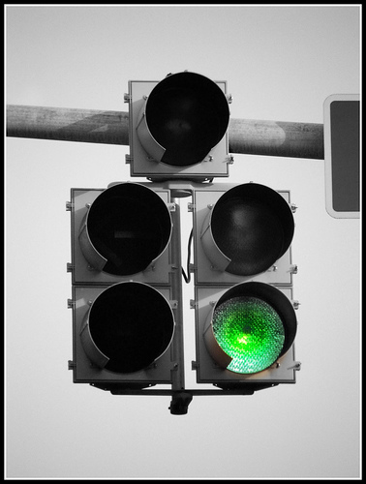
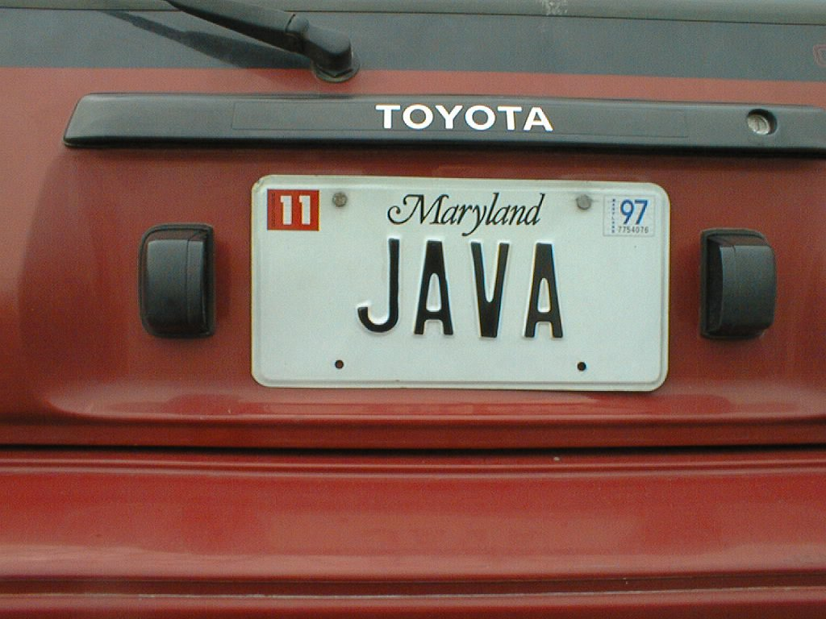
Go Java!

Slide 27
How do you read jata?

Slide 28
String jataFQClassName = "data.org.jata.write.sample.BoxWithLatch.a.BoxWithLatch";
String versionString = "0.0.1";
String projectName = "";
String uuidString = "9f8eef74-b8be-4c18-8168-668c2559786b";
BoxWithLatch readBox = (BoxWithLatch)JataReader.read(
jataFQClassName,
projectName,
versionString,
uuidString);
Setup info to identify the object instance
among multiple jata classes.

Slide 29
Code to read jata instance.
You get back what you wrote.
String jataFQClassName = "data.org.jata.write.sample.BoxWithLatch.a.BoxWithLatch";
String versionString = "0.0.1";
String projectName = "";
String uuidString = "9f8eef74-b8be-4c18-8168-668c2559786b";
BoxWithLatch readBox = (BoxWithLatch)JataReader.read(
jataFQClassName,
projectName,
versionString,
uuidString);

Slide 30
You read the precise jata instance identified
by the uuid.

Slide 31
You can hand edit jata to change values &
Read it back with changes.

Slide 32
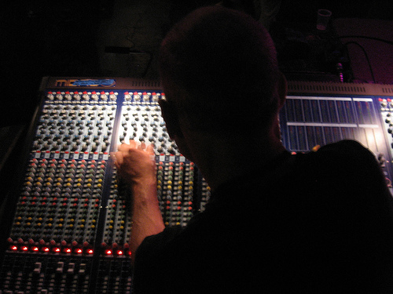
Why Jata?
Runtime configuration without XML

Slide 33
Annotation
Templates

Slide 34
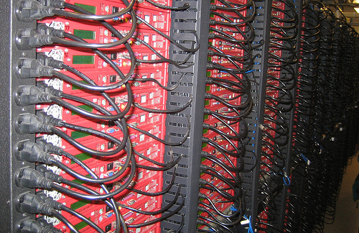
XML is for them

Slide 35
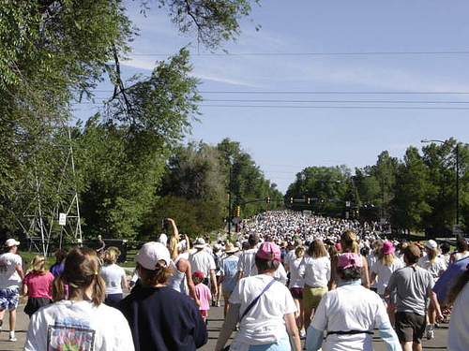
No habla XML

Slide 36
Annotation templates
have two parts too.

Slide 37
Where can one use annotation templates.

Slide 38
Potential uses in:
Hibernate/JPA persistence annotations.
Spring/SCA bean component annotations.
OSGI bundle/package visibility demarcation.
UI annotations on models.

Slide 39
Same two sample associated classes
to show off Annotation Templates.

Slide 40
package org.jata.write.sample;
public class BoxWithLatch {
private int width;
private int length;
private Latch latch;
public BoxWithLatch(int width, int length) {
}
}

Slide 41
package org.jata.write.sample;
public class Latch {
private String name;
public Latch(String Name) {
}
}

Slide 42
How to write Annotation Templates?

Slide 43
List<Class<?>> annotationClasses = new ArrayList<Class<?>>();
annotationClasses.add(SampleAnnot.class);
AnnotationTemplateWriter.write(OUTPUT_DIR, BoxWithLatch.class.getName(),
PROJECT_NAME, versionString, annotationClasses);
Include annotations that you will use.

Slide 44
Write out the templates.
List<Class<?>> annotationClasses = new ArrayList<Class<?>>();
annotationClasses.add(SampleAnnot.class);
AnnotationTemplateWriter.write(OUTPUT_DIR, BoxWithLatch.class.getName(),
PROJECT_NAME, versionString, annotationClasses);

Slide 45
What is written?
A set of annotation templates.

Slide 46
package annot.org.jata.write.sample;
@org.jata.id.JataUUId(id="8cb9e460-1a56-4130-a3ab-9ea0760d8463")
@org.jata.write.ATTypeLevelId(id="DemoJataAnnotTwo", projectName="DemoJataAnnotTwo", version="0.0.1")
public class BoxWithLatch {
public BoxWithLatch () {}
public int width ;
public int length ;
public annot.org.jata.write.sample.Latch latch = null ;
}
Package Name is different

Slide 47
package annot.org.jata.write.sample;
@org.jata.id.JataUUId(id="8cb9e460-1a56-4130-a3ab-9ea0760d8463")
@org.jata.write.ATTypeLevelId(id="DemoJataAnnotTwo", projectName="DemoJataAnnotTwo", version="0.0.1")
public class BoxWithLatch {
public BoxWithLatch () {}
public int width ;
public int length ;
public annot.org.jata.write.sample.Latch latch = null ;
}
Some framework meta info to identify
instance uniquely.

Slide 48
package annot.org.jata.write.sample;
@org.jata.id.JataUUId(id="8cb9e460-1a56-4130-a3ab-9ea0760d8463")
@org.jata.write.ATTypeLevelId(id="DemoJataAnnotTwo", projectName="DemoJataAnnotTwo", version="0.0.1")
public class BoxWithLatch {
public BoxWithLatch () {}
public int width ;
public int length ;
public annot.org.jata.write.sample.Latch latch = null ;
}
Primitive fields are as they are in Java class.

Slide 49
package annot.org.jata.write.sample;
@org.jata.id.JataUUId(id="8cb9e460-1a56-4130-a3ab-9ea0760d8463")
@org.jata.write.ATTypeLevelId(id="DemoJataAnnotTwo", projectName="DemoJataAnnotTwo", version="0.0.1")
public class BoxWithLatch {
public BoxWithLatch () {}
public int width ;
public int length ;
public annot.org.jata.write.sample.Latch latch = null ;
}
Notice the package name of the association.

Slide 50
package annot.org.jata.write.sample;
@org.jata.id.JataUUId(id="8cb9e460-1a56-4130-a3ab-9ea0760d8463")
@org.jata.write.ATTypeLevelId(id="DemoJataAnnotTwo", projectName="DemoJataAnnotTwo", version="0.0.1")
public class BoxWithLatch {
public BoxWithLatch () {}
public int width ;
public int length ;
public annot.org.jata.write.sample.Latch latch = null ;
}
Complete annotation template.

Slide 51
package annot.org.jata.write.sample;
@org.jata.id.JataUUId(id="8cb9e460-1a56-4130-a3ab-9ea0760d8463")
@org.jata.write.ATTypeLevelId(id="DemoJataAnnotTwo", projectName="DemoJataAnnotTwo", version="0.0.1")
public class Latch {
public Latch () {}
public java.lang.String name = null ;
}

Slide 52
How do you annotate the templates?

Slide 53
package annot.org.jata.write.sample;
@org.jata.id.JataUUId(id="8cb9e460-1a56-4130-a3ab-9ea0760d8463")
@org.jata.write.ATTypeLevelId(id="DemoJataAnnotTwo", projectName="DemoJataAnnotTwo", version="0.0.1")
@org.jata.write.sample.annot.SampleAnnot(id="xyz")
public class BoxWithLatch {
public BoxWithLatch () {}
public int width ;
public int length ;
public annot.org.jata.write.sample.Latch latch = null ;
}

Slide 54
How do you read the annotated templates?

Slide 55
String uuidString = "8cb9e460-1a56-4130-a3ab-9ea0760d8463";
String annotTemplateClassName = org.jata.write.sample.BoxWithLatch.class
.getName();
String versionString = "0.0.1";
String projectName = "";
List<Annotation> annotations = JataReader.readAnnotations(
SampleAnnot.class,
annotTemplateClassName,
projectName, versionString,
uuidString);
SampleAnnot sampleAnnotationOne = (SampleAnnot)annotations.get(0);
Info to identify the annotation among
multiple templates for the same class.

Slide 56
Read in the annotations and use them.
String uuidString = "8cb9e460-1a56-4130-a3ab-9ea0760d8463";
String annotTemplateClassName = org.jata.write.sample.BoxWithLatch.class
.getName();
String versionString = "0.0.1";
String projectName = "";
List<Annotation> annotations = JataReader.readAnnotations(
SampleAnnot.class,
annotTemplateClassName,
projectName, versionString,
uuidString);
SampleAnnot sampleAnnotationOne = (SampleAnnot)annotations.get(0);

Slide 57
You read the precise annotation identified
by the uuid even if several annotation
templates exist for the same class.

Slide 58
Why Annotation Templates?
Runtime Class related configuration without XML

Slide 59
Questions, comments & offers of help:
narashankar@users.sourceforge.net
http://narayanshankar.blogspot.com/2008/02/jata-java-data-annotation-templates.html
http://jata.svn.sourceforge.net/viewvc/jata
svn co http://jata.svn.sourceforge.net/svnroot/jata

Slide 60


Attributions:
Most of the images are
creative commons images from www.flickr.com.
They were all tagged as
Urls:
http://www.flickr.com/photos/lenore-m/379399516/
http://www.flickr.com/photos/tnarik/366393127/
http://www.flickr.com/photos/takomabibelot/2044735782/
http://www.flickr.com/photos/tinkerroll21/538146962/
http://www.flickr.com/photos/golliday/2078500737/
http://www.flickr.com/photos/mysterybee/1659329016/
http://www.flickr.com/photos/71217725@N00/156038233/

