Slide 1
Mockito
Mockito is a popular mocking framework for Java that is widely used for unit/component testing.
It integrates seamlessly with Java Spring Boot and JUnit 5 to facilitate the creation of mock objects and simplifies the testing process by isolating dependencies.
It enables the creation of "mock" objects, which are simulated versions of real dependencies, allowing for isolated testing of individual components.

Slide 2
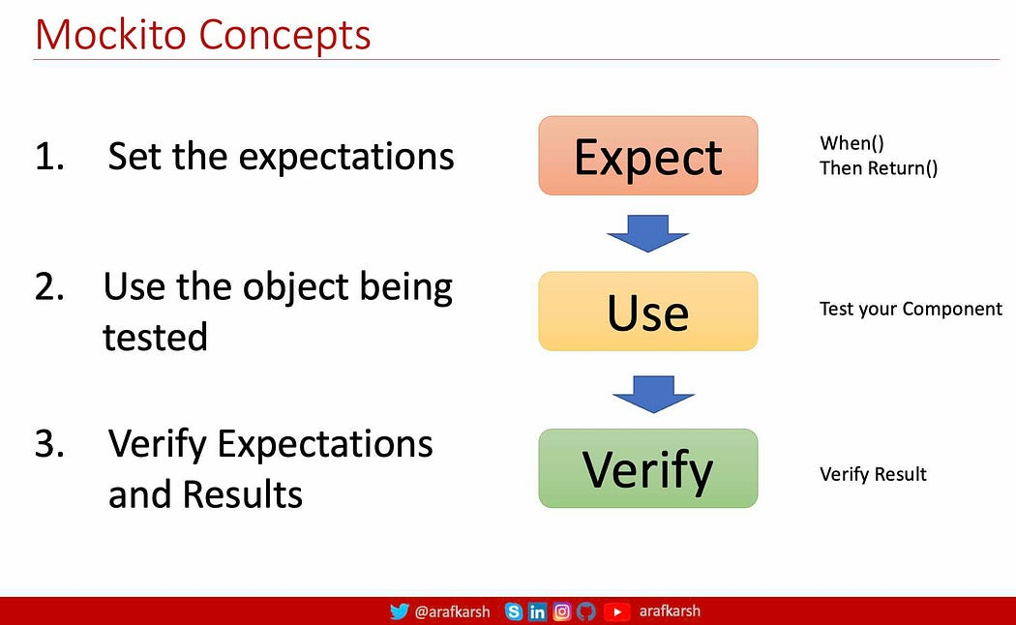

Slide 3
Expect: Set up the behavior of mock objects (using when and thenReturn).
Use: Execute the component under test and use the mock objects during the process.
Verify: Check that the desired interactions occurred and validate the results.

Slide 4
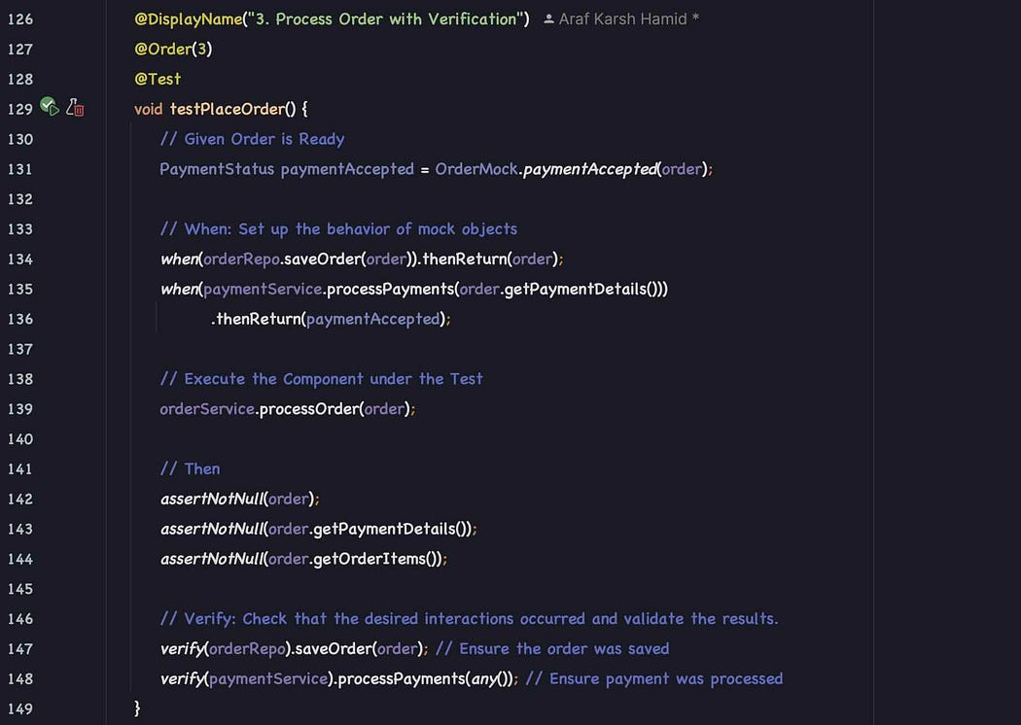

Slide 5
Key Features of Mockito
Integration with JUnit 5: Works seamlessly with JUnit 5 annotations and lifecycle methods.
Support for Annotations: Simplifies setup and reduces boilerplate code using annotations like @Mock, @Spy, @InjectMocks, etc.
Mocking Dependencies: Create mock objects for dependencies, allowing you to isolate the system under test (SUT) without relying on actual implementations.
Spy: Partial mocking for real objects, allowing some methods to be stubbed while others behave as normal.
Stubbing: Predefine the behaviour of methods on mocked objects (e.g., return specific values when certain methods are called).
Behaviour Verification: Verify if a particular method was called on a mock object with specific arguments.
Argument Matchers: Use flexible matchers (like any(), eq(), etc.) to match arguments while verifying or stubbing.
Behaviour Verification Order: Ensure methods are called in a specific order using InOrder.
Exception Handling: Simulate exception-throwing scenarios to test error handling.
Mock Static Methods (with mockito-inline or third-party libraries): Support for mocking static methods.

Slide 6
Key Annotations
@ExtendWith(MockitoExtension.class):
A JUnit 5 extension that enables Mockito annotations (@Mock, @InjectMocks, etc.) and simplifies test setup.
@ExtendWith(MockitoExtension.class)
public class MyTest {
// Mock and InjectMocks annotations work seamlessly here
}
@Mock: Creates a mock instance of a class or interface.
@Mock
private PaymentService paymentService;
@Spy: Creates a partial mock, allowing some real methods to be called while others can be stubbed.
@Spy
private OrderService orderService;

Slide 7
@Captor: Captures arguments passed to mocked methods for verification.
@Captor
private ArgumentCaptor<String> stringCaptor;
@InjectMocks: Automatically injects mocks into the object under test.
Dependencies marked with @Mock or @Spy are injected into the class being tested.
@InjectMocks
private WarehouseService warehouseService;

Slide 8
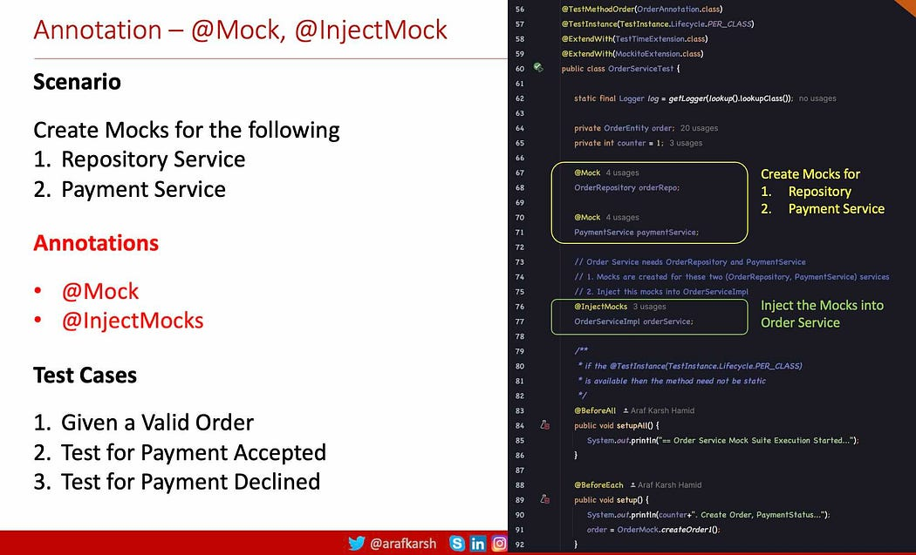

Slide 9
@ExtendWith(MockitoExtension.class)
class WarehouseServiceTest {
@Mock
private OrderRepository orderRepo;
@Spy
private PaymentService paymentService;
@InjectMocks
private OrderServiceImpl orderService;
@DisplayName("1.1 Check All the Paid Orders Ready for Packaging")
@ParameterizedTest
@MethodSource("createOrder")
@Test
void testForPaidOrders(OrderEntity order) {
// Given the Order is ready
// Order is Dynamically shared using the parametrized testing
// When
when(orderRepo.saveOrder(order)).thenReturn(order);
OrderEntity processedOrder = orderService.processOrder(order);
// Then Payment Service will return as Payment Accepted
assertTrue(processedOrder.isCustomerAvailable());
assertNotNull(processedOrder.getOrderStatus());
assertEquals(OrderStatus.PAID, processedOrder.getOrderStatus());
}
// The following method returns an ArrayList of Orders
public ArrayList<OrderEntity> createOrder() {
return OrderMock.createOrderList();
}
}

Slide 10
@Mock Annotation: Used to declare a mock object. This annotation is typically placed on a field within a test class.
@Mock
private MyDependency myDependency;
@InjectMocks Annotation: Used to inject the declared mock objects into the class under test.
@InjectMocks
private MyService myService;

Slide 11
Spring Boot offers test slices to focus on specific application layers:
@WebMvcTest: For testing the web layer (controllers), auto-configures MockMvc.
@DataJpaTest: For testing the data layer (repositories), sets up an in-memory database.
@SpringBootTest: For integration tests requiring the full application context.
@MockBean
annotation (for Spring context-aware tests) or Mockito.mock() (for pure unit tests) to create mock instances of the dependencies your component relies on.

Slide 12
List<Employee> list = Arrays.asList(employee);
Mockito.when(employeeService.getAllEmployeeList()).thenReturn(list);
mockMvc.perform(MockMvcRequestBuilders.get("/emp/employee")).
andExpect(MockMvcResultMatchers.status().isFound()).
andExpect(MockMvcResultMatchers.content().contentType(MediaType.APPLICATION_JSON)).
andExpect(MockMvcResultMatchers.jsonPath("$", Matchers.hasSize(3)))
.andExpect(MockMvcResultMatchers.jsonPath("$[0].id").value(1)).
andExpect(MockMvcResultMatchers.jsonPath("$[0].name").value("amit kumar")).
andExpect(MockMvcResultMatchers.jsonPath("$[0].salary").value(20000));
}
private static ObjectMapper mapper = new ObjectMapper();
@Test
public void addEmployeeTest() throws Exception {
Employee emp1 = Employee.builder().id(1).name("amit kumar").salary(20000).build();
Mockito.when(employeeService.addEmployee(emp1)).thenReturn(emp1);
String json = mapper.writeValueAsString(emp1);
mockMvc.perform(post("/emp/employee").contentType(MediaType.APPLICATION_JSON).
content(json).accept(MediaType.APPLICATION_JSON)).
andExpect(status().isCreated())//.
.andExpect(jsonPath("$.id").value(1)).
andExpect(jsonPath("$.name").value("amit kumar")).
andExpect(jsonPath("$.salary").value(20000));
}
}
@WebMvcTest
//@SpringBootTest
//@ContextConfiguration(classes=Application.class)
public class EmployeeControllerTest {
@Autowired
private MockMvc mockMvc;
@MockBean
private EmployeeService employeeService;
@Test
public void getAllEmployeeListTest() throws Exception {
Employee employee[] = new Employee[]{
Employee.builder().id(1).name("amit kumar").salary(20000).build(),
Employee.builder().id(2).name("subham kumar").salary(30000).build(),
Employee.builder().id(3).name("kapil kumar").salary(40000).build(),
};
employeeService.addEmployee(employee[0]);
employeeService.addEmployee(employee[1]);
employeeService.addEmployee(employee[2]);

