Slide 1
What is a Data Transfer Object (DTO)?
A Data Transfer Object is a design pattern that allows for the exchange of data between software application subsystems or layers.
Transfer data often between the business logic layer and the presentation or persistence layer.
The primary goal of DTOs is to reduce the number of method calls between these layers by aggregating data into a single object.

Slide 2
Spring boot dto
In Spring Boot application, DTOs are commonly used to encapsulate data transferred between the controller and service layers, or between the service layer and the persistence layer.
It helps in maintaining a clear separation of concerns and improves the overall modularity of the codebase.

Slide 3
Benifits
1. Reduced Network Calls:
DTOs help minimize the number of calls between different layers, especially in a microservices architecture where services communicate over a network.
By bundling relevant data into DTOs, fewer network calls are required, resulting in improved performance.
2. Enhanced Maintainability:
Separating the concerns of data transfer from the business logic enhances code maintainability.
Changes in the underlying data structures or business logic don’t necessarily impact the structure of DTOs, allowing for easier updates and modifications.
3. Versioning and Compatibility:
DTOs can be versioned independently of the underlying business logic.
This is particularly useful when dealing with evolving APIs or microservices, as it provides a level of backward compatibility by allowing older clients to still communicate using an older version of the DTO.
4. Reduced Overhead:
Transmitting only the necessary data instead of entire entities reduces bandwidth and minimizes data transfer overhead. This is particularly relevant in scenarios where resources are constrained, such as mobile or low-bandwidth environments.

Slide 4
Dto in service layer
In the service layer, when retrieving or saving a user, convert between the entity and DTO:
@Service
public class UserService {
@Autowired
private UserRepository userRepository;
public UserDTO getUserById(Long userId) {
User user = userRepository.findById(userId).orElse(null);
return convertToDTO(user);
}
public void saveUser(UserDTO userDTO) {
User user = convertToEntity(userDTO);
userRepository.save(user);
}
private UserDTO convertToDTO(User user) {
// logic to convert User to UserDTO
}
private User convertToEntity(UserDTO userDTO) {
// logic to convert UserDTO to User
}
}
@Entity
public class User {
@Id
@GeneratedValue(strategy = GenerationType.IDENTITY)
private Long id;
private String username;
private String email;
// other fields, getters, and setters
}
DTO UserDTO public class UserDTO {
private String username;
private String email;
// constructors, getters, and setters
}

Slide 5
This way, the service layer communicates with the controller using DTOs, ensuring a clean separation between the data transfer and business logic.

Slide 6
Mapper (Converting Between Entity & DTO)
A Mapper is responsible for converting between Entity and DTO objects to maintain a clean architecture.
@Component
public class UserMapper {
public UserDTO toDTO(UserEntity user) {
UserDTO dto = new UserDTO();
dto.setName(user.getName());
dto.setEmail(user.getEmail());
return dto;
}
public UserEntity toEntity(UserDTO dto) {
UserEntity user = new UserEntity();
user.setName(dto.getName());
user.setEmail(dto.getEmail());
return user;
}
}
public class UserDTO {
private String name;
private String email;
}

Slide 7
Service Layer (Business Logic Layer) with mapper
The Service Layer contains business logic and calls the Repository for data manipulation.
@Service
public class UserService {
private final UserRepository userRepository;
private final UserMapper userMapper;
public UserService(UserRepository userRepository, UserMapper userMapper) {
this.userRepository = userRepository;
this.userMapper = userMapper;
}
public UserDTO getUserById(Long id) {
UserEntity user = userRepository.findById(id)
.orElseThrow(() -> new RuntimeException("User not found"));
return userMapper.toDTO(user);
}
public void saveUser(UserDTO userDTO) {
UserEntity userEntity = userMapper.toEntity(userDTO);
userRepository.save(userEntity);
}
}

Slide 8
Controller (API Layer) with mapper
GetMapping("/{id}")
public ResponseEntity<UserDTO> getUser(@PathVariable Long id) {
return ResponseEntity.ok(userService.getUserById(id));
}
@PostMapping
public ResponseEntity<String> createUser(@RequestBody UserDTO userDTO) {
userService.saveUser(userDTO);
return ResponseEntity.status(HttpStatus.CREATED).body("User created");
}
}
A Controller handles HTTP requests, calls the Service Layer, and returns responses.
@RestController
@RequestMapping("/users")
public class UserController {
private final UserService userService;
public UserController(UserService userService) {
this.userService = userService;
}

Slide 9
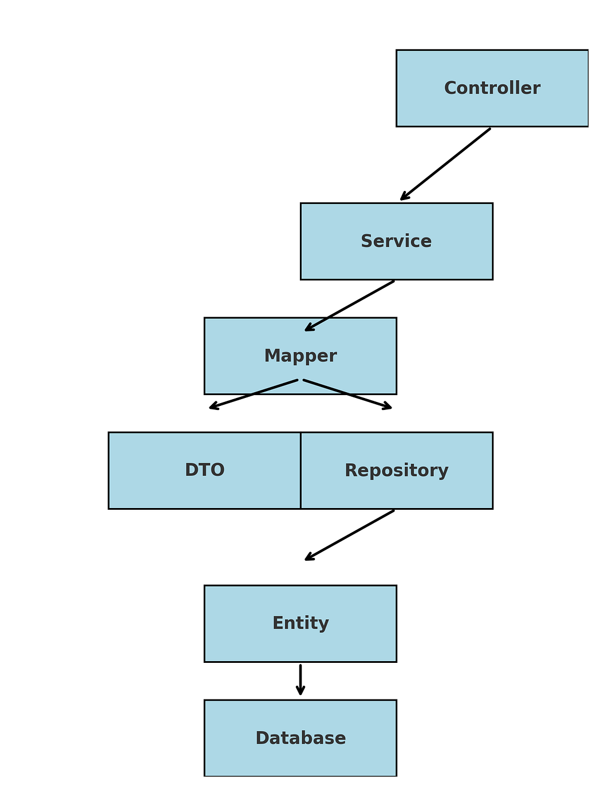
DTO with layers

Slide 10
@ElementCollection
@ElementCollection is a Java Persistence API (JPA) annotation used to map a collection of non-entity objects to a separate database table.
The non-entity objects can be either basic types (like Strings or Integers) or objects marked with the @Embeddable annotation.
The key characteristic of an @ElementCollection is that the lifecycle of the elements is entirely dependent on the owning entity.
When the parent entity is saved, its element collection is also saved. When the parent is deleted, all the associated elements are deleted as well. The elements do not have an independent identity and cannot be queried on their own.

Slide 11
How it works
A separate table is created: A new table is automatically generated to store the collection elements.
This table holds the element data and a foreign key referencing the primary key of the owning entity.
Owning entity manages lifecycle: JPA handles all the persistence operations for the elements.
You simply manage the collection field in your entity, and the persistence provider takes care of the database interactions.

Slide 12
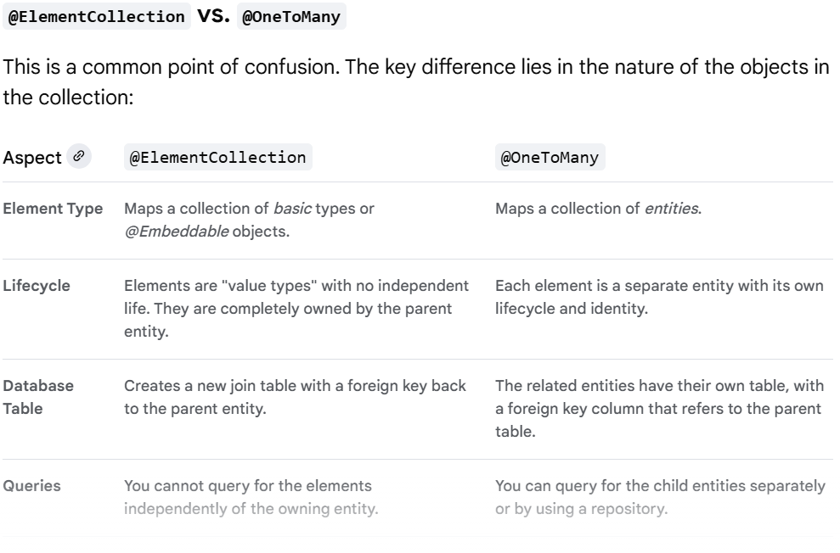
@ElementCollection vs. @OneToMany

Slide 13
example
@Entity
public class User {
@Id
@GeneratedValue(strategy = GenerationType.IDENTITY)
private Long id;
private String username;
@ElementCollection
@CollectionTable(name = "user_addresses", joinColumns = @JoinColumn(name = "user_id"))
private Set<Address> addresses = new HashSet<>(); // Getters and setters
}
@Embeddable
class Address {
private String street;
private String city;
private String zipcode;
// Getters and setters
}

Slide 14
@Embeddable
This annotation in JPA is used to designate a class whose instances can be embedded within other entity classes.
It allows for the grouping of related fields into a reusable class without requiring a separate database table for that clas
An example involves an Address class marked with @Embeddable and an Employee entity that uses @Embedded on its Address field, resulting in the Address's street, city, and zip code columns being directly inserted into the employee table in the database.

Slide 15
Key characteristics of @Embeddable:
No separate table: A class marked with @Embeddable does not correspond to its own table in the database. Instead, its fields are directly mapped to columns within the table of the entity that embeds it.
Encapsulation and reuse: It promotes a cleaner object-oriented design by allowing common fields, such as an address or contact information, to be encapsulated in a single class and reused across multiple entities.
Value type: Embeddable classes are treated as value types, meaning their lifecycle is dependent on the owning entity.
Usage with @Embedded: To actually embed an @Embeddable class within an entity, the field in the entity that holds an instance of the embeddable class must be annotated with @Embedded.

Slide 16
Example
@Entity
public class Employee {
@Id
private Long id;
private String name;
@Embedded
private Address address;
// Getters and Setters
}
@Embeddable
public class Address {
private String street;
private String city;
private String postalCode;
// Getters and Setters
}
the street, city, and postalCode fields of the Address class would be stored as columns directly within the Employee table in the database, alongside the id and name fields of the Employee entity.

Slide 17
@elementcollection vs @embedded
@Embedded maps a single, dependent object into its parent entity's table,
while @ElementCollection maps a collection of dependent objects into a separate, dedicated table. The key distinction is the cardinality of the relationship.

Slide 18
