Slide 1

Title: Implementing CQRS Pattern in Microservices Using Apache Kafka
Presented By: Shankar Merugu Usha Arukatla

Slide 2
Definition: CQRS stands for Command Query Responsibility Segregation.
Purpose: Separates the read (query) and write (command) operations in an application.
What is CQRS?

Slide 3
Key Components of CQRS
Commands: Requests to change the state of the system.
Example: Create, Update, Delete operations
Queries: Requests to read the state of the system.
Example: Fetch details, List items
Command Handler: Processes commands.
Query Handler: Handles queries.
Event Store: Captures events that trigger state changes.
Read Model: Optimized for queries.
Write Model: Optimized for commands.

Slide 4
Advantages of Using CQRS
Scalability: Separate scaling of read and write operations.
Performance: Optimized data models for reading and writing.
Flexibility: Different models for different concerns.
Security: Fine-grained access control.
Auditability: Clear event trail for auditing.

Slide 5
What is Apache Kafka?
Definition: Kafka is a distributed event streaming platform.
Purpose: Handles real-time data feeds with high throughput.
Key Features:
Pub/Sub messaging
Scalability and fault tolerance
Durable storage

Slide 6
Integrating Kafka with CQRS
Command Processing:
Commands are sent to Kafka topics.
Handled by command services.
Event Publishing:
State changes are published as events.
Events are recorded in Kafka topics.
Query Handling:
Queries are served from a read model updated by events.
Read model is updated asynchronously via Kafka consumers.

Slide 7
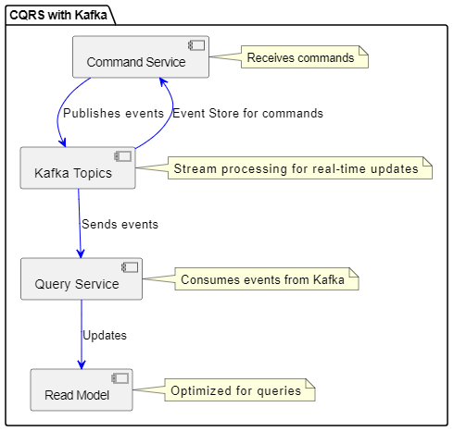
CQRS with Kafka: Architecture Diagram
Command Service:
Receives commands
Publishes events to Kafka topics
Kafka Topics:
Event Store for commands
Stream processing for real-time updates
Query Service:
Consumes events from Kafka
Updates the read model
Read Model:
Optimized for queries

Slide 8
Steps to Implement CQRS with Kafka
Define Command and Query Models:
Design command and query handlers.
Set Up Kafka Topics:
Create topics for commands and events.
Implement Command Handlers:
Publish events to Kafka.
Implement Query Handlers:
Consume events and update the read model.
Develop Read and Write Models:
Use optimized data stores for performance.

Slide 9
Challenges in CQRS with Kafka
Eventual Consistency:
Solution: Use proper event handling and retries.
Data Duplication:
Solution: Design read models carefully.
Complexity:
Solution: Use frameworks and libraries to simplify integration.

Slide 10
Summary and Takeaways
CQRS Benefits: Scalability, performance, and security.
Kafka Role: Reliable event streaming and real-time updates.
Best Practices:
Design efficient models
Handle eventual consistency
Monitor and manage Kafka topics

Slide 11
Thank you

