Slide 1
Comprehensive Digital Marketing
Project Work OF HIMAYALYA HERBAL

Slide 2


Part 1: Brand study, Competitor Analysis & Buyer’s/Audience’s Persona
Research Brand Identity: Study the brand's mission, values, vision, and unique selling propositions (USPs).
Introduction of brand identity:
The particular points or areas of study that a scientist is enthusiastic about and centers around in their work
logo:

Slide 3
Founder of Himalaya Herbals:Mohammad Manal
Founded year of Himalaya Herbals:1930
Official website: www.himalayawellness.com
Brand colour: Green
Mission: Establish Himalaya as a science-based, problem-solving, head-to-heel brand, harnessed from nature's wealth and characterized by trust and healthy lives. Develop markets worldwide with an in-depth and long-term approach, maintaining at each step the highest ethical standards. Respect, collaborate with, and utilize the talents of each member of the Himalaya family and the local communities, to drive our seed-to-shelf policy and to rigorously adopt eco-friendly practices to support the environment we inhabit.
Values: By being truthful, honesty The company is committed to promoting wellness through its range of natural and Ayurvedic products.
USP: Himalaya Herbals lies in its commitment to providing natural, safe, and effective herbal healthcare and personal care products.

Slide 4
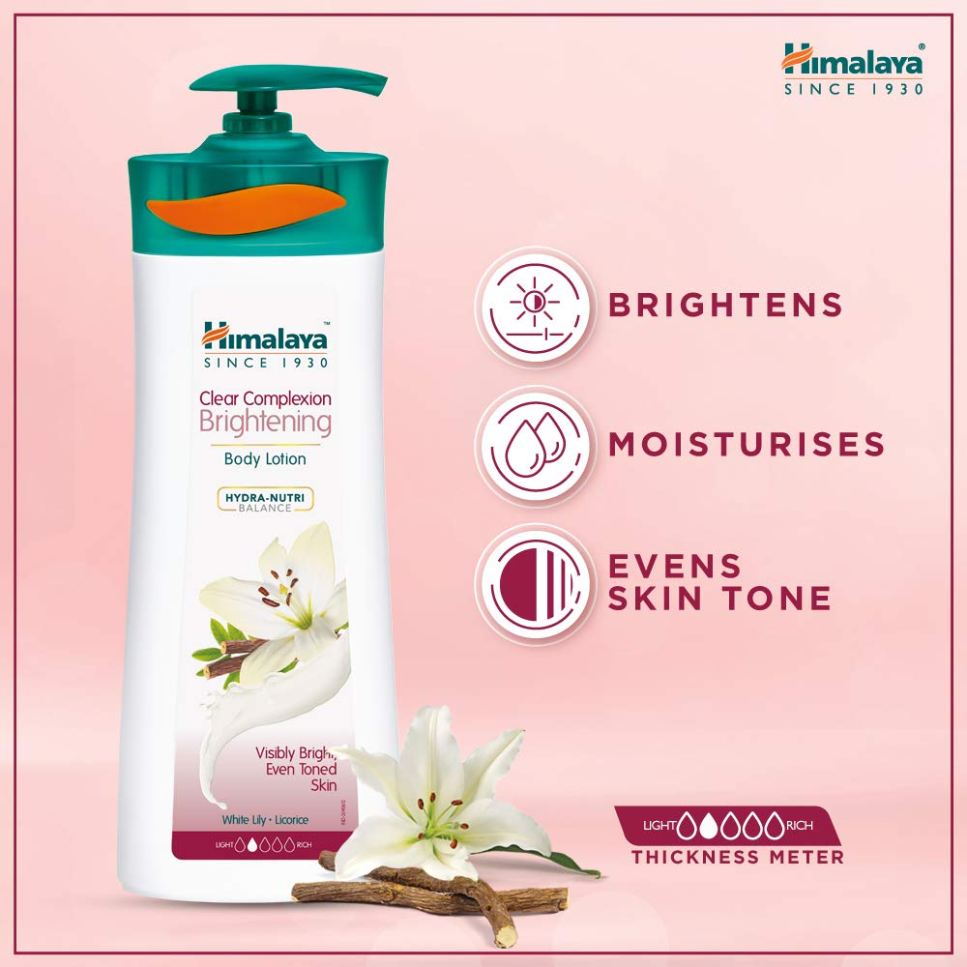

Part 1: Brand study, Competitor Analysis & Buyer’s/Audience’s Persona
Analyze Brand Messaging:
Brand Situating: Analyze how the brand positions itself on the lookout and against contenders. Search for messages that feature the brand's remarkable selling focuses (USPs) and differentiators. Solid brand situating builds up the brand's personality in the personalities of buyers.
Brand Tone and Character: Survey the tone and character passed on through the brand's messages. Is the brand serious, funny, legitimate, or agreeable? The brand's tone ought to line up with its character and resound with the main interest group.

Slide 5
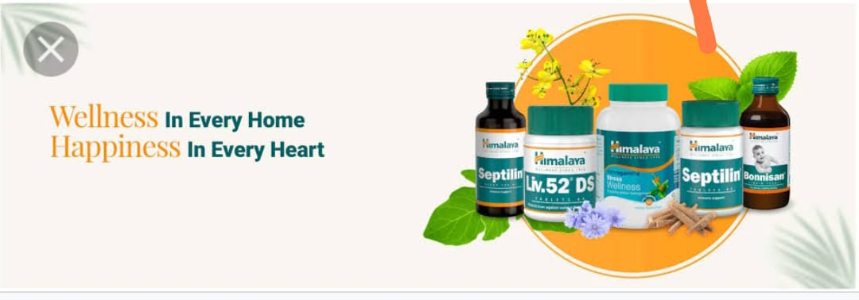
Examine the brand tagline:
Khush Raho, Khushaal Raho' bringing to life its vision of “Wellness in EveryHome, Happiness in Every Heart”.
"Herbal Healthcare with a Difference":
"Rooted in Nature, Crafted by Science":

Slide 6

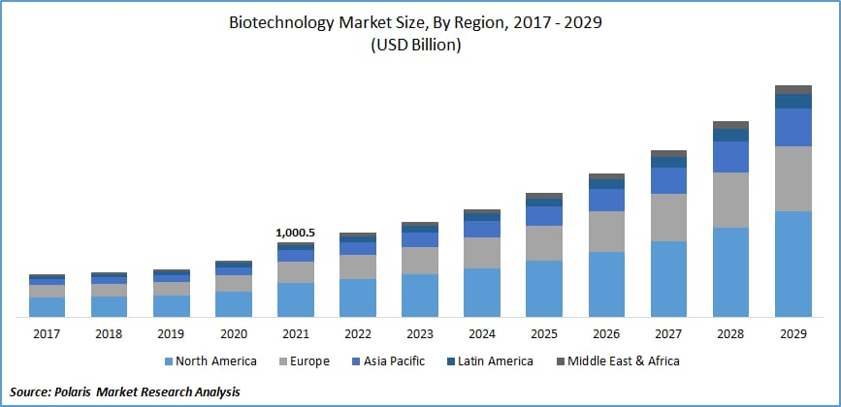
Part 1: Brand study, Competitor Analysis & Buyer’s/Audience’s Persona
Competitor Analysis: Select three competitors operating in the same industry or niche as the chosen brand, examine their USPs and online communication.
Competitor 1: http://www.biotique.com/
USP: Natural beauty, leave long days, International marketing, skin natural
Communication: Maintain a global consumer base ,benifits, campaigns.

Slide 7
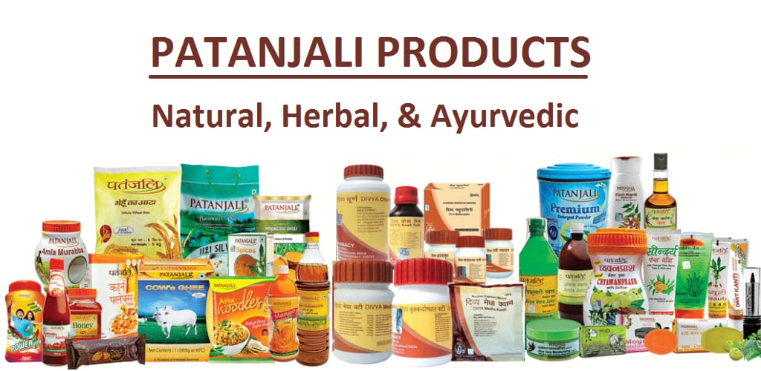
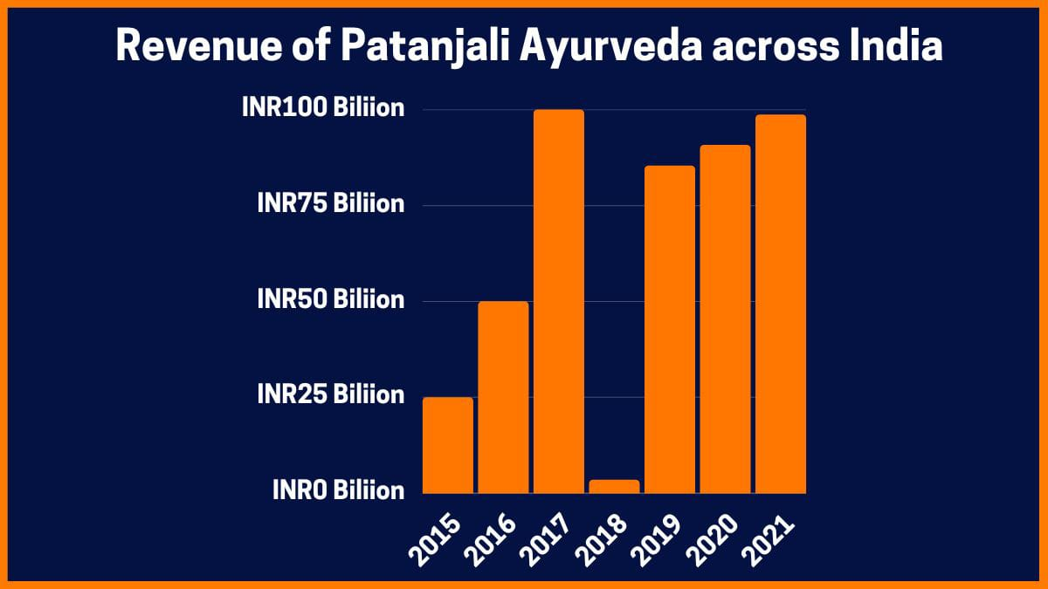
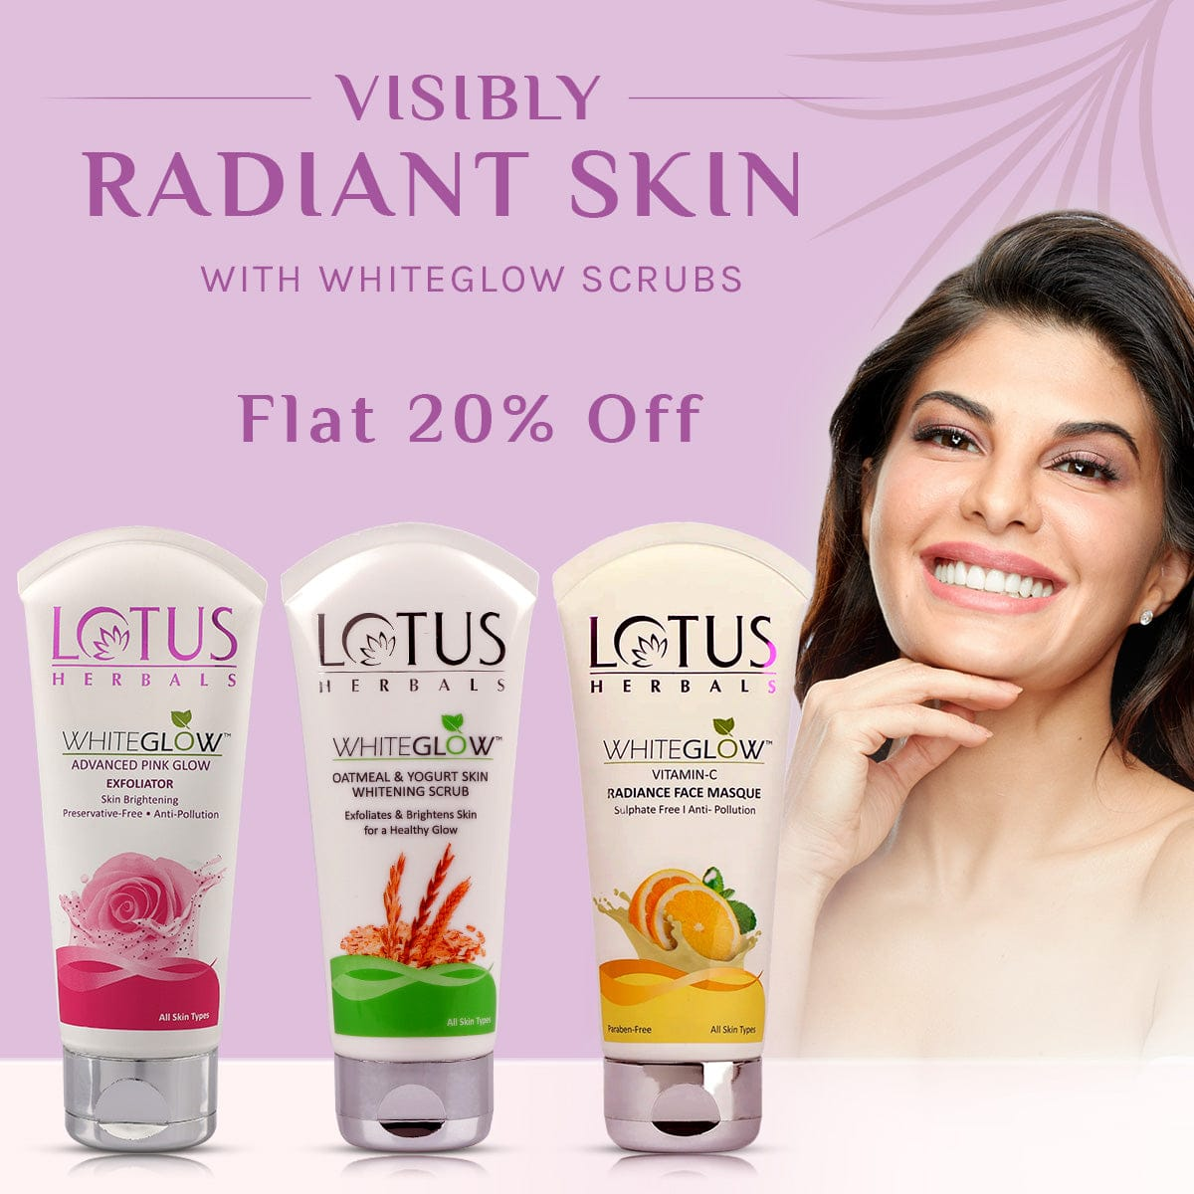
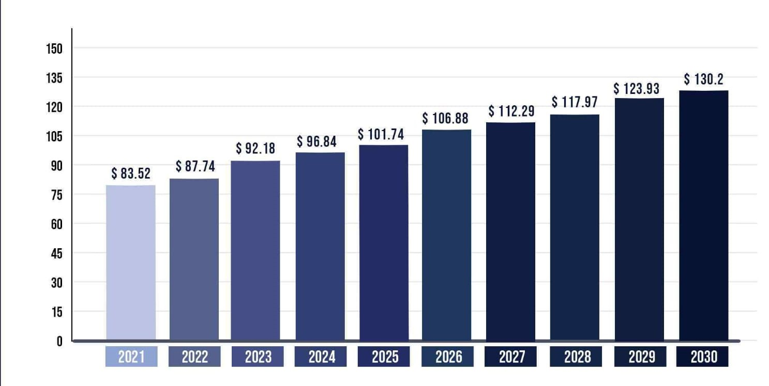
Competitor 2: http://www.patanjali.com/ USP: unhealthy product, Good services ,Range of categories
Communication: Comprehensive plane, Globalisation, Revolutionary approach
Comptitor 3: http://www.lotus.com
USP: Toxins free, loyal customers, ultra awesome, strength of purity.
Communication: Goodness inside, collaboration, beauty and wellness needs, personal care

Slide 8
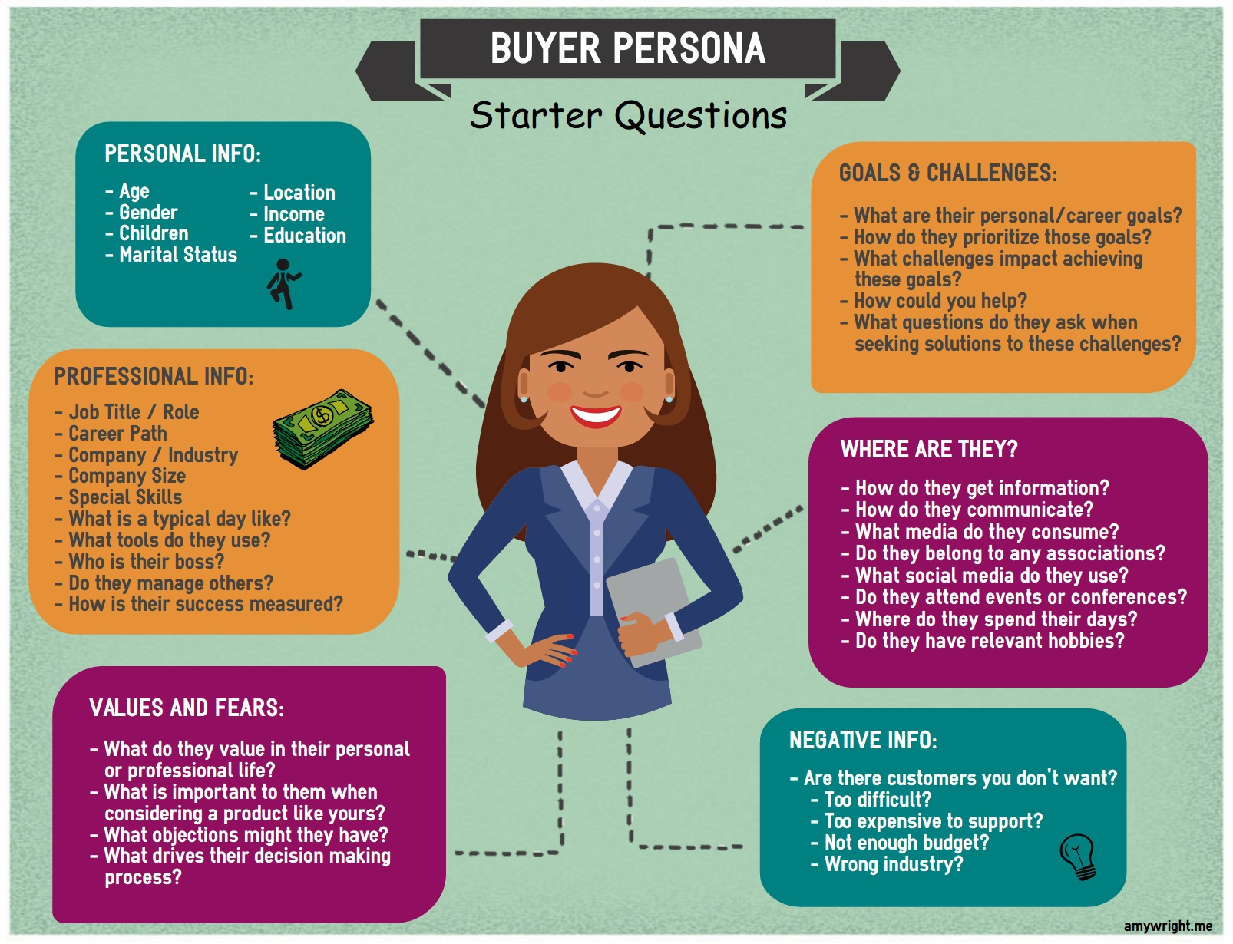
Part 1: Brand study, Competitor Analysis & Buyer’s/Audience’s Persona
Buyer's/Audience's Persona: Clearly define the target audience for the chosen brand. Consider demographics, psychographics, behaviours, and interests.
Himalaya herbals
18-50
Male
No
Unmarried
Metro cities like Banglore, Hyderabad,etc
Tier2 and tier3 cities
With remote villages
1,00,000 per annum to 20,00,000 per annum

Slide 9

Brand and Preference:
Online Customer: Sarah favors shopping on the web because of the comfort it offers. She explores items, understands surveys, and looks at costs prior to making a buy.
Brand Unwaveringness: When she finds a brand she trusts and is happy with, Sarah will in general stay faithful to it .
Messaging and Marketing strategies:
Underscore Regular Fixings: Feature Himalaya Herbals' utilization of normal and natural fixings in their items, exhibiting their obligation to manageable and eco-aactices.
The executives: Position Himalaya Herbals as a brand that advances in general prosperity and offers pressure alleviation answers for assist Sarah with adapting to her bustling way of life.
Advanced Presence: Keep a functioning web-based presence through online entertainment stages and connecting with content that teaches and illuminates Sarah about the advantages regarding home grown cures and Himalaya Herbals' item range.
Powerhouse Coordinated efforts: Join forces with wellbeing and health forces to be reckoned with to survey and suggest Himalaya Herbals items, utilizing their crowd's trust to arrive at additional potential clients like Sarah.

Slide 10
Part 2: SEO & Keyword Research
SEO Audit: Do an SEO audit of the brands website
Keyword Research: Define Research Objectives, Brainstorm Seed Keywords, Utilize Keyword Research Tools (SEMrush or Moz Keyword Explorer),Analyze Competitor Keywords, Long-tail Keyword Exploration (specific, longer phrases) that align with the research objectives and have lower competition but higher conversion potential.
On page Optimization: Meta Tag optimization & content optimization
Reflect on the process of conducting keyword research and the SEO recommendations provided.
Document the challenges faced during the research and analysis phase, as well as the key insights gained from the keyword research process.

Slide 11
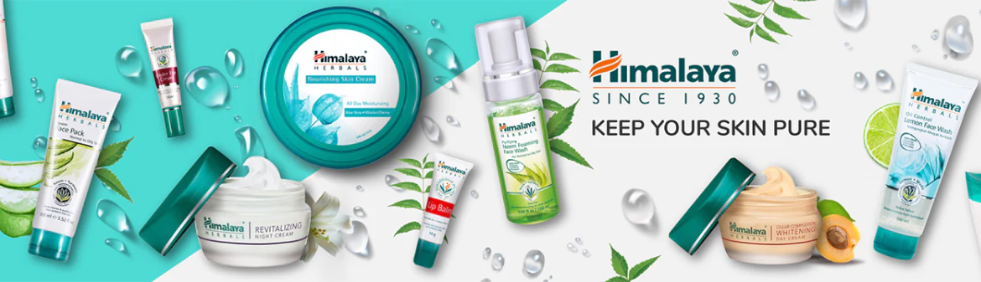
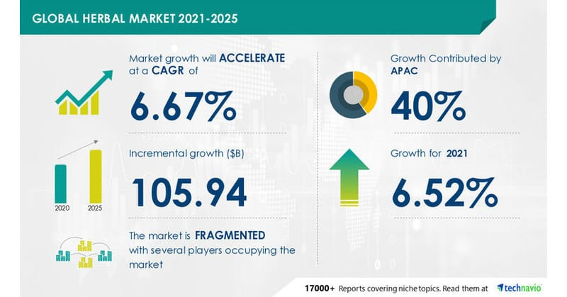
SEO Audit: Seo for Himalaya herbals A Web optimization review for Himalayas Natural, I will zero in on the specialized pans of the site, guaranteeing that it is enhanced for web crawlers and easy to understand. Here is a bit by bit breakdown of the review video link : https://youtu.be/LfIuIeqTTWI
Site speed and execution:

Slide 12
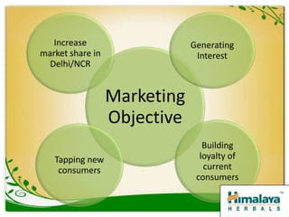
Check the site’s stacking speed on both work area and cell phones utilizing apparatuses like Google Page Speed Bits of knowledge or GT metric Enhance pictures, influence program reserving, and limit server reaction time to further develop site speed
Versality:
https://himalayausa
( check in the event that the site is portable responsive)
Site engineering: Audit the site‘s construction and route to guarantee it is easy to understand and simple for web search tools to slither. Carry out a consistent ordered progression with clear classifications and use HTML sitemaps to help with indexatian.
URL:

Slide 13
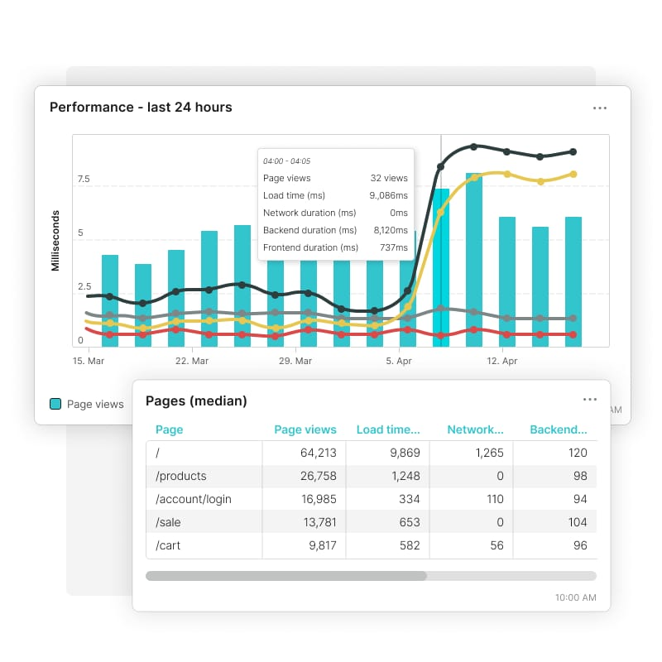
Really look at the URLs for each page and guarantee they are enlightening, brief, and incorporate pertinent watchwords. Stay away from extension URLs with pointless
Meta Labels: Evaluate the meta title and depiction* IabeIs for ea hpage. Guarantee they are special, convincing, and incorporate designated catchphrases vigate rates .

Slide 14
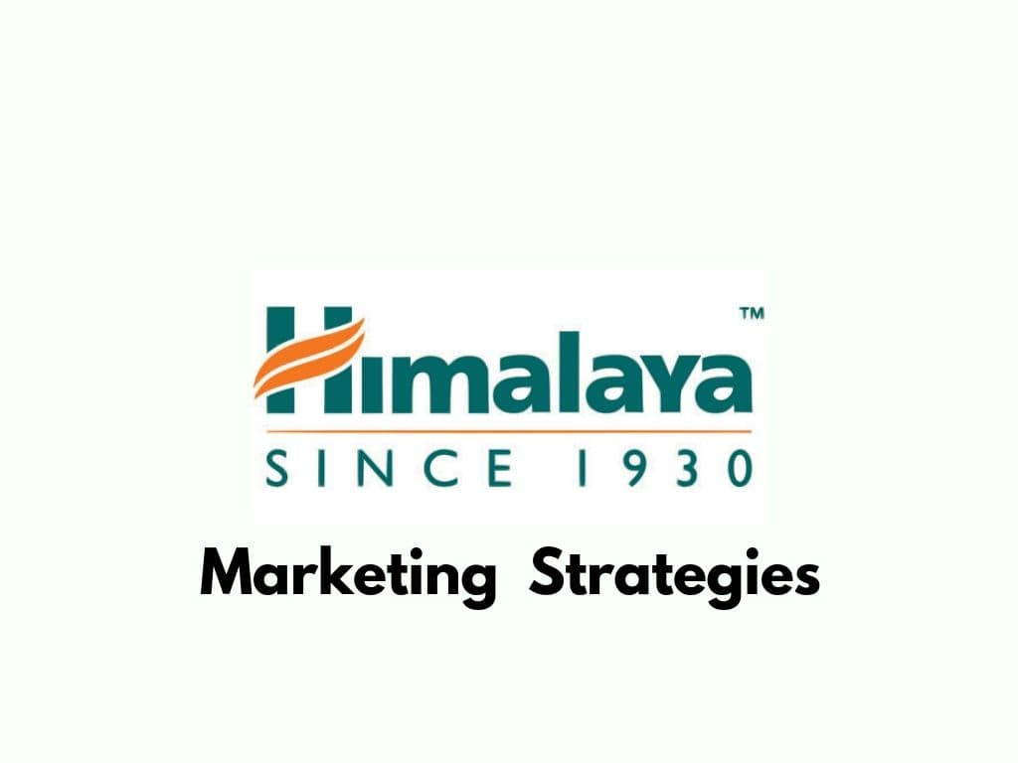
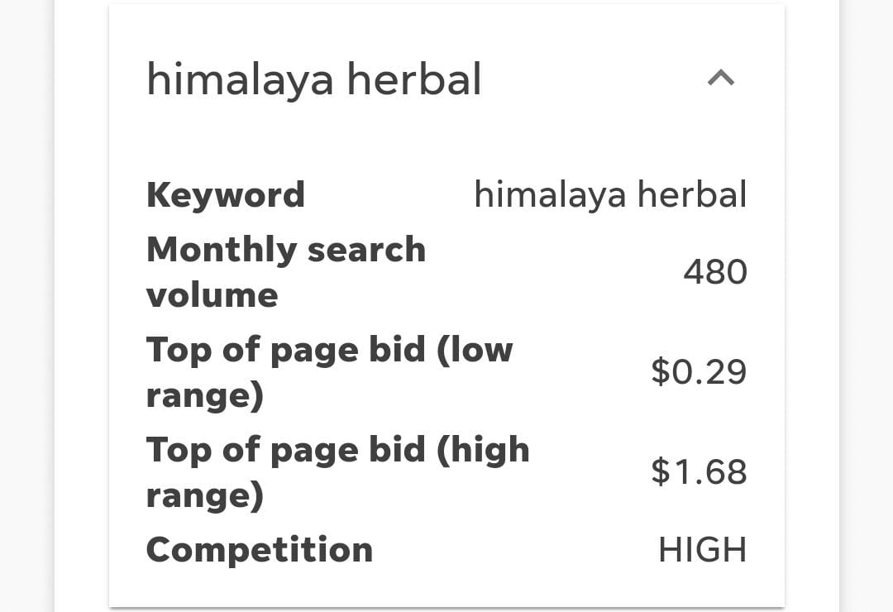
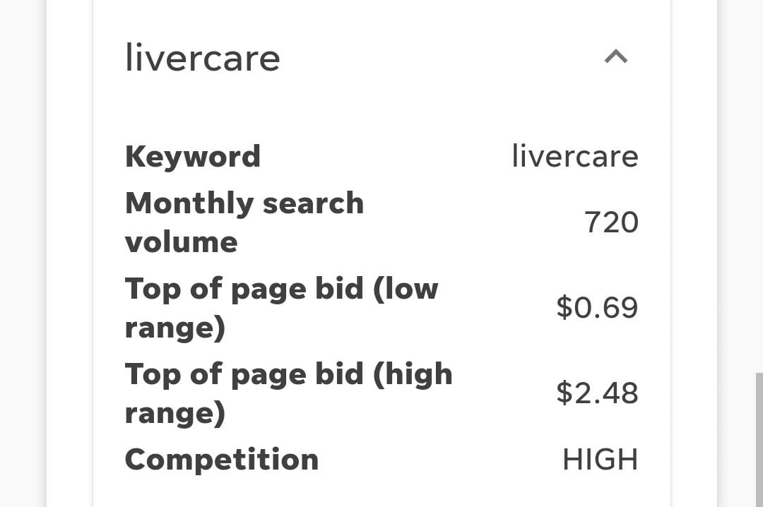
Himalaya Herbals keyword Research:
https://youtube.com/shorts/I11YFZVuIZs?feature=share3
Himalaya Natural: Himalaya Home grown alludes to an eminent brand that has some expertise in assembling and advancing natural medical services and individual consideration items. They are known for their regular Ayurvedic plans, got from Himalayan spices and fixings

Slide 15
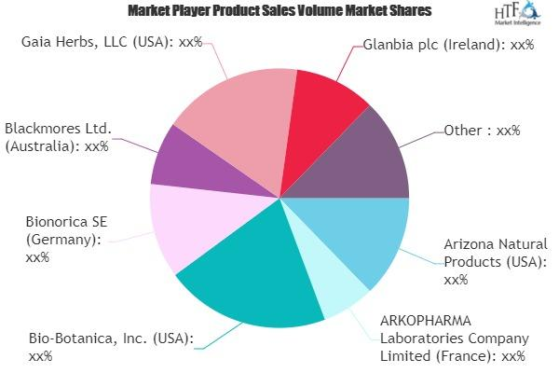
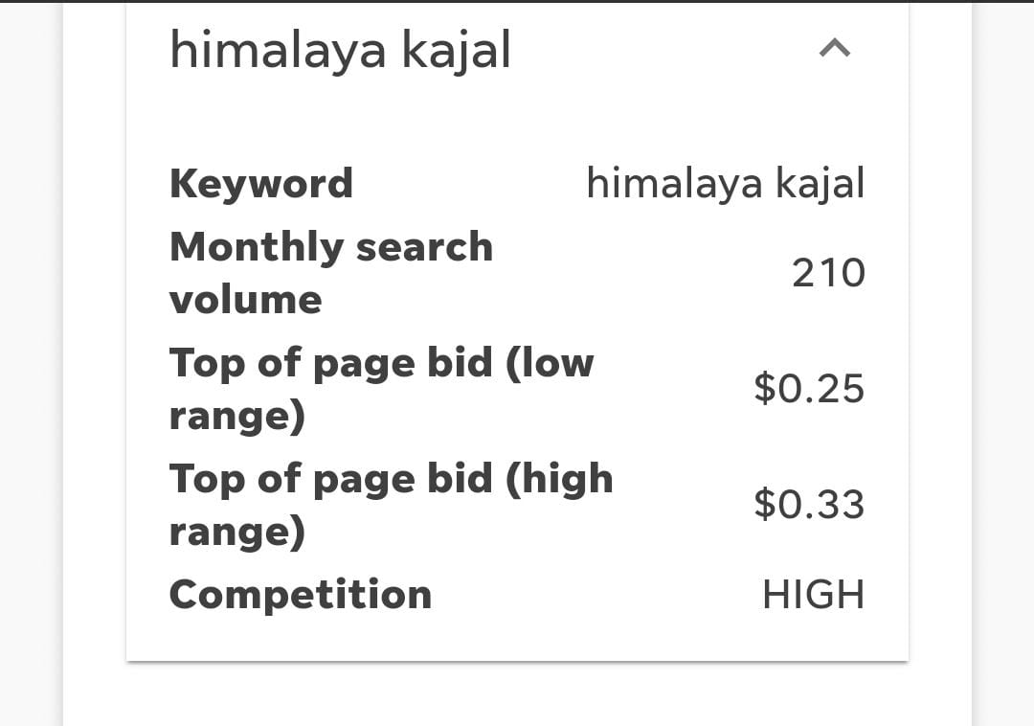
Wellbeing: Himalaya Home grown advances generally wellbeing through its natural items, focusing on various parts of wellbeing, including skincare, haircare, absorption, and invulnerable help
Healthy skin: Himalaya Home grown offers a complete line of skincare items, including chemicals, lotions, veils, and serums, intended to normally sustain and safeguard the skin
Individual Consideration: Himalaya Natural offers a wide exhibit of individual consideration items, incorporating dental consideration, body care, and cleanliness items, all figured out with home grown fixings..
Home grown Concentrates: Numerous Himalaya Natural items contain natural concentrates, which are concentrated types of helpful plant compounds.

Slide 16
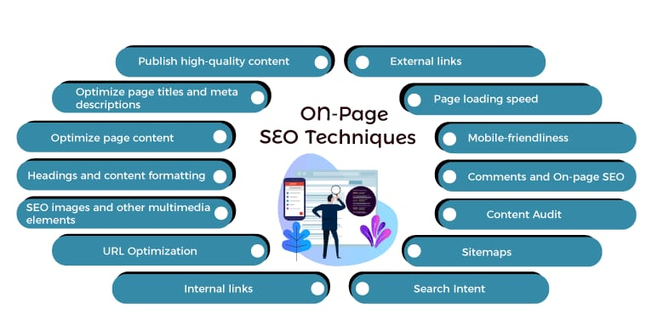
Onpage optimization:
Page optimization for Himalaya Herbal entails making changes to the company’s website to improve user experience, raise visibility in organic search results, and ultimately draw in more customers. Here are some crucial areas to concentrate on:
Meta tag optimization:
Title Tag: The title tag is one of the most critical meta tags. It should be concise, descriptive, and contain relevant keywords. Include the brand name, primary keyword, and a compelling call-to-action if possible.

Slide 17
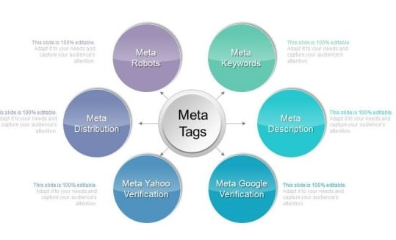
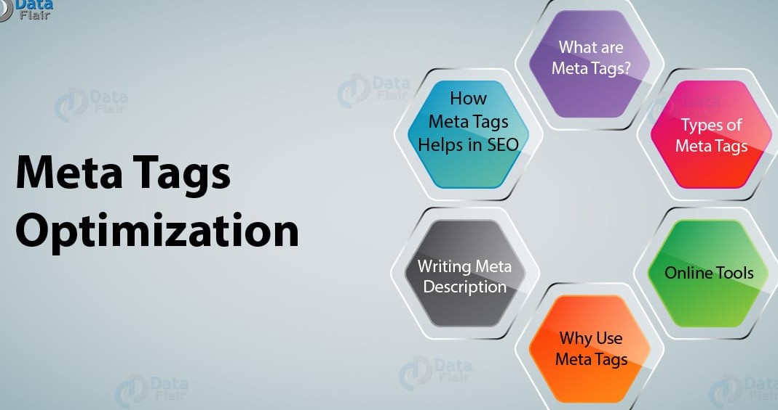
Meta Description: The meta description provides a brief summary of the page's content. It should be engaging, informative, and include the main keyword. Aim for 150-160 characters to avoid truncation in search results.
Use Brand Name: Consolidate the brand name "Himalaya Herbals" in the meta labels, particularly in the title tag, to help brand perceivability in query items.
Keep away from Copy Content: Try not to utilize the equivalent meta labels across different pages. Each page ought to have special and applicable meta labels..

Slide 18
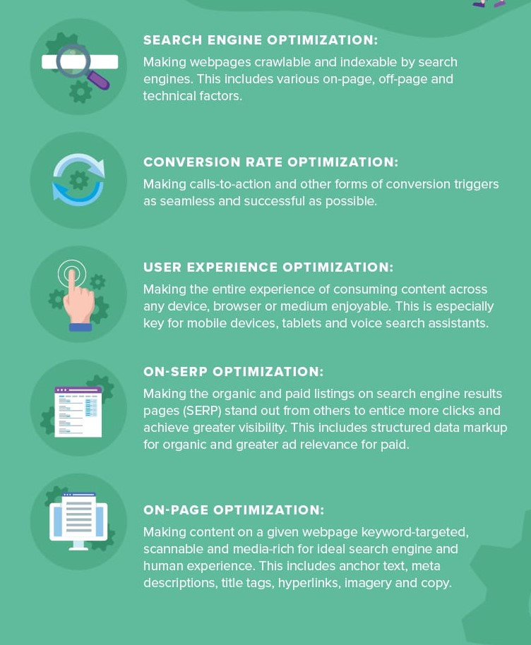
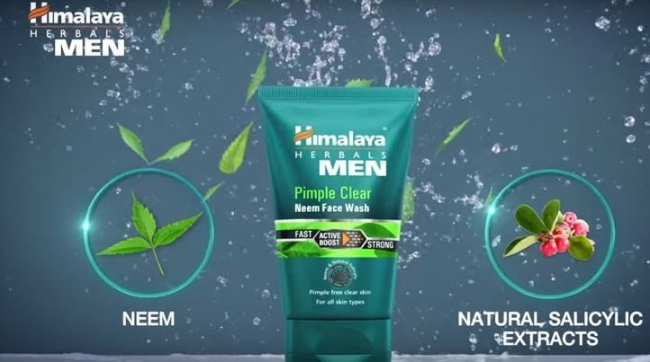
Content Optimization:
Measure Execution: Use examination apparatuses like Google Investigation to follow the exhibition of your substance. Screen key measurements like traffic, commitment, and changes to recognize what works and what needs improvement.
https://youtu.be/lw3wMn0bgTc

Slide 19
Part 3: Content Ideas and Marketing Strategies
Content Idea Generation & Strategy: Create a content calendar for the remaining month of July by brainstorming content themes, exploring various formats like blog posts, videos, infographics, podcasts, and interactive quizzes, and scheduling publication dates mainly on Facebook & Instagram. And include the strategy, aim and the idea behind these posts and story
Content Calendar Example (Try creating a table for the month of July)

Slide 20

Aim: It seems like you want to know about content and strategies. Content and strategies are essential elements in various fields, including marketing, writing, and business development.
Content: Content alludes to the data, media, or material introduced to a crowd of people through various channels like sites, online entertainment, websites, recordings, and that's just the beginning. Top notch content is vital in connecting with and holding your main interest group.
Strategies:
Techniques are thoroughly examined plans intended to accomplish explicit objectives and goals. Here are a few systems that can be applied in different settings:
Marketing Strategy: Develop a comprehensive marketing strategy that includes a target market analysis, positioning, pricing, promotion, and distribution plans.

Slide 21
DATE | PLATFORM | content Type | Content Description | Hashtag
17/07/2023 | Instagram | photo | Stunning Landscape Of Himalayan Herbals Fields | #Himalayan Herbals
 |  |  |  | #Nature Beauty
17/07/2023 | Twitter | Video | Quick Tutorial On Harvesting Herbs Sustainably | #Herb Harvesting
 |  |  |  | #Sustainable Living
18/07/2023 | Facebook | Blog Post | Discover the Heating Powers Of Himalayan Herbal | #Herbal Healing
 |  |  |  | #Wellness
18/07/2023 | Instagram | Quote Graphic | Natures bounty: Embrace the Healing herbal | #Natural Herbals
 |  |  |  | #Health Journey
19/07/2023 | Instagram | Photo Corousel | Different Himalayan herbs and their uses | #Herbal Medicine
 |  |  |  | #Holistic Health
19/07/2023 | Twitter | Video | Behind-the-scenes Herb processing and packaging | #Behind The Scenes
 |  |  |  | #Handmade

Slide 22
20/07/2023 | Facebook | Info graph | The Top 10 Himalayan Herbs for stress relief | #stress free Living
 |  |  |  | #Herb Remedies
20/07/2023 | instagram | photo | Himalayan herbs in traditional cuilsine | #Herbs in cooking
 |  |  |  | #Food culture
21/07/2023 | Twitter | Blog Post | Journey to the Himalayas: Un Earthing Herbal Treasures | #Himalayan Adventure
 |  |  |  | ##Herb Discovery
21/07/2023 | Facebook | Testimonial | Customer review on the effectiveness of Himalayan Herbs | #Happy Heating
 |  |  |  | #Herbal Lifestyle
22/07/2023 | Instagram | Quote Graphic | Healing from within: Embrace the power of herbal | #Inner Heating
 |  |  |  | #Herbal Lifestyle
23/07/2023 | Instagram | Photo Carousel | Sustainable practices in herb cultivation | #Sustainable Farming
 |  |  |  | #Green Living
24/07/2023 | Twitter | Video | O&A session: Addressing Common herb related queries | #Herbo and A
 |  |  |  | # Wellness Tips

Slide 23
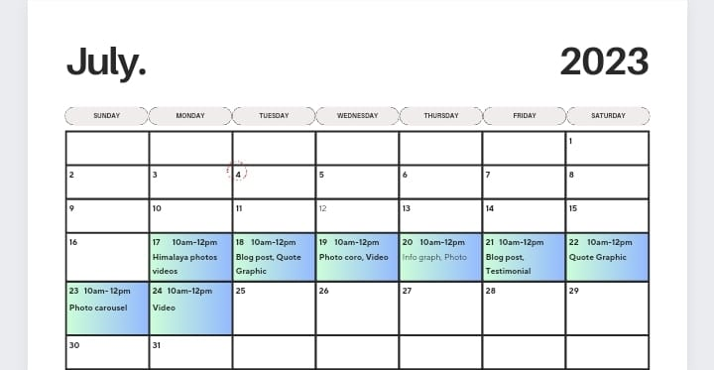
content calendar for month of july

Slide 24
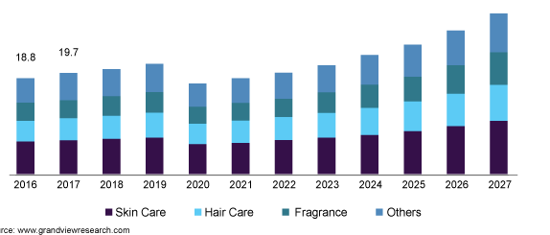
Part 3: Content Ideas and Marketing Strategies
Reflect on the content ideas and marketing strategies process, discussing the challenges encountered and lessons learned.
Marketing Strategies
Understanding the Objective Market: Distinguish the essential interest group for Himalaya Herbals items. Think about socioeconomics (age, orientation, area), psychographics (way of life, interests), and conduct (purchasing propensities, inclinations). Himalaya Herbals commonly targets wellbeing cognizant buyers searching for normal and natural based items
Extraordinary Selling Recommendation : Feature Himalaya Herbals' novel selling focuses. It very well may be their accentuation on regular fixings, hundreds of years of Ayurvedic intelligence, or a particular advantages that put them aside from contenders

Slide 25
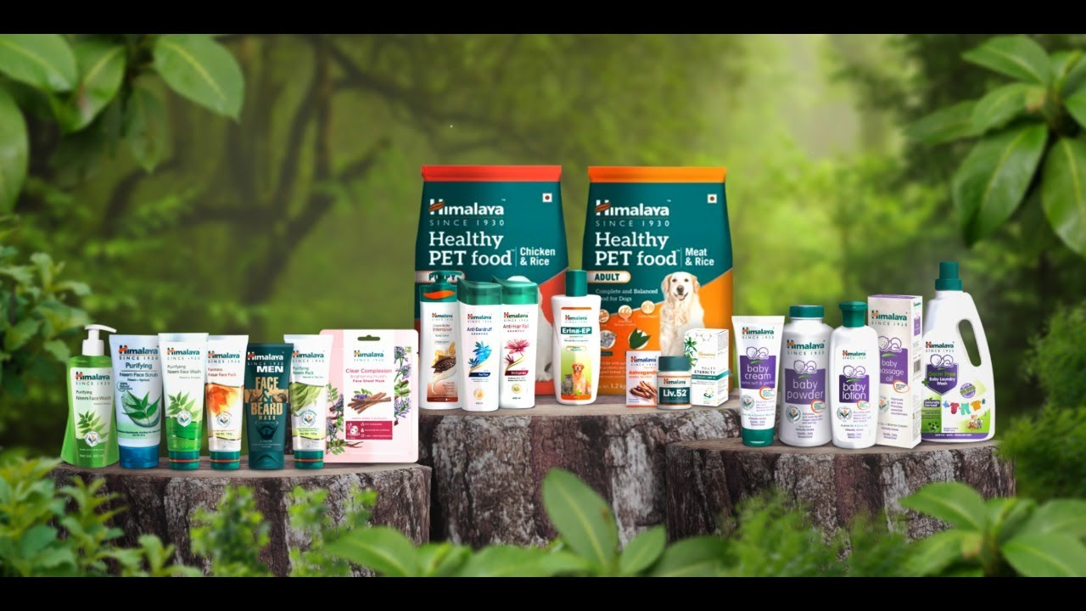
Retail and Distribution Channels: Strengthen relationships with retail partners and explore new channels to increase product availability in phyiscal stores and online platform.
Promotions and Offers: Implement periodic promotional campaigns, discounts, and offers to incentivize repeat purchases and attract new customers.
product : pharmaceuticals, personal care, baby care, well-being, nutrition and animal health products
Price: As of my last update in September 2021, there is no specific "Himalaya Prizes of Herbals" that I am aware of it.
promotion : Himalaya Herbal uses competitive pricing strategy to promote its products. The prices of Himalaya products

Slide 26
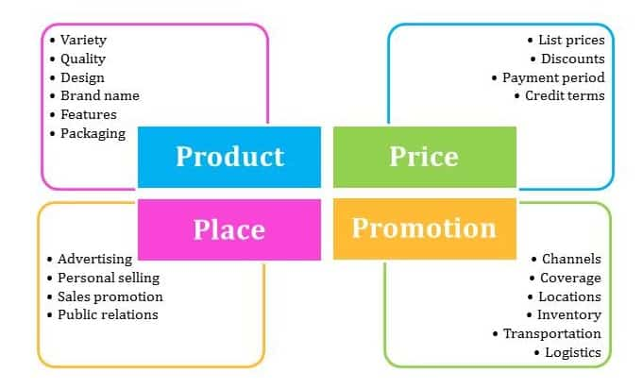
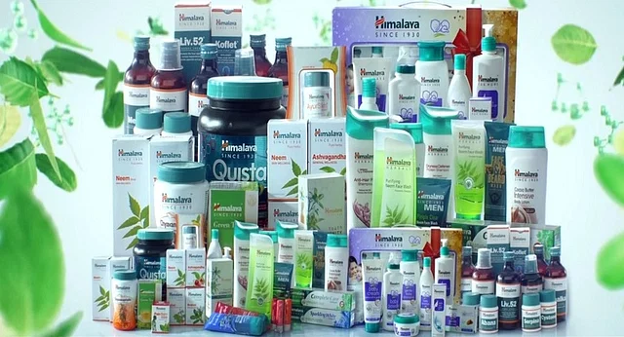
Client Maintenance Systems: Spotlight on continuing to exist clients blissful and connected through reliability programs, extraordinary offers, and magnificent client .

Slide 27
Part 4: Content Creation and Curation (Post creations, Designs/Video Editing, Ad Campaigns over Social Media and Email Ideation and Creation)
Post Creation:
Select Content Categories: Identify three different content formats relevant to the chosen topic or industry. Research and Brainstorm: Research trending topics, industry news, or audience interests within each category. Brainstorm ideas for social media posts that align with each category. Do note that 1 content format has to be video and additionally 3 stories/status are to be created.
Format 1: Blog
Aim: Himalaya Herbals
Date: 21/07/2023
Topic: https://www.blogger.com/blog/post/edit/6626036491955792916/7866118854501135612

Slide 28
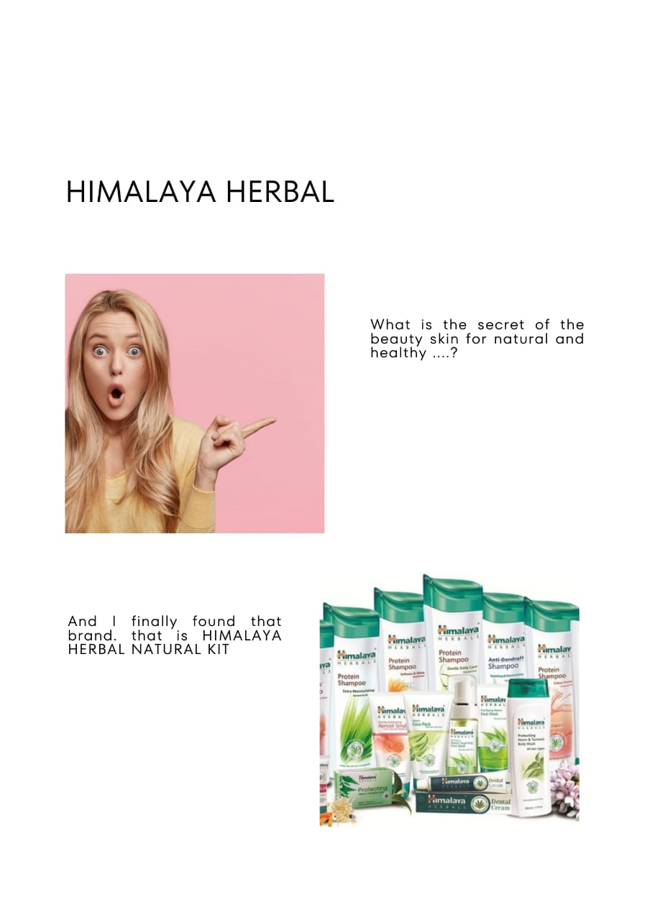

Format 2: Video
Aim: Himalaya herbal
Date: 19th july
Topic: https://youtu.be/jhEmn-kkAGQ
Format 3: Creative
Aim: Himalaya herbal
Date: 20th july
Topic:

Slide 29
Part 4: Content Creation and Curation (Post creations, Designs/Video Editing, Ad Campaigns over Social Media and Email Ideation and Creation) Are u
Instagram Story
Utilize the Stories feature on Instagram for three consecutive days. Share behind-the-scenes glimpses, polls, quizzes, or sneak peeks etc to encourage audience participation. Once uploaded use the story highlight feature on Instagram and save the 3 story with an appropriate name for each. Note: Once done monitor the performance of the posts and Stories using the insight tool and analyze the engagement metrics (likes, comments, shares, impressions, etc.). Based on the analysis, mention the strategies and areas for improvement.
1.Is it 100% natural product:
https://instagram.com/stories/himalayaherbals5/3151923819208502545?utm_source=ig_story_item_share&igshid=YTUzYTFiZDMwYg
2.Are u ready to to look pretty :
https://instagram.com/stories/himalayaherbals5/3151927066237337046?utm_source=ig_story_item_share&igshid=YTUzYTFiZDMwYg
3.Beauty secret:
https://instagram.com/stories/himalayaherbals5/3151952282980114712?utm_source=ig_story_item_share&igshid=YTUzYTFiZDMwYg
:

Slide 30
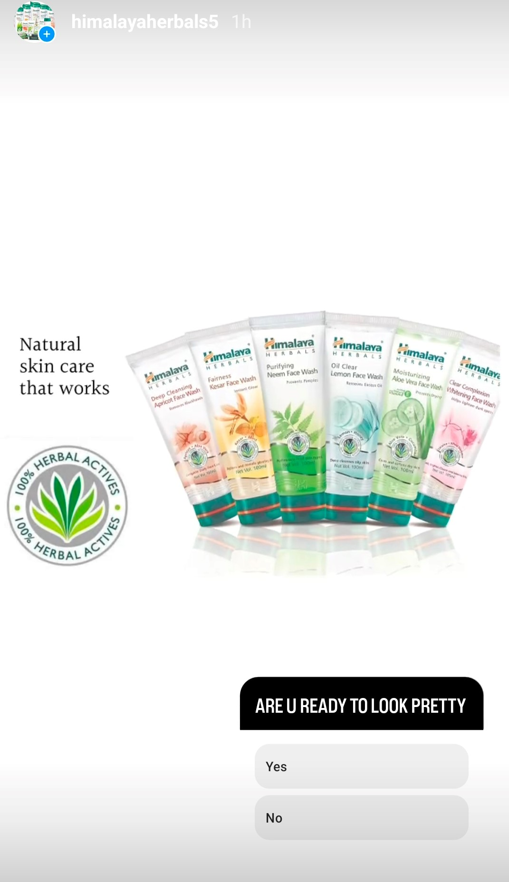
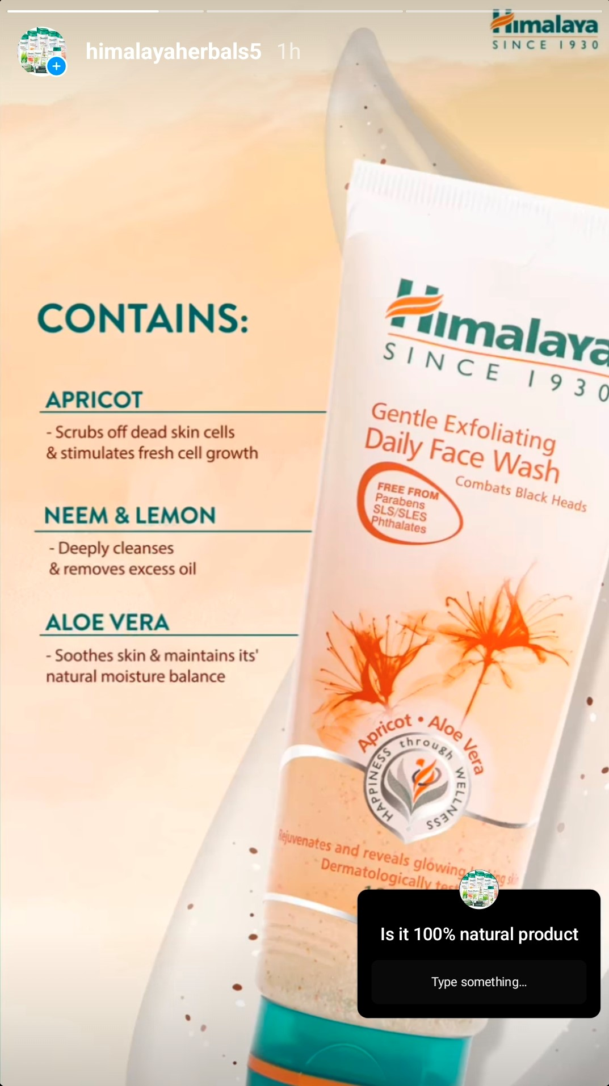
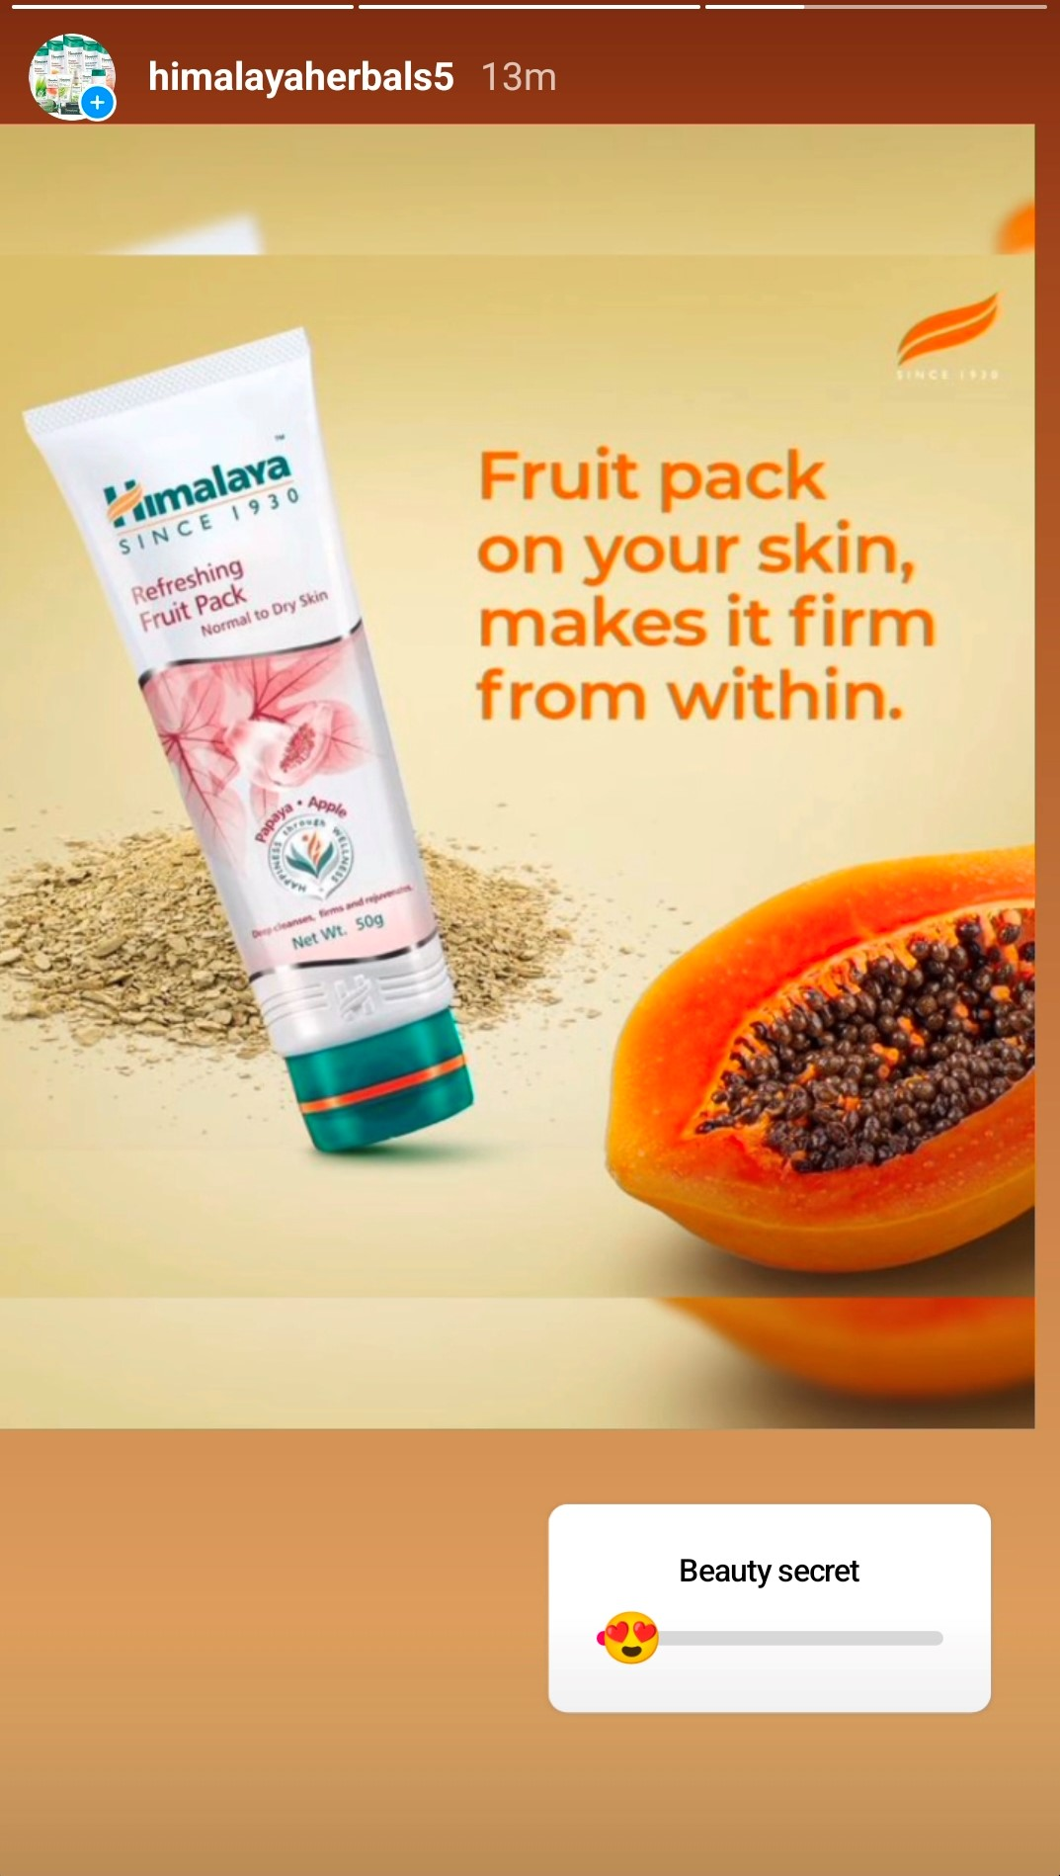

Slide 31
Part 4: Content Creation and Curation (Post creations, Designs/Video Editing, Ad Campaigns over Social Media and Email Ideation and Creation)
Degins/Video Editing
Design Tools Familiarization (use Canva for creating visually appealing graphics)
Video Creation: Utilize VN or any video editor of your choice to create videos related to the chosen topic.
Video 1:Himalaya Herbals for clear and natural skin types
https://youtu.be/yCAeT2ANUJc
Video 2: Himalaya Herbals face wash good for healthy skin
https://youtu.be/UY2KQ-V0ibM

Slide 32
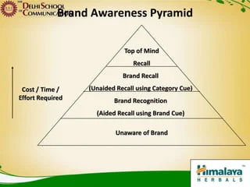
Part 4: Content Creation and Curation (Post creations, Designs/Video Editing, Ad Campaigns over Social Media and Email Ideation and Creation)
Social Media Ad Campaigns
Brand Awareness:Brand awareness in social media refers to the extent to which a brand is recognized and familiar to its target audience within the context of various social media platforms. It is a crucial aspect of a brand's marketing strategy as it directly impacts the brand's visibility, credibility, and overall success.
Social media platforms offer an ideal environment for building brand awareness due to their vast user base and the potential for content to go viral and reach a broader audience.

Slide 33
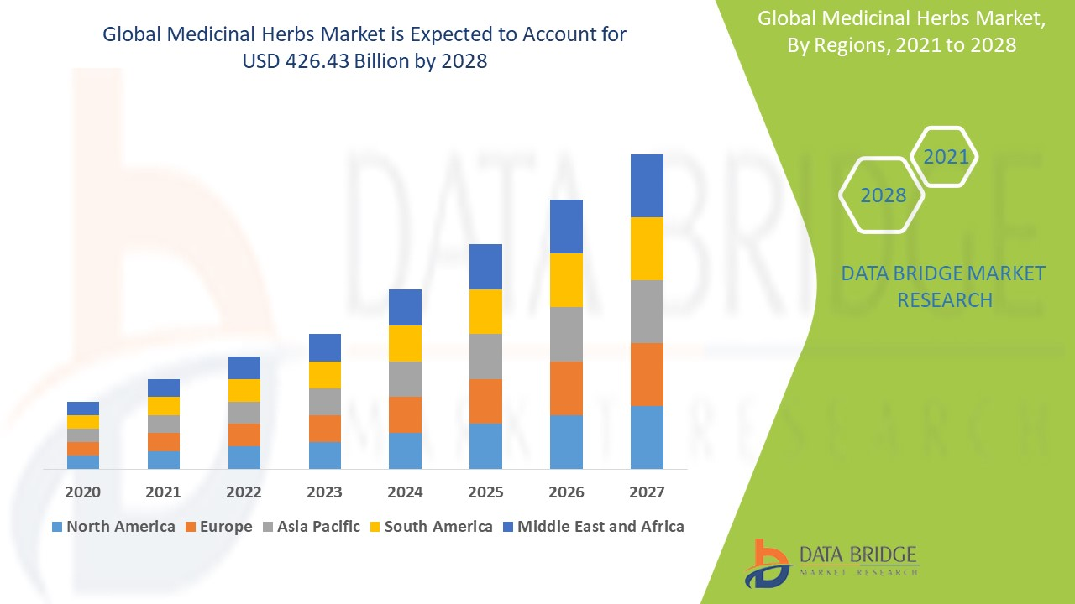
Examation and Investigation : Screen online entertainment examination to follow the exhibition of your image mindfulness endeavors. Distinguish which methodologies are working best and pursue information driven choices for future missions.
Social Media Advertising: Utilize paid advertising on social media platforms to reach a targeted audience beyond your existing followers. Platforms like Facebook, Instagram, Twitter, and LinkedIn offer powerful advertising tools to boost brand visibility.
Online Entertainment Challenges and Giveaways: Facilitating challenges and giveaways can make energy around your image and urge clients to impart your substance to their organization.
Analytics and Measurement: Monitor social media analytics to track the performance of your brand awareness efforts. Identify which strategies are working best and make data-driven decisions for future campaigns.
Cross-Advancement: Advance your web-based entertainment presence across different advertising channels, including your site, email bulletins, and other social stages, to urge your current crowd to follow you on various organizations.

Slide 34
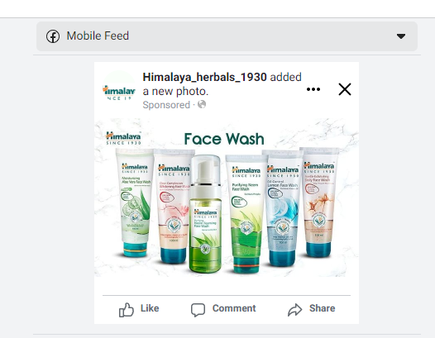
Facebook:
Facebook is a social media platform, and Himalaya Herbals is a well-known company that specializes in herbal healthcare products. The two operate in different industries and sectors. It is possible that they may have utilized Facebook for marketing or advertising purposes, like many other companies do, but any specific business relationship or partnership would require up-to-date information beyond my knowledge cutoff date

Slide 35
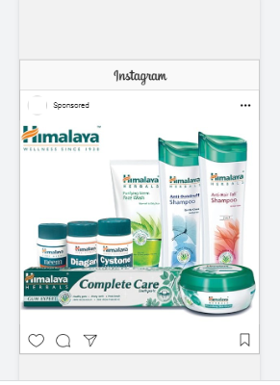
Instagram:
Himalaya is on an eternal quest to uncover the mysteries of nature. We chose the Himalaya mountain range of as our logo since it is a true reflection of nature's fascinating secrets. Our logo has been a representation of our closeness to nature and our pledge care for people and the Earth.

Slide 36
Part 4: Content Creation and Curation (Post creations, Designs/Video Editing, Ad Campaigns over Social Media and Email Ideation and Creation)
For every campaign clearly define:
Advertising Goals: increasing brand awareness, driving website traffic, or generating leads.
Audience Targeting: Define the target audience for the ad campaigns based on demographics, interests, and behavior.
Ad Creation: Create visually appealing ad creatives, compelling ad copy and relevant call-to-action.

Slide 37
Part 4: Content Creation and Curation (Post creations, Designs/Video Editing, Ad Campaigns over Social Media and Email Ideation and Creation)
Email Ad Campaigns
Ad Campaigns for email marketing:
Come up with 2 email ad campaigns with the mentioned goals: brand awareness & generating leads

Slide 38
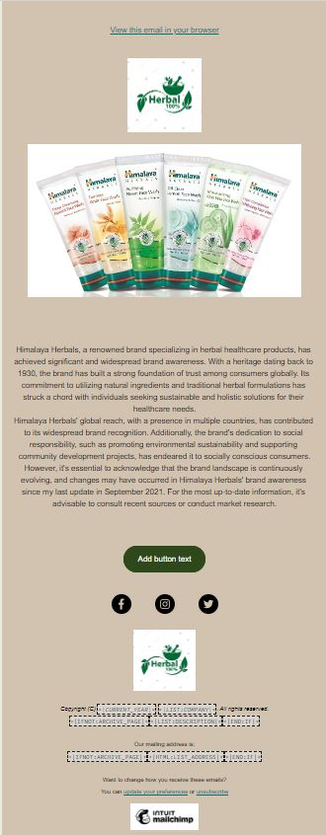
Email Ad Campaign 1 - Brand Awareness
(insert emailer image)

Slide 39
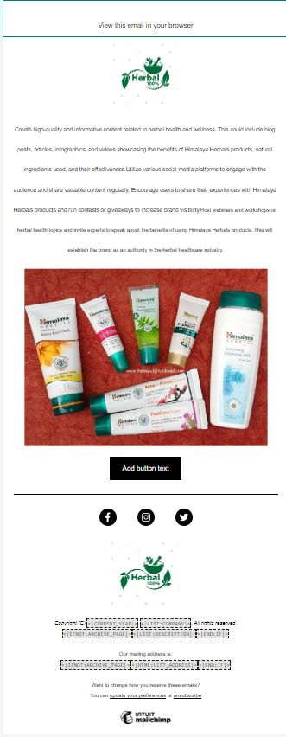
Email Ad Campaign 2 - Lead Generation
(insert emailer image)

Slide 40
Part 4: Content Creation and Curation (Post creations, Designs/Video
Editing, Ad Campaigns over Social Media and Email Ideation and Creation)
Hazy targets and prerequisites: In the event that the venture objectives and necessities are not distinct, it can prompt disarray, revamp, and shortcomings.
Correspondence issues: Unfortunate correspondence among colleagues, partners, or clients can prompt mistaken assumptions, missed cutoff times, and clashes.
Partner the executives: Dealing with the assumptions and requests of different partners can be testing, particularly when their inclinations struggle.
Changing requirements: As a project progresses, stakeholders may request changes or modifications that can affect the project's timeline and resources.
Seller or subcontractor the board: Assuming the undertaking includes outside merchants or subcontractors, dealing with their presentation and expectations can challenge.
Partner obstruction: A few partners might oppose changes achieved by the task, pursuing it trying to carry out specific choices or arrangements.

