Slide 1

SMART REHAB COMPANION
Affordable Assist Devices for
Health Care
SHANKAR M | HARI VENKATESH R
Notes:
NOTE: Want a different image on this slide? Select the picture and delete it. Now click the Pictures icon in the placeholder to insert your own image.

Slide 2
Problem Statement
Patients face challenges like inconsistent therapy and reliance on human therapists, which slows recovery.
So,there is a need of a hardware-based rehabilitation device for specific body parts like arms, hands, legs etc. which can deliver automated therapy
Moreover it should be scalable, energy efficient, and easy to use and cost effective.
Key Problem:
“Patients struggle with therapy consistency & progress tracking.”

Slide 3
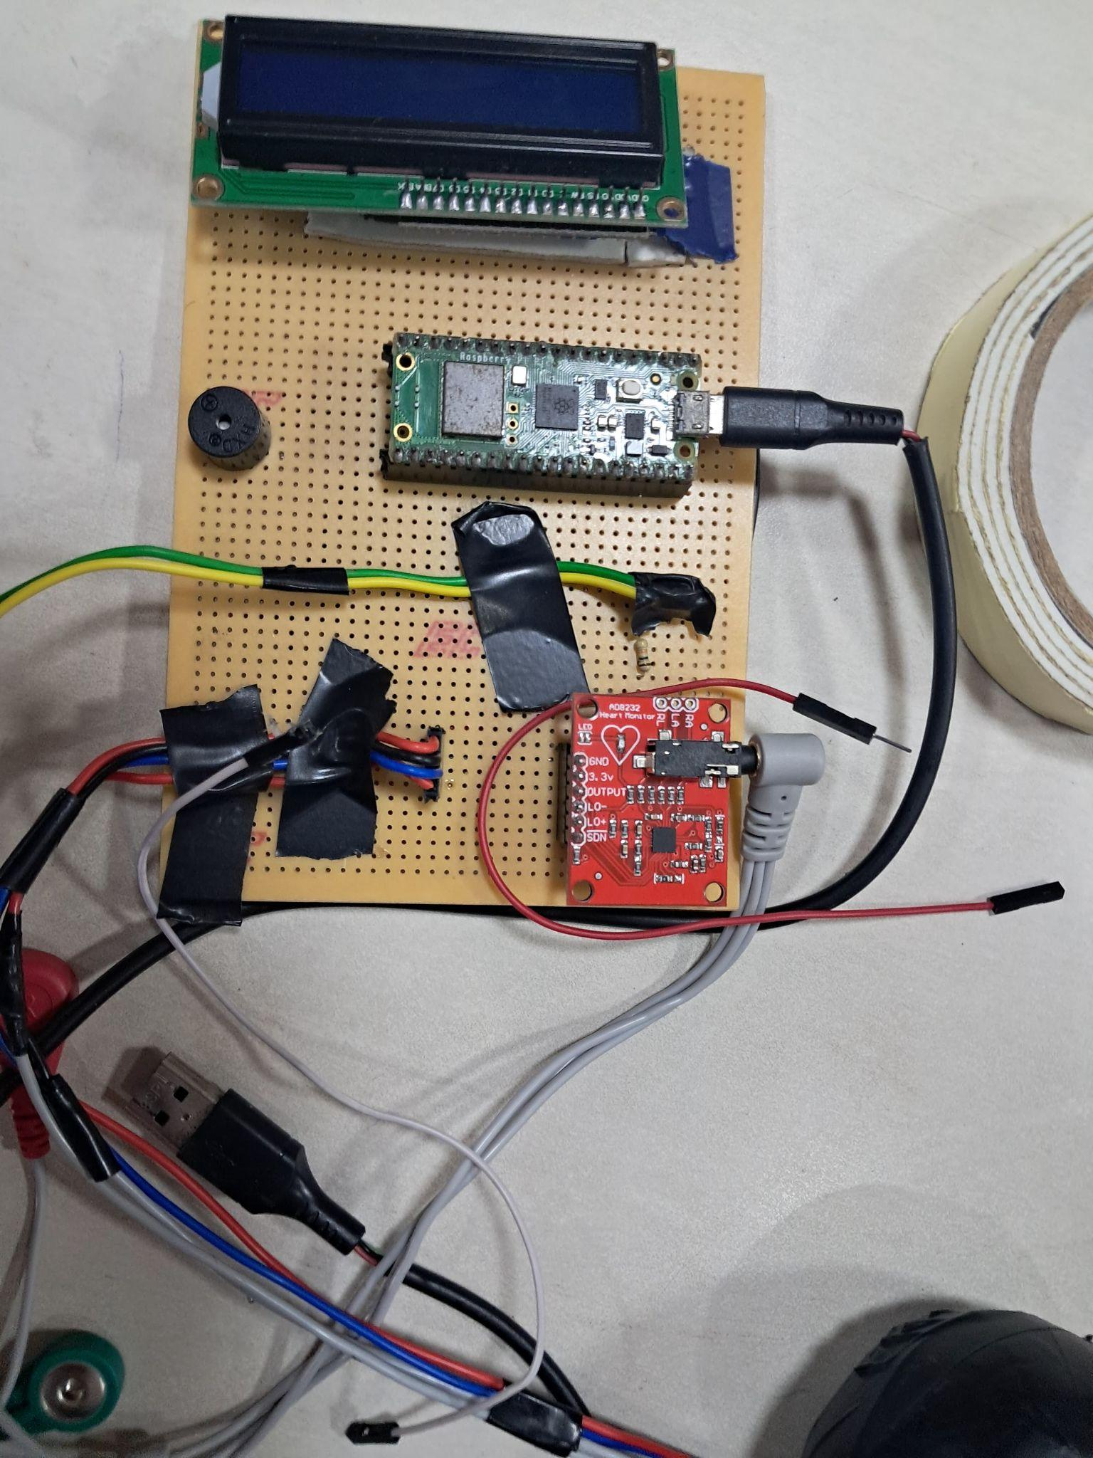
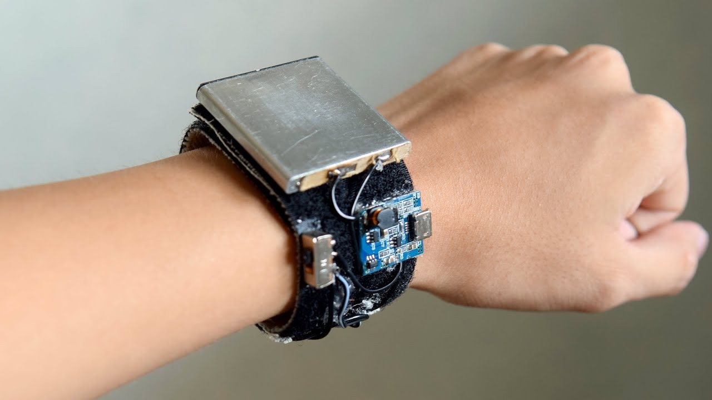
Solution Proposal
Smart Rehabilitation Companion: A wearable & interactive rehab system, which exclusively consists of 4 components.
Wearable Band, that tracks the muscle movement and its activation.
A Handheld Device that determines the Grip Strength of the patient.
Master Board is the Control and Display Unit of the system.
Mobile App– Remote monitoring for physiotherapists using IOT.
Master Board
Wearable Band

Slide 4
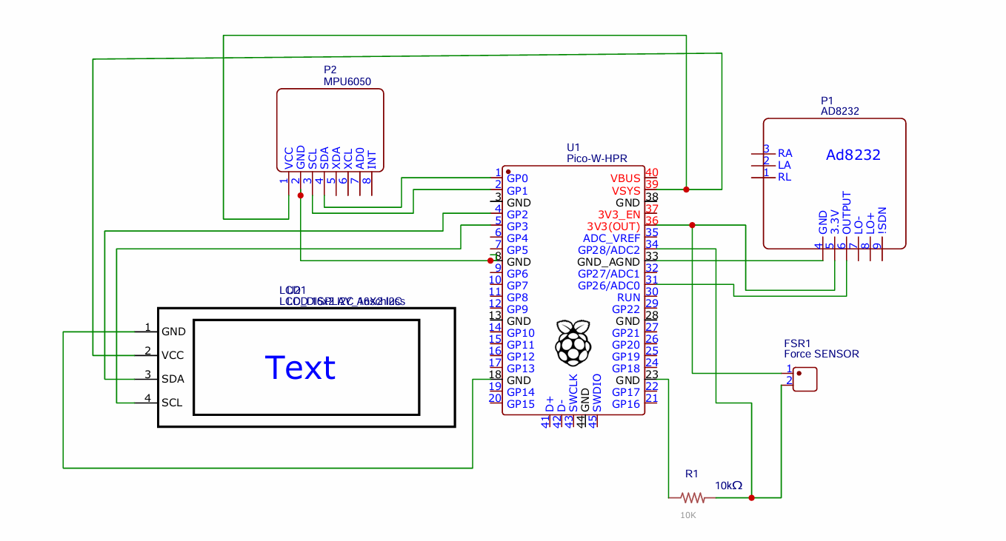
Circuit Diagram

Slide 5
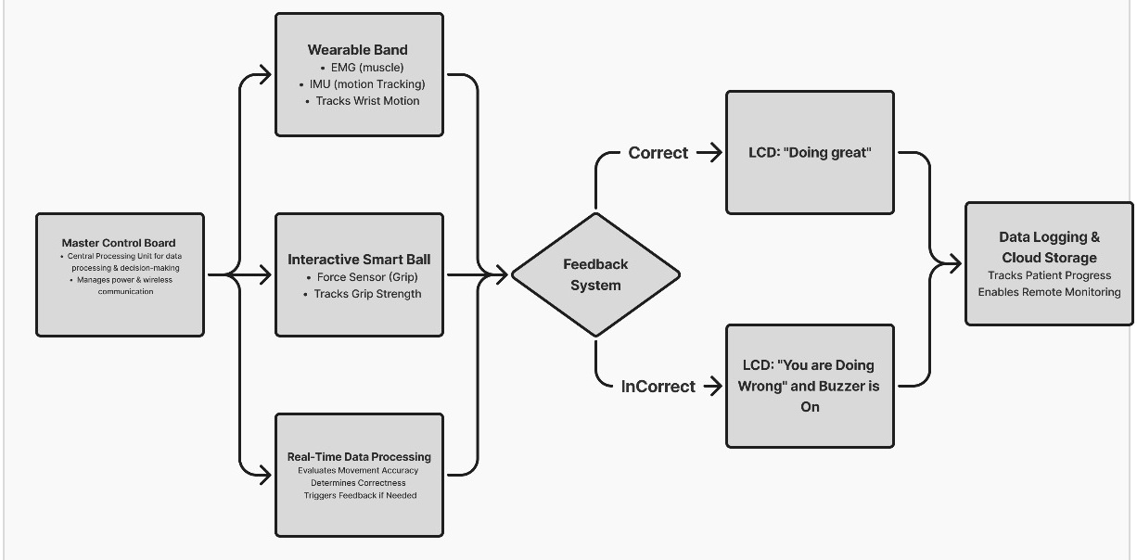
Architecture Diagram

Slide 6
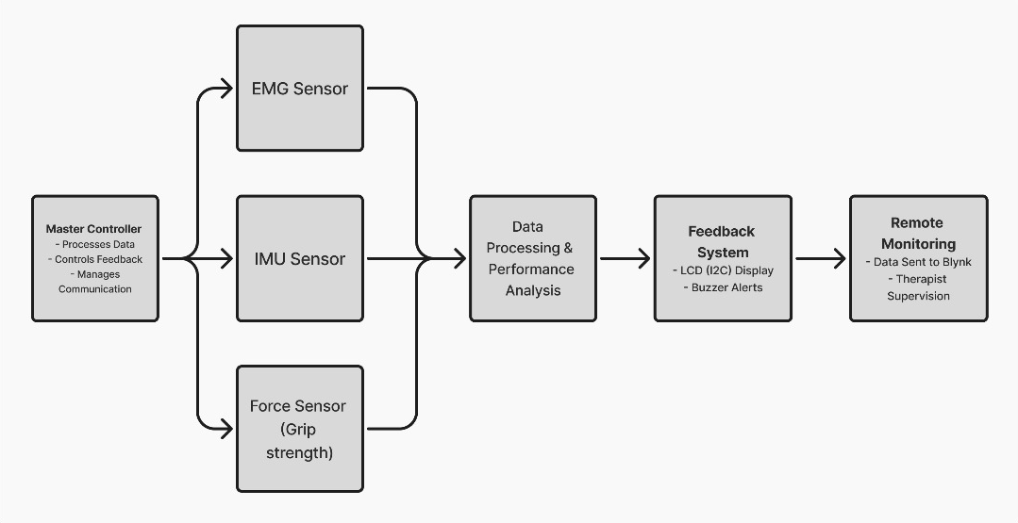
Block Diagram

Slide 7
Impact, Challenges & Drawbacks
Impact:
It reduces the no.of clinical visits, so that the hassle of the patients is being reduced directly.
Also, it facilitates the physiotherapists to concentrate more on critical patients, As the acute patients were monitored by this companion seamlessly.
Challenges:
Signal Noise in EMG sensor and Data Synchronization (seamless communication between wearable, master board & cloud)
Drawbacks:
The device can monitor muscle activation for a few set of exercises only, as it is developed as prototype.

Slide 8
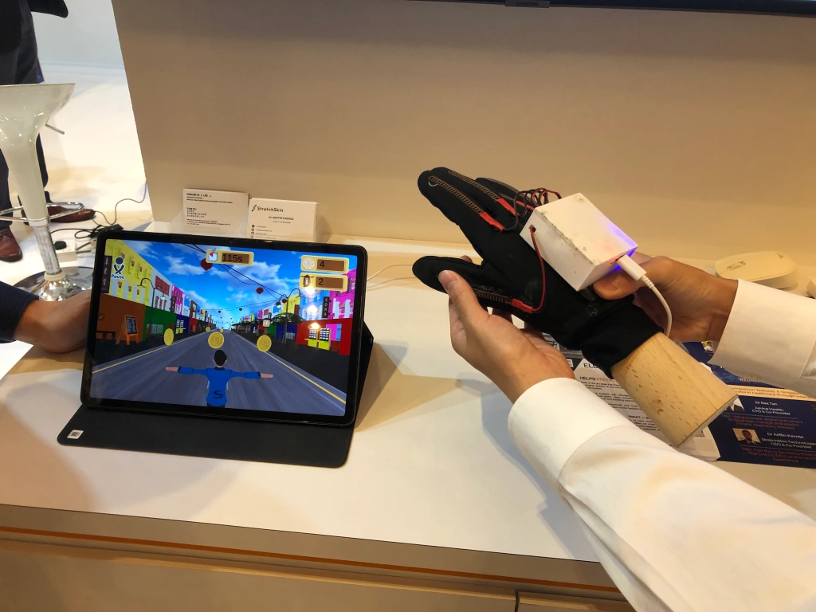
Conclusion & Future Scope
Our prototype demonstrates a robust foundation for accessible rehabilitation.
Future improvements: AI-driven exercise adaptation as a gamified version, expanded sensor capabilities, and lower-cost manufacturing.

Slide 9
Thank You

