Slide 1
Ex ante view of Disparity in Age Distribution in Technology Companies (as learned from JCN Inc.)* Persuasion : Immediate Industry wide Policy changes for Proactive Prevention
Natarajan Shankar
W201
Summer 2016
*Expanded scope and extension of an age distribution issue that I observed within my team at my employer - JCN Inc. in the last 5 years

Slide 2

Age distribution bias at leading technology companies
Lack of diversity in gender and ethnicity at technology companies is a well documented and discussed issue [1] [2] [3]
Public pronouncements by prominent industry influencers have indicated possible wide spread existence of age biased thinking amongst technology Executives:
"I want to stress the importance of being young and technical," Facebook's CEO at Y Combinator Startup event in 2007 [4]
Prominent Venture Capitalist in 2011 at the NASSCOM Product Enclave : “People under 35 are the people who make change happen”[5]
Technology companies are not currently required to report age distribution as a workforce metric to Federal watch group agencies [6]
Outdated and implicitly discriminatory employment practices used without target driven regulatory supervision
Age distribution bias is now apparent at most social gatherings
Persuasion challenge is to influence leading companies to address age distribution bias

Slide 3
Effecting policy implementation through Data and Persuasion
Prior to policy change leading to behavioral change, company leaders must first be persuaded about the origin and propagation dynamics of the problem.
With a age stratified workforce already having incidentally evolved in the last decade, the problem issue is now obvious at its current degree of magnification but most company executives have not acknowledged it.
Data [7] shows a significantly lower median age in prominent newer companies with major clustering around the median . Age distribution data is not published or available otherwise but incidental observation shows that data points with age > 40 are very few.
Some issues need deeper study. Older employees are not staying! Why?
Policy change will require immediate and drastic changes to existing hiring and retention policies
Persuasion is the key element to get decision makers on board
Company | Median Age | Age variance | Years with Company | Total Years of Experience
Facebook Inc. | 26 | Low | 0.83 | 3.5
Google Inc. | 29 | Low | 1.15 | 5.05
IBM | 37 | High | 6.3 | 9.91
Hewlett Packard | 39 | High | 5.17 | 10.27

Slide 4
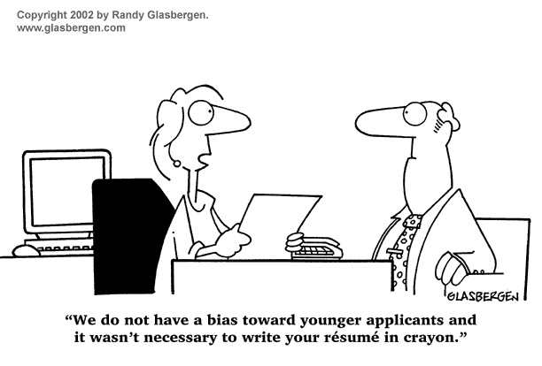
What’s needed? … and the case for pre-emptive persuasion
Access to age distribution data will provide an immediate perspective at each company. Companies such as Facebook and Google must lead the way with independent reporting of data.
Implementation of immediate staffing process changes to address stratified populations with equivalent decision team will start the rectification process
Rectifying the issue prior to it becoming a business affecting factor makes good sense!
Doing the right thing is the American way and it’s the law! [8]

Slide 5
References
http://www.forbes.com/sites/bonniemarcus/2015/08/12/the-lack-of-diversity-in-tech-is-a-cultural-issue/#631d3ed83577
http://www.mercurynews.com/business/ci_30128942/facebook-still-struggles-workforce-diversity
http://newsroom.fb.com/news/2014/06/building-a-more-diverse-facebook/
http://www.cnet.com/news/say-what-young-people-are-just-smarter/
https://news.ycombinator.com/item?id=3367644
https://backchannel.com/how-can-we-achieve-age-diversity-in-silicon-valley-11a847cb37b7#.27tiy8apa
http://www.payscale.com/top-tech-employers-compared-2012/employee-demographics
https://www.eeoc.gov/laws/types/age.cfm

