Slide 1
Plotting Hollywood’s Big Data Revolution
Natarajan Shankar, Raj Srinivasan, Leslie Teo, Qian Yu

Slide 2
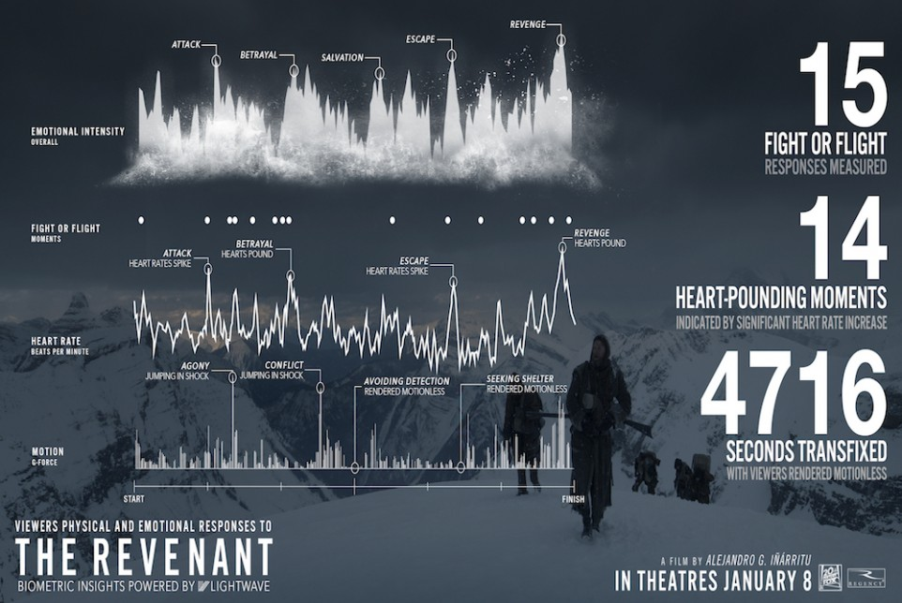
How Data Science is Currently Used?
Notes:
1.
To understand the audience
Preference and taste by demographic
Emotion tracking during screening with wearable technology
Predict what will work
Box office and popularity
Awards
Design strategy to create awareness
Marketing and promotion

Slide 3
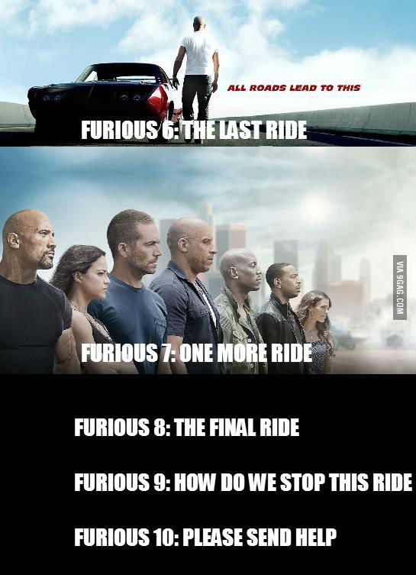
Key Challenges and Decisions
Production: How to produce the next big blockbuster to achieve revenue and profit goals?
Comic book franchise or sequel to past hits or a unique story?
Casting: Big stars or good proven actors?
Movie promotion: Which channel/s to focus?
TV, Facebook, billboard?
IP protection: How to combat piracy?
Market threats:How to compete with non-traditional content providers?

Slide 4

Research Question and Justification
Notes:
Peter: be brief in presentation, only have 7 minutes in final
Eliminate at least 3 of the challenges on earlier slide
Focus on one challenge. We have 9 bullet points, reduce to one
Studios receive scripts (1000s of them) : How do you analyze and create a script profile
What data would you collect for an unsolicited script that comes in through the door?
“How to leverage data science to enable movie studios to produce a portfolio of movies - inclusive of small and medium productions along with blockbuster productions - that will be marketed to different segments?”
Why? - This strategy is superior to just relying on blockbusters.
Stabilize Profits: Less susceptible to performance of summer blockbusters
Calculated bets with high upside: Not reliant on star power and investment into VFX & grand movie sets
Product differentiation: Present novel content besides on repetitive “super hero” flicks

