Slide 1

ETL and Analysis applied to Meetup
What ideas are cities and communities across the US curious about?
Karin Brodd
Chandler McCann
Natarajan Shankar
Dan Watson

Slide 2


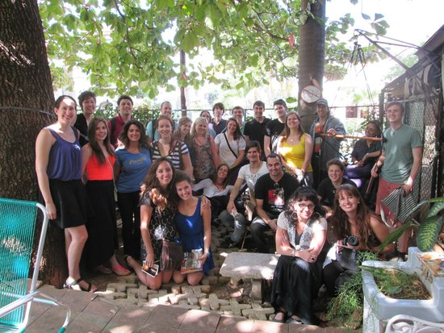
Project goals
What activities are communities throughout the United States excited about?
How and why people connect
Does how people connect through activity differ by region?
Data Source - Meetup.com APIs
Notes:
http://www.supthemag.com/wp-content/uploads/2015/07/Tim-Chandler-TRY-Standup-Paddle.jpg
From the API we can access the RSVP data in json format
The data is categorized, gives names of groups, number of members, and number of RSVPs
At the least, we want to get aggregate the number of rsvps by category in different locations
Events- what people are doing, who is attending, etc
Groups- categories of the groups
Use cases- helpful tool for people looking for a change
Marketing niche products to specific markets
Government services

Slide 3
Refined Architecture and Data Flow
Change from streaming to batch processing
Connect to Meetup’s streaming API
Capture JSON data from the API and store in MongoDB
Integrate PySpark to process the data
Connect data source to Tableau for visualization
PySpark
Tableau
API Call 1
(Events)
Table Update
Query & Data Viz
Schema on
write
MongoDB
Merge
Table Update
API Call 2
(Groups)
Table Update

Slide 4
Project Status
What’s working?
Data extraction via Meetup API
Autonomous MongoDB instance in AWS
Pyspark framework
Simulated data source presented via Tableau
Tasks that need completion...
Interface between Meetup data spout and MongoDB
Piping JSON data from the API and storing in MongoDB
Integrate PySpark with MongoDB hosted Meetup data
Connect Meetup data source to Tableau for visualization
Presentation format will be refined after PySpark interface is ready

Slide 5
Wrap up
Project is making progress per original plan
Batching vs Streaming
MongoDB
Next steps:
Completion of API -> MongoDB pipeline
Development of visualization
Will need example data to facilitate parallel work with PySpark data transformations
Completion of PySpark data transformations and setup of Spark ThriftServer

