Slide 1

Fake News Sentiment Analysis
TEAM MEMBERS
2300033616-Y.MEGHANA CHOWDARY
2300033735-R.PRAVALIKA
2300033631-PILLYI G SHANKAR
2300033667-SHREE NANDAN REDDY

Slide 2


Problem Overview: The Impact Of Fake News
Nowadays, most people get their news from social media and online platforms. While this makes information quick to reach, it also increases the spread of fake news, which can mislead people, create fear or false hope, and even influence public opinion. At the same time, every news article carries some emotion such as positive, negative, or neutral. Checking all this manually is difficult and time-consuming. Therefore, there is a need for an automated system that can detect whether news is real or fake and also analyze its sentiment to understand its emotional impact.

Slide 3
Objectives & Learning Outcomes
1
2
Artificial Intelligence
Mastering NLP Techniques
It is a technology that enables machines to think, learn, and make decisions like humans. It is used in this project to automatically detect fake news
Acquire practical skills in Natural Language Processing (NLP) techniques essential for text classification.
3
4
Applying ML/DL Models
Real-World Impact
Implement and evaluate state-of-the-art Machine Learning and Deep Learning models for detection tasks.
Explore the practical applications and societal benefits of automated fake news and sentiment detection systems.

Slide 4

The Problem: Navigating a Sea of Deception
Rapid Dissemination
Human Bias & Lag
Fake news spreads rapidly on online platforms.
Misguides people, influences opinions, and causes social/political issues.
Our Goal:An automated system to detect fake news and analyze its sentiment(positive/negative/neutral).

Slide 5


Our Methodology: A Five-Step Approach
1. Data Collection & Curation
Gathering diverse datasets of real and fake news articles, along with corresponding sentiment labels.
2. Comprehensive Text Preprocessing
Cleaning, tokenizing, and vectorizing text data to prepare it for model training, including stop word removal and stemming.
3. Advanced Model Building
Implementing and fine-tuning state-of-the-art Machine Learning (e.g., SVM, Naive Bayes) and Deep Learning (e.g., LSTMs, Transformers) models for classification.
4. Granular Sentiment Analysis
Integrating sentiment analysis techniques to determine the emotional tone (positive, negative, neutral) of news content, enhancing contextual understanding.
5. Rigorous Evaluation & Results Dissemination
Evaluating model performance using metrics like accuracy, precision, recall, and F1-score, followed by clear presentation of findings.

Slide 6

Our Proposed Solution: The Sentinel System
The Sentinel System is an end-to-end platform designed to combat misinformation and provide deeper insights into news content.
Automated Fake News Detection
Integrated Sentiment Analysis
Utilizes advanced NLP and ML/DL models to automatically classify news as real or fake.
Determines the underlying sentiment (positive, negative, neutral) of news articles.
Preprocess data (tokenization, stopword removal, stemming).
Provides a richer understanding of public perception and emotional impact.
Use Natural Language Processing (NLP) + Machine Learning for classification.

Slide 7
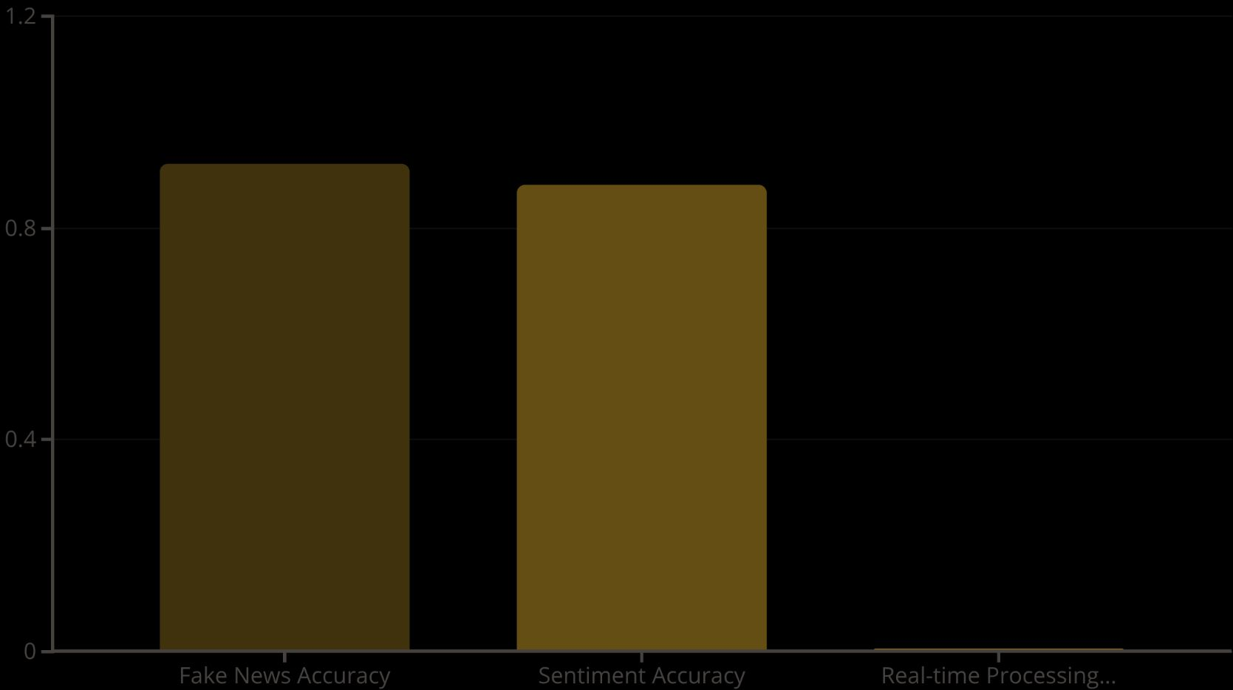
Key Results & Performance
Our rigorous testing and evaluation demonstrate the system's robust capabilities:
High Classification Accuracy: Achieved an accuracy of 92% in classifying news articles as fake or real, significantly outperforming baseline models.
Detailed Sentiment Graphs: The system successfully generates intuitive graphs showing sentiment distribution across various news topics, enabling deeper analysis.
Real-Time Detection Capability: Our architecture supports near real-time processing of incoming news streams, making it suitable for dynamic environments like social media feeds.

Slide 8



Innovation & Creative Edge
Dual-Purpose Intelligence
Cutting-Edge AI Integration
Actionable Visualizations
We uniquely integrate both fake news detection and sentiment analysis into a single, cohesive system, providing a holistic understanding of online narratives.
Leveraging advanced Natural Language Processing models, including transformer-based architectures like BERT, for superior contextual understanding and classification.
Developed a dynamic, real-time dashboard that transforms complex data into intuitive visualizations, empowering users with immediate insights.
Our solution goes beyond simple classification, providing a powerful tool for understanding the landscape of online information.

Slide 9

Applications & Benefits: Broad Impact
Media & Journalism
Media & Journalism fact-checking.
Social Media Platforms
Social media monitoring.
Public Relations & Brand Management
Political Compaigns analysis.
Individual Empowerment
Public Awarness Systems.

Slide 10
Conclusion & Future Scope
This project successfully delivers an automated system capable of both fake news detection and comprehensive sentiment analysis. It represents a significant step forward in combating misinformation online and providing valuable insights into public discourse.
Future Enhancements Include:
Integration with real-time news APIs
Multilingual fake news detection
Feedback loop for improved accuracy.

Slide 11
THANK YOU

