Slide 1
Python Programming
Powered by Sunil Singh

Slide 2
Introduction
Python is a general-purpose interpreted, interactive, object-oriented, and high-level programming language. It was created by Guido van Rossum during 1985- 1990. Like Perl, Python source code is also available under the GNU General Public License (GPL). This tutorial gives enough understanding on Python programming language.
Python is a high-level, interpreted, interactive and object-oriented scripting language. Python is designed to be highly readable. It uses English keywords frequently where as other languages use punctuation, and it has fewer syntactical constructions than other languages.

Slide 3
Python Features
Easy-to-learn − Python has few keywords, simple structure, and a clearly defined syntax. This allows the student to pick up the language quickly.
Easy-to-read − Python code is more clearly defined and visible to the eyes.
Easy-to-maintain − Python's source code is fairly easy-to-maintain.
A broad standard library − Python's bulk of the library is very portable and cross-platform compatible on UNIX, Windows, and Macintosh.
Interactive Mode − Python has support for an interactive mode which allows interactive testing and debugging of snippets of code.
Portable − Python can run on a wide variety of hardware platforms and has the same interface on all platforms.
Extendable − You can add low-level modules to the Python interpreter. These modules enable programmers to add to or customize their tools to be more efficient.
Databases − Python provides interfaces to all major commercial databases.
GUI Programming − Python supports GUI applications that can be created and ported to many system calls, libraries and windows systems, such as Windows MFC, Macintosh, and the X Window system of Unix.
Scalable − Python provides a better structure and support for large programs than shell scripting.

Slide 4
Python - Basic Syntax
The Python language has many similarities to Perl, C, and Java. However, there are some definite differences between the languages.
First Python Program
Let us execute programs in different modes of programming.
Interactive Mode Programming
Invoking the interpreter without passing a script file as a parameter brings up the following prompt −
Type the following text at the Python prompt and press the Enter −
>>> print(“hello world”)
And Enter
Output: hello world
# This is a comment

Slide 5
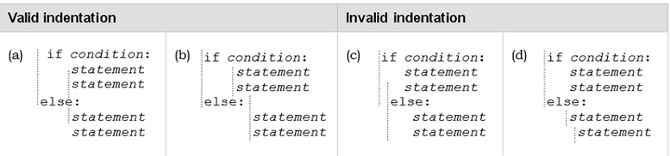
Indentation in Python
One fairly unique aspect of Python is that the amount of indentation of each program line is significant.
In Python indentation is used to associate and group statements

Slide 6
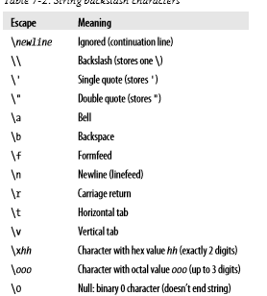
Escape Sequences

Slide 7
Strings
A string is an immutable sequence of characters
A string literal uses quotes
'Hello' or "Hello"
For strings, + means “concatenate”
When a string contains numbers, it is still a string
We can convert numbers in a string into a number using int()

Slide 8
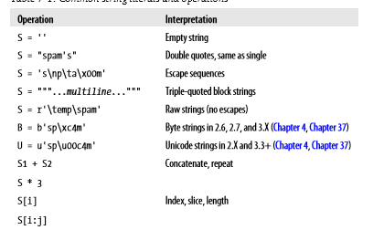
String Operations

Slide 9
If Statement
An if statement is a selection control statement based on the value of a given Boolean expression. The if statement in Python is
If statement | Example use
If condition: statements else: statements | If grade >=70: print(‘pass’) else: Print(‘fail’)

