Slide 1
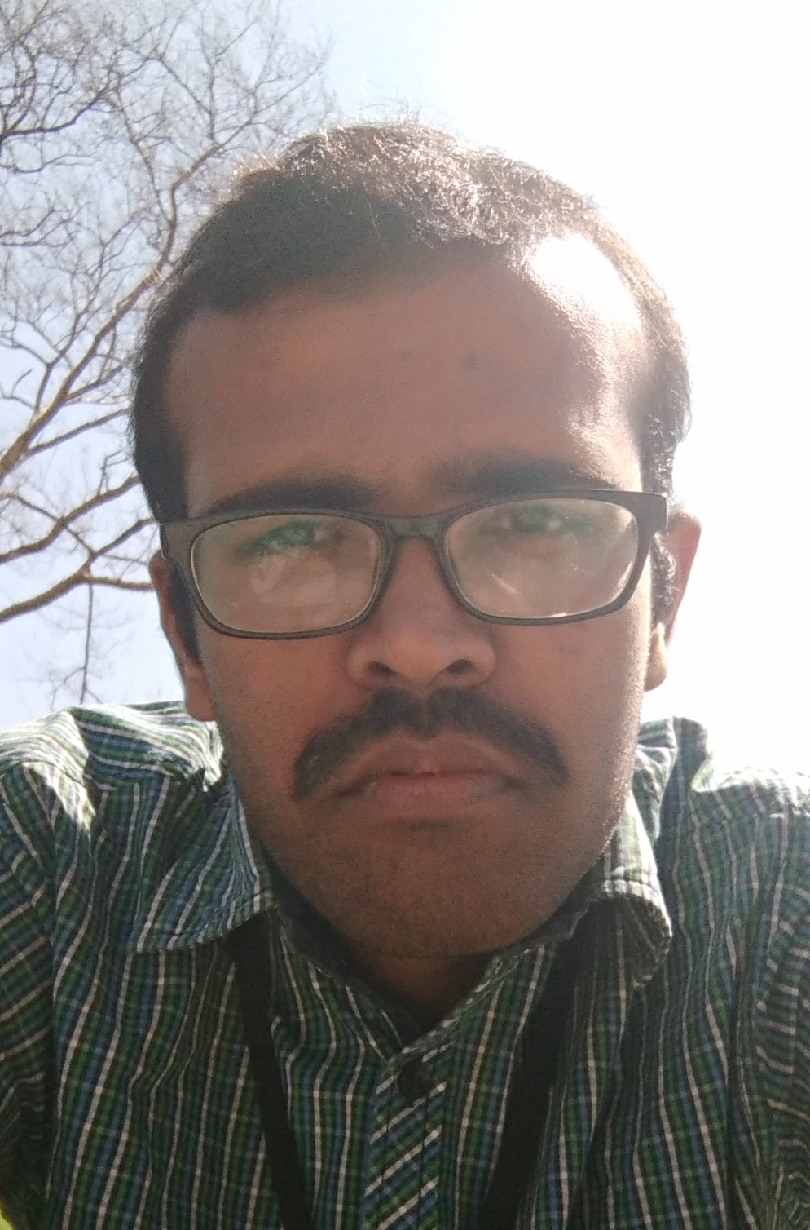

Shankara Chandrashekar
Selected Project References
Shankara Chandrashekar
Application Developer Sr. Analyst
  Back-End Java Developer
  Worked in 10 different projects as above declared roles.
  Have been involved product requirements Analysis, Design, Development and Code Reviews.
  Experienced in J2EE technologies Servlets, JSP, EJB2.0/3.0, JDBC, JNDI, and JMS.
  Experienced in Spring Framework (DI, IOC, AOP, MVC, JDBC, and ORM).
  Experience in using JPA/Hibernate for Object Relational Mapping.
  Expertise in Java Web Services using JAX-WS, JAX-RPC, REST implementations.
  Proficient in writing SQL queries, triggers and stored procedures in Oracle 10g/9i, MySQL, IBM DB2.
  Experienced with Oracle WebLogic, JBoss, IBM WebSphere Application Servers and Apache Tomcat Web Server.
  Excellent working experience with different operating systems like Mac, Windows, LINUX.
  Experience in developing J2EE/Java applications on different IDE’s including Eclipse, IntelliJ, NetBeans and Oracle JDeveloper.
  Experienced in OOAD(UML) designs for enterprise based applications using Microsoft VISIO.
  Have been used the below technologies and tools in my assigned projects.
  Programming languages : Java/J2EE, PL/SQL and ATG.
  Frameworks : Struts, Spring and JPA(Hibernate, Eclipse Link)
  Web/Application Servers : Tomcat, JBoss, WebLogic and WebSphere
  Scripting language : JavaScript
  JavaScript Frameworks : AJAX, jQuery, Angular JS
  Version Controls : CVS, SVN, GIT
  Package Managers : NPM
  Tools : Eclipse, Intellij, Sonar, Putty, WinSCP, Tectia, Toad, Soap-UI, Postman.
Build/Deployment : Ant, Maven, Jenkins and TeamCity.
Accenture
Bangalore, Karnataka
shankara.chandrasekr@accenture.com
Mobile: +91 9448882836
Professional Background
Full Stack Developer with over 6 years 2 months of experience in developing client server applications, internet/intranet web based applications using Java/J2EE, Struts, Spring, JPA/Hibernate with good standards.
Have been involved in respective phases like, Requirements Analysis, Design, Development and Maintenance.
- Have good analytical, problem solving, communication and interpersonal skills, with ability to interact with individuals at all levels and work as a part of a team as well as independently.
Domains and Industries Experience
Domains
Industries
E-Commerce, Retail
Health-Care, Banking
No Industry specialty
No Industry specialty
© 2014 Accenture. All rights reserved.

