Slide 1

EVCharge: Charging Station Locator
By Shankar Mupanna

Slide 2

Problem Statement
Problem
EV users often struggle to find nearby charging stations.
Different vehicles require different connector types.
Stations may be unavailable or busy.
Charging price and speed information is hard to find.
Objective
Build a web-based EV Charging Station Locator that allows users to:
Find EV charging stations
Check connector type and charger speed
View pricing information
Filter available stations
See detailed station information

Slide 3
My Solution
EVCharge: Charging Station Locator
A web application built using HTML, CSS, and JavaScript that helps EV users locate and check charging stations.
Key Features
Charging station dashboard
Availability filter
Charger speed indicators
Connector type display (CCS / Tesla)
Pricing and idle fee details
Station details page
Google Maps integration

Slide 4
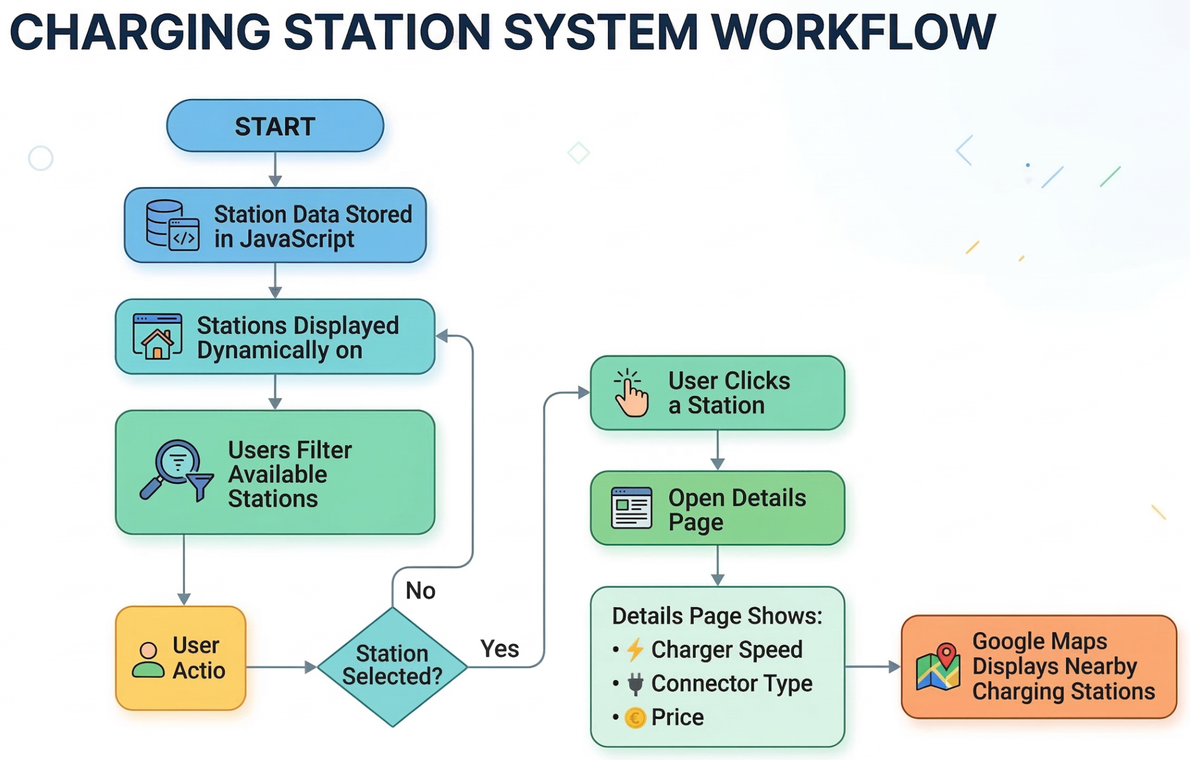
Working (Method / Mind Map)
System Workflow
Charging station data is stored in a JavaScript array.
Stations are dynamically displayed on the homepage.
Users can enable the availability filter to show only available stations.
Clicking a station stores its information in LocalStorage.
The Details page loads the station data and displays:
Charger speed
Connector type
Price per kWh
Parking fee
Idle fee
Google Maps shows nearby charging stations using geolocation.

Slide 5
Conclusion
The EVCharge system successfully demonstrates a web-based EV charging locator.
Users can easily find charging stations and view important charging information.
JavaScript enables dynamic filtering and station interaction.
CSS power indicators visually represent charger speed.
Future Improvements
Real-time station availability
Online payment integration
Mobile application version
Real-time reservation system

Slide 6
Thank You

