Slide 1
KEYLOGGER
Presented by,
Shankara Durga v-be(cse)
Grace college of engineering

Slide 2
OUTLINE
Problem Statement
Proposed system/Solution
System Development Approach
Algorithm & Deployment
Result
Conclusion
Future Scope
References

Slide 3
Problem statement
“The precise statement of any problem is the most important step in it’s solution.”

Slide 4

In today's digital age, where information security is paramount, there is a growing need for sophisticated monitoring and security solutions to protect sensitive data and ensure the integrity of systems.
Keyloggers, software or hardware tools designed to record keystrokes made on a computer or mobile device, serve as one such tool for monitoring user activity.
However, the development of an efficient and effective Keyloggers system poses several challenges and considerations.

Slide 5
Proposed system/ solution
“Focus on the solution, not on the problem.”

Slide 6

Implement functionality to record additional user activities such as clipboard operations, application usage, web browsing behavior, and file interactions.
Implement secure storage mechanisms to protect log files from unauthorized access or tampering, utilizing strong encryption algorithms and access controls.
Ensure that sensitive information, such as passwords and credit card numbers, is not captured or stored in plaintext, adhering to privacy regulations and best practices.

Slide 7
system development approach
“Our mission is skill development. There can be no development with a satiated system.”

Slide 8
Programming languages:
Technology:
C/C++
Java
Python
C#(.NET)
Go(Golang)
Rust
Assembly Language
Keyboard Hooks
System-level APIs
Remote Access Technologies
Data Encryption
Stealth Techniques
Machine Learning and Pattern Recognition

Slide 9
Algorithm & deployment

Slide 10
Algorithm :
Deployment:
Keyboard Input Capture Algorithm
Special Key Handling Algorithm
Encryption Algorithm
Data Storage Algorithm
Stealth Techniques Algorithm
Privacy Protection Algorithm
Local Installation
Remote Deployment
Email Attachment
Malicious Websites
Remote Administration Tools (RATs)
Legitimate Software Bundling

Slide 11
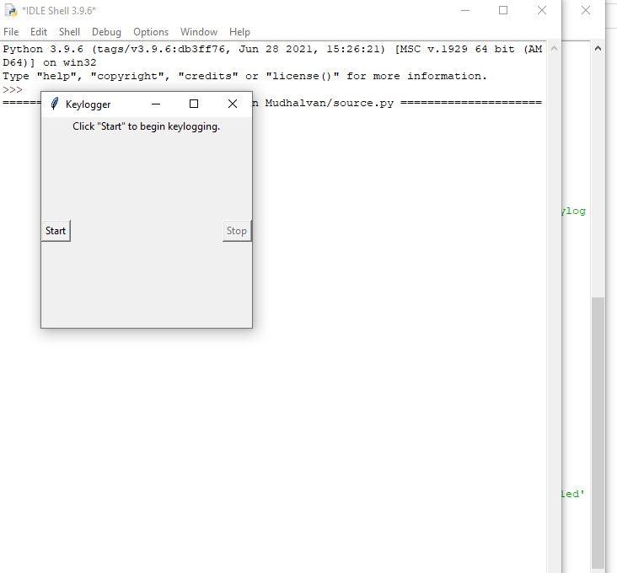
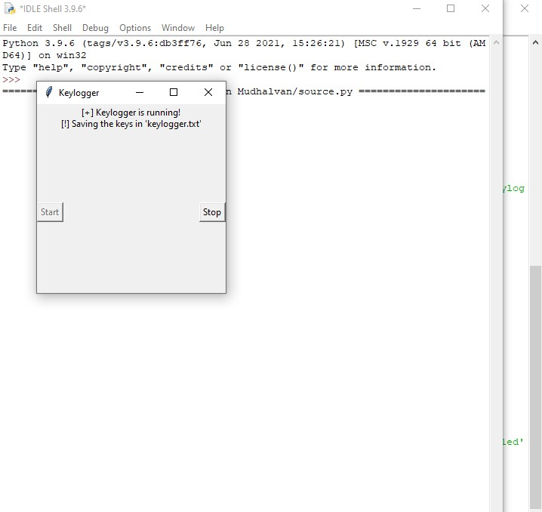
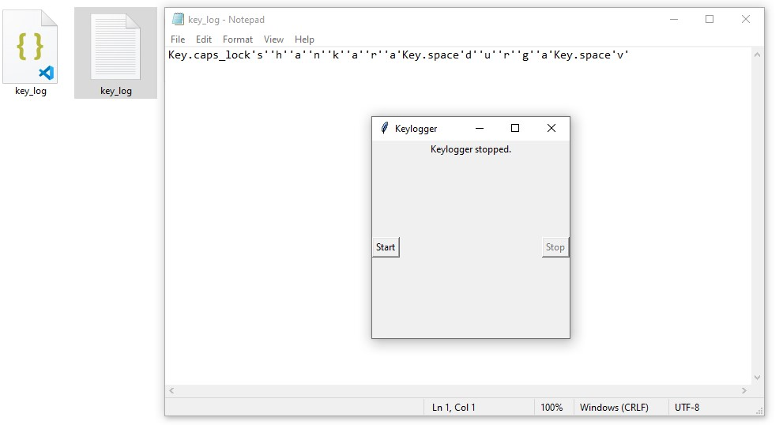
result

Slide 12
conclusion
In conclusion, keyloggers represent powerful tools for monitoring user activity, yet they also raise significant ethical and security concerns. Throughout this discussion, we explored the functionality, deployment methods, and potential implications of keylogger usage.

Slide 13
Future scope
The future scope of keyloggers is poised for significant advancements in technology and usability, driven by evolving cybersecurity challenges and emerging trends.
Moreover, integration with artificial intelligence and machine learning technologies will enable keyloggers to analyze user behavior patterns more intelligently, allowing for proactive threat detection and response capabilities.

Slide 14
references
"Deep Learning for Demand Prediction: A Survey" by X. Liang, L. Zhao, X.
Jiang, and Y. Dong. (IEEE Transactions on Industrial Informatics, 2020)
"Time Series Forecasting with Deep Learning: A Survey" by Z. Zhang, Y. Zhao,
and Y. Wang. (arXiv preprint arXiv:1809.04356, 2018)
"Machine Learning for Demand Forecasting: A Review" by C. McArdle, J.
Vinué, and P. Mues. (International Journal of Forecasting, 2020)
These sources cover a range of topics relevant to developing a solution for demand
prediction, including deep learning, time series forecasting, machine learning
techniques, data preprocessing, and model evaluation.

Slide 15
THANK YOU!!!

