Slide 1
Abstract Factory Pattern
Abstract Factory design pattern is one of the Creational pattern.
Abstract Factory pattern is almost similar to Factory Pattern is considered as another layer of abstraction over factory pattern.
Abstract Factory patterns work around a super-factory which creates other factories.
An Abstract Factory creates objects that are related by a common theme. An Abstract Factory has abstracted out a theme which is shared by the newly created objects.
@ShankaragoudaG

Slide 2
Abstract Factory Pattern
Abstract Factory provides interfaces for creating families of related or dependent objects without specifying their concrete classes.
Suppose we have two Abstract Factories whose task it is to create page controls, such as, buttons, textboxes, radio buttons, and listboxes.
One is the Light Factory which creates controls that are white and the other the Dark Factory which creates controls that are black.
Both Factories creates the same types of controls, but they differ in color, which is their common theme. This is an implementation of the Abstract Factory pattern.

Slide 3
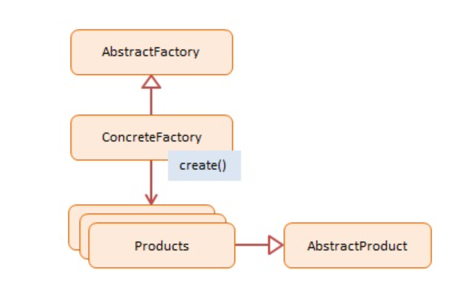
Abstract Factory Pattern Diagram

Slide 4
Abstract Factory Pattern Participants
AbstractFactory -- not used in JavaScript
declares an interface for creating products
ConcreteFactory -- In example code: EmployeeFactory,
VendorFactory
a factory object that 'manufactures' new products
the create() method returns new products
Products -- In example code: Employee, Vendor
the product instances being created by the factory
AbstractProduct -- not used in JavaScript
declares an interface for the products that are being created

Slide 5
Example
Two Concrete Factories:
EmployeeFactory and VendorFactory.
The first one creates Employee instances, the second one Vendor instances.
Both products are person types (with the same interface) which allows the client to treat them the same.
An array with two employees and two vendors is created. Each person is then asked to say what and who they are.

Slide 6
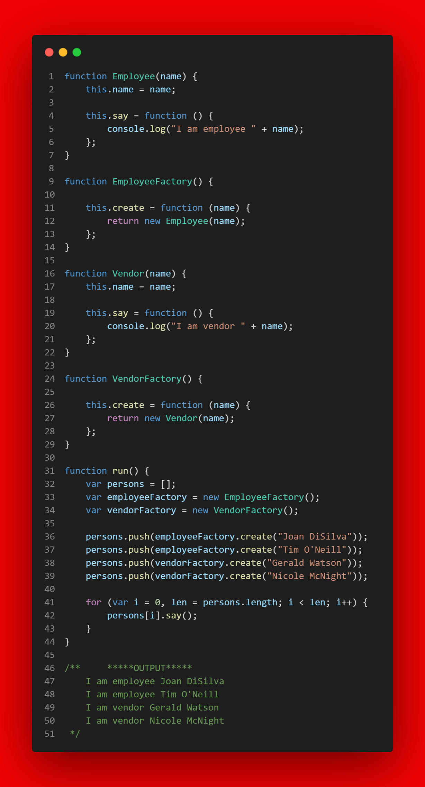

Slide 7
Useful resources
https://www.geeksforgeeks.org/abstract-factory-pattern/
https://www.dofactory.com/javascript/design-patterns/abstract-factory
https://www.patterns.dev/posts/classic-design-patterns/#factorypatternjavascript

