Slide 1
Builder Design Pattern
Builder pattern is a design pattern to provide a flexible solution for creating objects. Builder pattern separates the construction of a complex object from its representation.
The Builder pattern allows a client to construct a complex object by specifying the type and content only. Construction details are hidden from the client entirely.
Builder pattern builds a complex object using simple objects by providing a step by step approach. It belongs to the creational patterns.
@ShankaragoudaG

Slide 2
Builder Design Pattern
Usually it is the last step that returns the newly created object which makes it easy for a Builder to participate in fluent interfaces in which multiple method calls, separated by dot operators, are chained together.
NOTE: fluent interfaces are implementation of the Chaining Pattern as presented in the Modern patterns section.

Slide 3
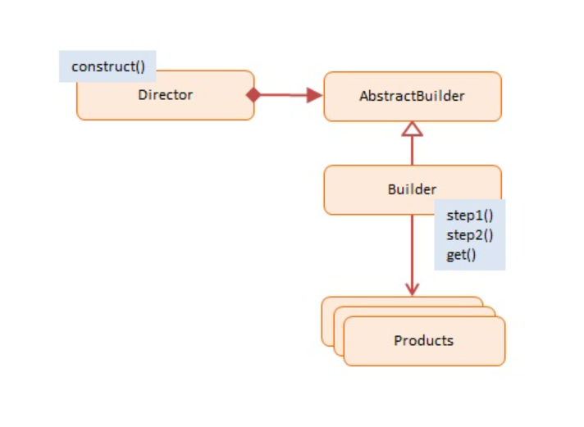
Diagram

Slide 4
Participants
Director
constructs products by using the Builder's multistep interface
Builder -- not used in JavaScript
declares a multistep interface for creating a complex product
ConcreteBuilder
implements the multistep Builder interface
maintains the product through the assembly process
offers the ability to retrieve the newly created product
Products
represents the complex objects being assembled

Slide 5
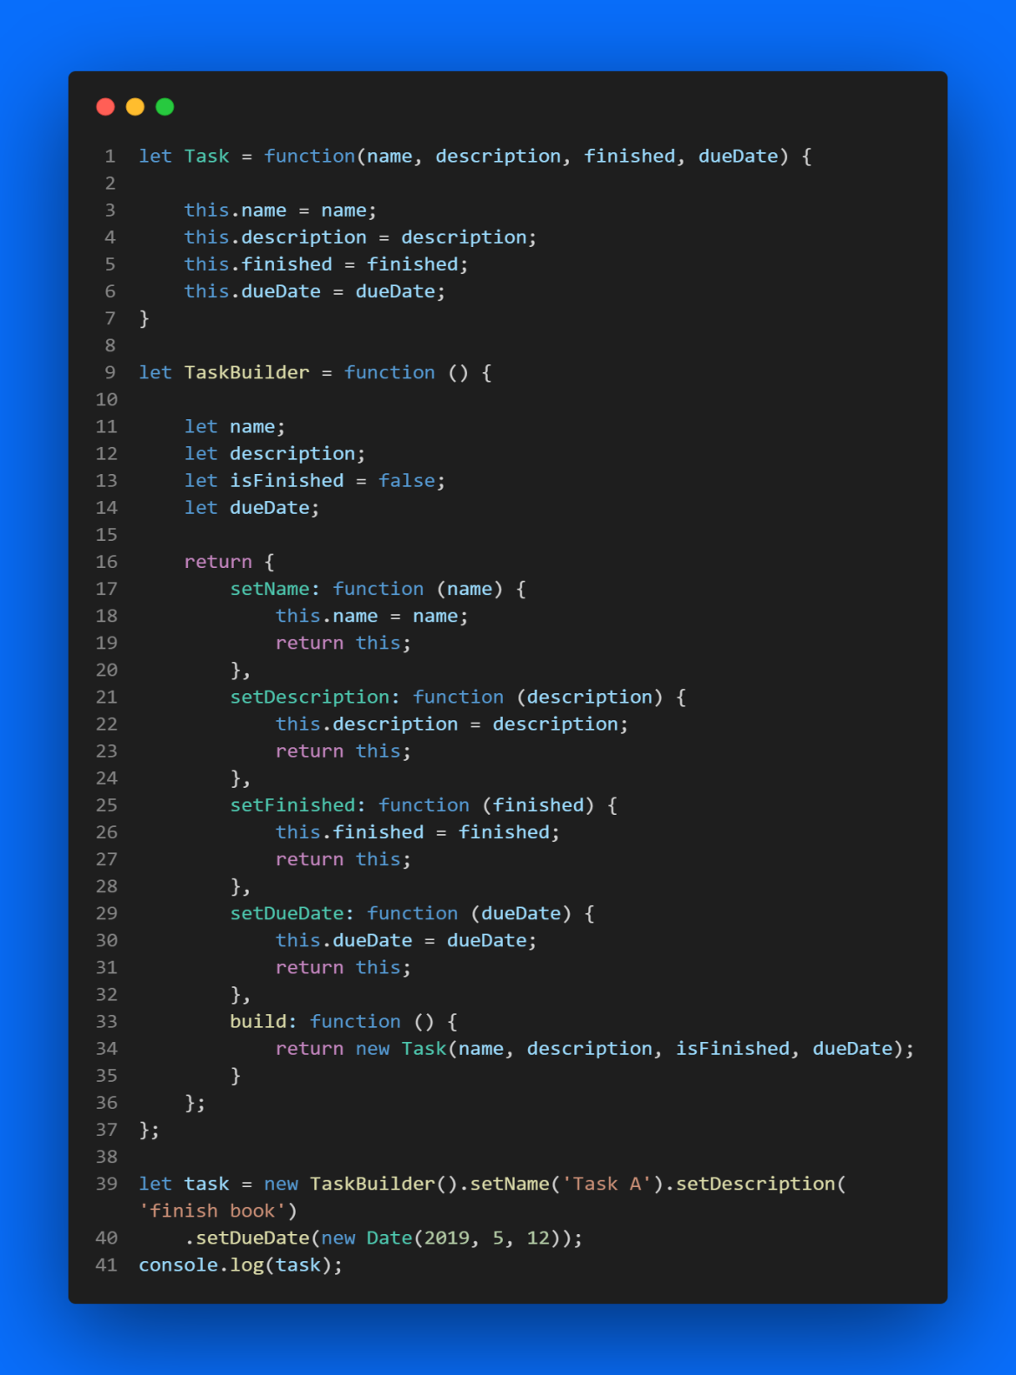
Example

Slide 6
Useful Resources
https://www.oreilly.com/library/view/design-patterns-and/9781786463593/0dd5230a-59ad-4d3c-a3a6-509ab2574fc1.xhtml
https://www.dofactory.com/javascript/design-patterns/builder
https://www.patterns.dev/posts/classic-design-patterns/#builderpatternjquery

