Slide 1
Factory Design Pattern
The factory pattern is a creational design pattern that provides a generic interface for creating objects.
In the factory pattern, we can specify the type of object being created and we do not need to explicitly require a constructor.
This is particularly useful if the object creation process is relatively complex, e.g. if it strongly depends on dynamic factors or application configuration.
Examples of this pattern can be found in UI libraries such as ExtJS.
@ShankaragoudaG

Slide 2
Factory Design Pattern
A factory is an object or class or a function in a functional programming paradigm for creating objects.
The key objective of the Factory Method is extensibility. Factory Methods are frequently used in applications that manage, maintain, or manipulate collections of objects that are different but at the same time have many characteristics (i.e. methods and properties) in common.
An example would be a collection of documents with a mix of Xml documents, Pdf documents, and Rtf documents.

Slide 3
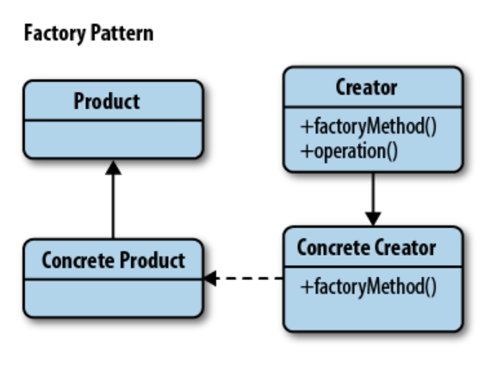
Factory Pattern Diagram

Slide 4
Continued...
The objects participating in this pattern are:
Creator
  the 'factory' object that creates new products
  implements 'factoryMethod' which returns newly created products
AbstractProduct -- not used in JavaScript
  declares an interface for products
ConcreteProduct
  the product being created
  all products support the same interface (properties and methods)

Slide 5
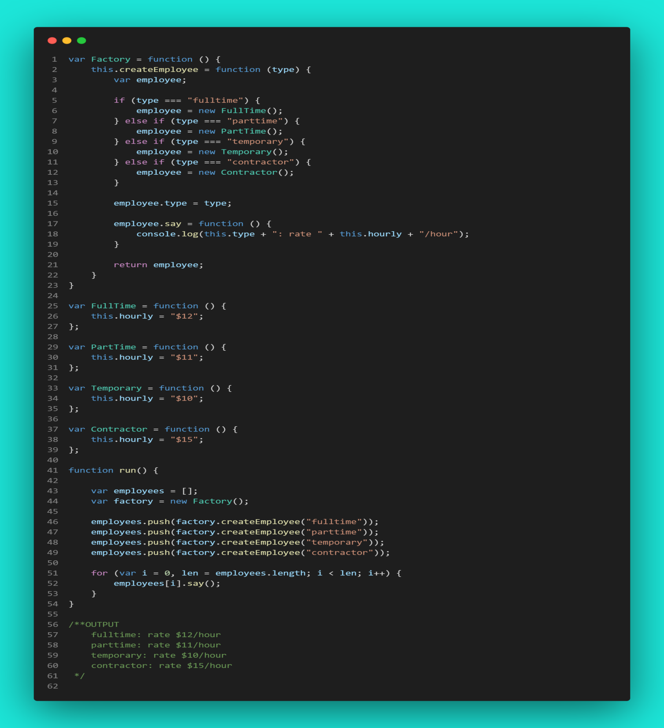
Example

Slide 6
When To Use
When our object or component setup involves a high level of complexity
When we need to easily generate different instances of objects depending on the environment we are in
When we're working with many small objects or components that share the same properties
When composing objects with instances of other objects that need only satisfy an API contract (aka, duck typing) to work. This is useful for decoupling.

Slide 7
When Not To Use
When applied to the wrong type of problem, this pattern can introduce an unnecessarily great deal of complexity to an application.
Unless providing an interface for object creation is a design goal for the library or framework we are writing, I would suggest sticking to explicit constructors to avoid the unnecessary overhead.
Since the process of object creation is effectively abstracted behind an interface, this can also introduce problems with unit testing depending on just how complex this process might be.

Slide 8
Useful Resources
https://www.oreilly.com/library/view/learning-javascript-design/9781449334840/ch09s10.html
https://www.dofactory.com/javascript/design-patterns/factory-method
https://www.patterns.dev/posts/classic-design-patterns/#factorypatternjavascript

