Slide 1
Prototype Design Pattern
The Prototype Pattern creates new objects, but rather than creating non-initialized objects it returns objects that are initialized with values it copied from a prototype - or example - object.
The Prototype pattern is also referred to as the Properties pattern.
The Prototype pattern as one which creates objects based on a template of an existing object through cloning.
@ShankaragoudaG

Slide 2
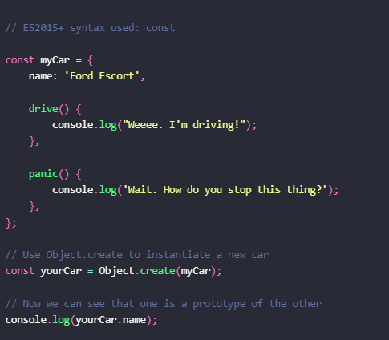
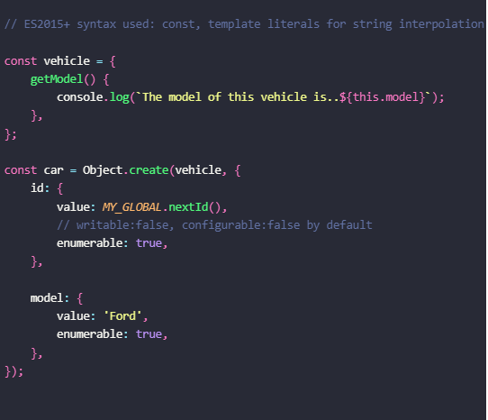
Prototype Pattern – Object.Create()
Object.create creates an object which has a specified prototype and optionally contains specified properties as well (e.g Object.create( prototype, optionalDescriptorObjects )).

Slide 3
Example
The Prototype pattern is useful is the initialization of business objects with values that match the default values in the database.
The prototype object holds the default values that are copied over into a newly created business object.
Classical languages rarely use the Prototype pattern, but JavaScript being a prototypal language uses this pattern in the construction of new objects and their prototypes.

Slide 4
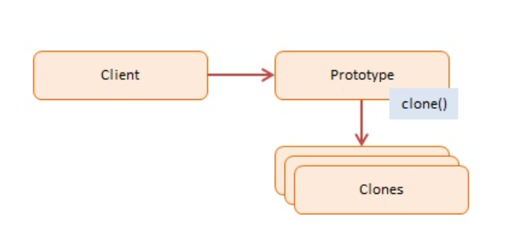
Prototype Pattern - Diagram
Participants:
Client -- In example code: the run() function.
creates a new object by asking a prototype to clone itself
Prototype -- In example code: CustomerPrototype
creates an interfaces to clone itself
Clones -- In example code: Customer
the cloned objects that are being created
Diagram->

Slide 5
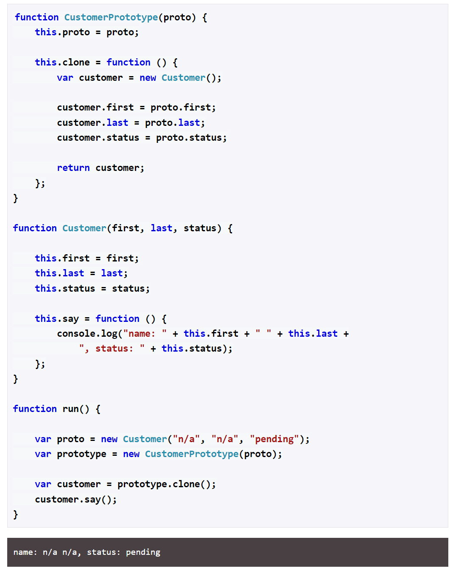

Slide 6
Useful Resources
https://www.patterns.dev/posts/classic-design-patterns/#prototypepatternjavascript
https://www.digitalocean.com/community/conceptual_articles/prototype-design-pattern-in-javascript
https://www.dofactory.com/javascript/design-patterns/prototype

