Slide 1
Singleton Design Pattern
The Singleton pattern is a design pattern that restricts the instantiation of a class to one object.
Singletons are useful in situations where system-wide actions need to be coordinated from a single central place.
An example is a database connection pool. The pool manages the creation, destruction, and lifetime of all database connections for the entire application ensuring that no connections are 'lost‘.
@ShankaragoudaG

Slide 2
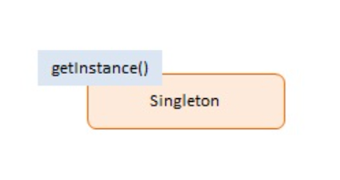
Singleton Pattern Diagram
Singleton -- In example code: Singleton
defines getInstance() which returns the unique instance.
responsible for creating and managing the instance object.

Slide 3
Singleton Pattern Implementation
The Singleton object is implemented as an immediate anonymous function.
The getInstance method is Singleton's gatekeeper. It returns the one and only instance of the object while maintaining a private reference to it which is not accessible to the outside world.
The getInstance method demonstates another design pattern called Lazy Load. Lazy Load checks if an instance has already been created; if not, it creates one and stores it for future reference. All subsequent calls will receive the stored instance.
Lazy loading is a CPU and memory saving technique by creating objects only when absolutely necessary.

Slide 4
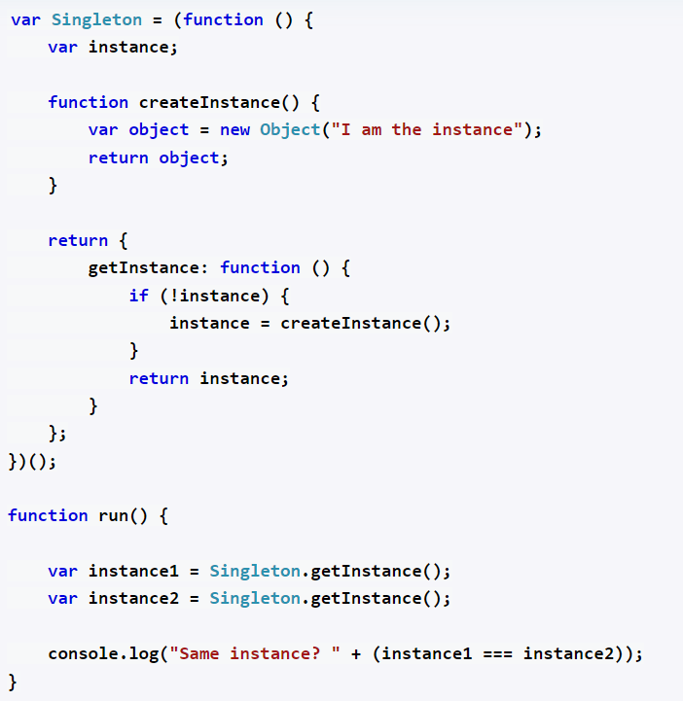
Example
OUTPUT: true

Slide 5
Useful Resources
https://robdodson.me/posts/javascript-design-patterns-singleton/
https://www.patterns.dev/posts/classic-design-patterns/#singletonpatternjavascript
https://www.dofactory.com/javascript/design-patterns/singleton

