Slide 1
WINE QUALITY PREDICTION USING MACHINE LEARNING
SHANKARI G
au21CB67
KGiSL INSTITUTE OF TECHNOLOGY
3/21/2024 Annual Review

Slide 2
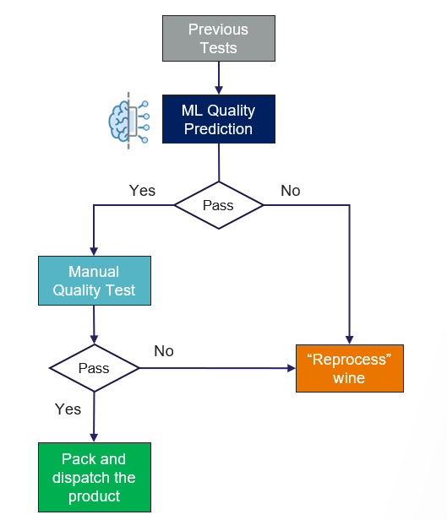
WINE QUALITY PREDICTION USING MACHINE LEARNING
3/21/2024 Annual Review

Slide 3


AGENDA
PROBLEM STATEMENT
PROJECT OVERVIEW
WHO ARE THE END USERS?
SOLUTION
WOW IN THE SOLUTION
MODEL
RESULT
3/21/2024 Annual Review

Slide 4

PROBLEM STATEMENT
Assessing and predicting wine quality remains a challenge due to subjective evaluations and diverse consumer preferences. This project aims to develop machine learning models using comprehensive wine datasets to predict quality objectively. By doing so, we aim to improve decision-making processes for winemakers, distributors, and consumers, enhancing overall satisfaction in the industry.
3/21/2024 Annual Review

Slide 5

PROJECT OVERVIEW
Our project aims to revolutionize wine quality assessment through data-driven methodologies.
We will employ advanced machine learning algorithms to analyze a comprehensive dataset encompassing diverse chemical and sensory attributes of wines.
By developing predictive models, we seek to provide objective evaluations of wine quality, enabling stakeholders to make informed decisions.
This project holds the potential to streamline processes for winemakers, optimize marketing strategies for distributors, and empower consumers with reliable information for selecting wines that align with their preferences.
Through rigorous analysis and model refinement, we aspire to establish a robust framework for enhancing the wine industry's efficiency and customer satisfaction.
3/21/2024 Annual Review

Slide 6

WHO ARE THE END USERS?
1. Winemakers
2. Wine Quality Control Teams
3. Wine Distributors
4. Wine Retailers
5. Wine Consumers
6. Wine Critics and Sommeliers
3/21/2024 Annual Review

Slide 7

SOLUTION AND PROPOSITION
Objective Quality Assessment: We will develop predictive models that objectively evaluate wine quality, reducing reliance on subjective assessments and providing consistent and reliable evaluations.
Enhanced Decision Making: Stakeholders across the wine industry, including winemakers, distributors, and retailers, can make more informed decisions regarding production, inventory management, marketing strategies, and consumer recommendations.
Improved Customer Satisfaction: By offering consumers access to objective quality assessments, they can select wines that align with their preferences and expectations, leading to increased satisfaction and loyalty.
Efficiency and Optimization: Our solution aims to streamline processes within the wine industry, optimizing production, distribution, and retail operations to maximize profitability and customer satisfaction.
Innovation and Competitiveness: By embracing data-driven methodologies, stakeholders can stay ahead of the curve, innovate their offerings, and remain competitive in an ever-evolving market landscape.
3/21/2024 Annual Review

Slide 8

THE WOW IN YOUR SOLUTION
1. Precision and Accuracy
2. Unparalleled Insights
3. Personalized Recommendation
4. Future proof Innovation
5. Value Addition Across the Supply Chain
6. Sustainable Success
3/21/2024 Annual Review

Slide 9
MODELLING
1. Data Exploration and Preparation: We start by exploring the dataset, examining the distribution of features, identifying outliers, and understanding the relationships between variables. We also preprocess the data, handling missing values, scaling features, and encoding categorical variables as necessary to ensure compatibility with our modeling algorithms.
2. Feature Selection and Engineering: Next, we select the most relevant features that have the greatest impact on wine quality prediction. We may also engineer new features or transformations to enhance the predictive power of our models.
3. Model Selection: We experiment with a variety of machine learning algorithms suitable for regression tasks, such as Linear Regression, Random Forest, Gradient Boosting, and Support Vector Regression. We evaluate the performance of each model using cross-validation and select the top-performing ones for further refinement.
4. Hyperparameter Tuning: To optimize the performance of our selected models, we conduct hyperparameter tuning using techniques like grid search or random search. This helps us find the optimal combination of model parameters that maximizes predictive accuracy.

Slide 10
MODELLING
5. Model Evaluation: We evaluate the performance of our tuned models using appropriate metrics such as Mean Squared Error (MSE), R-squared, and Mean Absolute Error (MAE). We also visualize the results using techniques like scatter plots to compare predicted versus actual wine quality.
6. Model Deployment: Once we have identified the best-performing model, we deploy it into a production environment where it can be integrated into existing workflows or systems for real-time wine quality assessment.
7. Continuous Monitoring and Improvement: We continuously monitor the performance of our deployed model and incorporate new data to retrain and improve its accuracy over time. This ensures that our predictive models remain robust and effective in addressing the evolving needs of the wine industry.
3/21/2024 Annual Review

Slide 11
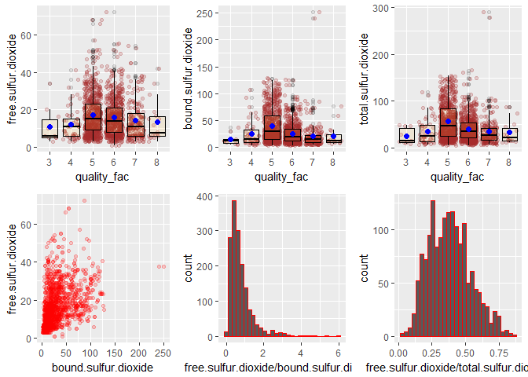
RESULTS
https://drive.google.com/drive/folders/1k30Iaa6hSZmtta73f9I9acHz3qijCphx
3/21/2024 Annual Review

