Slide 1
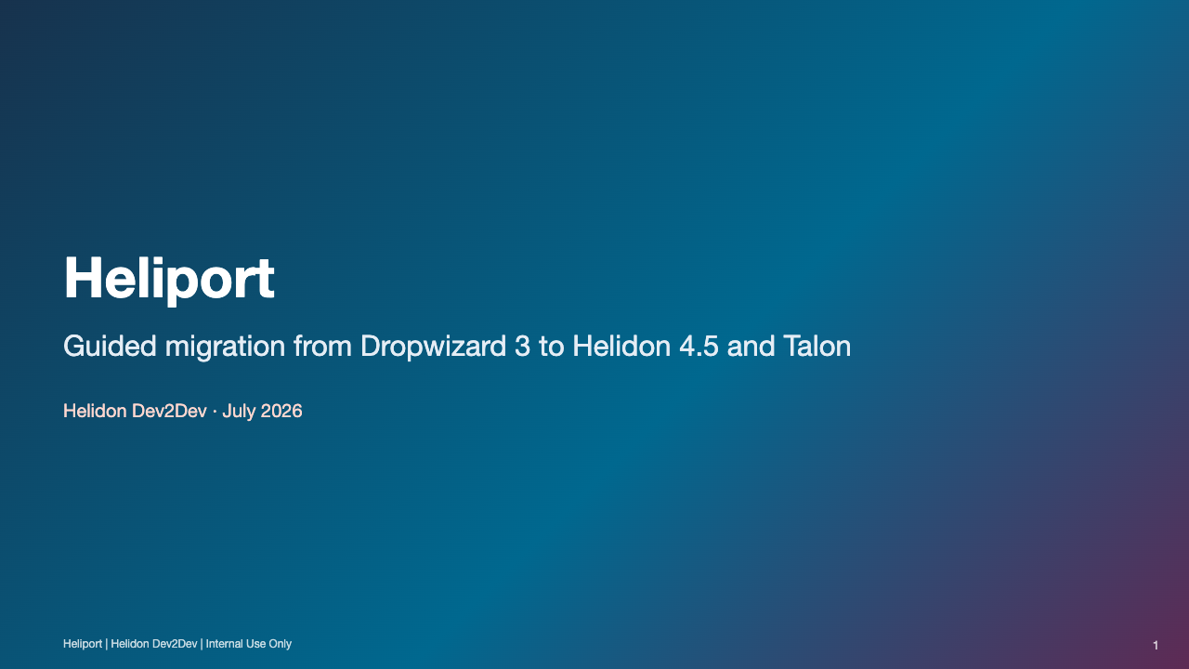
Notes:
Open with the audience's problem: a framework migration is not an import rewrite; it changes runtime responsibilities across build, bootstrap, routing, injection, configuration, OCI integrations, and tests.
The goal today is to make a Heliport run predictable: where to get it, what it changes, what it refuses to guess, and how to finish the work from its reports.

Slide 2
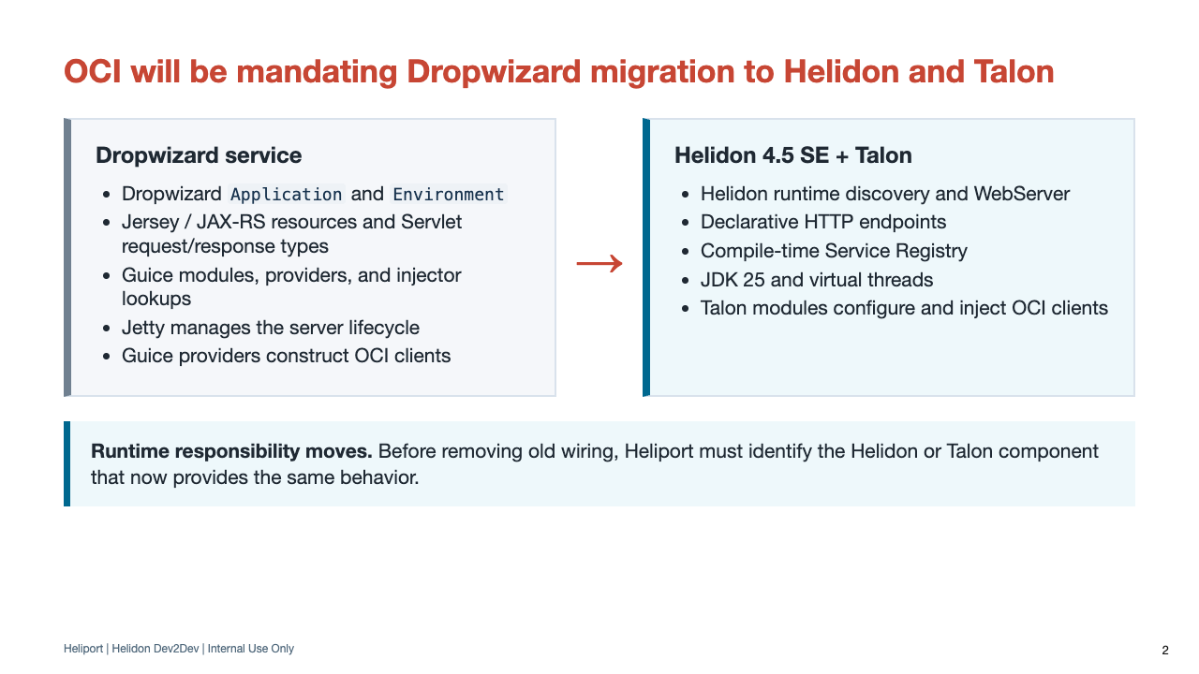
Notes:
Frame the OCI decision using the target platform described in the Talon presentation: Helidon 4, JDK 25, virtual threads, declarative HTTP, compile-time injection, and standardized OCI integrations.
Talon is the OCI-native service framework built on Helidon, providing standardized integrations and operational patterns for OCI control-plane and data-plane services.
Use ownership as shorthand for runtime responsibility: who creates and injects a client, registers and serves a route, starts and stops a lifecycle component, supplies configuration, or applies an OCI integration.
Heliport removes old wiring only after the corresponding Helidon or Talon behavior is confirmed. Otherwise it preserves the code or reports a developer action.

Slide 3
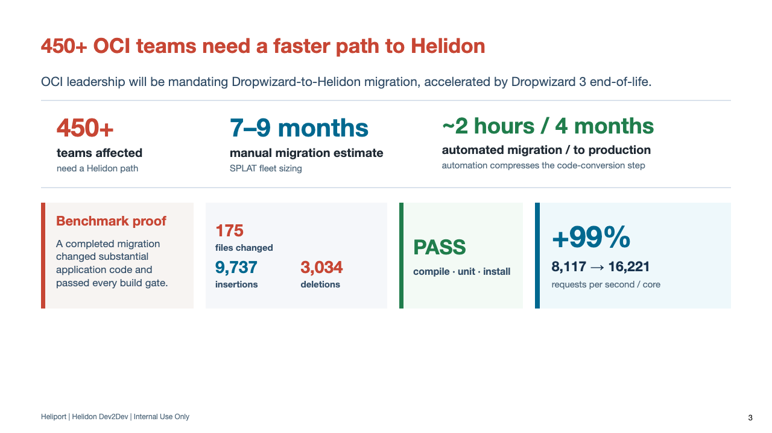
Notes:
Use this slide to establish why Heliport exists, then move directly into what the mandated target changes. The workflow is covered later in the presentation.
The 450+ figure is the number of affected OCI teams. The seven-to-nine-month manual estimate comes from SPLAT fleet sizing.
Separate the two automation milestones: the benchmark migration converted the code in roughly two hours; the service reached production in four months after application review, follow-up work, validation, and normal delivery processes.
Benchmark proof: 175 files changed, with 9,737 insertions and 3,034 deletions; compile, unit, and install gates passed. Throughput increased from 8,117 to 16,221 requests per second per core, a 99% improvement.
Treat the performance result as proof from this benchmark, not as a guaranteed result for every service.

Slide 4
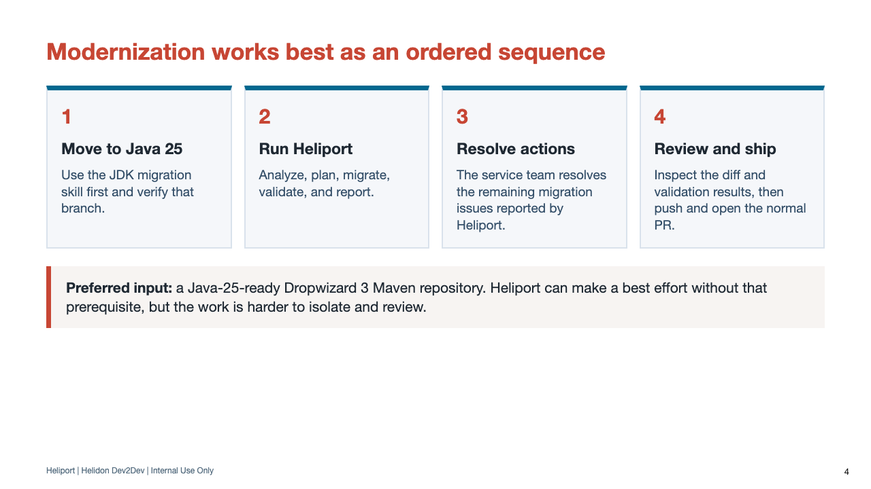
Notes:
Strongly recommend the JDK migration first. It separates compiler, dependency, and source compatibility changes from the framework migration.
Actions are the developer-facing list of remaining migration issues. The service team resolves application work and routes Heliport defects or environment blockers through the support paths covered later.
Heliport never pushes. Even with branch and commit options, the application team reviews the changes, pushes the branch, and creates the PR.

Slide 5
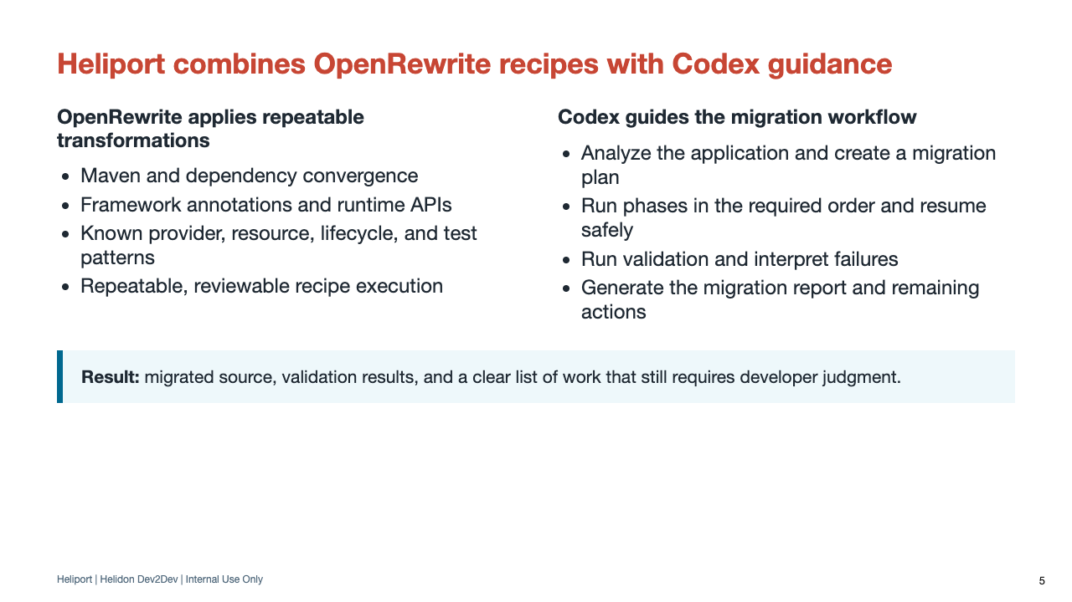
Notes:
Explain why both parts are needed. OpenRewrite recipes perform known, repeatable code and build changes; Codex analyzes the repository, guides the workflow, runs validation, and interprets the results.
Heliport is a Codex skill, not a separate one-shot binary that blindly changes a tree.

Slide 6
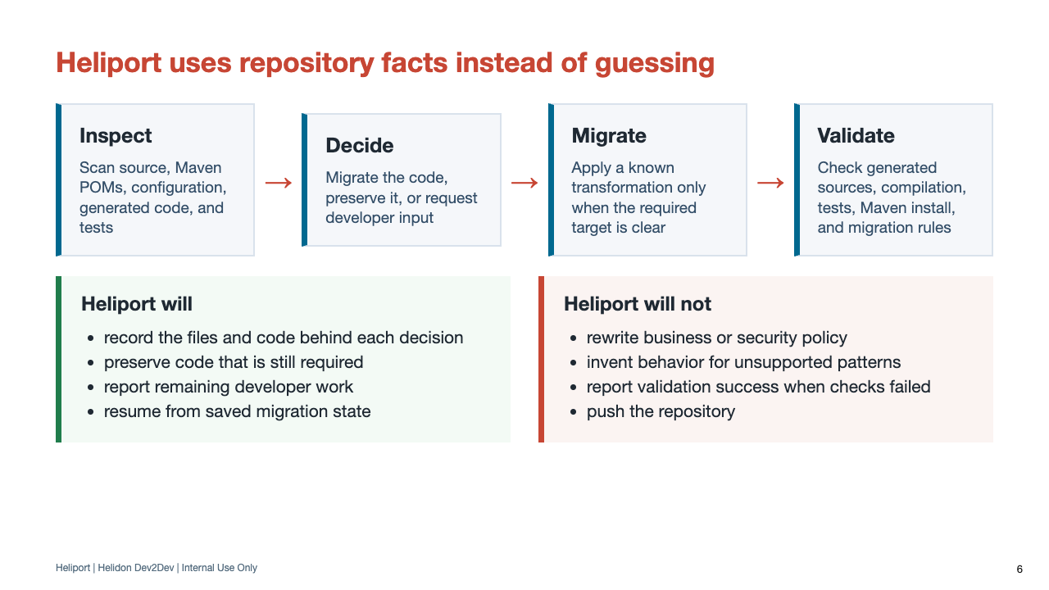
Notes:
Repository facts are concrete source symbols, dependencies, configuration keys, generated outputs, and tests. Heliport uses those facts to select a known transformation instead of inferring behavior from a compile failure alone.
If no safe, known target exists, Heliport preserves the code and reports a developer action rather than inventing an application-specific migration.

Slide 7
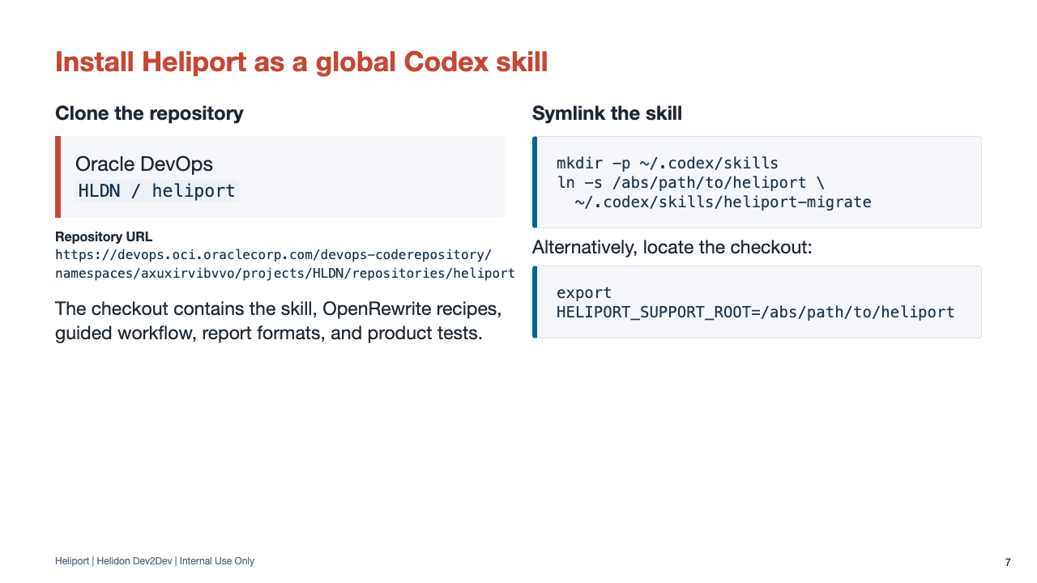
Notes:
The full Oracle DevOps URL is shown here and repeated on the closing resources slide. A symlink lets the installed skill follow updates in the checkout.
The direct .agents skill directory can also be linked, but the repository-root link is the simplest documented path.

Slide 8
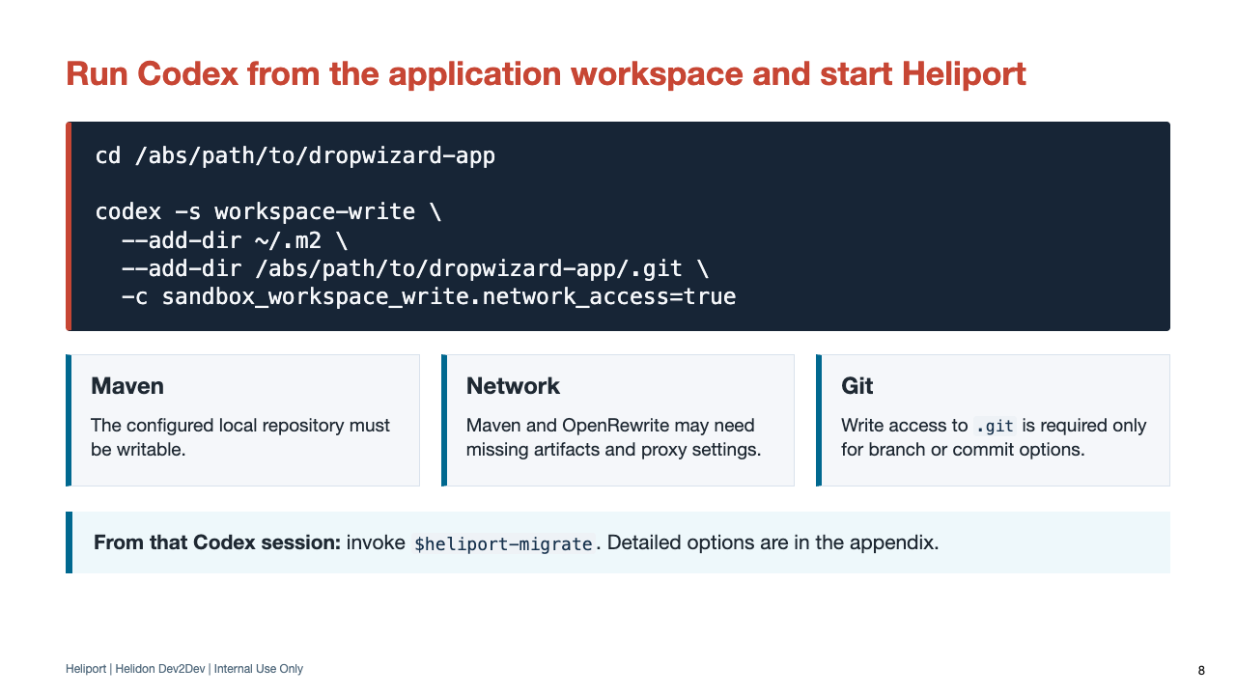
Notes:
The skill must run from the target repository. Positional project-path arguments are not supported.
If the Maven settings file selects another localRepository, grant that path instead of ~/.m2. Keep normal corporate Maven settings and proxy behavior intact.
After Codex starts, verify the intended model and reasoning level, then invoke $heliport-migrate. If time permits, this is enough context to begin a live demonstration without a separate transition slide.

Slide 9
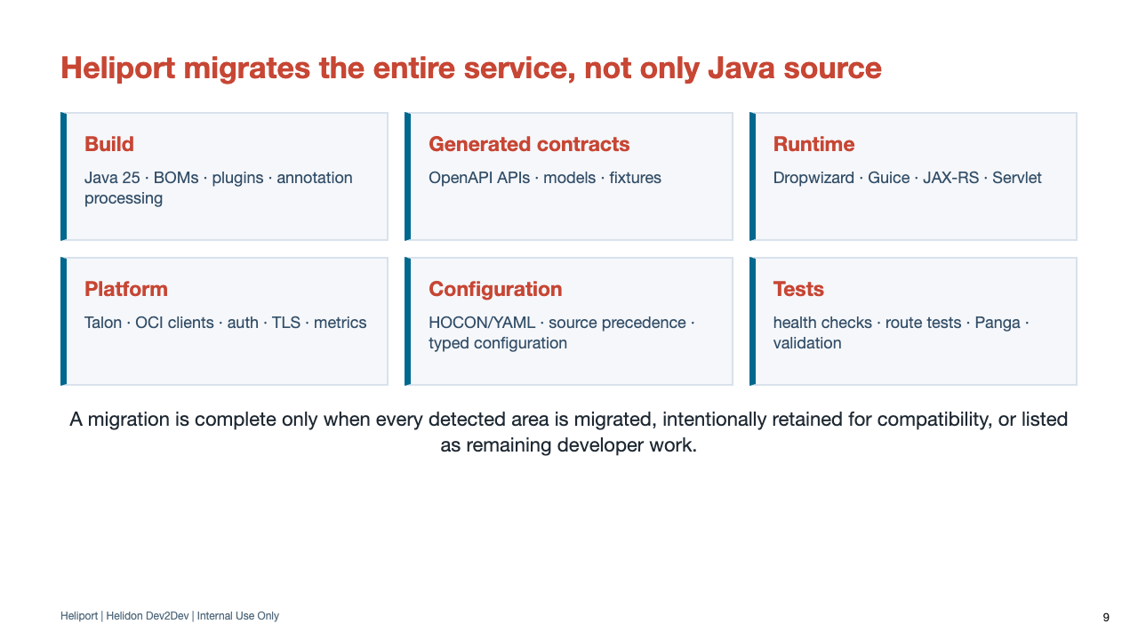
Notes:
Use this as the pivot into the technical bulk of the talk. The next slides walk these areas in the order developers will encounter them.

Slide 10
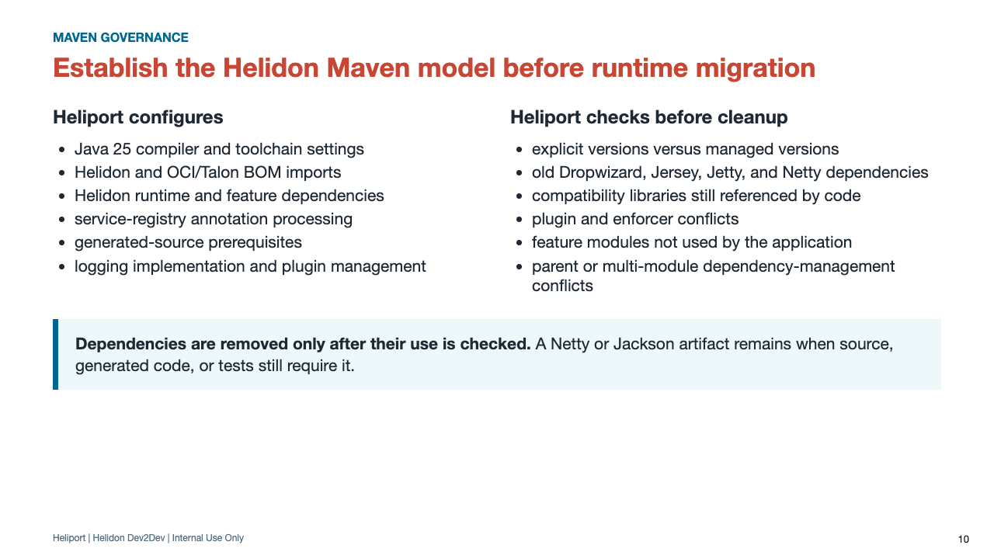
Notes:
The initial build phase creates a usable Helidon target before runtime recipes run. It also avoids two common mistakes: adding every Talon module and deleting every old dependency by name.
Maven install remains last so enforcer, dependency analysis, style, coverage, and packaging checks remain visible.

Slide 11
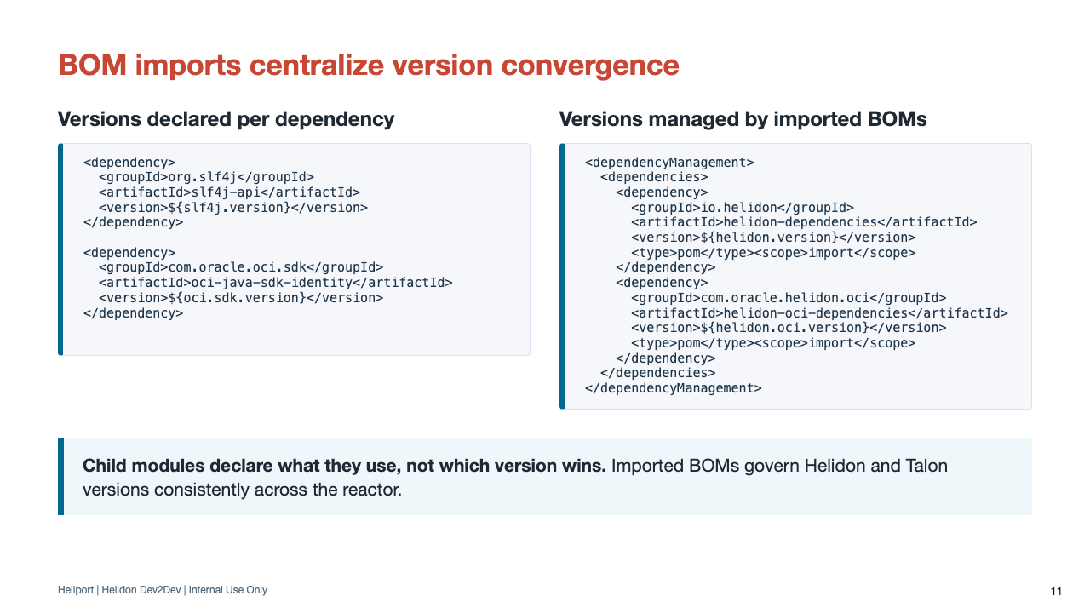
Notes:
Show the separation of responsibilities: dependencyManagement chooses versions; child dependencies express actual module use.
The application keeps declaring SLF4J and OCI SDK modules where they are used, but their versions move to the reactor's imported BOMs.

Slide 12
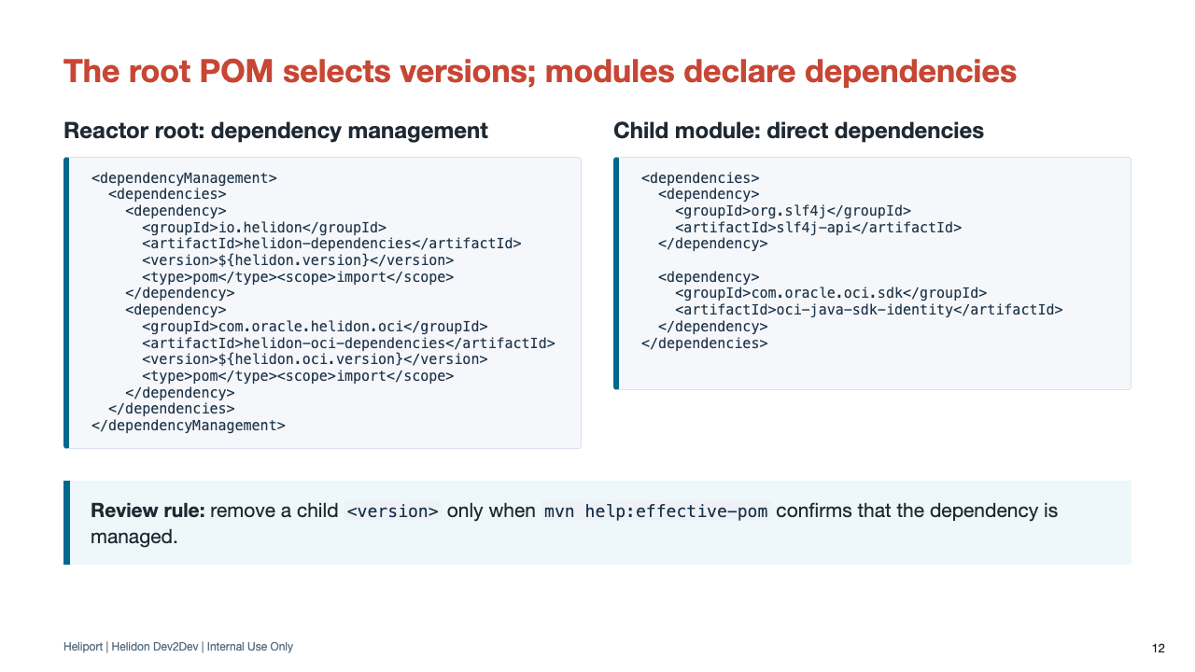
Notes:
The root chooses a compatible platform; modules state only what they actually compile or run against.
Heliport reads the effective parent and reactor structure. External-parent modules may correctly retain a local version, and aggregator-only POMs should not gain runtime dependencies.
BOMs and JPMS serve different layers: Maven selects artifact versions; module-info.java expresses readability and exports. Both should reflect the features the module actually uses.

Slide 13
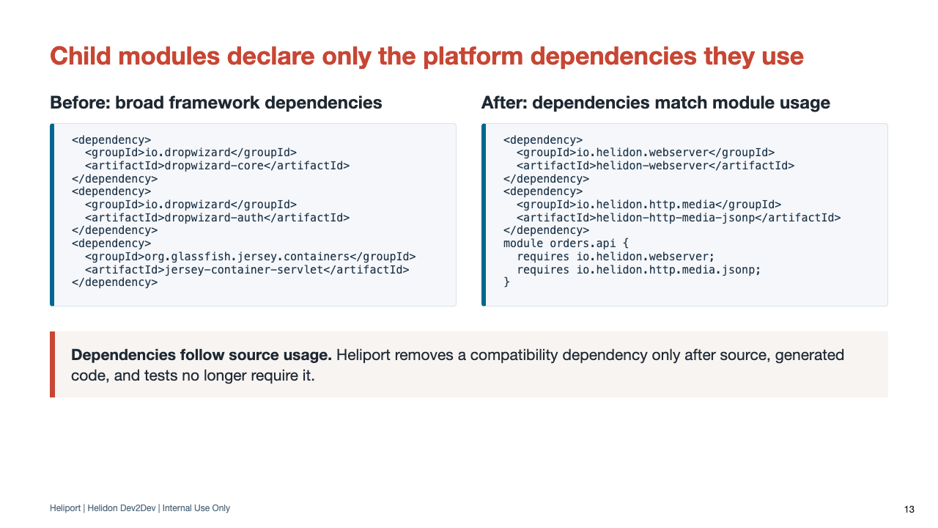
Notes:
A child POM contains direct dependencies for its source and runtime providers without repeating managed versions.
When the service has a module descriptor, Heliport aligns requires entries with the same repository usage facts used for Maven dependencies.
Each dependency is added, managed, kept, removed, or reported as a developer action. A clean tree results from checking every use before removal.

Slide 14
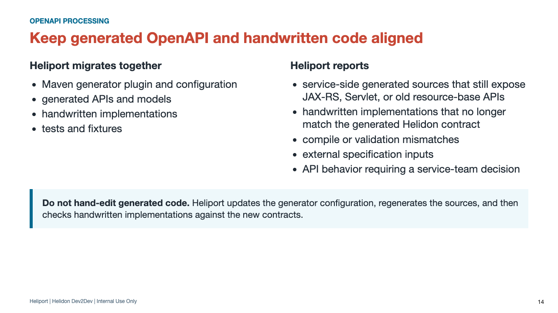
Notes:
Heliport checks generated contracts before runtime migration and again afterward. Generated resources can define statuses, headers, response types, and method signatures that handwritten implementations must preserve.
Examples of service-side legacy output include generated AbstractFooBaseResource contracts, javax.ws.rs or jakarta.ws.rs server types, JAX-RS Response and HttpHeaders carriers, Servlet request or response types, and old generated response wrappers.
Remote and out-of-project OpenAPI references are never fetched implicitly; the service team must make those specifications available as explicit build inputs or retain the compatibility path.

Slide 15
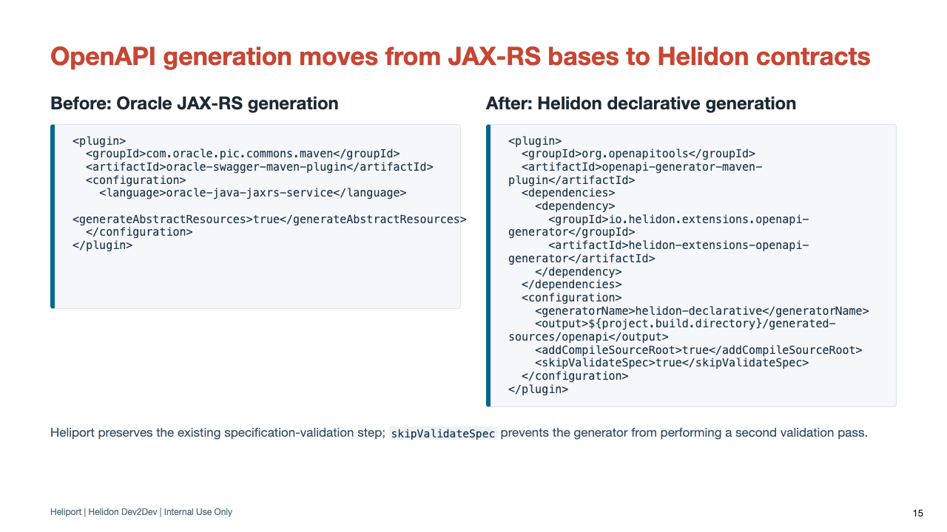
Notes:
The Helidon OpenAPI generator extension is a separately versioned toolchain. Heliport selects that version from its generator policy or explicit overrides; it is not derived from ${helidon.version}.
Heliport preserves each execution's input specification and base package when a module generates multiple service contracts.
When another module in the same Maven reactor produces the specification, Heliport must update the generator input path and preserve the build order. Moving dependency:unpack without updating that path can run generation before the specification exists.
Remote specifications are never fetched implicitly. The service team must provide a remote specification as an explicit build input or retain the existing compatibility path.

Slide 16
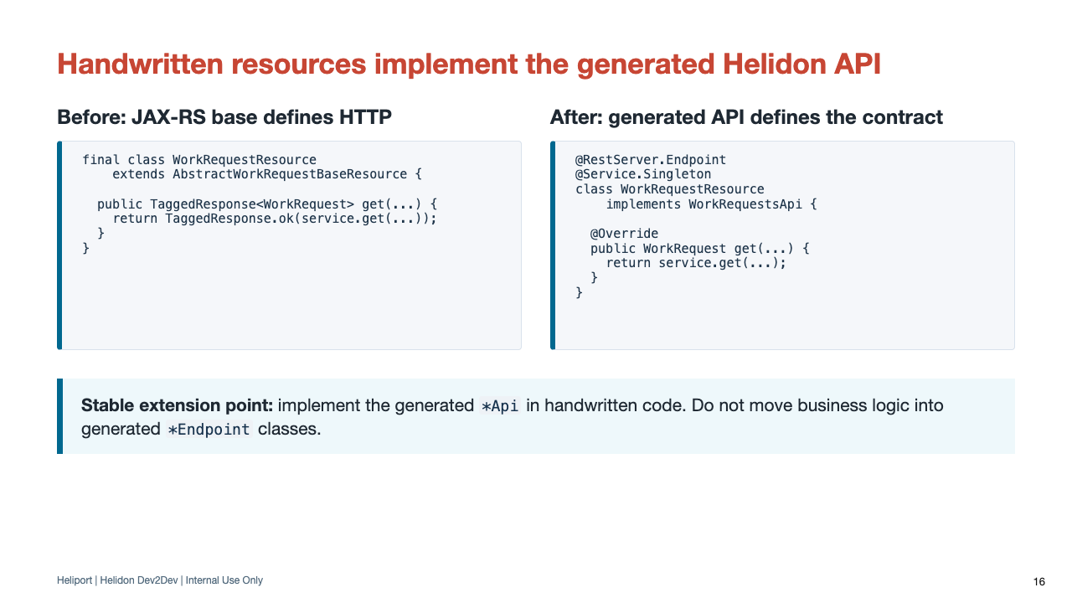
Notes:
The exact generated signature varies by contract; do not claim one universal method shape.
Heliport adapts one resource family at a time, preserving status, body, declared headers, auth inputs, model builders, enum shapes, temporal types, and handwritten implementation behavior.
Generated endpoints are overwritten on each build, so business logic must remain in stable application classes. Do not hand-edit target/generated-sources/openapi.

Slide 17
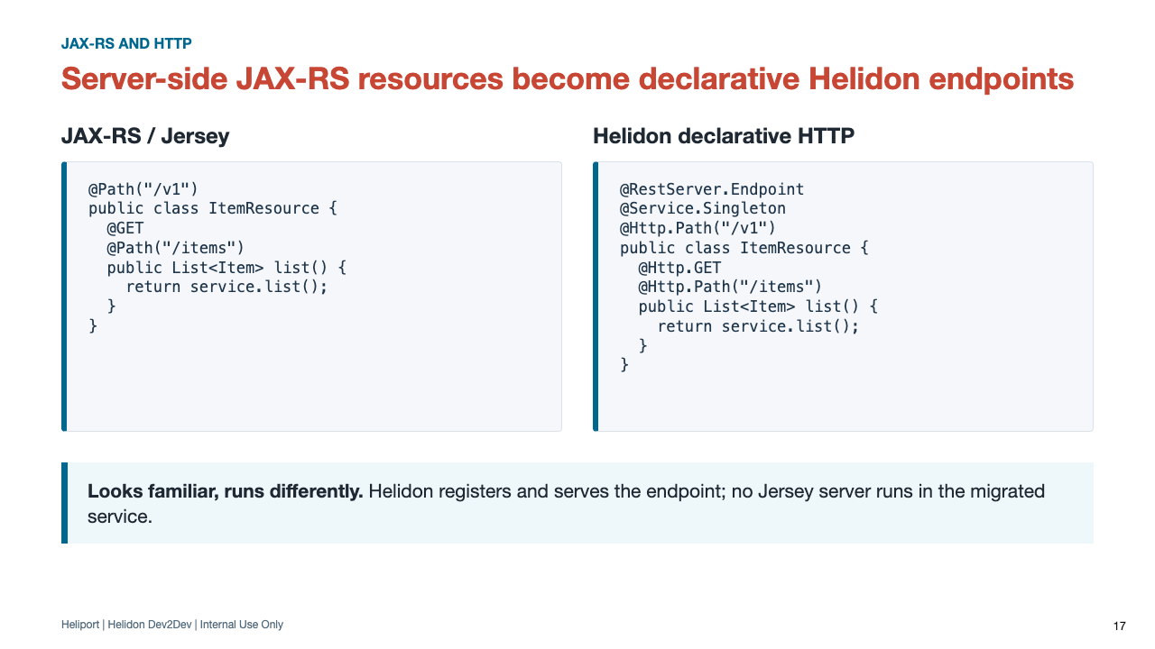
Notes:
The annotations look intentionally familiar, but the runtime is different. Resources become discovered Helidon services and endpoints; Heliport removes environment.jersey().register calls only after those endpoints exist.
This slide covers server-side JAX-RS. JAX-RS client APIs retained at OCI SDK or provider compatibility boundaries are classified and reported separately.
Heliport also normalizes class and method paths when trailing-slash behavior would otherwise change.

Slide 18
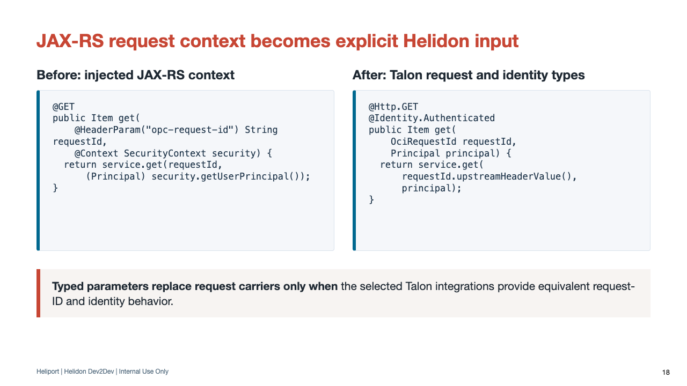
Notes:
This target assumes that Heliport selected the Talon request-ID webserver and OCI identity integrations. Otherwise Heliport retains ServerRequest or a compatibility adapter and reports the remaining work.
The injected Principal is com.oracle.pic.identity.authentication.Principal, not java.security.Principal. Direct resolution requires @Identity.Authenticated or a supported Auth SDK authorization annotation.
Prefer typed route parameters when they preserve the contract. Use ServerRequest only when the endpoint genuinely needs broader request metadata.
Principal-only SecurityContext use can move to OCI identity interception. Role checks and principal enrichment remain application policy.
UriInfo, Servlet wrappers, body replay, proxy behavior, async timeouts, and SSE broadcasters require an equivalent Helidon implementation or an explicit developer action.

Slide 19
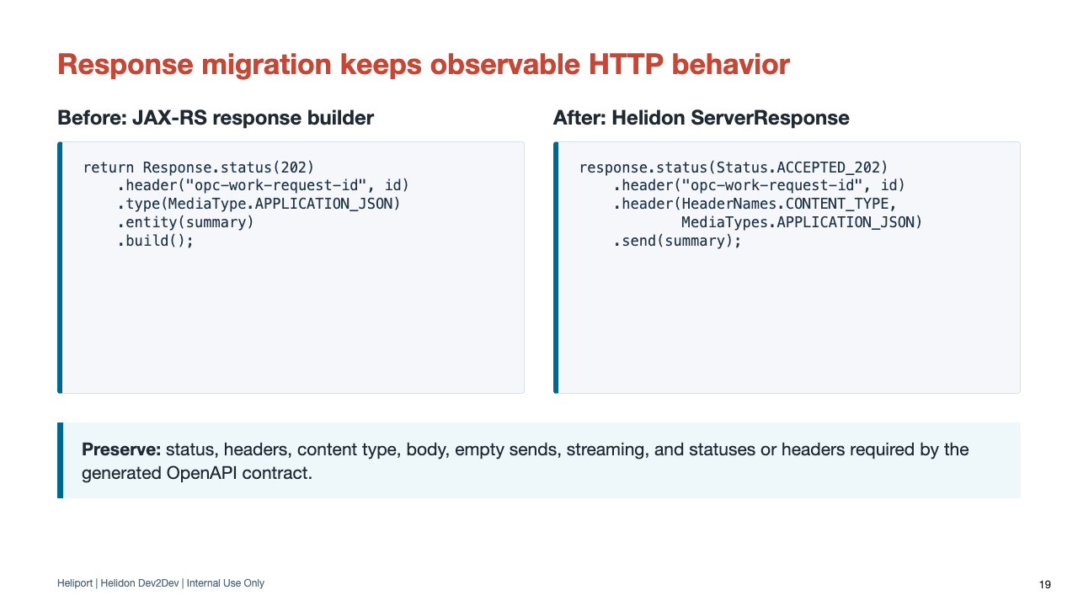
Notes:
Simple 200 responses can return the entity directly. ServerResponse is used when response metadata or stream behavior is observable.
Use the fluent ServerResponse API so status, headers, and the terminal send remain one visible response operation.
Downloads also preserve content-md5, content-encoding, downstream header replay, and whether the original InputStream is sent without buffering.
Complex exception mappers, gzip wrappers, proxy context, response wrappers, and body replay remain developer work until an equivalent Helidon implementation is identified.

Slide 20
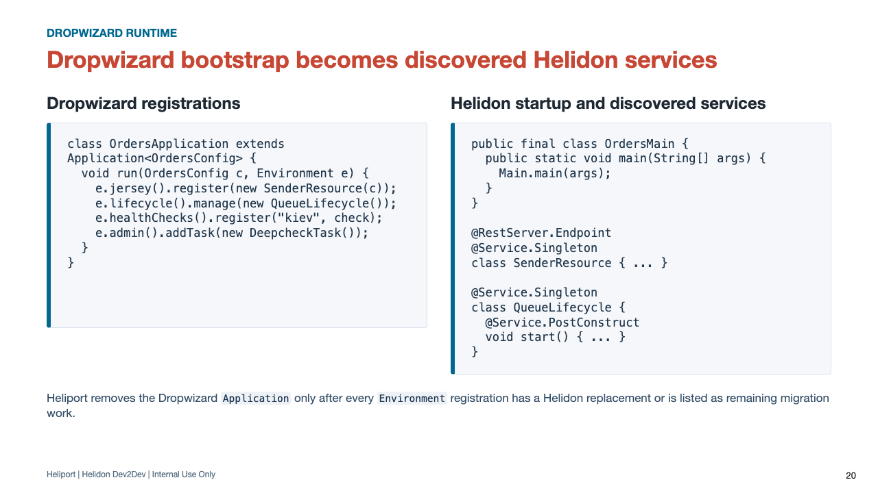
Notes:
Walk through the old Environment as the central Dropwizard registration point. Every line must move to an endpoint, lifecycle service, health feature, task endpoint, JSON/config service, or action item.
Custom Jetty connector, TLS, proxy, JMX, and listener behavior prevents broad bootstrap deletion until an equivalent WebServer implementation is identified.

Slide 21
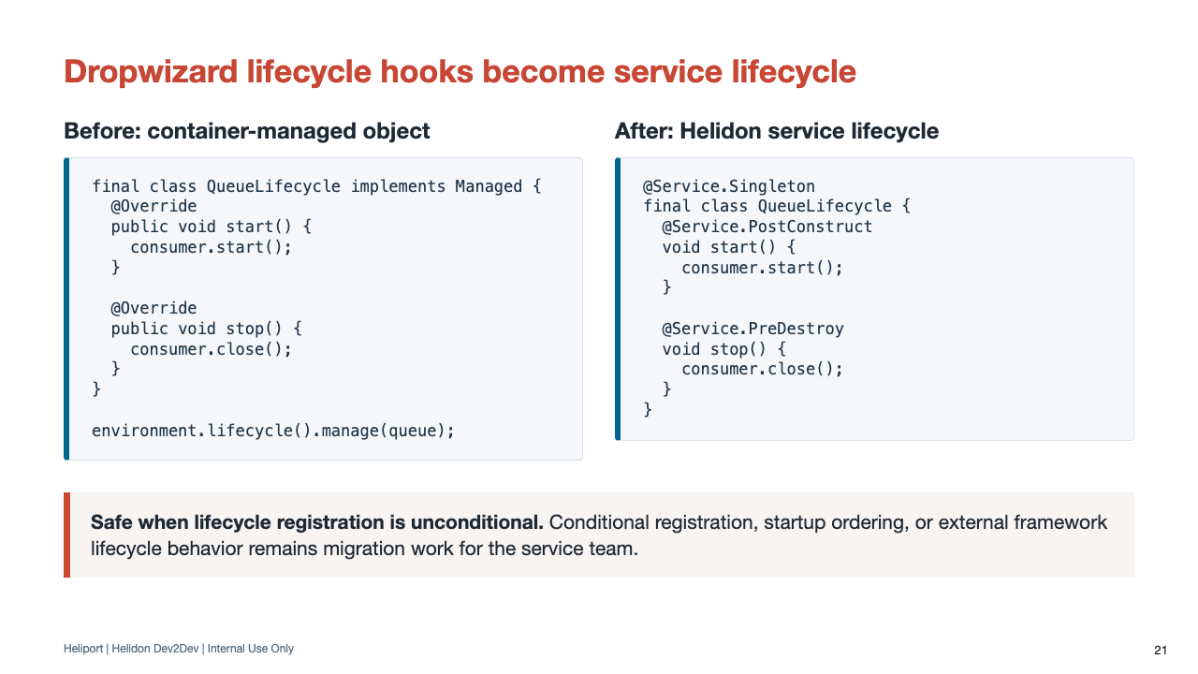
Notes:
This direct mapping applies when the lifecycle is event-independent and ordering is already represented by service dependencies.
ServerLifecycleListener moves to ServerLifecycle.afterStart(WebServer) only when it does not depend on Jetty connector, session, servlet, or custom listener state.
Conditional startup, custom TLS, JMX, SNI, mTLS, HTTP/2, and proxy-protocol behavior remain developer work until an equivalent Helidon implementation is identified.

Slide 22
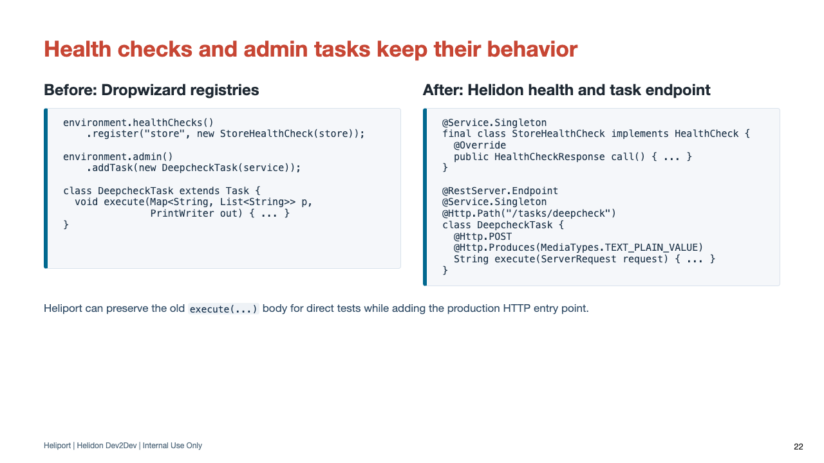
Notes:
Health tests migrate with the production health check. Status and diagnostic content must remain equivalent, not only the class name.
Task naming, authorization, and servlet-coupled output policy can require a service-team decision.

Slide 23
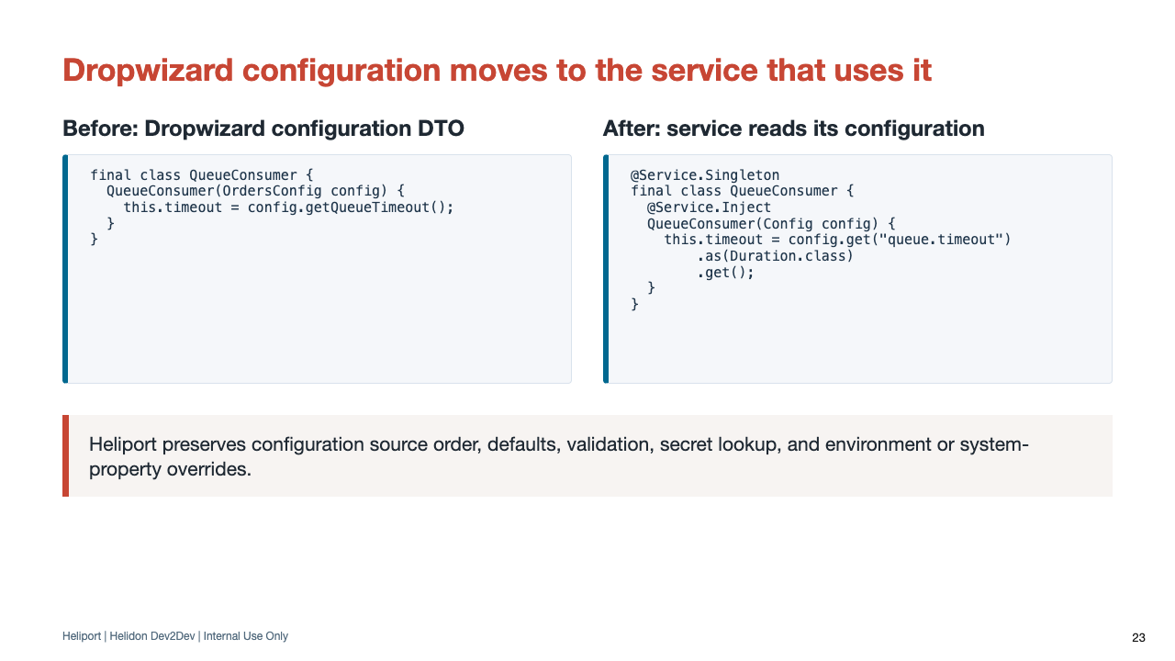
Notes:
Configuration moves to the production service that uses it and, for Talon integrations, into the integration's documented configuration root.
Review computed Java configuration, Dropwizard DataSize conversion, custom TLS or connector settings, secret reload, and operational override precedence carefully.

Slide 24
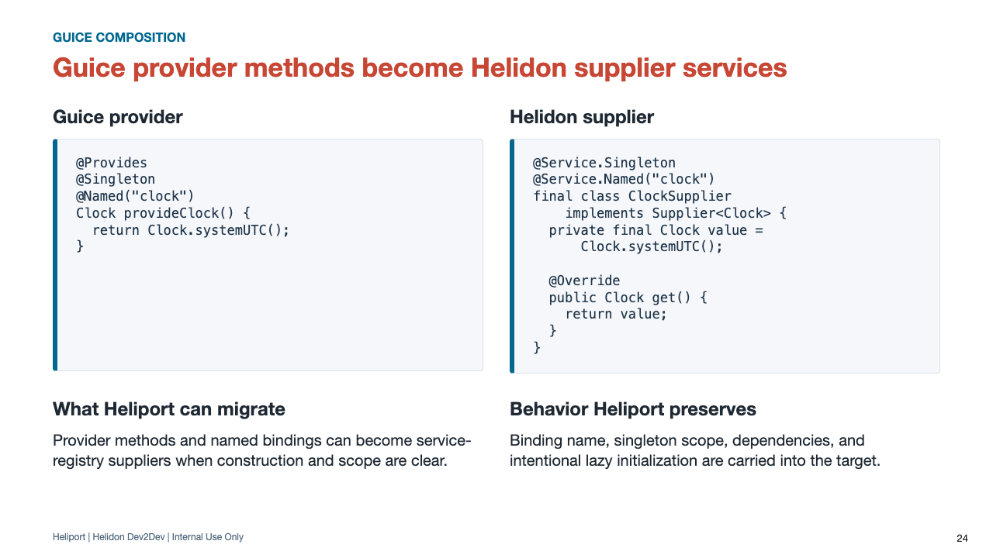
Notes:
A Supplier is the closest target for a Guice @Provides method whose product is not itself a discoverable service class. The cached field makes the original singleton scope explicit.
Lifecycle providers, runtime injector lookups, multibindings, and application-specific factory behavior may need specialized migration or developer action.

Slide 25
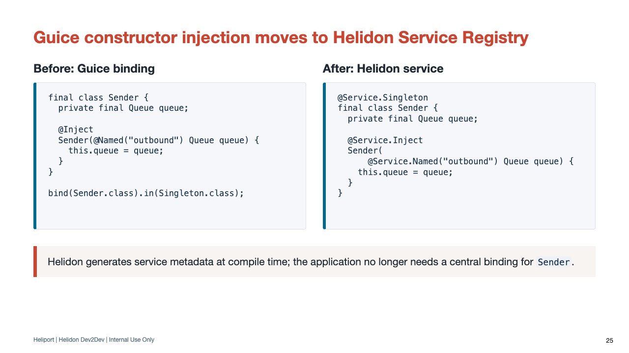
Notes:
The target architecture expresses composition on the service and constructor. Helidon code generation creates the service metadata instead of relying on a central Guice module binding.
Service.Named preserves the Guice qualifier while Service.Inject marks the injection constructor.
Custom scopes, assisted injection, AOP, listeners, and side-effect injection may still require developer attention.

Slide 26
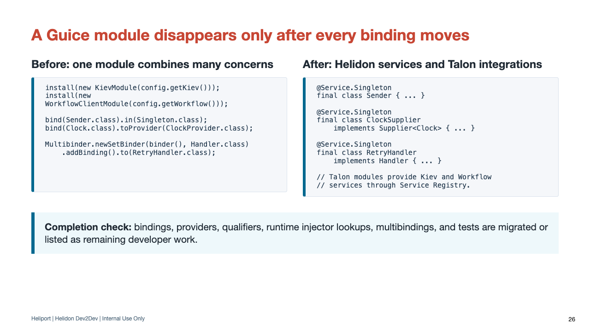
Notes:
Removing AbstractModule too early can lose runtime registrations even when compilation succeeds.
Heliport removes the module only after safe bindings have target services and anything it cannot safely migrate is listed as remaining developer work.

Slide 27
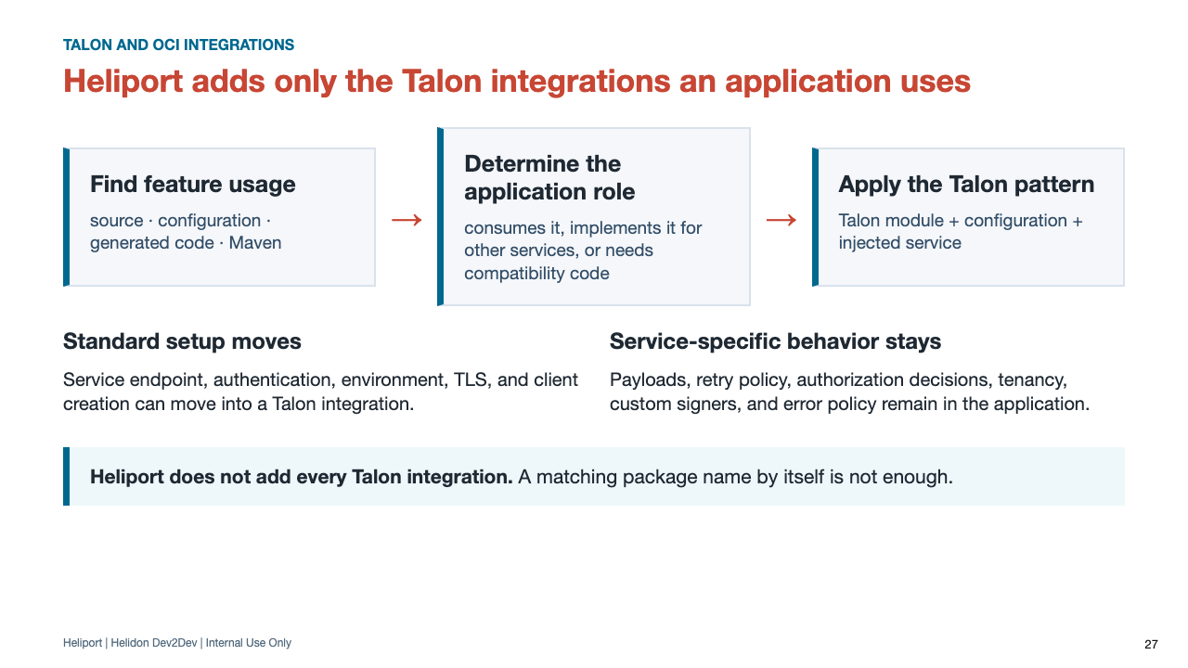
Notes:
This is the feature-selection rule. A module appears because concrete repository usage shows the application needs it, not because every migrated service gets the same platform bundle.
Some repositories implement shared integration code used by other services. Heliport must recognize that provider role instead of automatically adding the consumer-side Talon module.
Repositories that use custom transports may retain compatibility code or receive developer actions instead of a standard Talon integration.

Slide 28
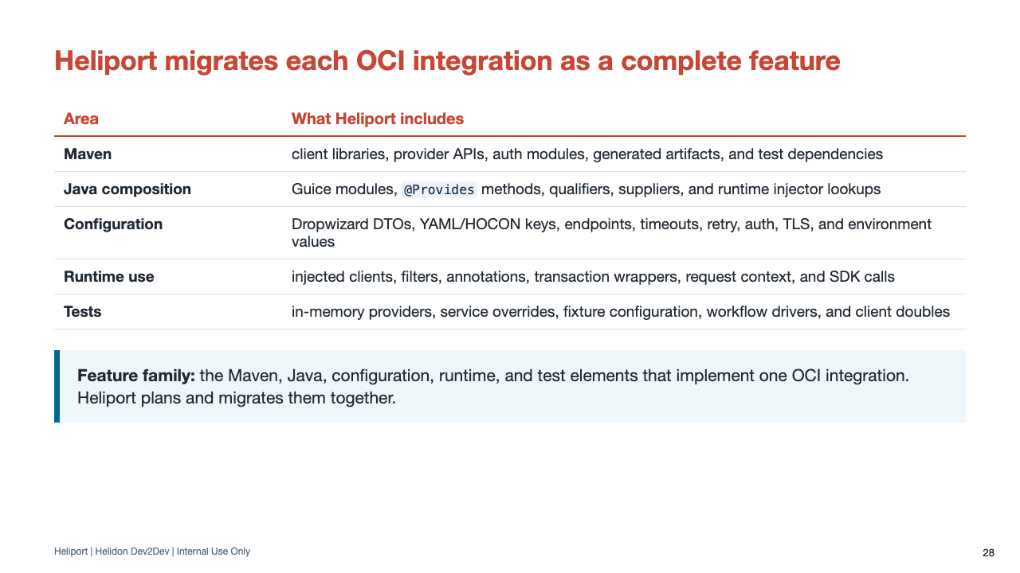
Notes:
This slide introduces feature family as a useful Heliport term: the complete set of build, source, configuration, runtime, and test elements associated with one integration.
Heliport also distinguishes an application that uses the integration from a repository that provides its implementation, so client artifacts are not added to the wrong module.
Use the Talon RC2 presentation as the integration reference: this talk explains how Heliport reaches those target code and configuration forms from Dropwizard, JAX-RS, and Guice code.
The same family contract applies to Workflow/WFaaS, Limits, Secret Service, Request ID, SPLAT, Audit, Object Storage, Identity Client, Tagging, Error Code, and the other Talon integrations. They are intentionally not expanded in this talk.

Slide 29
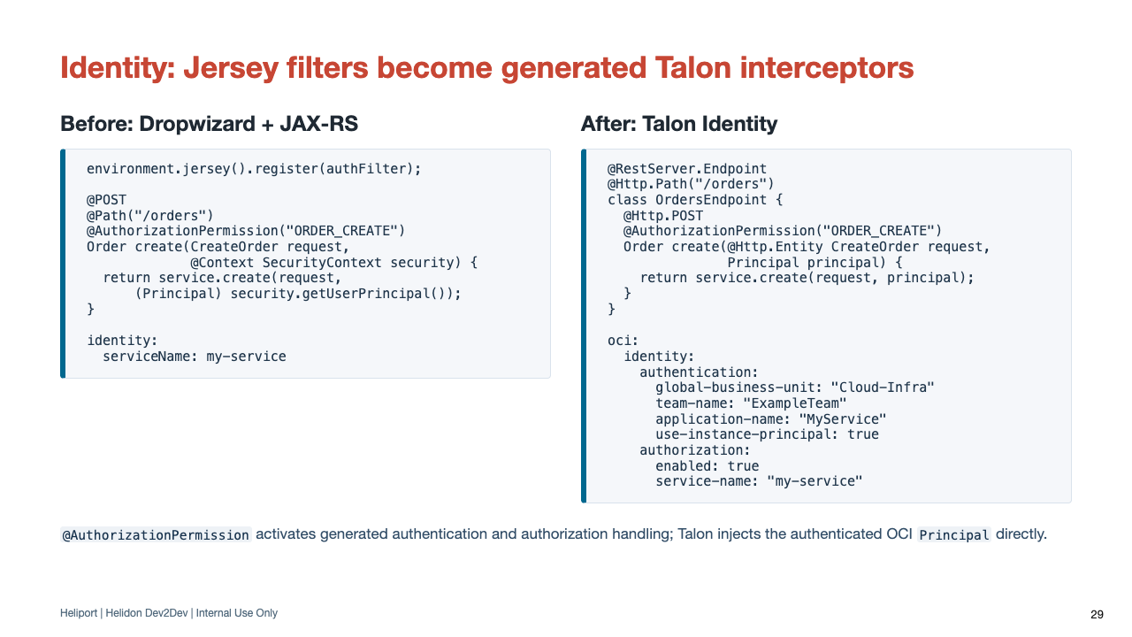
Notes:
This target deliberately mirrors the Talon RC2 Identity example: @RestServer.Endpoint, @Http.Path, @Http.POST, @AuthorizationPermission, @Http.Entity, and direct Principal injection.
Principal is com.oracle.pic.identity.authentication.Principal. The same business call now receives that type directly instead of reading and casting a JAX-RS SecurityContext.
AuthorizationPermission uses the authorization path, which includes authentication. Use @Identity.Authenticated when the endpoint needs authentication without service-side authorization.
Heliport collects the identity dependency, Dropwizard/Jersey registration, Guice filter or binder, auth configuration, request parameters, and endpoint annotations as one feature family.
Simple authentication-only name bindings and unused filter shells can migrate automatically. Custom route authorization, SAML, principal enrichment, local/mock behavior, and auth-provider construction remain explicit developer work.
Heliport preserves an existing permission contract; it does not invent ORDER_CREATE or choose a service name for the application.

Slide 30
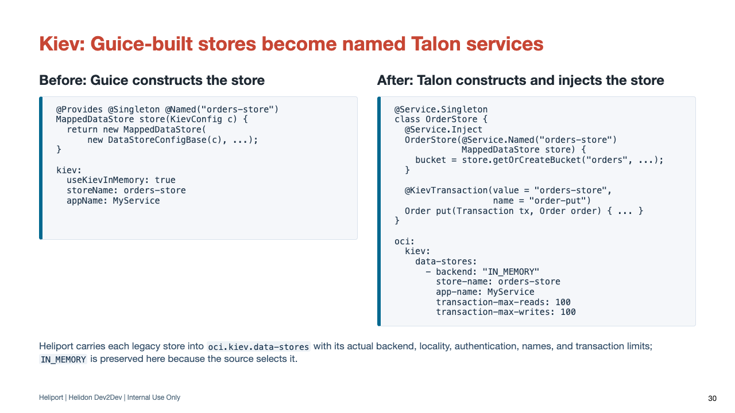
Notes:
This target mirrors the Talon RC2 Kiev examples: a named MappedDataStore, an oci.kiev.data-stores entry, and @KievTransaction around a clearly identified service method.
Kiev is the clearest feature-family example because the POM, Guice provider, Dropwizard configuration, named store, transaction boundary, runtime consumer, and tests must agree.
IN_MEMORY is the RC2 demonstration backend. Heliport preserves the backend, locality, authentication, app name, store name, and read/write limits found in the application rather than selecting demonstration values.
Application-specific DataStoreConfigBase construction and transaction-provider wrappers remain developer work until their behavior is understood. Heliport does not infer commit, abort, retry, or failure policy.

Slide 31
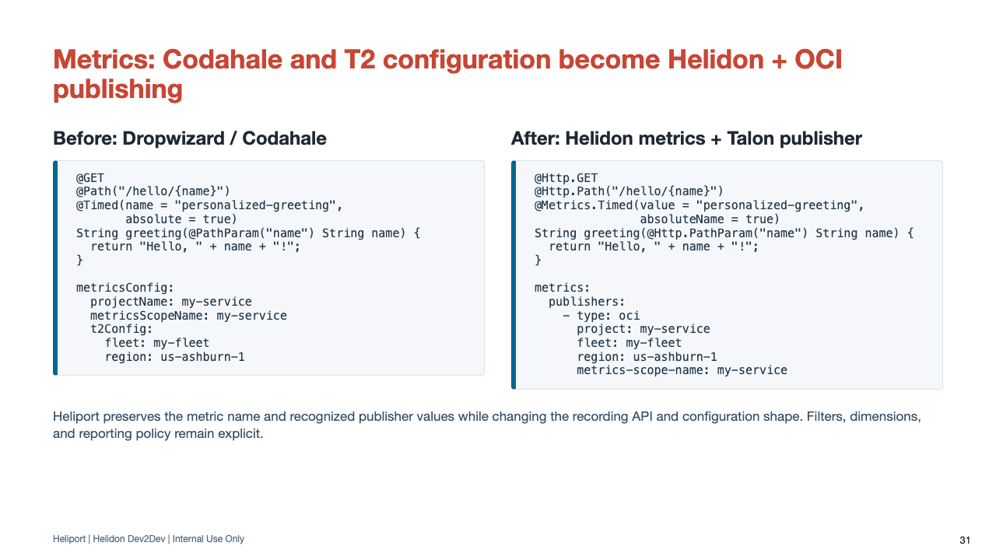
Notes:
The target code and configuration deliberately mirror the Talon RC2 Metrics example and publisher configuration.
Heliport can rewrite safe Codahale @Timed, @Metered, @Gauge, monotonic @Counted, and common MetricRegistry operations, then add the Helidon metrics API dependency when required.
Recognized legacy T2 and metricsConfig keys map to metrics.publishers entries, including endpoint, project, fleet, region, scope name, include/exclude filters, and detailed timing settings.
This example has no explicit sample interval, so the target omits it and Talon's default applies.
Non-equivalent Counted behavior, custom reporters, trust-store behavior without a Talon equivalent, metric naming, dimensions, and retention or fleet policy remain explicit service-team decisions.

Slide 32
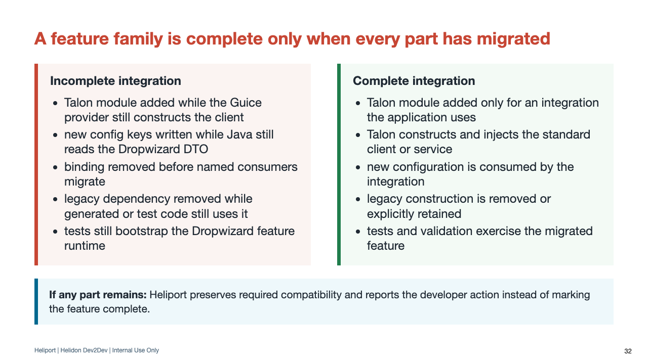
Notes:
This is the completion rule Heliport applies: the target integration is active, and legacy construction is either removed or explicitly retained for compatibility.
A green compile is not enough if the application can still run through the legacy provider or test harness.

Slide 33
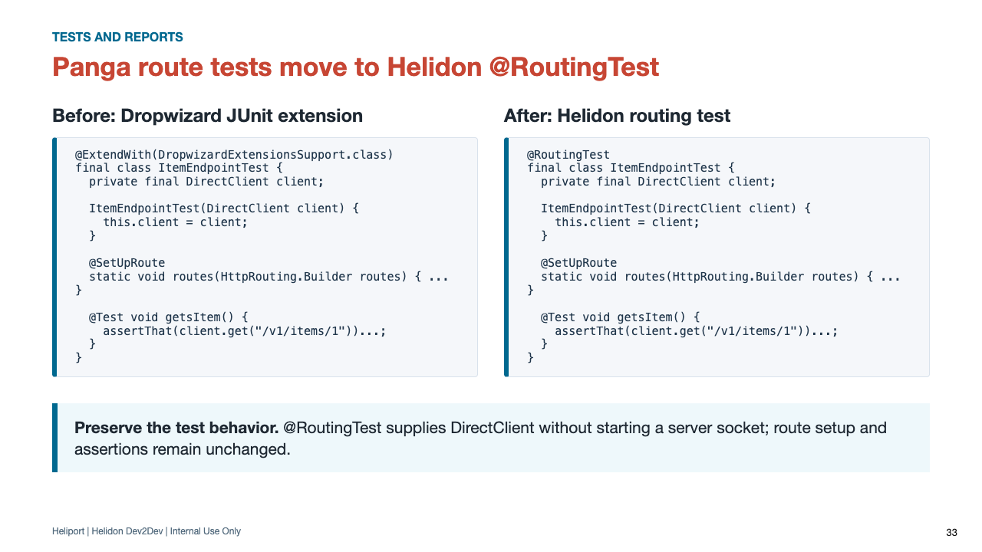
Notes:
Heliport replaces the obsolete Dropwizard JUnit extension with Helidon @RoutingTest.
The @SetUpRoute method, DirectClient constructor injection, request path, and behavioral assertions remain unchanged. @RoutingTest exercises the route without opening a server socket.

Slide 34
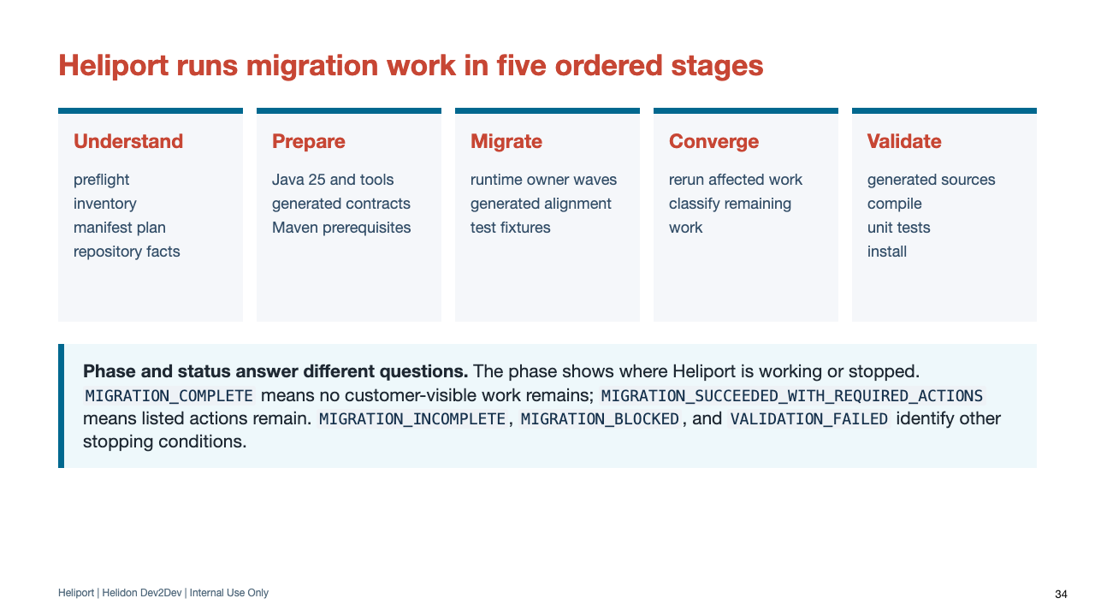
Notes:
The full 13-phase sequence is in the appendix. For the main talk, teach the five jobs: understand, prepare, migrate, converge, and validate.
A phase tells you where Heliport is working or stopped. The final status tells you the outcome and whether the report contains required actions or continuation instructions.
A phase completes only when its assigned work is migrated, intentionally retained for compatibility, or reported as a remaining action. --resume continues from the saved .heliport state.

Slide 35
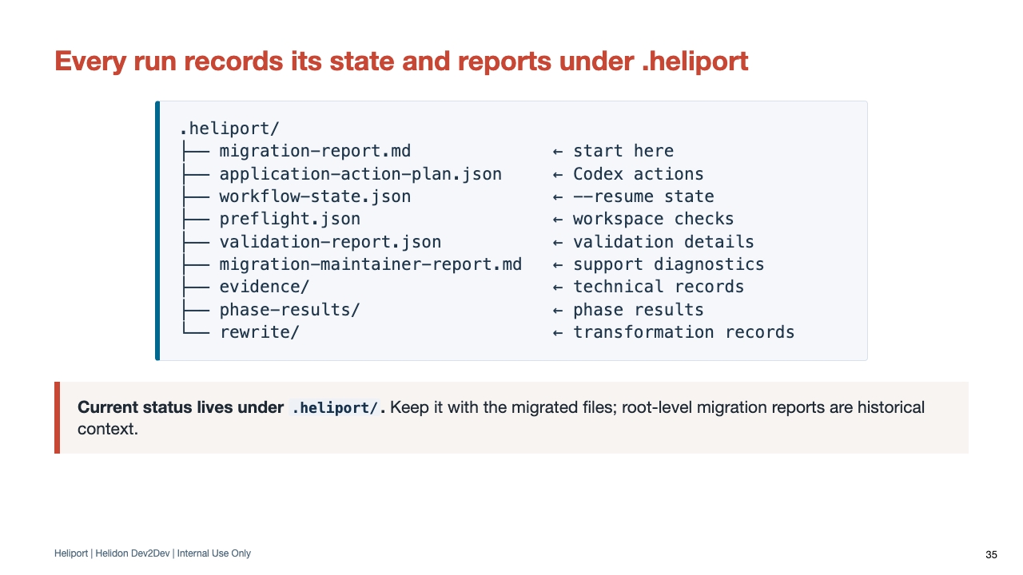
Notes:
Application teams start with migration-report.md and are not expected to interpret the JSON manually. The other files support Codex continuation and Heliport diagnosis.
Before sharing .heliport, follow normal source and log handling policy. Diagnostic files can contain source paths, coordinates, repository names, build output, and environment details; they must not contain credentials or private keys.

Slide 36
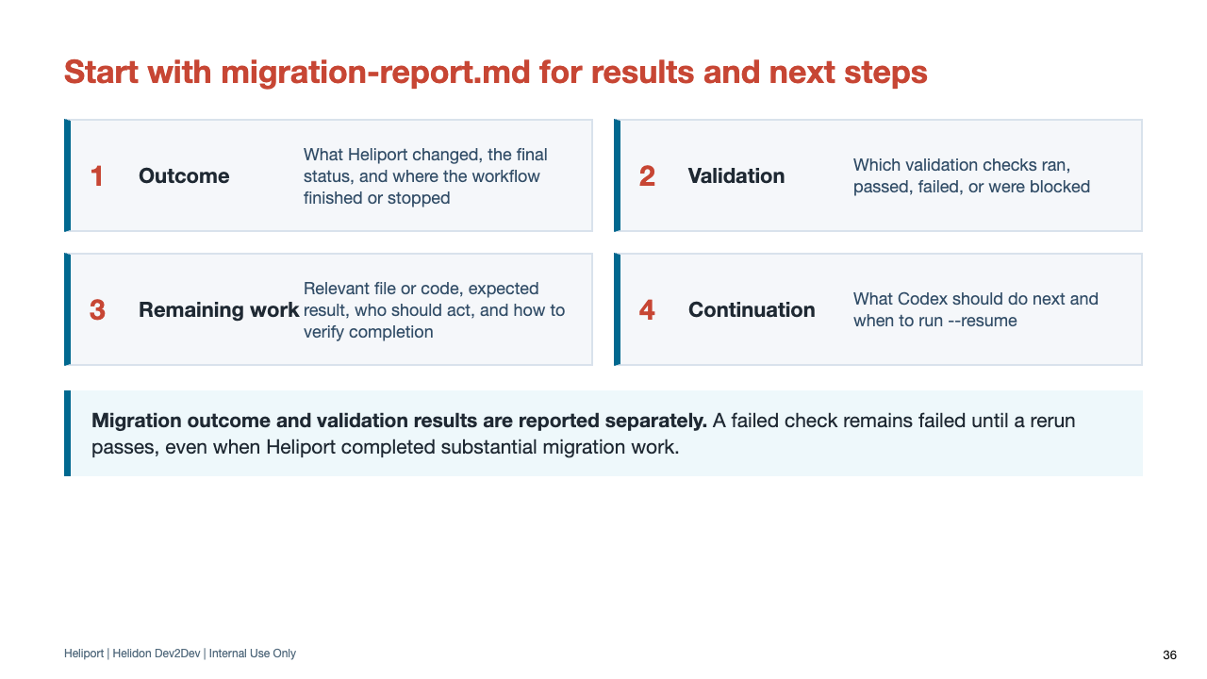
Notes:
Do not reduce the report to complete versus failed. It separates migration outcome from final validation and gives a continuation brief.
The report should be sufficient for the application team. Ask for deeper phase JSON only when Codex or a Heliport maintainer needs it.

Slide 37
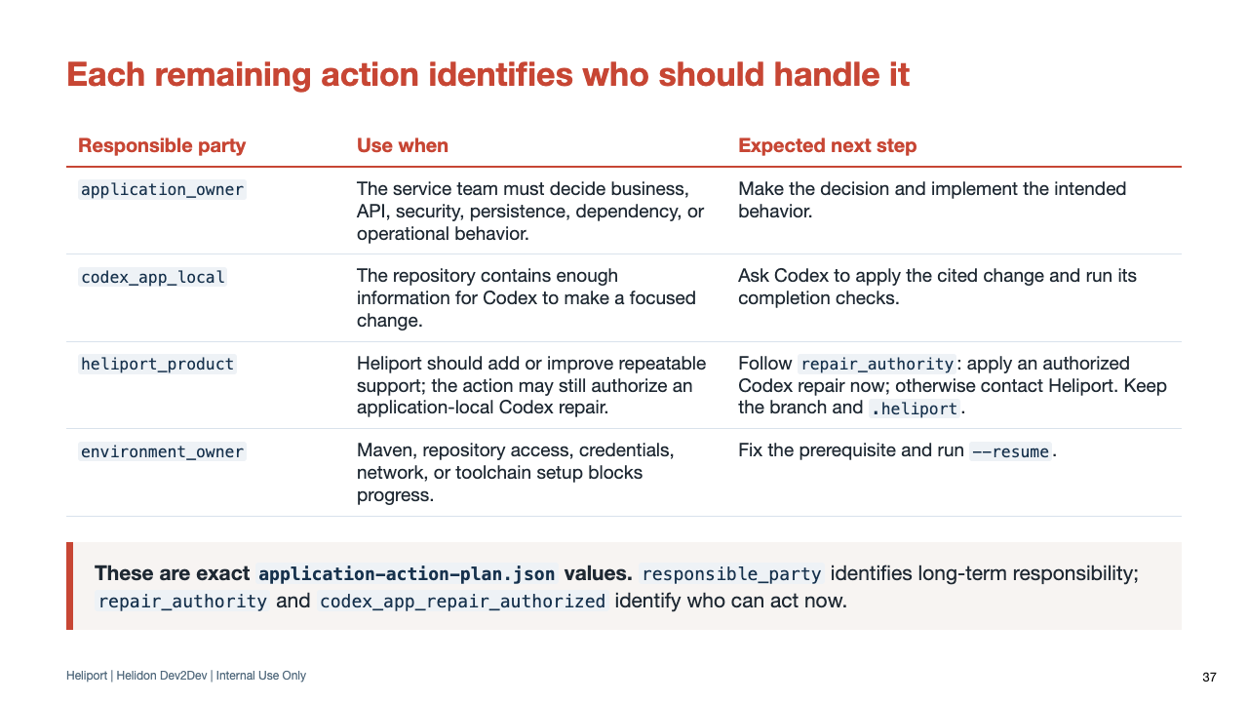
Notes:
The responsible-party label is exact application-action-plan.json vocabulary. It identifies long-term responsibility, while repair_authority identifies the immediate actor.
A heliport_product action can be a Heliport enhancement candidate with codex_app_repair_authorized set to true. In that case, the customer can ask Codex to apply the evidence-backed application repair now, retain the enhancement evidence, and resume Heliport.
When local_repair_disposition is no-safe-local-repair-proven, the customer should not improvise a workaround. Share the branch and .heliport with Heliport maintainers or use an updated Heliport version that resolves the gap.

Slide 38
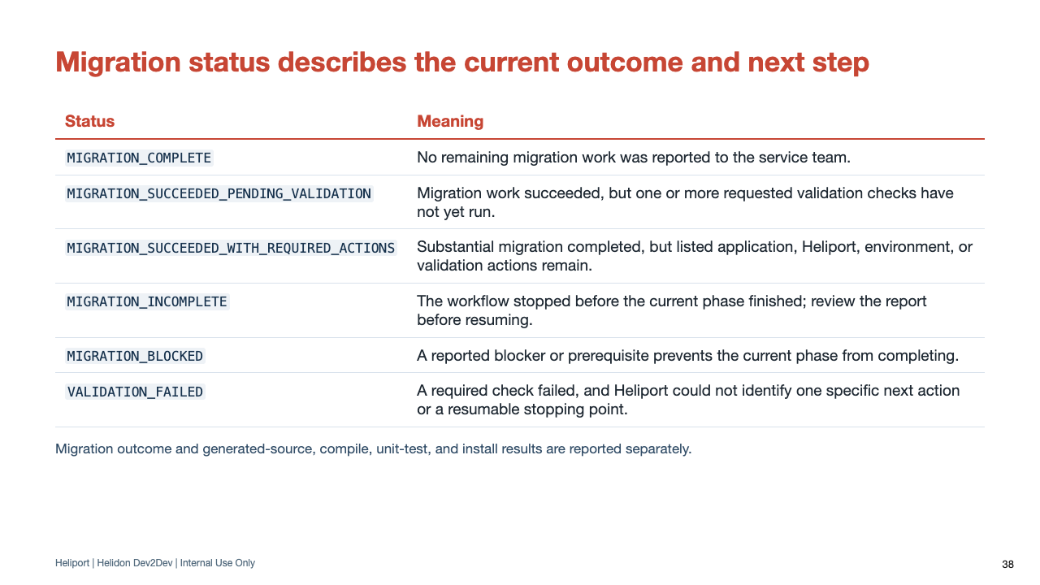
Notes:
Status describes the current migration outcome and next step; it should not be reduced to a simple pass or fail.
MIGRATION_SUCCEEDED_PENDING_VALIDATION means requested proof gates have not all run, so final validation is not yet determined.
Generated-source, compile, unit-test, and install checks retain their actual results and are reported separately from migration outcome.

Slide 39
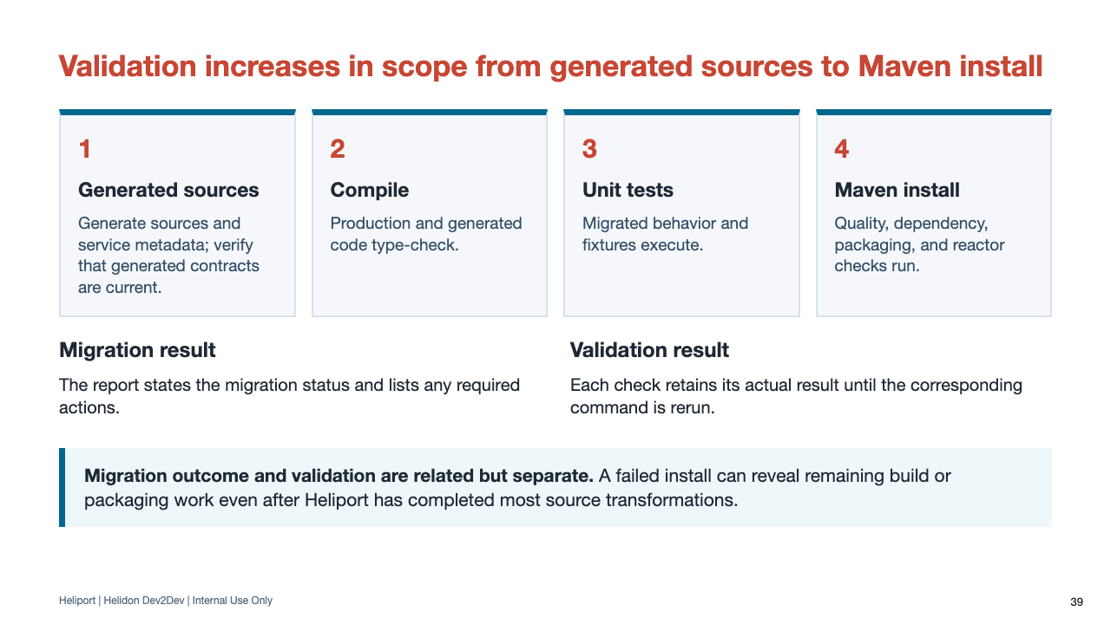
Notes:
Current Heliport reporting can represent substantial success with required actions. Avoid teaching a single pass/fail interpretation.
Install runs last so enforcer, dependency analysis, PMD, Checkstyle, SpotBugs, JaCoCo, and packaging remain visible rather than being skipped.

Slide 40
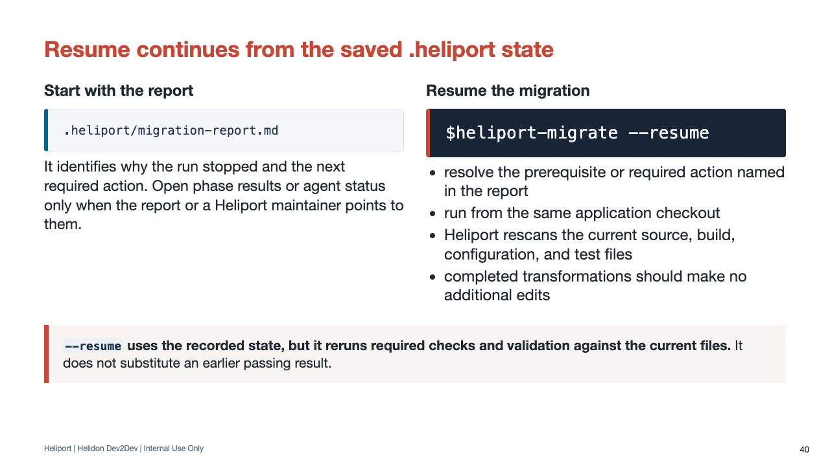
Notes:
Resume is the normal continuation mechanism. It is not only for crashes; it is also how teams continue after resolving application or environment work.
The report identifies the stopping phase and responsible party. Do not delete .heliport state unless a Heliport maintainer specifically asks for a clean restart.
Common blockers include the wrong workspace, dirty worktree, Java/toolchain gaps, an unwritable Maven cache, missing network/proxy settings, and Git metadata permissions.
The appendix expands the rerun contract: workflow state, current repository findings, repeatable transformations, and validation status must agree.

Slide 41
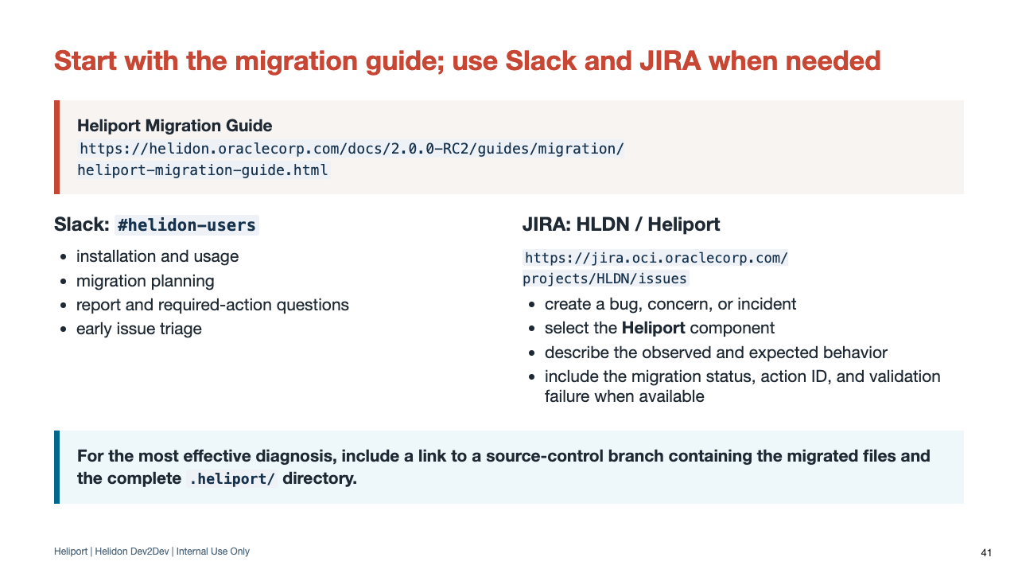
Notes:
Point customers to the Heliport Migration Guide first. Use #helidon-users for questions and early triage. Use the HLDN JIRA project for bugs, concerns, and incidents, and always select the Heliport component.
Ask the reporter for a source-control reference to a branch containing both the migrated files and .heliport. That gives maintainers the application state, report, actions, phase results, and diagnostic details needed to reproduce the issue.
The branch must follow normal access controls and secret-handling policy. Credentials, private keys, tokens, and unrelated sensitive configuration must never be committed for support.

Slide 42
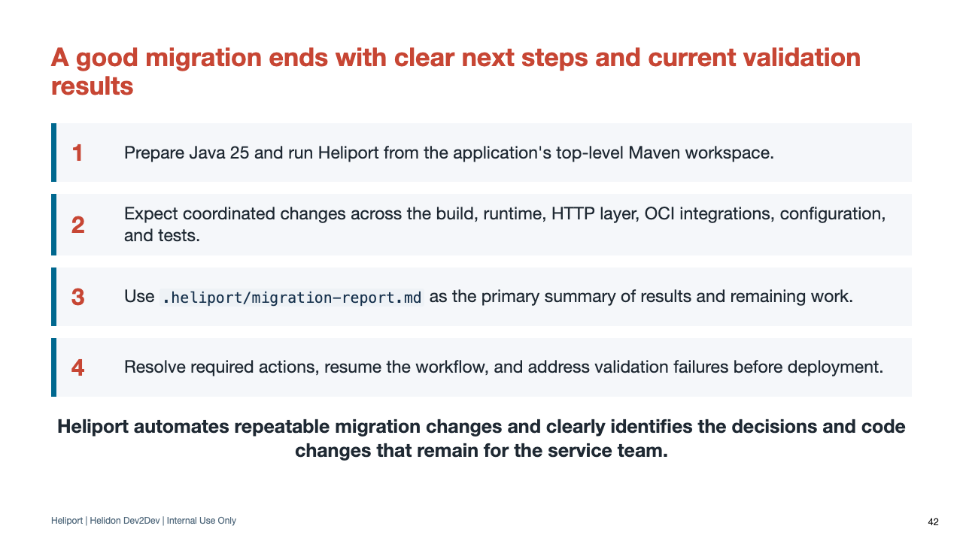
Notes:
Close by returning to runtime responsibility. Heliport automates repeated transformations, but a trustworthy migration keeps service policy and unsupported behavior visible.
Invite questions around a specific migration family, report action, or planned service.

Slide 43
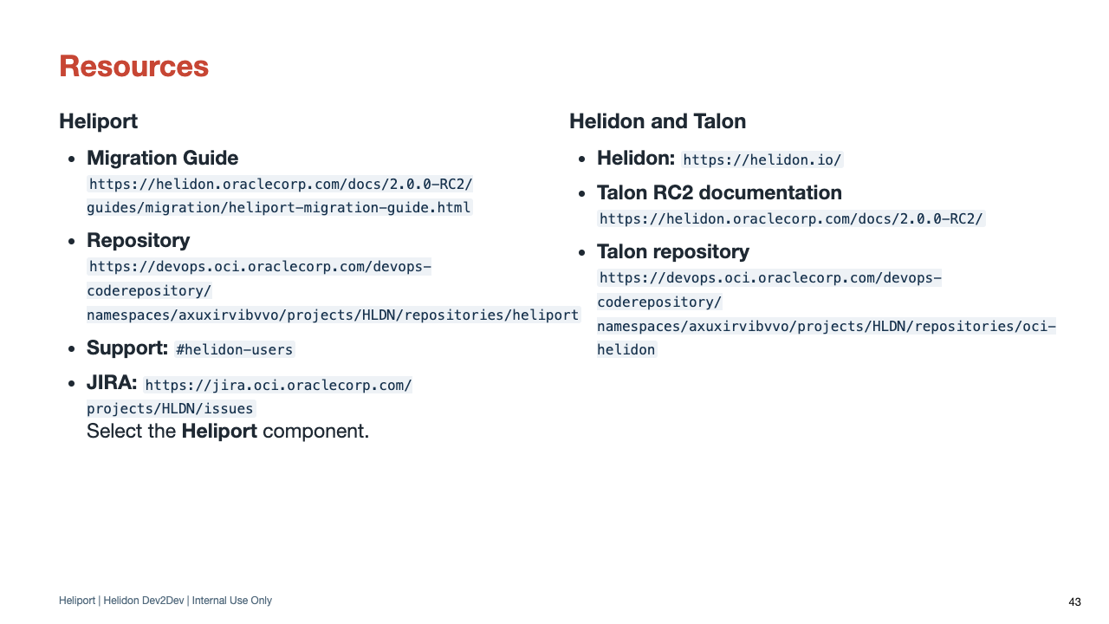
Notes:
This slide mirrors the Talon RC2 resources close and gives developers the exact documentation, repositories, and support paths used by both presentations.
Lead with the Heliport Migration Guide. Use #helidon-users for Heliport installation, migration, and report questions. The Talon repository and RC2 documentation remain the detailed reference for migrated OCI integrations.

Slide 44
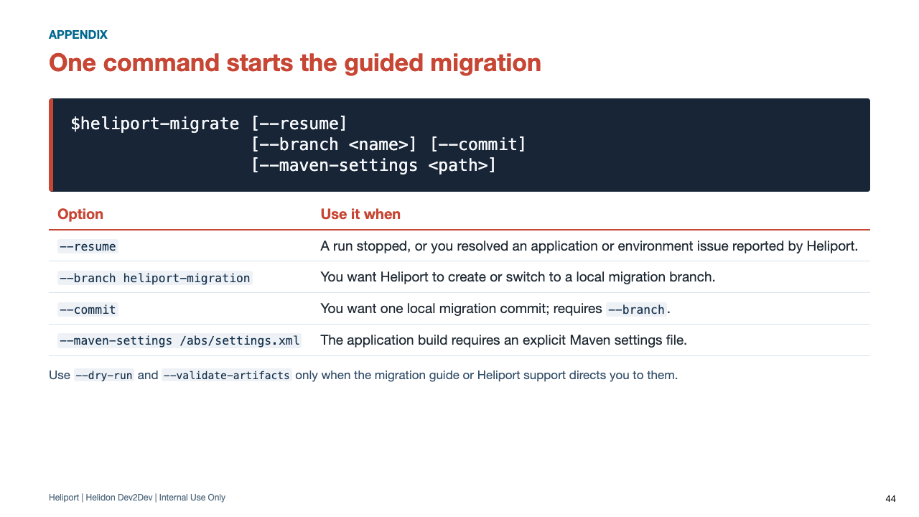
Notes:
This is an appendix reference for command options. The core presentation shows the basic invocation on the Codex workspace slide.
Repeat that --commit is local and Heliport never pushes.

Slide 45
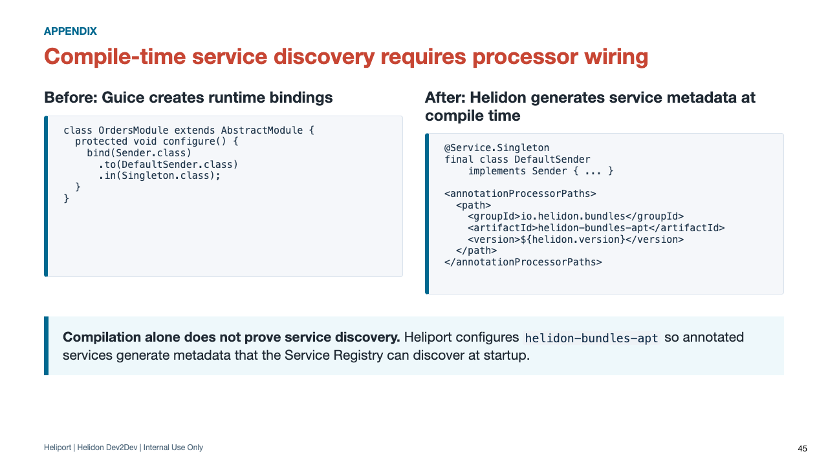
Notes:
Heliport treats compiler-plugin migration as runtime wiring, not build cleanup.
The canonical processor bundle is io.helidon.bundles:helidon-bundles-apt at the Helidon version.
Heliport checks Maven configuration twice: an early pass makes source transformations parseable, and a final pass sees the actual dependencies after runtime and test migration.

Slide 46
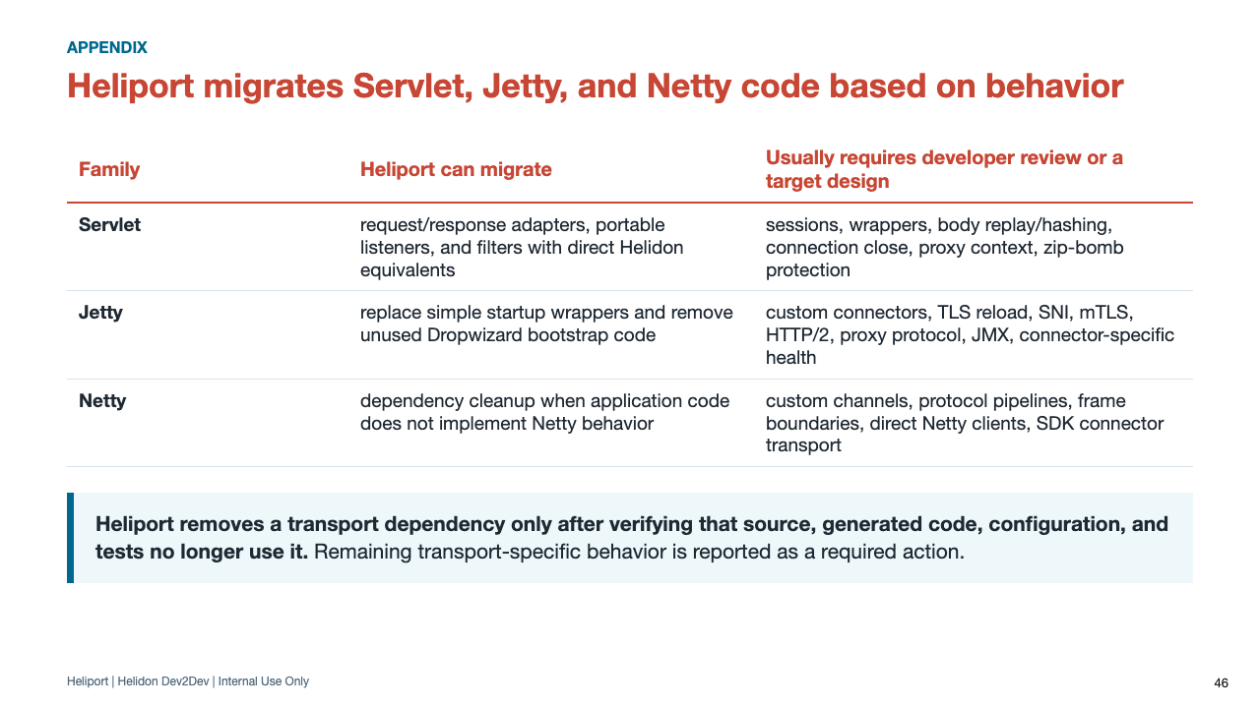
Notes:
This slide should reduce anxiety around hard runtime integrations. Heliport does not promise that every container-specific customization has a generic Helidon equivalent.
An unused Netty dependency and an application-defined protocol pipeline are different migration problems and receive different results.

Slide 47
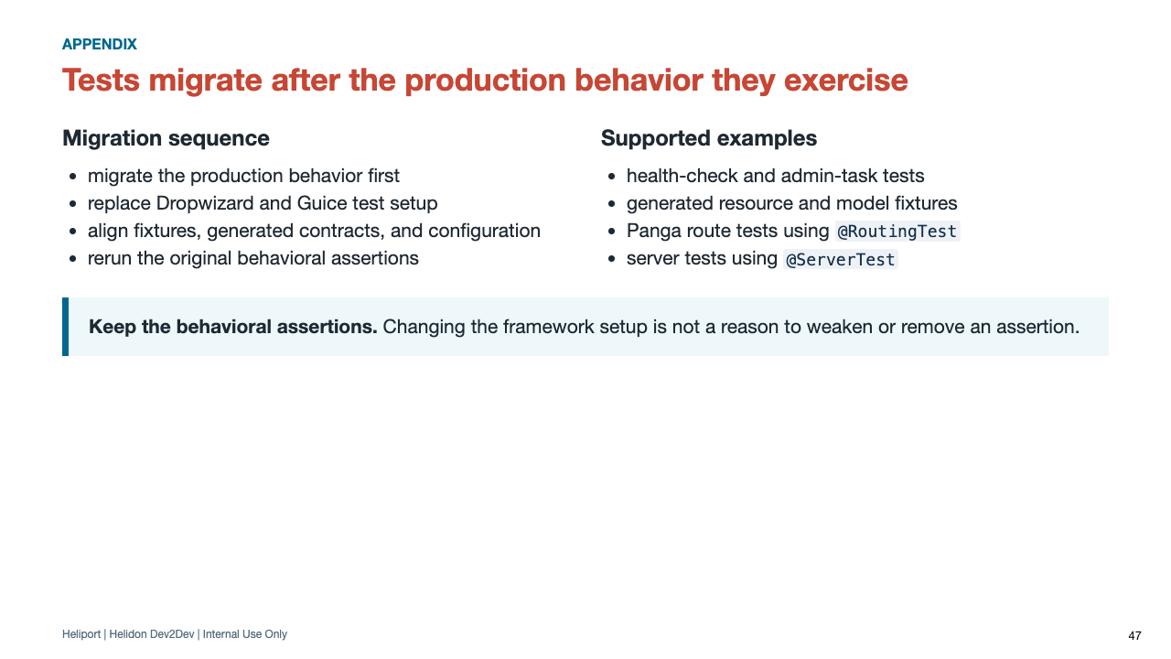
Notes:
Production behavior migrates before its tests so the target endpoint, health check, task, generated contract, or service wiring is known before Heliport changes the test harness.
The main Panga example shows the supported route-test migration in detail. Use this appendix slide to emphasize migration order and preservation of behavioral assertions.

Slide 48
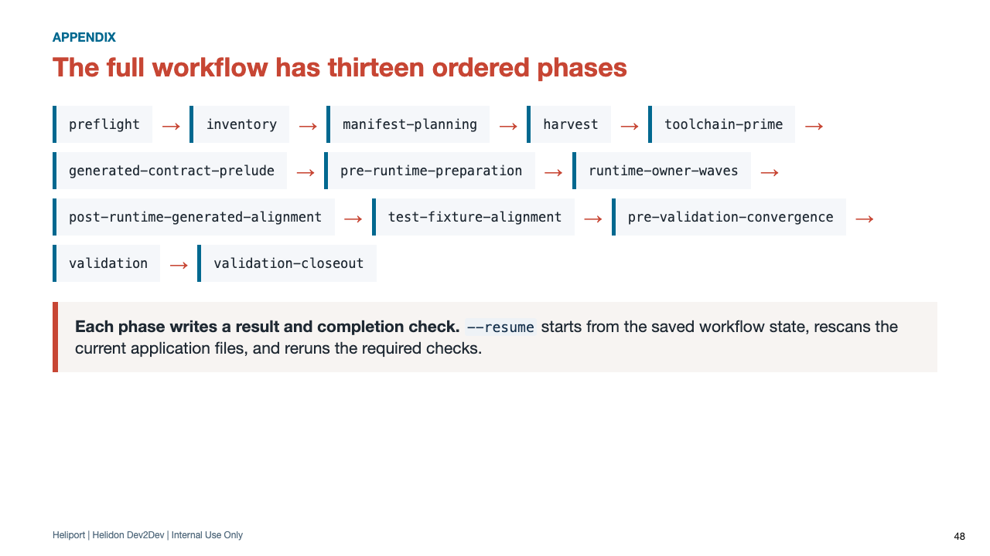
Notes:
Use this when someone asks where a reported phase sits in the overall workflow.

Slide 49
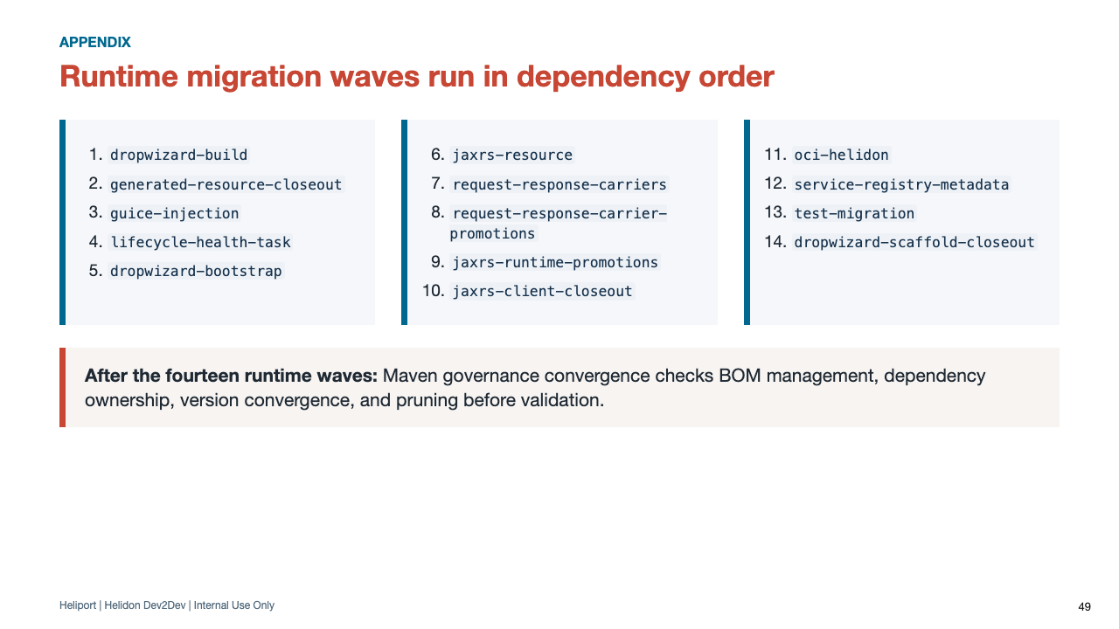
Notes:
Runtime owner wave is Heliport's report term for a related group of framework transformations and their completion checks.
Not every wave changes every service. Heliport selects applicable work from the migration manifest, then preserves this dependency order so later transformations do not invalidate earlier prerequisites.

Slide 50
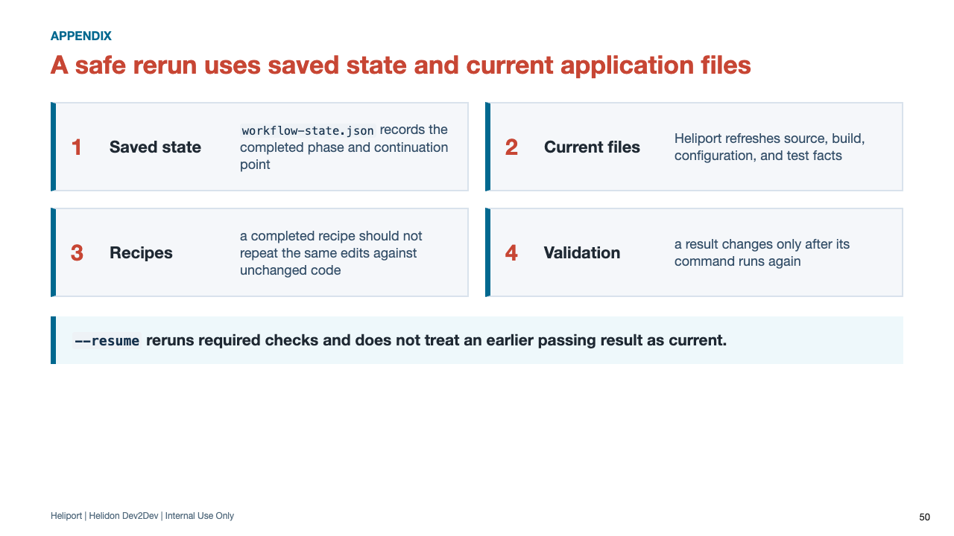
Notes:
Idempotence is useful Heliport vocabulary here: it means rerunning a completed recipe against unchanged migrated code should not produce the same edits again.
A prior passing validation is not silently reused after relevant source changes; final status follows the current rerun results.

Slide 51

Notes:
Use this as a checklist when a team asks whether Heliport will fully automate a particular service. The slide defines owner frontier because that exact term can appear in Heliport diagnostics.

Slide 52

Notes:
Keep this slide available during Q&A. The main Resources slide contains the full repository URLs.

