Slide 1

Deep Learning

Slide 2
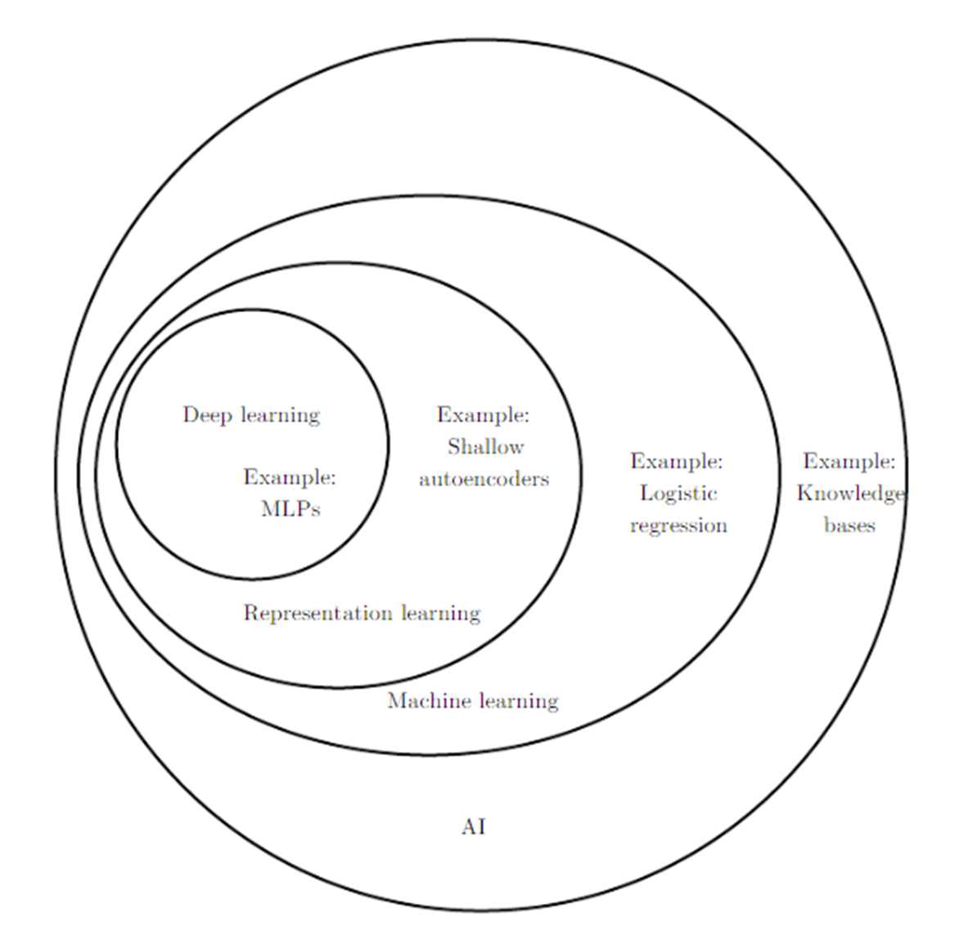
ML Vs. DL Vs. AI

Slide 3
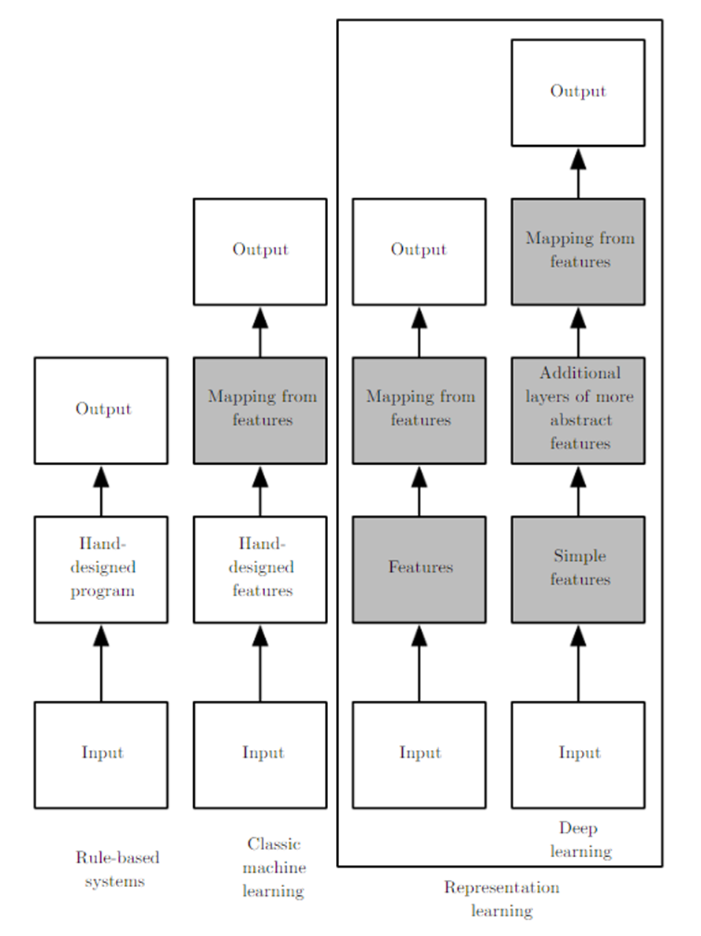
ML Vs. DL Vs. AI

Slide 4
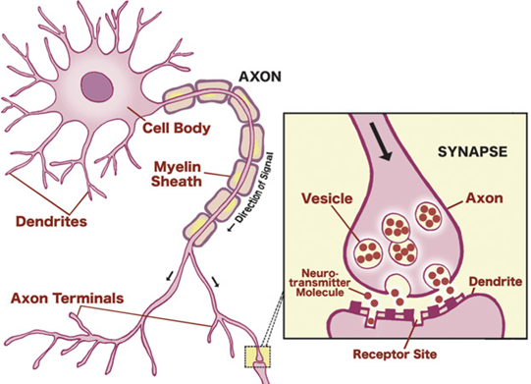
Brain - Neurons – Synapses

Slide 5
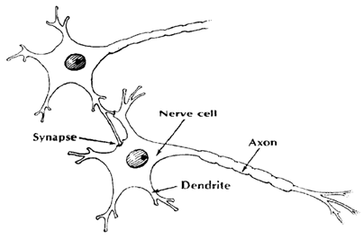
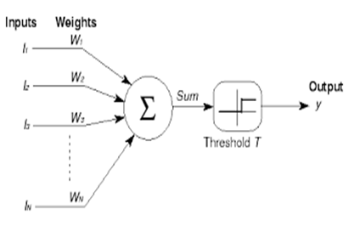
Biological Vs. Mathematical Model
Biological Network | Mathematical Model
Dendrites | Inputs
Synaptic weights | Weights
Nucleus (Nerve Cell) | Adder and Threshold
Axon | Output(s)

Slide 6
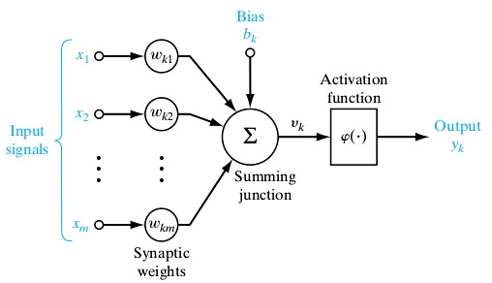
Neuron - McCulloch and Pitts’
Bias
Binary Threshold Device
Limitation – Too simple; Linearity; Single pulse; No Feedback.

Slide 7
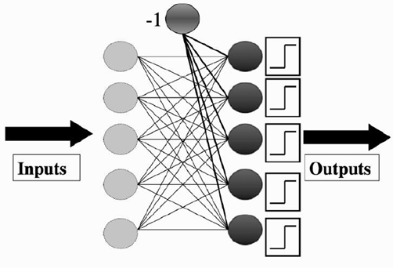
Neural Network - Perceptron
Collection of McCulloch and Pitts neurons
Learning happens in the synapse – weights.

Slide 8

Perceptron Network - Learning
Error: Target - Predicted.
Learning rate (η) – Moderate (0.1 to 0.4)

Slide 9
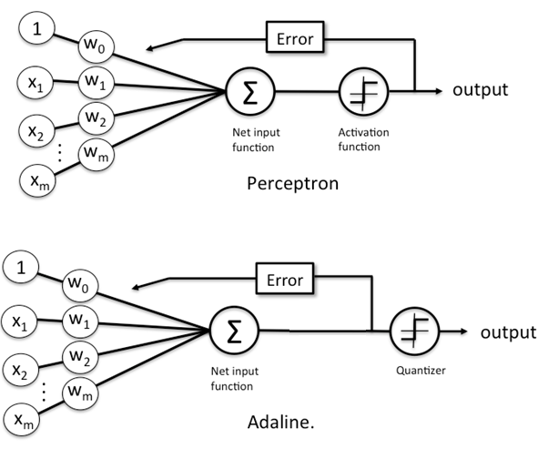
Perceptron Vs. Adaptive Linear Neurons
Adaline – SSE as the error. Uses Gradient Descent.

Slide 10
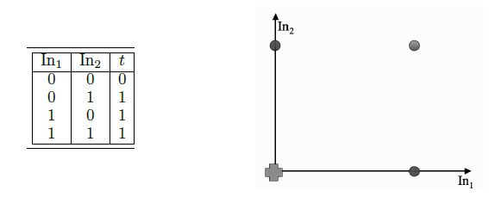
Perceptron Network Application – OR
perceptron_or.py

Slide 11
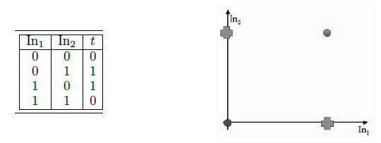
Perceptron Network Application – XOR
perceptron_xor.py

Slide 12

Perceptron Network – Non-Linearity Issue
Perceptron computes decision boundary such as line or hyperplane. Hence works for linearly separable case such as OR function.
Does not work in non-linearly separable case such as XOR function.

Slide 13
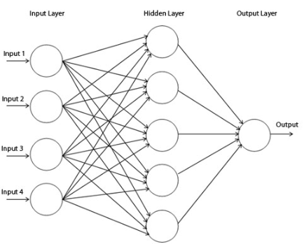
Multi-Layer Perceptron
http://playground.tensorflow.org

Slide 14

MLP
Going Forward -> Input to Hidden to Output Layers
Going Backwards -> Output to Hidden to Input layers and in the process updating the weights to reduce the error.
Gradient Descent Algorithm – Differentiation w.r.t weights

Slide 15
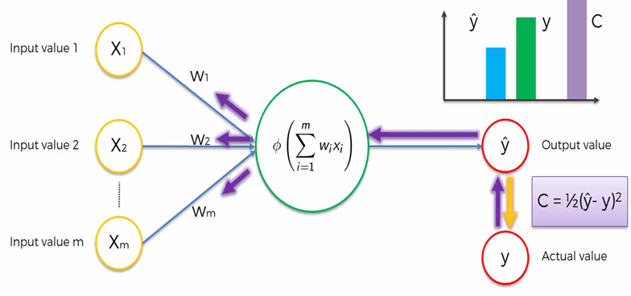
Back - Propagation

Slide 16
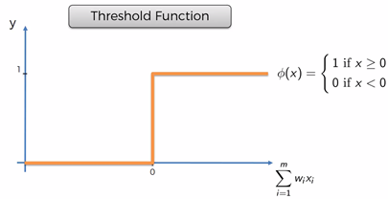
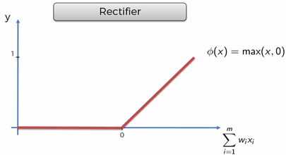
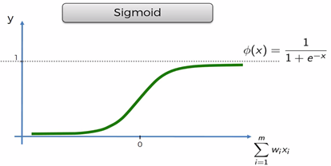
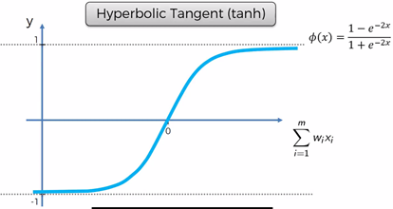
Activation Functions

Slide 17

MLP
Weight Initialization:
Suggestion: small random values
Guideline: −1/√n < w < 1/√n
Uniform learning
Glorot Initialization – Mean 0 and Variance = 1/n_in
Output Activation Function
Sigmoid: Binary Classification
Soft-max: Multi-nominal Classification (1-of-N encoding)

Slide 18
Local Minima & Global Minima
Like any optimization technique, gradient descent only guarantees local minima.
Solutions to find Global Minima:
Different starting points while training different network
Momentum
Adding a product of momentum constant (mostly around 0.9) and previous weight change.
Makes using smaller learning rate possible -> stable learning process.
Speed up training process
Stochastic Gradient Descent

Slide 19
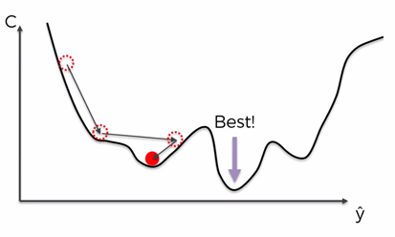
GD: Batch/Stochastic/Mini-batch
Batch – All records are considered for every iteration.
Faster
Local Minima
Computational expensive or not possible for big data
Stochastic: One record per iteration
Very Slow
Higher chances of global minima
Can handle big data
Mini-batch: Batch of records per iteration
Faster than Stochastic
Higher chances of global minima
Can handle big data

Slide 20
Implementation Steps
Select inputs and outputs for your problem
Normalize inputs
Split the data into training, testing, and validation sets
Select a network architecture – Number of hidden layers, neurons per layer
Train and evaluate a network
Test the network

Slide 21
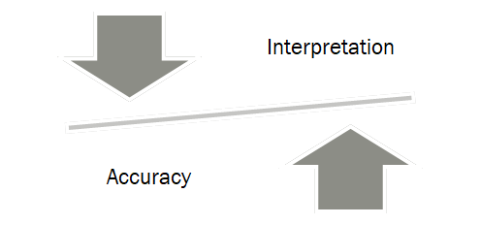
Weights Interpretation Vs. Accuracy
Without hidden layers, the interpretation is easier as the inputs link to the output variables directly.
With hidden layers, original variables are transformed which makes the interpretation difficult.

Slide 22
MLP – Practical Considerations
Amount of training data
With a, b, c number of nodes in input, hidden and output layer respectively, we end up with these many weights:
(a+1) * (b+1) * c
Guideline: Number of records >= 10 times the weight

Slide 23
MLP – Practical Considerations
Number of hidden layers and Number of neurons per layer
Guideline for layers:
Most of the time single layer is enough.
In fact adding more layers could be counter-productive (Prone to over-fitting).
Guideline for neurons:
At least equal to number of input nodes:
With low number on nodes, 2-3 times more
With large number of nodes, around 10-20% more

Slide 24
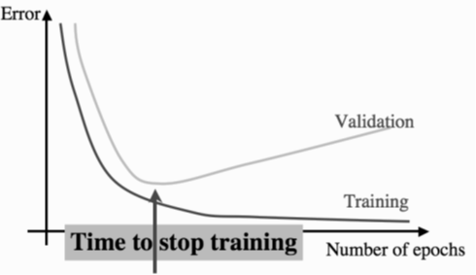
MLP – Practical Considerations
When to stop learning:
Setting number of iterations could lead to over-fit.
Setting the error rate might mean never ending iterations.
Balancing act: Validation/Cross-Validation: Stop when validation error increases.

Slide 25
Over-fitting
Regularization
L2 – Similar to Ridge regression. Adding the squared term of the weights with the regularization constant.
L1 – Similar to Lasso regression. Adding the absolute term of the weights with the regularization constant.
Dropout – Some percentage of neurons are disabled at each iteration.
Done only during training.

