Slide 1

Machine Learning Models for Salinity Stress Phenotyping of Rice.
Team Details
Shankar Prabhu S (4NM21IS148)
Sharan S Shetty (4NM21IS149)
Shashank B (4NM21IS152)
Shishir Wagle K (4NM21IS157)

Slide 2
Problem Statement
The problem revolves around the detrimental effects of soil salinity on rice plants, leading to the necessity of manually grading these plants in research laboratories to determine their condition. This manual grading process is labor-intensive and time-consuming. Hence, there is a need to find a more efficient and automated solution to assess the health and grade of rice plants affected by soil salinity, ultimately leading to improvements in crop yield.

Slide 3
Proposed Solution
Leveraging advanced machine learning techniques for precise classification of rice plants into five vulnerability categories to salinity stress during seedling stage.
Analyzing complex data patterns to accurately identify salinity stress levels in rice crops.
Incorporating a comparative analysis between traditional methods and a standardized evaluation system to ensure reliability and robustness of the classification approach.

Slide 4
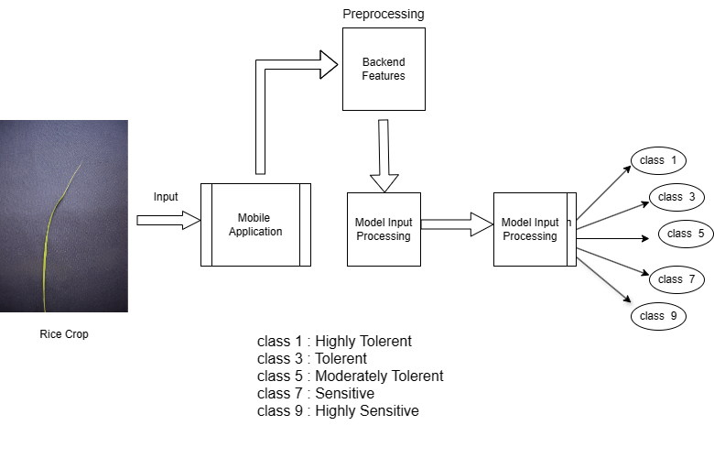
Figure 1: Proposed methodology.

Slide 5
Thank You

