Slide 1
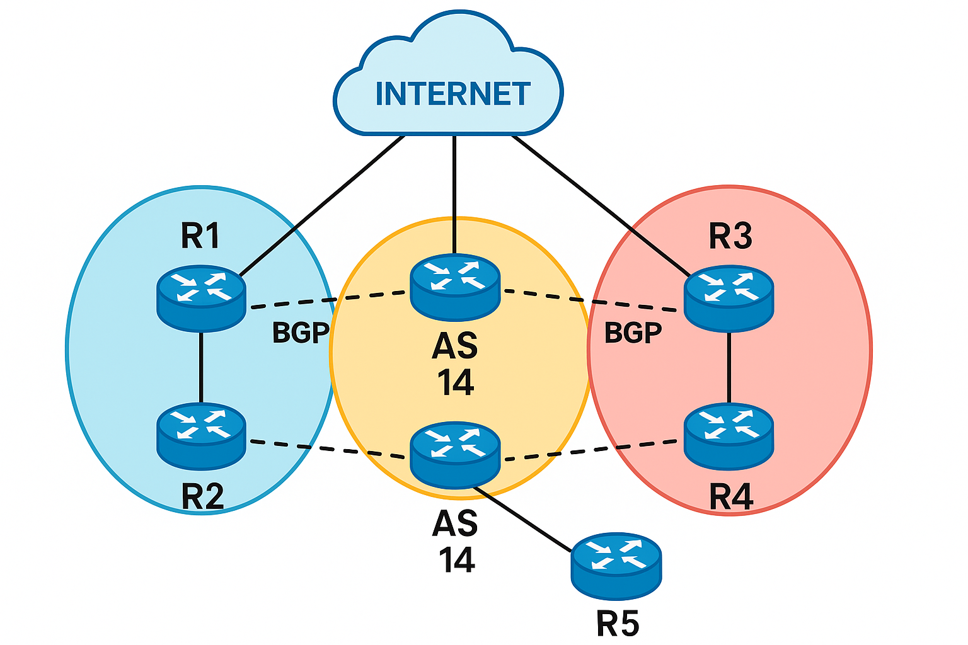

Slide 2
Introduction
BGP is an exterior gateway Path Vector routing protocol used for sharing routing information between different autonomous systems. (BGP is an inter-autonomous system routing protocol) -> current ver – BGPV4
It maintains a separate routing table based on shortest AS Path and various other attributes.
BGP works on TCP port no 179. ASNs 64512 through 65535 are private ASNs in the 16-bit range. ASNs 4.2B through 4,29,49,67,295 are private ASNs in the 32-bit range. BGP can form neighbour adjacencies. It can also form neighbour adjacencies with routers that multihop away. (sh ip bgp summary)
ASN is 16bit or 32 bit which is typically provided by service provider or IANA.
Full mesh in BGP means that every BGP router establishes a TCP session with every other BGP router, forming a complete set of peerings.”

Slide 3
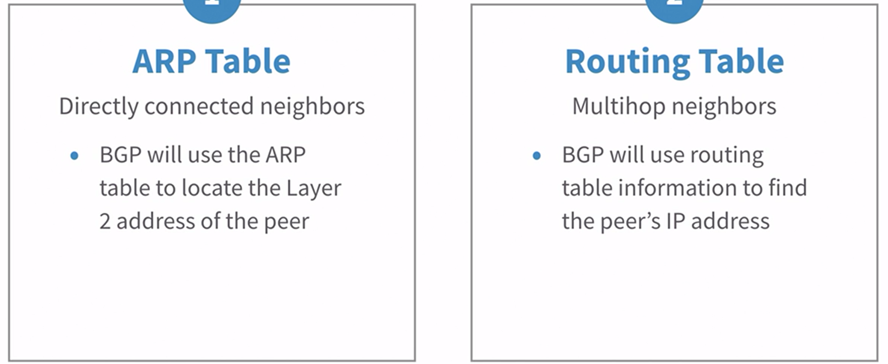

Slide 4
BGP PEER MESSAGES
BGP forms its peer relationships through a series of messages.
Open message is sent between peers to initiate the session. It contains: • BGP Version – must be the same between BGP peers • Local AS Number • BGP Router ID • Hold down timer
KEEPALIVE messages are sent periodically (every 60 seconds by default) to ensure that the remote peer is still available. If a router does not receive a KEEPALIVE from a peer for a Hold-time period (by default, 180 seconds), the router declares that peer dead.
UPDATE messages are used to exchange routes between peers. (NLRI)
Finally, NOTIFICATION messages are sent when there is a fatal error condition. If a NOTIFICATION message is sent, the BGP peer session is torn down and reset.

Slide 5
BGP PEER STATES
As a BGP peer session is forming, it will pass through several states. This process is known as the BGP Finite-State Machine (FSM):
Idle: administratively down or waiting for the next retry attempt.
Connect: BGP waits for a TCP connection with the remote peer. If successful, an open message is sent. If unsuccessful, the session is place in an active state. (goes active only if – routing issue, tcp port 179 is blocked, and ACL must Blocking the traffic)
Active – BGP attempts to initiate a TCP connection with the remote peer. If successful, an OPEN message is sent. If unsuccessful, BGP will wait for a ConnectRetry timer to expire, and place the session back in a Connect State
OpenSent – BGP has both established the TCP connection and sent an OPEN Message, and is awaiting a reply OPEN Message. Once it receives a reply OPEN Message, the BGP peer will send a KEEPALIVE message. (BGP compares the content of OPEN messages) (bgp ver, source ip address must match that is configured for the router, as, RID)
OpenConfirm – If all of the opensent is goes well then it will move to openconfirm state. In openconfirm state, BGP waits for a keepalive or a notification message.
Established – the BGP peer session is fully established. UPDATE messages containing routing information will now be sent.
(sh tcp brief - to check bgp state of the router)
When a BGP speaker is in the Idle or Active state, it is not yet ready to accept or fully establish BGP sessions. In the Active state, BGP actively tries to initiate a TCP connection (port 179) to its peer but may not accept incoming TCP connections from the peer (depending on timing or configuration).

Slide 6
BGP PEER STATES
As a BGP peer session is forming, it will pass through several states. This process is known as the BGP Finite-State Machine (FSM):
Idle:
In this state BGP refuses all incoming BGP connections. No resources are allocated to the BGP neighbor. In response to the Start event (initiated by either system or operator) the local system initializes all BGP resources and changes its state to BGP_Active. BGP waits for a start event (such as configuration of a neighbor).
→ It initializes resources, such as TCB (TCP Control Block).
→ It starts the ConnectRetryTimer.
→ But it does not yet send a TCP SYN or accept incoming TCP connections.
ii. Connect: BGP waits for a TCP connection with the remote peer. If successful, an open message is sent. If unsuccessful, the session is place in an active state. (goes active only if – routing issue, tcp port 179 is blocked, and ACL must Blocking the traffic)
Active – BGP attempts to initiate a TCP connection with the remote peer. If successful, an OPEN message is sent. If unsuccessful, BGP will wait for a ConnectRetry timer to expire, and place the session back in a Connect State
OpenSent – BGP has both established the TCP connection and sent an OPEN Message, and is awaiting a reply OPEN Message. Once it receives a reply OPEN Message, the BGP peer will send a KEEPALIVE message. (BGP compares the content of OPEN messages) (bgp ver, source ip address must match that is configured for the router, as, RID)
OpenConfirm – If all of the opensent is goes well then it will move to openconfirm state. In openconfirm state, BGP waits for a keepalive or a notification message.
Established – the BGP peer session is fully established. UPDATE messages containing routing information will now be sent.
(sh tcp brief - to check bgp state of the router)

Slide 7
When do you use BGP??
Multi-Homed Internet Connections (Dual/Multiple ISPs)
Scenario: Your company connects to two or more ISPs for redundancy and load balancing.
Why BGP?
Allows failover if one ISP fails.
Enables traffic engineering (e.g., prefer ISP-A for outbound, ISP-B for inbound).
Advertises your public IP space (PI/PA addresses) to the Internet.
2. Internet Exchange (IXP) & Peering
Scenario: Your company/ISP connects to an Internet Exchange Point (IXP) to peer with other networks (e.g., Google, Netflix, Cloudflare).
Why BGP?
Reduces latency by directly exchanging traffic (instead of routing through an ISP).
Lowers bandwidth costs (settlement-free peering).
3. Large Enterprise Networks with Multiple Data Centers
Scenario: A global company has multiple data centers (DCs) in different regions (e.g., AWS, Azure, on-prem).
Why BGP?
Ensures optimal routing between DCs.
Supports SD-WAN and hybrid cloud setups.
Used with MPLS for WAN routing.
4. Cloud & Hybrid Cloud Networking (AWS, Azure, GCP)
Scenario: Connecting your on-prem network to AWS (Direct Connect), Azure (ExpressRoute), or Google Cloud.
Why BGP?
Dynamically advertises on-prem routes to the cloud.
Allows VPN failover (e.g., backup connection via IPSec if Direct Connect fails).

Slide 8
When do you use BGP??
5. ISP & Carrier Networks
Scenario: ISPs use BGP to route traffic between their own network and other ISPs.
Why BGP?
The only protocol that scales for the entire Internet.
Supports traffic engineering (e.g., preferring certain paths). 6. Anycast Routing (Global Load Balancing)
Scenario: Services like DNS (Cloudflare, Google DNS 8.8.8.8) or CDNs use Anycast (same IP in multiple locations).
Why BGP?
Advertises the same IP prefix from multiple locations.
Users connect to the nearest server automatically.

Slide 9
BGP PEERS??
There are two types of BGP neighbor relationships: • iBGP Peers – BGP neighbors within the same autonomous system. • eBGP Peers – BGP neighbors connecting separate autonomous systems
By default, BGP assumes that eBGP peers are a maximum of one hop away.
The administrative distance of routes learn from egbp peer (outside the autonomous system) is 20, while the AD for the ibgp and locally-originated routes is 200.

Slide 10
BGP ATTRIBUTES
Each BGP route (prefix) is associated with attributes. These attributes help routers choose the best path when multiple routes are available.
🟩 Well-known Mandatory Attributes mut be recognized by all bgp implementation must be included in every update message that contains NLRIs.
ORIGIN – Describes where the route originated (IGP, EGP, or Incomplete).
AS_PATH – Lists all AS numbers a route has passed through.
NEXT_HOP – IP address of the next router to reach the destination.
🟨 Well-known Discretionary Attributes
Recognized by all BGP routers, but not mandatory.
LOCAL_PREF (Local Preference) – Used within an AS to prefer one path over another.
ATOMIC_AGGREGATE – Informs that some information was lost during route aggregation.
🟧 Optional Transitive Attributes
Optional, but if a router doesn't recognize them, it still forwards them to other BGP peers.
AGGREGATOR – Purpose: Identifies the router and AS that created the aggregated route Use Case: When multiple routes are summarized into one, this attribute stores info about the origin of the summary
COMMUNITY – Allows tagging routes for easier filtering and control. Purpose: Used to tag routes with extra information for grouping, filtering, or policy control. Use Case: You might tag routes with a community value like no-export, local-AS, or custom value like 65000:100 to control routing behaviour within and across Ases.

Slide 11
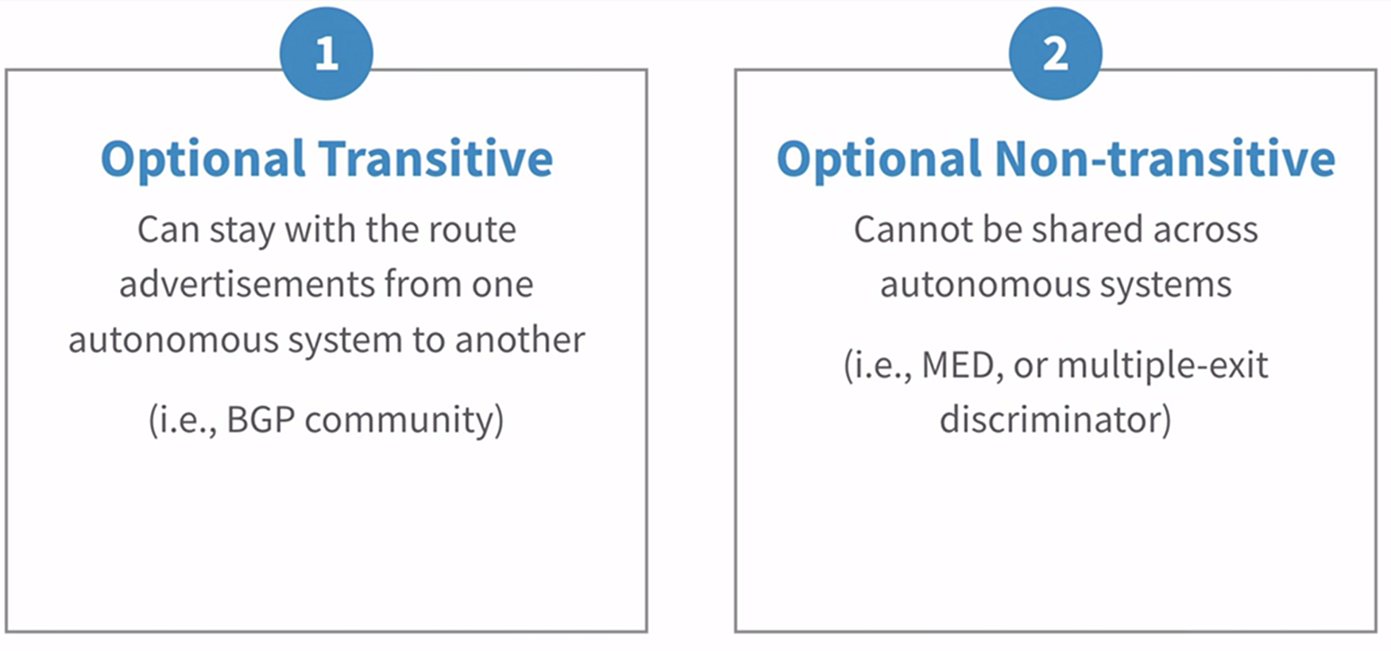

Slide 12
BGP ATTRIBUTES
🟥 Optional Non-Transitive Attributes
Optional and not passed to other BGP peers if not understood.
MULTI_EXIT_DISC (MED) – Suggests the preferred path into an AS when multiple links exist.
ORIGINATOR_ID – Identifies the originator of a route in BGP Route Reflector environments.
CLUSTER_LIST – Used in BGP Route Reflectors to prevent routing loops.
🔵 Additional Modern Attributes (Extended Features)
These may not be part of the core BGP-4 spec but are widely used in modern networks:
BGP Confederation Attributes – For internal AS structuring.
Extended Communities – Allow more tagging options.
AIGP (Accumulated IGP Metric) – Helps with IGP-based path selection.
BGP-LS (Link-State) – Used in SDN and IGP interworking.
BGPsec_PATH – Security extension (cryptographically signed AS_PATH).

Slide 13
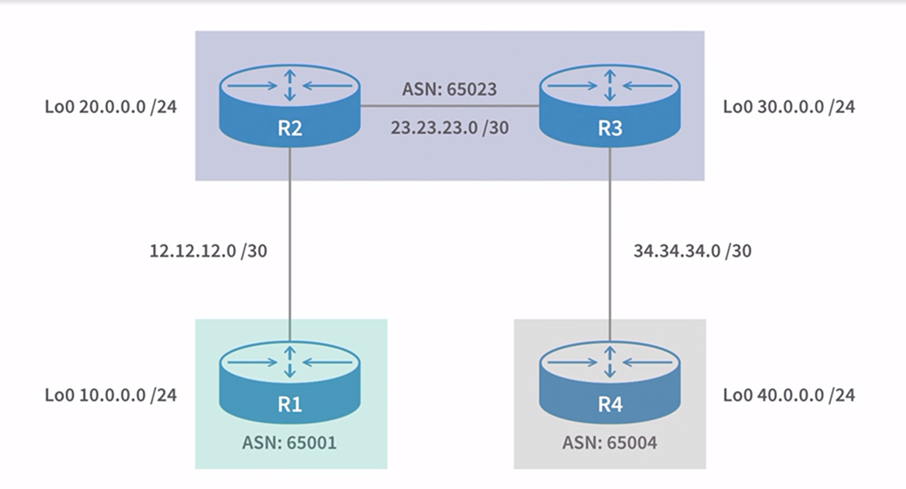
IPV4:

Slide 14
commands
router bgp <as-no> neighbor <neighbor-ip-address> remote-as <neighbor asn> network <network-address> mask <subnet-mask> BGP network statement don’t identify network, instead identify the specific network installed into the routing table. redistribute network to other routers: redistribute <sub-command> configure router id: bgp router-id <router-id>

Slide 15

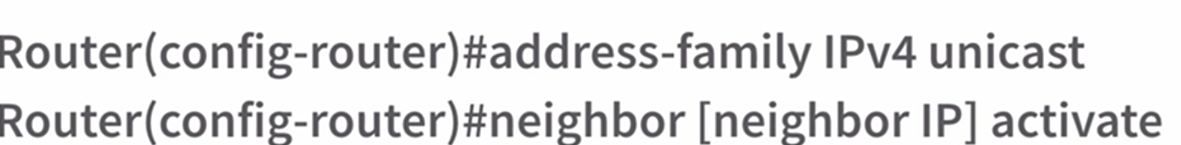
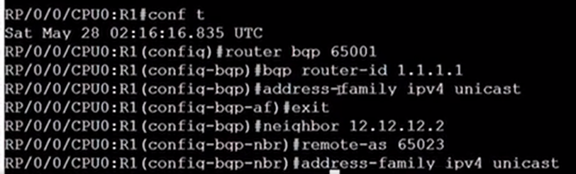
🔍 Purpose and Use: Modern BGP implementations support multiple address families—not just IPv4. This includes IPv6, VPNv4, multicast, etc. The command tells the router: “I want to configure BGP for sending and receiving IPv4 unicast routes.” IOS XR CONFIG:
Router differen ios: ios, ios xe, ios xr, nx-os

Slide 16
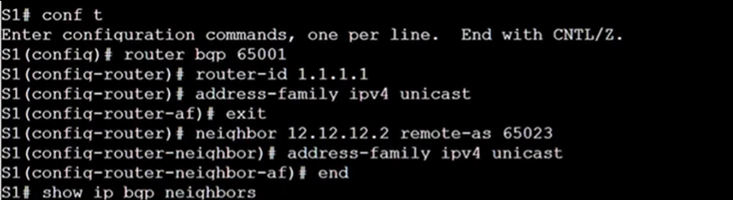
IOS NX-OS

Slide 17
AS PATH
AS_PATH is a well-known mandatory attribute. This attribute identifies the autonomous systems through which routing information carried in this UPDATE message has passed. The components of this list can be AS_SETS or AS_SEQUENCES.
When a BGP speaker propagates a route, it learned from another BGP speaker's UPDATE message, it modifies the route's AS_PATH attribute based on the location of the BGP speaker to which the route will be sent:
a) When a given BGP speaker advertises the route to an internal peer, the advertising speaker SHALL NOT modify the AS_PATH attribute associated with the route.
b) When a given BGP speaker advertises the route to an external peer, the advertising speaker updates the AS_PATH attribute as follows: Simply understand, when a router advertises routes to an iBGP peer (within the same autonomous system), it advertises the routes learned from eBGP with the same next-hop IP address. This creates a problem because other iBGP peers might not have reachability to that next hop.
Solution advertise IBGP learned networks: R2 - network 12.12.12.0 mask 255.255.255.0 (route redistribution) R3 – network 34.34.34.0 mask 255.255.255.0 or R2 - neighbor 23.23.23.3 next-hop-self (next-hop-self feature) R3 - neighbor 23.23.23.3 next-hop-self

Slide 18
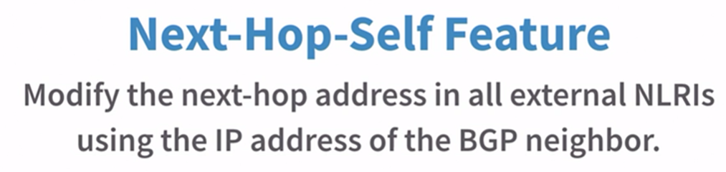
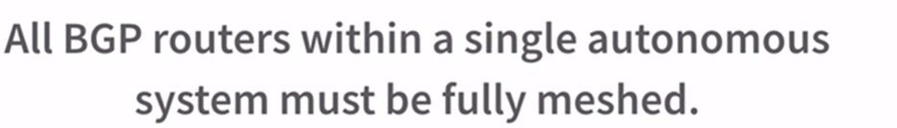
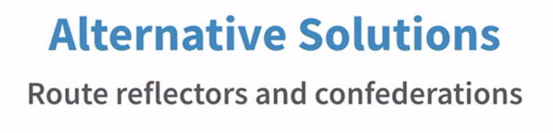

Slide 19
BGP TABLES:
Loc – RIB
Adj – RIB – in
Adj – RIB – out
📦 1. Adj-RIB-In (Adjacency RIB-In) 📥 What it stores: All routes received from BGP neighbors 🔍 Use: Before any filtering or policy is applied. ⚙️ Next Step: Routes are filtered and passed to Loc-RIB.
📘 2. Loc-RIB (Local RIB) (BGP Table) (sh ip bgp or sh bgp ipv4 unicast) 🧠 What it stores: Best routes selected by BGP after applying policies and comparing paths 🧾 This is the main BGP routing table ✅ Routes from here are installed in the main routing table (RIB/FIB) if chosen
📤 3. Adj-RIB-Out (Adjacency RIB-Out) (sh ip bgp neighbor <ip-address> advertised-routes) 📦 What it stores: Routes that are ready to be sent to BGP neighbors 🧰 These may be influenced by outbound route-maps, filters, etc 📡 Sent to each neighbor based on their policies

Slide 20
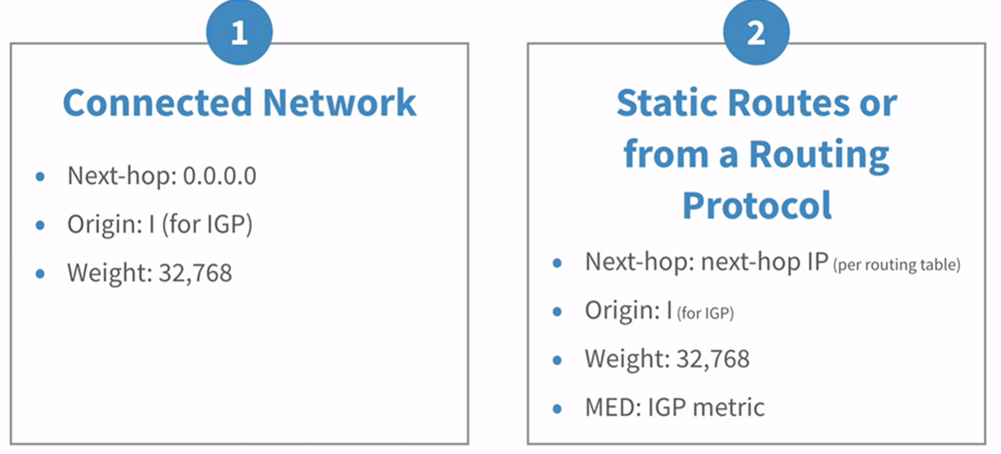

Slide 21
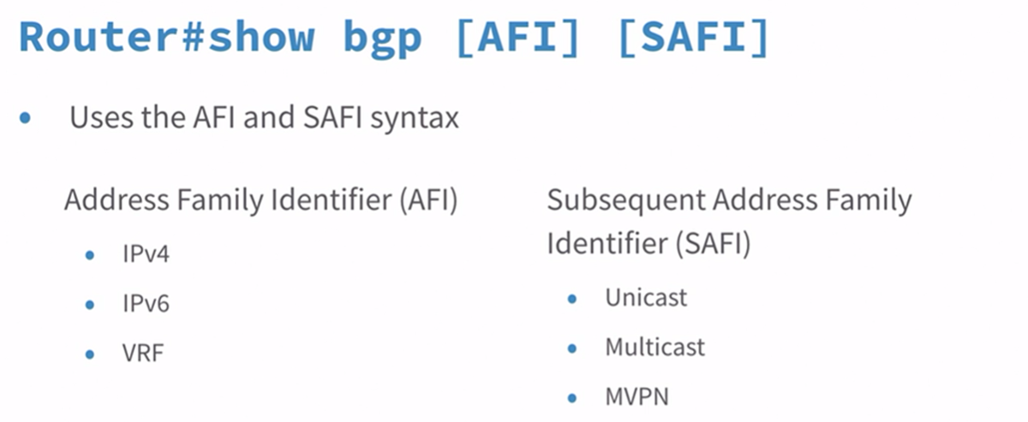
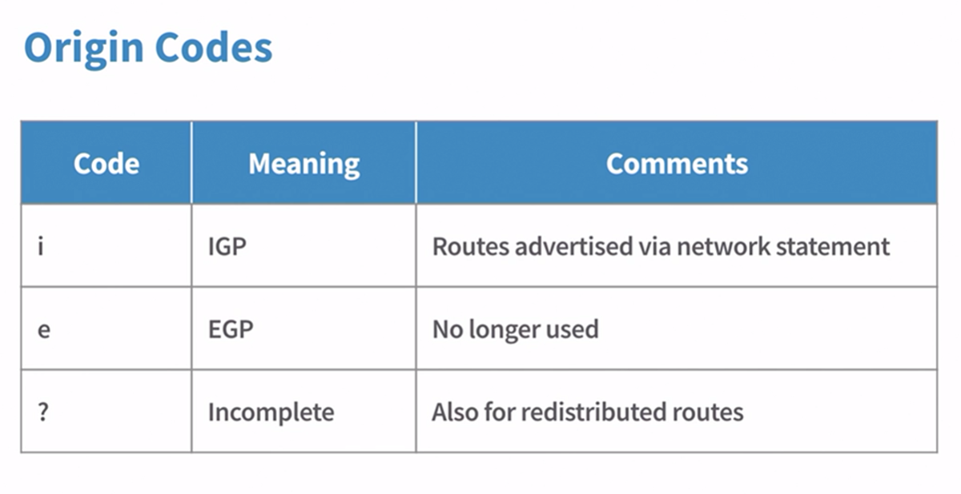
Show bgp ipv4 unicast
When bgp route is learned from a ibgp peer, it sets the next-hop 0.0.0.0 if it learns from ebgp peer or anyother protocol: next-hop <next-hop-ip>

Slide 22
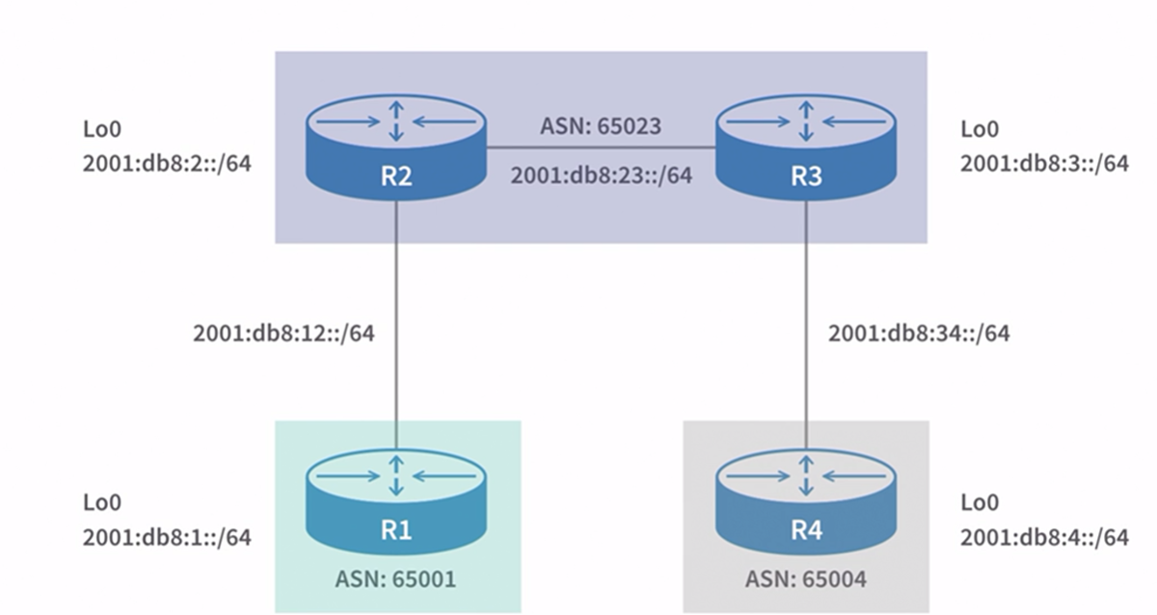
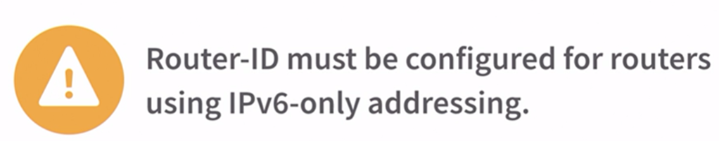
IPV6:

Slide 23
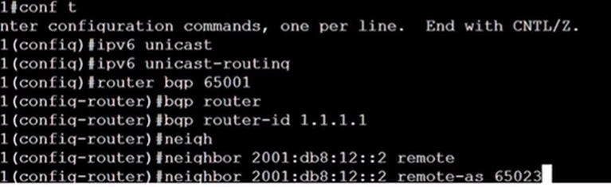


Slide 24
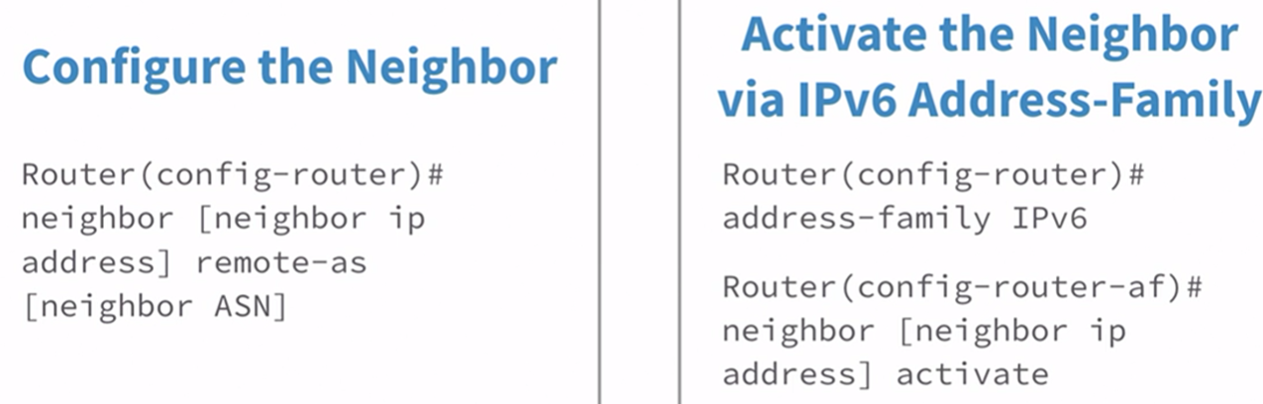
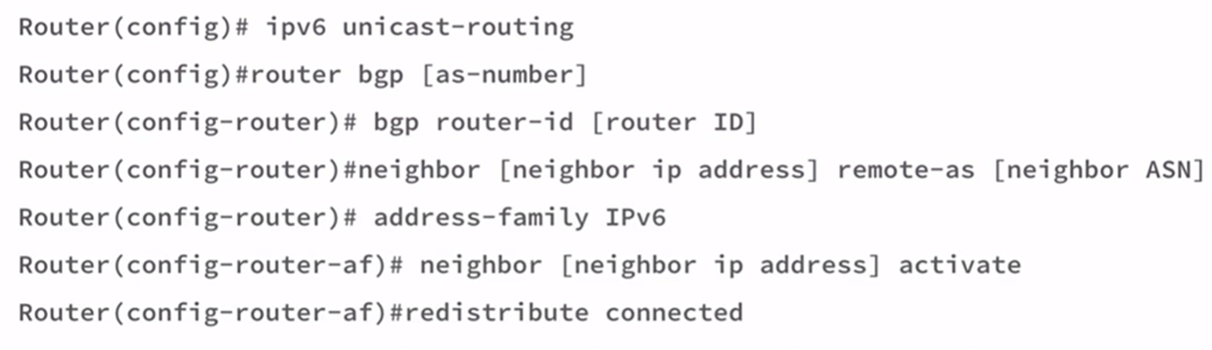
redistribute connected

Slide 25
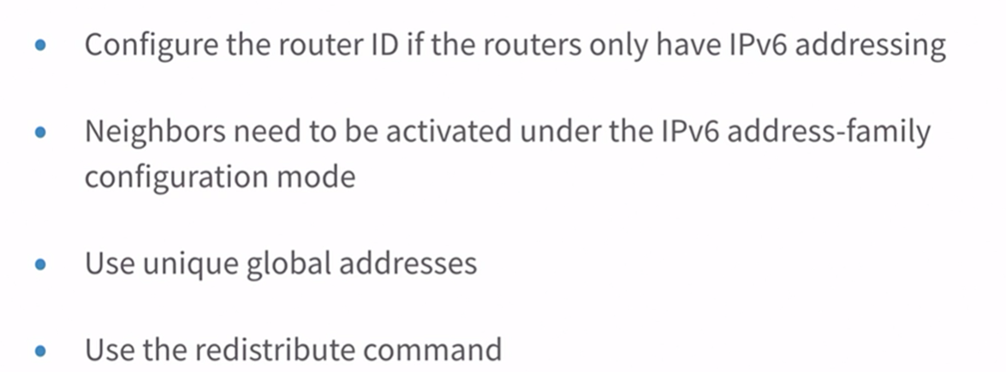
Reminders

Slide 26
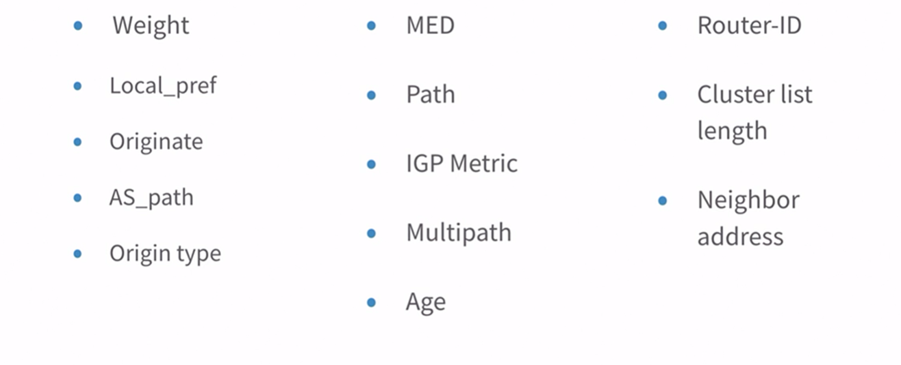
BGP Path Attributes

Slide 27
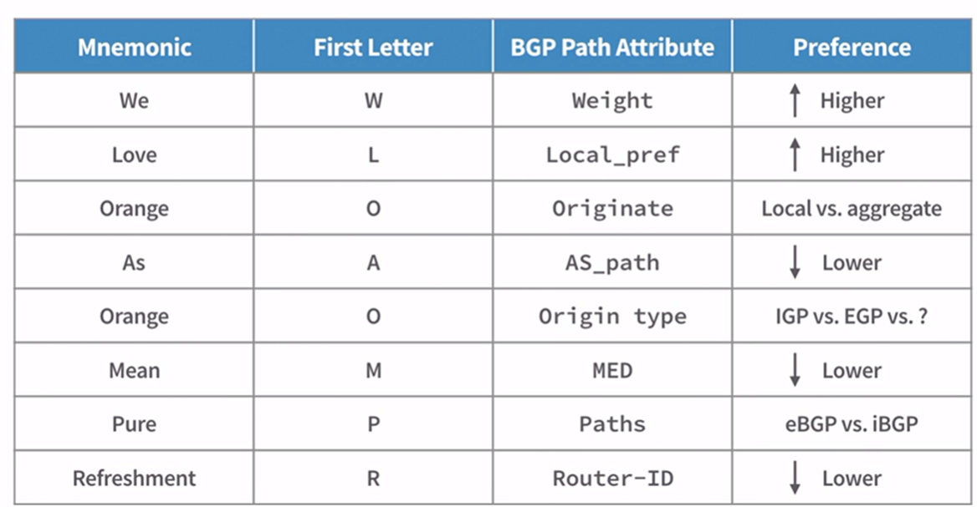
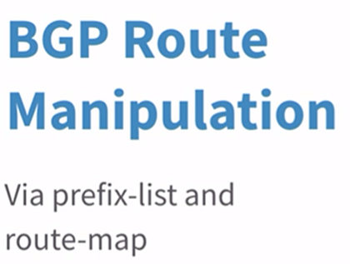
BGP Path Attributes

Slide 28
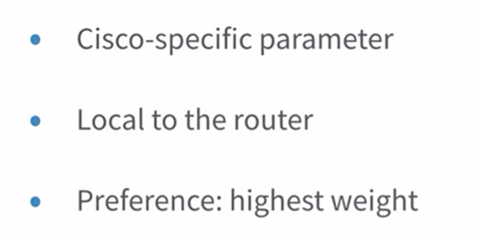
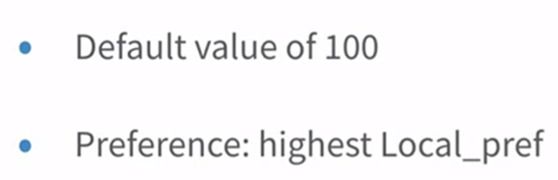
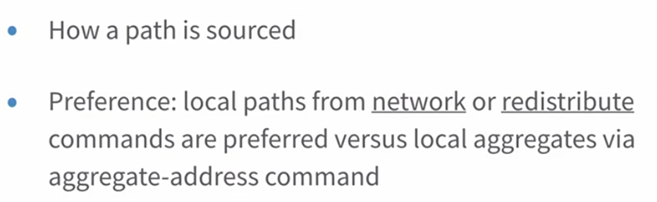
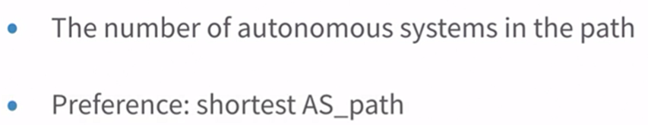
WEIGHT
LOCAL_PREFERNCE
ORIGINATE
AS PATH

Slide 29
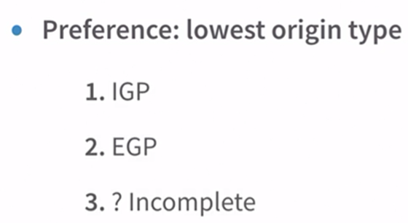
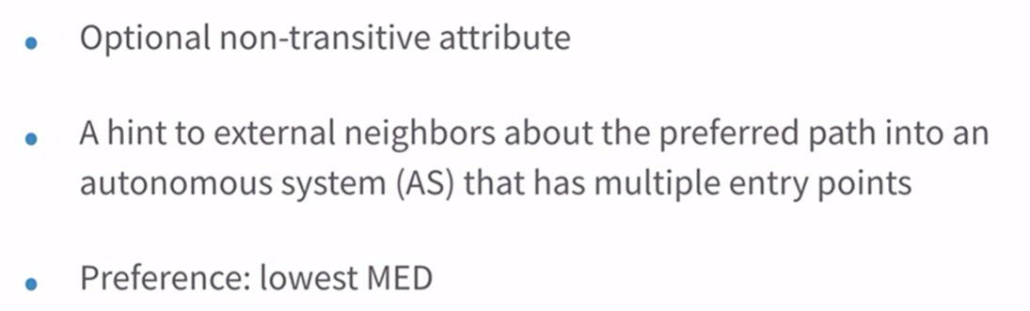
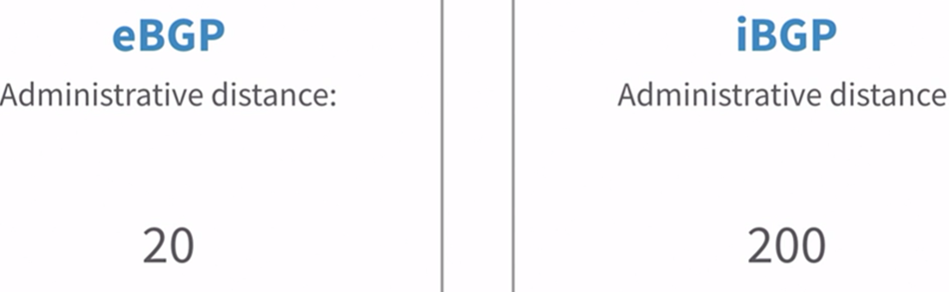
ORIGIN TYPE
MED (MULTI EXIT DISCRIMINATOR)
PATH
PREFERENCE

Slide 30
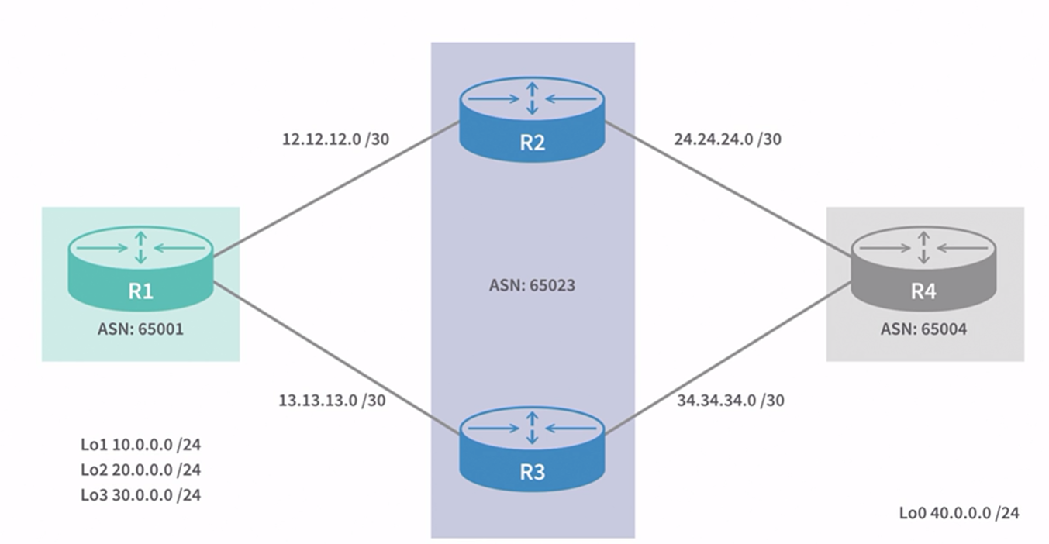

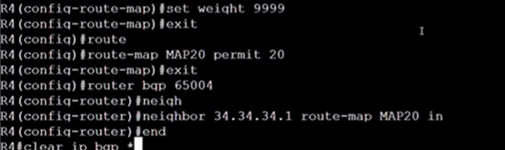
PATH CHANGING

Slide 31
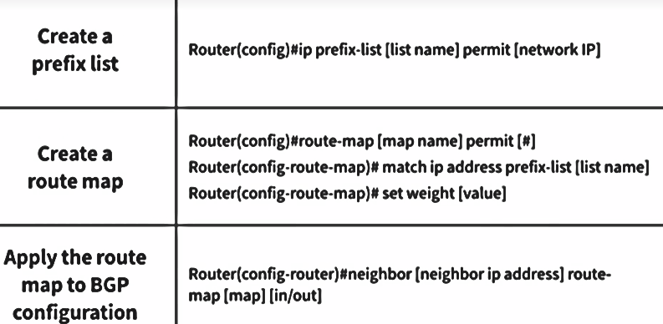
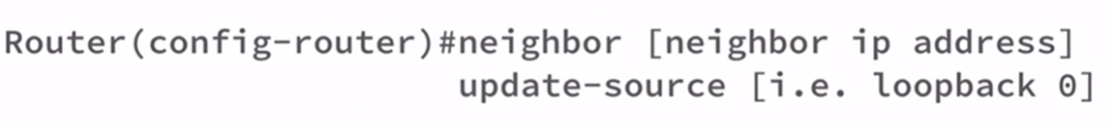
PATH CHANGING

Slide 32
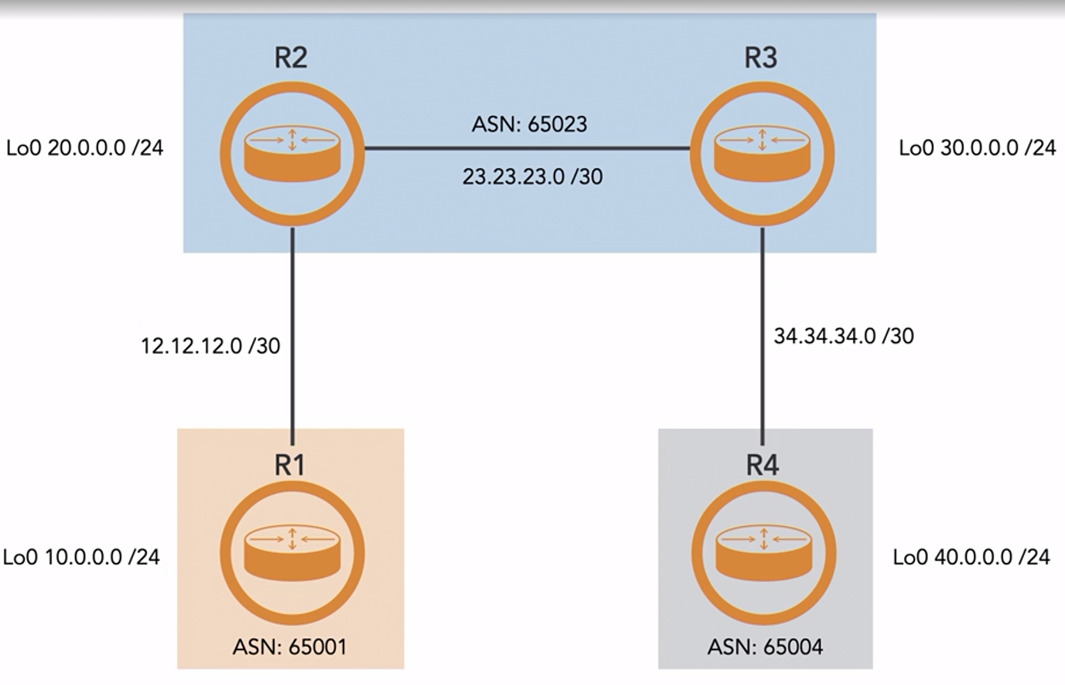
ADVANCED BGP

Slide 33

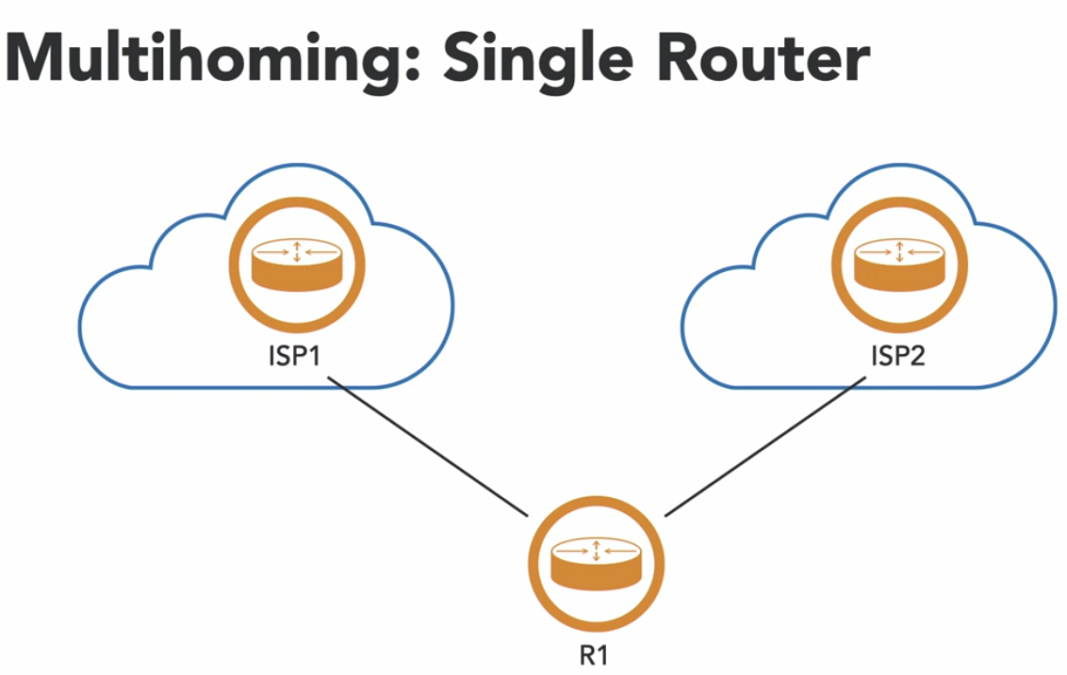
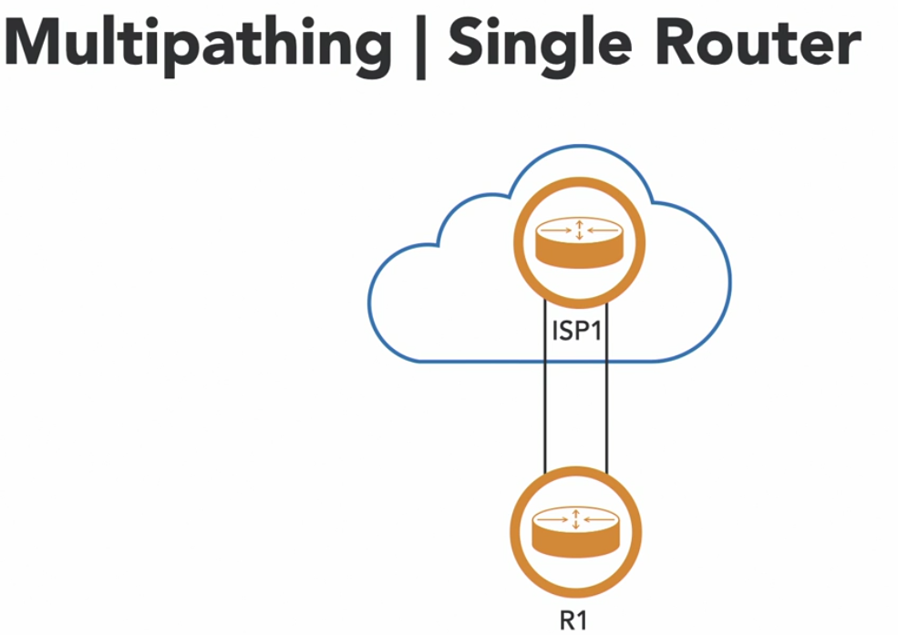
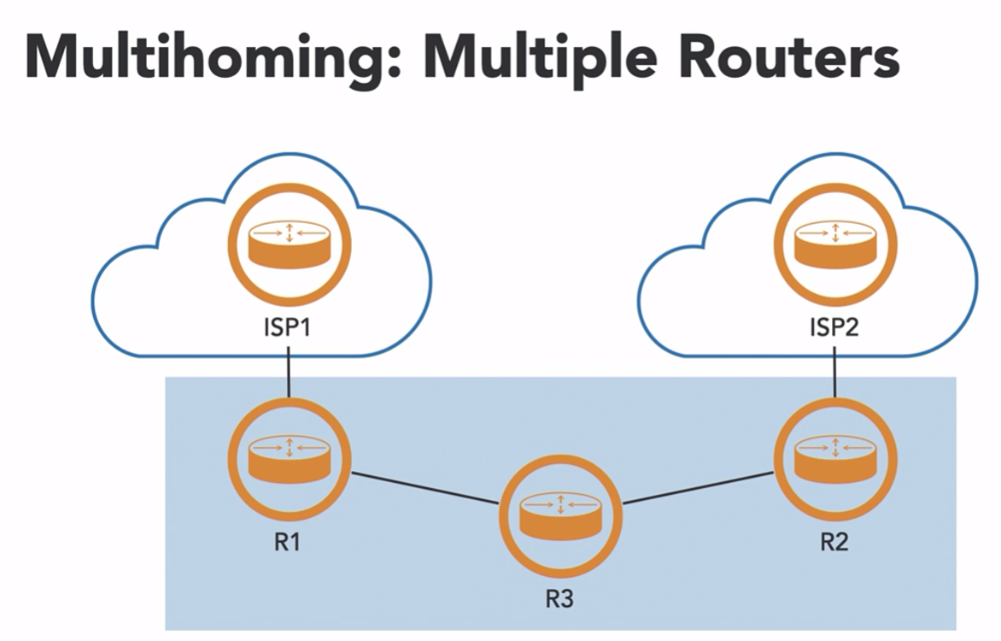
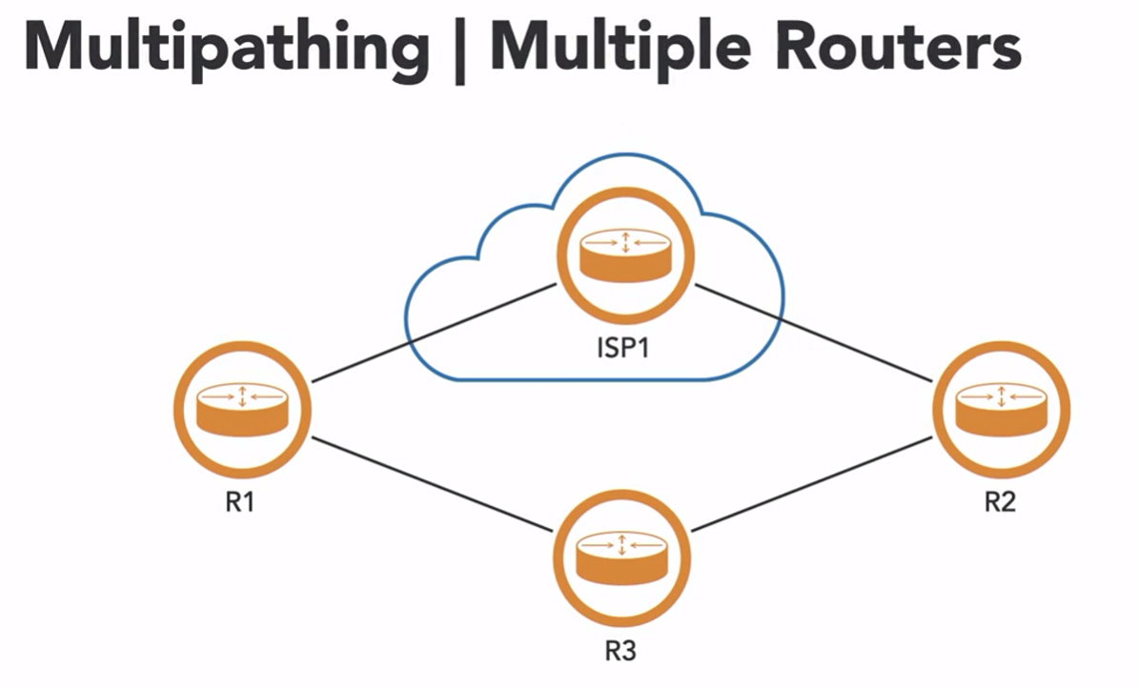
If IPV4 DEACTIVATED
BGP MULTI HOMING AND MULTIPATHING

Slide 34
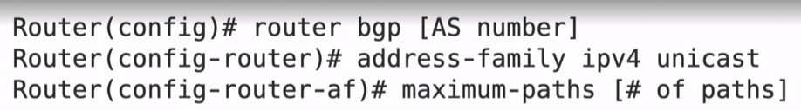
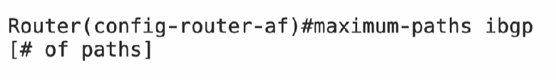
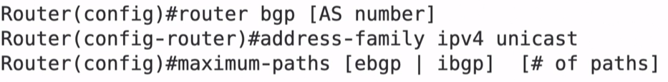
MULTIHOMING AND MULTIPATHING
Multihoming means connecting your network to two or more ISPs (or BGP peers) for redundancy or load balancing.
Multipathing allows installing and using multiple BGP routes to the same destination — even if one is not the “best” path.
Feature | BGP Multihoming | BGP Multipathing
Connects to | Multiple ISPs or external ASes | Multiple paths to the same destination
Goal | Redundancy & availability | Load sharing / bandwidth balancing
Route use | Chooses best route by default | Can install/use multiple equal-cost routes
Common Use | Enterprise-ISP setups | Data centers / ISPs with redundant links

Slide 35
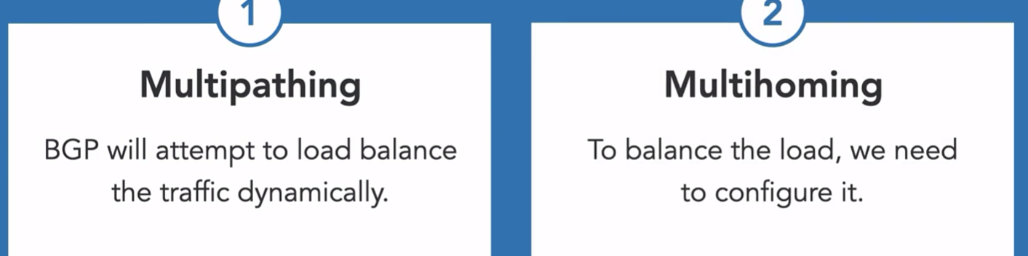
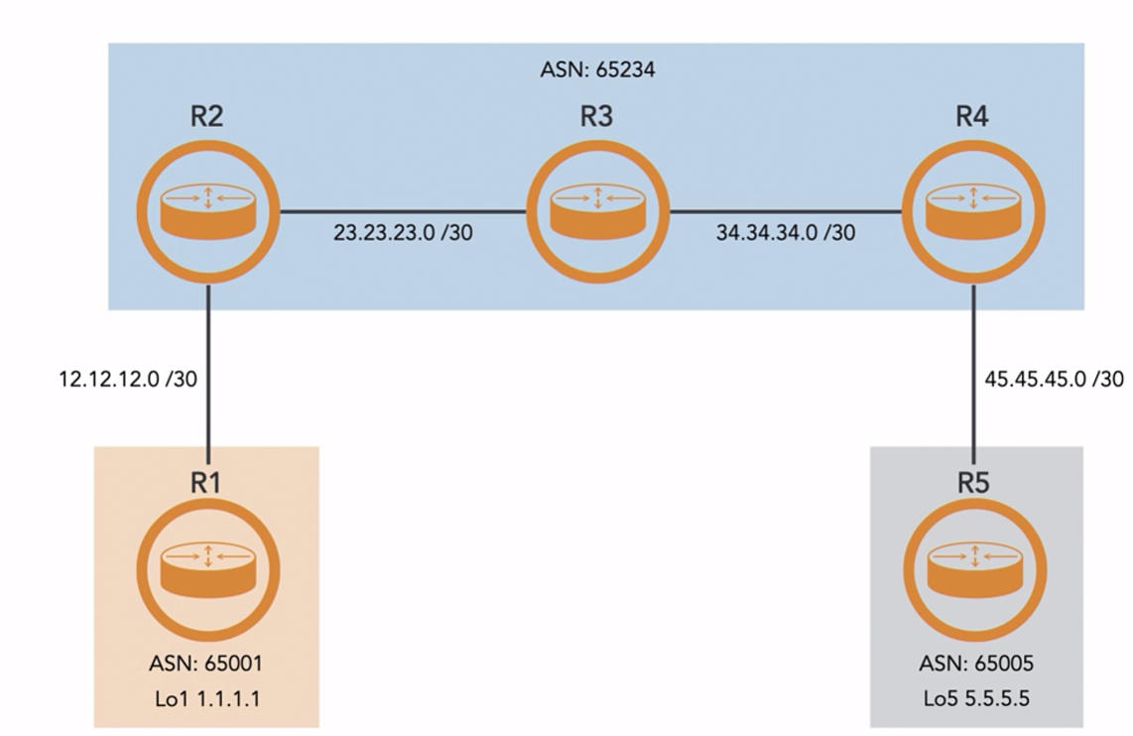

Slide 36
🧠 Why All BGP Routers Within a Single AS Must Be Fully Meshed (in iBGP):
📌 Because of the iBGP Split-Horizon Rule:
An iBGP router will never advertise routes learned from one iBGP peer to another iBGP peer. ✅ Solution Options:
Option Description
🔁 Full Mesh: Every iBGP router forms a session with every other iBGP router.
🌐 Route Reflector (RR): A central router reflects iBGP routes to clients.
🧱 Confederation: Split AS into sub-ASes to reduce session count.

Slide 37
BGP Route Reflector
✅ A Route Reflector (RR) allows an iBGP router to reflect BGP routes to other iBGP peers, removing the full mesh requirement. (Full Mesh means tcp connection between two routers)
📤 Route Reflector Behavior
Routes learned from Sent to
Client Other clients + non-clients
Non-client Only to clients
eBGP peer To everyone (clients + non-clients)
📘 Key Roles
Term Role
Route Reflector (RR) Central router that reflects routes.
Client Router that peers with the RR.
Non-Client Other routers that peer with RR but are not clients.

Slide 38
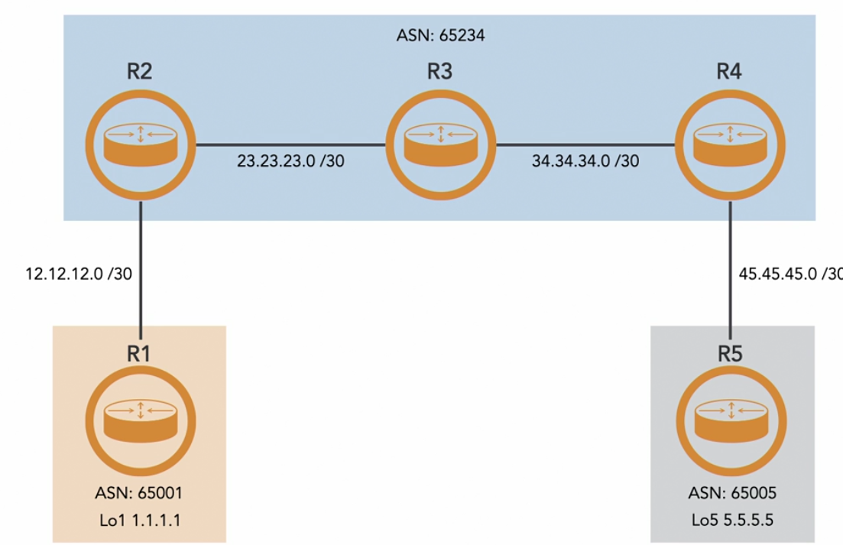
Why route reflector
When we use full mesh between IBGP peers, then the total TCP session will be n*(n-1)/2 to solve this; router reflector is used.
Normally, iBGP peers don't advertise routes to other iBGP peers (split-horizon rule).

Slide 39
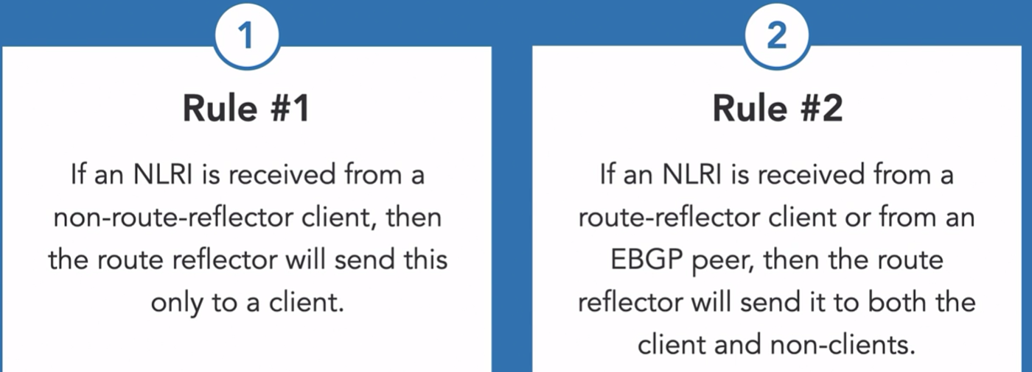
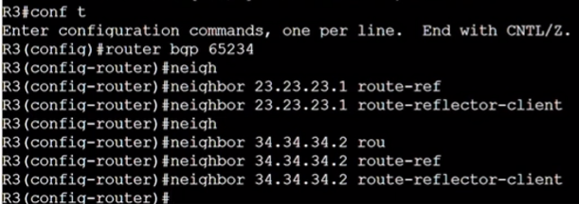

Slide 40
BGP Confederation
✅ BGP Confederation Explained (Simplified)
A BGP confederation is a method used in large networks to scale iBGP by dividing a single AS (Autonomous System) into multiple sub-ASes, while still presenting itself as one AS to the outside world.
Or
Confederation is consists of member autonomous that then combine into a large autonomous system. The member As will use AS numbers from the private ASN range.
📌 Why Use BGP Confederation?
Avoid full mesh iBGP requirement.
Easier route reflectors or hierarchical BGP design.
Better administrative control within large ASes.
Keeps internal complexity hidden from external ASes.

Slide 41
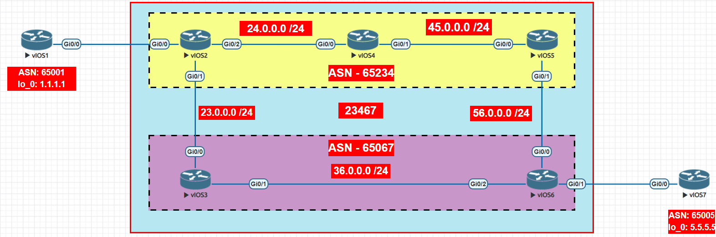
R2:
router bgp 65234
bgp confederation identifier 23457 ( router bgp confederation <outer-autonomous-system> ) bgp confederation peers 65067

Slide 42
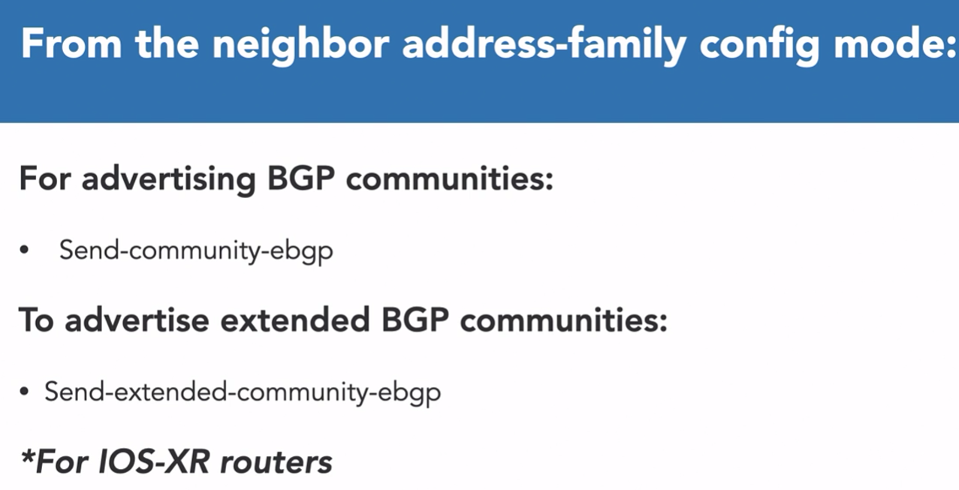
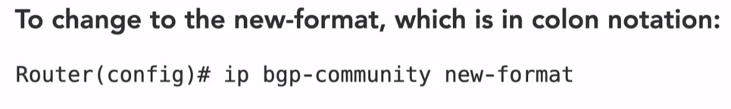
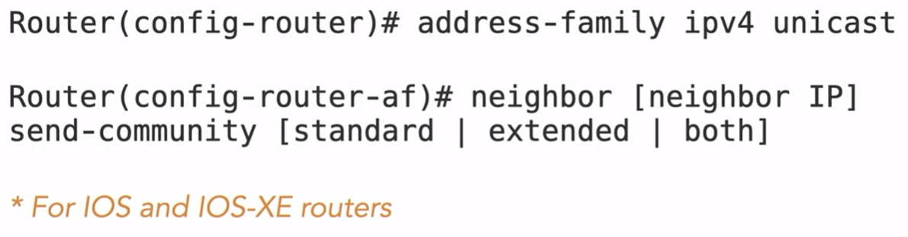
BGP COMMUNITY
A BGP community is a special tag that can be added to a route. It helps routers group certain routes together so they can be treated in a specific way, like choosing a faster path or blocking some traffic.
It is 32-bit value colon mark in new format and decimal mark in old format.

Slide 43




In this, when a router receives a advertise route, it doesn’t advertise to anyone else.
In this, when a router receives a advertise route, it advertises that route to routers in the same public as.
In this, when a router receives advertised routes, it advertises those routes to routers within the same member AS. It does not advertise the routes to BGP confederation peers.

Slide 44



Dynamic Route Summarization With Aggregation Tag
A route summary is a consolidation of multiple routes to single-route advertisement.
router bgp 1
address-family ipv4 unicast
aggregate-address 1.1.0.0 255.255.252.0
(the above command advertises the summary route in addition to the original networks)
aggregate-address 1.1.0.0 255.255.252.0 summary-only

Slide 45

BGP Atomic Aggregate
It is used to summarize the routes after receiving from a router. So, the router will advertise a single route to other routers.
router bgp 1
address-family ipv4 unicast
aggregate-address 1.1.0.0 255.255.252.0 summary-only To check the advertised routes got from bgp peers: sh ip bgp ipv4 unicast sh ip bgp
check atomic aggregate routes: sh bgp ipv4 unicast 1.1.0.0 (<summary-ip>) if we want to keep the as number in the history

Slide 46


BGP PEER Group
Peer groups are used to apply the same policy to multiple routers that have the same AS. We create one object and apply the same object for multiple routes. Or Reduces BGP router’s cpu load by creating an update once per group, rather than one per neighbor.
i. create the peer-group ii. Add the addresses in the peer-group

Slide 47

BGP PEER GROUP
We can also apply common attributes to peer group (e.g: AS number)

Slide 48

Conditional Route Selection
The method of selectively identifying which prefixes should receive or advertise from peers to what we refer as conditional route selection.
Distribute List – uses access-list to filter prefixes on neighbor-by-neighbor basis. (ACL)
Prefix List - same
Route Maps –
As-Path filtering – regular epressions
BGP community

Slide 49

ACCESS-LIST
I want 10.1.1.0 traffic should not come through 12.1.1.0 network , it should come by 13.1.1.0 network
Clear bgp session - clear ip bgp * soft
access-list 10 deny 10.1.1.0 0.255.255.255 access-list 10 permit any router bgp 65001
neighbor 12.1.1.2 remote-as 65002
neighbor 12.1.1.2 distribute-list 10 in
neighbor 13.1.1.3 remote-as 65003

Slide 51
BGP QUESTIONS
1. Do bgp advertise the received route from ebgp neighbor peer which is not routable by a router?? ANS: No, a route that is not considered valid/routable will not be advertised to other peers, even within iBGP or eBGP.
2. Does route reflector advertises the routes received from neighbor? ANS: Yes, a route reflector does advertise routes received from its clients. However, it does not modify the next-hop IP address by default; the next-hop remains as advertised by the original router.
3. When does a RIB failure occur in BGP? ANS: The rib failure tells us that a route is present which is better than advertised route.
Protocol Admin Distance default
Connected 0
Static 1
eBGP 20
OSPF 110
IS-IS 115
RIP 120
iBGP 200

Slide 52
BGP ERRORS MAY COME
When there is neighbor mismatch, typed wrong autonomous system *May 29 14:10:53.069: %BGP-3-NOTIFICATION: sent to neighbor 12.0.0.2 active 2/2 (peer in wrong AS) 2 bytes FFFE
*May 29 14:10:53.069: %BGP-4-MSGDUMP: unsupported or mal-formatted message received from 12.0.0.2:
FFFF FFFF FFFF FFFF FFFF FFFF FFFF FFFF 0039 0104 FFFE 00B4 1700 0002 1C02 0601
0400 0100 0102 0280 0002 0202 0002 0246 0002 0641 0400 00FF FE
*May 29 14:10:58.159: %BGP-5-NBR_RESET: Neighbor 12.0.0.2 active reset (BGP Notification sent)

