Slide 1
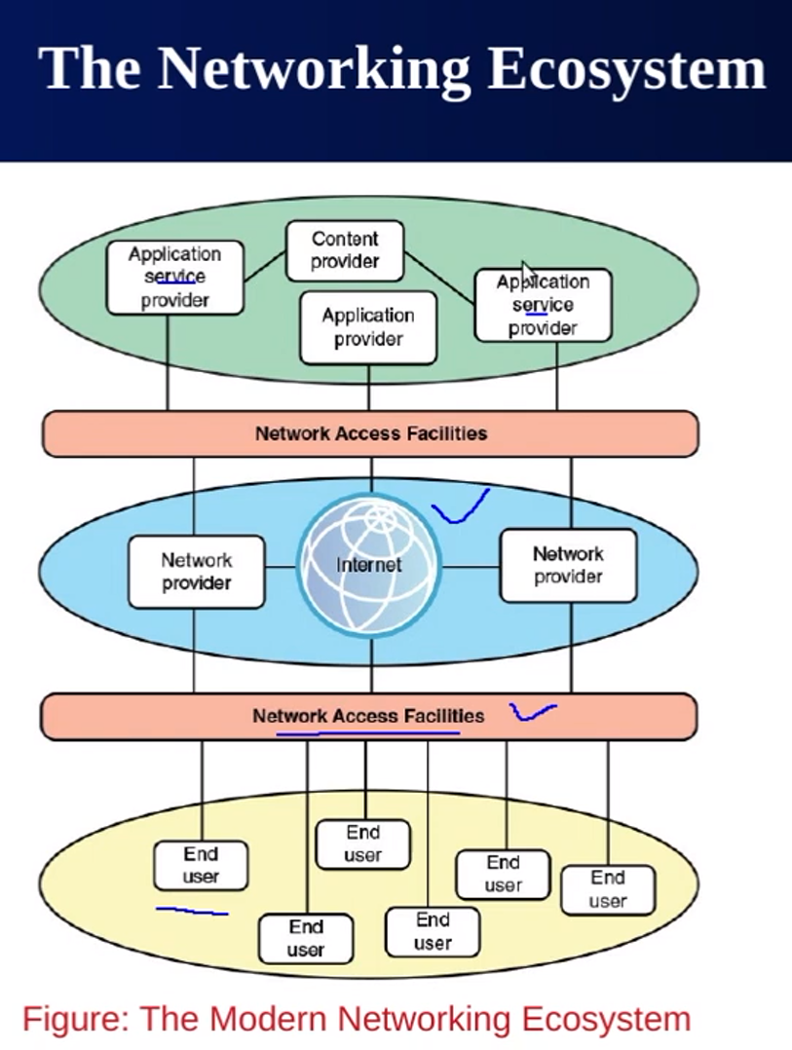
v

Slide 2
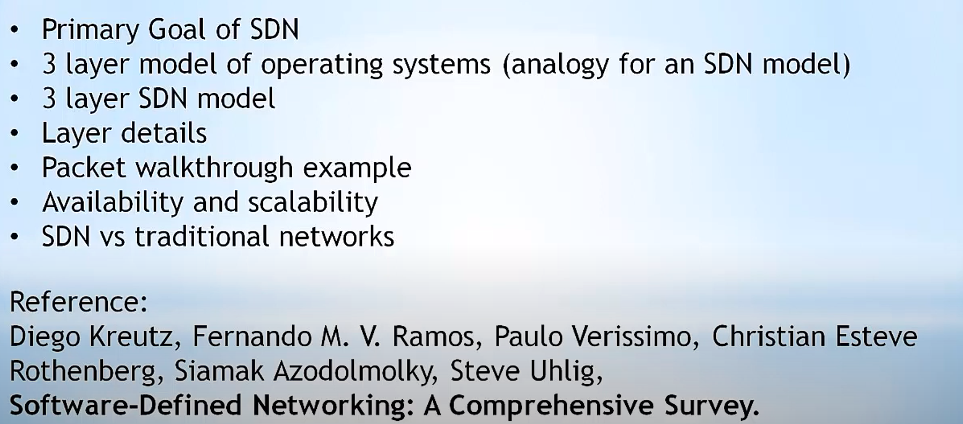
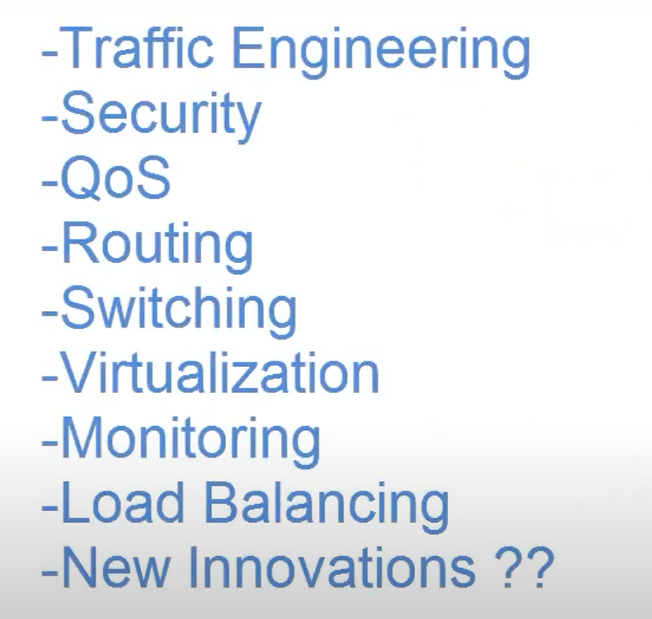
INTRODUCTION TO SDN
APPLICATION OF SDN

Slide 3
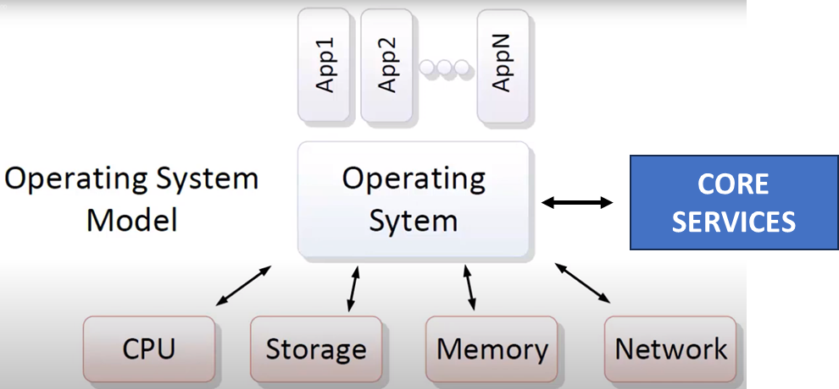
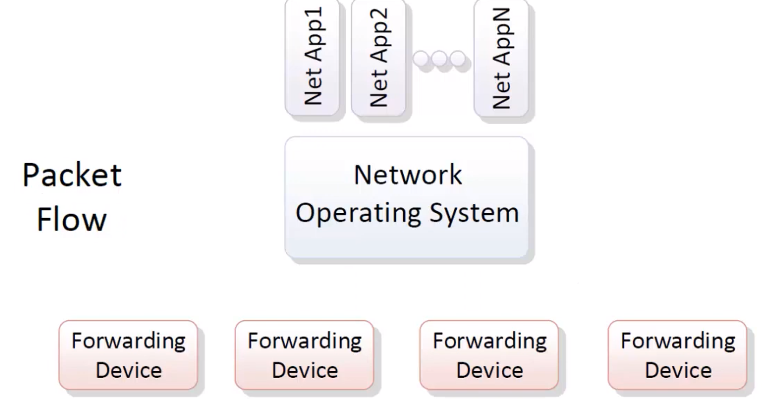
OS MODEL
SDN MODEL

Slide 4
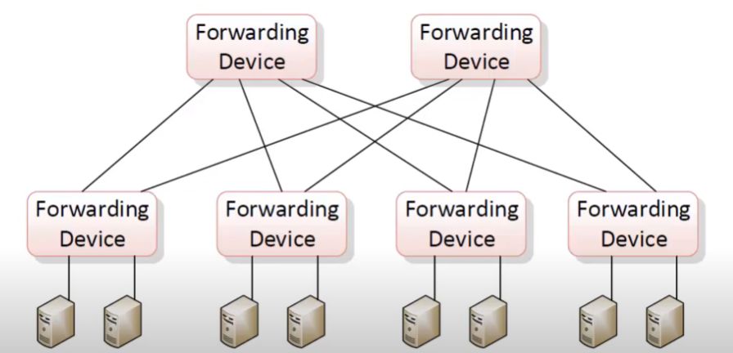
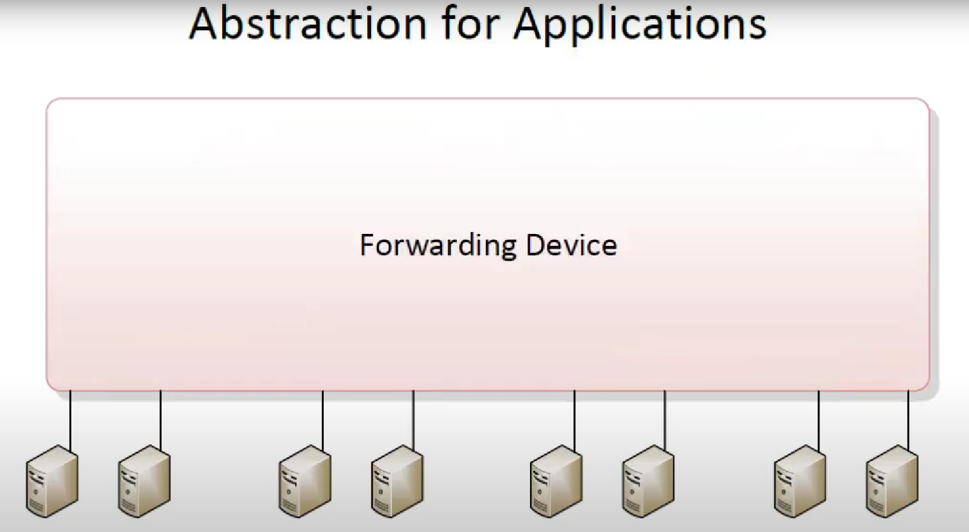
SDN MODEL
Without controller, they will make their own decision
With SDN, they will have central controller who has knowledge of whole topology

Slide 5
MAIN SERVICES OF SDN
SDN CONTROLLER / CONTROL PLANE COMPONENTS
An SDN Controller is the central component of the Software-Defined Networking (SDN) architecture. It manages and programs network devices (like switches and routers) by providing a global network view and central control. It communicates with the data plane (switches) using protocols such as OpenFlow, and provides APIs for applications.
⭐ Topology Service
Maintains an up-to-date map of the network topology. Discovers network devices (switches, routers, links). Helps the controller understand how switches are interconnected. Supports efficient path computation and network visualization.
➔ Example: The controller detects that Switch A is connected to Switch B and learns link bandwidth.
📚 Inventory Service
Keeps track of all network devices (switches, routers, hosts).
Stores metadata such as device types, port information, capabilities, etc.
Acts as a central registry of devices under control.
➔ Example: The controller knows that Switch ID=1 has 24 ports and supports OpenFlow 1.5.

Slide 6
MAIN SERVICES OF SDN
📊 Statistics Service
Collects real-time or periodic statistics from network devices. Monitors traffic counters, flow stats, port utilization, packet drops, errors. Enables traffic engineering decisions and performance monitoring.
➔ Example: The controller pulls port statistics every 5 seconds to track bandwidth usage and detect congestion.
🏠 Host Tracking Service
Tracks end-host devices (servers, clients) connected to the network. Maps IP/MAC addresses to switch ports. Helps in making forwarding decisions by knowing host locations.
➔ Example: Host with IP 192.168.1.10 is attached to Switch 3, Port 5.

Slide 7
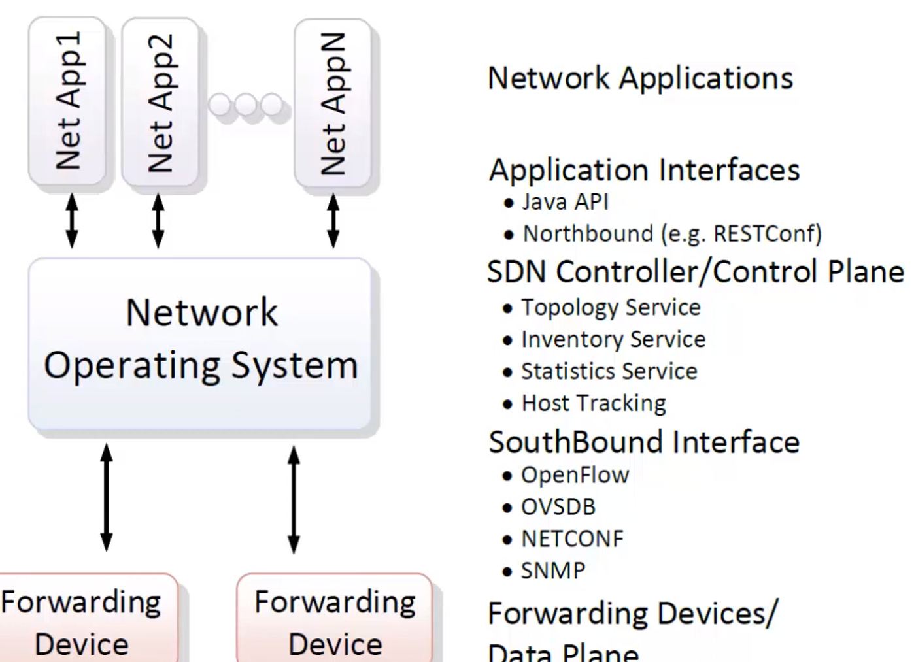
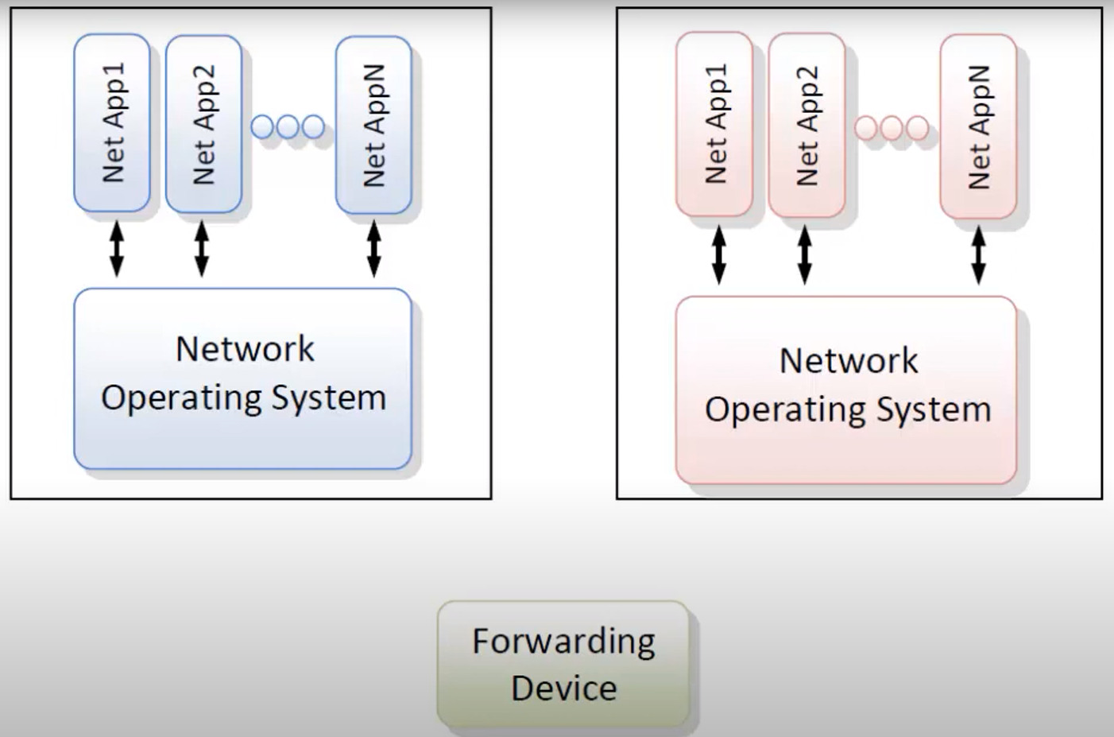

Slide 8
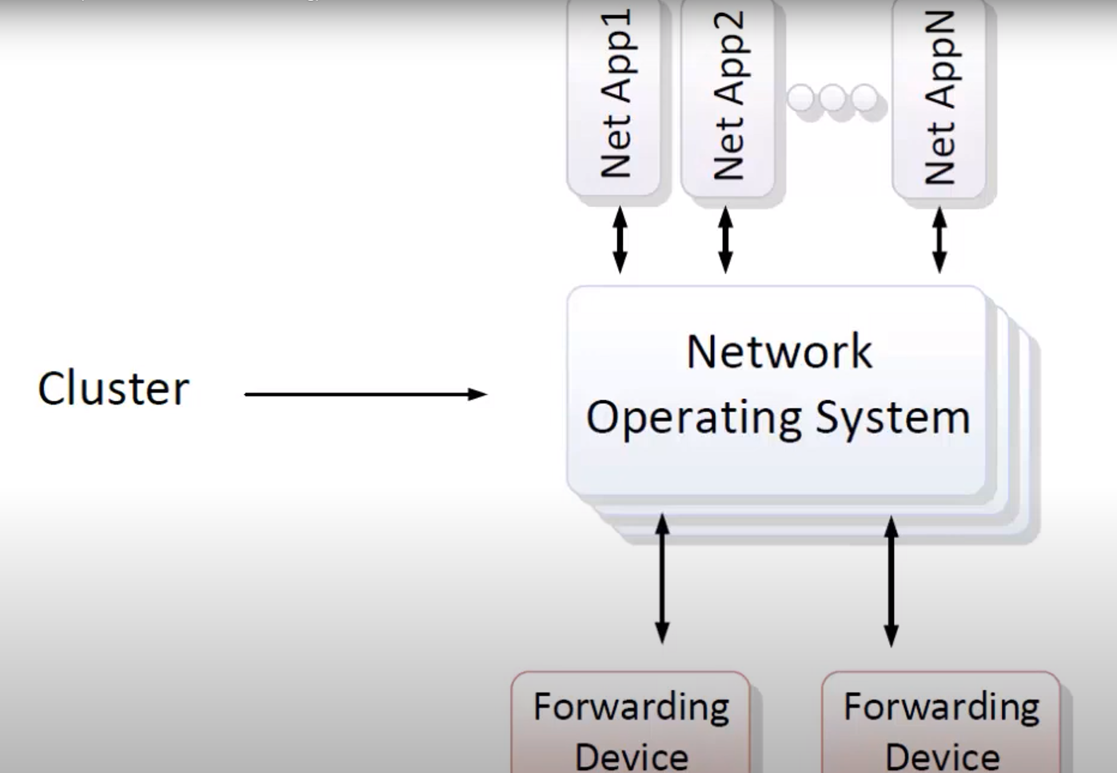
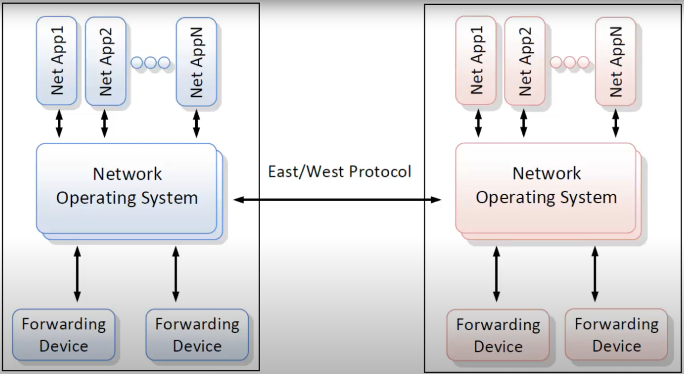
SDN into different regions and they can communicate using East/West Protocol.

Slide 9
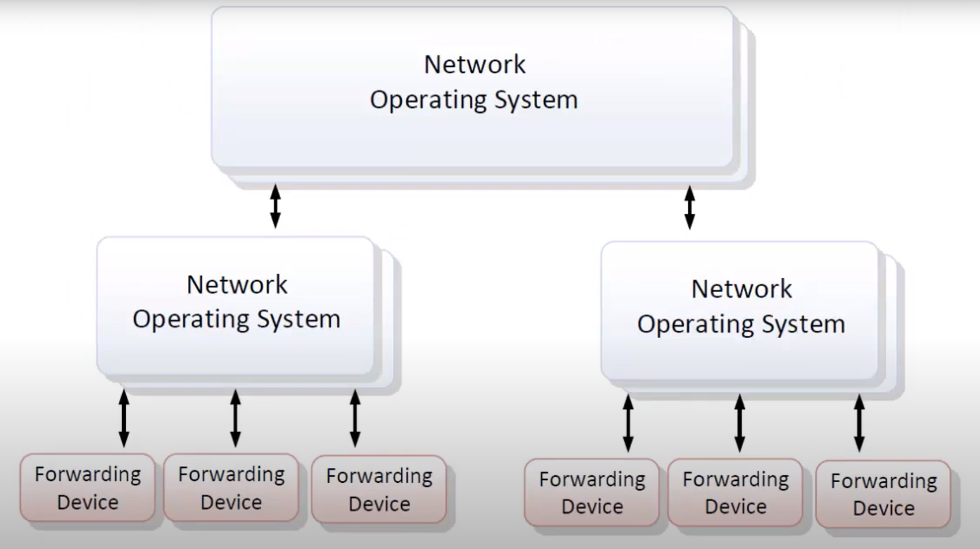
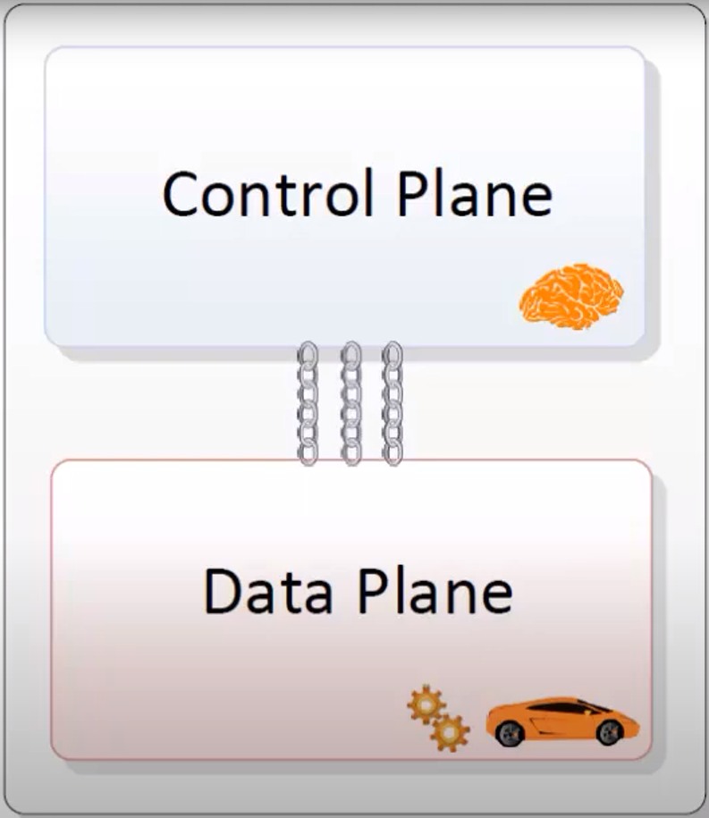

Slide 11
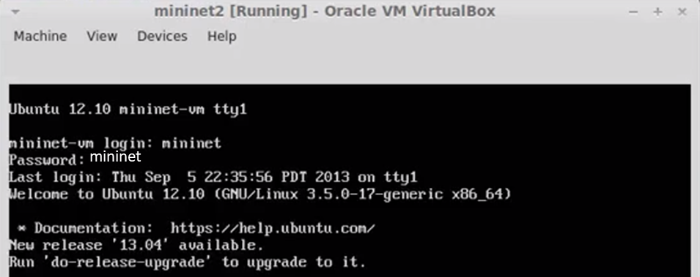
MININET (mininet.org)
Network emulation software that allows you to launch a virtual network with switches, hosts and an SDN controller all with a single command
Great way to start learning about SDN and OpenFIow as well as test SDN controllers and SDN applications
Go to mininet.org for full details, installation instructions, download a VM, tutorials, FAQs and to join the mailing list.

Slide 12
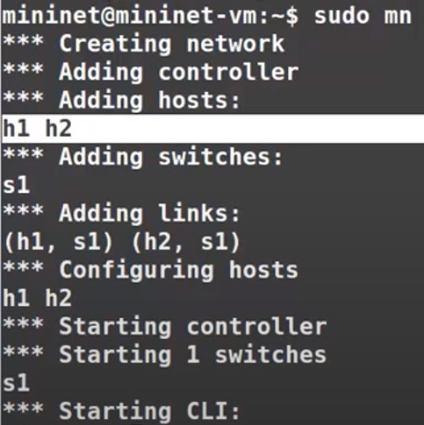
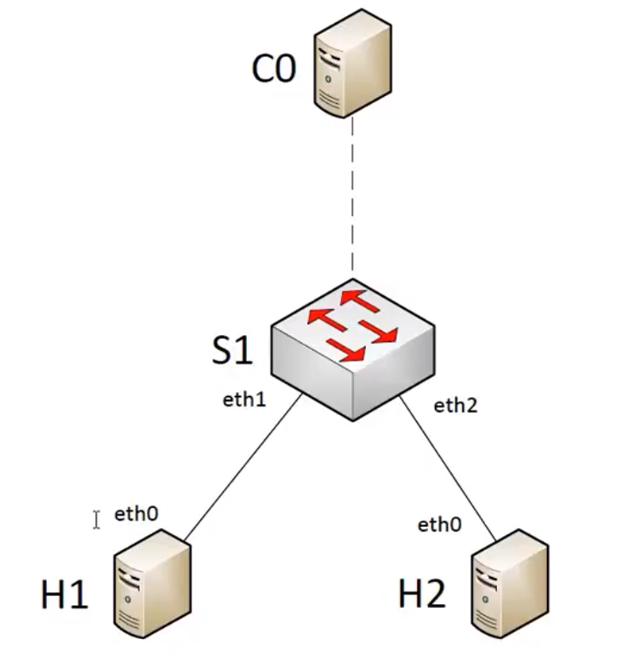
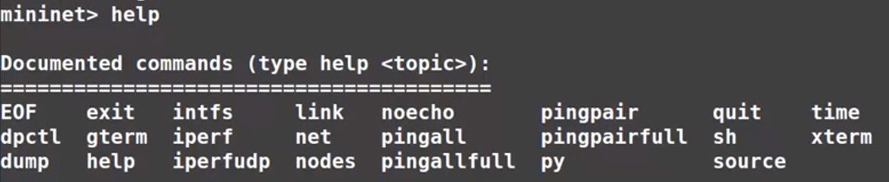

MININET (mininet.org)

Slide 13
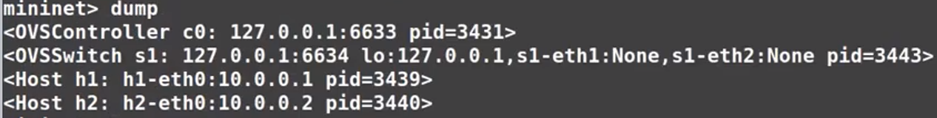
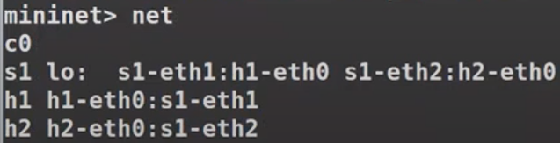
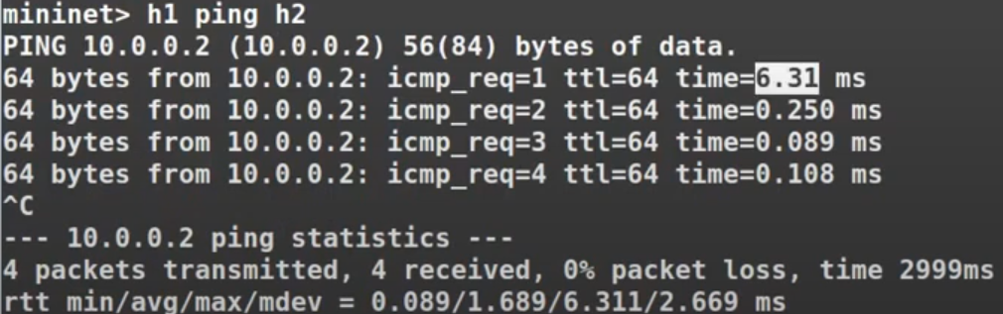
MININET (mininet.org)

Slide 14
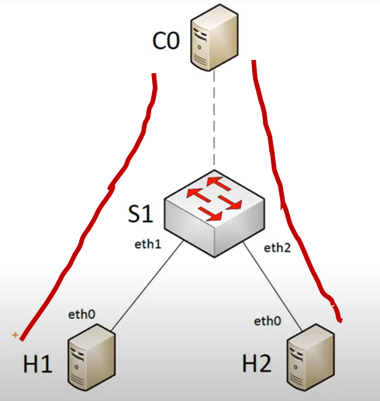
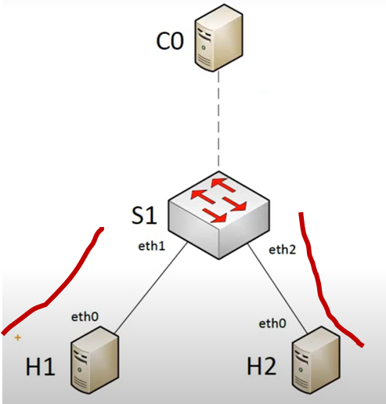
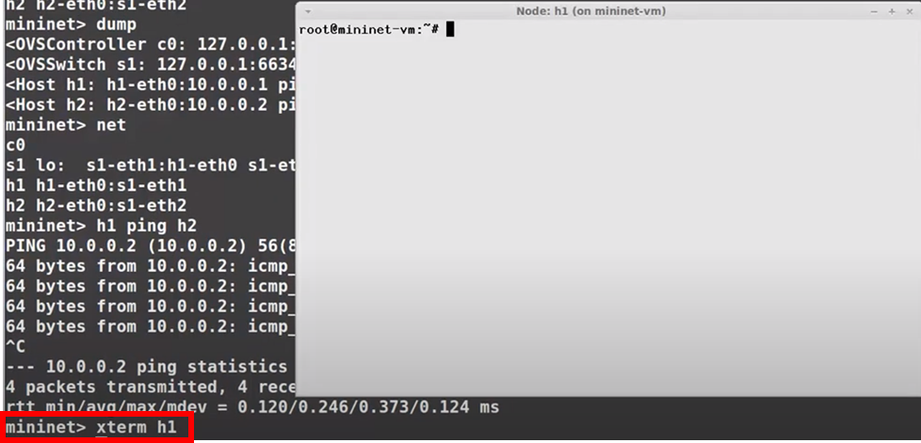
PACKET FLOW
1st Packet goes via controller 2nd – last packet goes via S1
(extra latency)

Slide 15
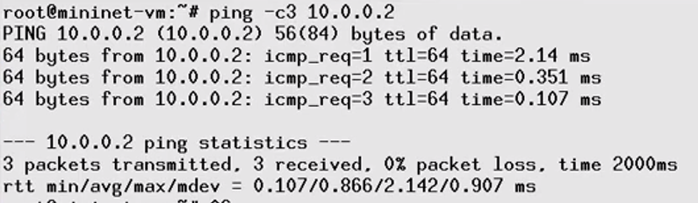
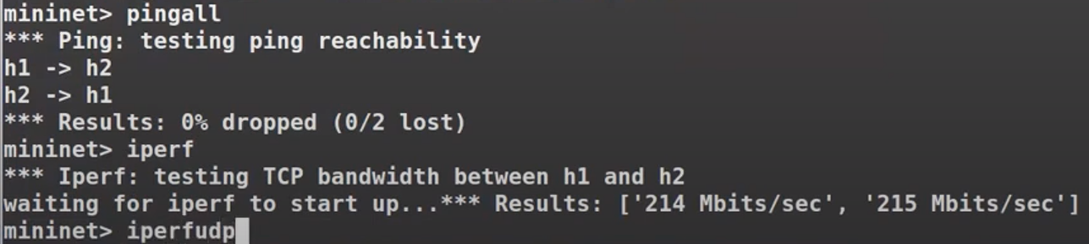
sudo mn –c mininet@mininet-vm:-$ sudo wireshark &

Slide 16
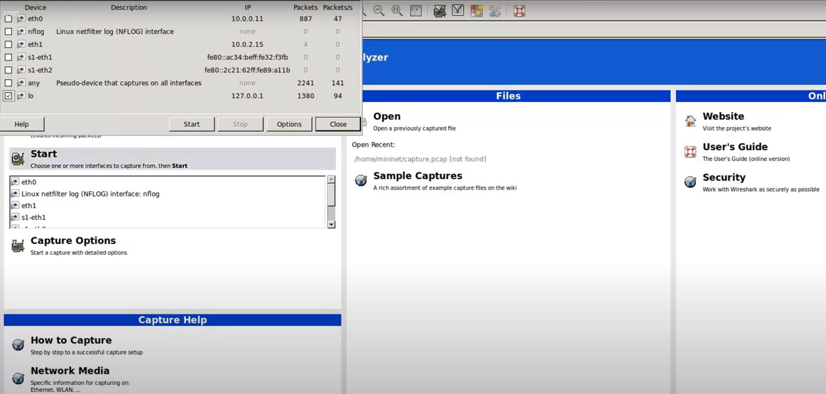
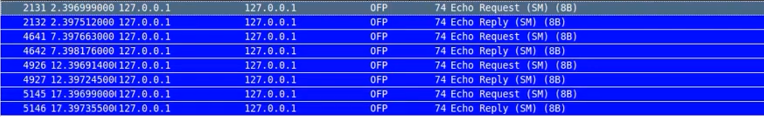
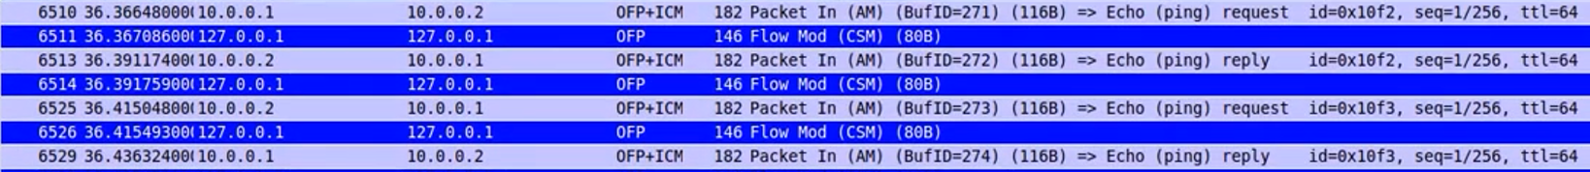

Slide 17
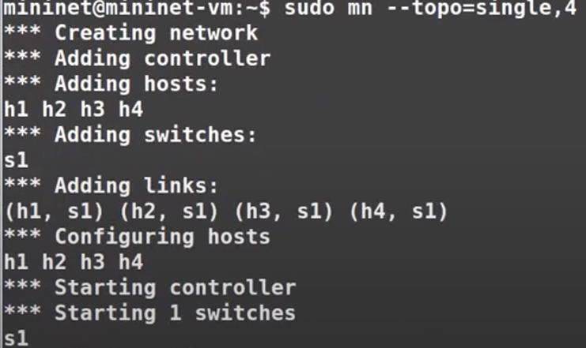
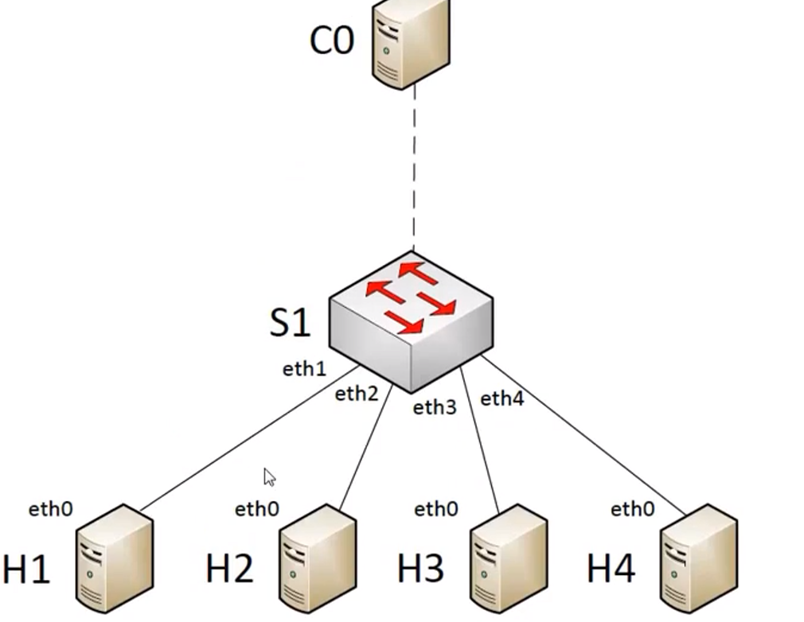
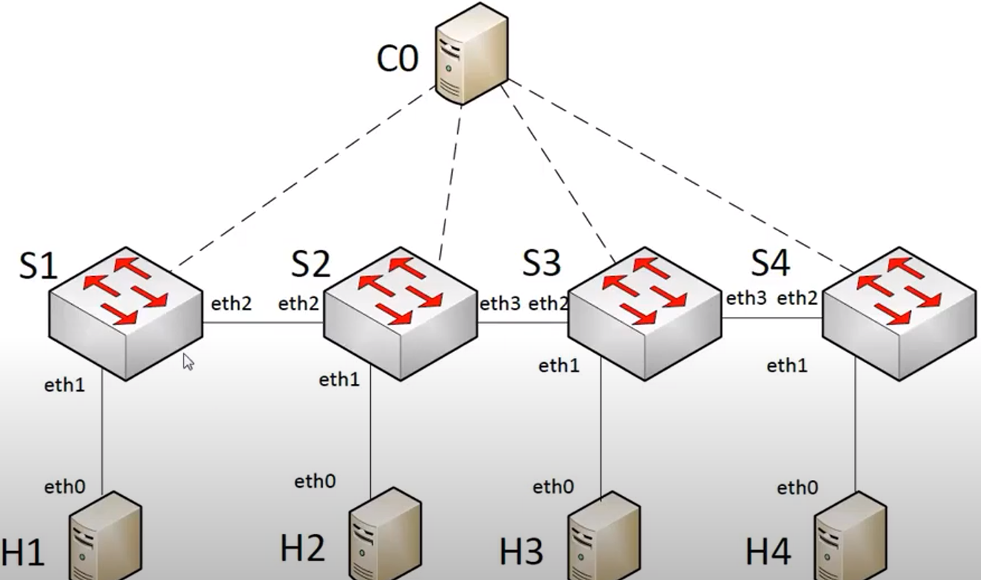
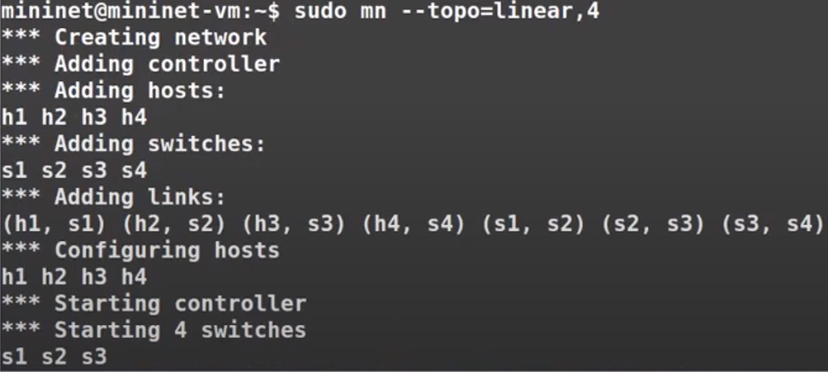
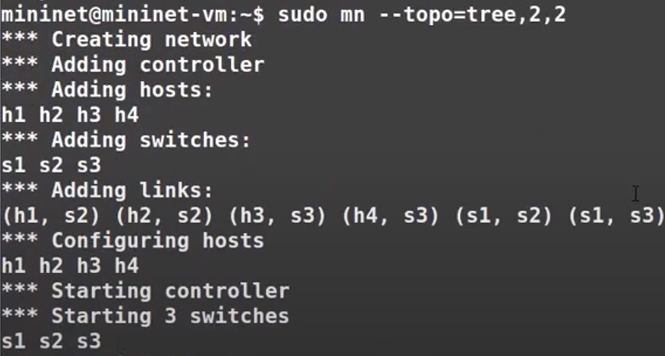
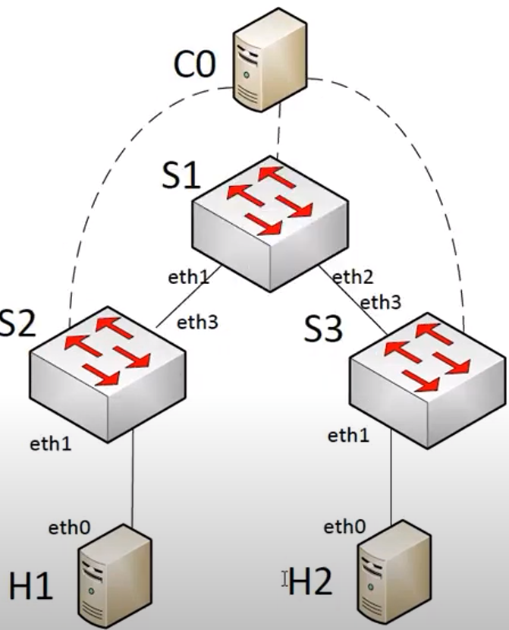
UNDERSTAND TOPOLOGY

Slide 18
UNDERSTAND TOPOLOGY

Slide 20
INTRODUCTION TO OPENFLOW
How packets move through an OpenFlow network
See packets in flight using Mininet network emulation and wireshark
Packet walkthrough of an example HTTP request and reply in an OpenFlow enabled network
Open Networking Foundation's (ONF) main features of what makes an OpenFlow switch
What is OPENFLOW
OpenFlow is a special language (protocol) that lets you control how network switches work.
Normally, switches from different companies have different ways of working. OpenFlow helps us control all of them in the same way.
This means we can change how switches send data in the network using a program, without doing it manually.
OpenFlow is very important for SDN (Software-Defined Networking), which helps us manage networks more easily and flexibly.
With OpenFlow and SDN, we can control the whole network from one place using software.
For more information, you can visit: 🌐 https://www.opennetworking.org/

Slide 21
Ransomware
Ransomware is a type of harmful software (malware) that criminals use to make money or cause problems.
It works by locking or encrypting your personal files (like photos, documents) on your computer so that you can’t open them.
The attacker then asks you to pay a ransom (money) in order to get your files back.
Ransomware can spread like a virus or worm, which means it can move from one computer to another.
Sometimes it encrypts just certain files, and other times it locks everything, even important parts of your computer like the master boot record (which helps your computer start)
Examples of well-known ransomware:
WannaCry
Petya
Sodinokibi
Bad Rabbit
Grandcrab
SamSam
CryptoLocker
CryptoDefense
CryptoWall
Spora

