Slide 1
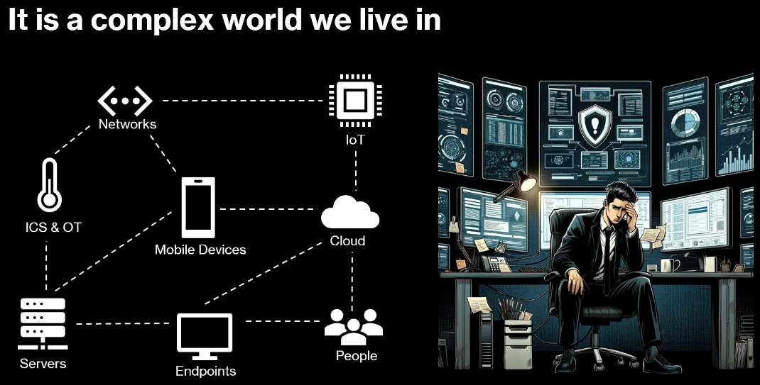
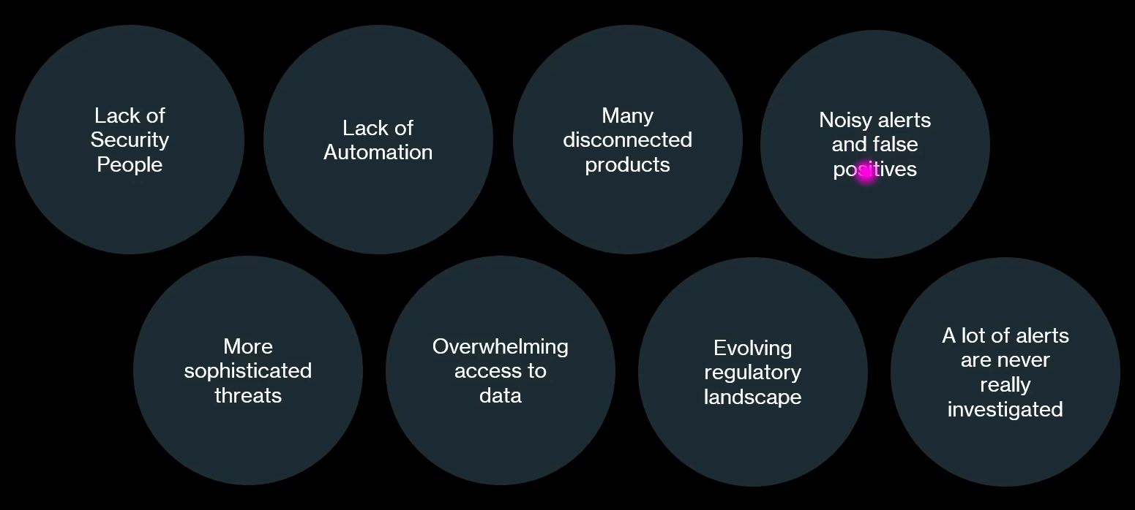
MITRE ATT & CK Framework
By Christopher Nett
Cyber Security Challenges

Slide 2
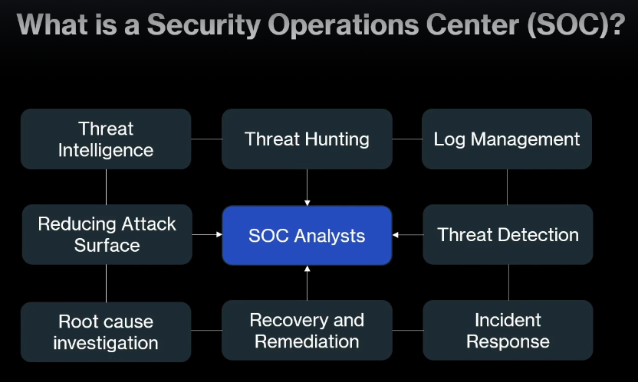
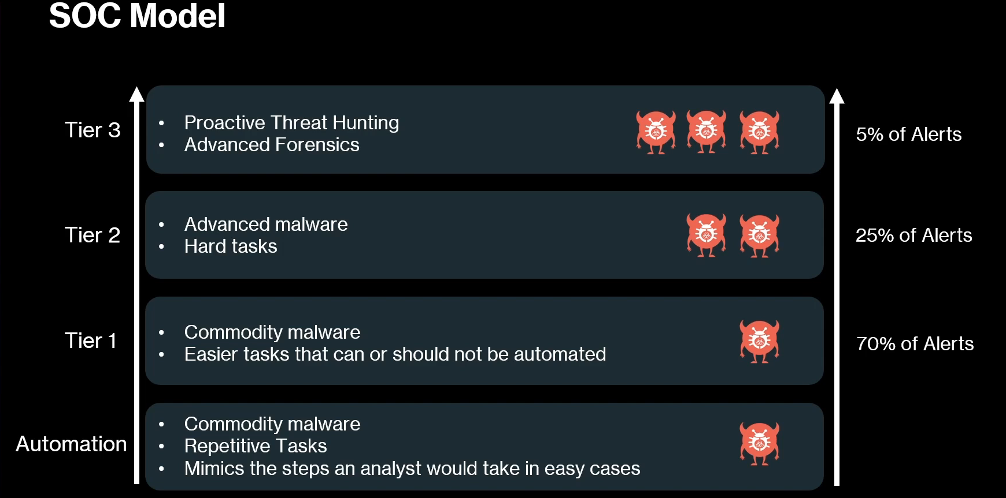
MITRE ATT & CK Framework
A Security Operations Center is a team that continuously monitors, detects, analyzes, and responds to cybersecurity threats in an organization.

Slide 3
Security Incident & Response

Slide 4
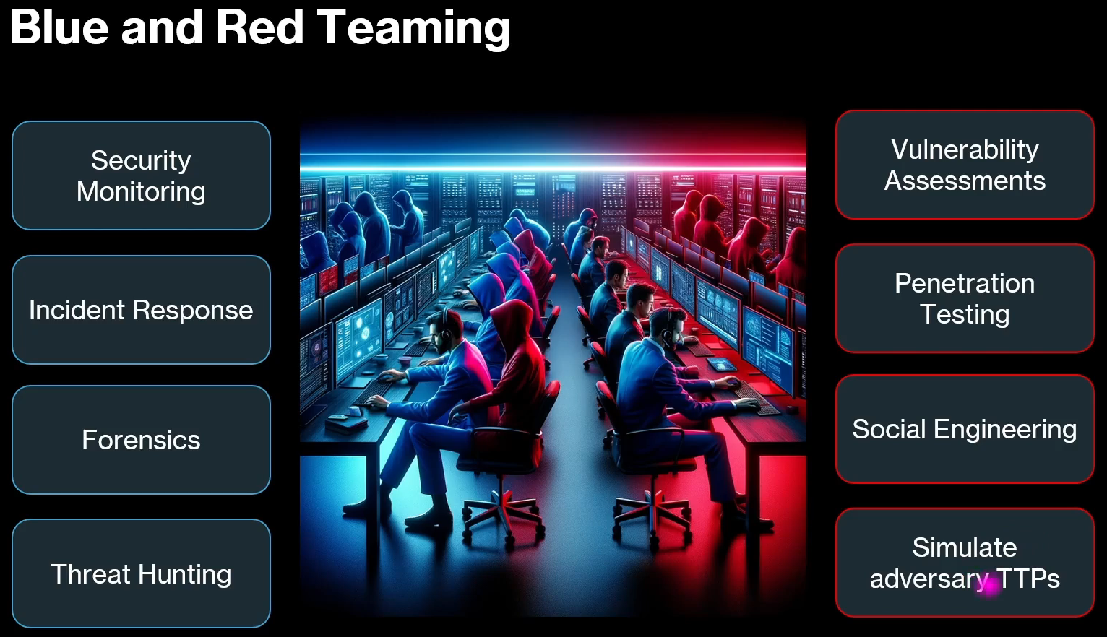
Blue, Red, & Purple Teaming
In Blue Team cybersecurity, the goal is to defend an organization’s systems, detect attacks, and respond quickly.
Blue team:
Security monitoring:
Incident Response: dealing with alert generated by XDR, EDR, and SIEM and SOAR
Forensics:
Threat Hunting: Real cyber defense in an enterprise

Slide 5
1. Security Monitoring
1. Security Monitoring
Security monitoring means continuously watching systems and network activity for suspicious behavior.
Tools commonly used:
Microsoft Defender XDR
CrowdStrike Falcon
Splunk
IBM QRadar
Elastic Security
What analysts monitor:
Login activity
File access
Network traffic
Malware alerts
Privilege escalation attempts
Example:
An alert appears showing:
Multiple failed logins followed by a successful login from another country.
The SOC analyst investigates immediately.

Slide 6
2. Incident Response (IR)
Incident Response means handling security alerts and minimizing damage.
Alerts usually come from:
EDR (Endpoint Detection and Response)
XDR (Extended Detection and Response)
SIEM (Security Information and Event Management)
SOAR (Security Orchestration Automation and Response)
Incident Response Process
Detection – Alert triggered in SIEM/XDR
Analysis – Determine if it’s real or false positive
Containment – Isolate affected system
Eradication – Remove malware or attacker access
Recovery – Restore system
Lessons learned – Improve defenses
Example incident
XDR detects PowerShell downloading malware
Analyst isolates the endpoint
Malware removed
Passwords reset

Slide 7
3. Digital Forensics
Forensics means investigating what happened after a cyberattack.
Tasks
Recover deleted files
Analyze system logs
Identify attacker entry point
Build attack timeline
Tools used
Autopsy (digital forensics platform)
Volatility Framework
FTK (Forensic Toolkit)
Wireshark
Example
Investigators find:
Malware file created at 02:10 AM
Attacker used PowerShell
Data exfiltration started at 02:30 AM

Slide 8
4. Threat Hunting
Threat hunting means actively searching for attackers that tools didn’t detect.
Instead of waiting for alerts, analysts proactively hunt threats.
Example hunting questions
Are there suspicious PowerShell executions?
Are any endpoints communicating with known malicious IPs?
Are there unauthorized admin accounts created?
Data sources
Endpoint logs
Network logs
Authentication logs
DNS logs
Framework used
Threat hunting often follows MITRE ATT&CK Framework to map attacker techniques.

Slide 9
4. Threat Hunting
Threat hunting means actively searching for attackers that tools didn’t detect.
Instead of waiting for alerts, analysts proactively hunt threats.
Example hunting questions
Are there suspicious PowerShell executions?
Are any endpoints communicating with known malicious IPs?
Are there unauthorized admin accounts created?
Data sources
Endpoint logs
Network logs
Authentication logs
DNS logs
Framework used
Threat hunting often follows MITRE ATT&CK Framework to map attacker techniques.

Slide 10
Red Teams (Vulnerability Assessment)
Vulnerability Assessment means finding security weaknesses in systems, networks, or applications.
Security tools scan the system
They detect known vulnerabilities
A report is generated with the risks and fixes
Example:
An outdated server software
Weak passwords
Open ports
Missing security patches
Tools commonly used:
Nessus
OpenVAS
Qualys
Nmap
Goal: Identify vulnerabilities before attackers exploit them.

Slide 11
Red Teams
1. Vulnerability Assessment
Vulnerability Assessment means finding security weaknesses in systems, networks, or applications.
Security tools scan the system
They detect known vulnerabilities
A report is generated with the risks and fixes
Example:
An outdated server software
Weak passwords
Open ports
Missing security patches
Tools commonly used:
Nessus
OpenVAS
Qualys
Nmap
Goal: Identify vulnerabilities before attackers exploit them.

Slide 12
2. Penetration Testing (Pentest)
Penetration Testing is actively trying to exploit the vulnerabilities found in a system to see if an attacker could break in.
It simulates a real hacker attack.
Steps usually include:
Reconnaissance (information gathering)
Scanning
Exploitation
Post-exploitation
Reporting
Example:
Exploiting a weak login system
Getting unauthorized access to a database
Privilege escalation
Tools commonly used:
Metasploit
Burp Suite
SQLmap
Nmap
Hydra
Goal: Prove that vulnerabilities can actually be exploited.

Slide 13
3. Social Engineering
Social Engineering is manipulating people to reveal confidential information.
Instead of hacking computers, attackers hack human psychology.
Examples:
Phishing emails
Fake login pages
Calling employees pretending to be IT support
USB drop attacks
Example scenario:
An attacker sends a fake bank email asking employees to reset their password → they enter credentials → attacker steals them.
Goal: Test whether employees can detect scams.

Slide 14
4️. Simulating Adversary TTPs
This is a more advanced security testing technique.
TTPs = Tactics, Techniques, and Procedures
It means simulating the real behavior of known hackers or threat groups.
Meaning: It means imitating the real techniques and behavior used by known hackers or threat groups to test how well an organization’s security can detect and stop them.
Security teams replicate how real attackers operate.
Example attacker behaviors:
Phishing emails
Malware execution
Lateral movement in the network
Data exfiltration
This is often done using frameworks like:
MITRE ATT&CK
Atomic Red Team
Caldera
Red Team operations
Goal: Test how well the organization's defense systems detect real attack behavior.

Slide 15
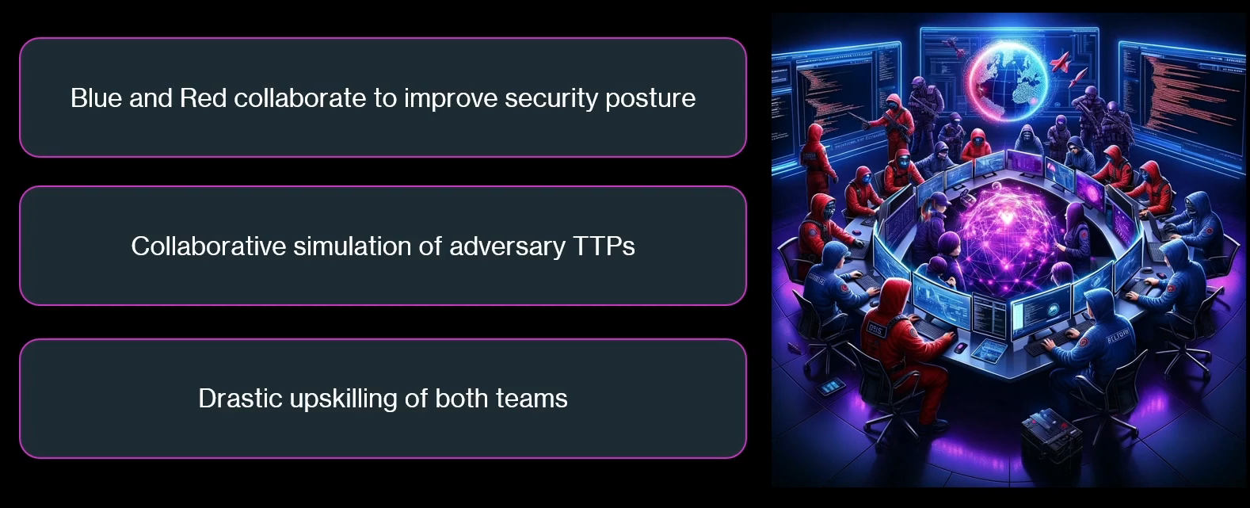
PURPLE TEAMING
Blue and Red Team collab to improve security posture

Slide 16
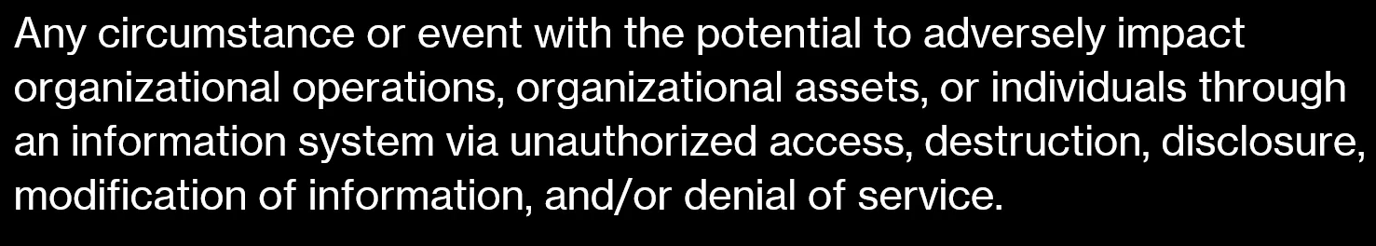
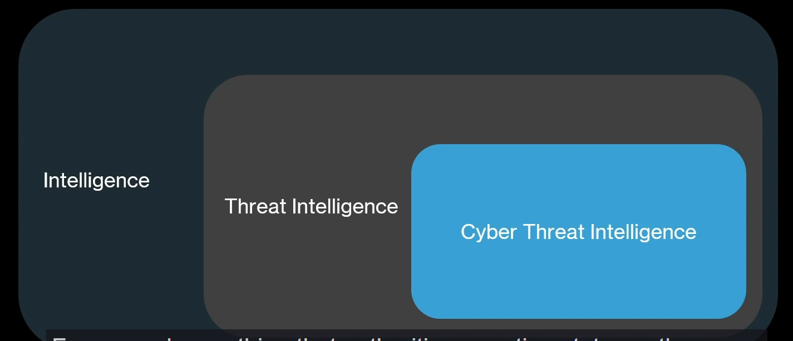
THREAT
INTELLIGENCE, THREAT INTELLIGENCE, AND CTI
Intelligence: It is a very broad term.
It means collecting, analyzing, and using information to understand situations and make decisions.
Threat Intelligence: Threat specifically, we talk about specific adversaries, specific threat actors that exist out there in the wild, and we talk about tactics, techniques, and procedures that they leverage, still this doesn’t need to be connected to cyber security, meaning there are a lot of threat actors out there that do bad things by leveraging certain tactics, techniques, and procedures that are not connected at all to cyber security.
Cyber Threat Intelligence: We really talk about adversary threat actors that leverage tactics which are in fact leveraging cyber security. So, if you have nation state sponsored hacking group that executes certain operations and leverages TTPs, this is Cyber Threat Intelligence

Slide 17
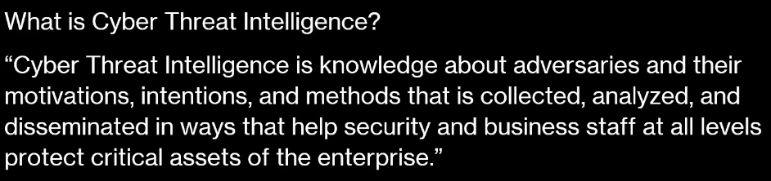
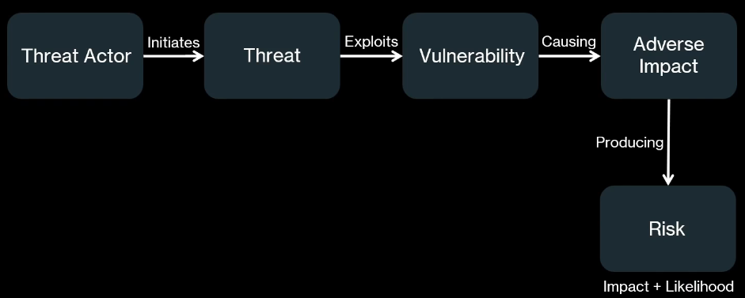
CYBER THREAT INTELLIGENCE
THREATS, VULNERABILITIES, AND ATTACKS

Slide 18
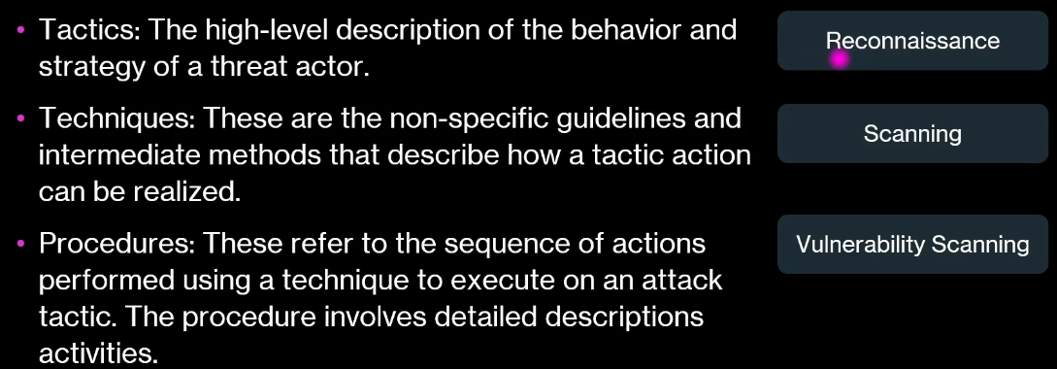
THREAT-INFORMED-DEFENSE
• What is the mission of my organization?
• What threat actors are interested in my organizations industry?
• What are the motivations of those threat actors?
• What TTPs are those threat actors are using?
• How can I detect and protect any organization against those TTPs?
Tactics, Techniques, and Procedures

Slide 19
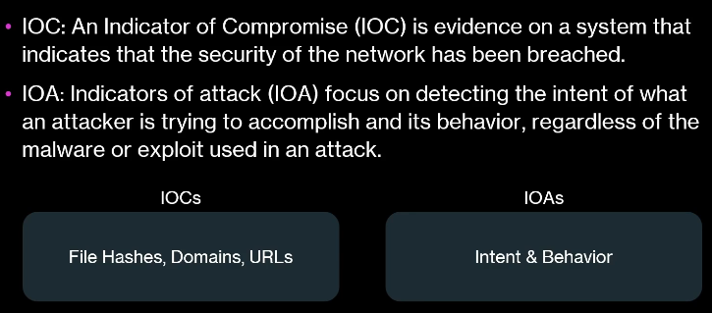
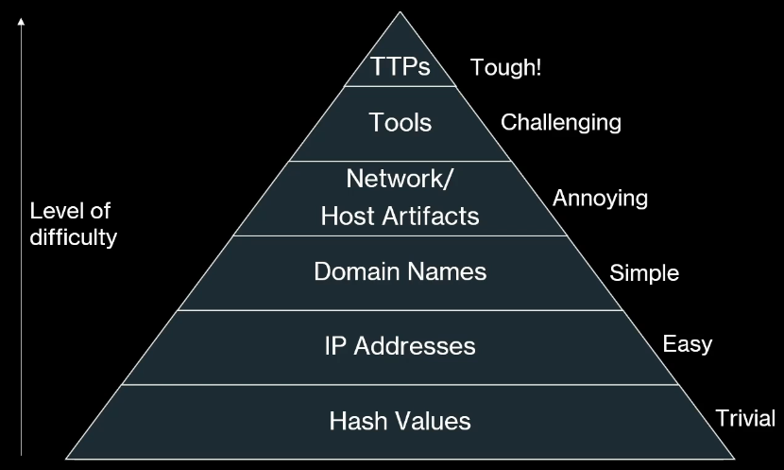
IOCs and IOAs
Pyramid of pain

Slide 20
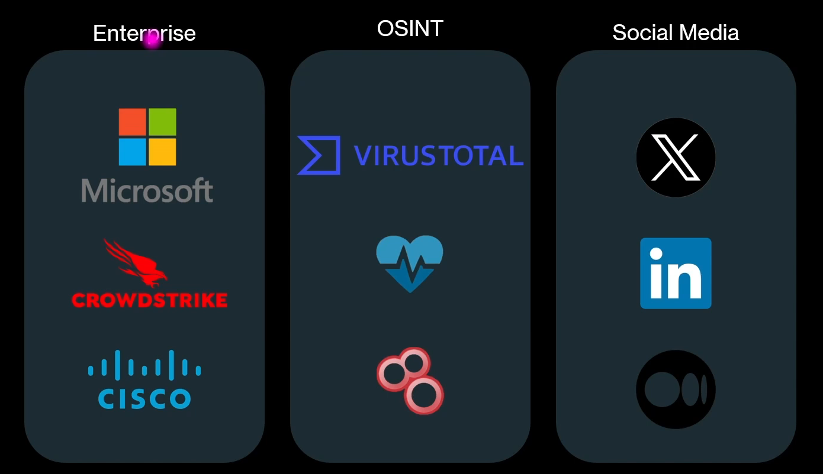
CTI Sources

Slide 21
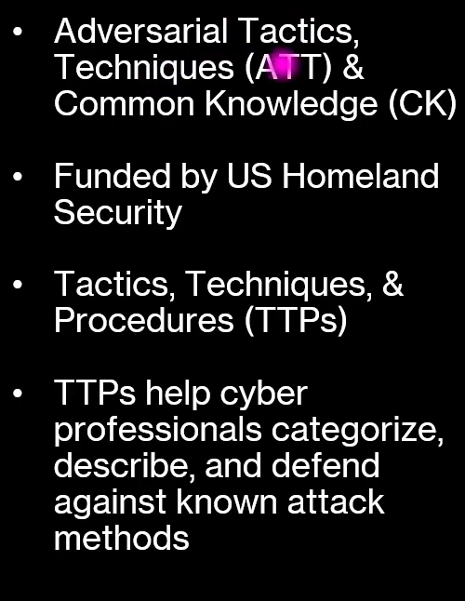
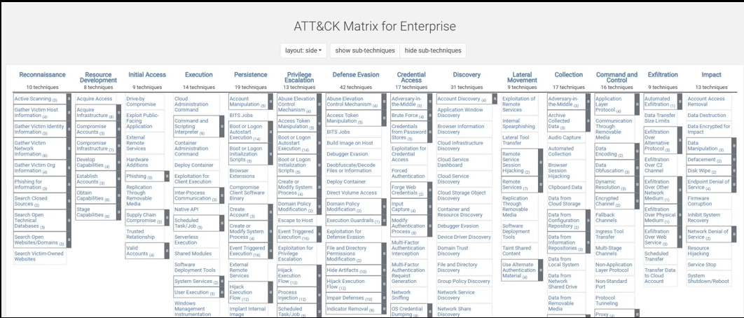
MITRE ATT&CK Framework

Slide 22
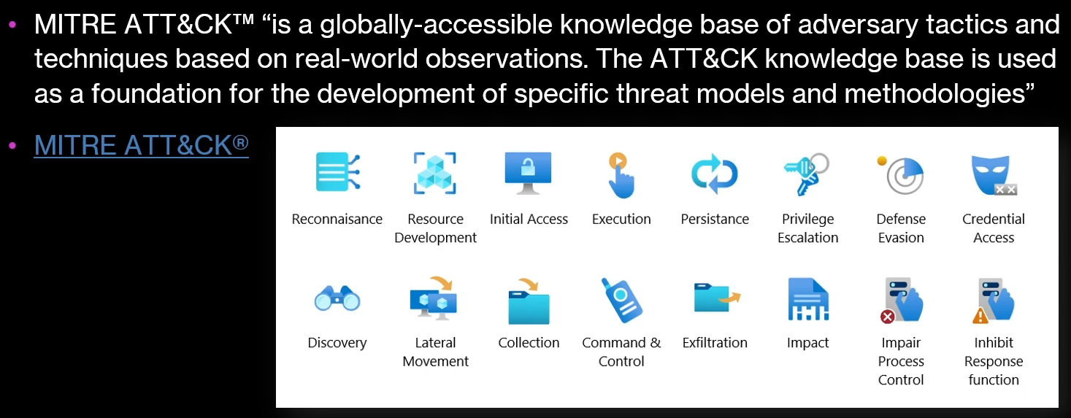
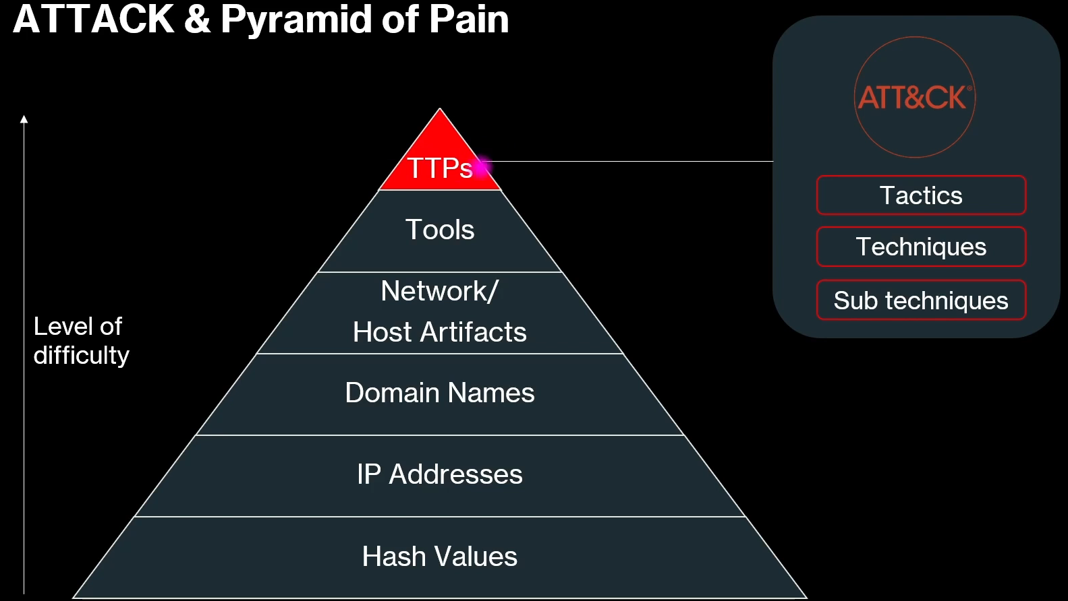
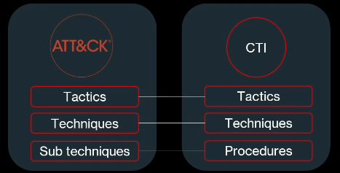

Slide 23
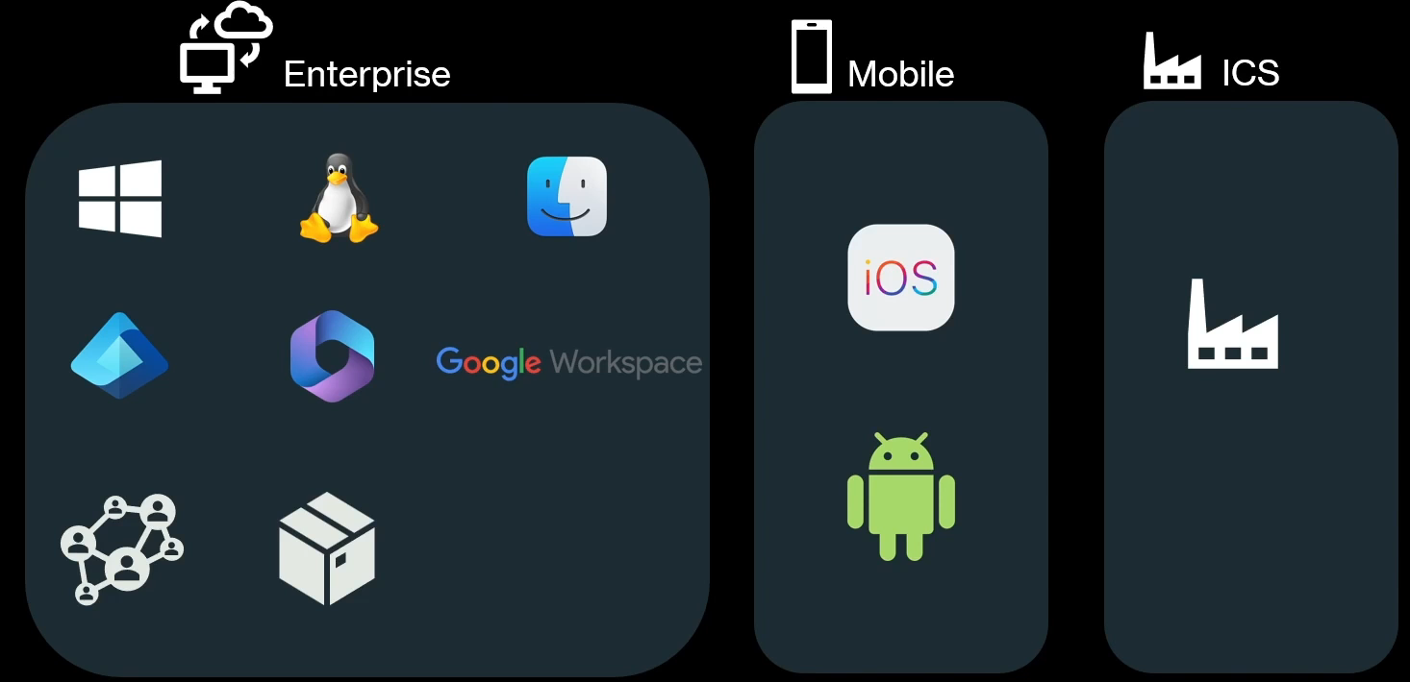
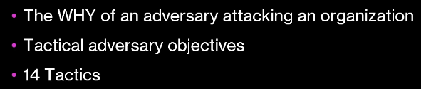
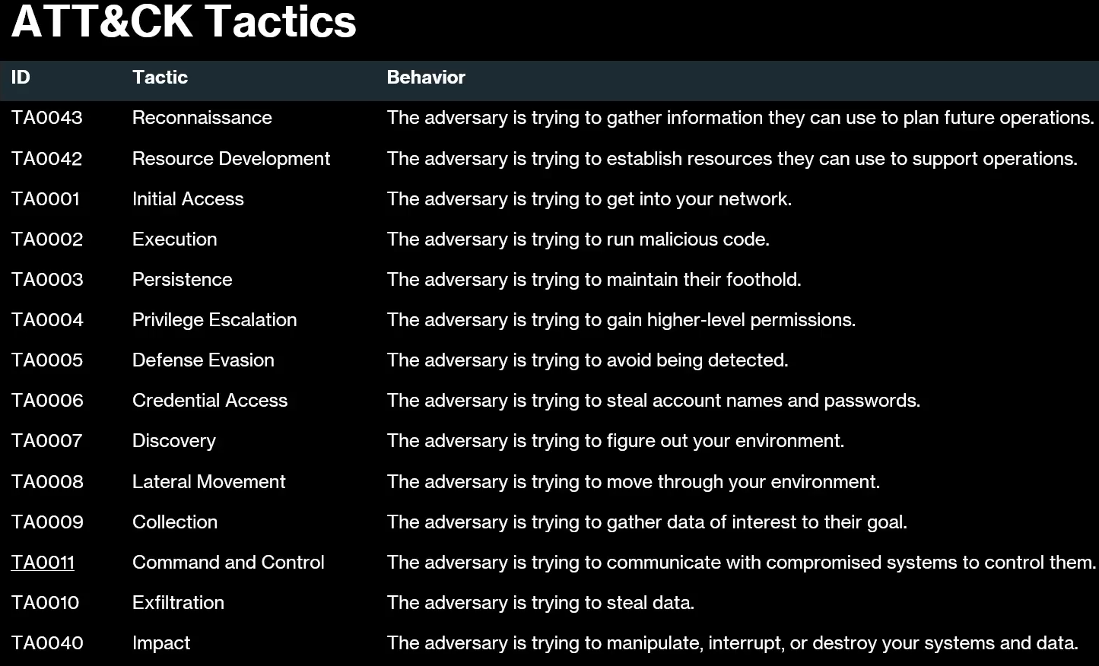
ATT&CK Matrices
TACTICS

Slide 24

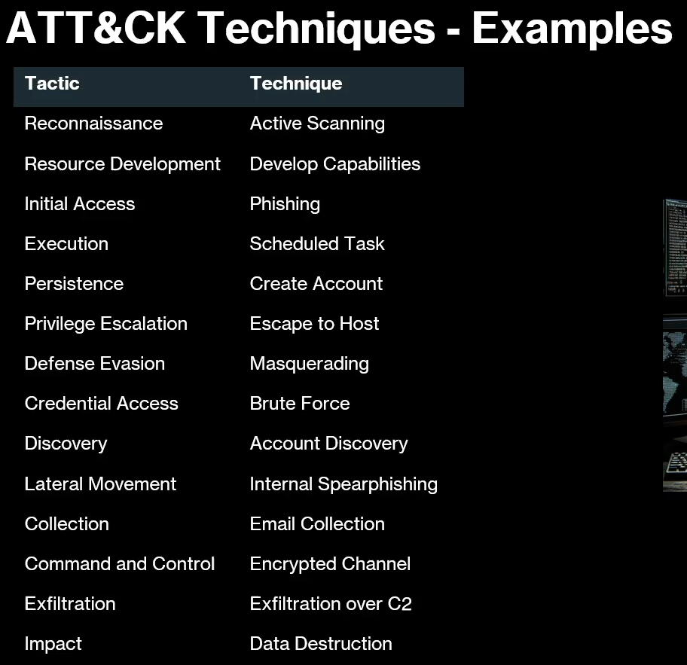
TECHNIQUES

Slide 25
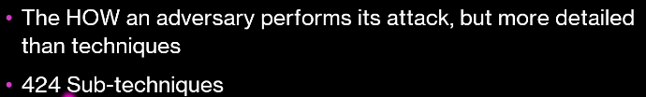
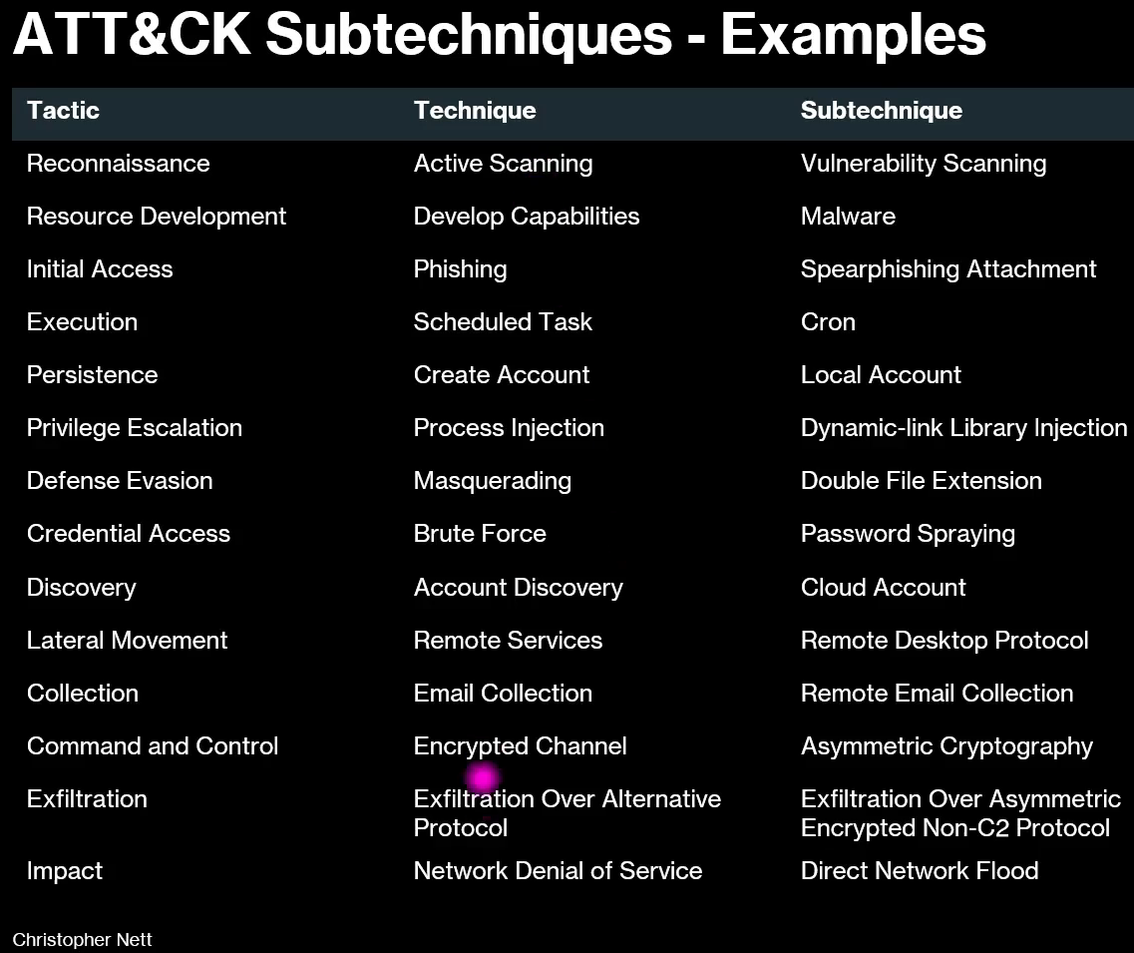
SUB-TECHNIQUES

Slide 26
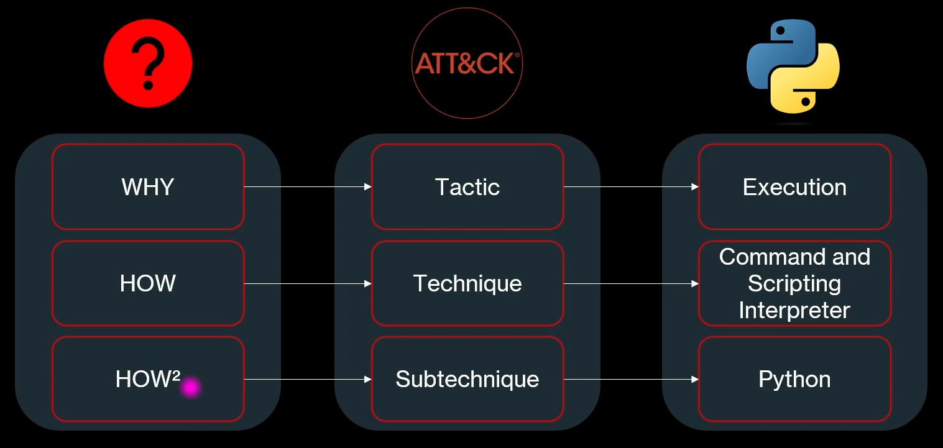
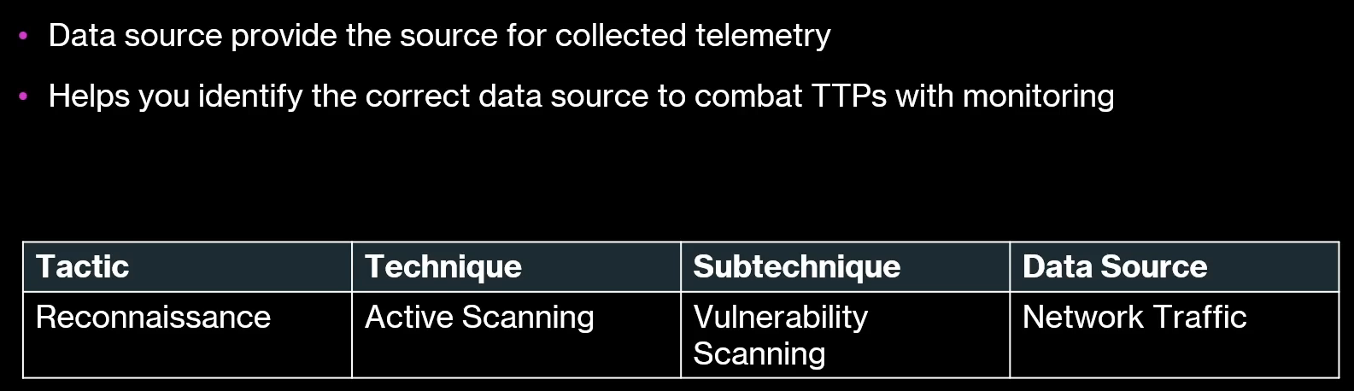
TACTICS, TECHNIQUES, AND SUB-TECHNIQUES
DATA RESOURCES
Telemetry is the automatic collection and transmission of data from one place to another for monitoring and analysis

Slide 27
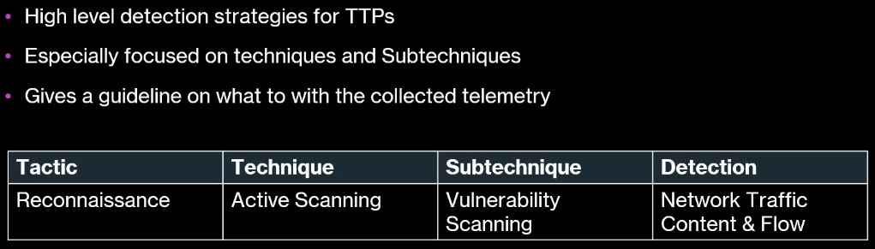
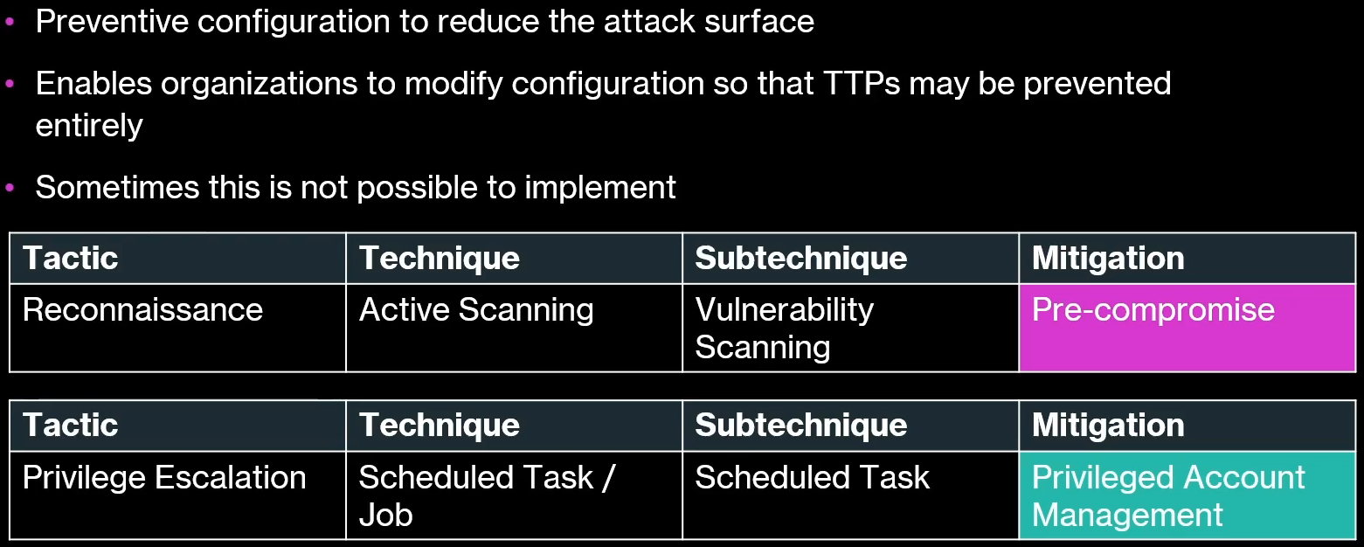
DETECTIONS
Alerts or findings that indicate something unusual or harmful has been identified
MITIGATIONS

Slide 28
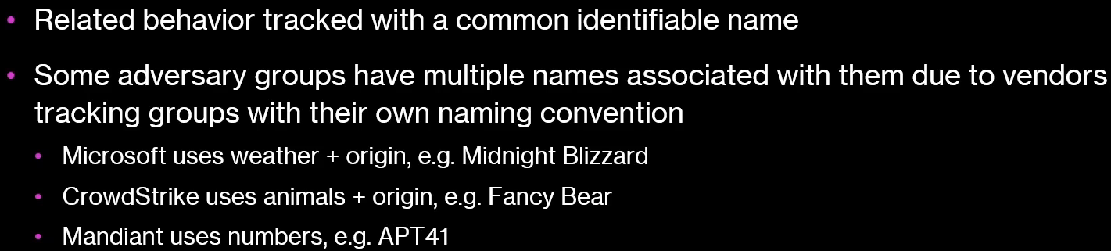
GROUPS
Adversary - Any person, group, or entity that tries to attack, exploit, or harm a system, network, or data
This text explains how cybersecurity vendors track threat actor groups using different naming conventions.
• Vendors assign unique names to track related adversary
behaviors.
• Threat groups often have multiple names across different
companies.
• Examples include Microsoft (weather patterns), CrowdStrike
(animals), and Mandiant (numerical designations)
SOFTWARE
• Actual tools or malware used by adversaries
• Software is always linked to techniques, groups and campaigns
• Tools can be commercial, open-source, built-in, or publicly
available software
• Malware can be commercial, custom closed source, or open-
source software intended to be used for malicious purposes

Slide 29
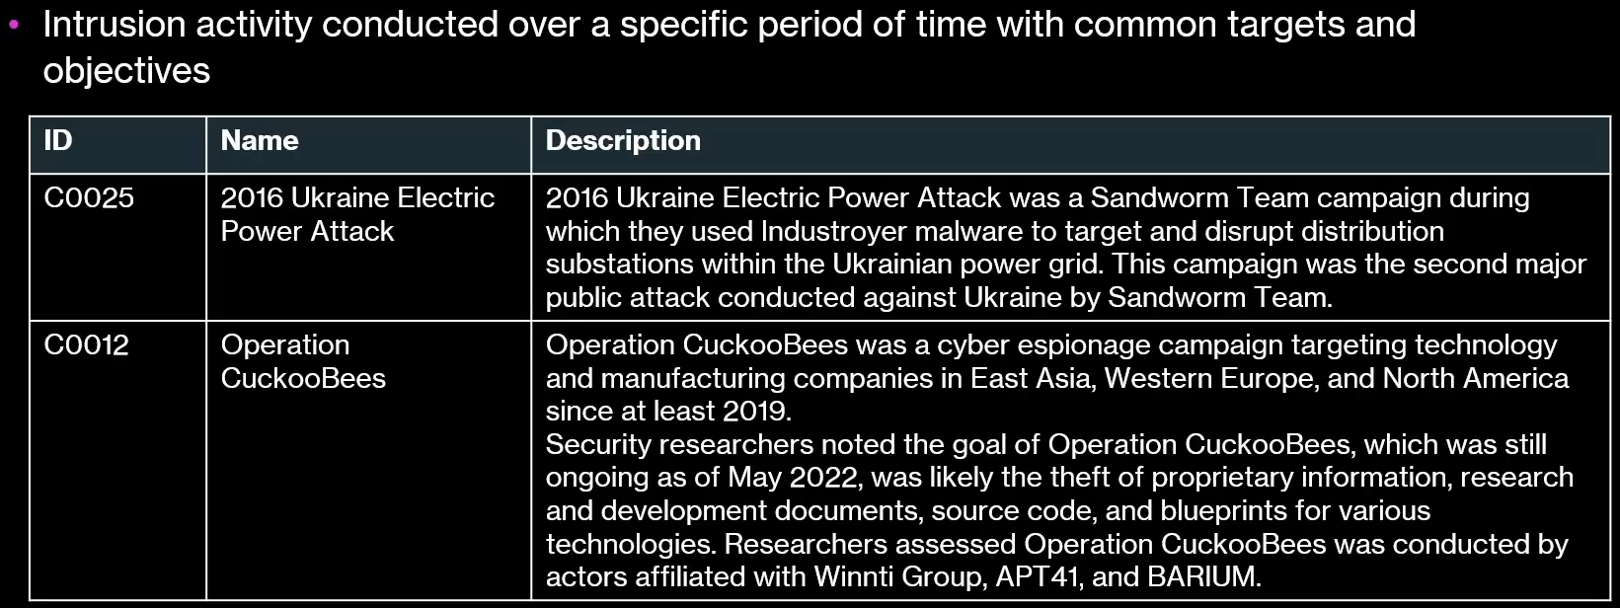
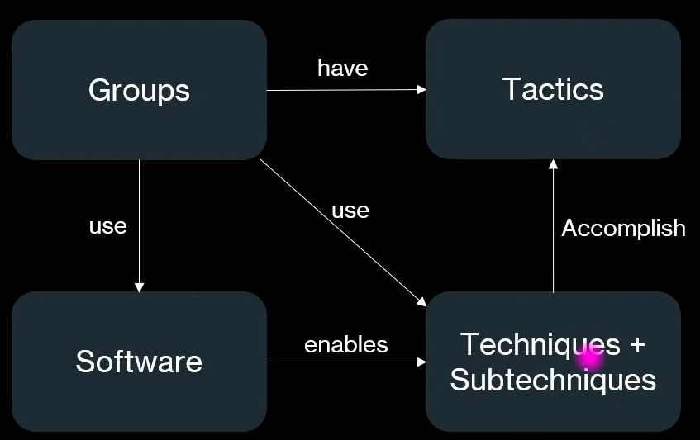
CAMPAIGNS
A campaign is like a planned operation where attackers don’t just attack once—they repeat, adapt, and continue targeting victims using different methods
RELATIONS
It shows step-by-step actions (tactics & techniques) that attackers use to break into and move inside company systems

Slide 30
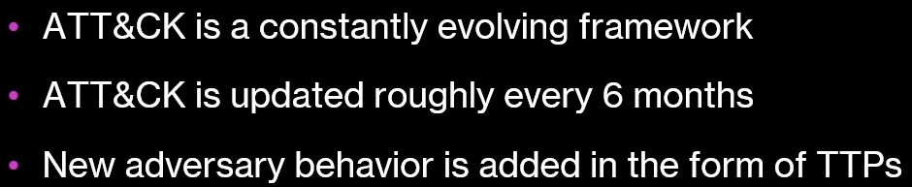
ENTERPRISE MATRIX
It shows step-by-step actions (tactics & techniques) that attackers use to break into and move inside company systems.
An enterprise matrix is a comprehensive, globally accessible knowledge base of adversary tactics and techniques observed in real-world cyberattacks
EVOLUTION OF ATT & CK

Slide 31
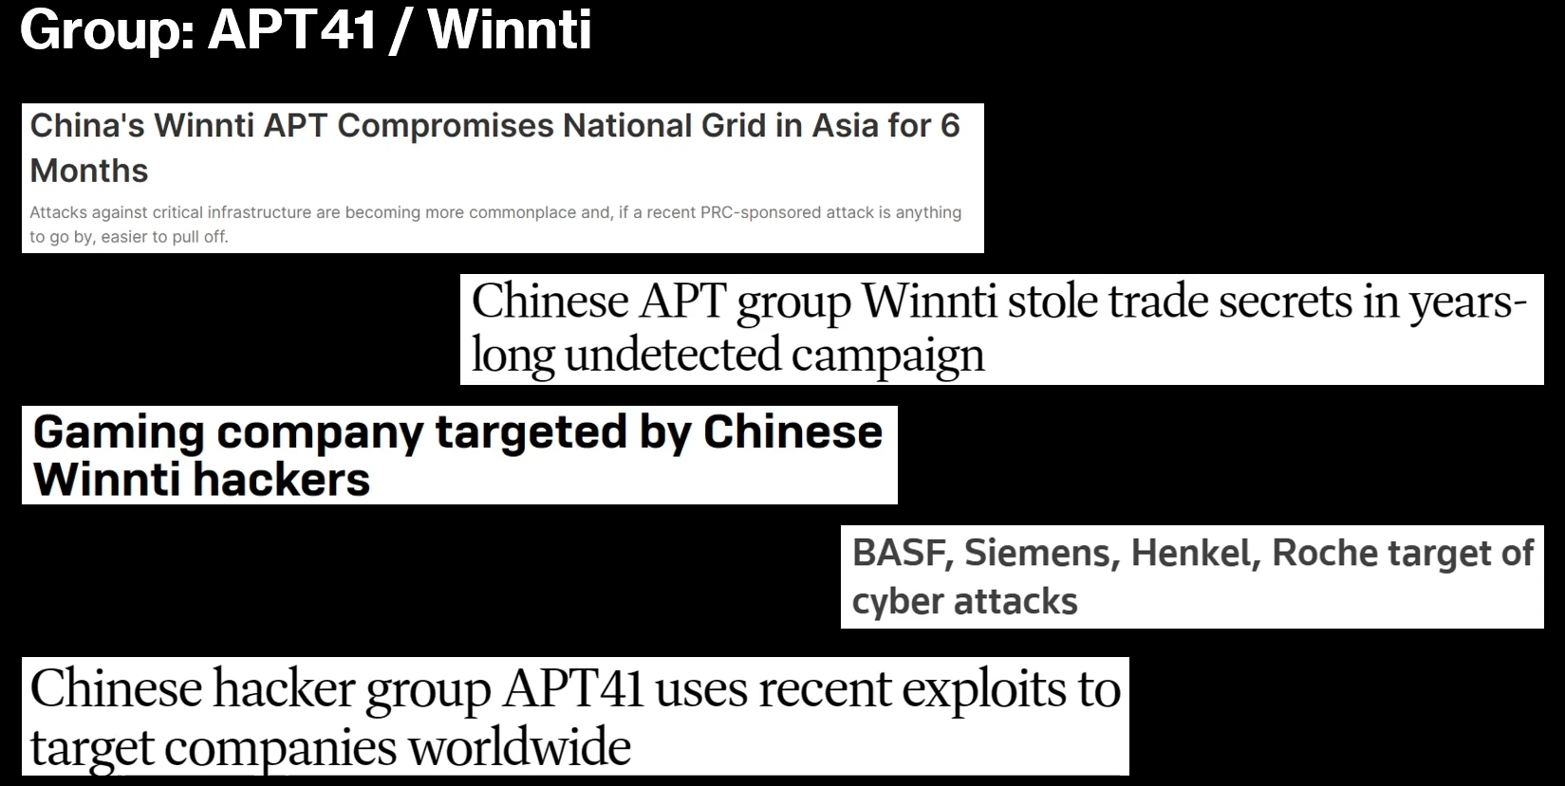
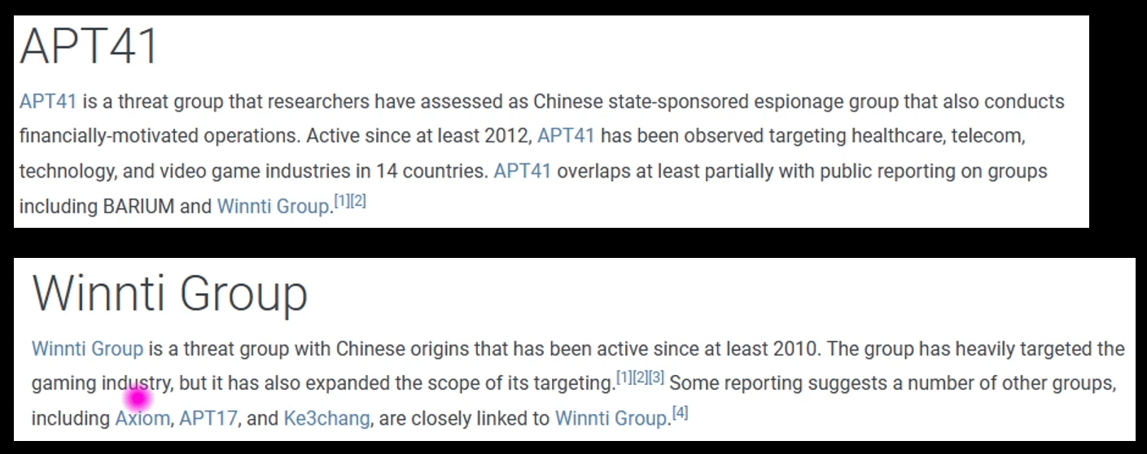
Section 5:
Case Study I - Group APT41 / Winnti
SCENARIO
CAMPAIGNS & THE GROUPS

Slide 32
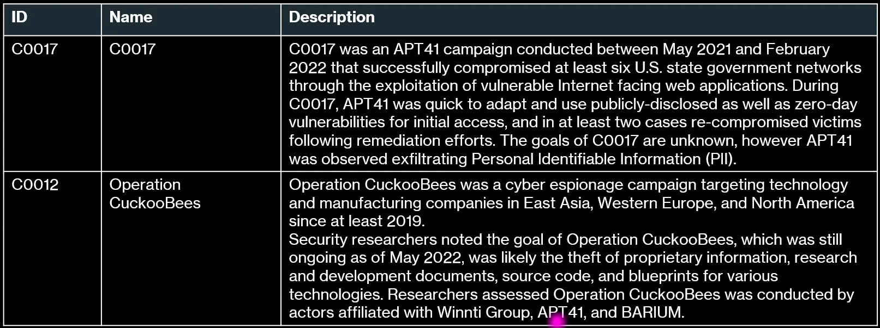
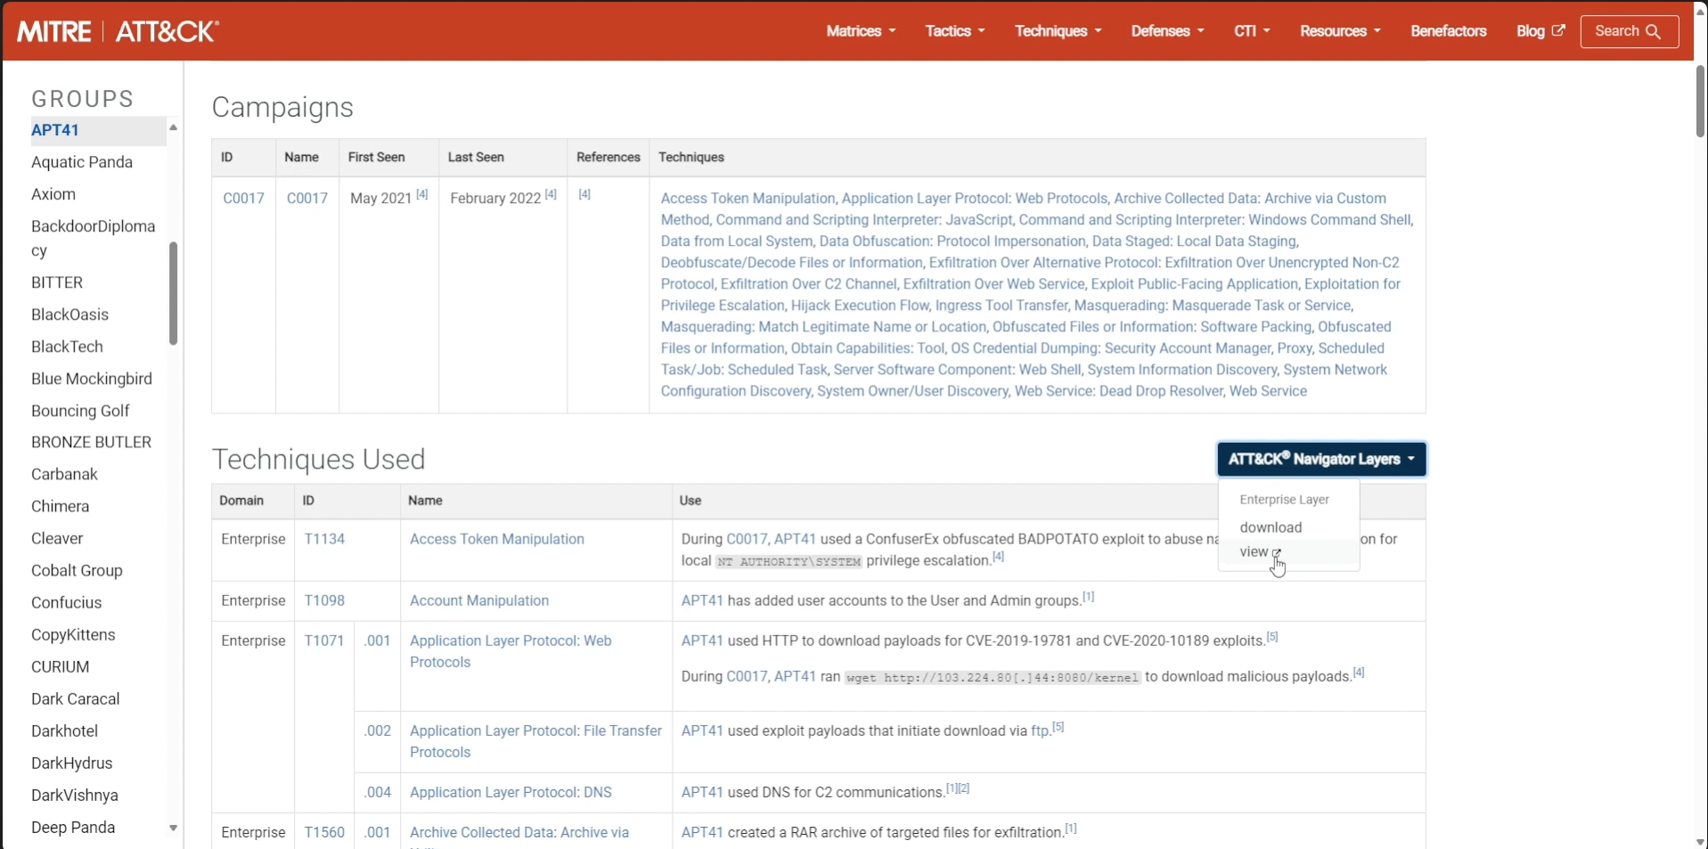
CAMPAIGNS OF APT41 / WINNTI

Slide 33
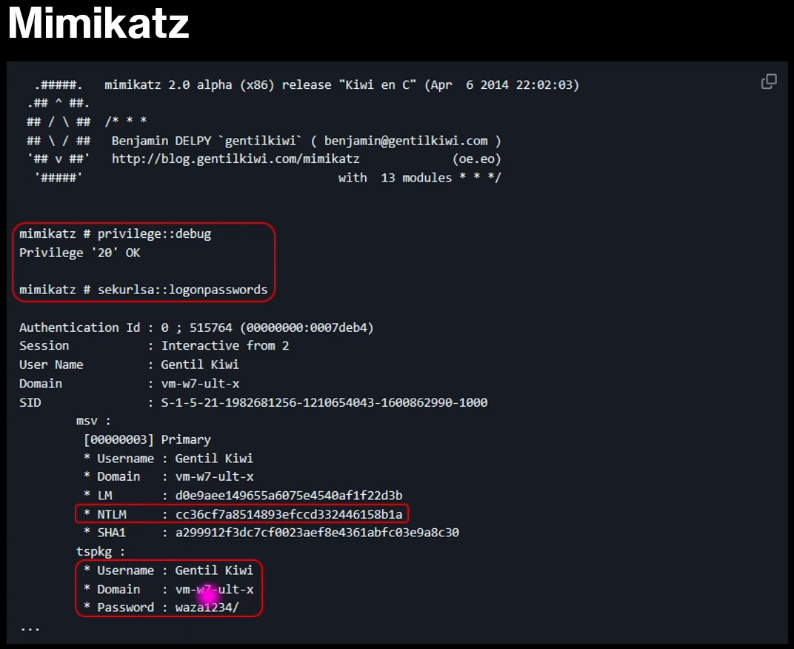
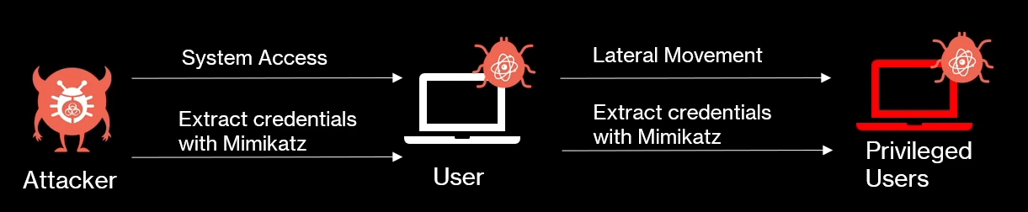
TACTICS, TECHNIQUES, AND
SUB-TECHNIQUES

Slide 34
DETECTIONS & MITIGATIONS
https:// attack.mitre.org/techniques/T1003/001
In the MITRE ATT&CK, Detection and Mitigation are two critical concepts used to defend against cyber attacks. They are mapped to each adversary technique so security teams know how to identify and stop threats.
Detection explains how you can identify that a specific attack technique is happening in your environment.
• It focuses on monitoring, logs, alerts, and behaviors that indicate
malicious activity.
• Goal: Detect the attack as early as possible before damage happens.
Mitigation explains how to prevent or reduce the impact of an attack technique.
• It focuses on security controls, configurations, and best practices.
• Goal: Stop the attack before it succeeds or limit its impact.

