Slide 1
CCNA
Introduction to networking and internet (what, models)
LAN, CAN, MAN, WAN
IP addressing, Devices
Switching Fundamentals (VLAN, STP, EtherChannel)
Fundamentals of IP routing (static, dynamic, eigrp, and ospf)
DHCP, DNS
Access Control List, NAT
Wireless
SDN

Slide 2
INTRODUCTION
Node: Network:
Internet: Globally connections of private autonomous system is called internet.
Medium: 1. Wired - Straight through (different ), Cross over (same device), Roll over (command line access)
2. Wireless

Slide 3
Models
There are two types of models: 1. TCP/IP - 5layers – real world
2. OSI (Open System Interconnection) – 7layers -
OSI: OSI – ISO(International organization of Standardization) – early 1980’s
Each layer defines some function which takes part in data communication between two devices.
Standardization:

Slide 4
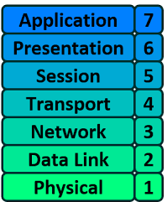
Models
User interface: http, email (pop3, Imap), DHCP, DNS
FORMAT: text (ASCII, ), video(Stream, MP4), IMG(PNG, JPEG)
Create, maintain, terminate (Appletalk)
End-end communication (UDP, TCP) – segment,Datagram
Ip address, Path determination (Protocols – Routed, Routing) – Packets
Physical address (Mac-address) – globally unique - Frame
Wired, Wireless
A
B

Slide 5
LAN (Local Area Network)
CAN – college (campus area network) MAN – cities (metropolitan area network)
WAN – Wide Area Network (Global)

Slide 6
IP Addressing
There are two types of ip addresses: IPV4, IPV6
Private (can repeatedly used in different network )
Public (Unique)
IPV4: 32 -- 0000000.00000000.0000000.0000000
IPV6: 128 ---

Slide 7
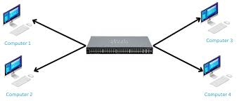
Network Devices
10.0.0.1 /24
10.0.0.3 /24
10.0.0.4 /24
10.0.0.2 /24

Slide 8
IPV4
Classes: 1. ClassA - (0 2^7-1) (0-127) (1.0.0.0 – 127.255.255.255) 10.x.x.x /8
10.0.0.0 – 10.255.255.255
2. ClassB - (128 + 2^6-1) (128 - 191)(128.0.0.0 – 191.255.255.255) /16
172.16.0.0 – 172.31.255.255
3. ClassC - (192 + 2^5-1) (192 - 223) /24
192.168.0.0 – 192.168.255.255
4. ClassD - (224 + 2^4-1) (224 - 239) Multicast address
5. ClassE - (240 - 255) (Research and development)
11111111
76543210
128+64+32+16+8+4+2+1 = 255

Slide 9
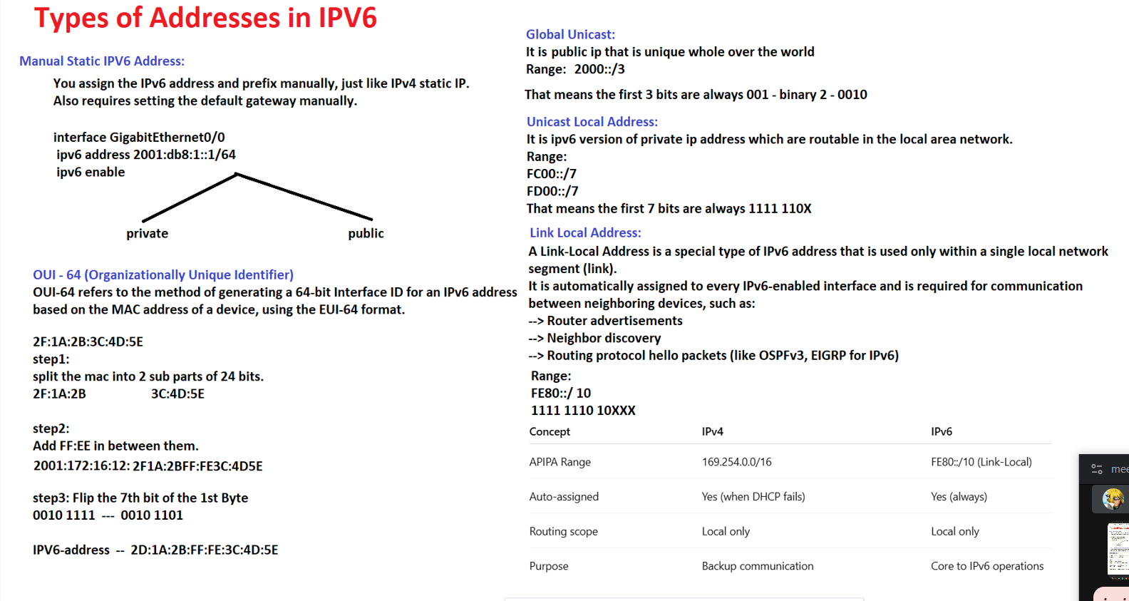
IPV6

Slide 10
IPV6
10.0.0.1 /8 - subnet mask
00001010 . 00000000 . 00000000. 00000001
Network address Host address Network address: 10.0.0.0 /8 Broadcast address: 10.255.255.255
Network-Address: Subnet-mask:

