Slide 1
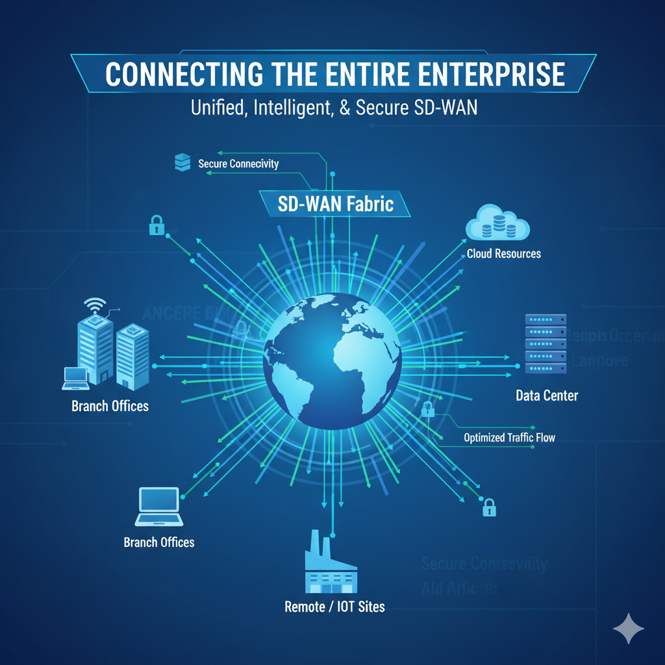

Slide 2
TOPICS
What is wide area networking?
How wan has been evolving over years
Let’s design typical enterprise network
Issue in traditional enterprises form wan perspective (why sometimes new??)
How these issues can be resolved? SD-WAN introduction
SD-WAN solutions is a big puzzle. Let’s break it down, control plane and data plane. Can we separate them? Any benefits? Concept of next route Tunneling
Let’s combine all the process together for a complete solution

Slide 3
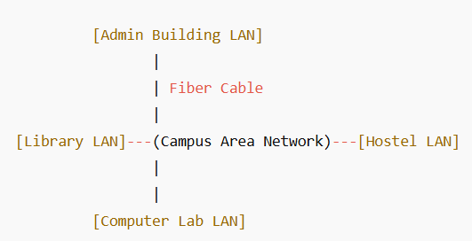
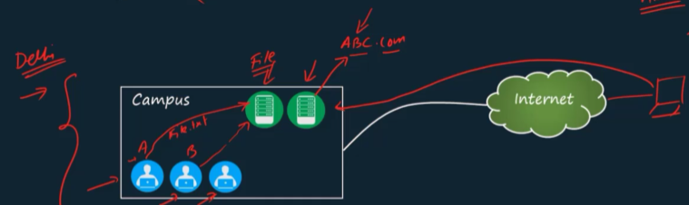
1-CAMPUS AREA NETWORK
What is CAN (Campus Area Network)?
A Campus Area Network (CAN) connects multiple Local Area Networks (LANs) within a limited area like a college campus, business park, or military base. It links buildings that are close to each other (usually within a few kilometers).
Example:
A university network that connects the library, labs, and admin office together — all sharing printers, internet, and resources.

Slide 4

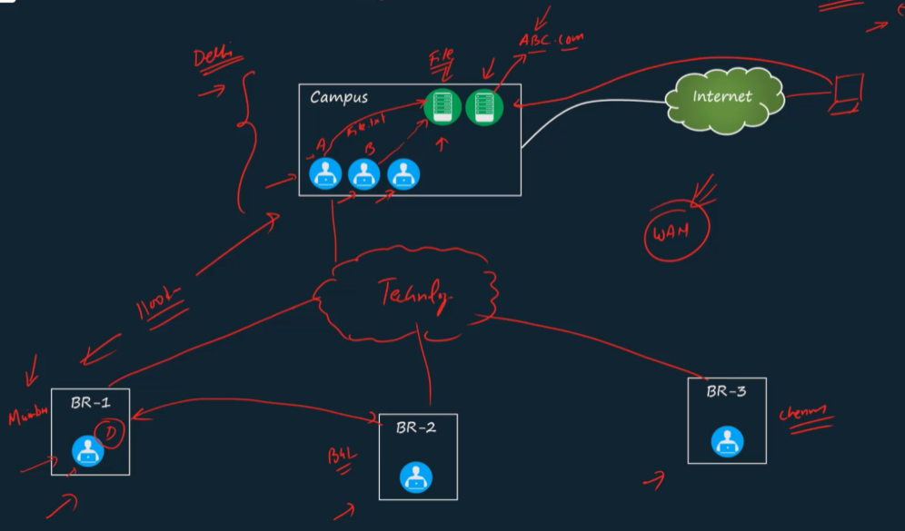
2-WIDE AREA NETWORK
What is WAN (Wide Area Network)?
A Wide Area Network (WAN) connects networks over large distances, like between different cities or countries. It uses public networks (like the internet) or private leased lines.
Example:
A bank network connecting its branches in Delhi, Mumbai, and Bangalore using leased lines or VPN over the internet.

Slide 5
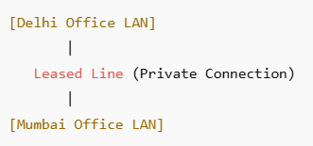
WAN-EVOLUTION
1. Leased lines 2. ATMs and FR 3. MPLS 4. Internet 5. GRE 6. IPSEC DMVPN
7. SD-WAN
1. LEASED LINES:
A leased line is a dedicated, private connection between two locations that is always active and not shared with anyone else. It’s used by businesses to connect offices in different places with fast and reliable internet or data transfer.
How It Works:
• The telecom company (like Airtel, BSNL, or Jio) provides a direct cable connection between two sites.
• Unlike normal internet, the bandwidth is fixed and guaranteed (e.g., 100 Mbps always).
• It’s secure because no other user shares that line.
The routers of both branches are connected through an ISP (has their routers in between this two branches), but they function as if they are directly connected to each other.

Slide 6
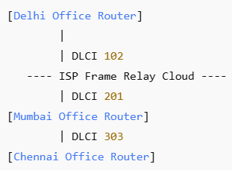
2. ATMs and FR:
What is Frame relay
Frame Relay is a Wide Area Network (WAN) technology that was used before modern systems like MPLS or SD-WAN.
It allows multiple offices to share a single physical connection to an ISP’s network, while still communicating as if they have private links between them.
How It Works:
Each site connects to the Frame Relay network using a router.
Inside the provider’s cloud, virtual connections called DLCIs (Data Link Connection Identifiers) link the sites together.
Data is sent in small units called frames (hence the name Frame Relay).
Cost: expensive
A company has three offices — Delhi, Mumbai, and Chennai. Each office connects to the service provider’s Frame Relay network through one physical line. Inside the provider’s network, virtual circuits are created between each office, so they can exchange data efficiently.

Slide 7
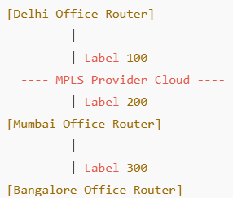
3. MPLS:
What is MPLS
MPLS is a high-speed, reliable WAN technology that sends data using labels instead of IP addresses. It helps route packets faster and more efficiently through a service provider’s network — like express lanes on a highway for your data.
How It Works:
When data enters the MPLS network, it gets a label (a short number).
Routers in the provider’s network use this label to forward data quickly — they don’t need to check the IP address every time.
This creates label-switched paths (LSPs) — fixed routes that ensure speed and reliability.
A company has offices in Delhi, Mumbai, and Bangalore.
Each office connects to the service provider’s MPLS cloud.
When data travels from Delhi to Mumbai, it follows a label-switched path inside the MPLS network — providing QoS (Quality of Service) for voice, video, or critical applications.

Slide 8
4. INTERNET: 18:02
What is INTERNET
When branches use the internet without SD-WAN or VLAN, it means each branch uses the normal public internet connection — just like your home Wi-Fi — to access online services, but not to connect directly to each other’s local networks.
How It Works:
→ Each Branch Has Its Own ISP Connection
Every branch (like Delhi, Mumbai, Chennai) buys an internet connection from a local ISP (Internet Service Provider)
Example: Airtel in Delhi, Jio in Mumbai.
→ Access Cloud Services or Websites
Employees in each branch use the internet to access email, cloud storage (like Google Drive), CRM systems, or company websites.
These services are hosted on the internet, so every branch can use them without needing a private link.
→ Communication Through Online Platforms
Branch employees communicate using Zoom, Google Meet, or Teams, which all work over the public internet.
→ No Direct LAN-to-LAN Connection
Branches cannot access each other’s local files or printers because there’s no VPN or VLAN connecting them privately.

Slide 9
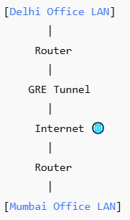
5. GRE (traffic forwarded based routing table)
What is INTERNET
GRE is a tunneling protocol that allows you to encapsulate one network protocol inside another. It is commonly used to connect two networks over the internet or WAN, making them appear as if they are directly connected, even if the connection goes over a public network.
How It Works:
GRE creates a “tunnel” between two routers. Packets from one network are wrapped (encapsulated) in GRE and sent through the tunnel. At the other end, the packets are unwrapped and delivered to the destination network. Works with any Layer 3 protocol (not just IP).
A company has offices in Delhi and Mumbai, and both offices are connected to the internet. A GRE tunnel is established between the routers at the Delhi and Mumbai offices. This tunnel makes it appear as if the two offices are directly connected, allowing employees to access internal servers and resources securely over the tunnel, even though the data travels through the public internet.

Slide 10
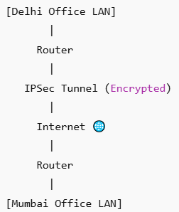
5. IPSEC (ACL controls the tunnel traffic)
What is INTERNET
IPSec is a security protocol used to encrypt and protect data sent over a network, especially over the internet or WAN. It ensures that data is confidential, authentic, and tamper-proof while traveling between two locations.
How It Works:
IPSec creates a secure tunnel between two devices (usually routers or firewalls). All traffic passing through the tunnel is encrypted, so outsiders cannot read it.
It provides:
- Encryption – keeps data private.
- Authentication – ensures data comes from the correct source.
- Integrity – ensures data isn’t changed in transit.
A company has offices in Delhi and Mumbai, and both offices are connected to the internet. An IPSec VPN tunnel is established between the routers at the Delhi and Mumbai offices. All data traveling through this tunnel is encrypted, allowing employees to securely access internal servers and resources over the public internet.

Slide 11
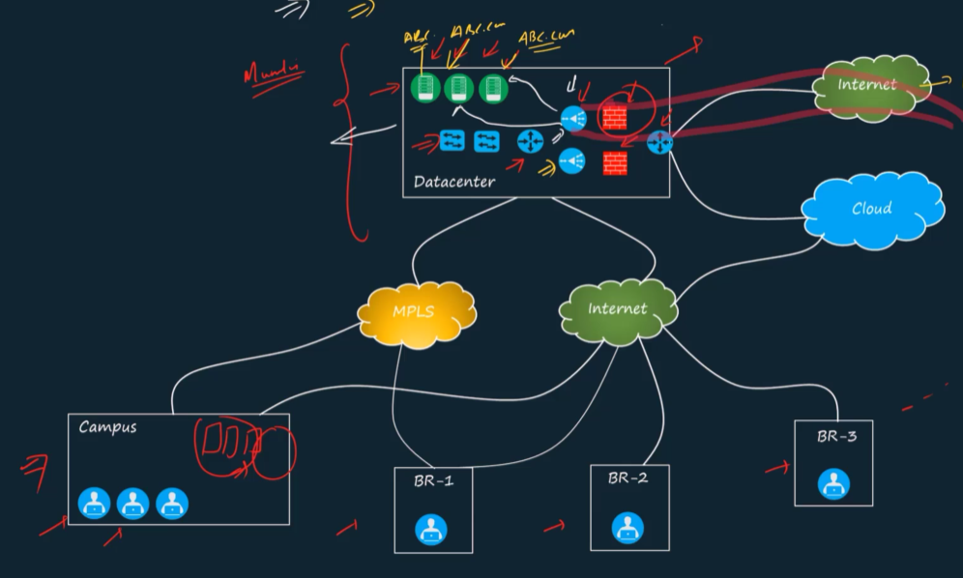
3-Design Of An Enterprise network
What is Datacenter?
A Data Center is a special facility where a large number of servers, storage systems, and networking equipment are kept together to store, manage, and process data for organizations or online services.
1000-typical enterprise design
3tier (Acc, Dist, Multi), VXLAN, ACI

Slide 12
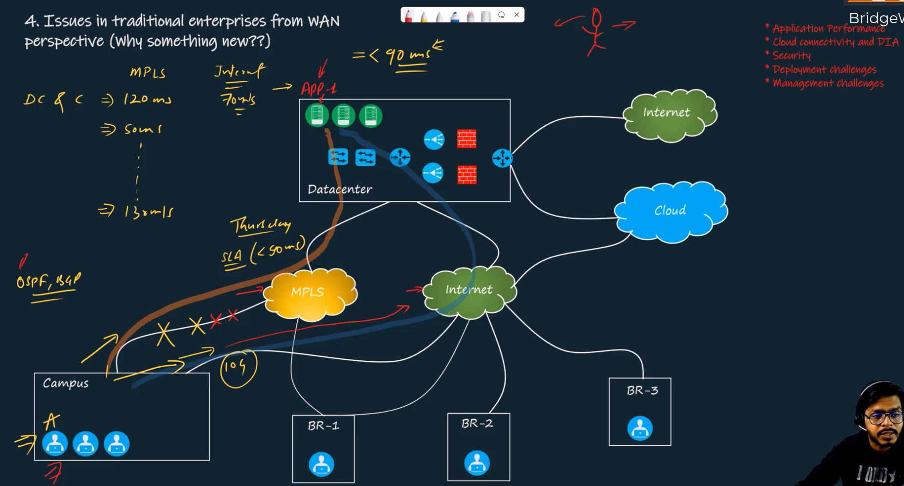
Issues Of Traditional Enterprise network (WAN)
IWAN, Performance routing

Slide 13
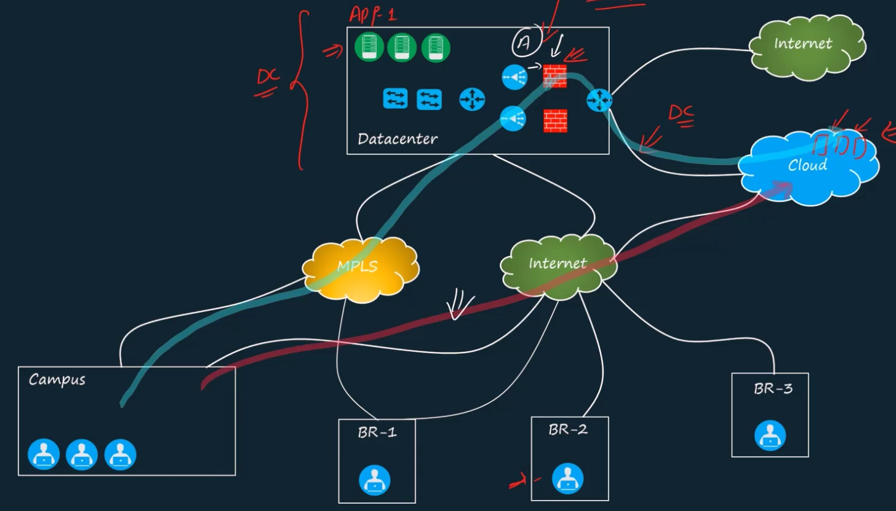
Issues Of Traditional Enterprise network (WAN)
BR1 and 2 data center, but br3 needs a vpn to go to data center

Slide 14
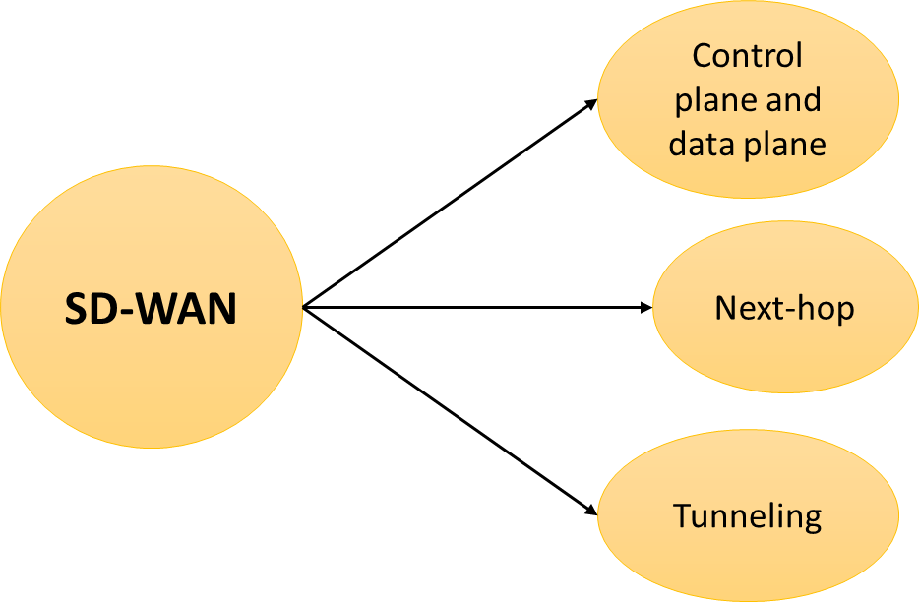
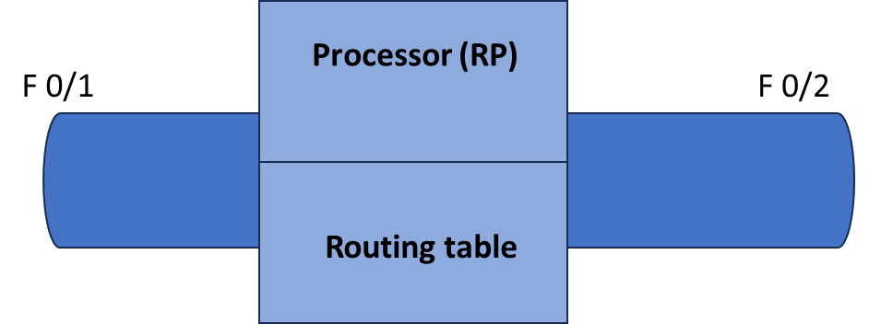
SD-WAN INTRO
Delay (Latency)
Jitter
Packet Loss
We need to feed something on smart devices and need someone to observe on this.

Slide 15
SDWAN – D1 (INTRO – V V V)
TOPICS: 1. SD-WAN solution is a big puzzle: • Control plane and Date plane. Can we separate them? Any Benefit? • concept of next-hop of a route
• Tunneling
2. Let’s combine all the pieces together for a complete solution
3. Looking slightly deeper into SD-WAN solution. Let’s introduce terms now.
4. The orchestrator: VBOND
5. Let’s talk about: Vmanage

Slide 16
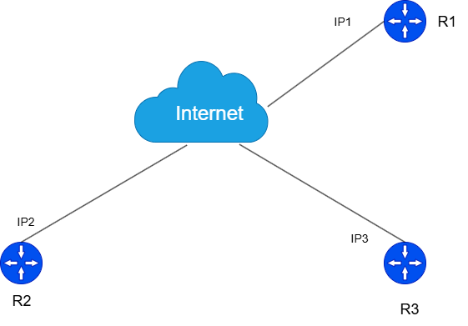
1. SD-WAN solution a big puzzle
i. CEF – Cisco Express Forwarding, FIB, LFIB
ii. Source Controller, other network devices (Router, Switch)
Source Controller – handles all control information of those routers. Other devices – handles all data plane by themselves after getting information from the Source controller
How it works: Each of the routers sends their routing table. Source device process the information and send appropriate or whole routing table to routers.
2. Concept of Next-Hop
I want that R2 should always reach R2 via R1. Full Mesh – already running – 1.1.1.0/24 via IP1 Hub & Spoke – Update need – 1.1.1.0/24 via IP3

Slide 17
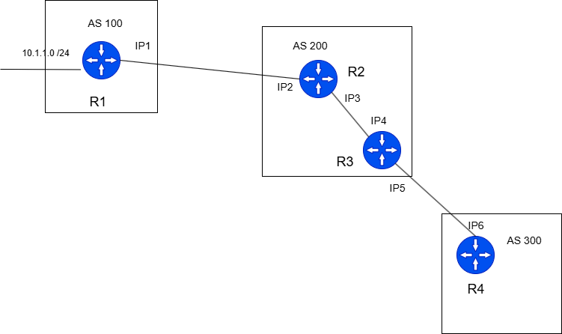
BGP
What is the next-hop for 10.1.1.0 network on every router?
R2 – IP1, R3 – IP1, R4 – IP1
BGP isn’t about sharing routes between two router, it is about sharing routes between 2As.

Slide 18
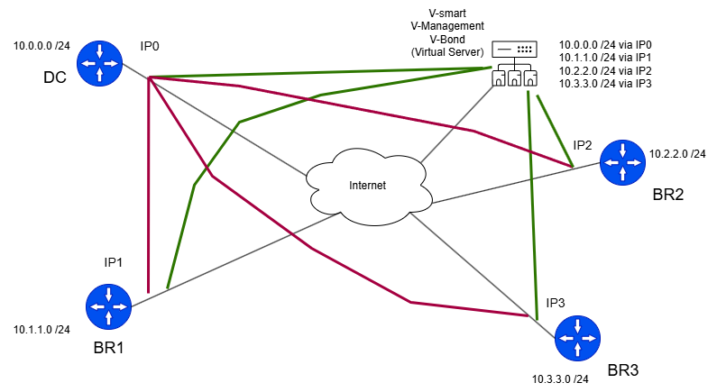
3. Tunneling (gre) – Already done
4. Let’s combine all the above
When the routers connected to the vSmart become active, they establish secure control tunnels with the vSmart controller. The vSmart then processes the received control connections and propagates the routes, setting the data center as the next-hop.
Vmanagement – It is application which is used to control the vsmart like configuration, monitoring, and troubleshooting. Configurations are pushed from Vmanagement to vsmart.
Vbond – It is responsible to give the ip address of Vsmart and Vmanagement to the Branch and DataCenter. Branches has a Gateway and DNS ip as V-Bond.

Slide 19
SD-WAN (D-2)
TOPICS:
2. Let’s talk about Vmanage
3. What we see in cisco’s documentation
4. Why we are learning network security in SD-WAN?
5. Basics of network security or CIA
1. The orchestrator: Vbond

Slide 20
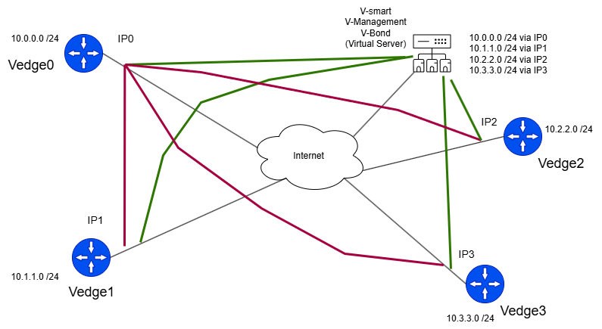
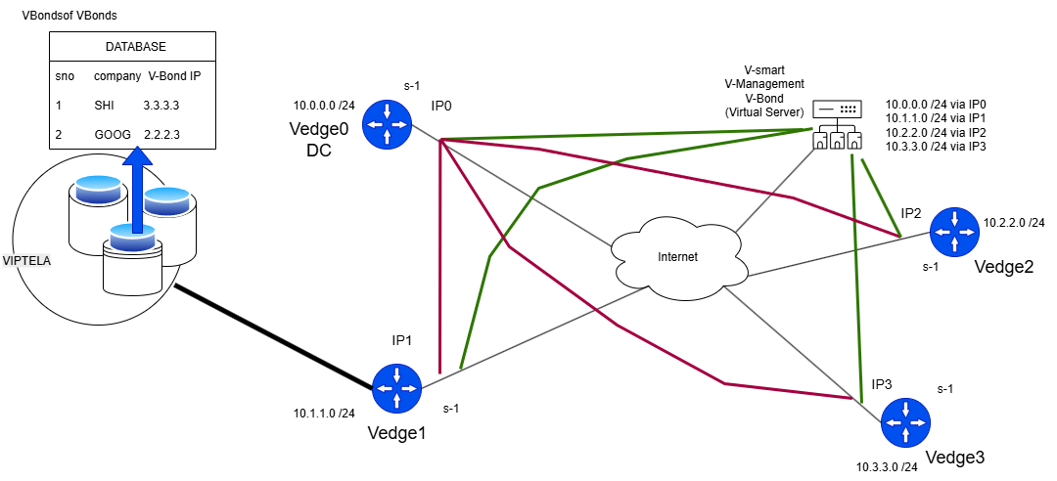
1. The orchestration: VBond
IPSEC VPN
Control connection + (TLS/DTLS)
Orchestration: Someone who can arrange things or combine things to get desired result.
Zero-Touch solution, plug and play -- when we power on this device, it create tunnel and connection everything by itself.

Slide 21
How a device get configuration after attaching to SD-WAN?
1. Device Boot & Initial Setup
When a new device is powered on:
You manually configure only a few bootstrap parameters, like:
system-ip 10.10.10.10
site-id 100
organization-name MyOrg
vbond <vbond-ip>
This minimal config allows the device to find and authenticate with the SD-WAN controllers.
2. vBond Orchestration – Authentication & Control Setup
The vBond orchestrator is the first controller the device contacts.
It helps the device discover and authenticate with:
vManage (management plane)
vSmart (control plane)
vBond ensures all devices trust each other using certificates issued by the SD-WAN PKI.
Result:
Device now forms secure DTLS/TLS control connections to vSmart and vManage.

Slide 22
3. vManage Delivers Configuration (via NETCONF)
Once authenticated:
vManage detects the new device (by its UUID and serial number) in its inventory (pre-added via the Smart Account or PnP portal).
Admin associates a Device Template and Feature Templates to that router.
vManage generates XML configuration from those templates.
It then pushes this config to the router using NETCONF over TLS.
Protocol used:
NETCONF (TCP port 830) → secure configuration channel.
Configuration includes:
Interface settings (VPN 0, VPN 512, etc.)
Routing (OMP, BGP, static)
Policies (control/data plane)
System parameters
4. vSmart Delivers Routing & Policy (via OMP)
After configuration is applied:
The router forms an OMP (Overlay Management Protocol) session with vSmart.
vSmart then sends routes and policies (centralized control policies, TLOCs, etc.) to the router.
Protocol used:
OMP over DTLS/TLS (control plane communication)

Slide 23
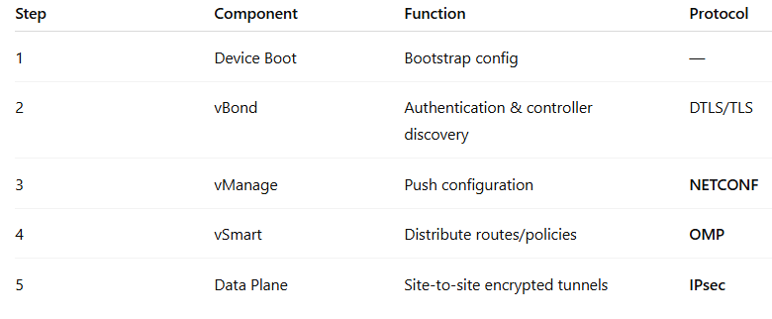
5. Operational State
Now the device:
Has its full configuration (from vManage)
Knows routing and policy information (from vSmart)
Can form secure IPsec data tunnels with other SD-WAN sites.
Data Plane Protocol:
IPsec tunnels built automatically based on OMP TLOC advertisements.
Summary Table
Step Component Function Protocol
1 Device Boot Bootstrap config —
2 vBond Authentication & controller discovery DTLS/TLS
3 vManage Push configuration NETCONF
4 vSmart Distribute routes/policies OMP
Data Plane Site-to-site encrypted tunnels Ipsec
------------------XXXXXXXXXX---------------
All together:

Slide 24
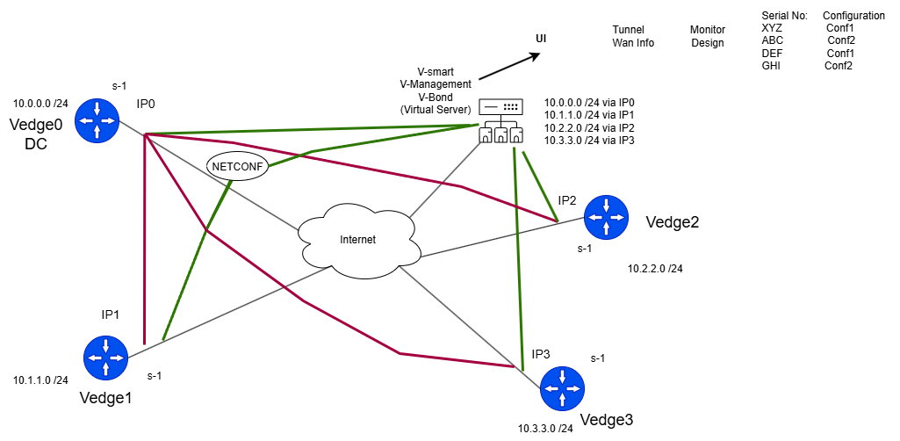
2. Vmanage: Single pane of Glass
The vManage platform is the centralized Network Management System (NMS) for the Cisco SD-WAN (Software-Defined Wide Area Network) solution. It serves as the single pane of glass for all day-to-day operations, including deployment, configuration, monitoring, and troubleshooting of the entire SD-WAN fabric.
In the SD-WAN architecture, vManage is the component that belongs to the Management Plane.
It provides a single graphical user interface (GUI) to configure and manage all devices in the SD-WAN overlay network, including WAN Edge routers, vSmart Controllers, and vBond Orchestrators.

Slide 25
Administrators use vManage to create configuration templates and policies, which are then pushed out to the devices. By applying a template, a device is switched to vManaged mode, where its configuration is centrally controlled by vManage, replacing local CLI configuration.
It utilizes protocols like NETCONF/YANG models to orchestrate policies to the rest of the SD-WAN infrastructure.

Slide 26
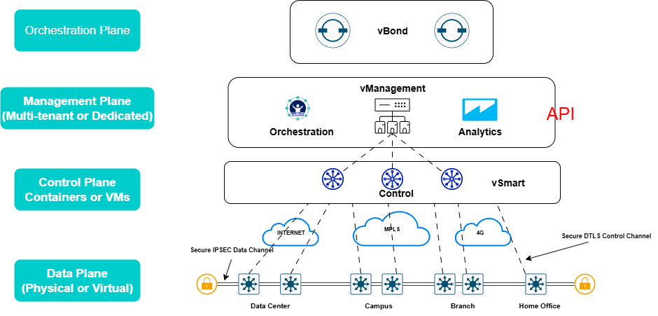
3. What we see in Cisco’s Documentation
vEdge and cEdge are the two primary types of WAN Edge Routers. These devices sit at the perimeter of a site (like a branch office, data center, or cloud) and perform the data plane functions, forming the secure overlay fabric.

Slide 27
3. Why we are learning SD-WAN?
CIA
DTLS (Datagram Transport Layer Security) is a communications protocol designed to provide security for applications that use datagram transport protocols, most commonly UDP (User Datagram Protocol)
t is essentially an adaptation of the stream-oriented TLS (Transport Layer Security) protocol, providing similar security guarantees—such as confidentiality, integrity, and authenticity—but is specifically engineered to handle the unreliable nature of datagrams (packet loss, reordering, and duplication).

Slide 28
SD-WAN (D-2)
Authentication (Public Key Infrastructure)
Confidentiality vs Authentication
Let’s combine CIA to get a complete picture of severity
Transport Layer Security (Our Control Connections)
Internet Protocol Security (Our Data Tunnels)
Let’s start talking about our LAB (If Time Permits)

Slide 29
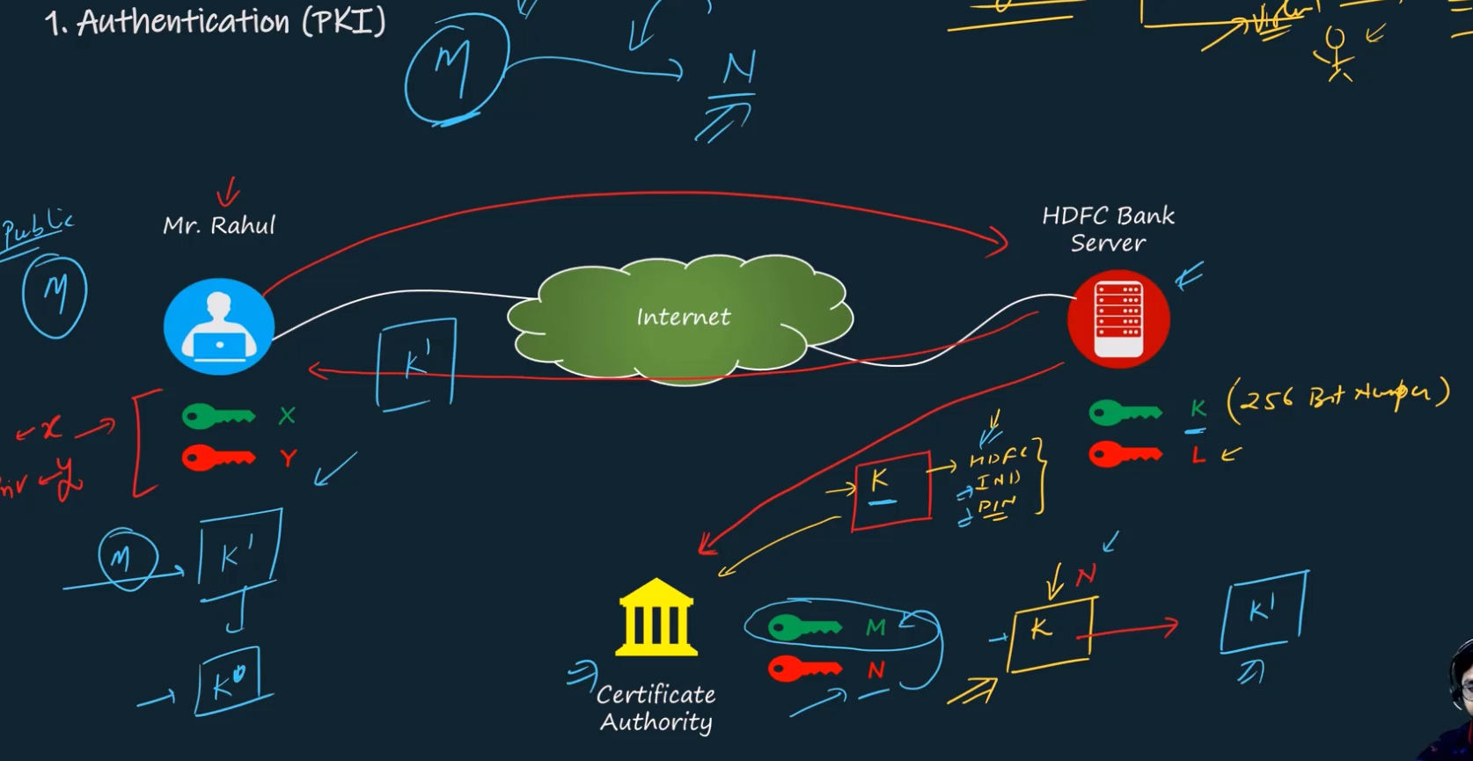
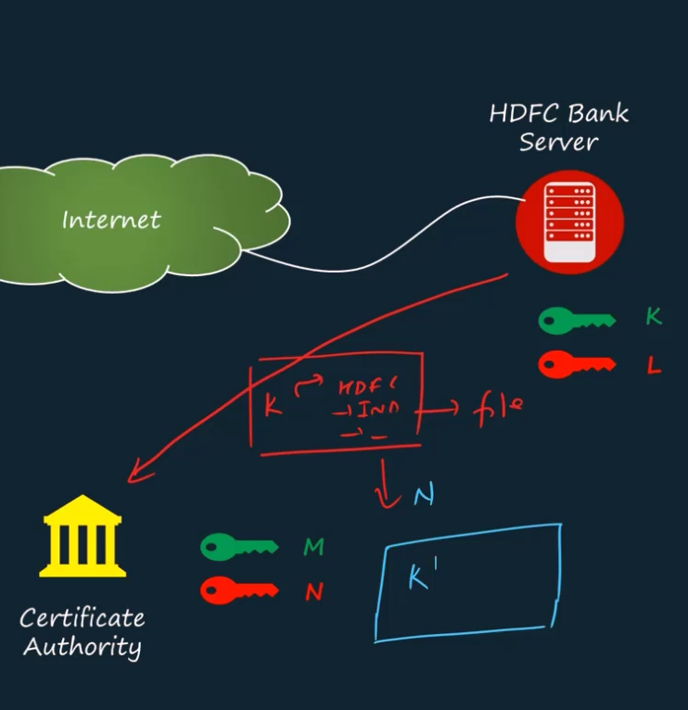
SD-WAN (D-2 )
Step1: HDFC sends its public key K with hash value.
A symmetric used for securely exchange secret keys, then both side will securely using symmetric secret keys.
Vsmart device taking care of key change problem. It will distribute algorithms.

Slide 30
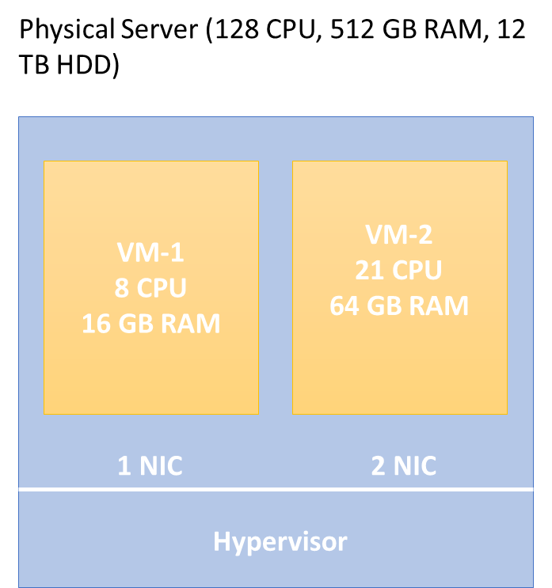
SD-WAN (D-2 )
6. Let’s talk about our lab (In GCP)
UNL

Slide 31
SD-WAN (D-3)
Let’s create our lab from scratch in GCP Server
Some basics of GCP
Understanding Eve-Ng
Let’s understand our lab and its various componenets
Vmanage as certificate authority
Virtual Routing and Forwarding aka VPN’s
Vmanage Demonstration if time permits

