Slide 1



b.Shankar sai
FINAL PROJECT

Slide 2

KEYLOGGER SECURITY
KEYLOGGER
SECURITY

Slide 3
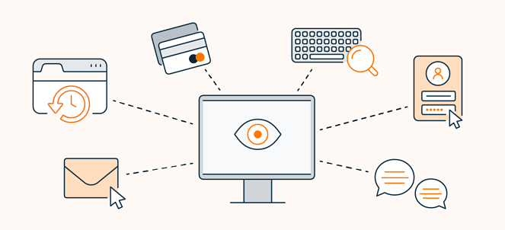
AGENDA:-
Keyloggers are a type of malware that is downloaded onto a device through an entry point. Entry points can be infected software, emails, files or cloud programs. When keylogging software gets installed on a victim’s device, it logs every keystroke to gather login credentials and other sensitive information.
TYPES OF KEYLOGGERS:
1. Software Keyloggers
2. Hardware Keyloggers
3. Mobile Keyloggers

Slide 4

PROBLEM STATEMENT:
Keyloggers are a genuine danger to clients and the clients' information, which is considered exploitative movement. The problem statement is that the keyloggers can be detected using antiviruses. Installation of hardware keyloggers is difficult without the knowledge of the owner of the system.
Keyloggers can be detected using antiviruses. Installation of hardware keyloggers is difficult without the knowledge of the owner of the system. The solution to the above existing problem is that we can build a software keyloggers instead of hardware keyloggers.
The problem statement is that the keyloggers can be detected using antiviruses. Installation of hardware keyloggers is difficult without the knowledge of the owner of the system. The solution to the above existing problem is that we can build a software keyloggers instead of hardware keyloggers.

Slide 5

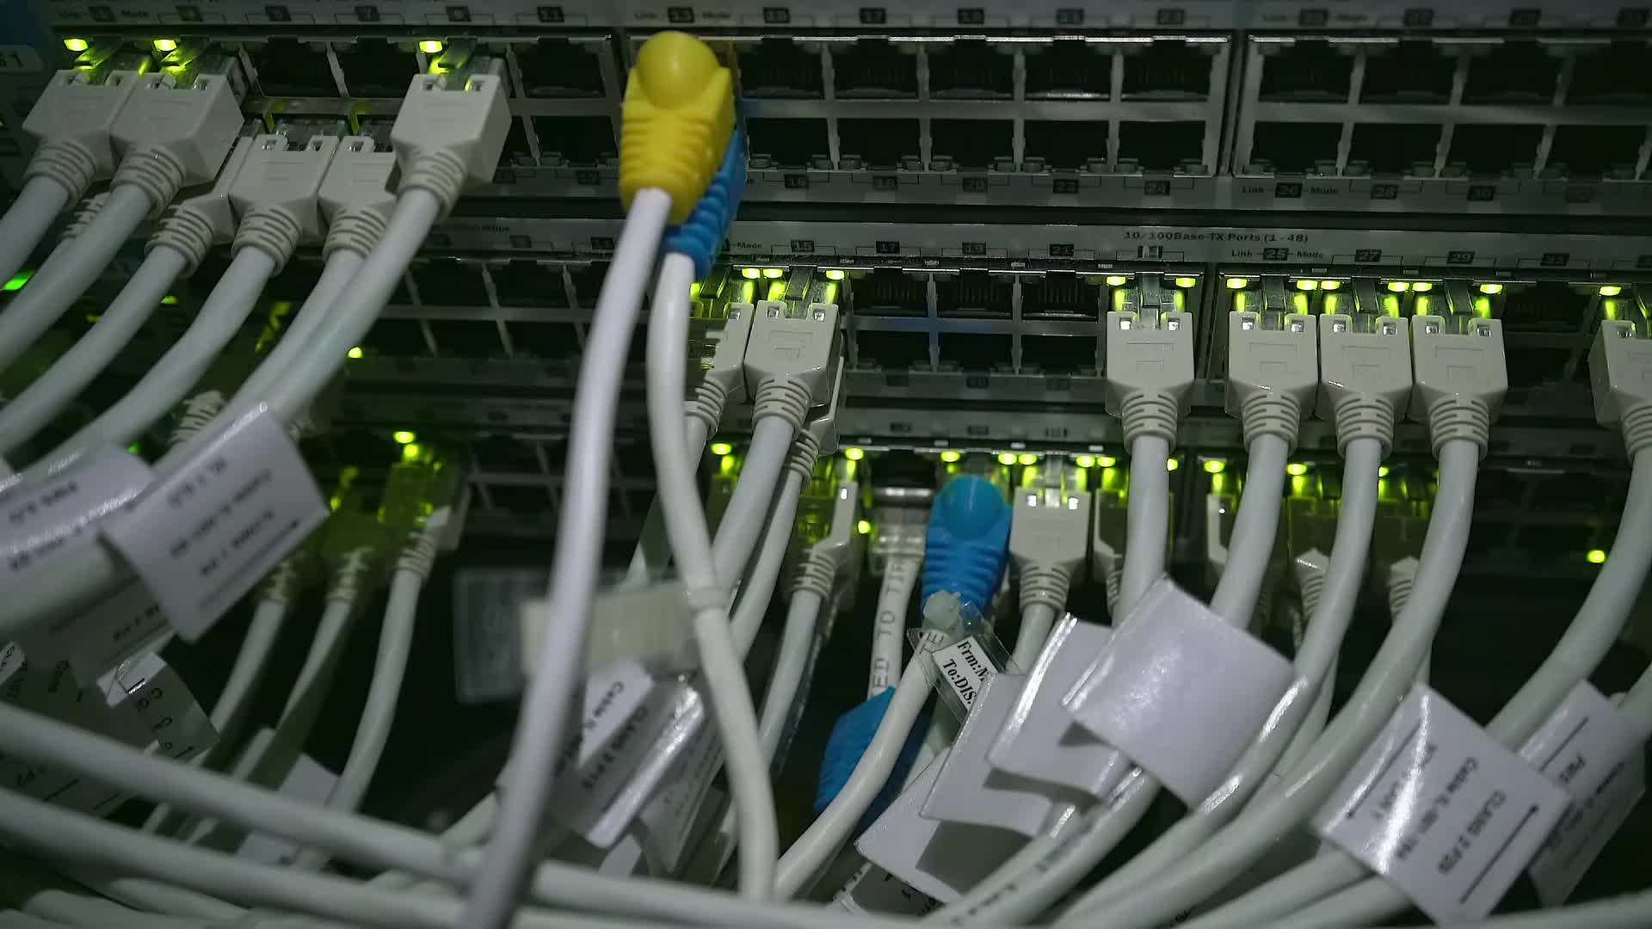
PROJECT OVERVIEW:-
1.Make sure you have python or IDE installed on your computer.
2.Install pynput by using the command pip install pynput.
3.Install pynput by using the command pip install Jsons.
4. After python, and pynput were installed on my computer, I copied the python script and created a Keylogger.py file
5. When you run this script, no new window will open indicating that the script is running. Instead, you will see a Keylogger.txt file appear in the directory of your Keylogger python script. This script uses pynput to record the keystrokes on your target’s computer and logs the keystrokes into a text file. You can open the log text file and see every keystroke made on the target computer.

Slide 6

Who are the end users ?
The term "end user" refers to the consumer of a good or service, often who has some innate know-how that is unique to consumers.
An end user is anyone who uses software and hardware assets in your organization to perform their job duties
External attacks can come in many forms. Two of the main cyberattacks to watch for include:
1. Malware
2. Phishing
End users are responsible for protecting the information resources to which they have access.

Slide 7
YOUR SOLUTION AND ITS VALUE PROPOSITION:-
An organization might have sought out cybersecurity software only after being attacked. But now, with cyber attacks routinely making headlines, many organizations want to be proactive about protecting their data and high-value assets. But don’t respond by pitching your feature sets to prospects. Instead, first identify their particular pain points and then address the kind of risk they’re most likely worried about. Depending on the prospect, your value proposition might speak to:
1. Financial Risk
2. Reputational Risk
3. Legal Risk
4. Compliance Risk

Slide 8
How Keyloggers Attack Your Device?
To gain access to your device, a keylogger has to be installed inside it or, in the case of a hardware keylogger, physically connected to your computer. There are a few different ways keyloggers attack your device
1. Spear phishing
2. Drive-by download
3. Trojan horse
Problems Caused by Keyloggers:-
Unknown processes consuming computing power
Delays during typing
Applications freeze randomly

Slide 9

HOW TO DETECT A KEYLOGGER:-
Here is how to access your extensions in some of the most common browsers:-
Safari: Choose "Preferences" in the Safari menu and click on "Extensions."
Chrome: Go to the address field and type "chrome://extensions."
Opera: Choose "Extensions," then select "Manage Extensions."
Firefox: Enter "about: addons" in the address field.
Microsoft Edge: Select "Extensions" in your browser menu.
Internet Explorer: Go to the Tools menu and choose "Manage add-ons."

Slide 10
CONCLUSION:-
A key logger is a type of surveillance software or hardware devices that has capability to record every stroke.
A key logger recorder can record instant messages,emails, and any information you type at any time using your keyboard
Keyloggers are a potent threat to both individuals and enterprises, with the potential to cause significant harm if left undetected. Understanding the nature of keyloggers, their methods of infiltration, and the dangers they pose is crucial for maintaining a secure digital environment.

Slide 11
Project link
https://github.com/shankarsai-7/shankar-project.git

