Slide 1
IQZeen
Next-Generation Restaurant Management System
Developed & Presented by:
Iqra Zeenat

Slide 2
The Problem in Modern Dining
Traditional restaurants suffer from massive inefficiencies: • Slow Ordering: Waiting for waiters causes delays and frustration. • Disconnected Kitchens: Paper tickets get lost, causing order errors. • Poor Analytics: Owners lack real-time data to make smart business decisions. • Messy Group Dining: Friends struggle to combine orders into one table bill.

Slide 3
Our Solution: IQZeen
Scan & Order
Group Sync
Live KDS
QR-based digital menus for zero-wait ordering.
WebSockets sync all phones at the same table in real-time.
Orders instantly appear on the Kitchen Display System without refreshing.

Slide 4
Technology Stack
Frontend: Next.js 15, React 19, Tailwind CSS, Lucide Icons Backend: NestJS (Node.js framework), Socket.io Database & ORM: PostgreSQL (hosted on Supabase), Prisma ORM Deployment: Vercel (Frontend) & Render (Backend API)
Microservice Architecture
Client <--> Next.js
Next.js <--> NestJS API
NestJS <--> PostgreSQL
WebSockets for Real-time events

Slide 5
Customer View: Digital Menu
Features: High-quality imagery, glassmorphic UI, real-time shared cart.

Slide 6
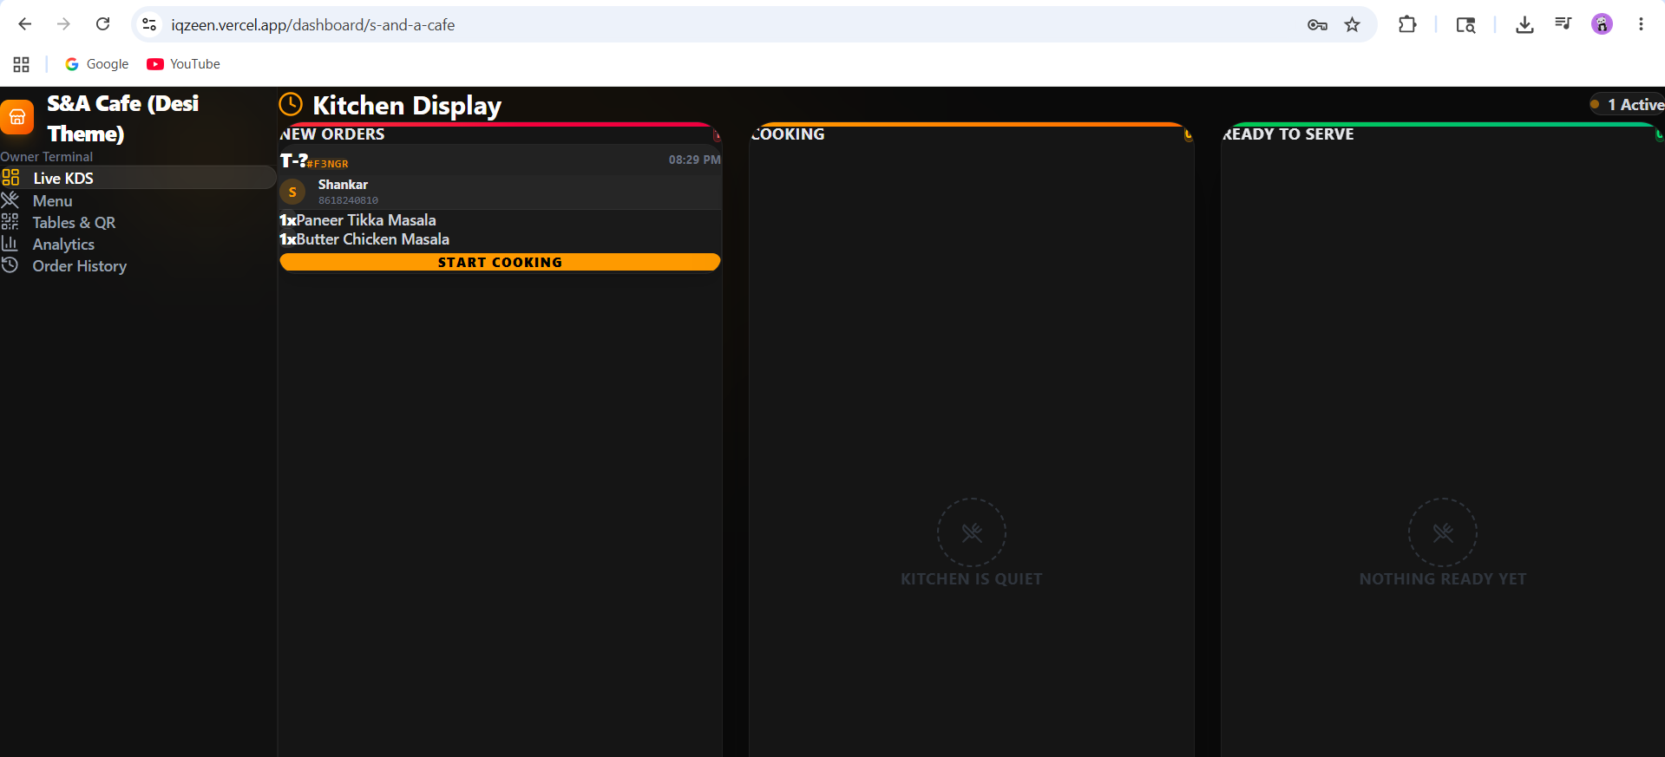
Owner Terminal: Kitchen Display System
Features: Live order synchronization, Kanban-style status tracking.

Slide 7
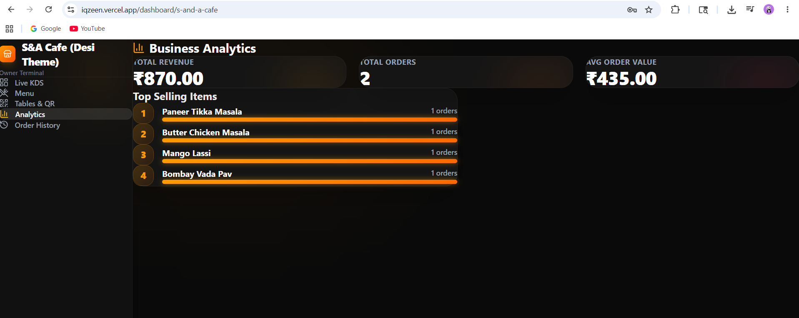
Business Analytics & Reporting
Features: Revenue tracking, order history ledger, top selling items visualizer.

Slide 8
Future Enhancements
• AI-Powered Recommendations: Suggesting sides and drinks based on ML models. • Integrated Payment Gateways: Direct checkout via Stripe/Razorpay on phone. • Inventory Management: Auto-deducting stock when dishes are ordered. • Waiter Call Button: Notifying staff via smartwatches instantly.

Slide 9
Thank You!
Live Demo: iqzeen.vercel.app

