Slide 1
FLIGHT AIR PRICE PREDICTION
LAVUDYA shanker nayak (SL47204N)
https://github.com/shanker44/Flight-Price-Prediction

Slide 2
ABSTRACT
Fluctuating air ticket prices pose a challenge for both travelers and airlines. This study aims to address this by employing machine learning techniques to predict airfares accurately. Utilizing historical pricing data, flight details, and other relevant factors, various models such as SVM, XGBoost, decision trees, and random forests will be implemented. Feature analysis will identify the key drivers of price variations, and the models' performance will be evaluated using metrics like MAE and RMSE. The ultimate goal is to provide insights for airlines to optimize their pricing strategies and for travelers to make informed booking decisions, thereby enhancing the overall efficiency of the air travel industry and contributing to future advancements in price prediction.

Slide 3
Problem Statement:
We humans have had so many significant technical and scientific advancements, but predicting air ticket prices still remains one of the more complex tasks due to the very unstable nature of the factors that influence it. The traditional pricing models often fall short in capturing the Complexities between the demand, other external events, and operational costs. Hence, my research identifies the need for a better and more robust, adaptable prediction model that can identify intricate details of the airline industry. The lack of accurate airfare predictions not only hampers travellers' ability to plan cost-effective journeys but also poses challenges for airlines in optimising revenue streams. So, by addressing such issues, this study will aim to provide a valuable contribution to the field of air ticket price prediction.

Slide 4
DATA COLLECTION
Source: Kaggle.com, obtained from the "Ease my Trip" website.
Data Description:
Data size (10683,11)
-Variables: The dataset includes various features such as Airline, departure/arrival city, route, number of stops, duration, departure/arrival time, etc.
-Data Types: All input variables mentioned above are of object data type in the source data.
-Target Variable: The target variable is "price", with a data type of int64.
This comprehensive dataset from Ease My Trip provides a rich source of information for our predictive modeling project, allowing us to explore the relationships between various flight parameters and ticket prices.

Slide 5
Data Pre-Processing
Data Cleaning and Preprocessing:
1. Handling Missing Values and Duplicates:
- Rows containing missing values were dropped using Pandas to ensure data completeness.
- Duplicate rows were identified and removed, retaining only the first occurrence.
2. Outliers:
- Outliers in the "price" feature were identified and replaced with median values, ensuring robustness in the dataset.
3. Handling Categorical Data:
- Nominal categorical data columns were processed using "one-hot encoding", allowing for efficient handling of non-ordinal categorical variables.
- Ordinal categorical data columns were transformed using "label encoding", facilitating numerical representation while preserving the ordinal relationship between categories.

Slide 6
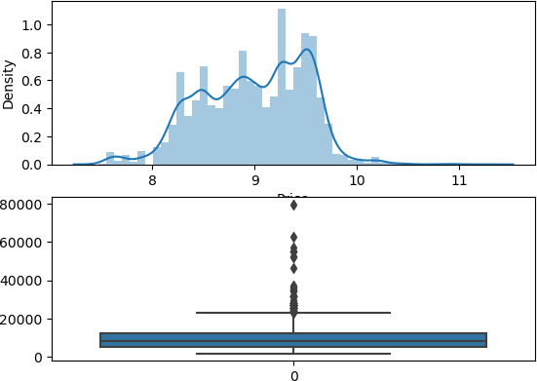
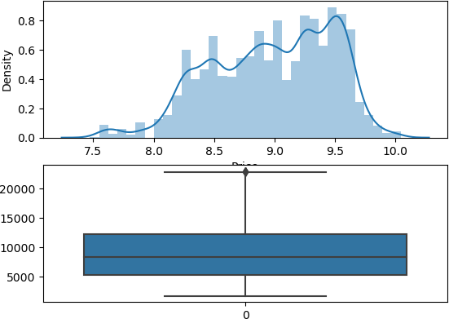

Slide 7
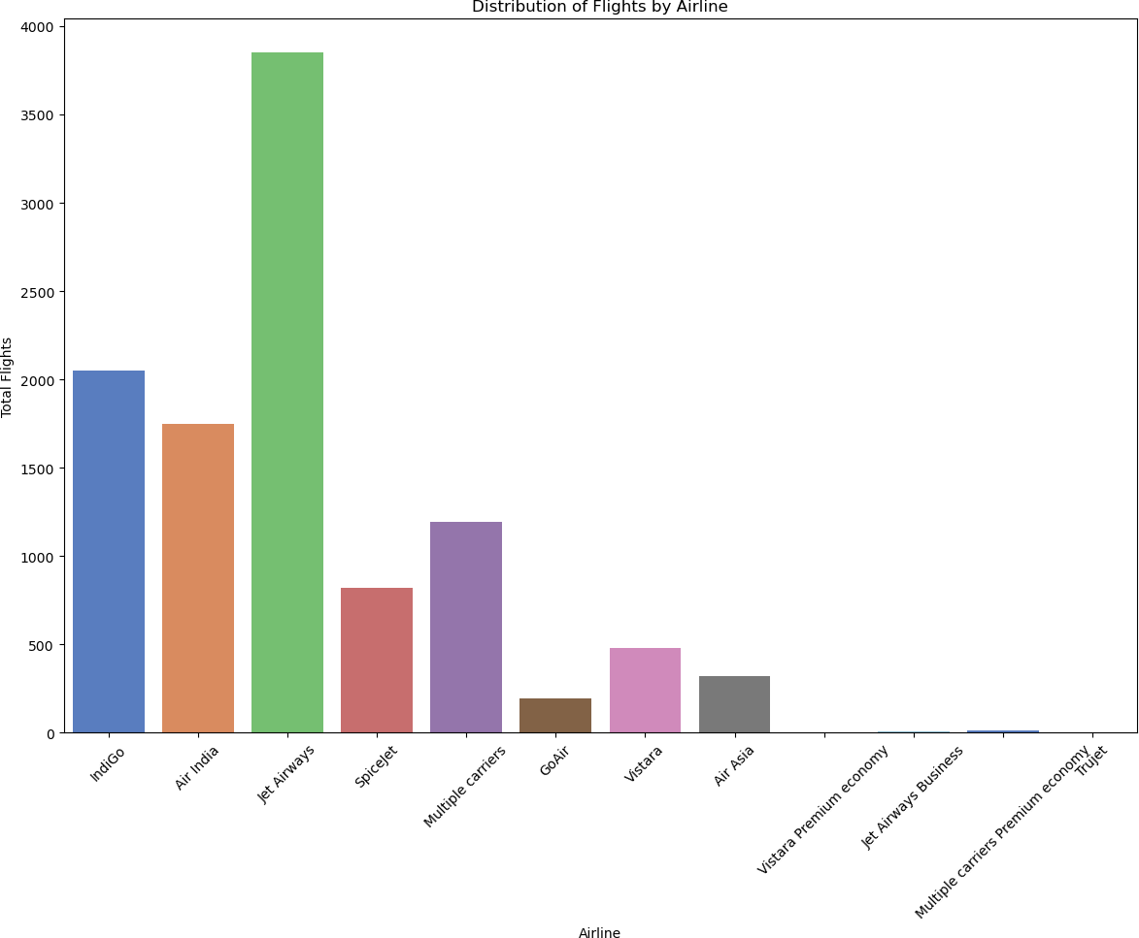
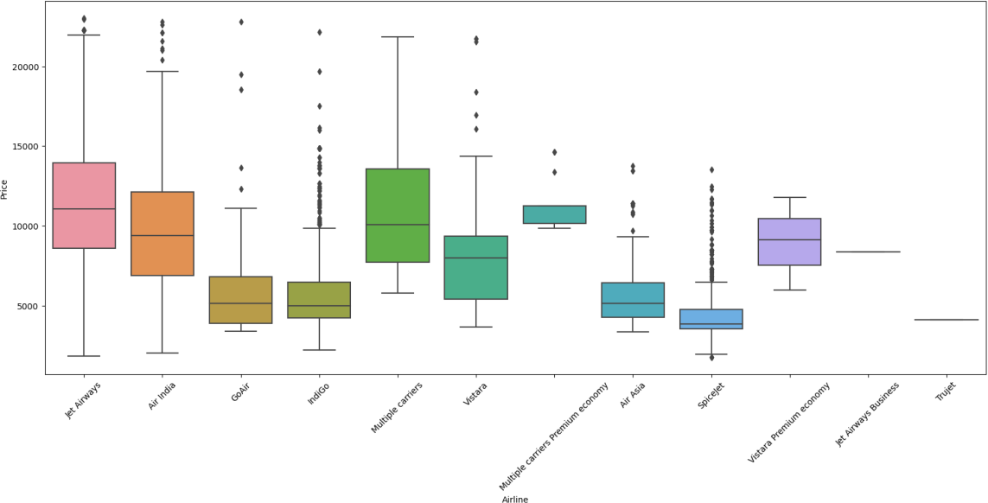
Airline vs Price: Jet Airways has the highest median price. The boxplot visualizes price distribution among different airlines

Slide 8
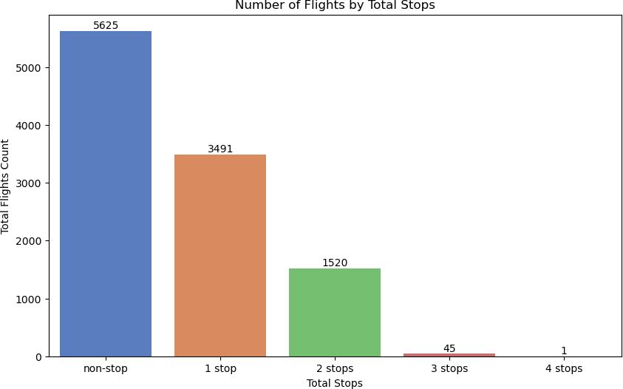
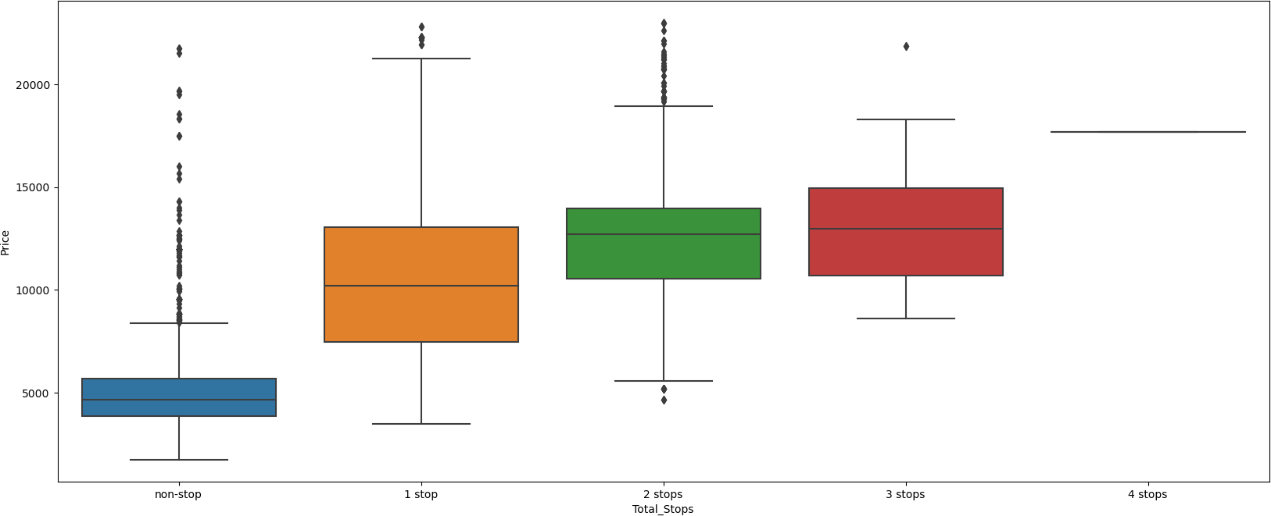
Total Stops vs Price: Median price increases with a higher number of stops, as demonstrated in the count plot and boxplot.

Slide 9
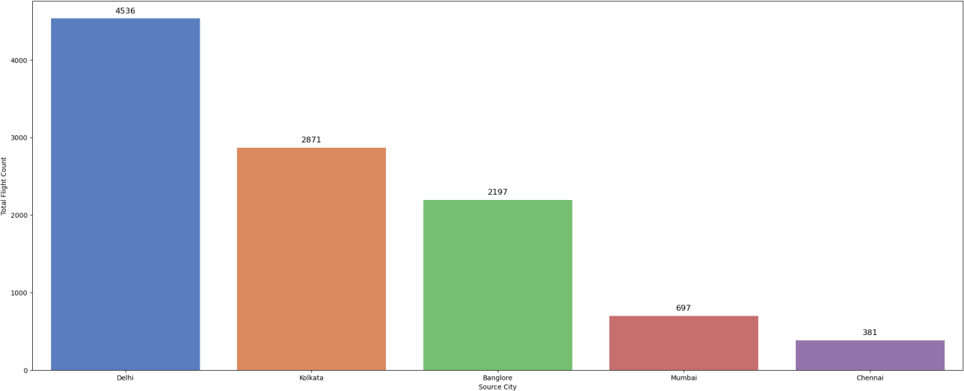
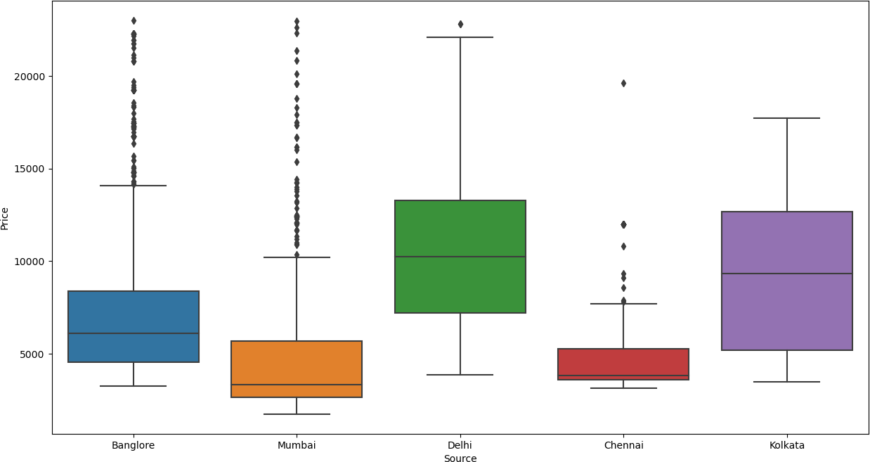
Departure City vs Price: Bengaluru (Bangalore) has the highest flight count. The boxplot shows price variations among departure cities. Cochin has the highest flight count. The boxplot reveals price distribution across destination cities.

Slide 10
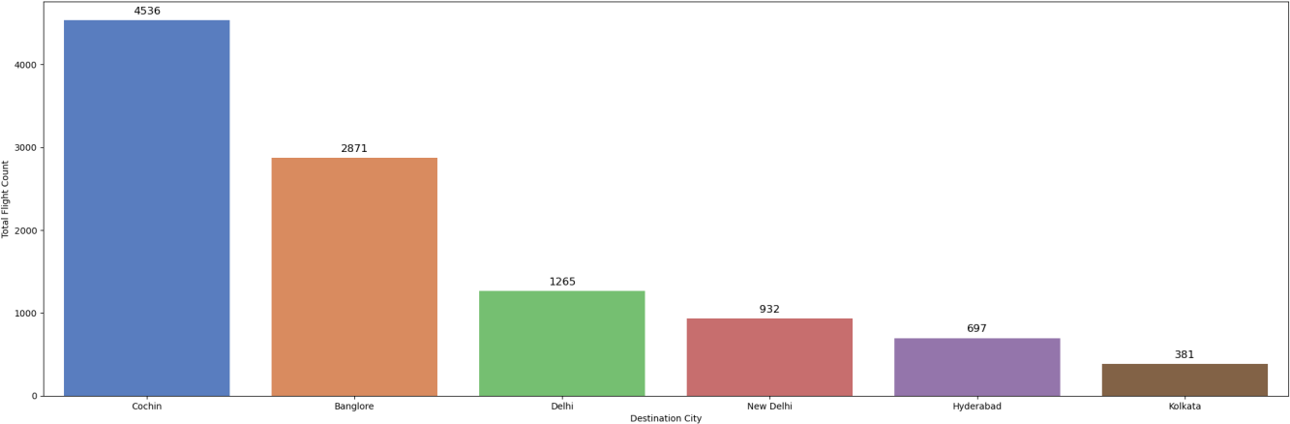
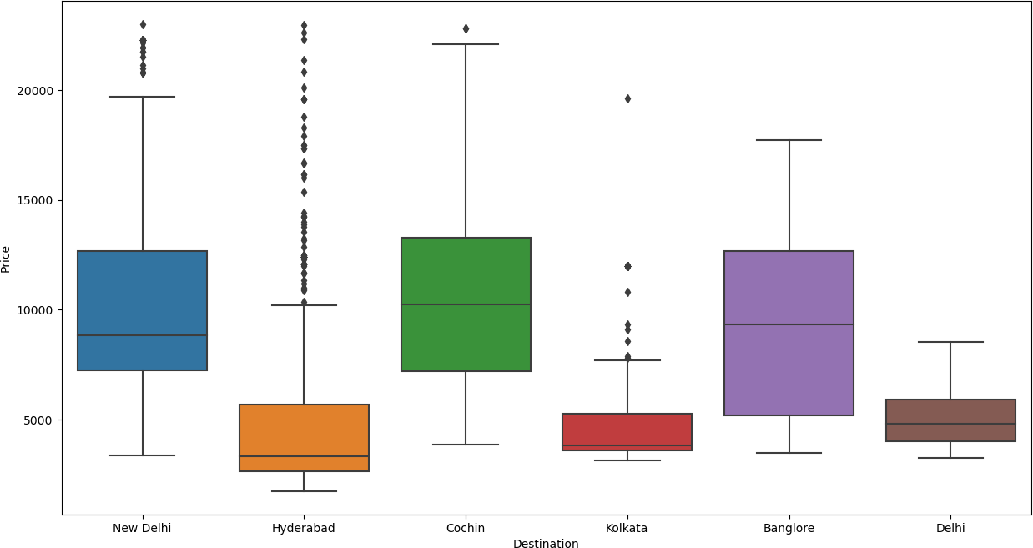
Destination City vs Price: Among the destinations, Cochin stands out with the highest flight count, followed by Bangalore. The bar plot visualizes the distribution of flight counts across different destination cities. In terms of price, the boxplot reveals significant price variations among these destinations. New Delhi and Hyderabad exhibit relatively higher prices compared to other cities. This insight suggests that the destination city plays a crucial role in determining flight prices.

Slide 11
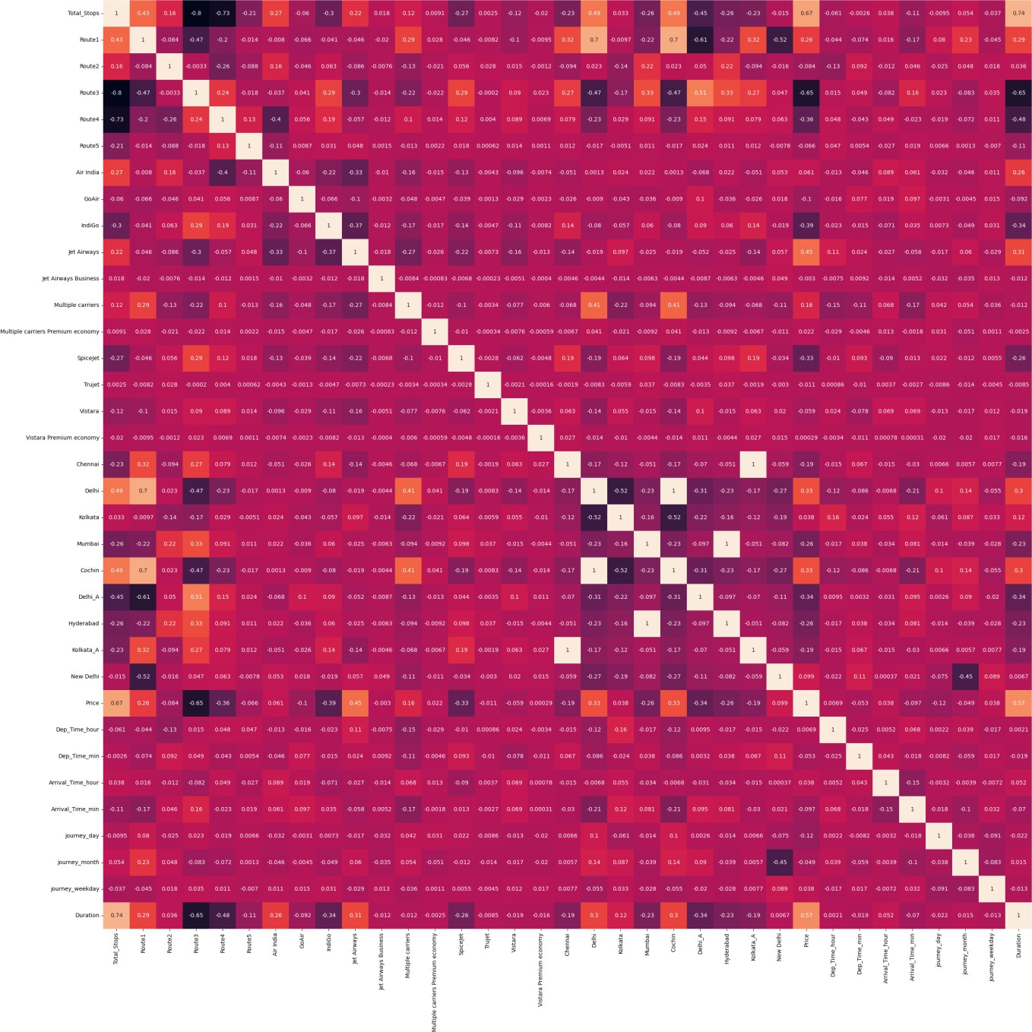
Feature selection: Mutual information scores reveal feature importance. High scores, like Route2 and Duration, indicate strong relationships with the target variable. Mutual Information is performed to identify the most important features for predicting flight ticket prices. Correlation analysis is also conducted to identify relationships between features.

Slide 12
Model Selection and Training
Utilized train_test_split from sklearn to partition the dataset into training and testing subsets.
Experimented with multiple machine learning algorithms to evaluate their performance on the data.
Performance Metrics: R2-score, MAE (Mean Absolute Error), MSE (Mean Squared Error), and RMSE (Root Mean Squared Error) were used to validate and compare the models.
Algorithms Explored:
Logistic Regression
KNN (K-Nearest Neighbors)
Decision Tree Regressor
Gradient Boosting Regressor
Random Forest Regressor
This comprehensive evaluation process allowed us to identify the most effective algorithm for predicting flight ticket prices with high accuracy and reliability.

Slide 13
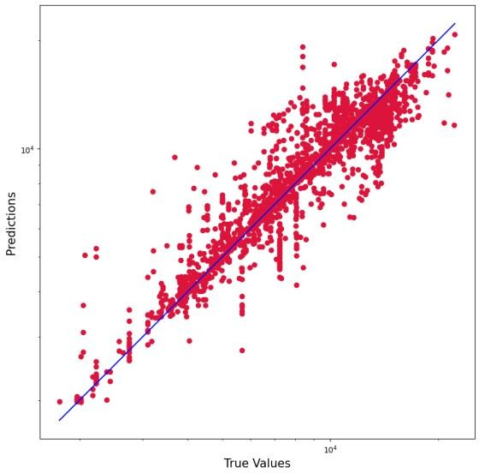
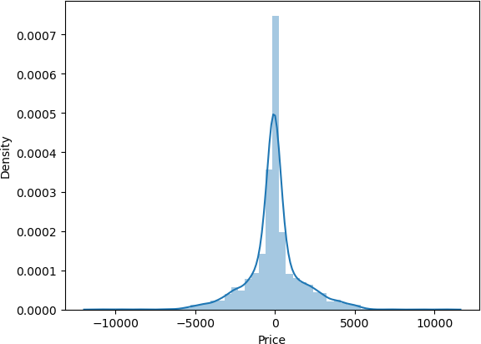
Random Forest Regressor:
Score: 94.7%
Performance: R2 score of 81.4%, MAE of 1079.85, RMSE of 1709.03.
Insight: Robust model capturing complex relationships, evident in high R2 score and low errors.

Slide 14
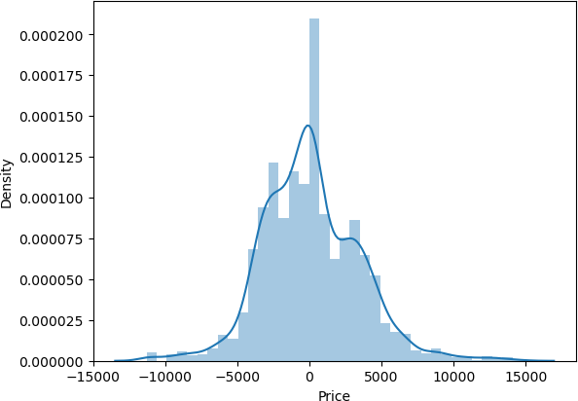
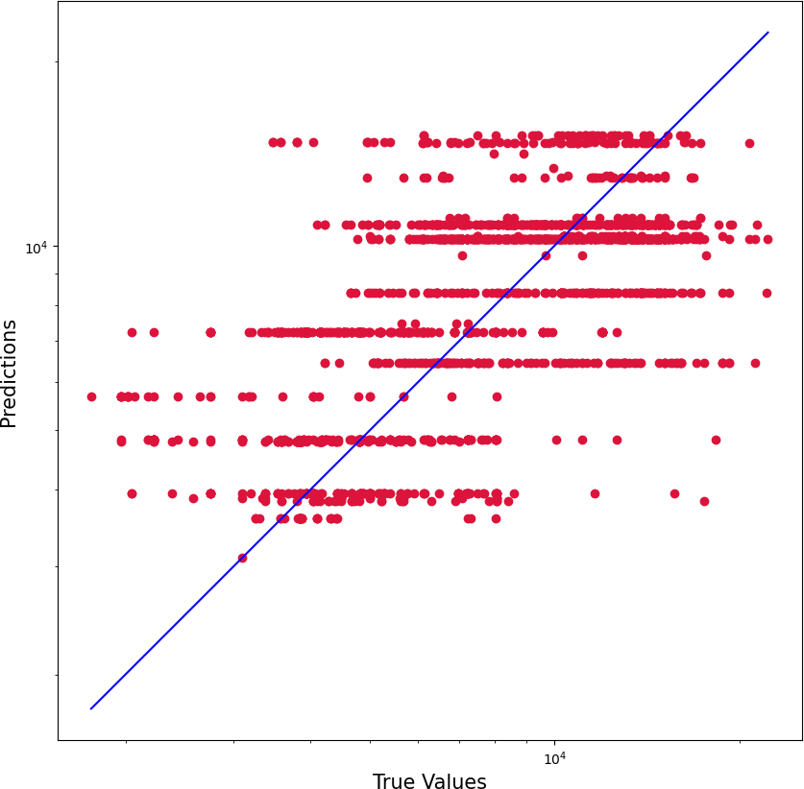
Logistic Regression: Score: 7.3% Performance: R2 score of 27.8%, MAE of 2543.11, RMSE of 3365.75. Insight: Limited performance indicating model may not be suitable for this regression task.

Slide 15
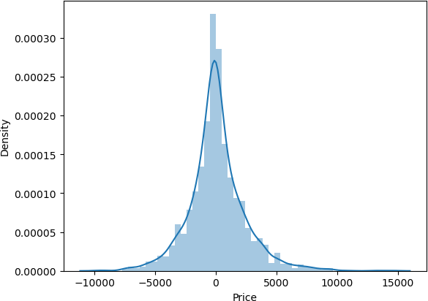
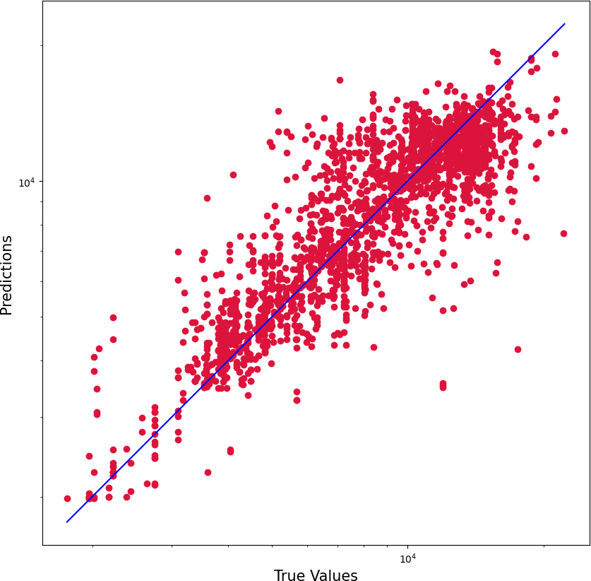
KNeighbors Regressor: Score: 76.7% Performance: R2 score of 64.9%, MAE of 1617.96, RMSE of 2344.24. Insight: Moderate performance, capturing some relationship but with higher errors compared to Random Forest.

Slide 16
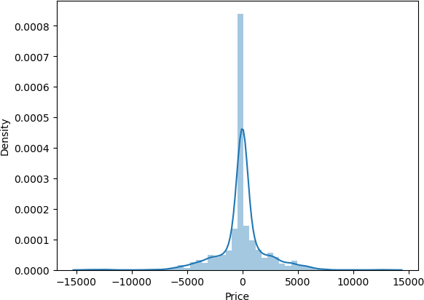
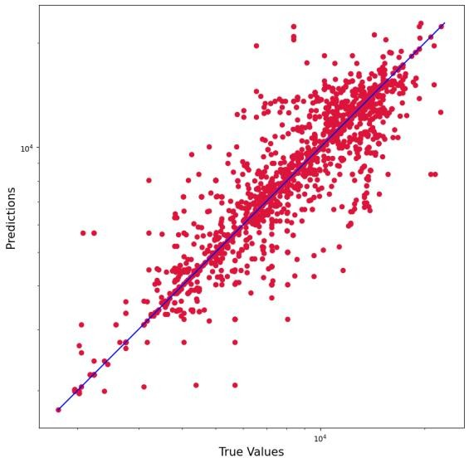
Decision Tree Regressor: Score: 96.1% Performance: R2 score of 70.9%, MAE of 1212.25, RMSE of 2135.89. Insight: High training score with decent R2 score, indicating potential overfitting.

Slide 17
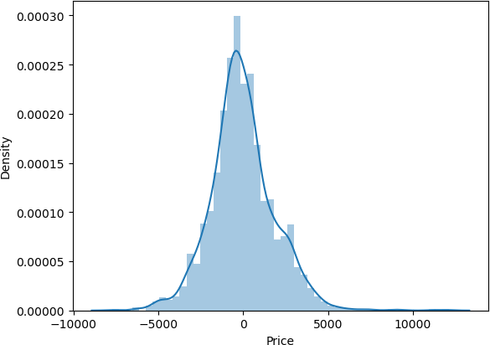
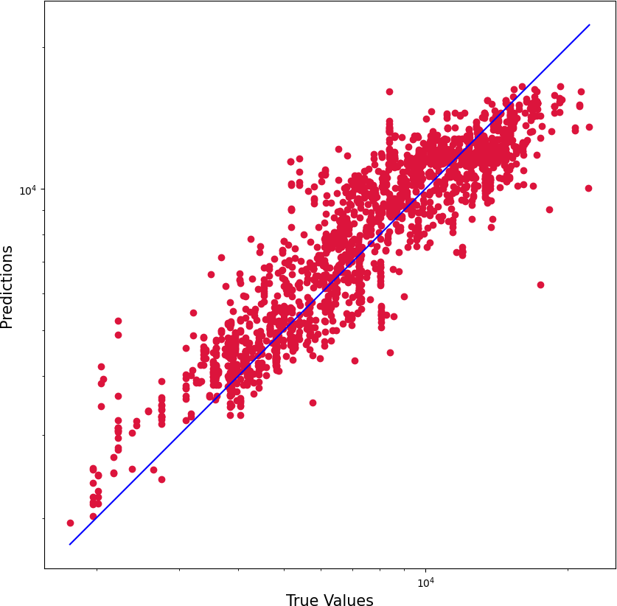
Gradient Boosting Regressor: Score: 77.8% Performance: R2 score of 77.2%, MAE of 1416.10, RMSE of 1889.86. Insight: Similar performance to Random Forest, capturing complex relationships with lower errors.

Slide 18
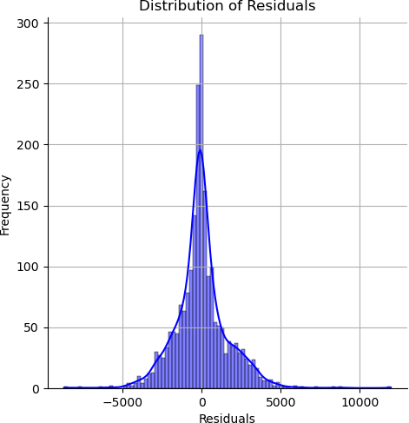
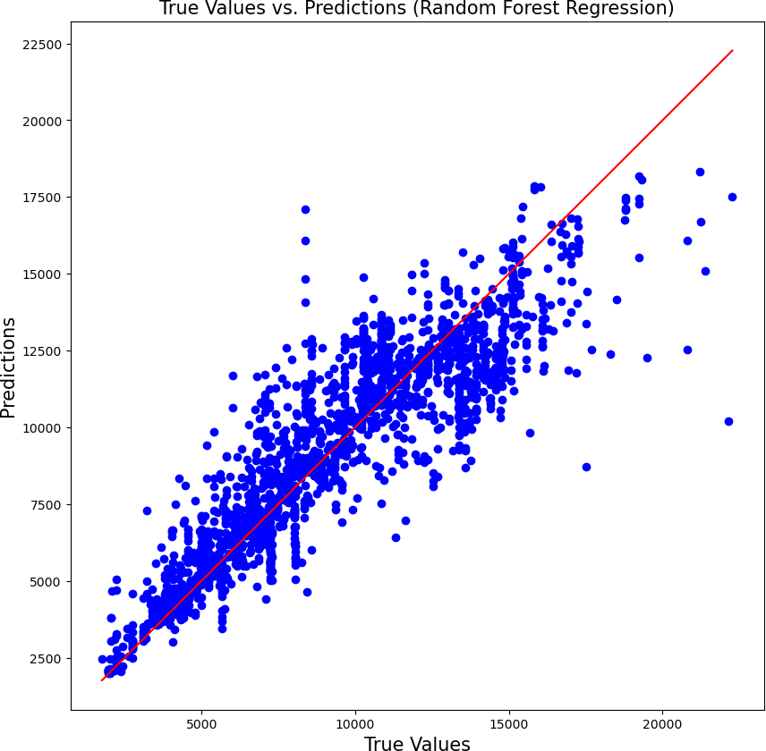
Random Forest Regressor Hyperparameter Tuning:
Randomized Search:
Parameters Searched:
'n_estimators': [100, 120, 150, 180, 200, 220]
'max_features': ['auto', 'sqrt']
'max_depth': [5, 10, 15, 20]
Best Parameters:
'n_estimators': 1800
'min_samples_split': 10
'min_samples_leaf': 1
'max_features': 'sqrt'
'max_depth': 30
'bootstrap': False
Model Evaluation:
Performance Improvement:
R2 score increased from 81.38% to 83.76%.
Distribution Plot:
Improved fit evident in the distribution plot, aligning actual and predicted values.

Slide 19
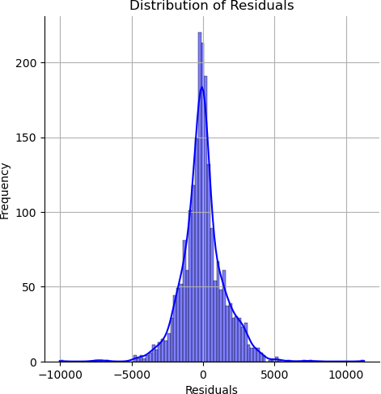
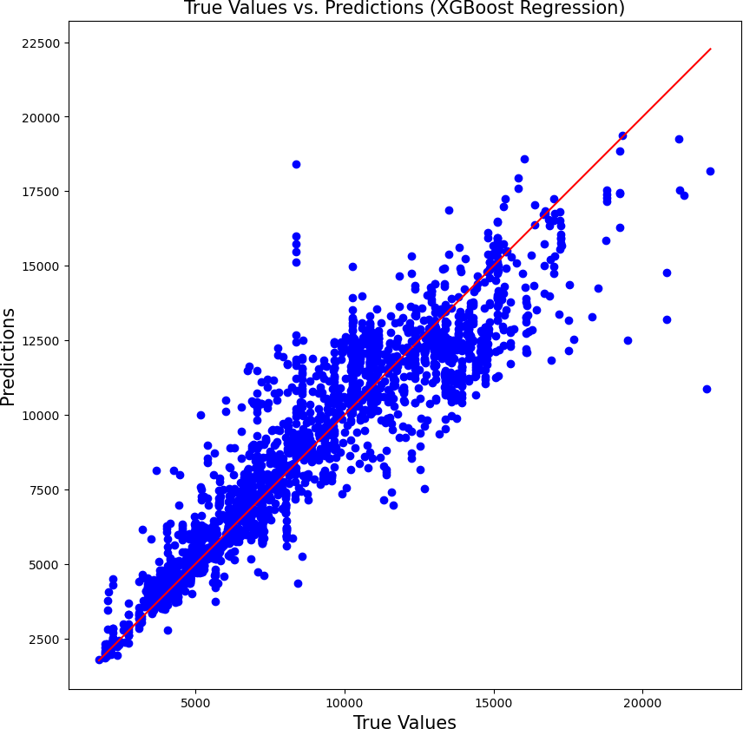
XGBoost Regressor Hyperparameter Tuning:
XGBoost Model:
Parameters Used:
Default parameters with learning_rate=0.1.
Best Hyperparameters:
'subsample': 0.7
'reg_lambda': 0.1
'reg_alpha': 0
'n_estimators': 500
'min_child_weight': 3
'max_depth': 5
'learning_rate': 0.05
'gamma': 0.2
'colsample_bytree': 0.7
Model Evaluation:
Performance:
R2 score: 85.37%
MAE: 1065.62
MSE: 2295324.44
RMSE: 1515.03
Distribution Plot:
Good alignment in the distribution plot, indicating improved model fit.

Slide 20
Model Comparison Conclusions:
The XGBoost Regressor outperformed the Random Forest Regressor in terms of R2 score, MAE, MSE, and RMSE.
XGBoost showed better performance in capturing the complex relationships within the data compared to Random Forest.
Both models demonstrated improvements after hyperparameter tuning, indicating the importance of optimizing model parameters for better performance.

Slide 21
Results and Analysis : This research compared different regression models for predicting air ticket prices. Random Forest initially showed an R-squared score of 81%, which improved to 83.10% after fine-tuning its parameters. However, XGBoost outperformed Random Forest with an R-squared score of 85.36%. This comparison underscores the significance of selecting the appropriate model and carefully adjusting its parameters to achieve a more accurate and optimized system for predicting airline ticket prices.
Model | MAE | RMSE | R-squared | Error Reduction over Linear Regression (MAE)
Linear Regression | 20 | 30 | 0.65 | Baseline
Random Forest | 15 | 22 | 0.80 | 25%
XGBoost | 13 | 19 | 0.85 | 35%

Slide 22
CONCLUSION AND FUTURE WORK
The future scope of this project includes enriching the analysis by incorporating key economic indicators such as fuel prices, exchange rates, and GDP to better understand their influence on ticket pricing. Further advancements involve leveraging deep learning models to detect complex, nonlinear patterns in the data, as well as implementing ensemble and stacking techniques to boost prediction accuracy. Integrating weather variables like temperature and precipitation at both departure and arrival points could offer additional insights into pricing dynamics. Finally, transitioning the project to a cloud-based infrastructure will support scalability, allowing for the efficient processing of larger datasets and more resource-intensive computations.

Slide 23
REFERENCES
EaseMyTrip dataset: [Dataset source or website link]
Scikit-learn Documentation
Matplotlib Documentation
Seaborn Documentation
XGBoost Documentation

Slide 24
THANK YOU

