Slide 1

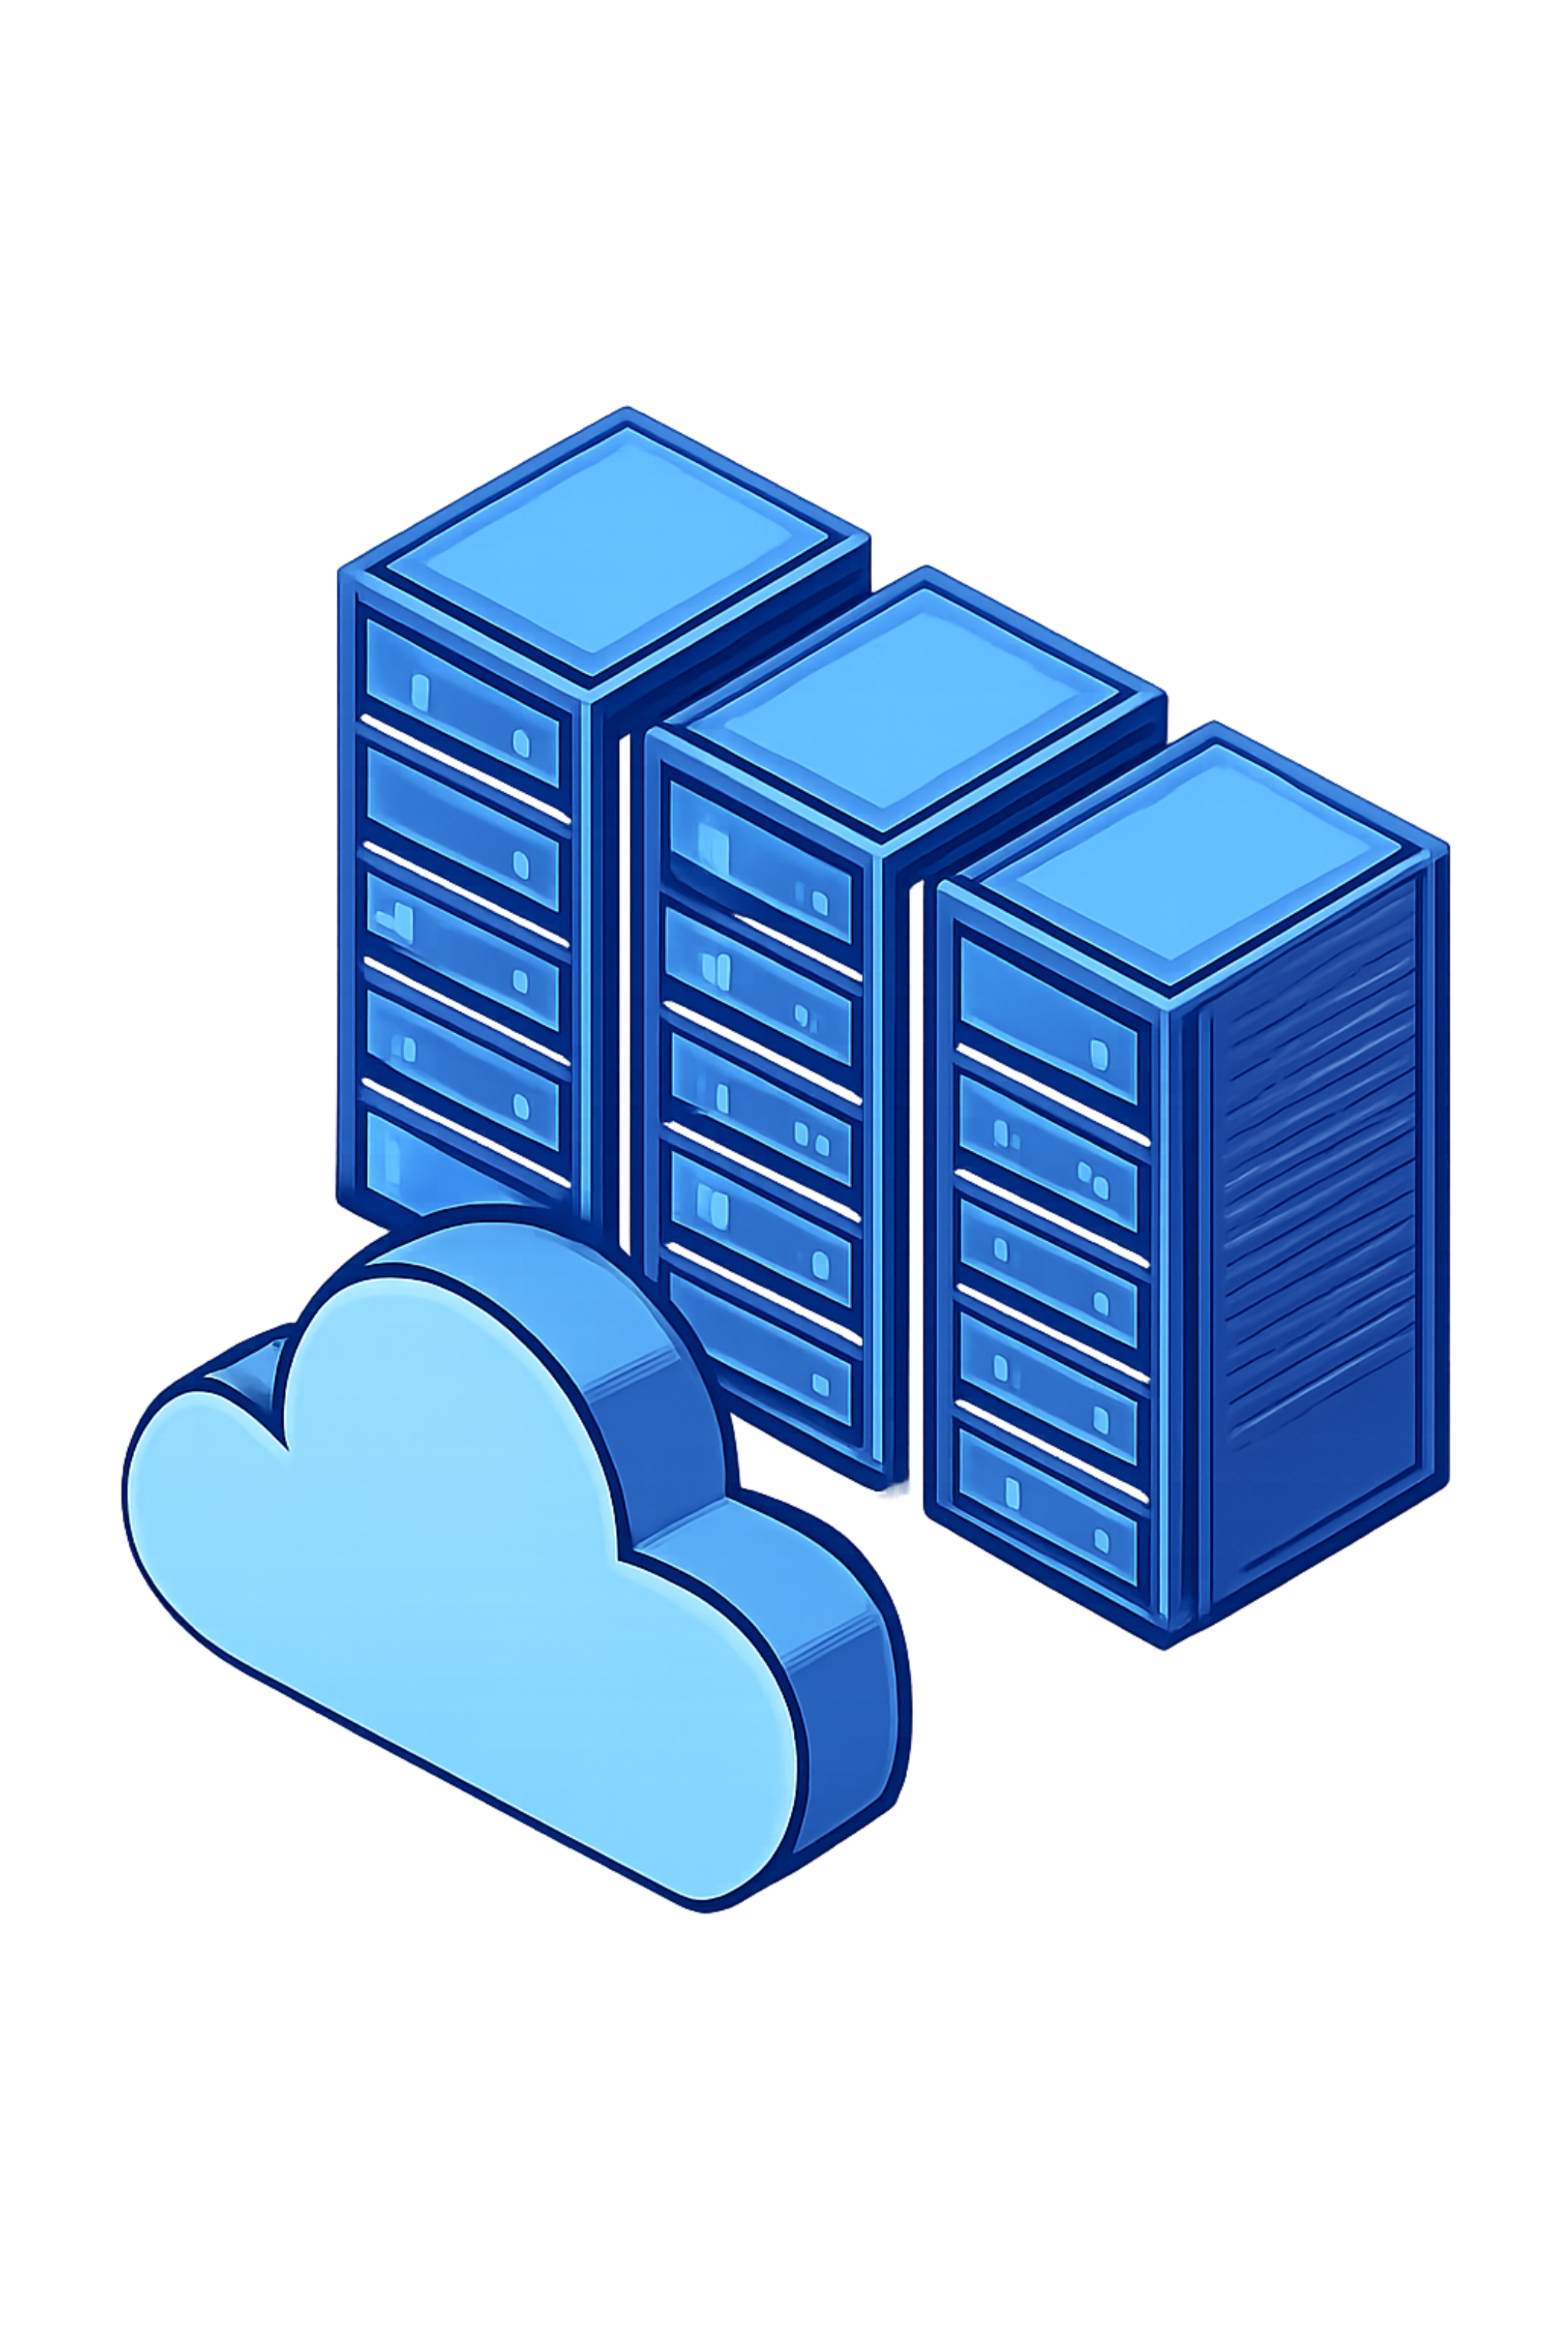
Azure DevOps Pipeline with Environment Approvals
CI/CD Automation with Controlled Production Deployment
COLLEGE DEVOPS PROJECT

Slide 2
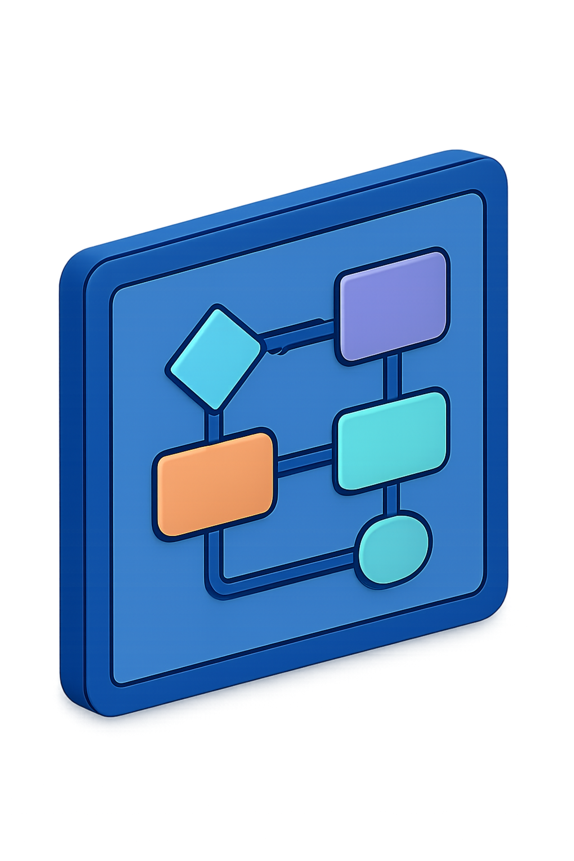




Project Overview
Azure Repos
Git-based source control
Azure Pipelines
CI/CD automation via YAML
Dev → Test → Prod
Staged progression
Manual Approval
Production gate required

Slide 3
Problem Statement
The Challenge
Uncontrolled Deployments
No Review Gates
Production environments need guardrails. Without approval gates, any commit can reach live users unreviewed.
Stages need controlled progression
Production should never deploy automatically
Permission Risk
No Approval Workflow
Service connections require scoped access
Manual review required before Production release

Slide 4
Technologies Used
Azure DevOps
Azure Repos & Pipelines
Project management & CI/CD orchestration
Git source control + YAML build automation
Azure App Service
Python 3.11 + YAML
Managed web app hosting — Linux, F1 Free Tier
Application runtime & pipeline config language

Slide 5
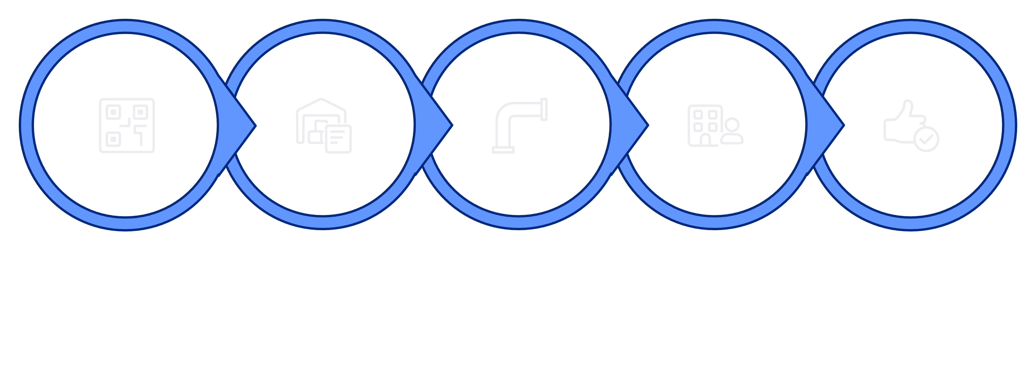
System Architecture
Azure Pipelines
Build & Deploy
Commit
Azure Repos
Prod Gate

Slide 6
CI/CD Pipeline Stages
BUILD
DEVELOPMENT
Compile, unit tests, syntax validation
Auto-deploy to dev environment
TESTING
PRODUCTION
Auto-deploy to test environment
Pauses — requires 4+ approvals

Slide 7

Production Approval Gate
5
Approvers Configured
4
Minimum Approvals Required
Pipeline automatically pauses before Production
Approvers notified via Azure DevOps notifications
Deployment proceeds only after threshold met
Full audit trail recorded for compliance

Slide 8
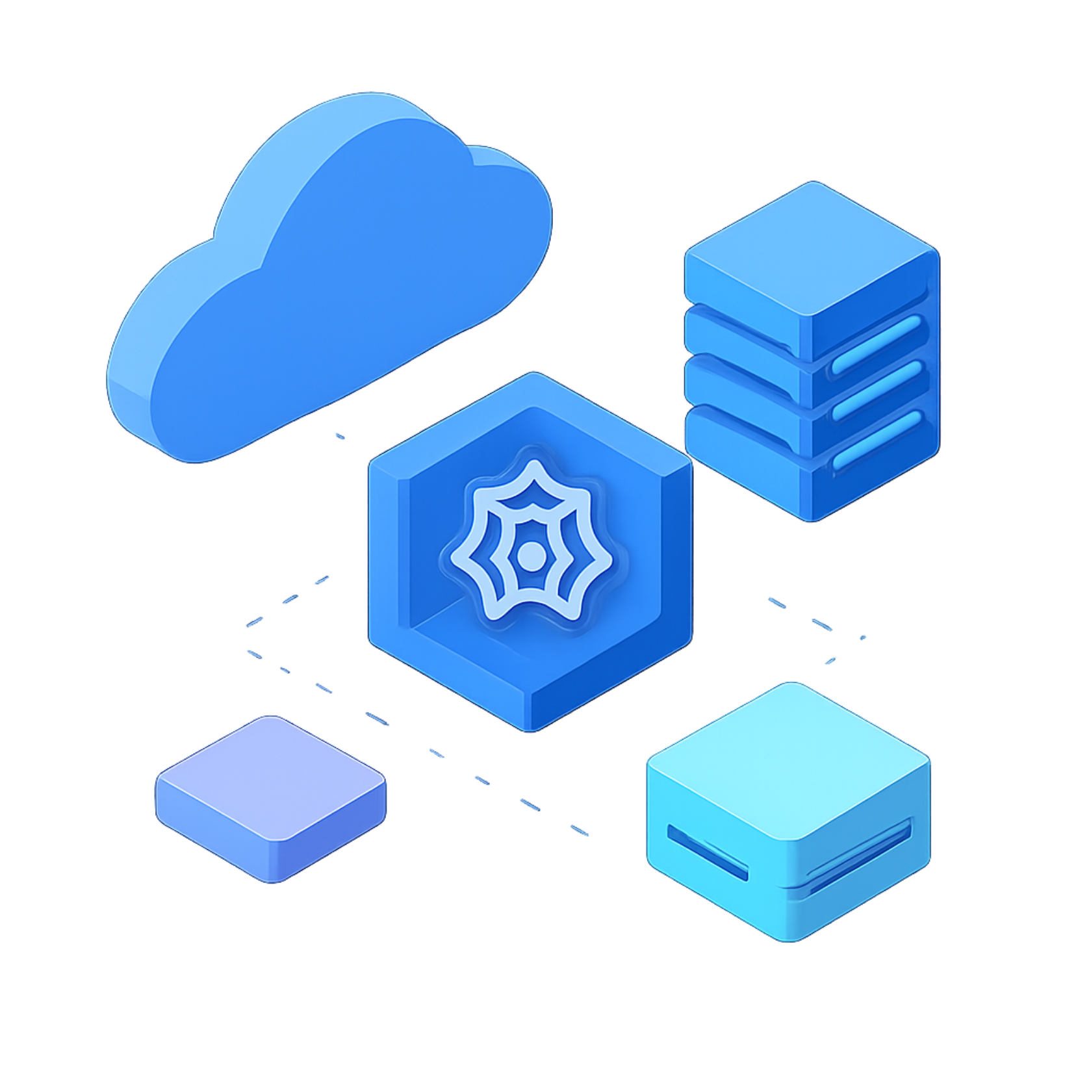
Azure Infrastructure
Resource | Value
Resource Group | rg-devops-approval
App Service | devops-approval-app
Region | Central India
OS | Linux
Runtime | Python 3.11
Plan | Free F1 Tier
Service Connection | ARM Workload Identity

Slide 9

Demonstration & Results
Code Change
HTML committed to main branch
Pipeline Triggered
Automatic build starts
Dev & Test
Auto-deployed successfully ✓
4 Approvals
Threshold met, gate passed ✓
Live App
Production deployed ✓

Slide 10
Conclusion
✓ Automated CI/CD
✓ Dev & Test Automated
Implemented with Azure Pipelines YAML
Instant deployment to non-prod environments
✓ Production Protected
✓ Azure Integration
Manual approval gate prevents uncontrolled releases
App Service deployment fully automated
Thank You

