Slide 1
GRAMENER CASE STUDY SUBMISSION
Group Name:
Shankhadeep Ghosal
Praveen Kumar Telugu
Vishnu Vardhan Reddy
Amar Mallick

Slide 2
Business Understanding
A consumer finance company which specializes in lending various types of loans to urban customers. This company is the largest online loan marketplace, facilitating personal loans, business loans, and financing of medical procedures. Borrowers can easily access lower interest rate loans through a fast online interface. When the company receives a loan application, the company has to make a decision for loan approval based on the applicant’s profile. Two types of risks are associated with the bank’s decision:
If the applicant is likely to repay the loan, then not approving the loan results in a loss of business to the company
If the applicant is not likely to repay the loan, i.e. he/she is likely to default, then approving the loan may lead to a financial loss for the company
When a person applies for a loan, there are two types of decisions that could be taken by the company:
Loan accepted: If the company approves the loan, there are 3 possible scenarios described below:
Fully paid: Applicant has fully paid the loan (the principal and the interest rate)
Current: Applicant is in the process of paying the instalments, i.e. the tenure of the loan is not yet completed. These candidates are not labelled as 'defaulted'.
Charged-off: Applicant has not paid the instalments in due time for a long period of time, i.e. he/she has defaulted on the loan
Loan rejected: The company had rejected the loan (because the candidate does not meet their requirements etc.). Since the loan was rejected, there is no transactional history of those applicants with the company and so this data is not available with the company (and thus in this dataset)

Slide 3
Business Objectives
Like most other lending companies, lending loans to ‘risky’ applicants is the largest source of financial loss (called credit loss). The credit loss is the amount of money lost by the lender when the borrower refuses to pay or runs away with the money owed. In other words, borrowers who default cause the largest amount of loss to the lenders. In this case, the customers labelled as 'charged-off' are the 'defaulters'.
If one is able to identify these risky loan applicants, then such loans can be reduced thereby cutting down the amount of credit loss. Identification of such applicants using EDA is the aim of this case study.
In other words, the company wants to understand the driving factors (or driver variables) behind loan default, i.e. the variables which are strong indicators of default. The company can utilise this knowledge for its portfolio and risk assessment

Slide 4
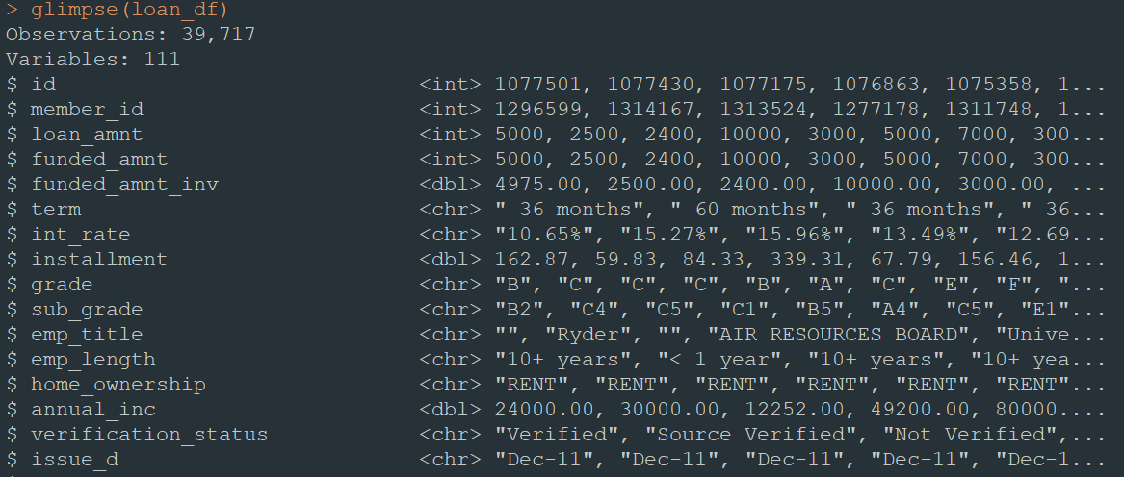
Data Cleaning and preparation
In the data set total 39717 observations and 111 variables are present. A snippet of that large data set is given below :

Slide 5
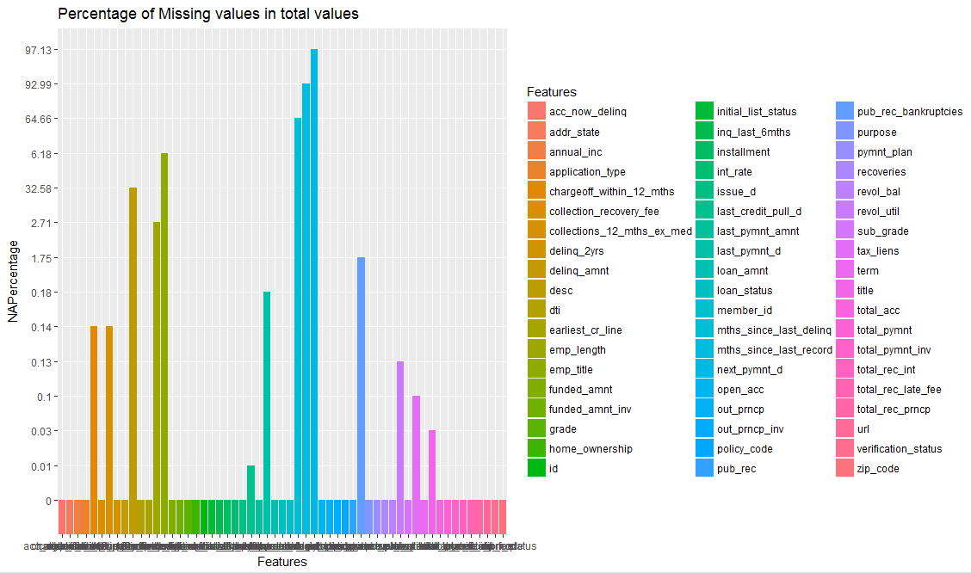
Data Cleaning and preparation NA Percentages in total values

Slide 6


Data Cleaning and preparation
There are many columns with only a single unique value- e.g. NA, 0, F etc. Lets us drop, all such columns as they will not be useful for EDA or visualization.
As a next step we should also drop columns which only have 0 or NA's as their unique values
We will drop all of those column which are having more than 15% NA data of total records as those column are not fit for analysis.
After dropping column based on the above constraints now 46 columns are there for analysis.

Slide 7
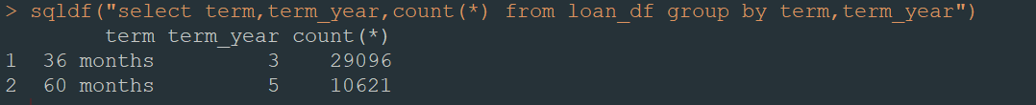
Data Cleaning and preparation
As there almost 46 columns are there, we checked all those columns by 10 columns at a time.
From loan_df$term data, we derived term_year which is a new derived column.
loan_df$int_rate data, we cleaned the data by removing “%” from the data.
Desc and URL is irrelevant in this analysis so we are dropping the column.
loan_df$emp_length is having inconsistent data. In some places it is having years or year. We removed years/year from the data and made it categorical data. As Example : <1 , 10+ etc.
From Loan_df$issue_d ,we derived issue_d_year. From this we will analyse loan_status distribution over different years.
We have built a separate column for sub_grade for the numerical value.
Loan_amnt_range is a derived column from loan_amnt
based on the mean and median value we can say that data is evenly distributed .We are going to consider median for replacement of NA values in loan_df$revol_util

Slide 8
Data Cleaning and preparation
earliest_cr_line data cleaning : set all the date 1st of that month.
From revol_util data we removed “%”
last_pymnt_d, next_pymnt_d, last_credit_pull_d for these columns we converted the data into proper data format.
Outliers checking:
For a given continuous variable, outliers are those observations
that lie outside 1.5 * IQR, where IQR, the ‘Inter Quartile Range’
is the difference between 75th and 25th quartiles.
Look at the points outside the whiskers in below box plot.

Slide 9
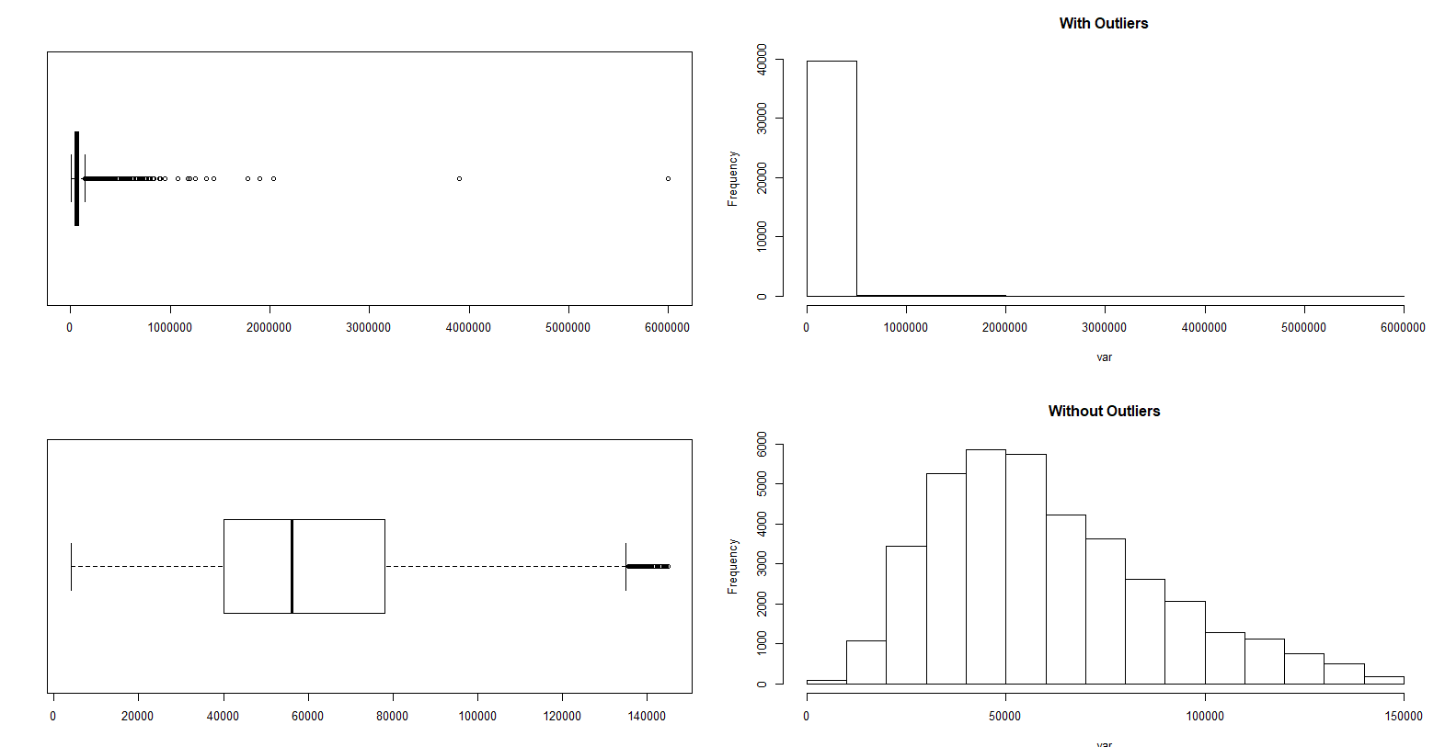
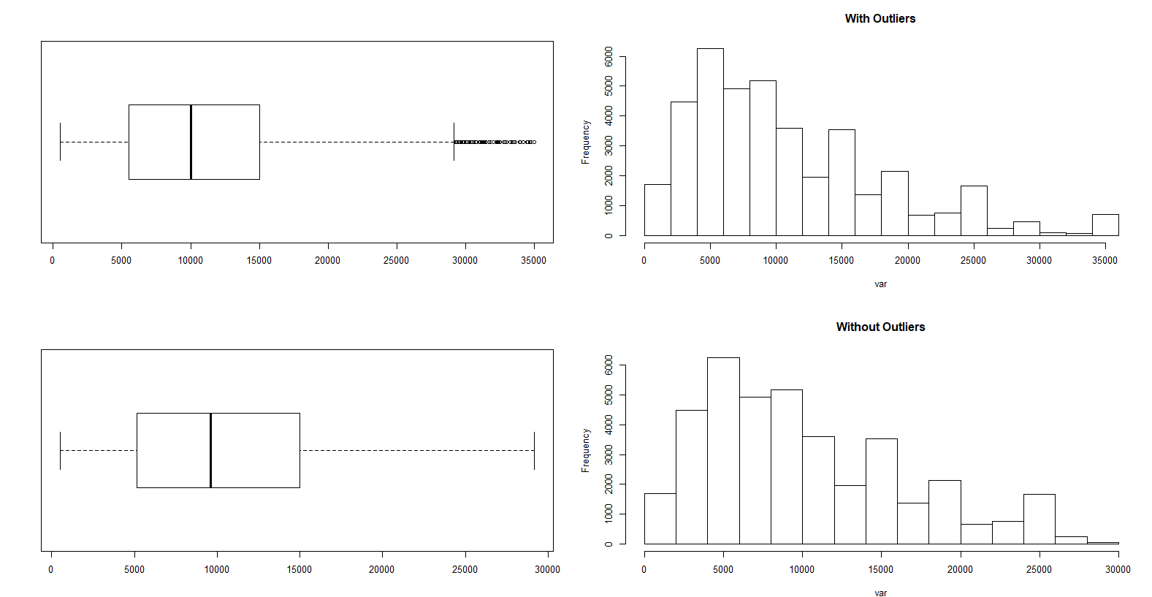
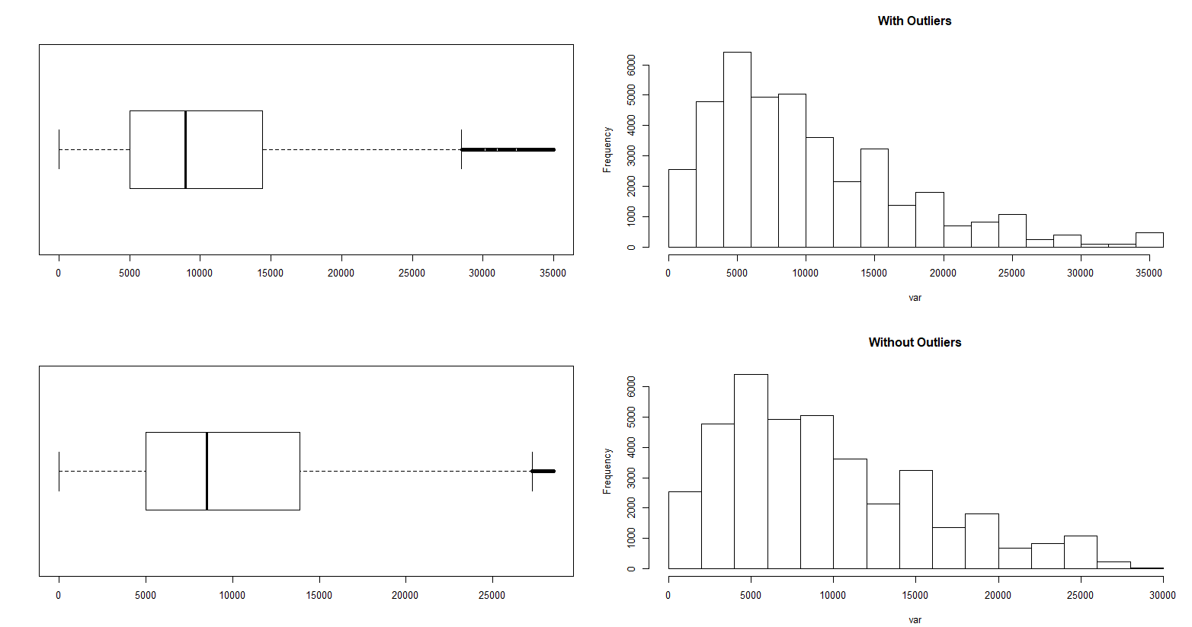
Data Cleaning and preparation
Handling Outliers
Loan_amnt outliers check
Annual_inc outliers check
funded_amnt_inv outliers check

Slide 10
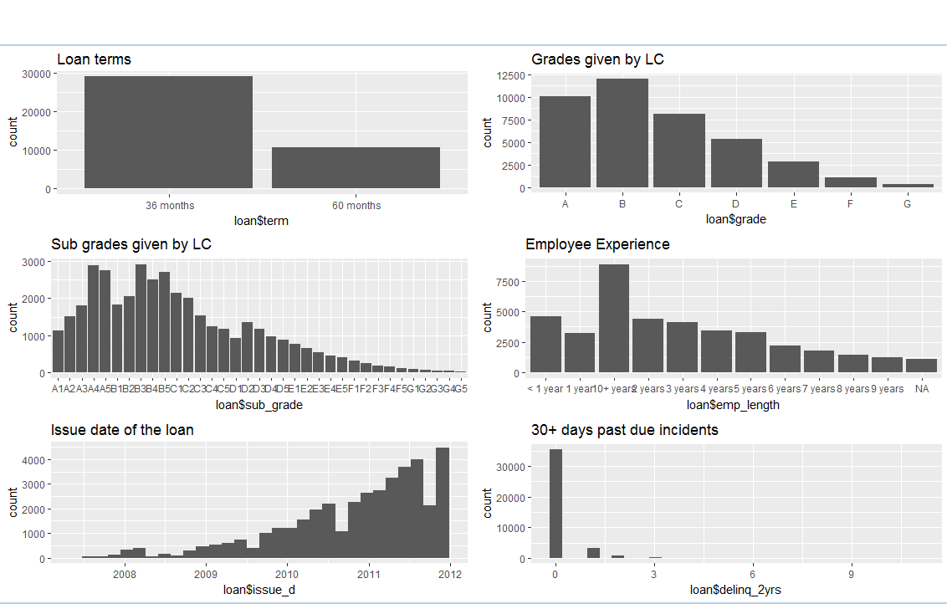
Univariate Analysis-Ordered Categorical Variables

Slide 11
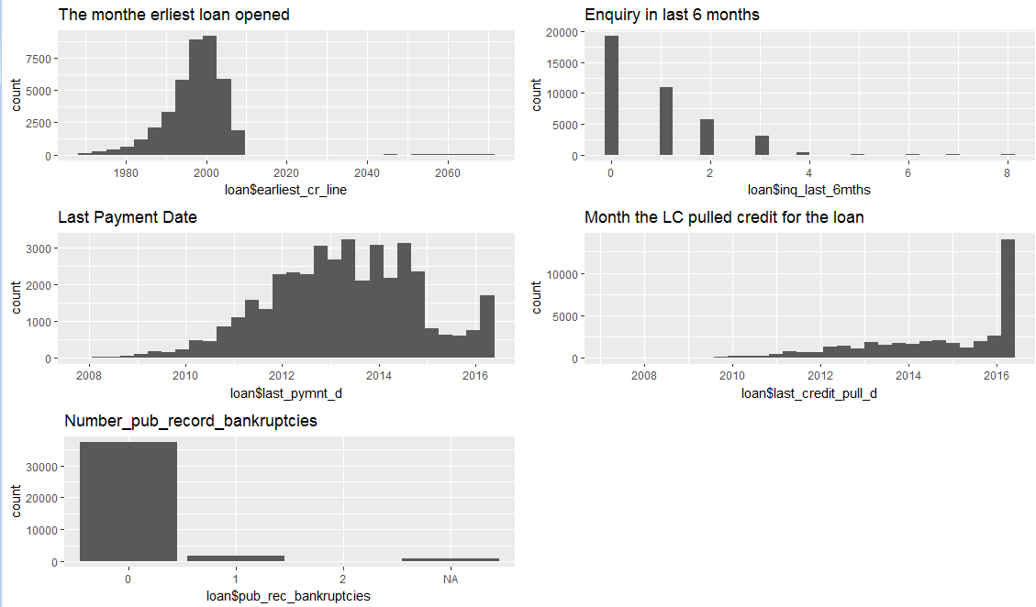
Univariate Analysis-Ordered Categorical Variables

Slide 12
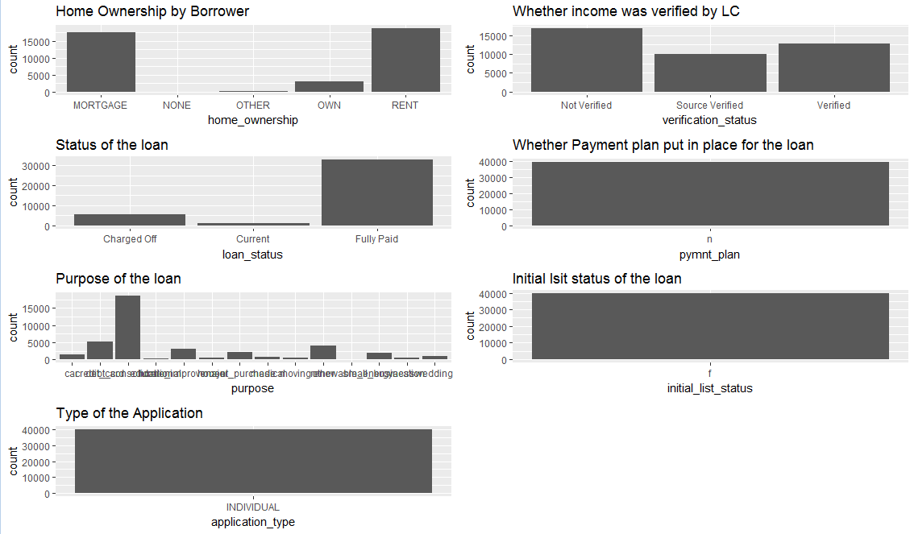
Univariate Analysis-Un ordered categorical variables
From above unordered categorical variable plots it shows that pymnt_plan, application_type and
Initial_list_status can be excluded as there is one category which cannot influence whether the loan can be defaulted or not

Slide 13
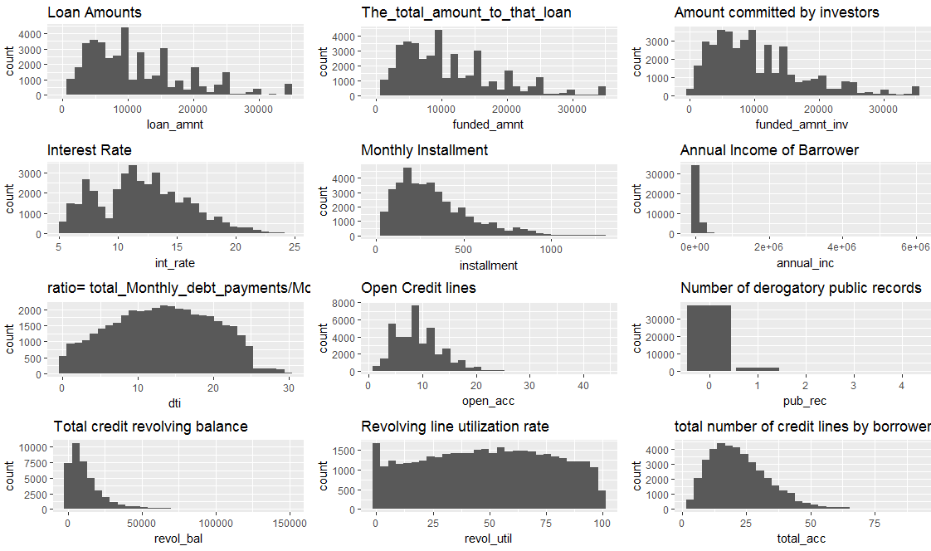
Univariate Analysis-Metric Variables

Slide 14
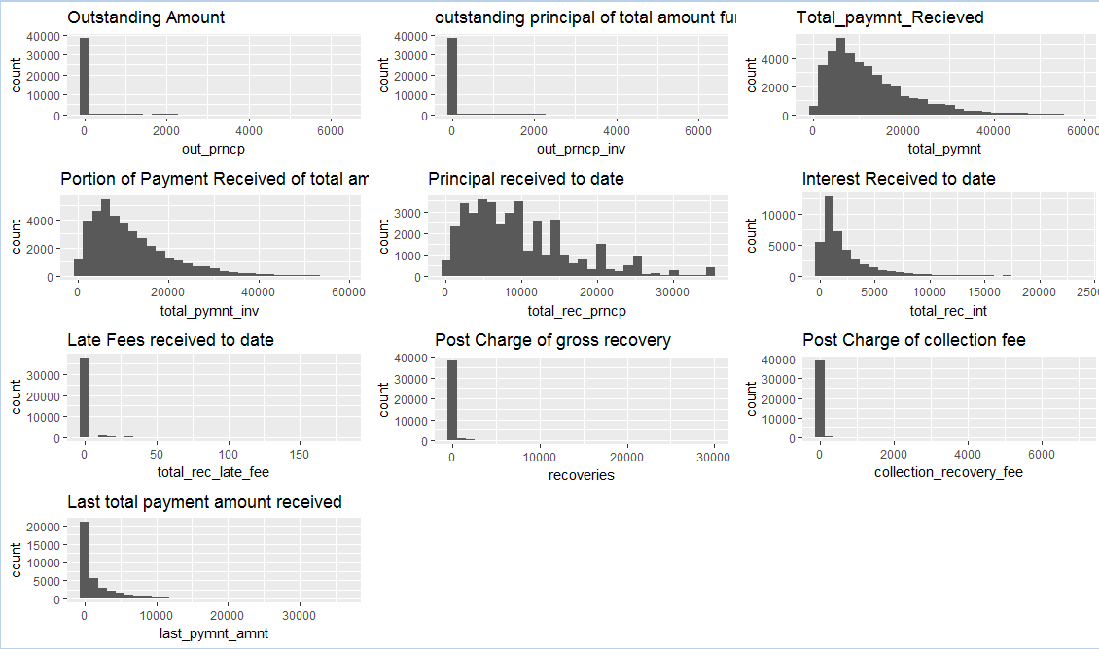
Univariate Analysis-Metric Variables

Slide 15
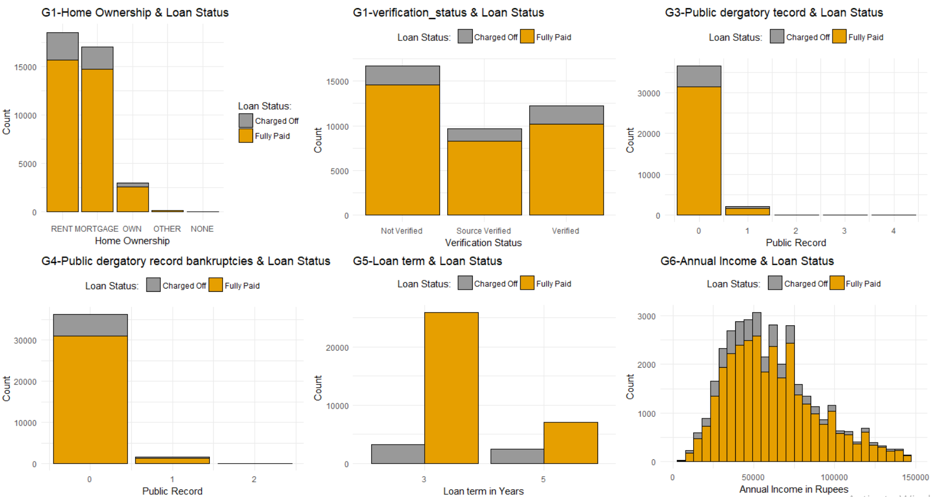
Segmented Univariate Analysis

Slide 16
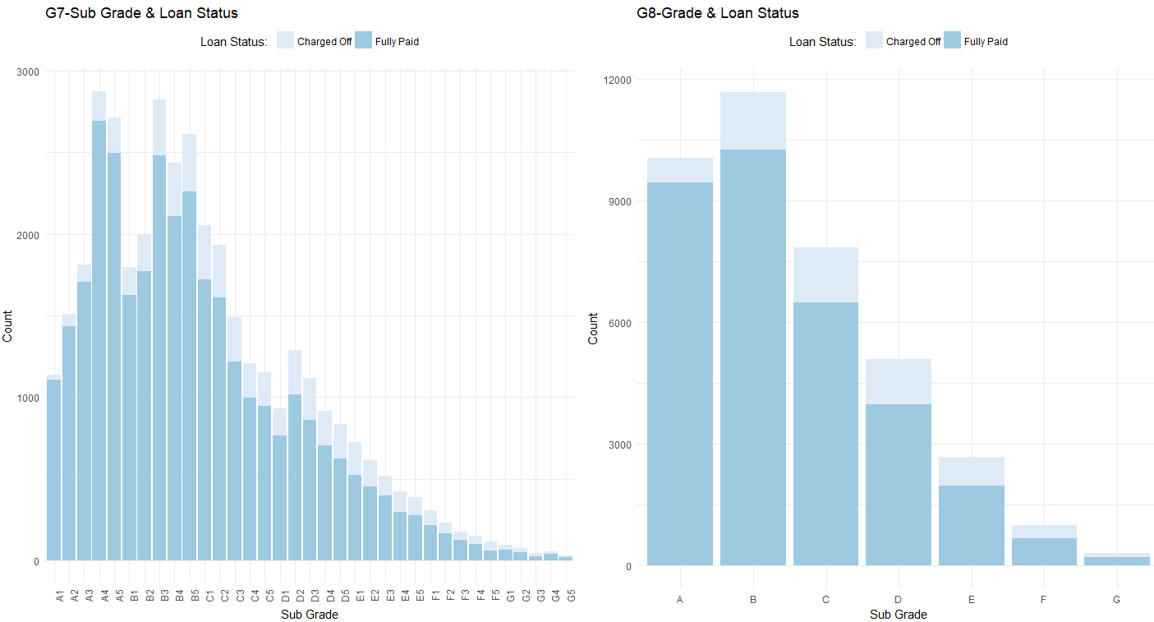
Segmented Univariate Analysis

Slide 17
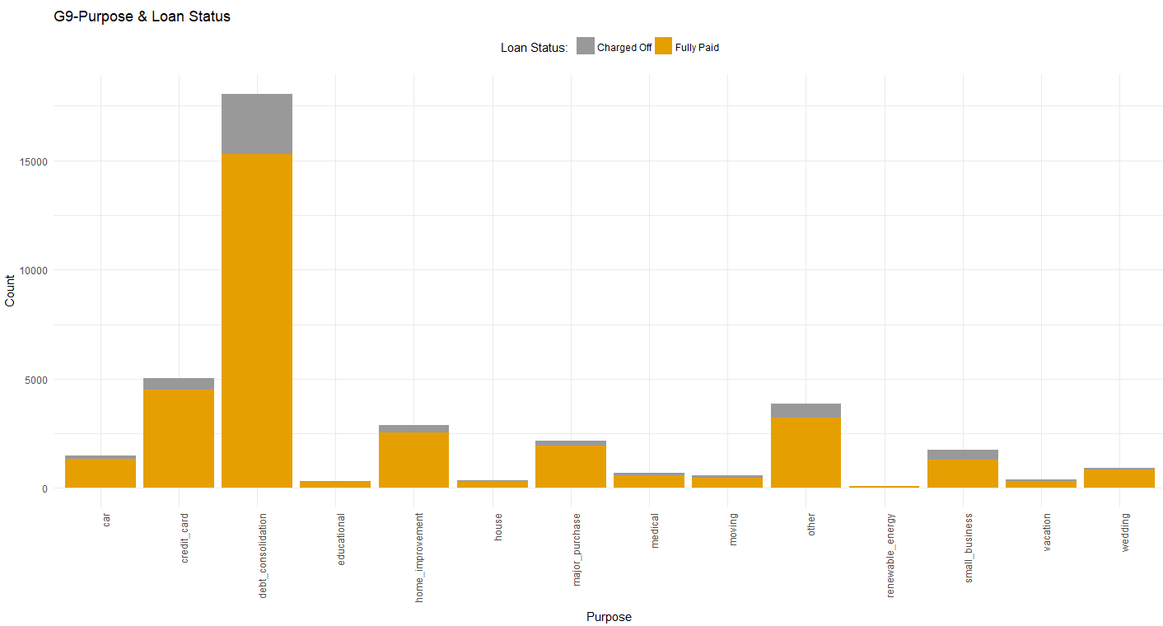
Segmented Univariate Analysis

Slide 18
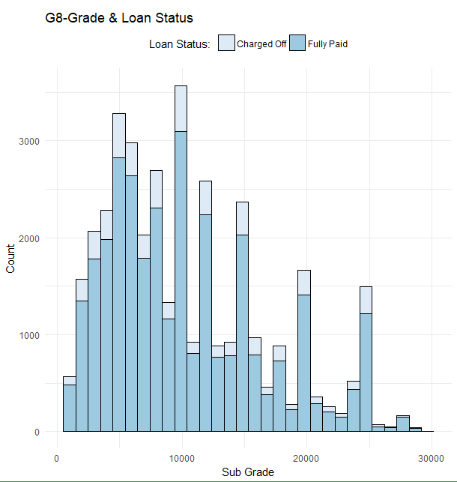
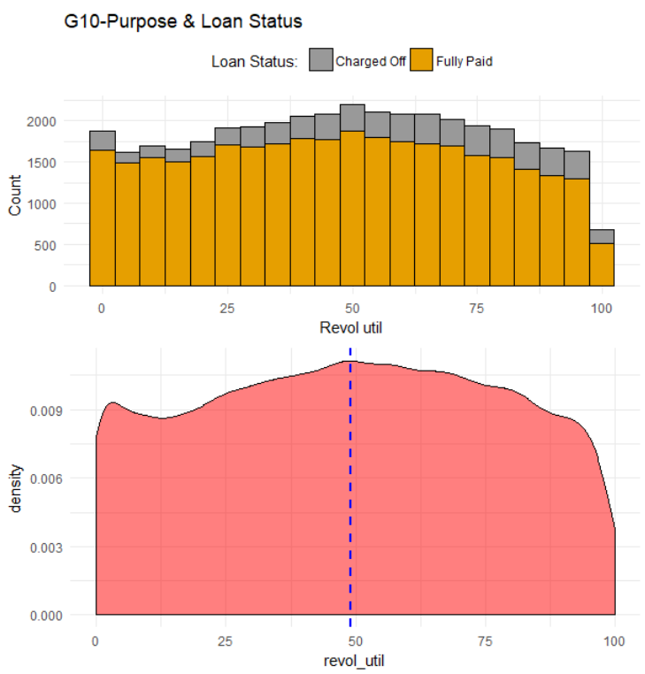
Segmented Univariate Analysis

Slide 19
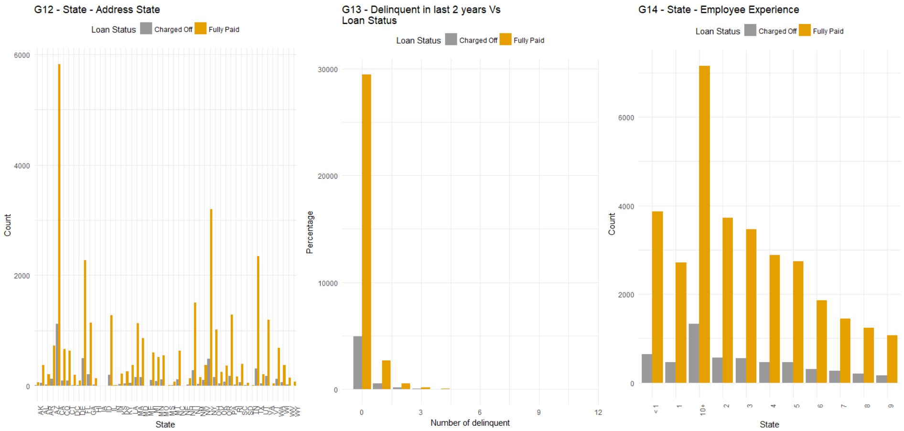
Segmented Univariate Analysis

Slide 20
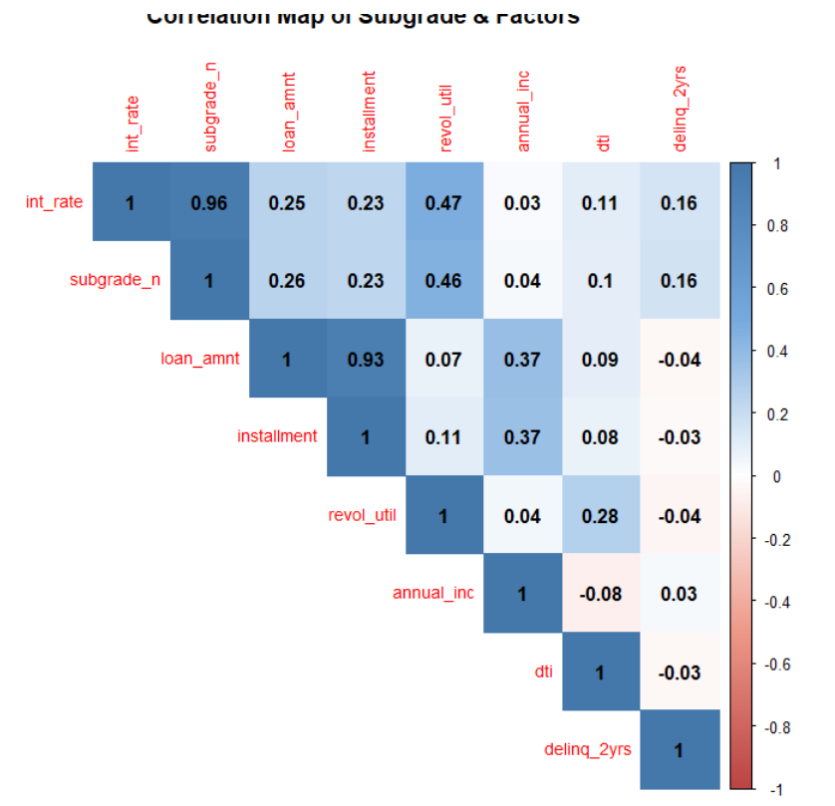
Bi-Variate Analysis
This is Correlation among below columns
>0 indicates positively correlated
<0 indicates negatively correlated
=0 indicates neutral correlation
int_rate
subgrade_n
loan_amnt
Installment
revol_util
Annual_inc
dti
delinq_2yrs

Slide 21
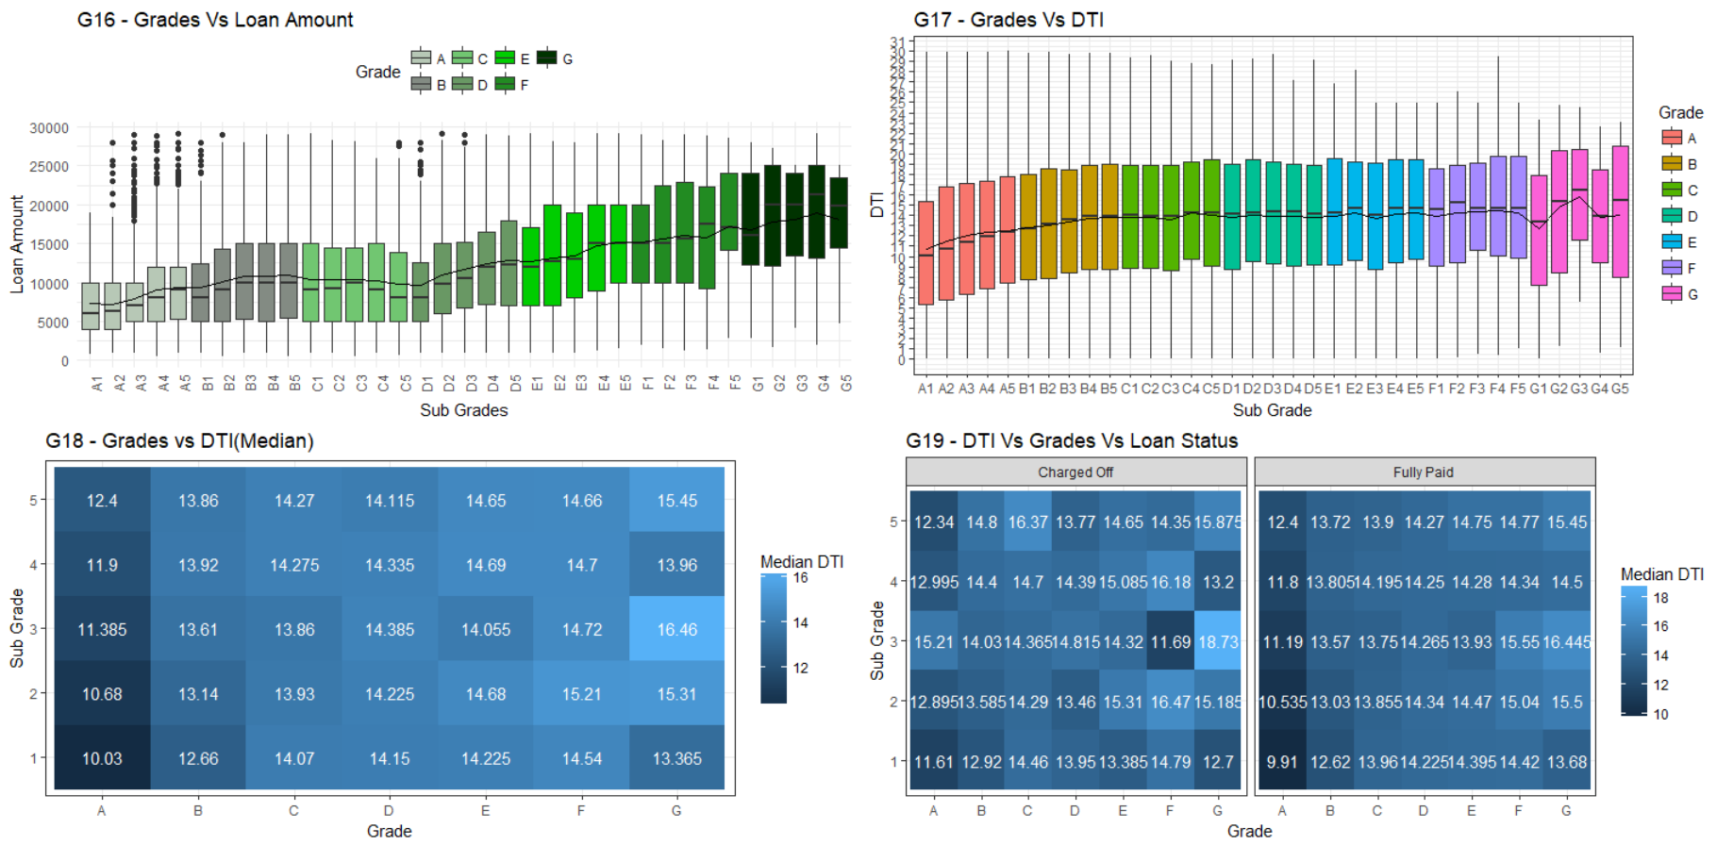
Bi-Variate Analysis

Slide 22
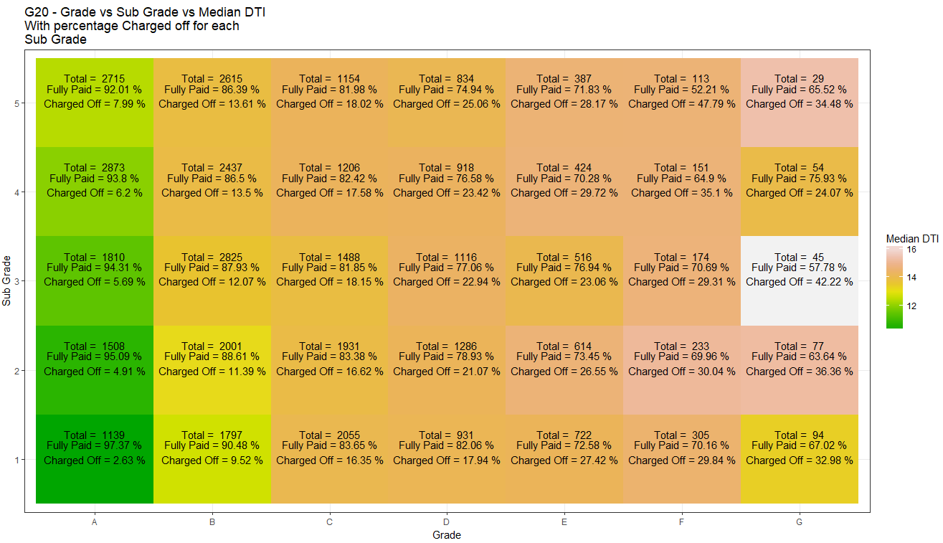
Bi-Variate Analysis

Slide 23
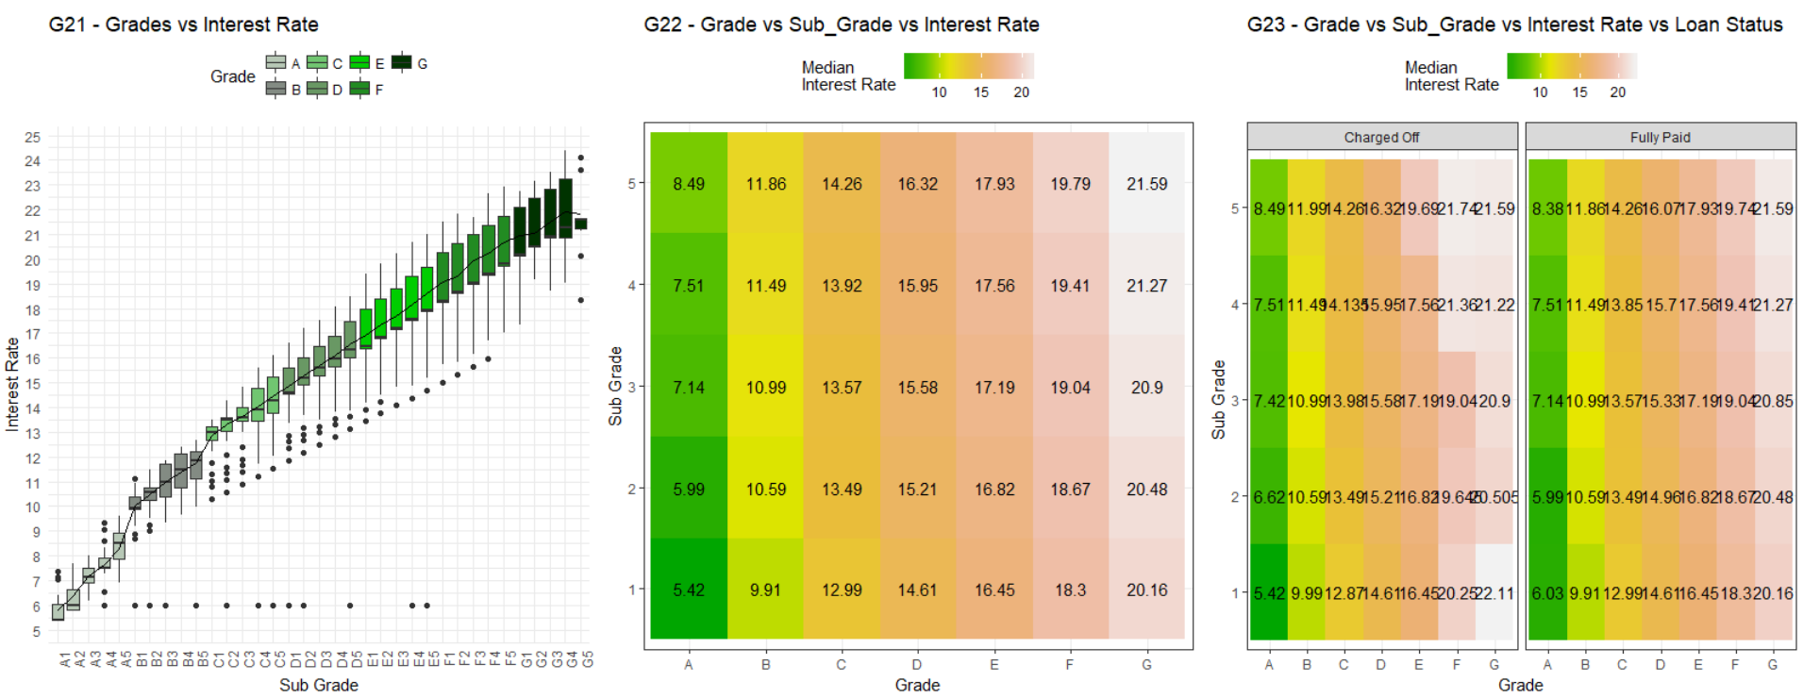
Bi-Variate Analysis

Slide 24
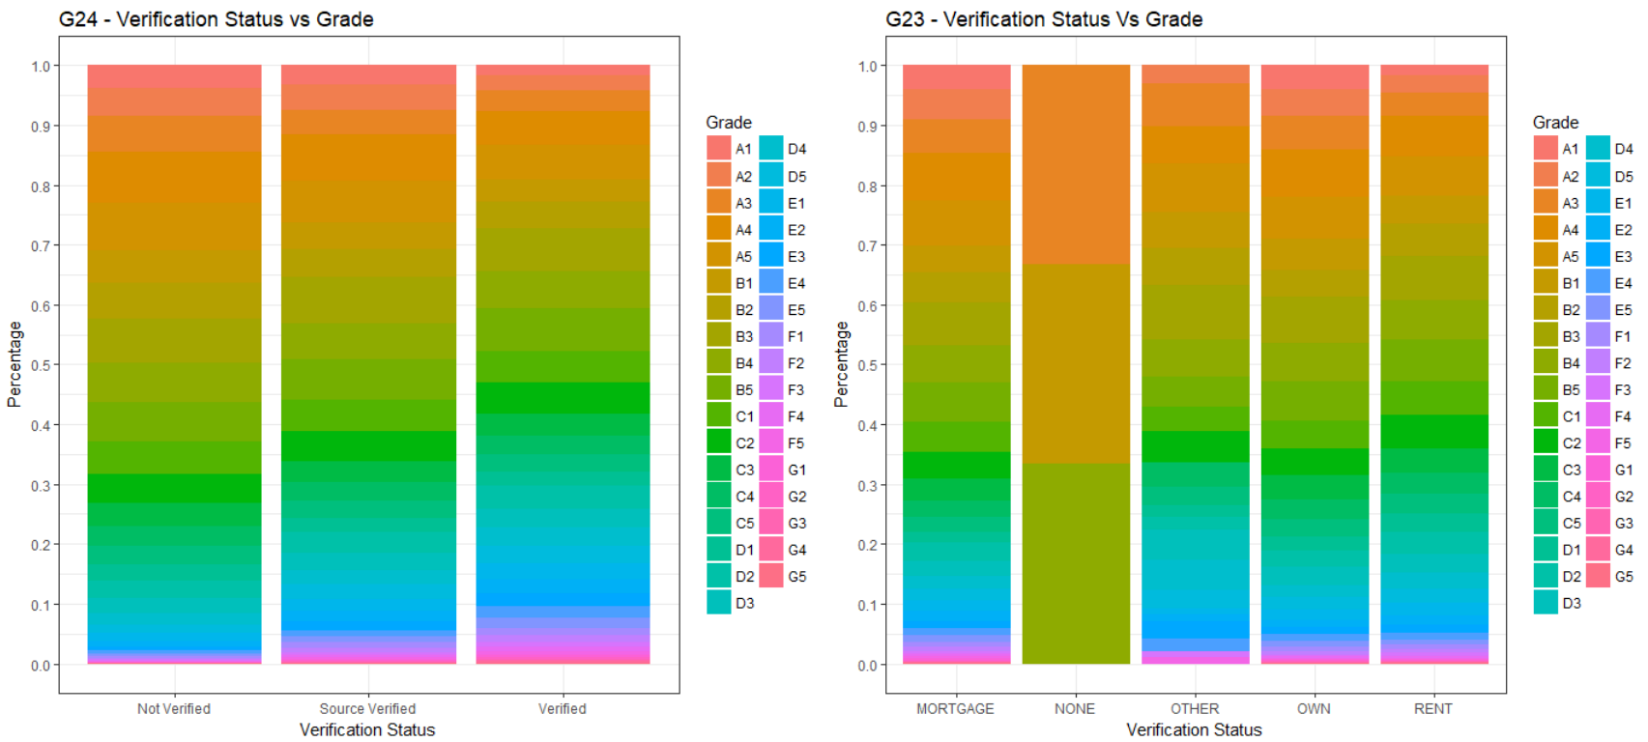
Bi-Variate Analysis

Slide 25
Inferences
Below variables that effect the charge off Vs Fully paid loans
sub_grade
purpose
term
home_ownership
verification_status
public bankruptcy records
revol_util_range
loan_amnt_range
Above variables will help us to predict whether the borrower is likely to default or not.

