Slide 1



project_file
View in Power BI
Last data refresh:
30-12-2022 14:57:06 UTC
Downloaded at:
30-12-2022 15:07:15 UTC

Slide 2
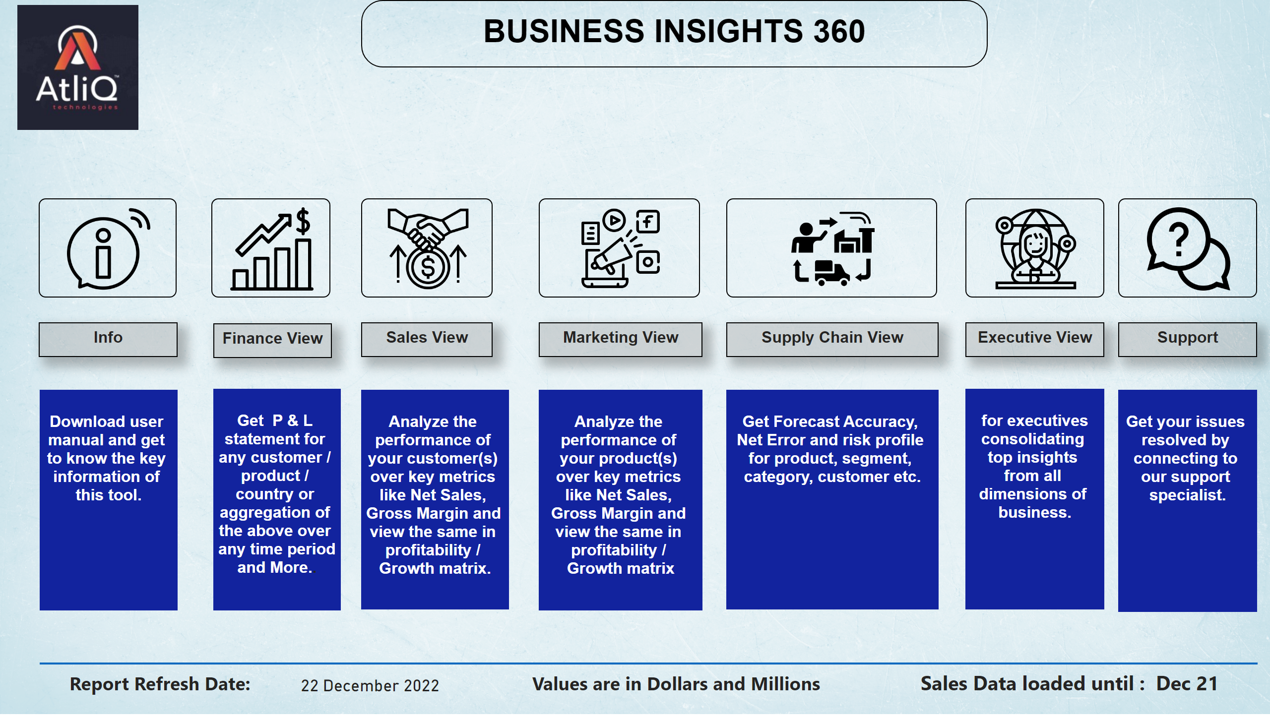
Home
Notes:
image
No alt text provided
image
No alt text provided
image
No alt text provided
image
No alt text provided
image
No alt text provided
image
No alt text provided
image
No alt text provided
image
No alt text provided
textbox
No alt text provided
textbox
No alt text provided
textbox
No alt text provided
textbox
No alt text provided
textbox
No alt text provided
textbox
No alt text provided
textbox
No alt text provided
textbox
No alt text provided
textbox
No alt text provided
textbox
No alt text provided
textbox
No alt text provided
textbox
No alt text provided
textbox
No alt text provided
textbox
No alt text provided
textbox
No alt text provided
shape
No alt text provided
card
No alt text provided
textbox
No alt text provided
textbox
No alt text provided
card
No alt text provided

