Slide 1
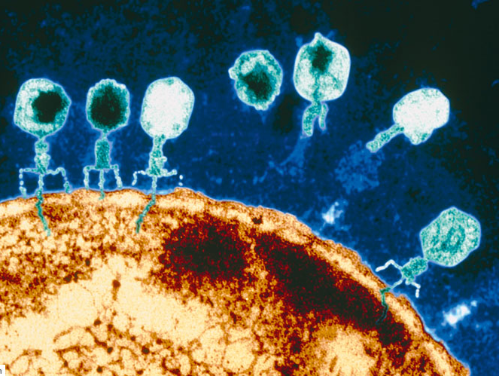
Simulating Virus and Host Coevolution
Laura Colbran, Samuel Greaves, Liz Shank

Slide 2
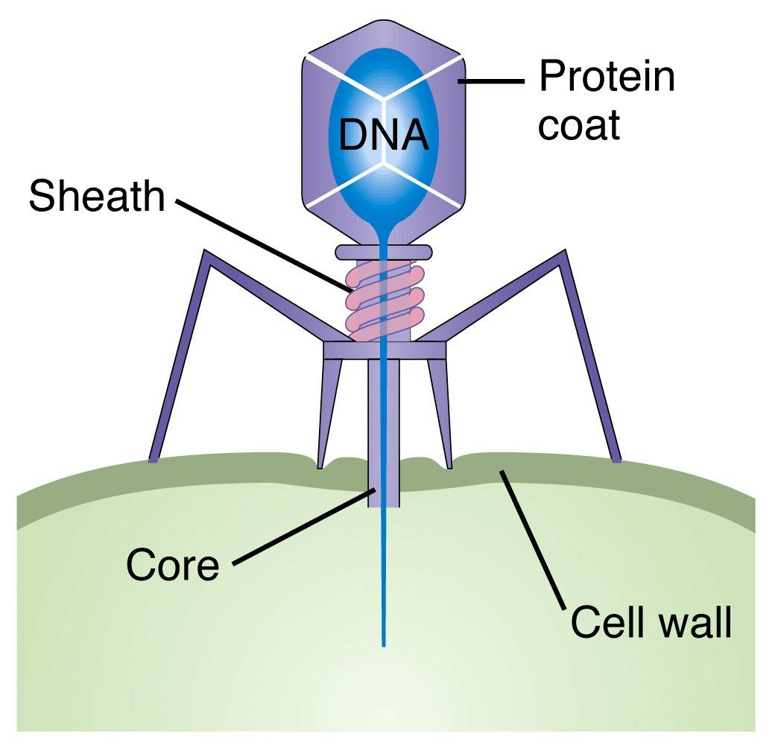
Biology Background
Bacteria- single cells, have a genome
Bacteriophages- type of virus that is a bacteria specialist

Slide 3
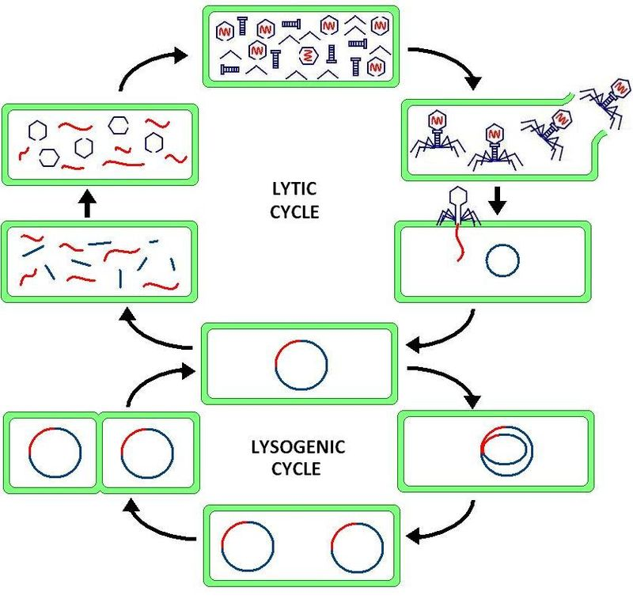
How do Viruses actually work?
Assembly
Spreading
Infection
Replication in host genome. We’re ignoring this.
Notes:
The virus injects genetic material (RNA or DNA) into the host.
This can be incorporated into the host to silently replicate, but we are not modelling it.
The genetic material is used to take over the host’s replication machinery and create viral genetic material and proteins.
These are assembled into viruses and the cell is lysed to release them.

Slide 4
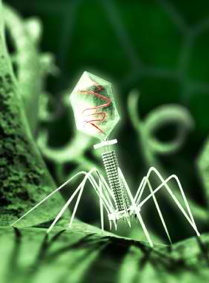
Gene-for-Gene Interaction
Viruses have genes that make proteins that help them do their thing.
Bacteria evolve resistance genes to recognize and destroy specific viral proteins.
It’s an arms race!

Slide 5
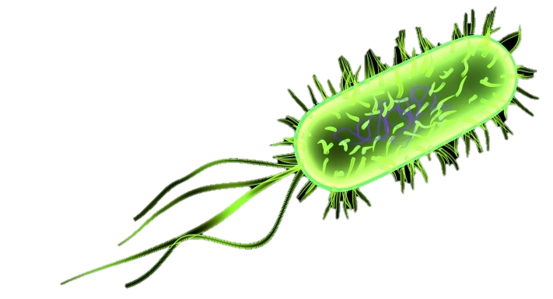
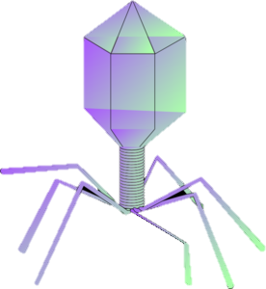
For example….
Bacteria
0100011
The bacteria can resist this virus, because it has a resistance gene for every protein.
0100001
It cannot resist this virus, as the virus has a protein the bacteria doesn’t recognize.
0100100

Slide 6
Matching Allele Interaction
Bacteria
0100011
The bacteria can resist this virus, because it can detect the difference between itself and the viral genome
0100001
It cannot resist this virus, as the virus matches the host recognition sequence perfectly.
0100011

Slide 7
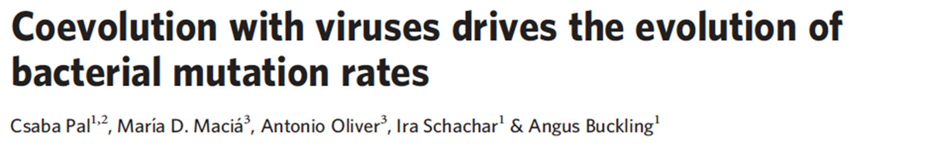
What are we doing?
Replicating and improving on this paper
Used a GA to simulate evolution of mutation rates in hosts
Explored further and confirmed using wet lab methods

Slide 8
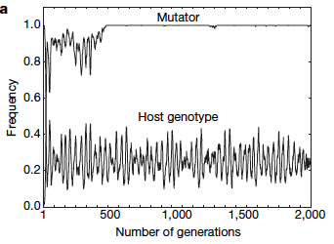
What did they find?
Coevolution with viruses drives relatively high mutation rates in bacteria
Mutator- gene that increases mutation rate
Specific host genotype frequencies fluctuate in response to viruses

Slide 9
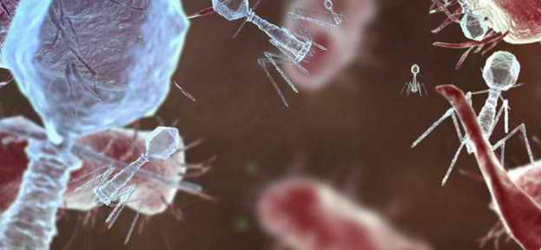
What have we done?
Implemented a coevolution GA using the Gene-for-gene interaction model

Slide 10
How does it work?
Representation
Genome
Virus
Bacteria
Interaction Model
Virulence
Viability
Interaction Model | Mutator
Resistance

Slide 11


How does it work?
No crossover (both reproduce asexually in nature)
Mutation rate?
Fitness functions?
Selection- fitness-proportional

Slide 12
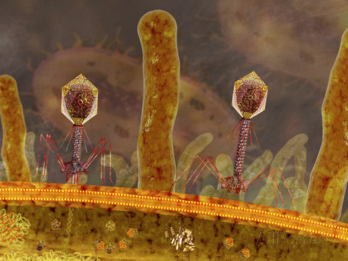
Any interesting results?

Slide 13
What do we still need to do?
Allow mutation evolution in both populations
Allow mutation in interaction model
How does sampling bacteria methods affect evolution?

