Slide 1
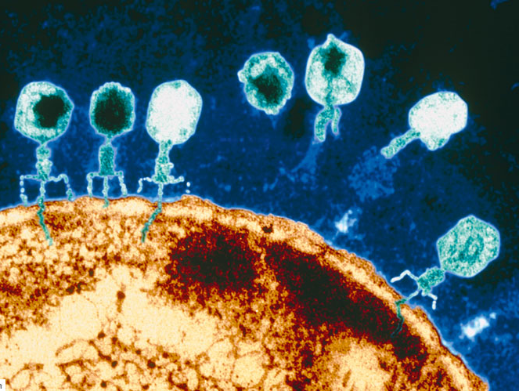
Simulating Virus and Host Coevolution
Laura Colbran, Samuel Greaves, Liz Shank

Slide 2
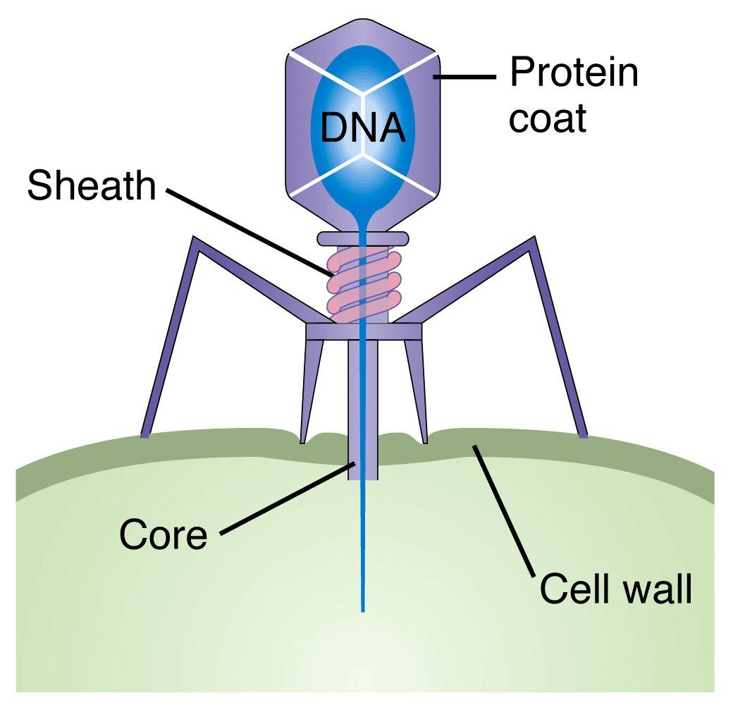
Biology Background
Bacteria- single cells, have a genome
Bacteriophages- type of virus that is a bacteria specialist

Slide 3
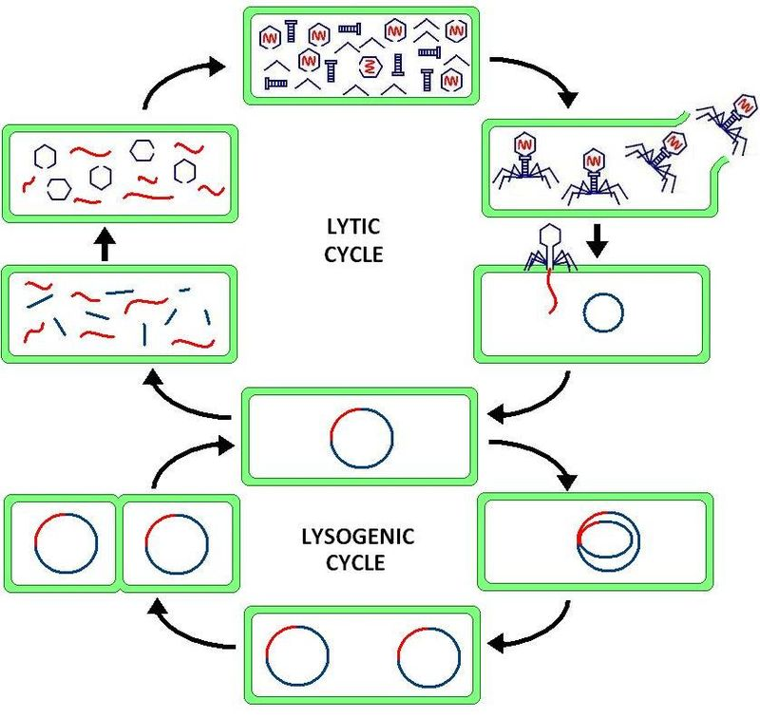
How do Viruses actually work?
Assembly
Spreading
Infection
Replication in host genome. We’re ignoring this.
Notes:
The virus injects genetic material (RNA or DNA) into the host.
This can be incorporated into the host to silently replicate, but we are not modelling it.
The genetic material is used to take over the host’s replication machinery and create viral genetic material and proteins.
These are assembled into viruses and the cell is lysed to release them.

Slide 4
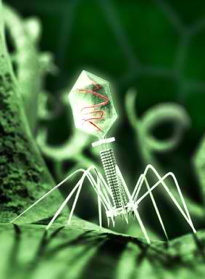
Gene-for-Gene Interaction
Viruses have genes that make proteins that help them do their thing.
Bacteria evolve resistance genes to recognize and destroy specific viral proteins.
It’s an arms race!

Slide 5
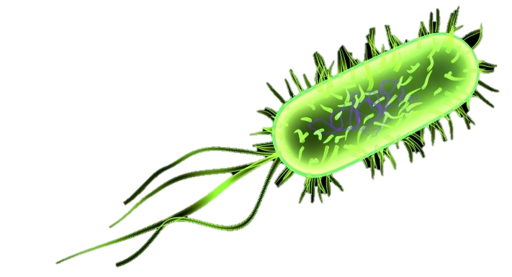
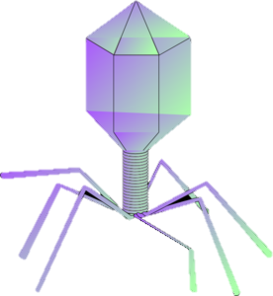
For example….
Bacteria
0100011
The bacteria can resist this virus, because it has a resistance gene for every protein.
0100001
It cannot resist this virus, as the virus has a protein the bacteria doesn’t recognize.
0100100
This models allows for a broader range of infectivity than the other model

Slide 6
Matching Allele Interaction
Bacteria
0100011
The bacteria can resist this virus, because it can detect the difference between itself and the viral genome
0100001
It cannot resist this virus, as the virus matches the host recognition sequence perfectly.
0100011

Slide 7
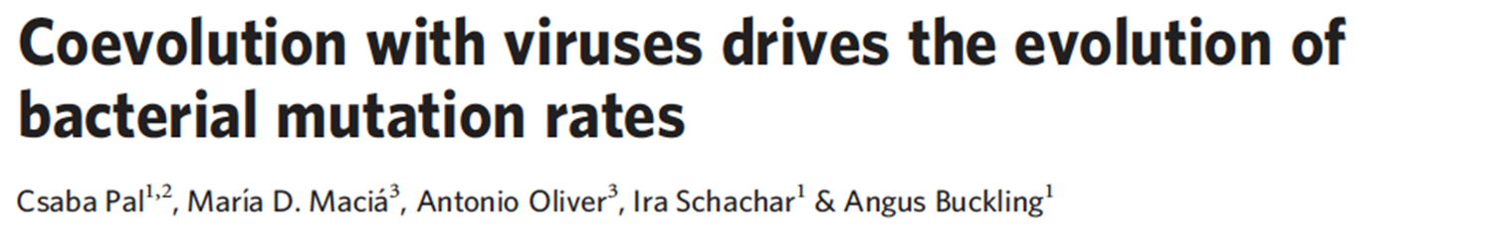
What are we doing?
Replicating and improving on this paper
Used a GA to simulate evolution of mutation rates in hosts
Explored further and confirmed using wet lab methods

Slide 8
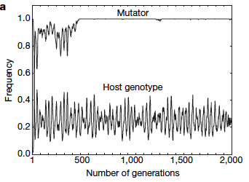
What did they find?
Coevolution with viruses drives relatively high mutation rates in bacteria
Mutator- gene that increases mutation rate
Specific host genotype frequencies fluctuate in response to viruses

Slide 9
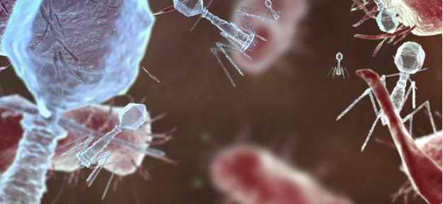
What have we done?
Implemented a coevolution GA to model the changes of various alleles as the populations interact.

Slide 10
How does it work?
Representation
Genome
Virus
Bacteria
Resistance, viability, and virulence genes are variable length
There is a cost to virulence and resistance, defined in the config
Interaction Model
Virulence
Viability
Interaction Model | Mutator
Resistance
Notes:
Mutator on virus?

Slide 11
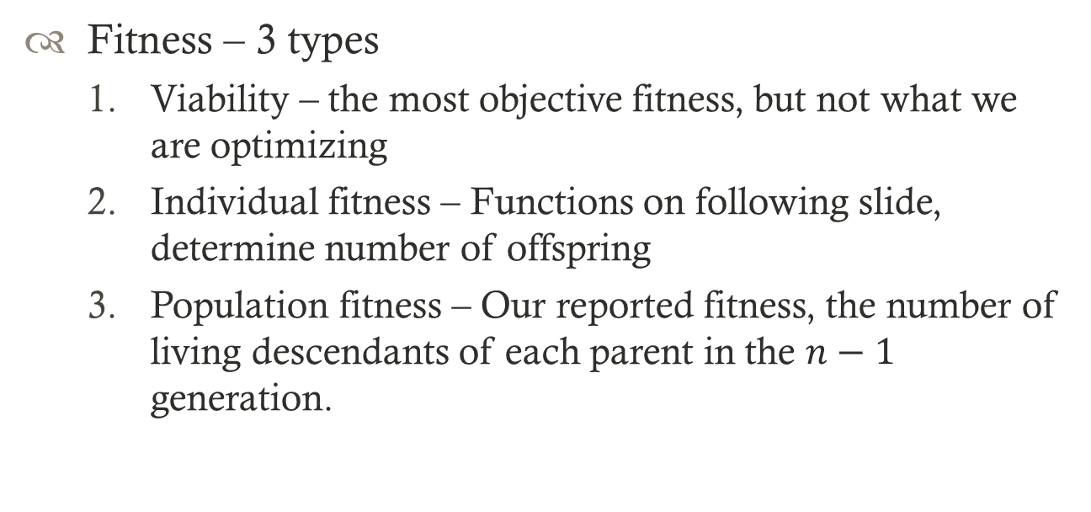
How does it work?
Fitness – 3 types
Viability – the most objective fitness, but not what we are optimizing
Individual fitness – Functions on following slide, determine number of offspring
Population fitness – Our reported fitness, the number of living descendants of each parent in the $n−1$ generation.

Slide 12
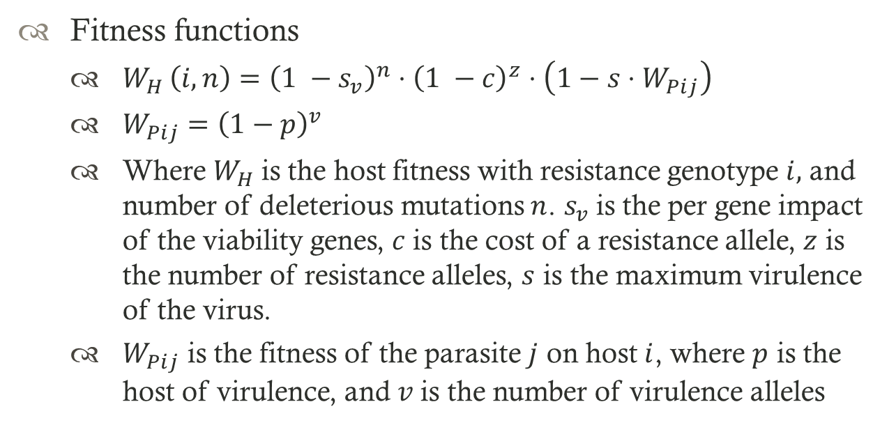
How does it work?
Fitness functions
$W_{H }\left(i,n\right)={\left(1 −s_{v}\right)}^{n}⋅{\left(1 −c\right)}^{z}⋅\left(1−s⋅W_{Pij}\right)$
$W_{Pij}={\left(1−p\right)}^{v}$
Where $W_{H}$is the host fitness with resistance genotype $i,$ and number of deleterious mutations $n$. $s_{v}$is the per gene impact of the viability genes, $c$is the cost of a resistance allele, $z$ is the number of resistance alleles, $s$ is the maximum virulence of the virus.
$W_{Pij}$ is the fitness of the parasite $j$ on host$i$, where $p$ is the host of virulence, and $v$is the number of virulence alleles

Slide 13
How does it work?
Viability
Deleterious or wild type (no effect) phenotypes
Start out all wild type, adds cost to high mutation rates
Virulence & Resistance
Determine whether a virus can infect a bacteria according to the interaction model

Slide 14
How does it work?
No crossover (both reproduce asexually in nature)
Mutation rate
Base is .001, increases to .1 if the mutator gene is 1.
Selection
Natural selection: Virus selects first bacteria it can infect (if it can). Organisms that have the most offspring before they die are selected for.
fitness-proportional: Used to cull the population when it reaches carrying capacity.

Slide 15
How does it work?
Select & Infect
Evaluate individual Fitness
Create offspring
Parents die
Mutate
Evaluate Population Fitness/Cull
Output
Initialize

Slide 16
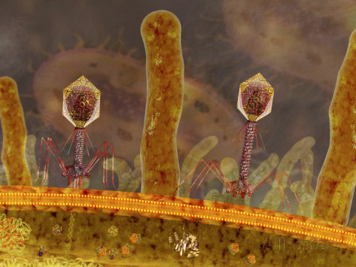
Any interesting results?

Slide 17
What do we still need to do?
Allow mutation evolution in both populations
Allow mutation in interaction model
Wider variety of mutation rates
How does sampling bacteria methods affect evolution?

