Slide 1
Predicting sample disease state based on ATACseq data for blood cells
Kyle Alford (kla2122)
Rohan Dayal (rod2105)
Stephen Shanko (sjs2287)
Notes:
Everyone
Kyle introduces himself
Hi my name is Rohan Dayal
Steve introduces himself and says our project is “Predicting sample disease state based on ATACseq data for blood cells

Slide 2
Problem
ATACSeq data is readily available, but what can it tell us about the mechanisms of disease? We set out to see if ATACSeq data can predict disease state in blood cells, and further if we could extract feature importance to guide further research on the causation of certain diseases
Notes:
Rohan
The main problem we focused on with this project was being able to predict the disease state of blood cells using ATACSeq data. Previous literature indicated that such a signal may exist, though did not focus on this question in particular. Our goal was to see if ATACSeq can predict disease state in blood cells, and then use those results to extract information on the causation of certain diseases. Our data focused on general disease state across different diseases including Leukemia, Yellow Fever, and others, along with general healthy cells.

Slide 3
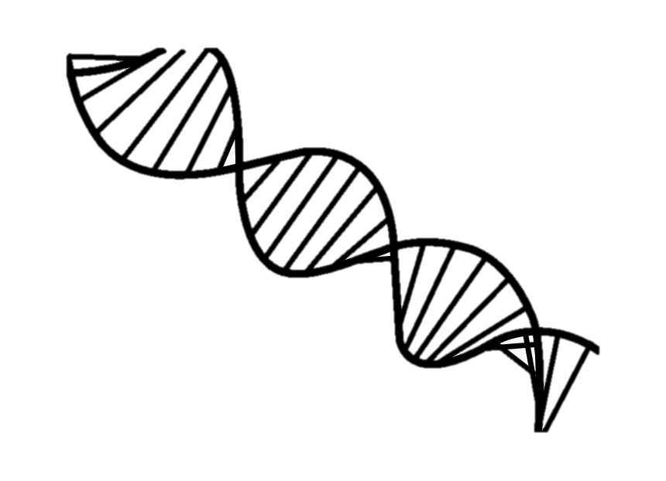
Genome (hg 19) ~3B bp
Discretize into 10k bp bins
Bin zzzz
Sample_xxxx reads
Sample_yyyy reads
Three Methods
Long merged sequence (all reads)
Accessibility % per bin
(all bins 309568)
Selected bin sequence
(77 PCA inferred bins)
Notes:
Steve
We took an iterative approach to data preprocessing and refining our final datasets
We began by merging all the reads for a given sample sequentially based on their position in the genome. Even though the reads are sparse in comparison with the size of the genome itself, the resulting sequences were very large, hard to deal with, and did not produce any good results with the baseline RNNs we attempted.
It was essential to pivot to a different representation of the data that was easier to work with.
This led us to the idea of discretizing the genome in buckets of 10k bp. Within these bins we would calculate the % of the bin covered by sequence reads for each sample.
After using that dataset to do some initial EDA and model building, we were able to filter down to 77 bins of particular interest. We used that dataset for training our final non-PCA models and also developed an additional shorter dataset of sequences and blanks as shown in Method 3. We hope that this dataset could be used in the future to train more accurate sequence based models.

Slide 4
Training Methods
Models
Linear Regression (+ Ridge, Lasso)
SVM
XGBoost
Logistic Regression
Neural Network (Dropout + ELU + FC-16, x8)
RNN
Metrics: Accuracy, TPR, FPR, Precision, F1-score
assess the predictive power of the models on both datasets
Notes:
Kyle
The megasequence dataset was too large, as Steve mentioned, for the RNN both in storing it within RAM and the weights within the model. So we decided to focus on the latter two datasets (PCA and filtered buckets)
Linear Regression: The motivation behind employing the linear regression model was to conduct an initial exploration
to determine if there existed linear trends in the dataset.
SVM: SVM with a linear kernel is comparable to a Logistic Regression model, but an
SVM may be more computationally efficient
XGBoost: less data to train than a DNN with similar accuracy to DNNs.
NN: the motivation was that if the
relationships in the data were not linear, then a DNN would be able to obtain more signal from using
non-linear activation functions after the FC layers

Slide 5
Motivations for Data
Create discretized buckets of genomic regions
hope to reverse-engineer the buckets to find most important regions
Original data was ~500x300,000
PCA to compress to 50 PCs, find most variant genetic buckets
Notes:
Kyle
The discretized buckets of genomic regions

Slide 6
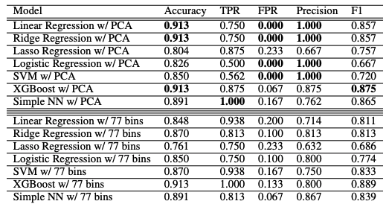
Results
Notes:
Rohan
The results from across our models confirmed our original hypothesis that the ATACSeq data contained signal to allow us to predict disease state across the samples. For the PCA transformed data, the standard linear regression model, Ridge regression model, and XGBoost model performed best in terms of accuracy; Linear regression and ridge regression had better FPR rates and precision than XGBoost, while XGBoost had better F1 score than linear regression and ridge regression.
When the models were run on the dataset with the non-PCA transformed data, with the data filtered to only include the segments or buckets which were most important based on the PCA analysis, the models still performed strongly in general. XGBoost had the strongest performance, followed by Simple NN and Ridge Regression. An interesting thing to note is that Logisitc regression actually improved
The bins filtered gave us similar performance to the PCA transformed data. This is important because the PCA transformed data is a bit difficult to interpret from a biological perspective. With the bins filtered by PCA dataset, we are able to better interpret the biology since we know the sequenced regions corresponding to the buckets in the filtered dataset are important predictors for whether or not the cell is healthy or disease state. So the predictive signal is associated with those specific buckets which are associated with , and not just with the transformed data.

Slide 7
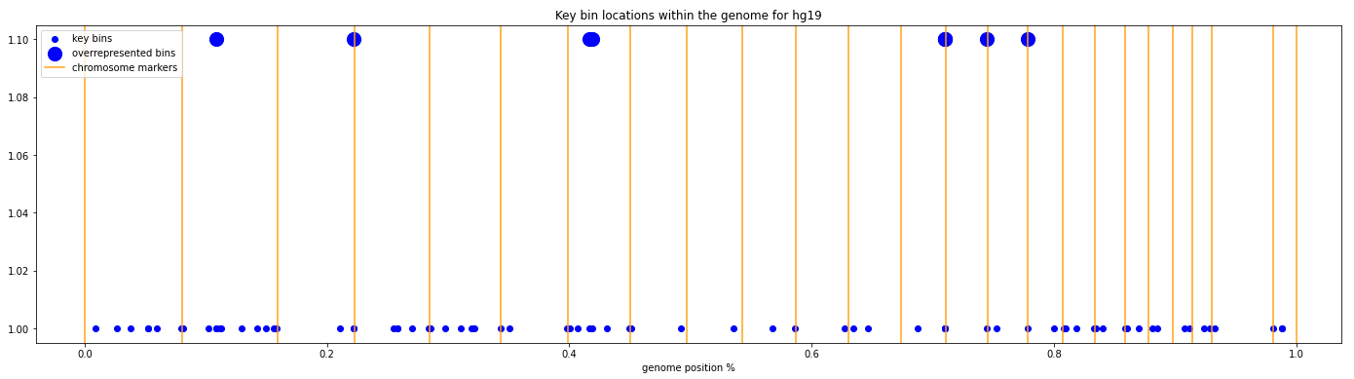
Discussion
Notes:
Steve
Here is a graphic showing the 77 key bins we identified from PCA on the original full dataset. We looked at the top 10 PCs and looked further at the top 10 contributions in each PC to come up with these bins.
Interesting to note that 9 bins were “overrepresented” and showed up in this list more than once. This is why we had 77 key bins and not 100
33697 2, 68767 3, 129054 4, 129687 4, 219770 3, 219771 3, 219772 5, 230563 3, 240958 5 = 32 times!

Slide 8
Next Steps
Explore relationship between identified bins and disease mechanisms
Create RNN architectures capable of handling very long sequences
explore literature/conferences for architecture ideas
Perform a multiclass classification on the same data for different cancer subtypes
compare with current SOTA
Notes:
Kyle

