Slide 1
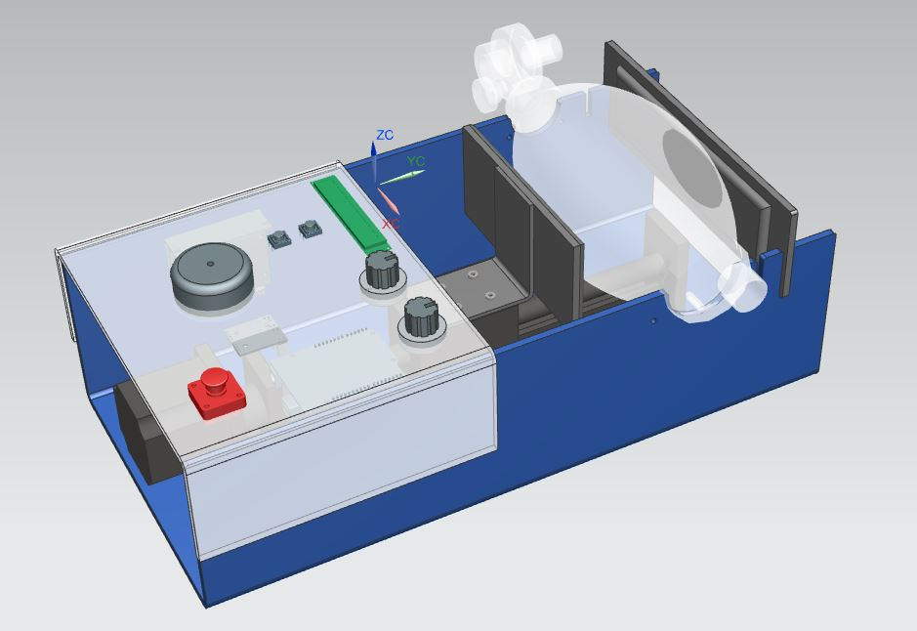
Columbia DIY Ventilator Challenge
Team Biryani
Shet, Shashank (Lead)
Badjatya, Palash
Chan, Monica Miaoxia
Indaram, Shrikar
Shanko, Stephen John
Shorey, Sagar

Slide 2
Outline
The Team
Problem Statement
Overall Design
Detailed Design
Mechanical
Electrical
Specifications
Parts list
Caveats
Requested Funding

Slide 3
The Team
Name | Affiliation | Email | Phone
Shet, Shashank (Team Lead) | MS Student, Columbia SEAS | ss5922@columbia.edu | +1 (646) 829-8144
Badjatya, Palash | PhD Student, Columbia SEAS | pb2797@columbia.edu | +1 (646) 266-4356
Chan, Monica Miaoxia | EdD Student, Teachers College | monica.chan@tc.columbia.edu | +1 (650) 518-6337
Indaram, Shrikar | MS Student, Columbia SEAS | shrikar.indaram@columbia.edu | +1 (212) 729-0531
Shanko, Stephen John | MS Student, Columbia SEAS | sjs2287@columbia.edu | +1 (732) 947-6277
Shorey, Sagar | MS Student, Columbia SEAS | sagar.shorey@columbia.edu | +1 (646) 267-3703

Slide 4
Problem Statement and Solution
Due to the sudden COVID-19 pandemic outbreak and the imminent shortage of essential ventilator machines in New York City (and potentially in the United States), there is an urgent need for temporary makeshift ventilators that are easy-to-make, accessible and affordable for all.
Named the “DIY Ventilator”, our solution is a low-cost portable ventilator made from an automated mechanism squeezing an Ambu-Bag (or any similar BVM) at regular intervals to ensure consistent airflow to a patient in need of urgent ventilation, until a medical ventilator becomes available.

Slide 5
Overall Design
Overall Dimensions:
Height: 125 mm Width: 230 mm Length: 450 mm
Weight: 10 lbs (Approx)

Slide 6
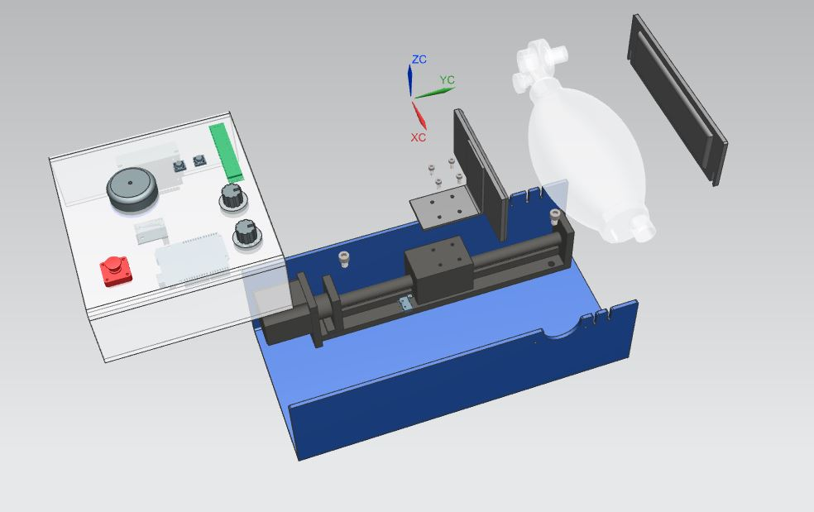
Detailed Design - Exploded
Electronics Panel
Backplane
Squeezer Paddle
AMBU Bag
Ball Screw Linear Guide
Acrylic Enclosure

Slide 7
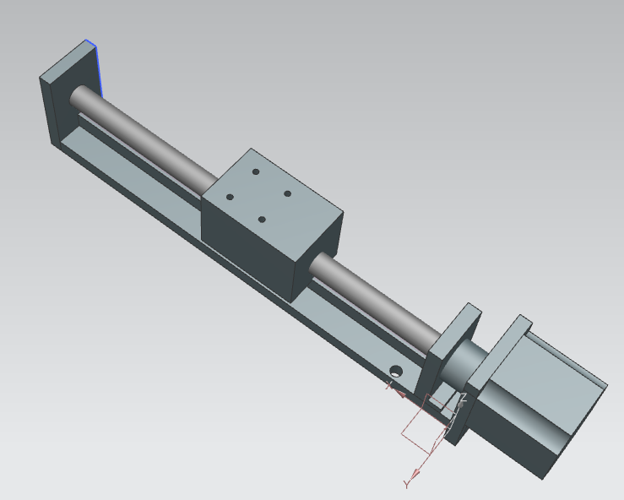
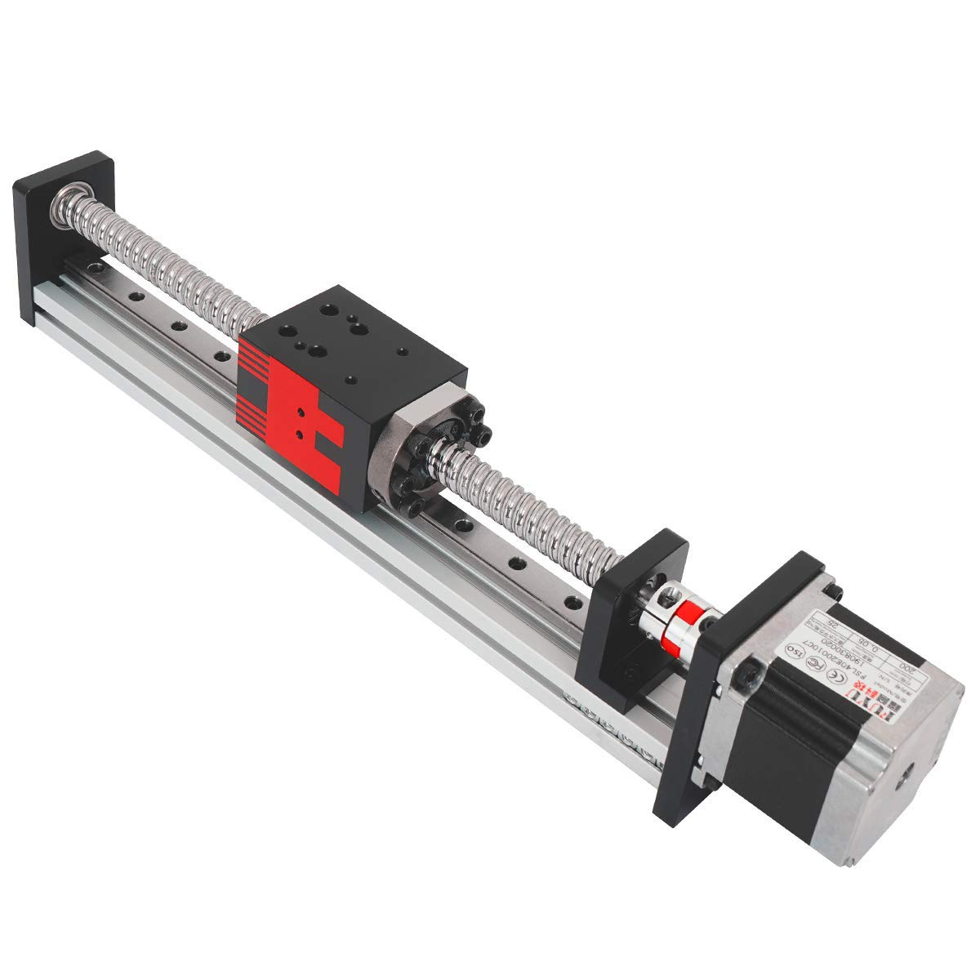
Component Detail - Linear Guide Ball Screw
Off-the-shelf component - Available on Amazon, Ebay etc, variety of manufacturers
Specifications Travel: 200mm Max Load: 40 -50 lbs Max Speed: 150mm/sec at full load
See link for video of movement: https://www.youtube.com/watch?v=Z7Ue73CAqeM
Advantages:
Off-the-shelf OEM component
Reliable
Long Duty Cycle
Pre-assembled Mechanism
Accurate

Slide 8
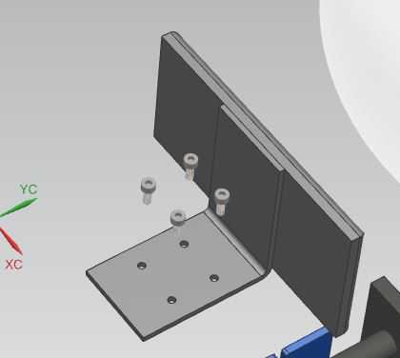
Component Detail - Squeeze Paddle
Acrylic Sheet
Off-the-shelf component with minor modifications
L-Bracket + Foam Padded Acrylic Sheet Specs: L-Bracket: Steel, 75mm X 60 X 50mm Acrylic Sheet: 5 mm thick with foam padding
This is fastened to the linear guide using 4 screws on the L-bracket
Advantages:
L-Bracket, Acrylic Sheet available off-the-shelf on various hardware websites
Easy to manufacture
Foam Pad
L-Bracket

Slide 9
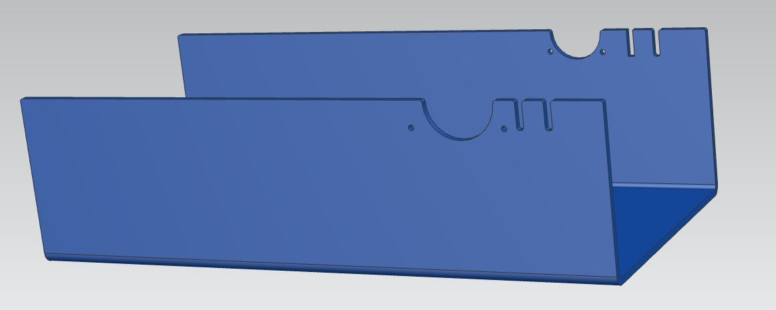
Component Detail - Enclosure
Backplane cutouts
Ambu Bag cutout,
with cable ties/rubber -band holes
Material: Acrylic Sheets, 5 mm thickness, Angle brackets to support sidewalls Specs: Approx. 450mm X 125 mm X 223mm
Features:
Adjustable Backplane position to accommodate smaller Ambu bags
Cutouts designed as per selected Ambu Bag and Linear Guide Dimensions
Different Sized Ambu Bag held in place securely using cable ties passed through the cutout holes
Advantages: Easy to Manufacture, No dust or debris suitable for hospital environment

Slide 10
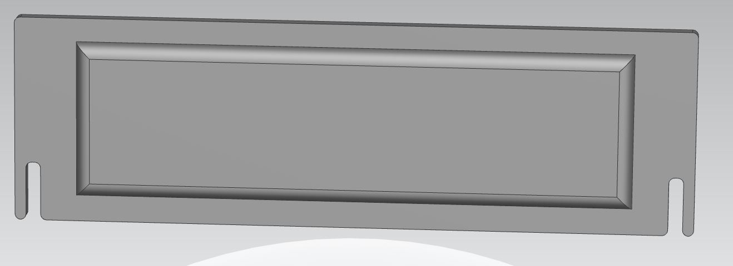
Component Detail - Backplane
Acrylic Sheet
Foam Padding
Cutouts for Position Change
Material: Acrylic Sheets, 5 mm thickness Specs: Approx. 225 mm X 70 mm
Features:
Adjustable Backplane position to accommodate smaller Ambu bags
Cutouts designed as per selected Ambu Bag and Linear Guide dimensions
Advantages: Easy to Manufacture

Slide 11
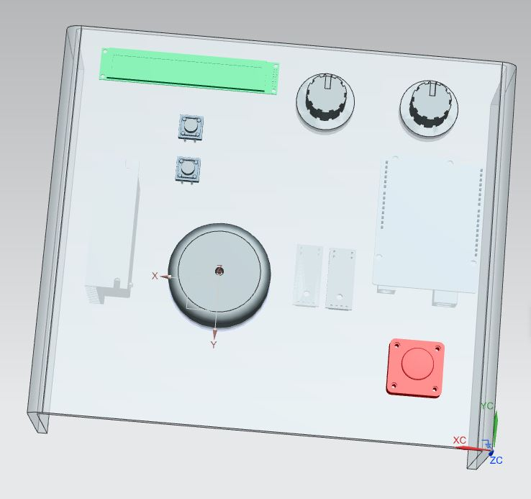
Component Detail - User Interface Electronics Panel
Compression
Breathing Rate
Momentary buttons for starting and stopping the mechanism as well as applying new settings
Potentiometer dials for fine grain adjustment of Compression and Breathing Rate
Emergency stop for safety
OLED display for settings verification
Redundant current sensor for pressure drop detection
Buzzer for auditory feedback of pressure drop or other system failure
OLED Display
Set Parameters
Arduino (Under)
Motor Controller (Under)
Emergency Stop
Start / Stop
Buzzer
Current Sensors (Under)

Slide 12
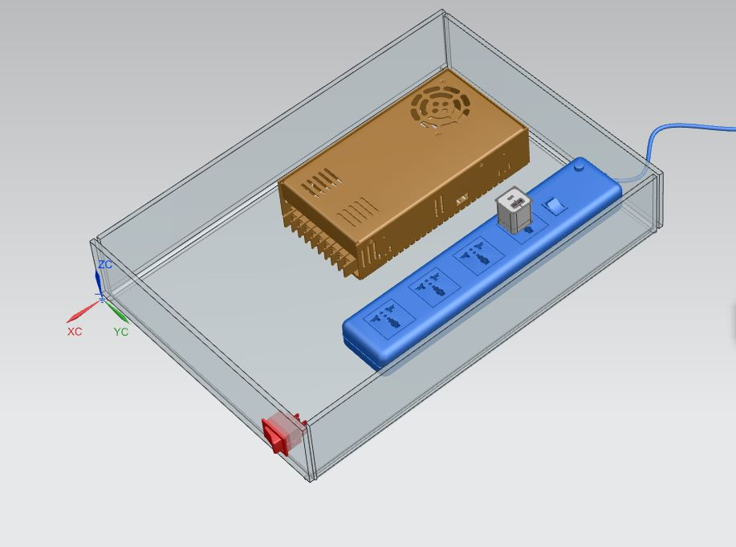
Component Detail - Power Cabinet
Dedicated power conversion box for safety
Household materials except for 24V DC supply
On/Off switch
Supplies 5V, 24V DC power to control system and motor

Slide 13
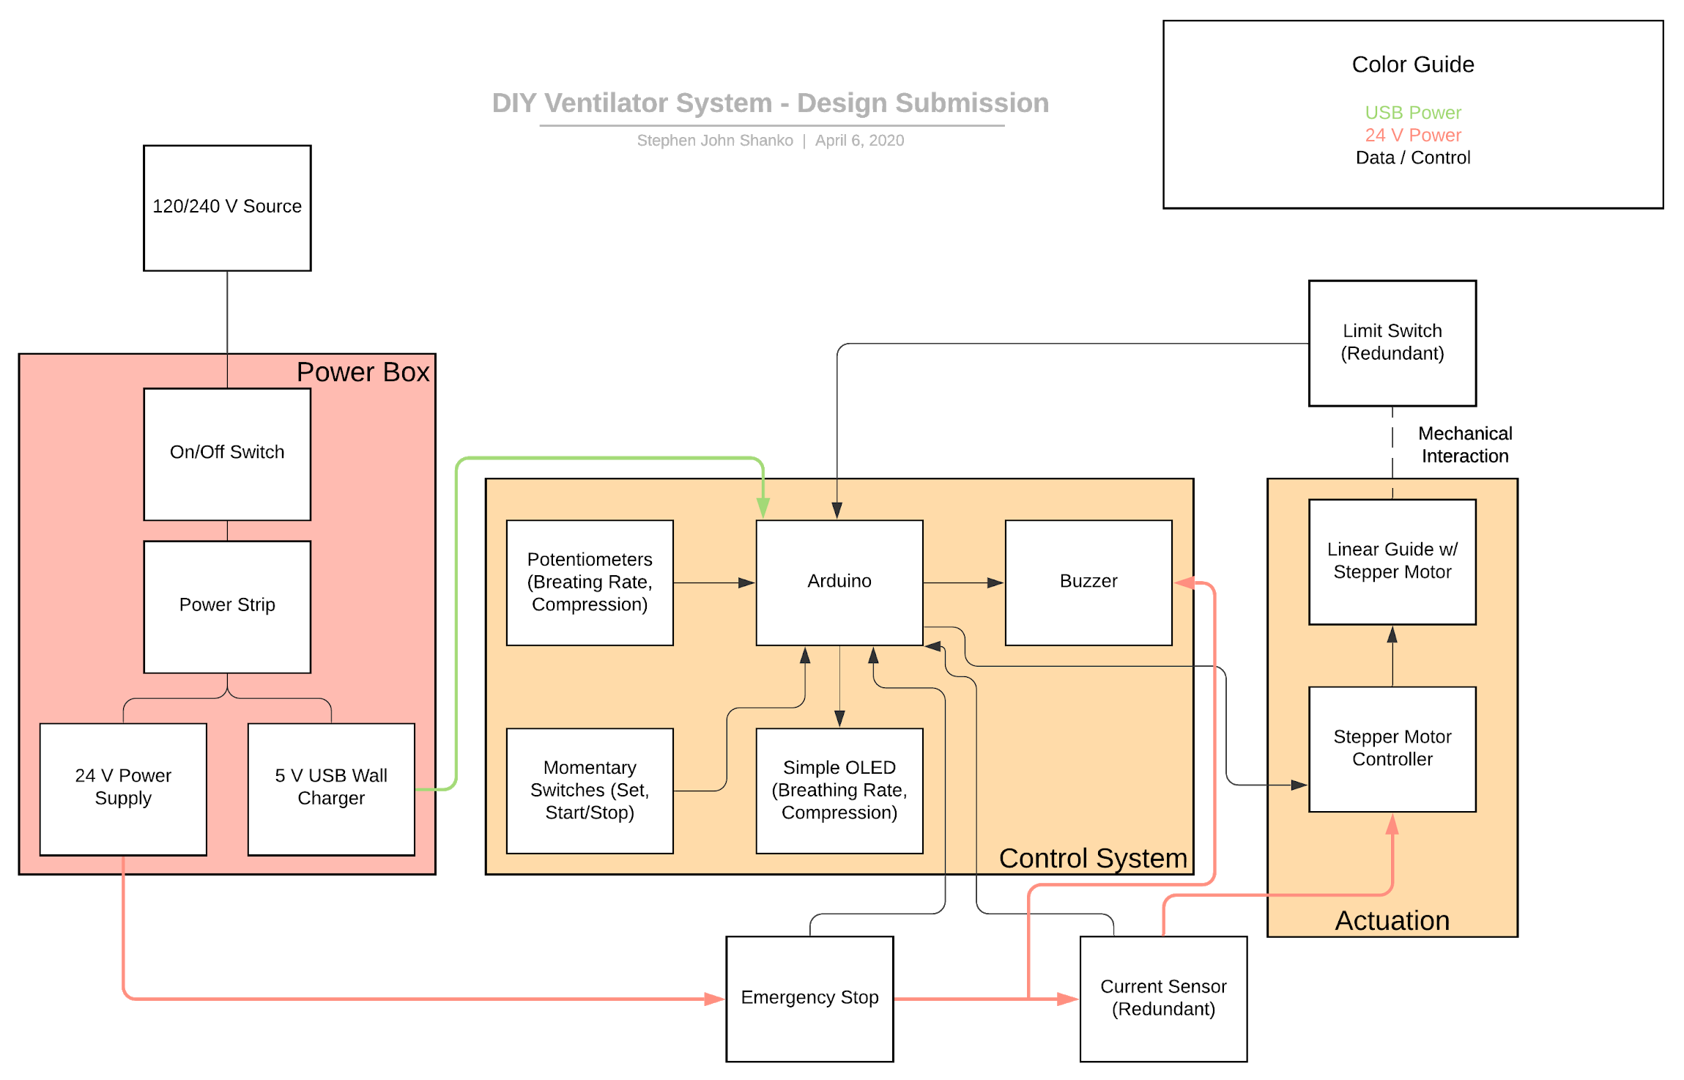
Electrical - System
Simple household and industry standard power components
120VAC/240VAC compatible
Simple display + controls which are easily sourced
Redundant limit switch for mechanism protection
Redundant current sensor for leak detection
Reliable and simple Arduino microcontroller
https://www.lucidchart.com/invitations/accept/662df293-888f-4b63-a903-dcfa0ff7d38e

Slide 14
Specifications
Operations
0 - 30 pumps per minute*
20 lb maximum force*
0 - 7.5 inch compression
Controls
Main power switch - controls all electric input
Start/stop button - controls start/stop of operation (stop => motor return to 0)
Abnormal operation/pressure drop sensing capability - with buzzer for alarm
Emergency stop button
Set parameters button prevents accidental modification
120/240 V AC in and power conversion housed in separate enclosure
*Actual performance may vary based on specific motor and linear guide available

Slide 15
Assembly
Number of parts: 33
Total cost of parts: $588.25
Additional tools required: Saw, screwdriver, soldering iron, solder, wire stripper/pliers, drill, razor knife
Time required: 40 hours first attempt, 8 hours once detailed instructions are verified

Slide 16
Mechanical Parts List
Color Key
Steve already has
Not critical for prototype
# | Part/Material | Qty | Design Specs | Cost per Unit | Default Source | Source Link
1 | Frame (5mm Acrylic Sheet) | 1 | 450x125x223 mm | N/A | Refer Part 13 | N/A
2 | Backplane (5mm Acrylic Sheet) | 1 | 225mm X 70 mm | N/A | Refer Part 13 | N/A
3 | Linear Guide Ball Screw | 1 | Travel : 200mm; Max Load = 40-50 lbs; Max Speed = 150mm/s | $98.86 | eBay | eBay
4 | Ambu Bag | 1 | Adult | $25.94 | AED Superstore | Source
5 | Foam Padding | 1 | Cut according to need | $5.75 | Amazon | Amazon
6 | L Bracket (Steel) | 2 | Steel 75x60x55 mm | $8.56 | Home Depot | Home Depot
7 | Epoxy | 2 | N/A | $10.94 | Home Depot | Home Depot

Slide 17
Mechanical Parts List (contd.)
Color Key
Steve already has
Not critical for prototype
# | Part/Material | Qty | Design Specs | Cost per Unit | Default Source | Source Link
8 | Electronics Panel | 1 | Acrylic Sheet 5mm Cut to Size | N/A | Refer Part 13 | N/A
9 | M8 Screw | 2 | N/A | $2.32 for a pack of 2 | Home Depot | Home Depot
10 | M8 Nut | 2 | N/A | $0.53 per unit | Home Depot | Home Depot
11 | M4 Screw | 4 | N/A | $0.72 for a pack of 2 | Home Depot | Home Depot
12 | M4 Nut | 4 | N/A | $0.53 for a pack of 2 | Home Depot | Home Depot
13 | Acrylic Sheet | 1 | 36” x 72” x .22” | $156 | Home Depot | Home Depot
 | Mech Subtotal |  |  | $286.29

Slide 18
Electronics Parts List
Color Key
Steve already has
Not critical for prototype
# | Part/Material | Qty | Specs | Total Cost | Default Source | Source Link
1 | Arduino MEGA | 1 | Microcontroller | $16.98 | Amazon | Aurdino MEGA
2 | DC Stepper Controller | 1 | 4.2A 20-50 VDC Stepper controller | $38.99 | Amazon | DC Stepper Controller
3 | Breadboard Jumpers | 1 | 120 pcs | $6.49 | Amazon | Breadboard Jumpers
4 | Current Sensor | 1 | -20 to 20A 100mV / A - 3 pack | $9.99 | Amazon | Current Sensor
5 | Buzzers | 1 | 5 pack | $8.99 | Amazon | Buzzers
6 | Potentiometers | 1 | 10K Ohm - 5 pack | $5.99 | Amazon | Potentiometers
7 | Limit Switches | 1 | 10 pack | $7.99 | Amazon | Limit Switches
8 | Power Strips | 1 | 2 pack | $11.99 | Amazon | Power Strips

Slide 19
Electronics Parts List (cont’d)
Color Key
Steve already has
Not critical for prototype
# | Part/Material | Qty | Specs | Total Cost | Default Source | Source Link
9 | USB Wall Chargers | 1 | 2.1A - 2 pack | $9.99 | Amazon | USB Wall Chargers
10 | 24 V Power Supply | 1 | 24VDC 15 A | $29.95 | Amazon | 24 V Power Supply
11 | 16 AWG Stranded | 1 | 100 ft for motor power | $9.85 | Amazon | 16 AWG Stranded
12 | 22 AWG Solid | 1 | 180 ft for logic signals | $15.99 | Amazon | 22 AWG Solid
13 | Zip ties | 1 | assorted - 250 pack | $11.99 | Amazon | Zip ties
14 | I2C OLED Displays | 1 | 1" - 2 pack | $10.99 | Amazon | I2C OLED Displays
15 | 22 AWG Stranded | 1 | 138 ft for logic signals | $14.99 | Amazon | 22 AWG Stranded
16 | Momentary Switches | 1 | 12 pack | $7.99 | Amazon | Momentary Switches
17 | Latching Switches | 1 | 12 pack | $6.99 | Amazon | Latching Switches

Slide 20
Electronics Parts List (cont’d)
Color Key
Steve already has
Not critical for prototype
# | Part/Material | Qty | Specs | Total Cost | Default Source | Source Link
18 | Extension Cord | 1 | 25' | $11.98 | Amazon | Extension Cord
19 | Stepper Motor | 1 | Nema 23 4.2A 3.0Nm 8mm shaft | $33 | Amazon | Stepper Motor
20 | Rocker Switches | 1 | SPST 10A / 125V - 15 pack | $6.99 | Amazon | Rocker Switches
21 | E-Stop Switches | 1 | 1 NO 1 NC - 2 pack | $10.99 | Amazon | E-Stop Switches
22 | Main Power Switch | 1 | N/A | $6.42 | Amazon | Main Power Switch
23 | Long USB Cable | 1 | 16ft | $6.44 | Amazon | Long USB Cable
Color Code | Non-Critical Items | Critical Items | Elec Subtotal
Steve already has | $65.92
Not critical for prototype | $55.45 | $180.59 | $301.96

Slide 21
Caveats
Use of easily accessible materials means there may be a lower level of performance as compared to using more customized equipment
Variability of enclosure size is based on the particular linear guide that can be procured
While simplicity and sourceability of electrical components is high, this design will result in more low-level wiring
Exact level of correspondence between measured current and system pressure for pressure sensing is untested
Notes:
Caveats: List of known issues with this design, that would need to be addressed in the future, or features that were omitted by design as a tradeoff decision.

Slide 22
Requested Funding
Estimated parts cost is roughly $600 but we anticipate additional potential costs for shipping, tools, and additional misc items to be up to $400, as we revise the design during fabrication. We estimate that our prototype can be achieved within a cost of $1000, subject to future adjustments.

Slide 23
References
https://e-vent.mit.edu/
https://www.facebook.com/watch/?v=147462893262908
https://www.gtech.co.uk/ventilators
https://news.utexas.edu/2020/04/01/solving-the-ventilator-shortage-with-windshield-wiper-parts/
https://www.youtube.com/watch?v=OOu1ABEAPaU
https://www.youtube.com/watch?v=jutBw_xIwTw
https://www.youtube.com/watch?v=oLQ5bXakWq8
https://youtu.be/HRgLUAvY7io
https://www.youtube.com/watch?v=US7JeW2uynM

Slide 24
Stay Home
Stay Safe

