Slide 1
House Price Prediction
🤖 AI | 🧠 Machine Learning | 🐍 Python | 📊 Data Science
Prepared by: Shankramma Baganal
Department of Information Science & Engineering
SDM College of Engineering and Technology, Dharwad
AI & ML Internship – MainCrafts Technology
Submission Date: July 2026
MainCrafts Technology | AI & ML Internship
1

Slide 2
Dataset Overview
Property | Details
Dataset Name | California Housing Dataset
Source | Scikit-Learn
Number of Samples | 20,640
Number of Features | 8
Target Variable | Median House Value
MainCrafts Technology | AI & ML Internship
2

Slide 3
Machine Learning Workflow
Dataset
Data Preprocessing
EDA
Train-Test Split
Linear Regression
Prediction
Evaluation
MainCrafts Technology | AI & ML Internship
3

Slide 4
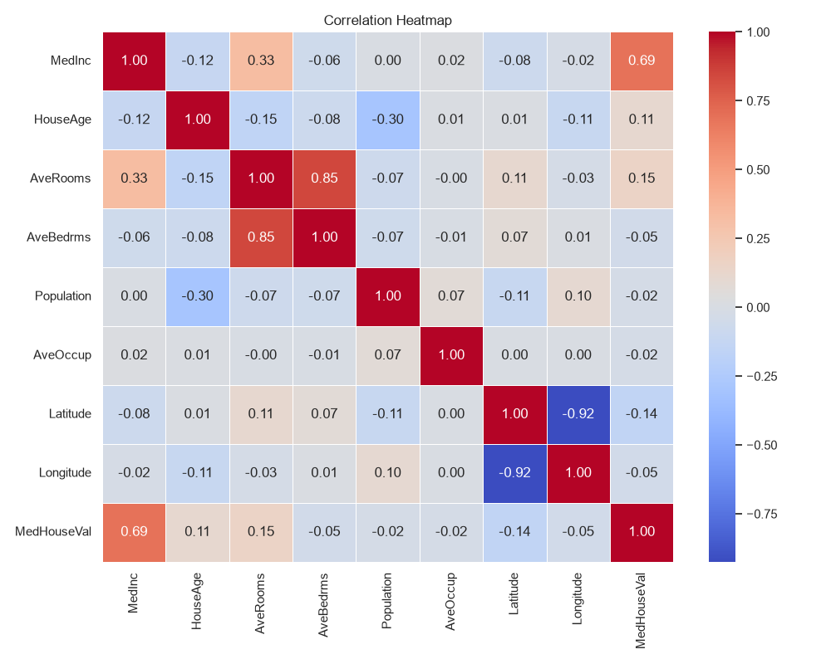
Exploratory Data Analysis
MainCrafts Technology | AI & ML Internship
4

Slide 5
Model Evaluation Metrics
Metric | Value
Mean Absolute Error (MAE) | 0.5332
Mean Squared Error (MSE) | 0.5559
Root Mean Sq. Error (RMSE) | 0.7456
R-squared (R²) | 0.5758
MainCrafts Technology | AI & ML Internship
5

Slide 6
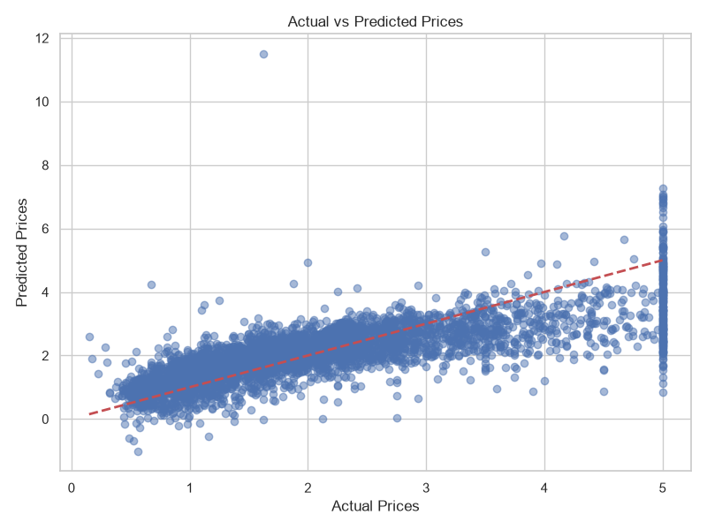
Results: Actual vs Predicted
Observation: The model predictions align closely with actual prices along the diagonal, demonstrating reasonable accuracy, though some variance exists for extreme values.
MainCrafts Technology | AI & ML Internship
6

Slide 7
Conclusion & Key Learning Outcomes
1. Successfully developed an end-to-end Machine Learning pipeline.
2. Gained practical experience in Exploratory Data Analysis (EDA).
3. Implemented and evaluated a Multiple Linear Regression model using Scikit-Learn.
4. Understood the impact of regression evaluation metrics (MAE, MSE, RMSE, R²).
5. Improved skills in visualizing data insights and model predictions.
MainCrafts Technology | AI & ML Internship
7

