Slide 1
Sales Data Analysis Report

Slide 2

Hello!
My Name is Shan Kuriakose .
I am a data enthusiast , who wishes to give raw data a meaning.

Slide 3
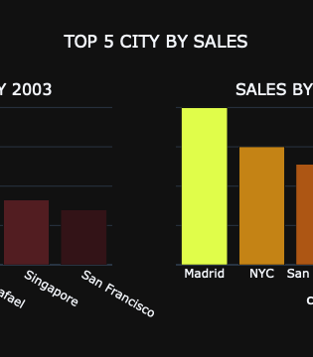
About the Project
The Sales Data Analysis project is dedicated to offering a thorough exploration of our company's sales performance. Through meticulous analysis and insights derived from the sales data, our objective is to make well-informed strategic decisions that will propel our company toward future success.

Slide 4
Sales Trend Analysis

Slide 5
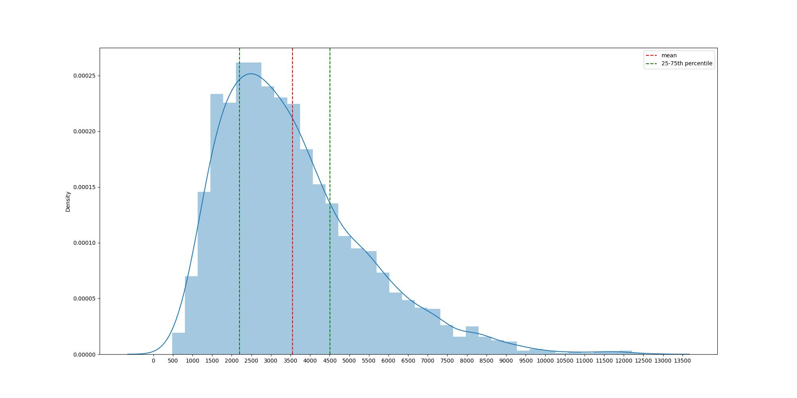
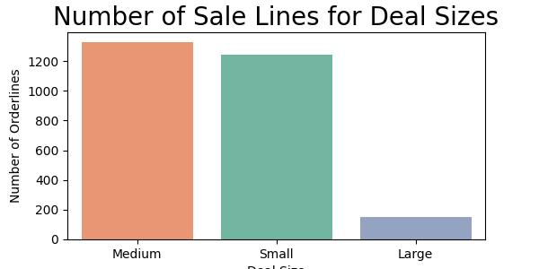
Total Sales Distribution
Sales distribution is right skewed , meaning most of the sales has hapened between 2000-2500. mean is around 3500 .
Most of the sales deals were of médium size deals , followed by small , large deal sizes were very very less

Slide 6
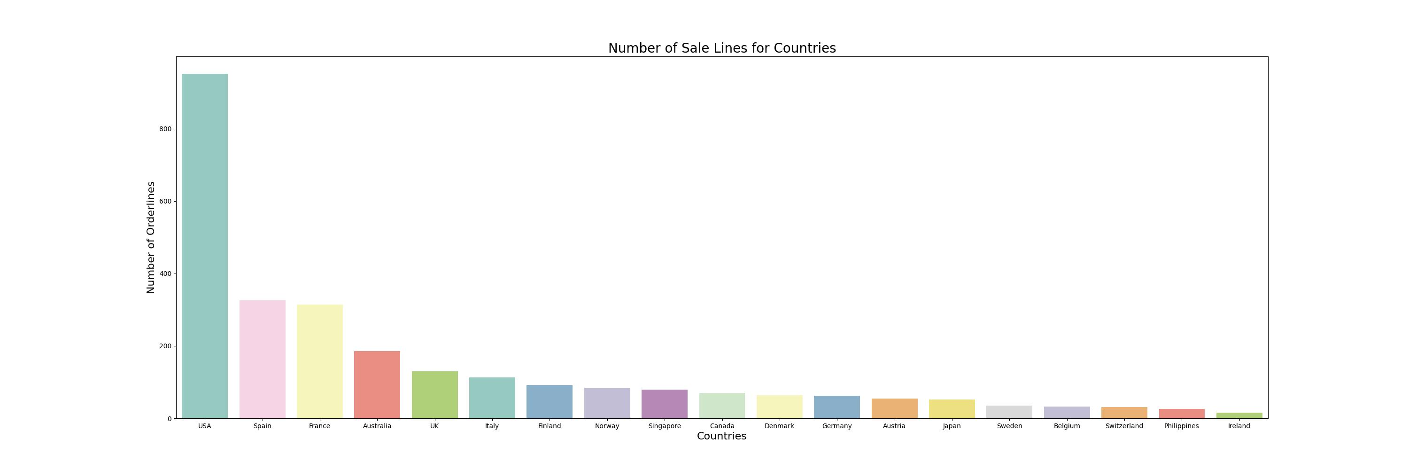
Data Analysis
The most of the sales are from USA, Spain and France are second and third.
But it is worth mentioning that us has more sales than France and Spain combined. So its safe to recognize USA as the prime market

Slide 7
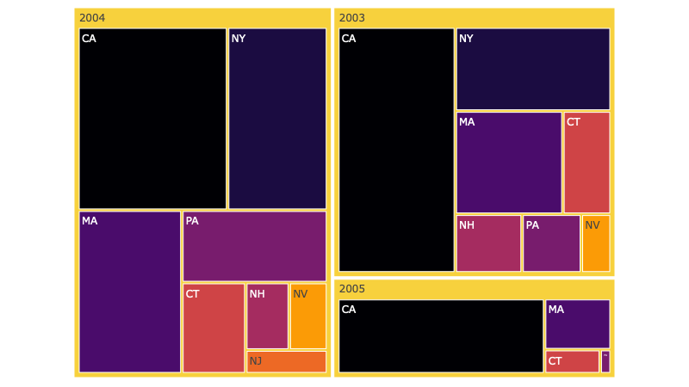
Data Analysis Report
This graph shows the revenue share of sates in the us

Slide 8
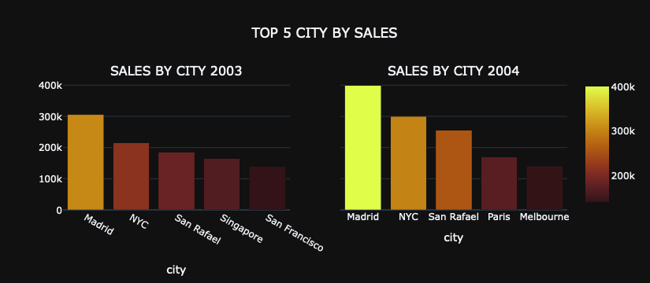
City-Wise-Sales split
2003
* Madrid ,NYC and San Rafael are the leading contributors in sales
2004
Madrid ,NYC and San Rafael are continuing to be the leading contributors in sales, paris also showed some commendable improvement

Slide 9
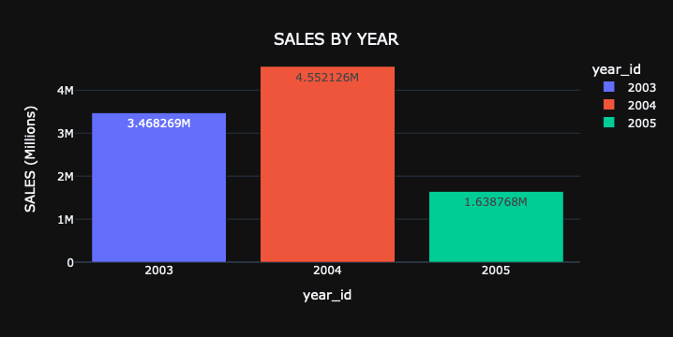
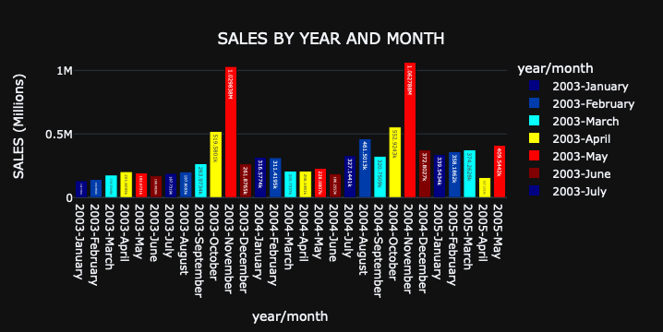
Sales by Time
2004 recorded a significant increase in the sales revenue from that of in 2003
Sales peak during mid October-November;this could be due to festive seasons , onset of vacations or due to offers.
2005 data is not complete to make any comments on patterns

Slide 10
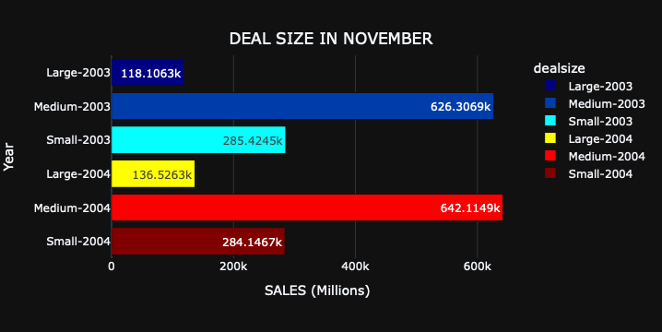
The November Rush
2003
* The Rush is primarly fueld by the medium deals
2004
The rush is fueld by medium seized deals .All the categories has registered increase in revenue from 2003 sales

Slide 11
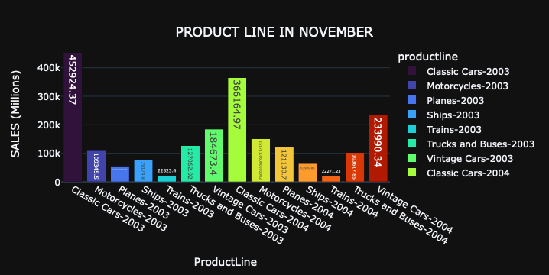
The November Rush-Product Split
2003
Classic Cars are the most sold commodity
2004
Classic cars has recorded a fall in sales , where as vintage cars and motorcyles recorderd significant growth

Slide 12
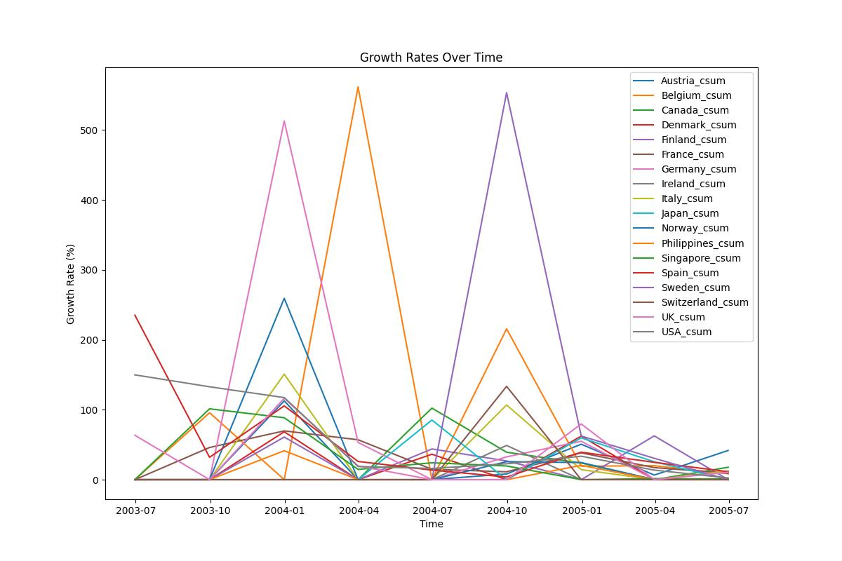
Promising Marketing
Some markets that shows promises are Belgium
USA - it offers a consistent growth pattern
Sweden has also picked up some momentum post 2007 July.

Slide 13
Summary
Size of the deals.
Peak volume sales
Growth of Sales
Most of the sales deals were of médium size deals , followed by small , large deal sizes were very very less
Sales peak during mid October-November;this could be due to festive seasons , onset of vacations or due to offers.
2004 recorded a significant increase in the sales revenue from that of in 2003. There is a progressive trend
Sales by cities
Sales by countries
Emerging Market
Madrid ,NYC and San Rafael are continuing to be the leading contributors in sales, Paris also showed some commendable improvement
The most of the sales are from USA, Spain and France are second and third
Some markets that shows promises are Belgium
USA - it offers a consistent growth pattern

Slide 14
Thanks!

