Slide 1
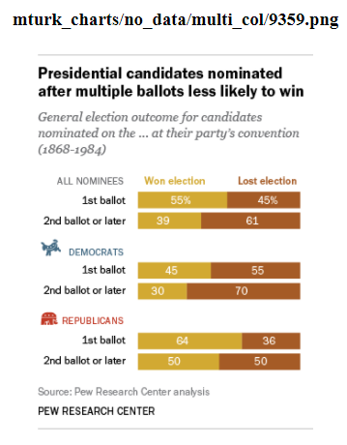
Cannot Create Open Ended Question
A contested convention, for those who’ve never experienced one (which is to say, everyone under the age of 35 or 40), occurs when no candidate has amassed the majority of delegate votes needed to win his or her party’s nomination in advance of the convention. A candidate still might gather the delegates needed by the time balloting begins, in which case the nomination is settled on the first ballot. But should the first ballot not produce a nominee, most delegates become free to vote for whomever they wish, leading potentially to multiple ballots, horse-trading, smoke-filled rooms, favorite sons, dark horses and other colorful elements that have enlivened American political journalism, literature and
(cannot create open ended question since there is no reference to the data in the chart.)

Slide 2
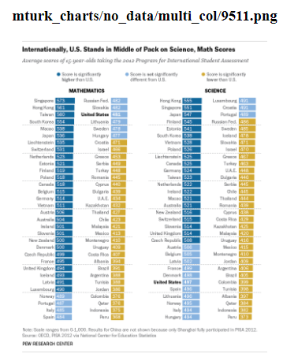
Cannot Create Open Ended Question
Fact Tank’s look at standardized test results around the world seemed to bear out these sentiments: U.S. students are improving – slowly – in math and science, but still lagging their peers internationally.
(cannot create open ended question since summary doesn’t reference any information in chart.)

Slide 3
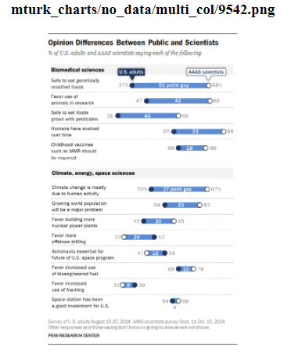
Cannot Create Open Ended Question
Scientists and the American public are often far apart when it comes to views about science-related issues. Members of the science community, for example, are much more likely to say genetically modified foods and foods grown with pesticides are safe to eat, and that climate change is mostly due to human activity, according to our recent survey of U.S.-based members of the American Association for the Advancement of Science. A global median of 54% consider climate change a very serious problem, according to our survey of 40 nations. But there are regional differences on views of climate change, with people from Latin America and Africa expressing more concern than others. Before delegates from 195 nations approved a landmark climate accord in Paris this year to limit carbon emissions, our spring survey found a median of 78% supporting such a deal.
(cannot create open ended question since values mentioned in summary cannot be derived from data shown in chart.)

Slide 4
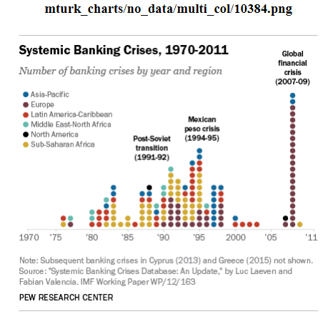
Too Complex
We examined a comprehensive database of financial crises from 1970 through 2012 compiled and maintained by two economists for the International Monetary Fund to see just how unusual the current situation in Greece is. The IMF economists defined “systemic banking crises” as those with both “significant signs of financial distress in the banking system,” such as major bank runs, losses and liquidations, and significant policy interventions in response, such as deposit guarantees, nationalizations, recapitalizations, deposit freezes and bank holidays.
(too complex since bars have no axis labels and is in unconventional format .)

Slide 5
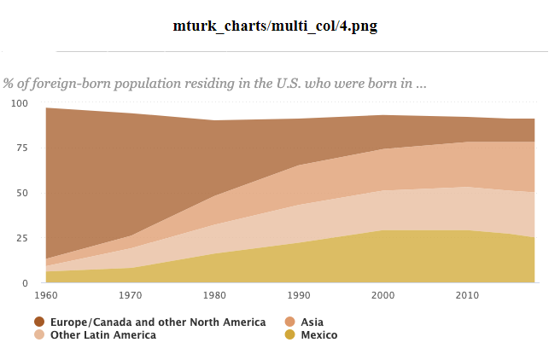
Too Complex
The regions of origin for immigrant populations residing in the U.S. have dramatically shifted since the passage of the 1965 Immigration and Naturalization Act. In 1960, 84% of immigrants living in the U.S. were born in Europe, Canada or other North American countries, while only 6% were from Mexico, 4% from Asia, 3% from the rest of Latin America and 3% from other areas. Immigrant origins now differ drastically, with European, Canadian and other North American immigrants making up only a small share of the foreign-born population (13%) in 2018. Asians (28%), Mexicans (25%) and other Latin Americans (25%) each make up about a quarter of the U.S. immigrant population, followed by 9% who were born in another region.
(too complex since area charts are difficult in extracting values for each time period.)

Slide 6
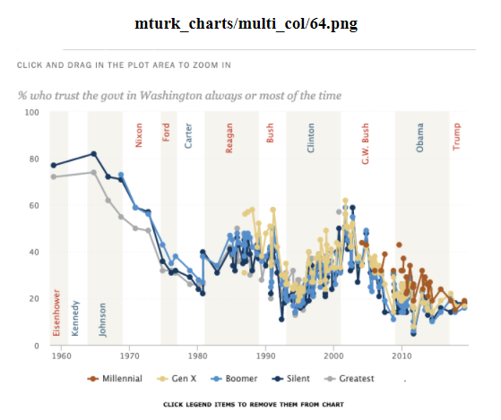
Too Complex
Historically, there have been modest differences between generational groups in trust in government and that remains the case today. Currently, 19% of Millennials (now ages 23-38) report trusting the government, similar to the shares of older generations who say the same. Trust in government remains at or near historically low levels across generational lines.
(too complex since the line charts are difficult to separate.)

Slide 7
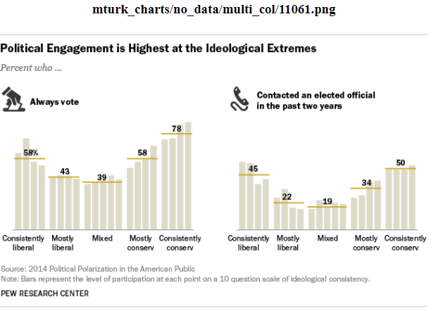
Too Complex
Last year’s series of Pew Research Center reports on political polarization used a 10-item scale of ideological consistency to place Americans into five categories: consistently conservative or liberal, mostly conservative or liberal, and mixed. By that metric, 9% of the public overall is consistently conservative, including 20% of Republicans and Republican leaners; most of the remaining Republicans and leaners were “mostly conservative” (33%) or had a mixture of liberal and conservative views (37%). Consistent conservatives participate in politics at higher rates than most other ideological groups. Political engagement tends to be highest among the most consistent conservatives and liberals, the Pew Research survey found. Half of consistent conservatives, for example, said they had contacted an elected official within the past two years – the highest level of any of our five groups. (The corresponding figure for all Americans, by the way, was 28%.) Consistent conservatives also ranked high on other measurements of political engagement, such as donating money (26%), attending campaign events (24%) and volunteering on a campaign (12%).
(This chart is too complex since the labels are not available for all bars and there are no axis labels.)

Slide 8
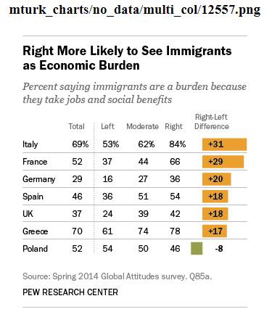
Too Complex
Among the seven nations surveyed, Greeks and Italians express particularly negative views about immigration. Eight-in-ten or more in both countries want less immigration, as do majorities in France and the UK. Public opinion is more closely divided in Spain, Germany and Poland, between those who want fewer immigrants admitted to their countries and those who say current levels should stay about the same. However, there is very little desire for allowing more immigrants in any of these seven nations – the percentage who hold this view ranges from 14% in Germany to only 1% in Greece.
(too complex since this chart is a table as opposed to a graph.)

Slide 9
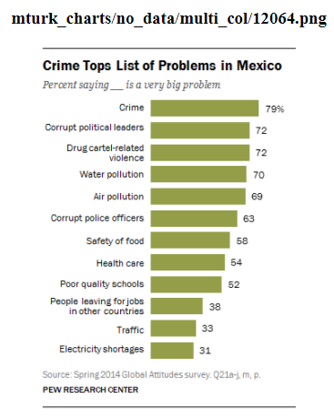
Good
About six-in-ten (58%) say food safety is a very big problem, and 54% say the same about health care. Roughly four-in-ten or fewer are troubled by people leaving for jobs in other countries (38%), traffic (33%) and electricity shortages (31%).

Slide 10
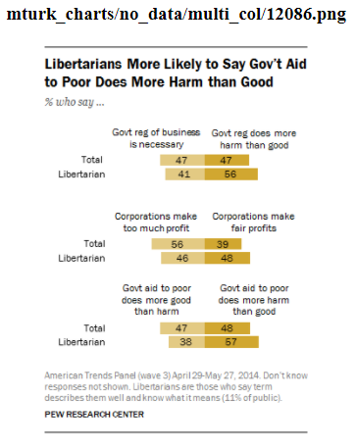
Good
When it comes to attitudes about the size and scope of government, people who say the term libertarian describes them well (and who are able to correctly define the term) are somewhat more likely than the public overall to say government regulation of business does more harm than good (56% vs. 47%). However, about four-in-ten libertarians say that government regulation of business is necessary to protect the public interest (41%).

Slide 11
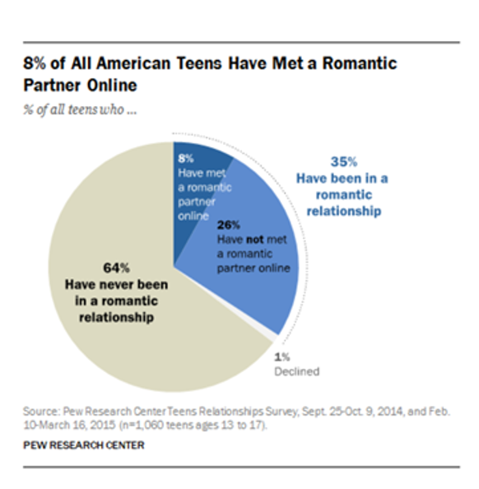
Sample QA
Good Example:
Question: How has social media affected teenage dating?
Answer: When it comes to meeting romantic partners, most teens do this offline. Only 8% of teens say they have met a romantic partner online.
Bad Example:
Question: What percent of American teens prefer meeting online?
Answer: In a study of 100,000 American teens, they found that 10% of teens have met a romantic partner online.
(Wrong since 100,000 American teens and 10% are not mentioned anywhere in the graph.)

Slide 12
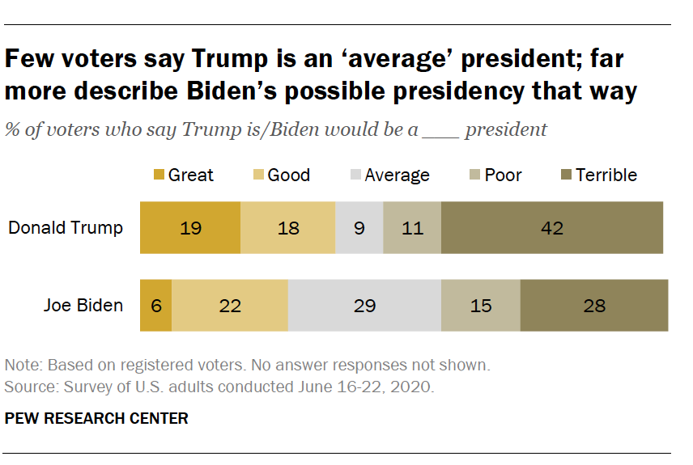
Sample QA
Good Example:
Question: What was the voters' opinion about Trump ’s presidency ?
Answer: Very few voters – just 9 % – say Trump is an average president ; 37 % say he is a good or great president ; and a much larger share ( 53 % ) say he is poor or terrible , including 42 % who think he is a terrible president .
Bad Example:
Question: How many voters say Trump is an average president ?
Answer: 9%
(This is not a good example question because the answer is just a number as opposed to descriptive text.)

Slide 13
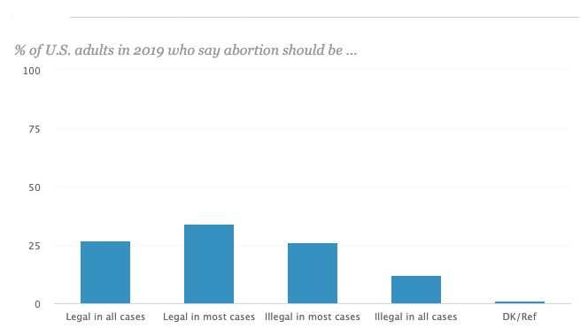
Sample QA
Good Example:
Question: What position do Americans hold on abortion?
Answer: Though abortion is a divisive issue, more than half of U.S. adults take a non-absolutist position, saying that in most – but not all – cases, abortion should be legal (34%) or illegal (26%). Fewer take the position that in all cases abortion should be either legal (27%) or illegal (12%).
Bad Example:
Question: Do most Americans think abortion should be Legal?
Answer: Yes
(This is not a good example question because the answer is just a single word as opposed to descriptive text.)

Slide 14
Baselines
Extractive :
Electra-https://github.com/google-research/electra
contextual info allowed in extractive summarisation
Model should know what to extract based on the question, and for contextual questions it should understand how the context is related
BertQA
Abstractive:
BART
T5
Document Grounded Generation

Slide 15
Annotation Process
Data Collection
dataset collection from pew
possibly collect from owid/oecd
Chart Filtering
categorizing into 'too complex’, 'good’, 'cannot make open ended question’
Annotation Study
Collecting questions and answers for each chart/summary pair according to rules
question check
check if question is open ended
check coherency, grammar
Disagreement Resolution
First pass samples through automatic resolution script:
check percentage of words in smaller answer that appear in longer answer, and if above a certain percentage, take the longer answer to the next step
Many questions were manually altered between two batches and have different versions, and since they are manually created by workers
it would be better to do a direct matching between them and resolve incoherent questions in decontextualization stage
Questions that are not exact matches can be resolved in interface manually
Next view remaining samples manually through interface:
if one version is wrong choose correct version(both question and answer)
if both are wrong select the answer yourself from the summary( and recreate wrong questions)
Decontextualization(abstractive)
removing info that is irrelevant to the question.(for now include info that is not derivable but is relevant)
add text that makes the sentence coherent
Add text from summary that is relevant to the question
Remove samples which leaked from the chart filtering step
Dataset Analysis
Chart Type Classification
Question Type Classification

Slide 16
Decontextualization(extractive+abstractive)
Extractive and abstractive summarisation should be very focussed to the question
Exclude statistics that cannot be derived from this chart even if relevant to the question
Exclude background information that cannot be derived from the chart even if relevant to the question
Abstractive should be same as extractive just change pronouns to nouns and add extra words to make answers coherent

Slide 17
Question(extractive+abstractive) criteria
Questions should be open ended,coherent and should require the chart to answer(otherwise modify)
Two part questions fine
‘Explain pew research survey?’ questions should be modified

Slide 18
Instructions
Answer Selection Criteria
The answer should be atleast one sentence long
It should provide a descriptive answer to the question asked. For example, ‘Describe the distribution of non-English speakers among immigrants of U.S?’ requires a textual description whereas ‘What percentage of immigrants speak Arabic?’ requires just a number as an answer.
The answer should not reference any knowledge outside the data represented in the chart
Question Creation Criteria
The question should be open ended and require a descriptive answer
The descriptive answer of the chart should answer the question

Slide 19
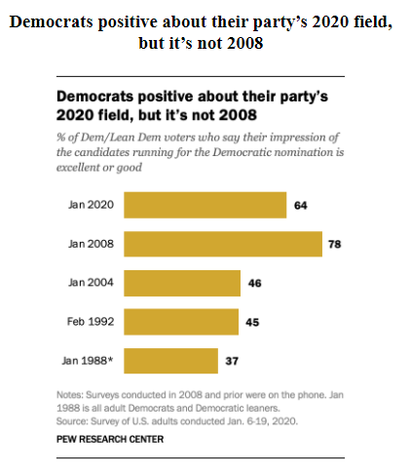
Example Question Check
Summary
Democrats are positive about their presidential field , though less so than in 2008 . Overall , 64 % of Democratic voters have an excellent or good impression of the candidates running for the Democratic nomination . That is much higher than at similar points during the 1988 , 1992 and 2004 presidential campaigns . In January 2008 , however , 78 % had a positive view of the presidential candidates as a group .
User question:
Democrats are positive about their presidential field , though less so than in 2008 . Overall , 64 % of Democratic voters have an excellent or good impression of the candidates running for the Democratic nomination . That is much higher than at similar points during the 1988 , 1992 and 2004 presidential campaigns . In January 2008 , however , 78 % had a positive view of the presidential candidates as a group .
Modified question
What is the impression of Democratic voters on Democratic candidates running for election?
(Question submitted by user is copied from the summary)

Slide 20
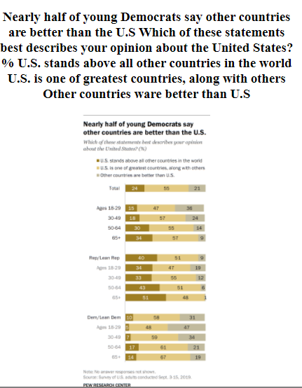
Example Question Check
Summary
Overall , most Americans say either that the U.S. “ stands above all other countries ” ( 24 % ) or that it is “ one of the greatest countries , along with some others ” ( 55 % ) . About one - in - five ( 21 % ) say “ there are other countries that are better than the U.S. ”
User question:
What proportion of Americans say there are better countries than the US?
Modified question
What opinions do Americans have about US?
Answer1:
About one - in - five ( 21 % ) say “ there are other countries that are better than the U.S.
Answer2:
About one - in - five ( 21 %
(Question submitted by user is not open ended)

Slide 21
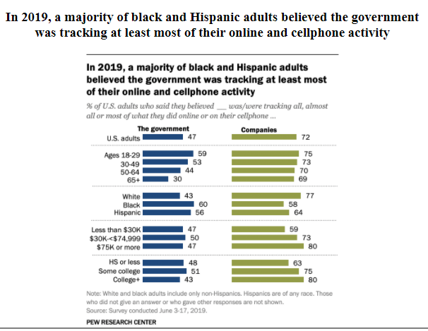
Example Question Check
Summary
About seven - in - ten Americans ( 72 % ) believe that all , almost all or most of what they do online or while using a cellphone is being tracked by advertisers , technology firms or other companies , according to the June 2019 survey . Close to half of Americans ( 47 % ) said the same about their online activities being tracked by the government .
User question:
which year majority of black and Hispanic adults believed the government was tracking at least most of their online and cellphone activity?
Modified question
Describe the opinion of Americans on cellphone tracking by advertisers?
Answer1:
About seven - in - ten Americans ( 72 % ) believe that all , almost all or most of what they do online or while using a cellphone is being tracked by advertisers , technology firms or other companies , according to the June 2019 survey . Close to half of Americans ( 47 % ) said the same about their online activities being tracked by the government .
(Question submitted by user is copied from the title and is not open ended)

Slide 22
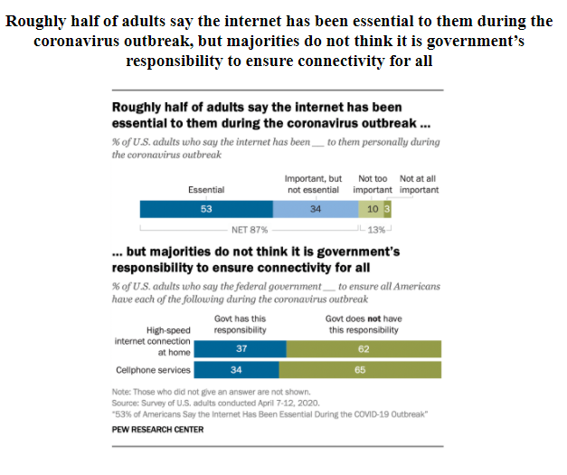
Example Question Check
Summary
A new Pew Research Center survey conducted in early April finds that roughly half of U.S. adults ( 53 % ) say the internet has been essential for them personally during the pandemic and another 34 % describe it as “ important , but not essential . ” The new national survey of 4,917 U.S. adults conducted April 7 to 12 using the Center ’s American Trends Panel explores public attitudes about the role of government in addressing these issues and finds that a majority of Americans ( 62 % ) do not think it is the federal government ’s responsibility to ensure that all Americans have a high - speed internet connection at home during the COVID-19 outbreak . And a similar share ( 65 % ) do not think the federal government should be responsible for ensuring cellphone services to all .
User question:
Roughly half of adults say the internet has been essential to them during which virus outbreak, but majorities do not think it is government’s responsibility to ensure connectivity for all?
Modified question
What are the sentiments of Americans to the internet during the coronavirus outbreak?
Answer1:
” The new national survey of 4,917 U.S. adults conducted April 7 to 12 using the Center ’s American Trends Panel explores public attitudes about the role of government in addressing these issues and finds that a majority of Americans ( 62 % ) do not think it is the federal government ’s responsibility to ensure that all Americans have a high - speed internet connection at home during the COVID-19 outbreak .
(Question submitted by user is copied from the title)

Slide 23
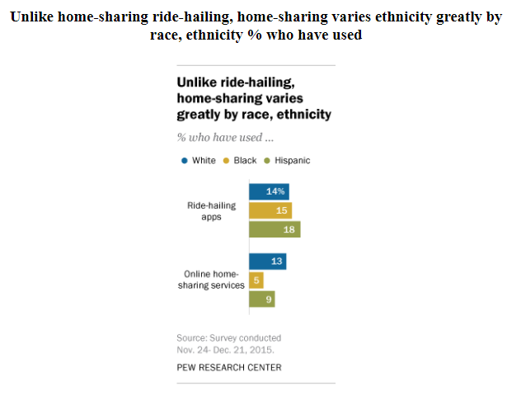
Example Question Check
Summary
Overall , 15 % of blacks and 18 % of Latinos have used ride - hailing , similar to the 14 % of whites who have done so , according to a Pew Research Center survey exploring the digital economy . And a new analysis of this survey data finds that Americans who live in majority - minority communities ( census - block groups where more than 50 % of residents are racial or ethnic minorities ) are more likely than those who reside in predominately white neighborhoods to say that ride - hailing apps serve neighborhoods that taxis wo n’t visit . Just over half ( 53 % ) of ride - hailing users living in majority - minority communities feel that this statement describes ride - hailing well , compared with 46 % of users living in majority - white neighborhoods . ( Many ride - hailers – about four - in - ten overall – were unsure if this statement described ride - hailing well ) . In sharp contrast to ride - hailing services , few blacks make use of home - sharing sites like Airbnb and VRBO : Just 5 % of blacks have ever used these services , compared with 13 % of whites . And although blacks are less likely than whites to say they travel overnight away from home for work or personal reasons , even among those who do travel on occasion , whites ( 16 % ) are still substantially more likely than blacks ( 5 % ) to use home - sharing services .
User question:
Tell About Pew Research Canter survey that explores the digital economy.
Modified question
Tell About usagof home sharing and ride-hailing services?
e Answer1:
15 % of blacks and 18 % of Latinos have used ride - hailing , similar to the 14 % of whites who have done so , according to a Pew Research Center survey exploring the digital economy . block 50 % of residents are racial or ethnic minorities ) are more likely than those who reside in predominately white neighborhoods to say that ride - hailing apps serve neighborhoods that taxis wo n’t visit . ( 53 % ) of ride - hailing users living in majority - minority communities feel that this statement describes ride - hailing well , compared with 46 % of users living in majority - white neighborhoods . ( Many ride - hailers – about four - in - ten overall – were unsure if this statement described ride - hailing well ) . contrast 5 % of blacks have ever used these services , compared with 13 % of whites . And although blacks are less likely than whites to say they travel overnight away from home for work or personal reasons , even among those who do travel on occasion , whites ( 16 % ) are still substantially more likely than blacks ( 5 % ) to use home - sharing services .
(Question submitted by user is too general)

Slide 24
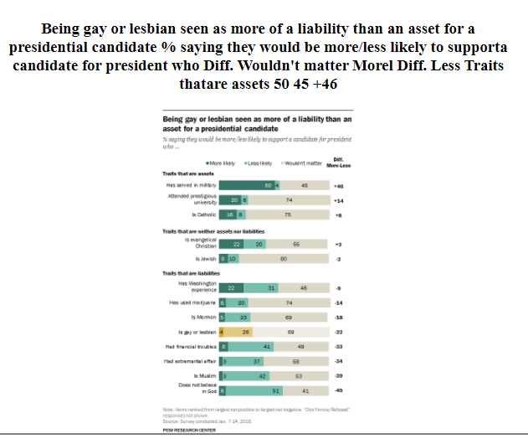
Example Question Check
Summary
A majority of Americans ( 69 % ) say a candidate ’s sexuality would not affect their support of a presidential candidate . But those who say it would have an impact are much more likely to say it would have a negative than a positive one . About a quarter of the public ( 26 % ) says it would make them less likely to support the hypothetical candidate , compared with 4 % who say it would make them more likely to support that candidate .
User question:
The sexuality a candidate is the of affect a presidential candidate ?
Modified question
How does a candidates sexuality affect their support for presidential candidates ?
Answer1:
A majority of Americans ( 69 % ) say a candidate ’s sexuality would not affect their support of a presidential candidate public ( 26 % ) says it would make them less likely to support the hypothetical candidate , compared with 4 % who say it would make them more likely to support that candidate .
(Question submitted by user is not coherent)

Slide 25
Example Disagreement Resolution
Summary
Democrats are positive about their presidential field , though less so than in 2008 . Overall , 64 % of Democratic voters have an excellent or good impression of the candidates running for the Democratic nomination . That is much higher than at similar points during the 1988 , 1992 and 2004 presidential campaigns . In January 2008 , however , 78 % had a positive view of the presidential candidates as a group .
Question:
Democrats are positive about their presidential field , though less so than in 2008 . Overall , 64 % of Democratic voters have an excellent or good impression of the candidates running for the Democratic nomination . That is much higher than at similar points during the 1988 , 1992 and 2004 presidential campaigns . In January 2008 , however , 78 % had a positive view of the presidential candidates as a group .
Answer1:
Democrats are positive about their presidential field , though less so than in 2008 . Overall , 64 % of Democratic voters have an excellent or good impression of the candidates running for the Democratic nomination In January 2008 , however , 78 % had a positive view of the presidential candidates as a group .
Answer2:
Democrats are positive about their presidential field , though less so than in 2008 . Overall , 64 % of Democratic voters have an excellent or good impression of the candidates running for the Democratic nomination . That is much higher than at similar points during the 1988 , 1992 and 2004 presidential campaigns . In January 2008 , however , 78 % had a positive view of the presidential candidates as a group .

Slide 26
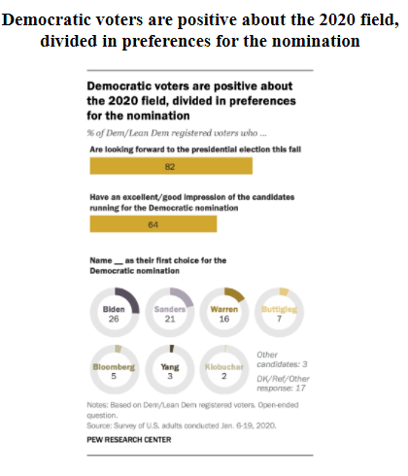
Example Disagreement Resolution
Summary
As many national and early primary state surveys have found , Democrats ’ preferences for the nomination are divided . Asked an open - ended question about their first choice for the nomination , 26 % of Democratic and Democratic - leaning registered voters favor Biden , 21 % Sanders , 16 % Warren , 7 % Buttigieg and 5 % Bloomberg .
Question:
Tell about the Democratic voter preferences in 2020?
Answer1:
As many national and early primary state surveys have found , Democrats ’ preferences for the nomination are divided 26 % of Democratic and Democratic - leaning registered voters favor Biden , 21 % Sanders , 16 % Warren , 7 % Buttigieg and 5 % Bloomberg .
Answer2:
As many national and early primary state surveys have found , Democrats ’ preferences for the nomination are divided . Asked an open - ended question about their first choice for the nomination , 26 % of Democratic and Democratic - leaning registered voters favor Biden , 21 % Sanders , 16 % Warren , 7 % Buttigieg and 5 % Bloomberg

Slide 27
Example Disagreement Resolution
Summary
Overall , most Americans say either that the U.S. “ stands above all other countries ” ( 24 % ) or that it is “ one of the greatest countries , along with some others ” ( 55 % ) . About one - in - five ( 21 % ) say “ there are other countries that are better than the U.S. ”
User question:
What opinions do Americans have about US?
Answer1:
About one - in - five ( 21 % ) say “ there are other countries that are better than the U.S.
Answer2:
About one - in - five ( 21 %
(Answer2 is part of answer1 and thus answer1 can be selected)

Slide 28
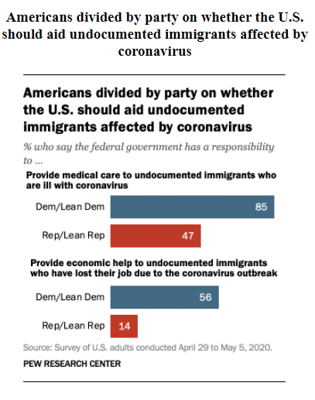
Example Decontextualization
Summary
Democrats and Republicans hold sharply different views on the federal government ’s role in helping undocumented immigrants affected by the coronavirus . The vast majority ( 85 % ) of Democrats and Democratic - leaning independents say the federal government has a responsibility to provide medical care to undocumented immigrants , compared with about half of Republicans and Republican leaners ( 47 % ) . Meanwhile , more than half ( 56 % ) of Democrats say the U.S. government has a responsibility to provide economic help to undocumented immigrants who have lost a job , compared with only 14 % of Republicans . Democrats and Republicans have long held starkly different views on issues related to undocumented immigrants and asylum seekers .
Question:
What is the opinion of Democrats about providing medical care to undocumented immigrants ?
Answer1:
Democrats and Republicans hold sharply different views on the federal government ’s role in helping undocumented immigrants affected by the coronavirus . The vast majority ( 85 % ) of Democrats and Democratic - leaning independents say the federal government has a responsibility to provide medical care to undocumented immigrants.
(Green portion is relevant text added to support argument and make sentence more natural)

Slide 29
Example Decontextualization
Summary
Overall , most Americans say either that the U.S. “ stands above all other countries ” ( 24 % ) or that it is “ one of the greatest countries , along with some others ” ( 55 % ) . About one - in - five ( 21 % ) say “ there are other countries that are better than the U.S. ”
User question:
What opinions do Americans have about US?
Answer1:
Overall , most Americans say either that the U.S. “ stands above all other countries ” ( 24 % ) or that it is “ one of the greatest countries , along with some others ” ( 55 % ) . About one - in - five ( 21 % ) say “ there are other countries that are better than the U.S.”
(Green portion is relevant text added to support argument and make sentence more natural)

Slide 30
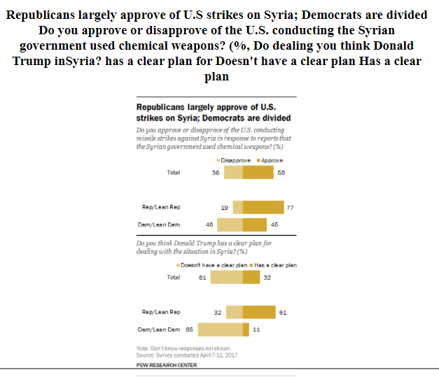
Example Decontextualization
Summary
By a wide margin ( 58 % to 36 % ) , Americans approve of the U.S. missile strikes against Syria in response to reports of the use of chemical weapons by Bashar al - Assad ’s government . By a comparable margin ( 61 % to 32 % ) , the public says that Donald Trump does not have a clear plan for dealing with the situation in Syria .
User question:
Describe the public opinion about Trump actions against Syria.
Answer1:
By a wide margin ( 58 % to 36 % ) , Americans approve of the U.S. missile strikes against Syria in response to reports of the use of chemical weapons by Bashar al - Assad ’s government . By a comparable margin ( 61 % to 32 % ) , the public says that Donald Trump does not have a clear plan for dealing with the situation in Syria
(Red portion is text to remove since it is relevant but cannot be derived from the chart data)

Slide 31
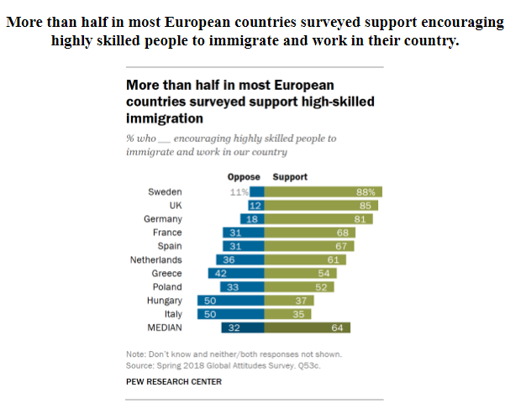
Example Decontextualization
Summary
Even though many people in the nations surveyed say they want less immigration , there is considerable support for accepting both refugees who flee violence ( a median of 77 % ) and immigrants who are highly skilled ( 64 % ) . At the same time , large shares back deporting immigrants currently in the country illegally ( a median of 69 % ) . When asked if highly skilled people from other nations should be encouraged to move to their country , roughly half or more in eight of 10 European countries polled support this approach . Agreement with this policy ranges from 35 % in Italy to 88 % in Sweden .
User question:
Is there a utilitarianism view toward immigration?
Answer1:
Even though many people in the nations surveyed say they want less immigration , there is considerable support for accepting both refugees who flee violence ( a median of 77 % ) and immigrants who are highly skilled ( 64 % ) . At the same time , large shares back deporting immigrants currently in the country illegally ( a median of 69 % ) . When asked if highly skilled people from other nations should be encouraged to move to their country , roughly half or more in eight of 10 European countries polled support this approach . Agreement with this policy ranges from 35 % in Italy to 88 % in Sweden .
(Red portion is text to remove since it is relevant but cannot be derived from the chart data)

Slide 32
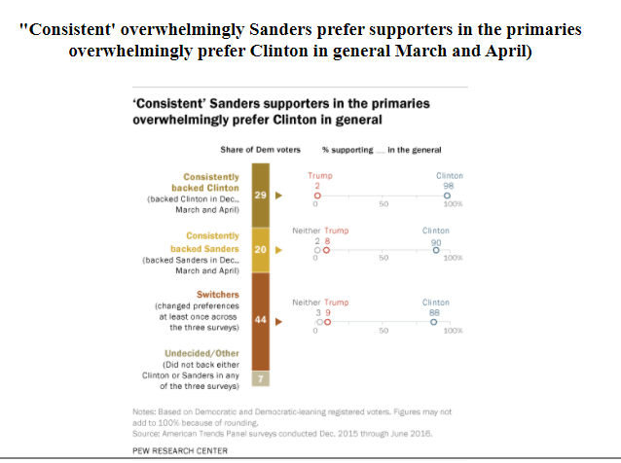
Chart filtering Leak
Summary
This report and accompanying interactive is based on a longitudinal analysis of the primary and general election preferences of Democratic and Democratic - leaning registered voters in Pew Research Center ’s nationally representative American Trends Panel . This approach provides the ability to examine voters ’ choices at an individual level over the course of six surveys conducted throughout 2015 and 2016 . For more detail , see Methodology used in this report . And for a similar look at the GOP nomination contest , see “ For GOP Voters , a Winding Path to a Trump Nomination . ”
Question:
What the six surveys conducted throughout 2015 and 2016 says ?
Answer1:
This approach provides the ability to examine voters ’ choices at an individual level over the course of six surveys conducted throughout 2015 and 2016 . For more detail , see Methodology used in this report . And for a similar look at the GOP nomination contest , see “ For GOP Voters , a Winding Path to a Trump Nomination . ”
(The summary for this chart does not reference the chart and should have been classified as ‘cannot create open ended question’. Since this chart was not filtered before the study, this worker could not make a suitable question.)

Slide 33
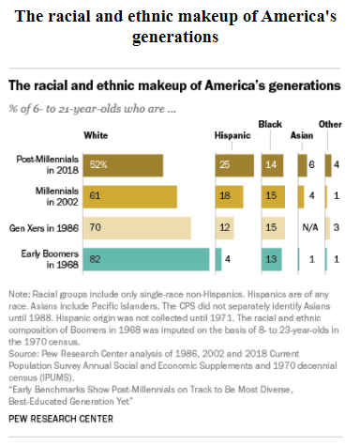
Extractive vs Abstractive
Summary
Post-millennials -today’s 6 to 21 year olds, also known as Generation Z- are on track to be the most racially and ethnically diverse generation yet. A bare majority of post-millennials are non-Hispanic white (52%) , while a quarter are Hispanic. And while most post- millennials are still pursuing their K12 education, the oldest members of this generation are enrolling in college at a significantly higher rate than millennials were at a comparable age.
Question:
Describe the racial diversification among post-millennials?
Extractive answer:
Post-millennials -today’s 6 to 21 year olds, also known as Generation Z- are on track to be the most racially and ethnically diverse generation yet. A bare majority of post-millennials are non-Hispanic white (52%) , while a quarter are Hispanic. And while most post- millennials are still pursuing their K12 education, the oldest members of this generation are enrolling in college at a significantly higher rate than millennials were at a comparable age.
abstractive answer:
Post - Millennials are on track to be the most racially and ethnically diverse generation yet . A bare majority of post - Millennials are non - Hispanic white ( 52 % ) , while a quarter are Hispanic .
(Extractive answer should include all information relevant to the question from the chart including information that cannot be derived from the chart. Abstractive answers should further filter extractive answers to only include information that can be derived from the chart.)

Slide 34
Making KG on Charts
Use Pytorch-Geometric building the KG
Use chart for making KG
Required Extraction Elements:
Legend labels
Text labels
Associations between legends and visual encodings
Axes labels
Title
Bounding boxes
Colors
Shapes
ChartType
Logical relationships(one bar height>another)
Possibly creating synthetic relations that can be used on downstream logical reasoning
Overall stats for chart
Could possibly add nodes and relationships to KG based on information in the question

Slide 35
Possible Relations
General Stats:
Median, Average
Min/max values of magnitude channel
Number of fields
Number of axis labels for categorical field
Derived from Chart
Highest numerical values
Derived from Summary

Slide 36
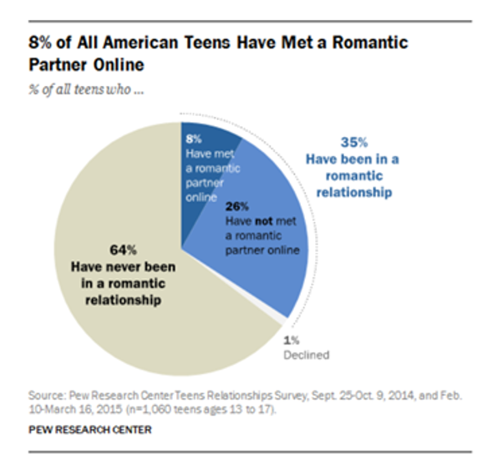
Example KG relationships
Activity:dating
Activity:dating
Synonym:Internet
Synonym:Internet
Subject:teens
Subject:teens
Summary
When it comes to meeting romantic partners, most teens do this offline. Only 8% of teens say they have met a romantic partner online. For the small share of teen daters who have met a romantic partner over the internet, Facebook was cited more than any other social media site as a way that teens connect with potential partners.
User question:
How has social media affected teenage dating?
Answer1:
When it comes to meeting romantic partners, most teens do this offline. Only 8% of teens say they have met a romantic partner online.
Red: Question-to-Chart Relationships
Purple: Summary-to-Chart Relationship
Activity:dating
Subject:teens
Number:8%
Number:26%
8%<26%

Slide 37
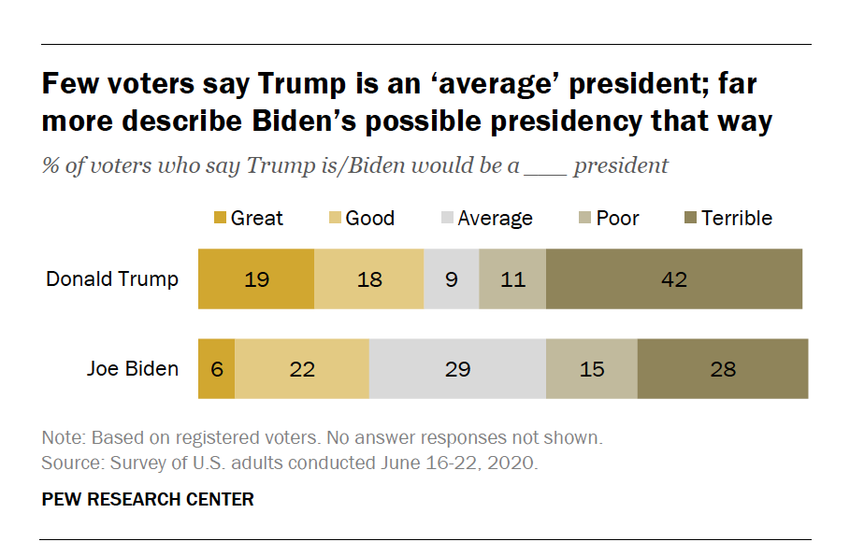
Example KG relationships
Synonymous noun: president
subject:voters
Person:Trump
Noun/Synonymous
noun: president
Subject:voters
synonym: views
Person:Trump
Summary
The new national survey by Pew Research Center , conducted June 16 - 22 among 4,708 adults , including 3,577 registered voters , finds sharp differences in how voters evaluate Trump ’s presidency compared with Biden ’s presidency , if he is elected . Very few voters – just 9 % – say Trump is an average president ; 37 % say he is a good or great president ; and a much larger share ( 53 % ) say he is poor or terrible , including 42 % who think he is a terrible president . Fewer voters ( 28 % ) say Biden would be a good or great president than say that about Trump as president . And compared with Trump , many more say Biden would be average ; 29 % say he would be an average president . However , 43 % say Biden would be poor or terrible , which is 10 percentage points lower than the share expressing such negative views about Trump as president .
synonym: views
User question:
What was the voters opinions about Trump’s presidency ?
Answer1:
Very few voters – just 9 % – say Trump is an average president ; 37 % say he is a good or great president ; and a much larger share ( 53 % ) say he is poor or terrible , including 42 % who think he is a terrible president .
Red: Question-to-Chart Relationships
Purple: Summary-to-Chart Relationship
Subset of rating labels
Noun/Synonymous
noun: president
Subset of ratings
Ratings
Person:Trump
Rating labels

Slide 38

Example KG relationships
noun: abortion
subject:Americans
Noun:abortion
synonym: views
subject:Americans
Summary
Though abortion is a divisive issue, more than half of U.S. adults take a non-absolutist position, saying that in most – but not all – cases, abortion should be legal (34%) or illegal (26%). Fewer take the position that in all cases abortion should be either legal (27%) or illegal (12%).
User question:
What position do Americans hold on abortion?
Answer1:
Though abortion is a divisive issue, more than half of U.S. adults take a non-absolutist position, saying that in most – but not all – cases, abortion should be legal (34%) or illegal (26%). Fewer take the position that in all cases abortion should be either legal (27%) or illegal (12%).
subject:Americans
noun: abortion
synonym: views
Category values
categories
categories

Slide 39
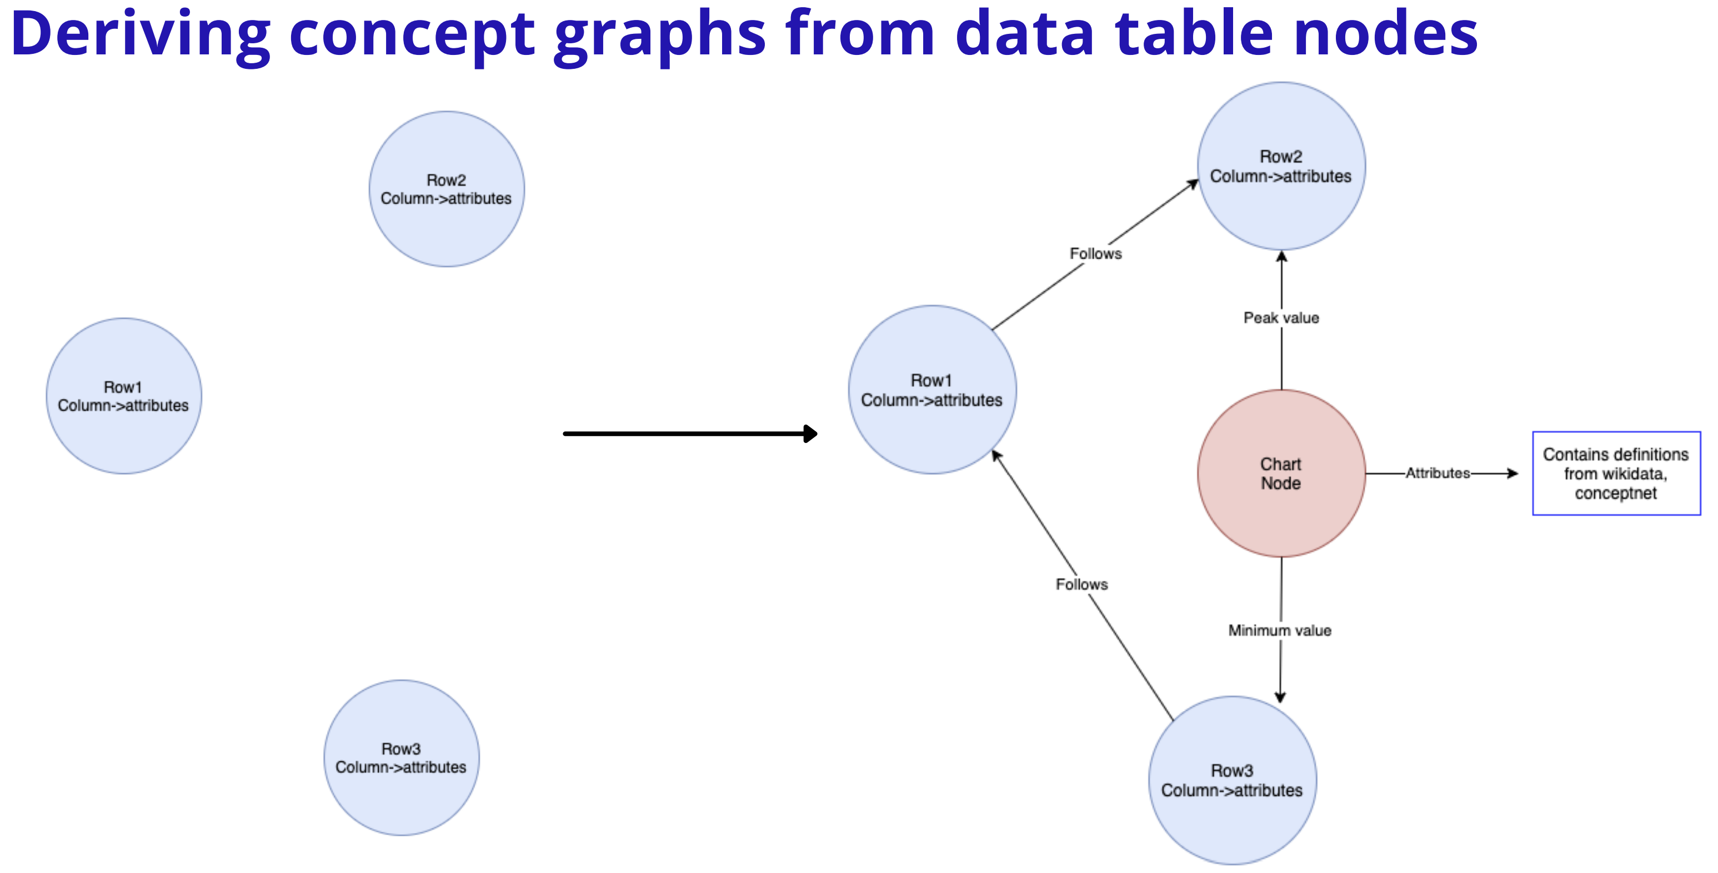
Second Order Representation

Slide 40
Dataset Updates
Mturk Study:
Samples annotated: 7800
Samples remaining: 360
Original Total Number of Charts: 9287
Total filtered: 1179
Total Good samples: 7800+308
Disagreement Analysis:
Samples analysed: 2400

Slide 41
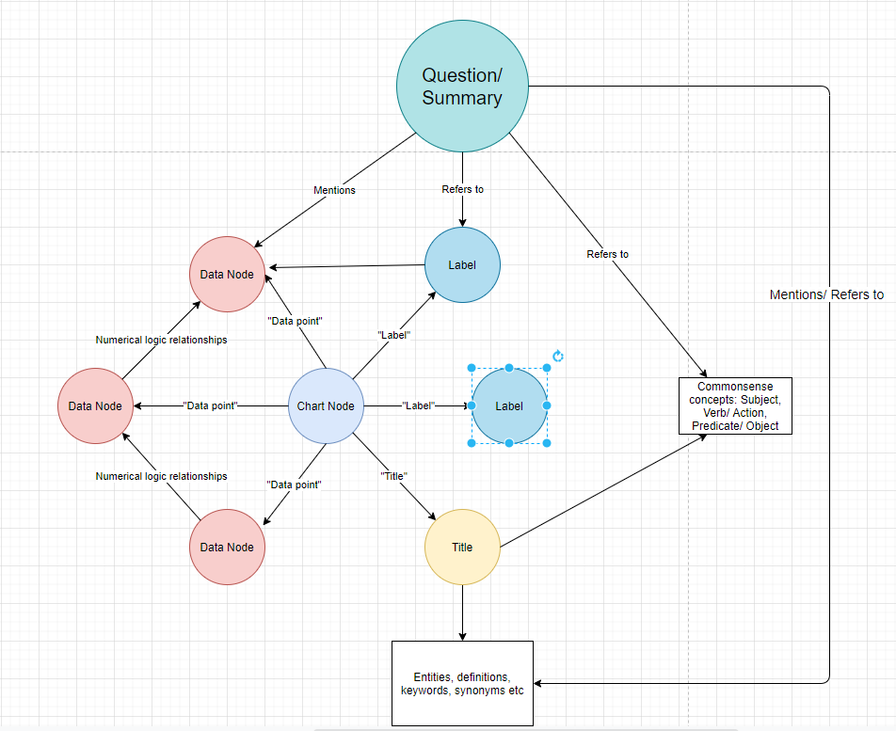
Example KG for Charts using chart+table+question+summary input

Slide 42
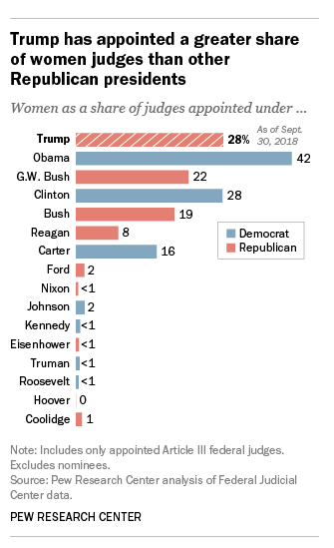
Bertqa analysis
Generated answer(200_tokens):
"Women account for more than a quarter ( 28 % ) of the 67 judges President Donald Trump has successfully appointed to the federal courts since taking office . That ‘s well below the share appointed by Barack Obama - whose 324 judicial appointees were a record 42 % female - but higher than the share appointed by any other Republican president , according to a Pew Research Center analysis of data from the Federal Judicial Center . In both parties , presidents have appointed a growing share of female judges in recent decades . Women represented 22 % of the 324 judges appointed by Republican George W. Bush during his eight years in office , 19 % of the 188 judges appointed by George H.W. Bush and 8 % of the 364 judges appointed by Ronald Reagan . Among recent Democratic presidents , Obama ‘s total exceeded the share appointed by Bill Clinton ( 28 % of 372 judges ) and Jimmy Carter ( 16 %“
Generated answer(200_tokens):
Obama ’s total exceeded the share appointed by Bill Clinton ( 28 % of 372 judges ) and Jimmy Carter ( 16 %
Summary
Women account for more than a quarter ( 28 % ) of the 67 judges President Donald Trump has successfully appointed to the federal courts since taking office . That ’s well below the share appointed by Barack Obama – whose 324 judicial appointees were a record 42 % female – but higher than the share appointed by any other Republican president , according to a Pew Research Center analysis of data from the Federal Judicial Center . In both parties , presidents have appointed a growing share of female judges in recent decades . Women represented 22 % of the 324 judges appointed by Republican George W. Bush during his eight years in office , 19 % of the 188 judges appointed by George H.W. Bush and 8 % of the 364 judges appointed by Ronald Reagan .
Title: "Trump has appointed a greater share of women judges than any other Republican presidents“
Question: "What are the women's thoughts on the government?"
(Target)Extractive answer:
"Women account for more than a quarter ( 28 % ) of the judges President Donald Trump has successfully appointed to the federal courts since taking office . That ’s well below the share appointed by Barack Obama – whose judicial appointees were a record 42 % female – but higher than the share appointed by any other Republican president , according to a Pew Research Center analysis of data from the Federal Judicial Center . In both parties , presidents have appointed a growing share of female judges in recent decades . Women represented 22 % of the judges appointed by Republican George W. Bush during his eight years in office , 19 % of the judges appointed by George H.W. Bush and 8 % of the judges appointed by Ronald Reagan ."

Slide 43
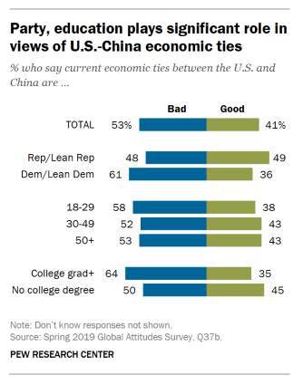
Bertqa analysis
Generated answer(128_tokens):
Today , just over half of Americans ( 53 % ) believe current economic ties between the U.S. and China are bad . Fewer ( 41 % ) think economic relations between the two nations are good , with just 2 % of American adults saying ties
Summary
"Shifting attitudes toward China are colored , in part , by the context of the continued trade frictions and tariffs between the United States and China . Today , just over half of Americans ( 53 % ) believe current economic ties between the U.S. and China are bad . Fewer ( 41 % ) think economic relations between the two nations are good , with just 2 % of American adults saying ties are very good . Partisanship is associated with views of the U.S.-China economic relationship : While 49 % of Republicans and Republican - leaning independents see current ties as good , around one - third ( 36 % ) of Democrats and Democratic - leaning independents share this view . And , despite having more favorable views of China , younger Americans ( ages 18 to 29 ) are about as likely as those 50 and older to have negative views of current economic relations with China ( 58 % and 53 % , respectively , say ties are bad ) .",
Title: "Party and education play significant role in views of U.S.-China economic ties. “
Question: "Describe the proportion of Americans who think economic relations between the US and China are bad?"
(Target)Extractive answer:
Today , just over half of Americans ( 53 % ) believe current economic ties between the U.S. and China are bad

Slide 44
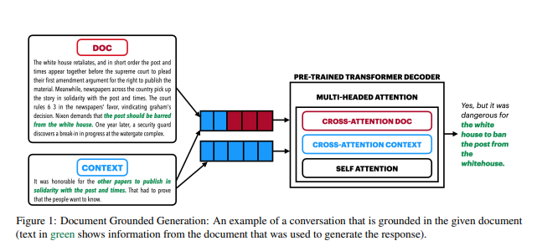
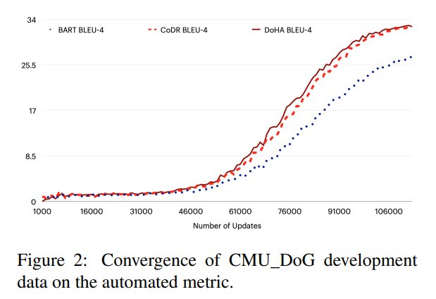
Document grounded Generation
hd = BARTEncoder([ci ; di ])
hc = BARTEncoder(ci)
h = [hc; hd]
BARTDecoder(h)
(ci-context i,
di-document i)
Note: the context sets the background while the document provides the content necessary to generate the text.
Training setup:
(580,000 samples, batch_size :2,epochs:25,
Surce_len:1024,target_len:128, 15 days training)

Slide 45
Doc2grnd generation
Women account for more than a quarter ( 28 % ) of the judges President Donald Trump has successfully appointed to the federal courts since taking office . That ’s well below the share appointed by Barack Obama – whose judicial appointees were a record 42 % female – but higher than the share appointed by any other Republican president , according to a Pew Research Center analysis of data from the Federal Judicial Center . In both parties , presidents have appointed a growing share of female judges in recent decades . Women represented 22 % of the judges appointed by Republican George W. Bush during his eight years in office , 19 % of the judges appointed by George H.W. Bush and 8 % of the judges appointed by Ronald Reagan .
What are the women's thoughts on the government?
28 % of the public says they are “ very likely ” to approve of the job Trump is doing as a husband or partner , and 38 % say they are somewhat interested ” in working with him .

Slide 46
Dataset Stats
Total size: 9285(Pew dataset)
Annotated samples: 7800
Will be finished:6900
Remaining: 900

Slide 47
Doc2grnd Analysis
With summary as input(BLEU-1.61)
With chart ocr as input(BLEU-1.60)
Both overfitting data
With summary as input:
nearly nine - in - ten Americans ( 91 % ) say it is at least somewhat confident that the world would be better off with the U.S. as the leading power , rather than China .
90 % of Americans who reported eating lunch at home in the summer , or doing things with it because of their cellphone use . And a similar share of Americans ( 64 % ) say they ’d rather have tacos and desktops .
nearly nine - in - ten Americans ( 91 % ) say it is at least somewhat helpful than annoying , while 58 % say they are not too or not at all good .
nearly nine - in - ten Americans ( 91 % ) say it is at least somewhat confident that the world would be better off with the U.S. as the leading power , rather than China .
nearly nine - in - ten Americans ( 91 % ) say eating lunch at home is acceptable relative to 44 % who say the same about dressing modestly . Modest dress is more widely held among Americans ( 71 % ) .
With chart ocr as input:
28 % of the public says they are “ very likely ” to approve of the job Trump is doing as a husband or partner , and 38 % say they are somewhat interested ” in working with him .
28 % of the public says they are “ very likely ” to have a conversation with someone about their city ’s government . A similar share ( 20 % ) says they constitute “ some role ” in helping them find a job or career .
28 % of the public says they are “ very likely ” to have a conversation with someone about their city ’s government . A similar share ( 20 % ) says they constitute “ some link ” between their household and the government .
28 % of the public says they are “ very likely ” to have a successful marriage

