Slide 1

by
R K RAJU YARAKARAJU (06A81A0495)
MUKESH TIRUPATHI (06A81A0484)
D. PRAVEEN KUMAR (06A81A0492)
Under the guidance of
M.Kishore M.tech
assistant professor in ECE

Slide 2
CONTENTS:
1.Introduction of project
2.Introduction of CAN
3.Criterian for selecting CAN
4.Applications of CAN
5.How to working of CAN
6. Frame formats of CAN
7. CAN messages
8. Error checking

Slide 3
9. Main components
AT mega 16
MCP2515
12.MCP2551
13.Temperature sensor
14. DC motor
15. Block diagram of project
16. Working process

Slide 4
Introduction to project
Modern automobile industries may have as many as electronic devices (ECU) for various subsystems. Typically the biggest processor is the engine control unit, which is also referred to as “ECU”.
In this project, to implement CAN based industrial automation we are using three nodes one in the main node, In main node temperature sensor is connected, In node1 dc motor is connected, In node2 fuel sensor is connected. Each node contains the common features like AVR controller, CAN controller, CAN Transceiver

Slide 5
Introduction of CAN
CAN is one of the most dominating bus protocols. This protocol has wide acceptance in automotive in vehicle applications as well as many non-automotive due to its low cost, high performance.
CAN is nothing but OSI model physical layers (tells about how we communicate with wires or cables) required one or two twisted pairs to transmit data. Good error handling mechanism and reliability its data.

Slide 6
Criterion for selecting CAN
Multi master hierarchy
A sender of information transmits to all devices on the bus. All receiving devices read the message and then decide if it relevant to them .
Sophisticated error detecting mechanism and re-transmission of faulty messages.
Data rates up to 1Mbps.

Slide 7
Applications of CAN:
Automotive applications
Railway Applications
Medical equipments
Agriculture equipments
Industrial controls
Machine controls
Factory Assembly Lines
Marine electronics
Avionics
Aerospace
Flight simulators
Elevators
Building Automations

Slide 8
CAN PROTOCOL:
The CAN communication protocol is a carrier-sense multiple-access protocol with collision detection and arbitration on message priority (CSMA/CD+AMP).
CSMA means that each node on a bus must wait for a prescribed period of inactivity before attempting to send a message.
CD+AMP mean that collisions are resolved through a bit-wise arbitration, based upon a preprogrammed priority of each message in the identifier field of a message.
The higher priority Identifier always wins bus access

Slide 9

Standard CAN

Slide 10

Extended CAN

Slide 11
CAN messages:
There are four different message types
Data frame
Remote frame
Error Frame
Overload Frame

Slide 12
Error Checking and Fault Confinement:
The robustness of CAN may be attributed in part to its abundant error checking procedures.
The CAN protocol incorporates five methods of error checking: three at the message level and two at the bit level.
If a message fails with any one of these error detection methods, it is not accepted and an error frame is generated from the receiving nodes, causing the transmitting node to resend the message until it is received correctly.
However, if a faulty node hangs up a bus by continuously repeating an error, its transmit capability is removed by its controller after an error limit is reached.

Slide 13
Main components used in project:
MCP 2515
MCP 2551
Atmega 16
DC motor
Temperature sensor
DC motor driver
Fuel sensor

Slide 14
MCP 2515:
The MCP2515 is a stand-alone CAN controller developed to simplify applications that require interfacing with a CAN bus.
The device consists of three main blocks:
1.The CAN module
2. The control logic
3. The SPI protocol block.

Slide 15
Features of MCP 2515:
• Implements CAN V2.0B at 1 Mb/s:
• Receive buffers, masks and filters:
• Three transmit buffers with prioritization and abort features.
• High-speed SPI™ Interface (10 MHz):
• Start-of-Frame (SOF) signal is available for monitoring the SOF signal:
• Interrupt output pin with selectable enables
• Request-to-Send (RTS) input pins individually configurable as:
- Control pins to request transmission for each transmit buffer
- General purpose inputs
• Low-power CMOS technology:
- Operates from 2.7V – 5.5V
- 5 mA active current (typical)
- 1 μA standby current (typical) (Sleep mode)
• Temperature ranges supported:
- Industrial (I): -40°C to +85°C
- Extended (E): -40°C to +125°C

Slide 16
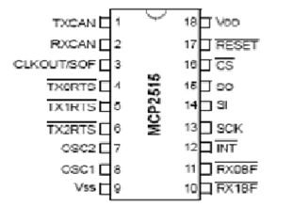
Pin diagram of MCP2515:

Slide 17
Operating modes of MCP2515:

Slide 18
MCP2551:
The MCP2551 is a high-speed CAN, fault-tolerant device that serves as the interface between a CAN protocol controller and the physical bus.
The MCP2551 provides differential transmit and receive capability for the CAN protocol controller and is fully compatible with the ISO-11898 standard, including 24V requirements.
It will operate at speeds of up to 1 Mb/s.
It also provides a buffer between the CAN controller and the high-voltage spikes that can be generated on the CAN bus by outside sources (EMI, ESD, electrical transients, etc.).

Slide 19
Working of MCP2551:
1. Transmitter Function
2. Maximum number of nodes
3. Receiver Function
4. Internal Protection

Slide 20
Operating Modes of MCP2551:
The RS pin allows three modes of operation to be selected:
• High-Speed
• Slope-Control
• Standby

Slide 21
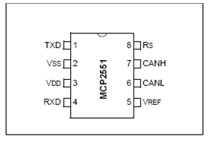
Pin diagram of MCP2551:

Slide 22
Features:
• Supports 1 Mb/s operation
• Implements ISO-11898 standard physical layer requirements
• Externally-controlled slope for reduced RFI emissions
• Detection of ground fault (permanent dominant) on TXD input
• Power-on reset and voltage brown-out protection
• An UN powered node or brown-out event will not disturb the CAN bus
• Low current standby operation
• Protection against damage due to short-circuit conditions
• Protection against high-voltage transients
• Automatic thermal shutdown protection
• Up to 112 nodes can be connected
• High noise immunity due to differential bus implementation
• Temperature ranges:
- Industrial (I): -40°C to +85°C
- Extended (E): -40°C to +125°C

Slide 23
Atmega 16:
The ATmega16 is a low-power CMOS 8-bit microcontroller based on the AVR enhanced RISC architecture.
By executing powerful instructions in a single clock cycle, the ATmega16 achieves throughputs approaching 1 MIPS per MHz allowing the system designer to optimize power consumption versus processing speed.

Slide 24
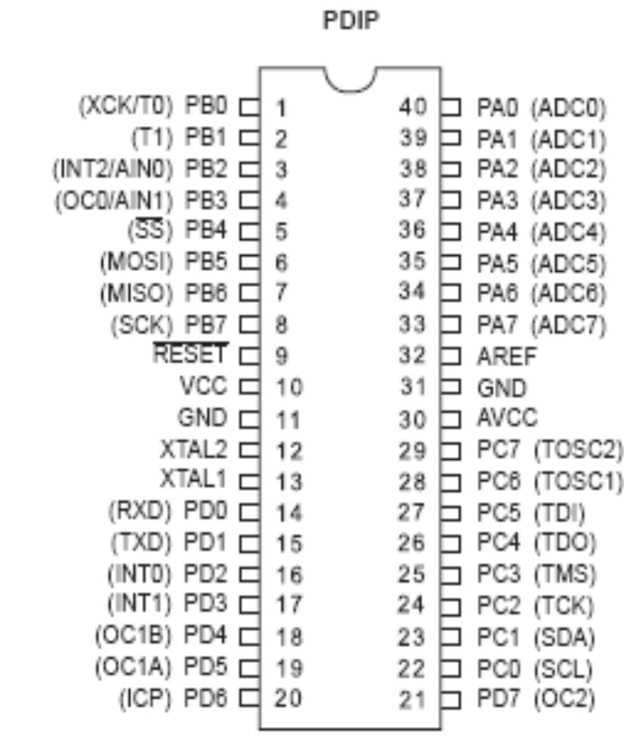
Pin diagram of Atmega 16:

Slide 25
Features:
• High-performance, Low-power AVR® 8-bit Microcontroller
• Advanced RISC Architecture
• Nonvolatile Program and Data Memories
• Peripheral Features
– Two 8-bit Timer/Counters with Separate Pre scalars and Compare Modes
– One 16-bit Timer/Counter with Separate Pre scalar, Compare Mode, and Capture Mode
– Four PWM Channels
– Byte-oriented Two-wire Serial Interface
– Programmable Serial USART
– Master/Slave SPI Serial Interface
– Programmable Watchdog Timer with Separate On-chip Oscillator
• Special Microcontroller Features
– Six Sleep Modes: Idle, ADC Noise Reduction, Power-save, Power-down, Standby and Extended Standby.
• Operating Voltages
– 4.5 - 5.5V for ATmega16
• Speed Grades
– 0 - 16 MHz for ATmega16

Slide 26
DC motor:
It is an electric motor that runs on direct current (DC) electricity.
Motor Principle:
When a current-carrying conductor is located in an external magnetic field perpendicular to the conductor, the conductor experiences a force perpendicular to itself and to the external magnetic field.

Slide 27
DC motor driver:
L293 is a quadruple high-current half-H driver.
L293 is designed to provide bidirectional drive currents of up to 1 A at voltages from 4.5 V to 36 V.
This device is designed to drive inductive loads such as relays, solenoids, dc and bipolar stepping motors, as well as other high-current/high-voltage loads in positive-supply applications.

Slide 28
LM35:
The LM35 series are precision integrated-circuit temperature sensors, whose output voltage is linearly proportional to the Celsius (Centigrade) temperature.
The LM35 thus has an advantage over linear temperature sensors calibrated in ° Kelvin, as the user is not required to subtract a large constant voltage from its output to obtain convenient Centigrade scaling

Slide 29
Features of LM35:
Calibrated directly in ° Celsius (Centigrade).
Linear + 10.0 mV/°C scale factor.
0.5°C accuracy guaranteeable (at +25°C).
Rated for full −55° to +150°C range.
Suitable for remote applications.
Low cost due to wafer-level trimming.
Operates from 4 to 30 volts.
Less than 60 μA current drain.

Slide 30
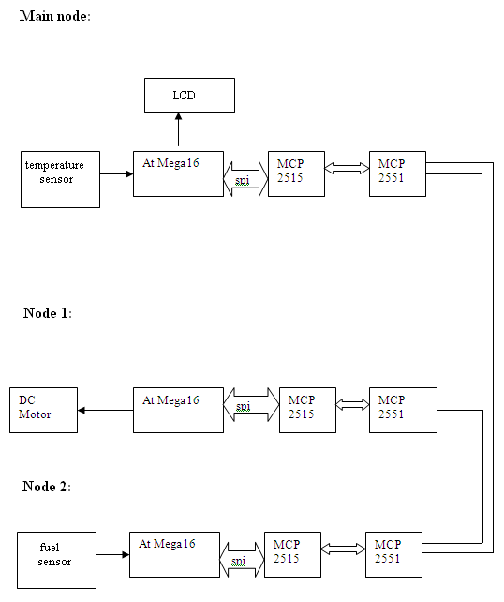
Block diagram:

Slide 31


