Slide 1
INCA - recording Report
Generated on 04-19-2020

Slide 2
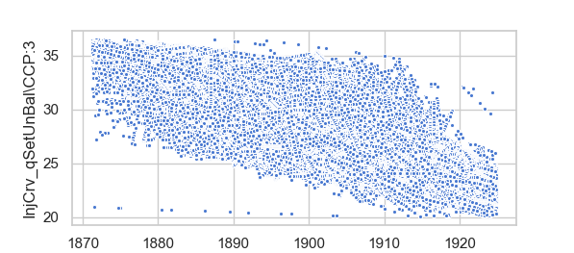
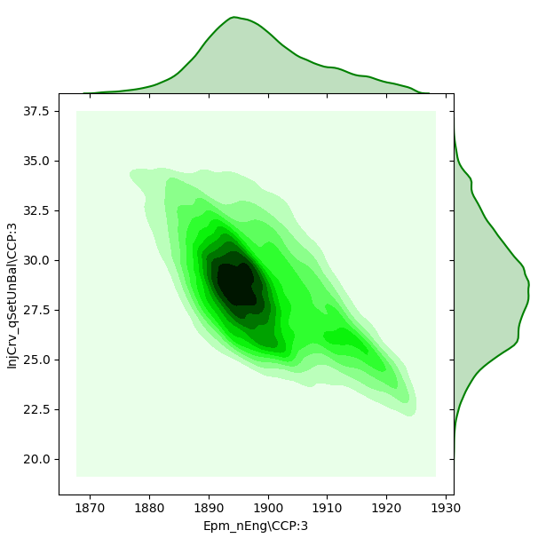
1
Zone mapping of the data w.r.t Qset and Speed
Qset and Speed scatter

