Slide 1
INCA - recording Report
Generated on 04-16-2020

Slide 2
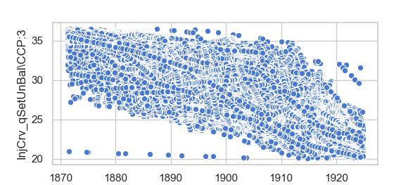
1
17
22
23
Qset and Speed scatter
21
25

