Slide 1
INCA - recording Report
Generated on 04-25-2020

Slide 2
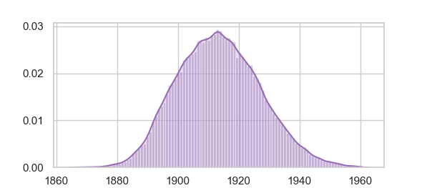
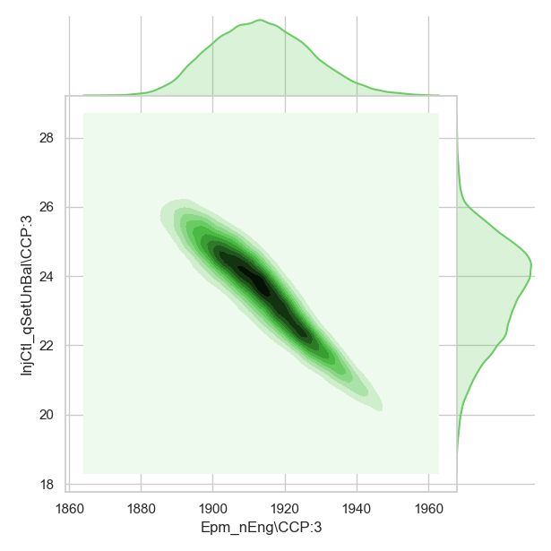
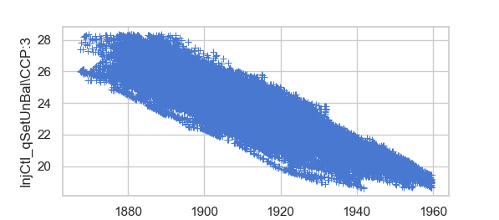
Epm_nEng\CCP:3 Distribution plot
Zone mapping of the data w.r.t InjCtl_qSetUnBal\CCP:3 and Epm_nEng\CCP:3
InjCtl_qSetUnBal\CCP:3 and Epm_nEng\CCP:3 scatter

Slide 3
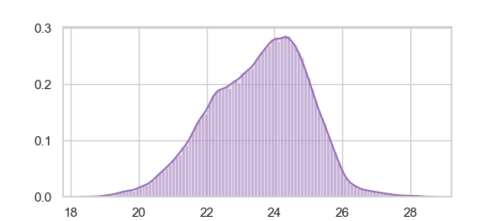
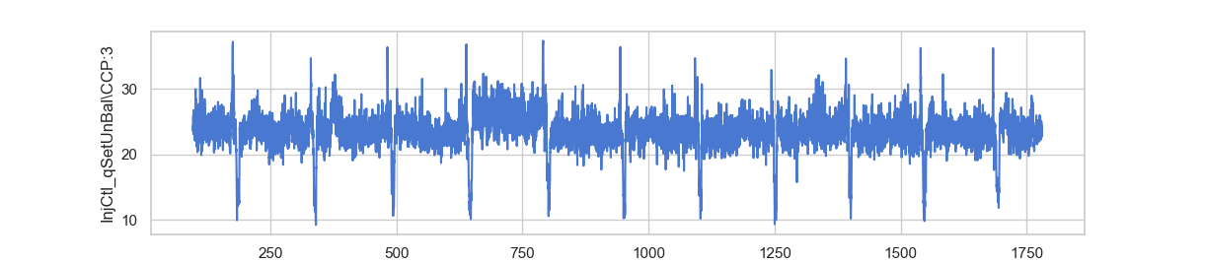
Scatter plot for InjCtl_qSetUnBal\CCP:3
Distribution plot for InjCtl_qSetUnBal\CCP:3
y/t Plot for InjCtl_qSetUnBal\CCP:3 at 0.05 truncation

Slide 4
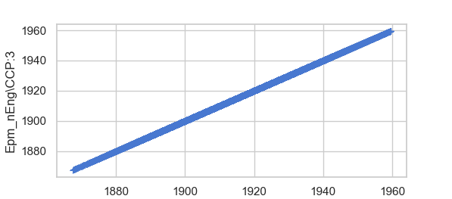
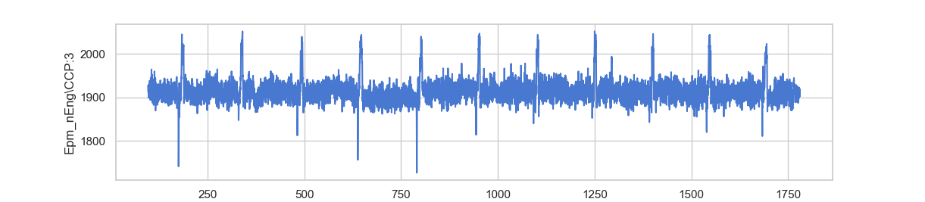
Scatter plot for Epm_nEng\CCP:3
Distribution plot for Epm_nEng\CCP:3
y/t Plot for Epm_nEng\CCP:3 at 0.05 truncation

Slide 5
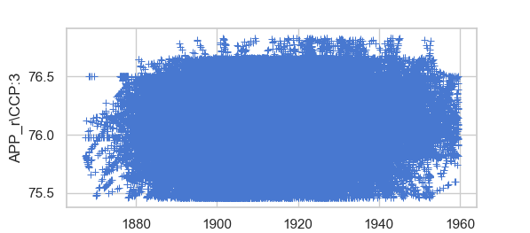
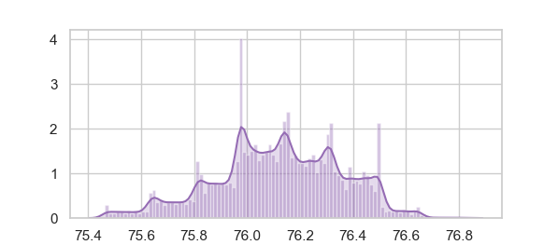
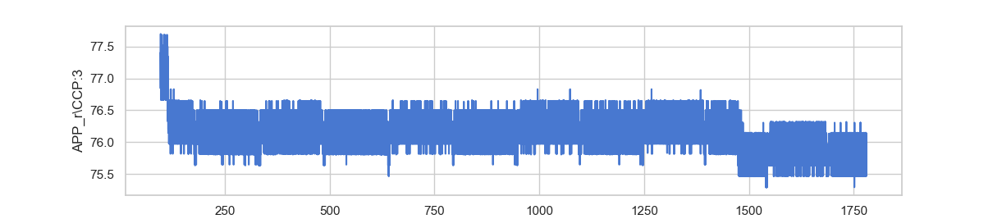
Scatter plot for APP_r\CCP:3
Distribution plot for APP_r\CCP:3
y/t Plot for APP_r\CCP:3 at 0.05 truncation

Slide 6
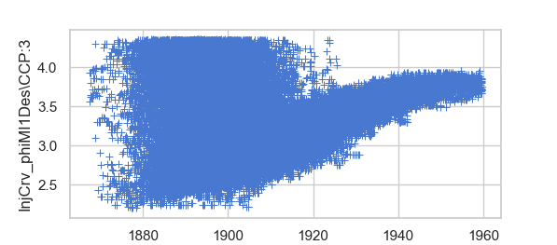
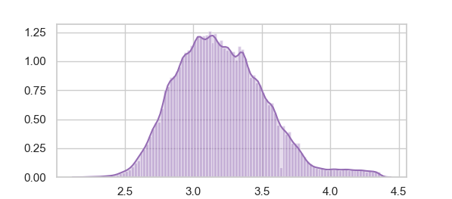
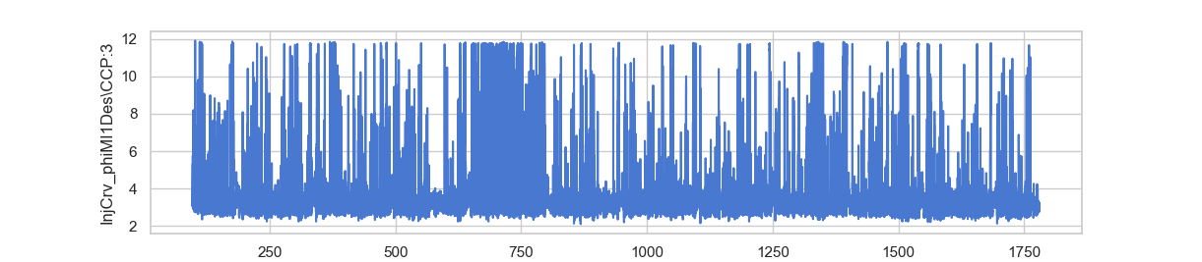
Scatter plot for InjCrv_phiMI1Des\CCP:3
Distribution plot for InjCrv_phiMI1Des\CCP:3
y/t Plot for InjCrv_phiMI1Des\CCP:3 at 0.05 truncation

Slide 7
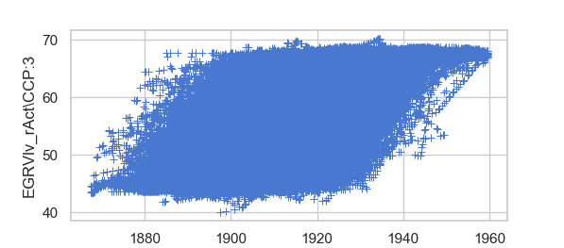
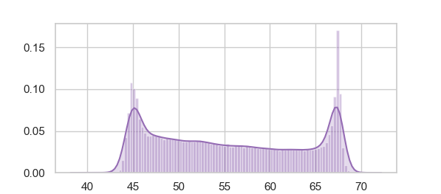
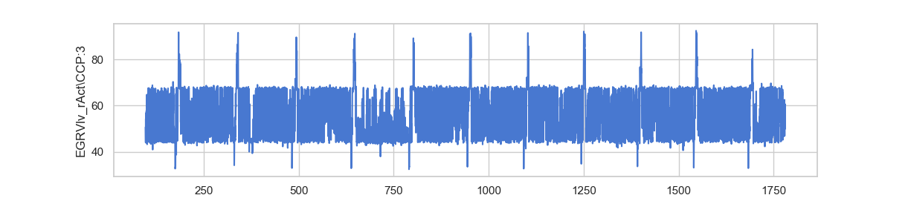
Scatter plot for EGRVlv_rAct\CCP:3
Distribution plot for EGRVlv_rAct\CCP:3
y/t Plot for EGRVlv_rAct\CCP:3 at 0.05 truncation

Slide 8
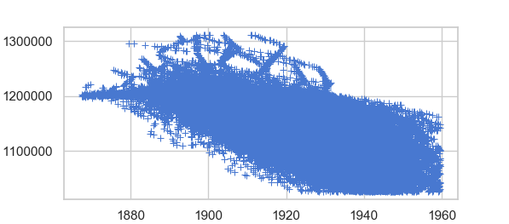
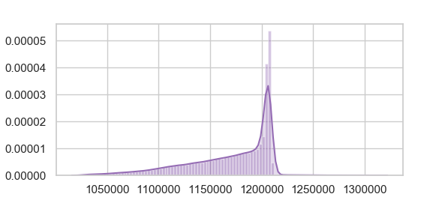
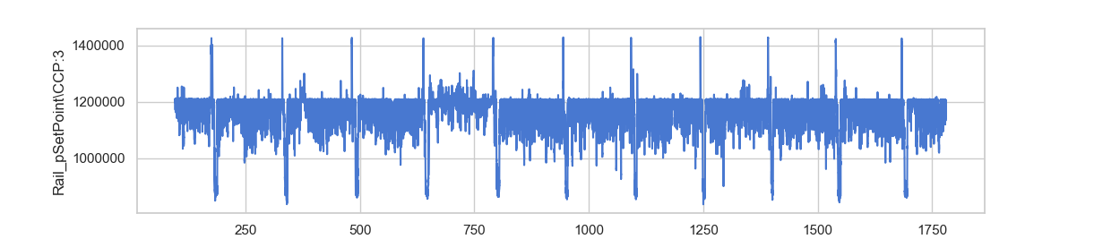
Scatter plot for Rail_pSetPoint\CCP:3
Distribution plot for Rail_pSetPoint\CCP:3
y/t Plot for Rail_pSetPoint\CCP:3 at 0.05 truncation

