Slide 1
INCA - recording Report
Generated on 04-19-2020

Slide 2
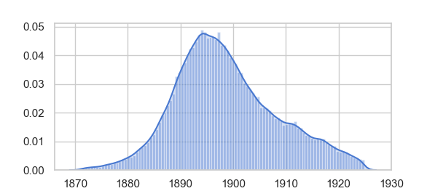
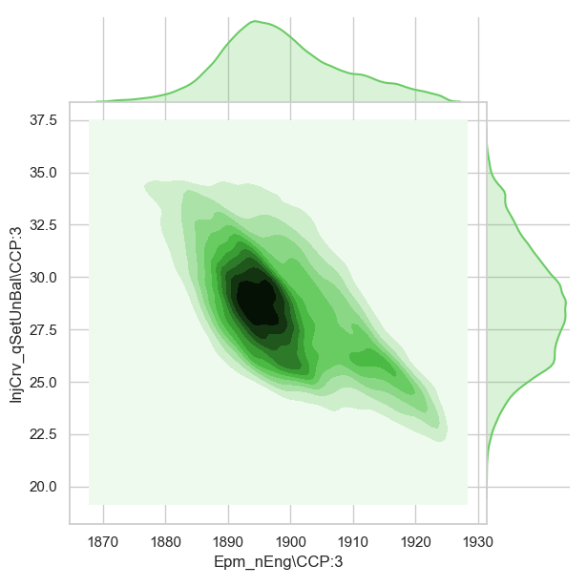
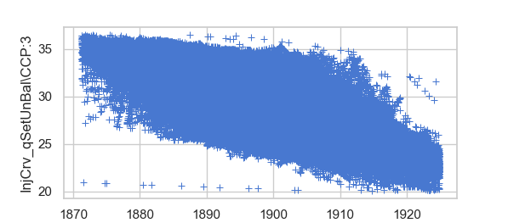
Qset Distribution plot :
Zone mapping of the data w.r.t Qset and Speed :
Qset and Speed scatter

