Slide 1
Agile Basics
Notes:
This course isn’t about agile, but there’s some key terms and concepts you’ll need to know about agile if you want to use JIRA’s agile system.

Slide 2
What is agile?
Team-based project management methodology
There’s two methods of working with agile in JIRA
Kanban
Scrum
Notes:
This course isn’t about agile, but there’s some key terms and concepts you’ll need to know about agile if you want to use JIRA’s agile system.

Slide 3
Kanban
Means “billboard” in Japanese
Kanban methodology is sometimes referred to as “lean” or “just-in-time”

Slide 4
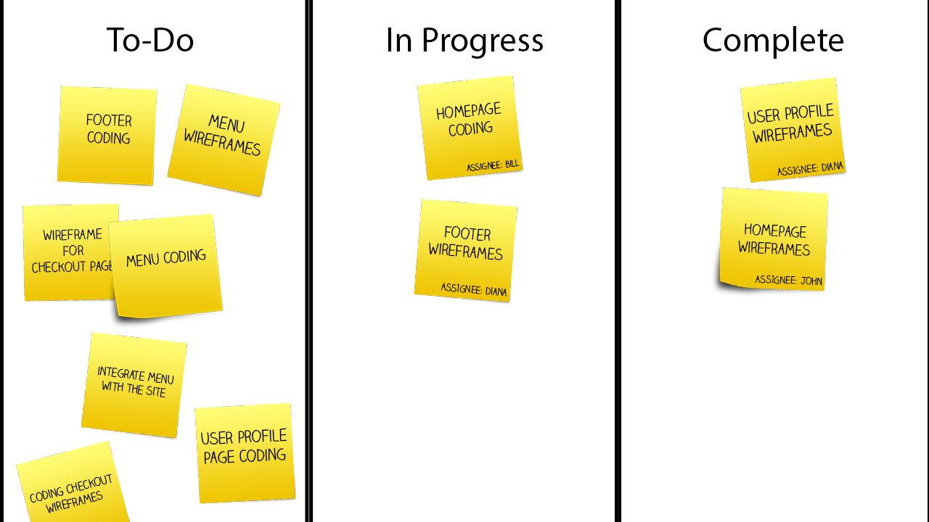
Kanban
Notes:
Kanban means “billboard” because it refers to this board that teams use to get things done

Slide 5
Scrum
Scrum is a rugby term
Sprints are the defining part of a scrum methodology
Notes:
Scrum is a rugby reference, where the team is packed together trying to get the ball. So the idea of scrum is that teams work together to get something achieved.

Slide 6
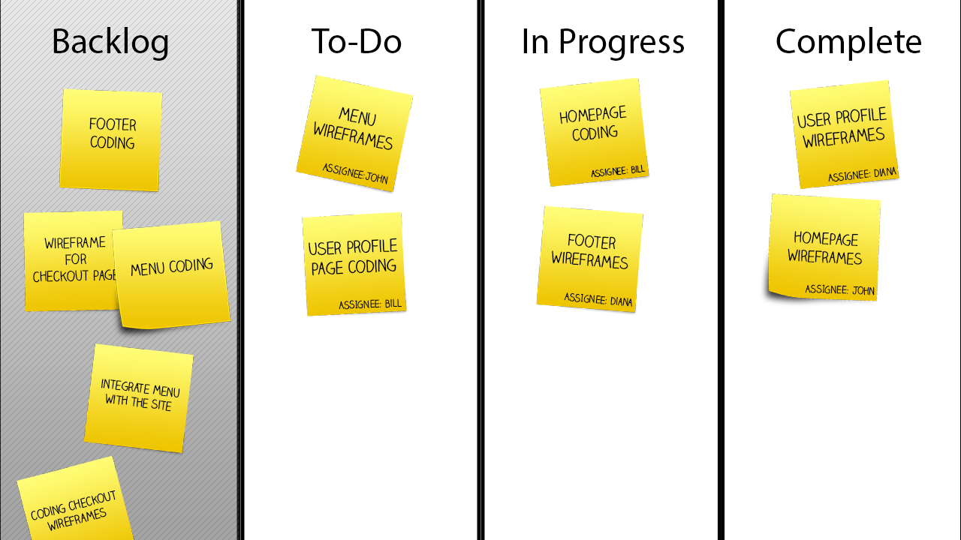
Scrum
Notes:
Kanban means “billboard” because it refers to this board that teams use to get things done

Slide 7
Sprint
A sprint is a set period of time (commonly 1 to 4 weeks)
To start a sprint, the team meets with the scrum board open
Two main questions are typically asked:
What went well in the last sprint?
What can we improve on for the next sprint?
Go through tickets to determine and agree on what will get accomplished in the next sprint
Notes:
These are fundamentals of a sprint. But if something works for your teams, customize it! Doing what works for your team is more important than strictly following “agile” methodology. But this is a great starting point and a great baseline to determine success. If something’s not working, come back to the basics.

Slide 8
Daily Stand-Up
First thing every morning (before emails), the team gathers
Each team member answers three questions:
What did I accomplish yesterday?
What will I do today?
What roadblocks do I foresee to stop me from accomplishing my goal?
Nothing other than the three questions are discussed
Notes:
Daily stand-up is typically only in scrum, but I’ve seen it used in Kanban or lean environments as well. It’s a great way to get everyone on the same page and set a daily goal. It’s called a stand-up to help it go faster. Don’t discuss details of projects. If you need to do that, set up a different meeting.

Slide 9
Summary
Kanban
Work is tracked on a board that everyone can see
Ongoing work, meaning there’s no sprints
Scrum
Work is tracked on a board that everyone can see
Work is broken up into sprints
Daily stand-ups each morning
Notes:
Daily stand-up is typically only in scrum, but I’ve seen it used in Kanban or lean environments as well. It’s a great way to get everyone on the same page and set a daily goal. It’s called a stand-up to help it go faster. Don’t discuss details of projects. If you need to do that, set up a different meeting.

