Slide 1
Routing of Messages In Data Center
Multithreaded

Slide 2
PROBLEM STATEMENT
A lot of times enterprise applications need to relay information present on different data centers to the user in most efficient and shortest time possible. Often the data centers have different processing powers and information also lies in the different priority bucket. As part of this assignment, you have to design a system which does this routing of messages and does it in the shortest amount of time possible.
Specifications:
The system can have N data centers and they might be directly or indirectly connected to each other.
For each connection i.e A <—> B, we have the time it takes to for the data to travel between them.
Each Datacentre can be of one of the following types:
High Capacity (HC) (ii) Medium Capacity (MC) (iii) Low Capacity (LC)
Information exchange happens in the form of messages and they are also of 3 types:
High Importance (HI) 2) Low Importance (LI) 3) Medium Importance (MI)
When a message reaches a node, the node does some processing on it before sending it to next node in the route. This processing time in seconds is as below:

Slide 3
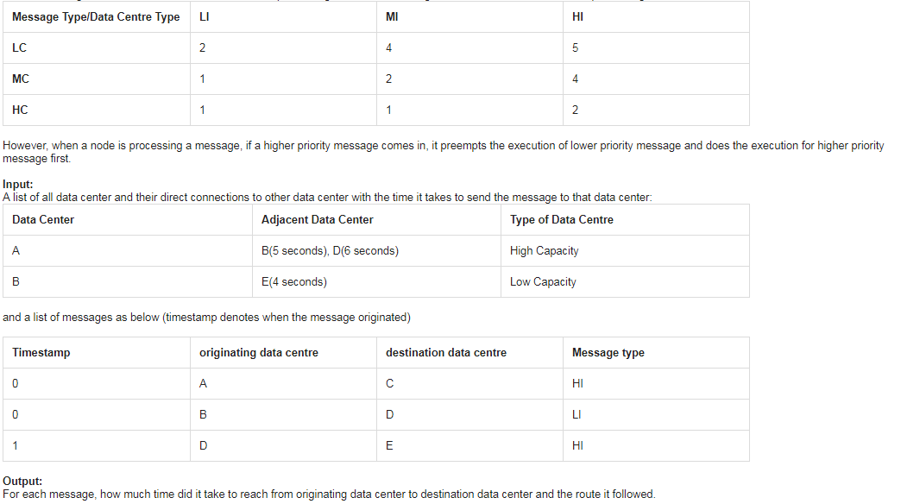
PROBLEM STATEMENT

Slide 4
THREADS
Main Thread : Displays the following menu : Please select an option by entering integer value corresponding to it :
1 - Read msges from msg.txt
2 - Kill a node
3 - Add a node
4 - Exit
Routing Table Computation Thread : - Computes next hop node for all src,dstn pairs. - Factors : Edge wt, delay due to pending queue of node, Data Center capacity, Msg priority - updates Routing Tables every 10 secs.
Thread per Node : - Route msg whenever processing time completes - Premption based routing. Higher priority msg gets CPU first - Real-time processing

Slide 5
FEATURES
Dynamic Routing – If a node heavily loaded, messages routed through alternate path if exists
Pre-emption – Higher priority messages get CPU first
Add node dynamically – Routing table adjusts itself automatically
Delete node dynamically
Add a new edge dynamically
Fault tolerance – Messages recovered automatically if a node deleted
Real-time msg routing – Messages routed based on system time
Data Structures used in a thread safe manner using mutexes and atomic variables

Slide 6
NOTES
Add a node – allocate a new Node class object and start a new thread
Delete a node – terminate the thread and delete dynamically allocated Node instance
Lock ensures that node addition/deletion doesn’t happen while routing table is being recomputed. Done to avoid race conditions.
Pre-emption done by using priority queues
Queues are accessed by multiple threads and hence made private. Read/write done through exported APIs which ensure thread sync.
Initially, node threads started only when nextHop matrix has finished computation

Slide 7
DATA STRUCTURES
class Graph{
private: mutex nextHopLock; map<Priority , map<char, map<char, char>>> nextHop; public: map<char, Node*> NodeList;
mutex NodeListLock; char readNextHop(Priority p, char src, char dstn);
void setNextHopMatrix(map<Priority , map<char, map<char, char>>>& nextHopLocal); };
nextHop : map containing next Node for each (msg_priority, src, dstn) triplet
readNextHop, setNextHopMatrix : thread safe way of accessing nextHop
nextHopLock, NodeListLock : mutex locks used for thread synchronisation

Slide 8
DATA STRUCTURES
currMsgLock, arrivingMsgLock : mutex lock for accessing currMsg and arrivingMsg respectively
currMsg : Msges which are currently being processed by Node based on priority
arrivingMsg : After a msg is processed, it is pushed to arrivingMsg queue of neighboring node.
class Node{ private: mutex currMsgLock; mutex arrivingMsgLock; priority_queue<pair<int, Msg>, vector<pair<int,Msg>>, Compare> currMsg; priority_queue<pair<time_t, Msg>, vector<pair<time_t, Msg>>, Compare2> arrivingMsg; public: Priority pri; char key; map<char, int> neighbors; // key = node key; value = edge weight atomic_bool terminate; Node(char key); Node(); void pushDataCurrMsg(Msg msg); void pushDataArrivingMsg(Msg msg, time_t t); void processArrivedMsges(); void processCurrMsg(); int getCurrentDelay(Priority pri_msg); void deleteAllQueues(); };
neighbors : list of neighbors of this node
Terminate : flag which signifies that this thread needs to terminate
Key : node key
Other functions provide thread safe way of accessing data structures and doing common tasks

Slide 9
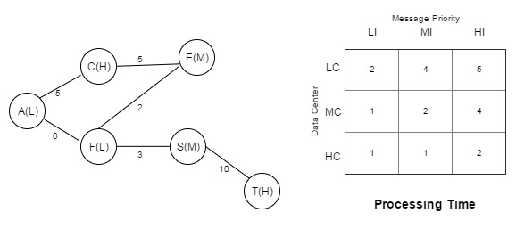
SAMPLE INPUT

Slide 10
DEMO
Basic msg routing
Pre-emption : Higher priority msg pre-empts lower priority msg
In case of load on one node, routing table adjusts to route msges from alternative path
Add a node – Node added to routing table, and msges sent through it
Delete a node – Node removed from routing table
Fault tolerance – Msges lost due to a node going down recovered
Adding a edge

Slide 11
FILES/INPUT FORMAT
INPUT FILES
input.txt - Used only once at starting of program. Used to create an initial graph
msg.txt – Provite input msges to program in bulk.
OUTPUT FILES
output.txt – Whenever a msg reaches dstn and finishes processing, msg info displayed in this file
debug.txt – For debug prints. Periodically prints update routing tables containing next hop node for (src,dstn) pair
/* input.txt * 3 //V = list of all nodes & adjacent edges * A 2 B 5 D 6 H //node, num_neighbors, adjacent node, edge wt,..., priority * B 2 A 5 E 4 L * E 1 B 4 M
* // L=low, M=medium, H=high
*/
/* msg.txt * 3 //N = num_messages
* A E H //src, destination, msg importance * A E M
* F S L
* 2
* A T L
* A S M
*/

Slide 12
POSSIBLE IMPROVEMENTS
Starvation not handled
Even after fault tolerance mechanism, some messages might be lost. A small window exists, when a msg might be freshly routed towards a node going down and before the routing table can update itself
Only few negative test cases tried

