Slide 1
A Programmatic Approach to Circuit Placement and Partitioning
By Christina Nikolova, Siddharth Kawatra, and Ishaan Kothari

Slide 2
Overview
Circuits can have millions of gates
Given an 8x8 grid filled with logic gates, there are 64! (that’s 1.2688693e+89)
So, our goal is to find good placement, partitioning, and routing solutions

Slide 3
What is a Netlist Circuit?
Used to describe electrical circuits
Nodes represent logic gates
Lines or edges represent wires
The flow
Verilog Netlist Internal Model

Slide 4
Parsing the JSON files into Python
Parsing the JSON Files into Python is a crucial part of our project
First step: Convert the JSON Files into a python dictionary
Name and size agnostic approach

Slide 5
Parsing the JSON Files into Python continued
#Gets source from top level module
print("SRC: " + data["modules"][list(data["modules"].keys())[0]]["attributes"]["src"])
(name agnostic way)
#Iterates through ports in a given module
for k in data["modules"][list(data["modules"].keys())[0]]["ports"]:
(Iterate through all ports regardless of length of port array)
#Adds +1 to destinations and appends a port to output list if it is an output
if data["modules"][list(data["modules"].keys())[0]]["ports"][k]["direction"] == "output":
destinations += 1
output_arr.append(k)
#Adds +1 to inputs and appends a port to input list if it is an output
elif data["modules"][list(data["modules"].keys())[0]]["ports"][k]["direction"] == "input":
inputs += 1
input_arr.append(k)
(This is a very simple implementation for counting the ports for input and output but leaves a lot of space for inputting any other information about the ports.)

Slide 6
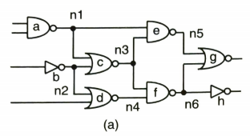
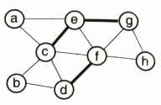
How Does the KL Algorithm Work? (1)
The KL algorithm takes a group of logic gates and turns them into individual nodes.
These nodes get assigned “weights” that connect them to other nodes from the given graph.
Weights hold a value that is calculated by using the formula w = 1/(k-1), where k is the number of gates in a clique.
Notes:
In reality, there can be an infinite number of weights for these nodes.

Slide 7
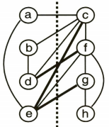
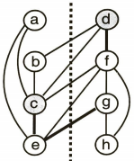
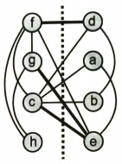
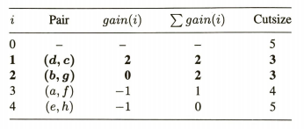
How Does the KL Algorithm Work? (2)
The algorithm divides the two into equal groups and places an imaginary “cutline” between them.
Each node is swapped with another on the other side.
A gain value is given for each swap made. This gain represents whether or not the swap made a decrease or increase in the cut size
The best gain (greatest) is chosen and the nodes that were swapped for that gain are locked in their swap
continues until all the nodes are locked.

Slide 8
Why Lower Cut Size?
Lowering the cut size of the group of nodes will keep the closely related nodes closer to one another.
Since the wire lengths are relatively smaller in a reduced cut size, the faster (speed) it is and uses up less resources in producing those wires.

Slide 9
How Does the visualization work? (1)
we decided to go with a simple approach in visualizing KL: HTML Rendering.
We used a framework that wraps around the scripting for the canvas: p5.js.
To send data of the KL algorithm’s output we decided to create a server written in Flask - a python web server framework - that serves the HTML visualization and data in JSON from the KL.
Algorithm
Server
Request
Client
HTML
Display
Javascript
Local Repo
Fetch
JSON
HTML
Notes:
First, we had to choose how we were going to visualize the KL algorithm. We could’ve used a game engine such as Unity or Unreal. Since the the nodes and weights were just simple lines and circles, the HTML and Javascript canvas was perfect.

Slide 10
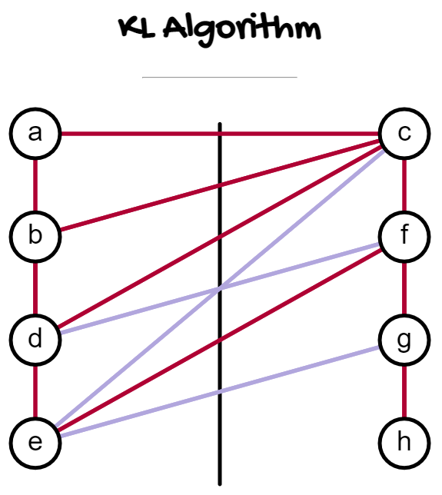
Visualization
Click Me!

Slide 11
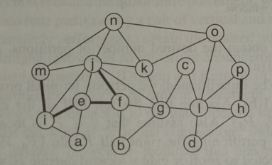
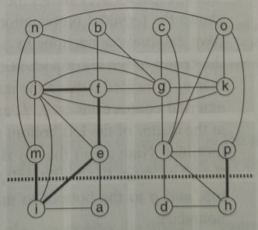
Quadrature Mincut: High Level Overview
Goal is to find a placement for each node (representing logic gates) while minimizing wirelength
Alternate between horizontal and vertical cuts to create smaller and smaller quadrants
The Kernighan-Lin (KL) algorithm, or some other partitioning algorithm, runs each time a cut is made to minimize the cut size
Before
After

Slide 12
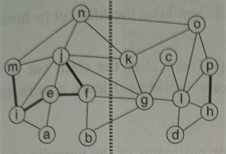
Quadrature Mincut: Recursion
function recursive_KL(group_of_nodes) {
First_half, second_half = split group_of_nodes into two;
resulting_first_half, resulting_second_half = run_KL_algorithm(first_half, second_half);
recursive_KL(resulting_first_half);
recursive_KL(resulting_second_half);
}
1. Recursion
KL runs recursively, repeatedly running with each new grouping that is made
Lowest cutsize is found by running through the entire KL process until all nodes are locked, but the best cut size and best pair is saved in a variable and returned
KL runs until each node is allocated one quadrant via Mincut
Coordinates are set for each grouping

Slide 13
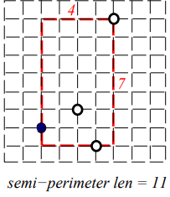
Quadrature Mincut: Wirelength
2. Calculating Wirelength
A bounding box is drawn around coordinates in a clique netlist
The half-perimeter of the bounding box is calculated
Wirelength cost equals all the half-perimeters of all clique netlist bounding boxes in a graph
Image Credit: Northwestern University (http://users.eecs.northwestern.edu/~haizhou/357/lec4.pdf)

Slide 14
Next Steps
Visualize the mincut algorithm using p5.js
Focus on routing algorithms such as Steiner Routing

Slide 15
Thank you! Questions?

